Slide 1
swift : 初始化
iOS行動程式基礎開發上架
Notes:
使用目的：正式進入各堂講課前的區段標題，主要讓學員知道今天是第幾堂課。
出現時機：會出現在每一堂課。
編修方式：灰色字是「課程名稱」，黑色字是第幾堂與堂名（堂名必須與課程大綱中的同步）。

Slide 2

本堂教學重點
為儲存屬設定初始值
初始者
預設的屬性值
自訂初始化
初始化參數
參數名稱和引數標籤
沒有引數標籤的初始化參數
可nil的屬性類型
初始化期間，指定常數屬性
預設的初始化
結構的智慧型初始化
值類型的初始化委派
類別繼承和初始化
主要的初始化者和便利初始化者的語法
類別的初始化委派
二階段的初始化
初始化的繼承和覆寫
自動化的初始化繼承
實作主要的初始化者和便利初始化者
可失敗的初始化
Required 初始化者
使用閉鎖和函式設定屬性值
Notes:
使用目的：讓學員知道該堂課的教學重點有哪些。其他授課講師也可以從該頁看出種子講師對該堂的教學安排。
出現時機：會出現在每一堂課。
編修方式：以此頁範例來看，黑字表示該堂有六個重點，每一個重點再分別列出小重點。藍字部份表示有設計與學員互動的「問題回答」（Q&A) 或 「自我練習」（學員實機操作練習）。問題回答（Q&A）的題型可以：選擇題，是非題，配合題。
補充說明：一堂課要設計多少個「問題回答」或「自我練習」，由種子講師決定即可。

Slide 3
1.為儲存屬設定初始值
覆寫方法
init() {
// perform some initialization here
}
struct Fahrenheit {
var temperature: Double
init() {
temperature = 32.0
}
}
var f = Fahrenheit()
print("The default temperature is \(f.temperature)° Fahrenheit")
// Prints "The default temperature is 32.0° Fahrenheit"

Slide 4
1.為儲存屬設定初始值
預設的屬性值
struct Fahrenheit {
var temperature = 32.0
}

Slide 5
2.自訂初始化
初始化參數
struct Celsius {
var temperatureInCelsius: Double
init(fromFahrenheit fahrenheit: Double) {
temperatureInCelsius = (fahrenheit - 32.0) / 1.8
}
init(fromKelvin kelvin: Double) {
temperatureInCelsius = kelvin - 273.15
}
}
let boilingPointOfWater = Celsius(fromFahrenheit: 212.0)
// boilingPointOfWater.temperatureInCelsius is 100.0
let freezingPointOfWater = Celsius(fromKelvin: 273.15)
// freezingPointOfWater.temperatureInCelsius is 0.0

Slide 6
2.自訂初始化
參數名稱和引數標籤
struct Color {
let red, green, blue: Double
init(red: Double, green: Double, blue: Double) {
self.red = red
self.green = green
self.blue = blue
}
init(white: Double) {
red = white
green = white
blue = white
}
}
let magenta = Color(red: 1.0, green: 0.0, blue: 1.0)
let halfGray = Color(white: 0.5)
let veryGreen = Color(0.0, 1.0, 0.0)
// this reports a compile-time error - argument labels are required

Slide 7
2.自訂初始化
沒有引數標籤的初始化參數
struct Celsius {
var temperatureInCelsius: Double
init(fromFahrenheit fahrenheit: Double) {
temperatureInCelsius = (fahrenheit - 32.0) / 1.8
}
init(fromKelvin kelvin: Double) {
temperatureInCelsius = kelvin - 273.15
}
init(_ celsius: Double) {
temperatureInCelsius = celsius
}
}
let bodyTemperature = Celsius(37.0)
// bodyTemperature.temperatureInCelsius is 37.0

Slide 8
2.自訂初始化
可nil的屬性類型
class SurveyQuestion {
var text: String
var response: String?
init(text: String) {
self.text = text
}
func ask() {
print(text)
}
}
let cheeseQuestion = SurveyQuestion(text: "Do you like cheese?")
cheeseQuestion.ask()
// Prints "Do you like cheese?"
cheeseQuestion.response = "Yes, I do like cheese."

Slide 9
2.自訂初始化
初始化期間，指定常數屬性
class SurveyQuestion {
let text: String
var response: String?
init(text: String) {
self.text = text
}
func ask() {
print(text)
}
}
let beetsQuestion = SurveyQuestion(text: "How about beets?")
beetsQuestion.ask()
// Prints "How about beets?"
beetsQuestion.response = "I also like beets. (But not with cheese.)"

Slide 10
3.預設的初始化
class ShoppingListItem {
var name: String?
var quantity = 1
var purchased = false
}
var item = ShoppingListItem()

Slide 11
4.值類型的初始化委派
struct Size {
var width = 0.0, height = 0.0
}
struct Point {
var x = 0.0, y = 0.0
}
struct Rect {
var origin = Point()
var size = Size()
init() {}
init(origin: Point, size: Size) {
self.origin = origin
self.size = size
}
init(center: Point, size: Size) {
let originX = center.x - (size.width / 2)
let originY = center.y - (size.height / 2)
self.init(origin: Point(x: originX, y: originY), size: size)
}
}

Slide 12
4.值類型的初始化委派
let basicRect = Rect()
// basicRect's origin is (0.0, 0.0) and its size is (0.0, 0.0)
let originRect = Rect(origin: Point(x: 2.0, y: 2.0),
size: Size(width: 5.0, height: 5.0))
// originRect's origin is (2.0, 2.0) and its size is (5.0, 5.0)
let centerRect = Rect(center: Point(x: 4.0, y: 4.0),
size: Size(width: 3.0, height: 3.0))
// centerRect's origin is (2.5, 2.5) and its size is (3.0, 3.0)

Slide 13
5.類別繼承和初始化
主要的初始化者和便利初始化者的語法
init(parameters) {
statements
}
convenience init(parameters) {
statements
}

Slide 14
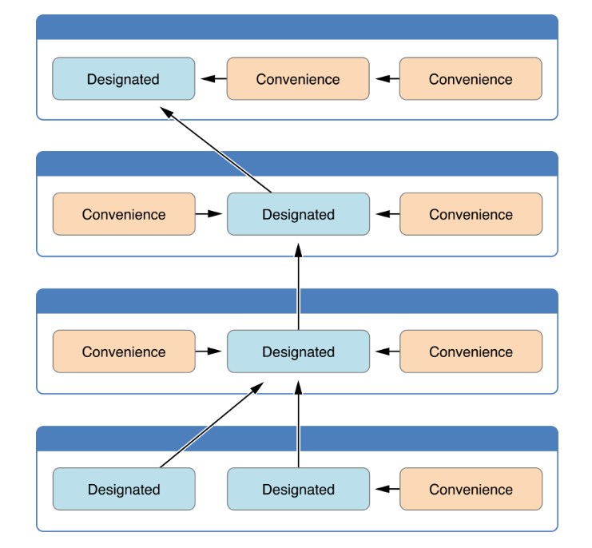
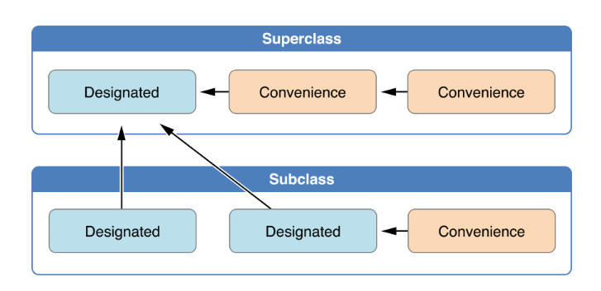
5.類別繼承和初始化
類別的初始化委派

Slide 15
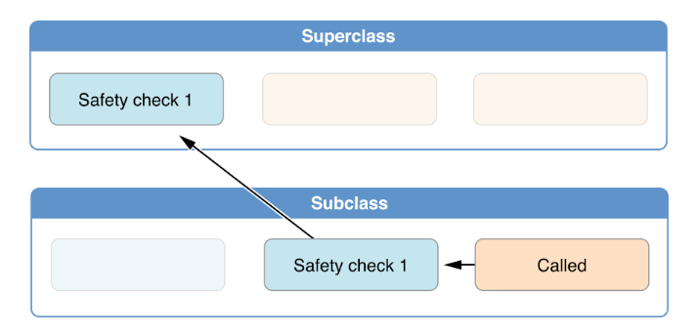
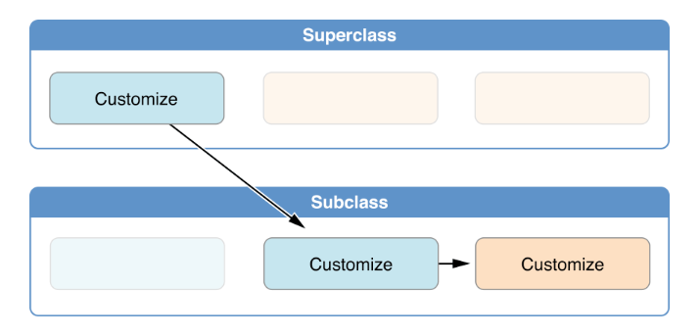
5.類別繼承和初始化
二階段的初始化

Slide 16
5.類別繼承和初始化
初始化的繼承和覆寫1
class Vehicle {
var numberOfWheels = 0
var description: String {
return "\(numberOfWheels) wheel(s)"
}
}
class Bicycle: Vehicle {
override init() {
super.init()
numberOfWheels = 2
}
}
let vehicle = Vehicle()
print("Vehicle: \(vehicle.description)")
// Vehicle: 0 wheel(s)

Slide 17
5.類別繼承和初始化
初始化的繼承和覆寫2
let hoverboard = Hoverboard(color: "silver")
print("Hoverboard: \(hoverboard.description)")
// Hoverboard: 0 wheel(s) in a beautiful silver
let bicycle = Bicycle()
print("Bicycle: \(bicycle.description)")
// Bicycle: 2 wheel(s)
class Hoverboard: Vehicle {
var color: String
init(color: String) {
self.color = color
// super.init() implicitly called here
}
override var description: String {
return "\(super.description) in a beautiful \(color)"
}
}

Slide 18
5.類別繼承和初始化
自動化的初始化繼承
Rule 1
如果子類別沒有定義任何的主要初始化者，自動繼承父類別的所有主要初始化者
Rule 2
如果子類別實做所有父類別的主要初始化者，不管是不是由父類別繼承下來的主要初始化者。則會繼承所有父類別的便利初始化者

Slide 19
5.類別繼承和初始化
實作主要的初始化者和便利初始化者1
class Food {
var name: String
init(name: String) {
self.name = name
}
convenience init() {
self.init(name: "[Unnamed]")
}
}
let namedMeat = Food(name: "Bacon")
// namedMeat's name is "Bacon"
let mysteryMeat = Food()
// mysteryMeat's name is "[Unnamed]"

Slide 20
5.類別繼承和初始化
實作主要的初始化者和便利初始化者2
class RecipeIngredient: Food {
var quantity: Int
init(name: String, quantity: Int) {
self.quantity = quantity
super.init(name: name)
}
override convenience init(name: String) {
self.init(name: name, quantity: 1)
}
}
let oneMysteryItem = RecipeIngredient()
let oneBacon = RecipeIngredient(name: "Bacon")
let sixEggs = RecipeIngredient(name: "Eggs", quantity: 6)

Slide 21
5.類別繼承和初始化
實作主要的初始化者和便利初始化者3
class ShoppingListItem: RecipeIngredient {
var purchased = false
var description: String {
var output = "\(quantity) x \(name)"
output += purchased ? " ✔" : " ✘"
return output
}
var breakfastList = [
ShoppingListItem(),
ShoppingListItem(name: "Bacon"),
ShoppingListItem(name: "Eggs", quantity: 6),
]
breakfastList[0].name = "Orange juice"
breakfastList[0].purchased = true
for item in breakfastList {
print(item.description)
}
// 1 x Orange juice ✔
// 1 x Bacon ✘
// 6 x Eggs ✘

Slide 22
5.類別繼承和初始化
可失敗的初始化1
struct Animal {
let species: String
init?(species: String) {
if species.isEmpty { return nil }
self.species = species
}
}
let someCreature = Animal(species: "Giraffe")
// someCreature is of type Animal?, not Animal
if let giraffe = someCreature {
print("An animal was initialized with a species of \(giraffe.species)")
}
// Prints "An animal was initialized with a species of Giraffe"

Slide 23
5.類別繼承和初始化
可失敗的初始化2
let anonymousCreature = Animal(species: "")
// anonymousCreature is of type Animal?, not Animal
if anonymousCreature == nil {
print("The anonymous creature could not be initialized")
}
// Prints "The anonymous creature could not be initialized"

Slide 24
5.類別繼承和初始化
Required 初始化者
class SomeClass {
required init() {
// initializer implementation goes here
}
}
class SomeSubclass: SomeClass {
required init() {
// subclass implementation of the required initializer goes here
}
}

Slide 25
6.Required 初始化者
class SomeClass {
required init() {
// initializer implementation goes here
}
}
class SomeSubclass: SomeClass {
required init() {
// subclass implementation of the required initializer goes here
}
}

Slide 26
7.使用閉鎖和函式設定屬性值
class SomeClass {
let someProperty: SomeType = {
// create a default value for someProperty inside this closure
// someValue must be of the same type as SomeType
return someValue
}()
}

Slide 27
7.使用閉鎖和函式設定屬性值
struct Chessboard {
let boardColors: [Bool] = {
var temporaryBoard = [Bool]()
var isBlack = false
for i in 1...8 {
for j in 1...8 {
temporaryBoard.append(isBlack)
isBlack = !isBlack
}
isBlack = !isBlack
}
return temporaryBoard
}()
func squareIsBlackAt(row: Int, column: Int) -> Bool {
return boardColors[(row * 8) + column]
}
}
let board = Chessboard()
print(board.squareIsBlackAt(row: 0, column: 1))
// Prints "true"
print(board.squareIsBlackAt(row: 7, column: 7))
// Prints "false"

