Slide 1
第四堂 : 流程控制
iOS行動程式基礎開發上架
Notes:
使用目的：正式進入各堂講課前的區段標題，主要讓學員知道今天是第幾堂課。
出現時機：會出現在每一堂課。
編修方式：灰色字是「課程名稱」，黑色字是第幾堂與堂名（堂名必須與課程大綱中的同步）。

Slide 2

本堂教學重點
For-in 迴圈
while 迴圈
Repeat-While
if
Switch
無貫穿
區間符合
Tuples
Value Bindings
Where
Compound Cases
改變流程控制
continue
break
fallthrough
Early Exit
Notes:
使用目的：讓學員知道該堂課的教學重點有哪些。其他授課講師也可以從該頁看出種子講師對該堂的教學安排。
出現時機：會出現在每一堂課。
編修方式：以此頁範例來看，黑字表示該堂有六個重點，每一個重點再分別列出小重點。藍字部份表示有設計與學員互動的「問題回答」（Q&A) 或 「自我練習」（學員實機操作練習）。問題回答（Q&A）的題型可以：選擇題，是非題，配合題。
補充說明：一堂課要設計多少個「問題回答」或「自我練習」，由種子講師決定即可。

Slide 3
1.For-in 迴圈
let names = ["Anna", "Alex", "Brian", "Jack"]
for name in names {
print("Hello, \(name)!")
}
// Hello, Anna!
// Hello, Alex!
// Hello, Brian!
// Hello, Jack!
let numberOfLegs = ["spider": 8, "ant": 6, "cat": 4]
for (animalName, legCount) in numberOfLegs {
print("\(animalName)s have \(legCount) legs")
}
// ants have 6 legs
// cats have 4 legs
// spiders have 8 legs

Slide 4
1.For-in 迴圈
for index in 1...5 {
print("\(index) times 5 is \(index * 5)")
}
// 1 times 5 is 5
// 2 times 5 is 10
// 3 times 5 is 15
// 4 times 5 is 20
// 5 times 5 is 25
let base = 3
let power = 10
var answer = 1
for _ in 1...power {
answer *= base
}
print("\(base) to the power of \(power) is \(answer)")
// Prints "3 to the power of 10 is 59049"

Slide 5
1.For-in 迴圈
let minutes = 60
for tickMark in 0..<minutes {
// render the tick mark each minute (60 times)
}
let minuteInterval = 5
for tickMark in stride(from: 0, to: minutes, by: minuteInterval) {
// render the tick mark every 5 minutes (0, 5, 10, 15 ... 45, 50, 55)
}
let hours = 12
let hourInterval = 3
for tickMark in stride(from: 3, through: hours, by: hourInterval) {
// render the tick mark every 3 hours (3, 6, 9, 12)
}

Slide 6
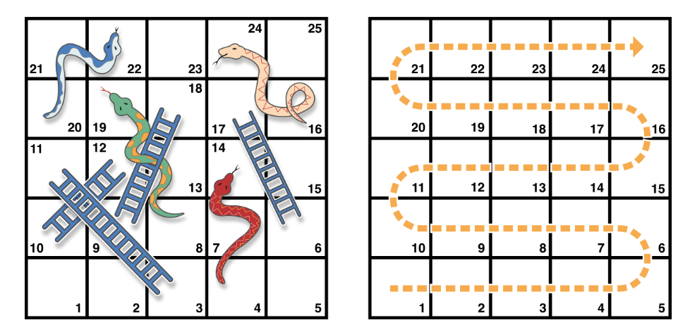
2.while 迴圈

Slide 7
2.while 迴圈
let finalSquare = 25
var board = [Int](repeating: 0, count: finalSquare + 1)
board[03] = +08; board[06] = +11; board[09] = +09; board[10] = +02
board[14] = -10; board[19] = -11; board[22] = -02; board[24] = -08
var square = 0
var diceRoll = 0
while square < finalSquare {
// roll the dice
diceRoll += 1
if diceRoll == 7 { diceRoll = 1 }
// move by the rolled amount
square += diceRoll
if square < board.count {
// if we're still on the board, move up or down for a snake or a ladder
square += board[square]
}
}
print("Game over!")

Slide 8
3.Repeat-While 迴圈
let finalSquare = 25
var board = [Int](repeating: 0, count: finalSquare + 1)
board[03] = +08; board[06] = +11; board[09] = +09; board[10] = +02
board[14] = -10; board[19] = -11; board[22] = -02; board[24] = -08
var square = 0
var diceRoll = 0
repeat {
// move up or down for a snake or ladder
square += board[square]
// roll the dice
diceRoll += 1
if diceRoll == 7 { diceRoll = 1 }
// move by the rolled amount
square += diceRoll
} while square < finalSquare
print("Game over!")

Slide 9
4.if
var temperatureInFahrenheit = 30
if temperatureInFahrenheit <= 32 {
print("It's very cold. Consider wearing a scarf.")
}
// Prints "It's very cold. Consider wearing a scarf."
temperatureInFahrenheit = 40
if temperatureInFahrenheit <= 32 {
print("It's very cold. Consider wearing a scarf.")
} else {
print("It's not that cold. Wear a t-shirt.")
}
// Prints "It's not that cold. Wear a t-shirt."

Slide 10
4.if
temperatureInFahrenheit = 90
if temperatureInFahrenheit <= 32 {
print("It's very cold. Consider wearing a scarf.")
} else if temperatureInFahrenheit >= 86 {
print("It's really warm. Don't forget to wear sunscreen.")
} else {
print("It's not that cold. Wear a t-shirt.")
}
// Prints "It's really warm. Don't forget to wear sunscreen."
temperatureInFahrenheit = 72
if temperatureInFahrenheit <= 32 {
print("It's very cold. Consider wearing a scarf.")
} else if temperatureInFahrenheit >= 86 {
print("It's really warm. Don't forget to wear sunscreen.")
}

Slide 11
5.switch
let someCharacter: Character = "z"
switch someCharacter {
case "a":
print("The first letter of the alphabet")
case "z":
print("The last letter of the alphabet")
default:
print("Some other character")
}
// Prints "The last letter of the alphabet"

Slide 12
5.switch
無貫穿
let anotherCharacter: Character = "a"
switch anotherCharacter {
case "a": // Invalid, the case has an empty body
case "A":
print("The letter A")
default:
print("Not the letter A")
}
// This will report a compile-time error.
let anotherCharacter: Character = "a"
switch anotherCharacter {
case "a", "A":
print("The letter A")
default:
print("Not the letter A")
}
// Prints "The letter A"

Slide 13
5.switch
區間符合
let approximateCount = 62
let countedThings = "moons orbiting Saturn"
let naturalCount: String
switch approximateCount {
case 0:
naturalCount = "no"
case 1..<5:
naturalCount = "a few"
case 5..<12:
naturalCount = "several"
case 12..<100:
naturalCount = "dozens of"
case 100..<1000:
naturalCount = "hundreds of"
default:
naturalCount = "many"
}
print("There are \(naturalCount) \(countedThings).")
// Prints "There are dozens of moons orbiting Saturn."

Slide 14
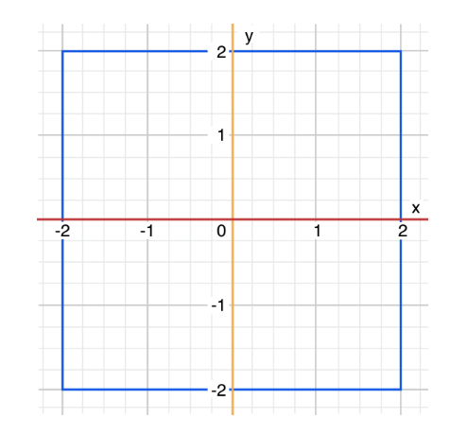
5.switch
Tuples
let somePoint = (1, 1)
switch somePoint {
case (0, 0):
print("\(somePoint) is at the origin")
case (_, 0):
print("\(somePoint) is on the x-axis")
case (0, _):
print("\(somePoint) is on the y-axis")
case (-2...2, -2...2):
print("\(somePoint) is inside the box")
default:
print("\(somePoint) is outside of the box")
}
// Prints "(1, 1) is inside the box"

Slide 15
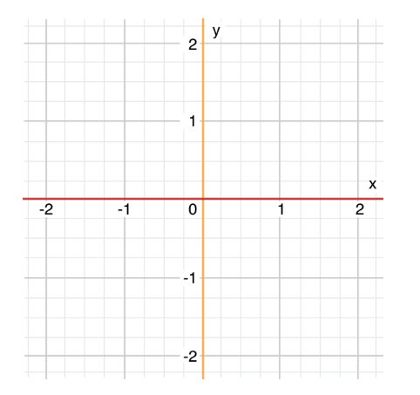
5.switch
Value bindings
let anotherPoint = (2, 0)
switch anotherPoint {
case (let x, 0):
print("on the x-axis with an x value of \(x)")
case (0, let y):
print("on the y-axis with a y value of \(y)")
case let (x, y):
print("somewhere else at (\(x), \(y))")
}
// Prints "on the x-axis with an x value of 2"

Slide 16
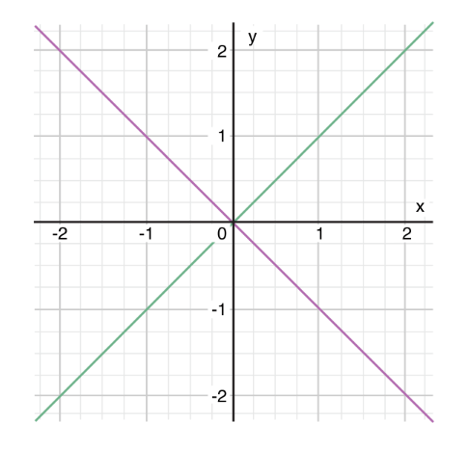
5.switch
Where
let yetAnotherPoint = (1, -1)
switch yetAnotherPoint {
case let (x, y) where x == y:
print("(\(x), \(y)) is on the line x == y")
case let (x, y) where x == -y:
print("(\(x), \(y)) is on the line x == -y")
case let (x, y):
print("(\(x), \(y)) is just some arbitrary point")
}
// Prints "(1, -1) is on the line x == -y"

Slide 17
5.switch
Compound Cases
let someCharacter: Character = "e"
switch someCharacter {
case "a", "e", "i", "o", "u":
print("\(someCharacter) is a vowel")
case "b", "c", "d", "f", "g", "h", "j", "k", "l", "m",
"n", "p", "q", "r", "s", "t", "v", "w", "x", "y", "z":
print("\(someCharacter) is a consonant")
default:
print("\(someCharacter) is not a vowel or a consonant")
}
// Prints "e is a vowel"

Slide 18
6.改變流程控制
Continue
let puzzleInput = "great minds think alike"
var puzzleOutput = ""
let charactersToRemove: [Character] = ["a", "e", "i", "o", "u", " "]
for character in puzzleInput {
if charactersToRemove.contains(character) {
continue
}
puzzleOutput.append(character)
}
print(puzzleOutput)
// Prints "grtmndsthnklk"

Slide 19
6.改變流程控制
Early Exit
func greet(person: [String: String]) {
guard let name = person["name"] else {
return
}
print("Hello \(name)!")
guard let location = person["location"] else {
print("I hope the weather is nice near you.")
return
}
print("I hope the weather is nice in \(location).")
}
greet(person: ["name": "John"])
// Prints "Hello John!"
// Prints "I hope the weather is nice near you."
greet(person: ["name": "Jane", "location": "Cupertino"])
// Prints "Hello Jane!"
// Prints "I hope the weather is nice in Cupertino."

