Slide 1
Lab Meeting
Long Read Sequencing & Tree Climbing Justin Landis

Slide 2
Outline
Assisting in the Development of DE of RNAseq methods for long read sequencing
Use current methods for quantifying RNAseq of Published long read data
Prototype isoform grouping method with known complex gene
investigate error control solutions to combat double dipping of grouping methods

Slide 3
Part 1 - The Search For Data

Slide 4
Long Read Data
To meet the first goal, I needed data from the Sequance Read Archive (SRA). The perfect long read data would come from an experiment that…
implemented RNAseq
has at least 2 groups to evaluate differential expression
has at least 3 samples per group
Is not related to cancer research
Important
The Grant is submitted to the National Human Genome Research Institute (NHGRI). Thus its best to avoid experiments that research cancer as there is a separate source of funding for that (NCI).

Slide 5
Tequila Seq - PRJNA883409
Cell Line | Time Points | N Replicates
Brain tissue | NA | 3
SH-SY5Y/neuroblastoma | 4 hours | 3
SH-SY5Y/neuroblastoma | 8 hours | 3
SH-SY5Y/neuroblastoma | 48 hours | 3
Technically a “Targeted” sequencing approach - not purely RNAseq.

Slide 6
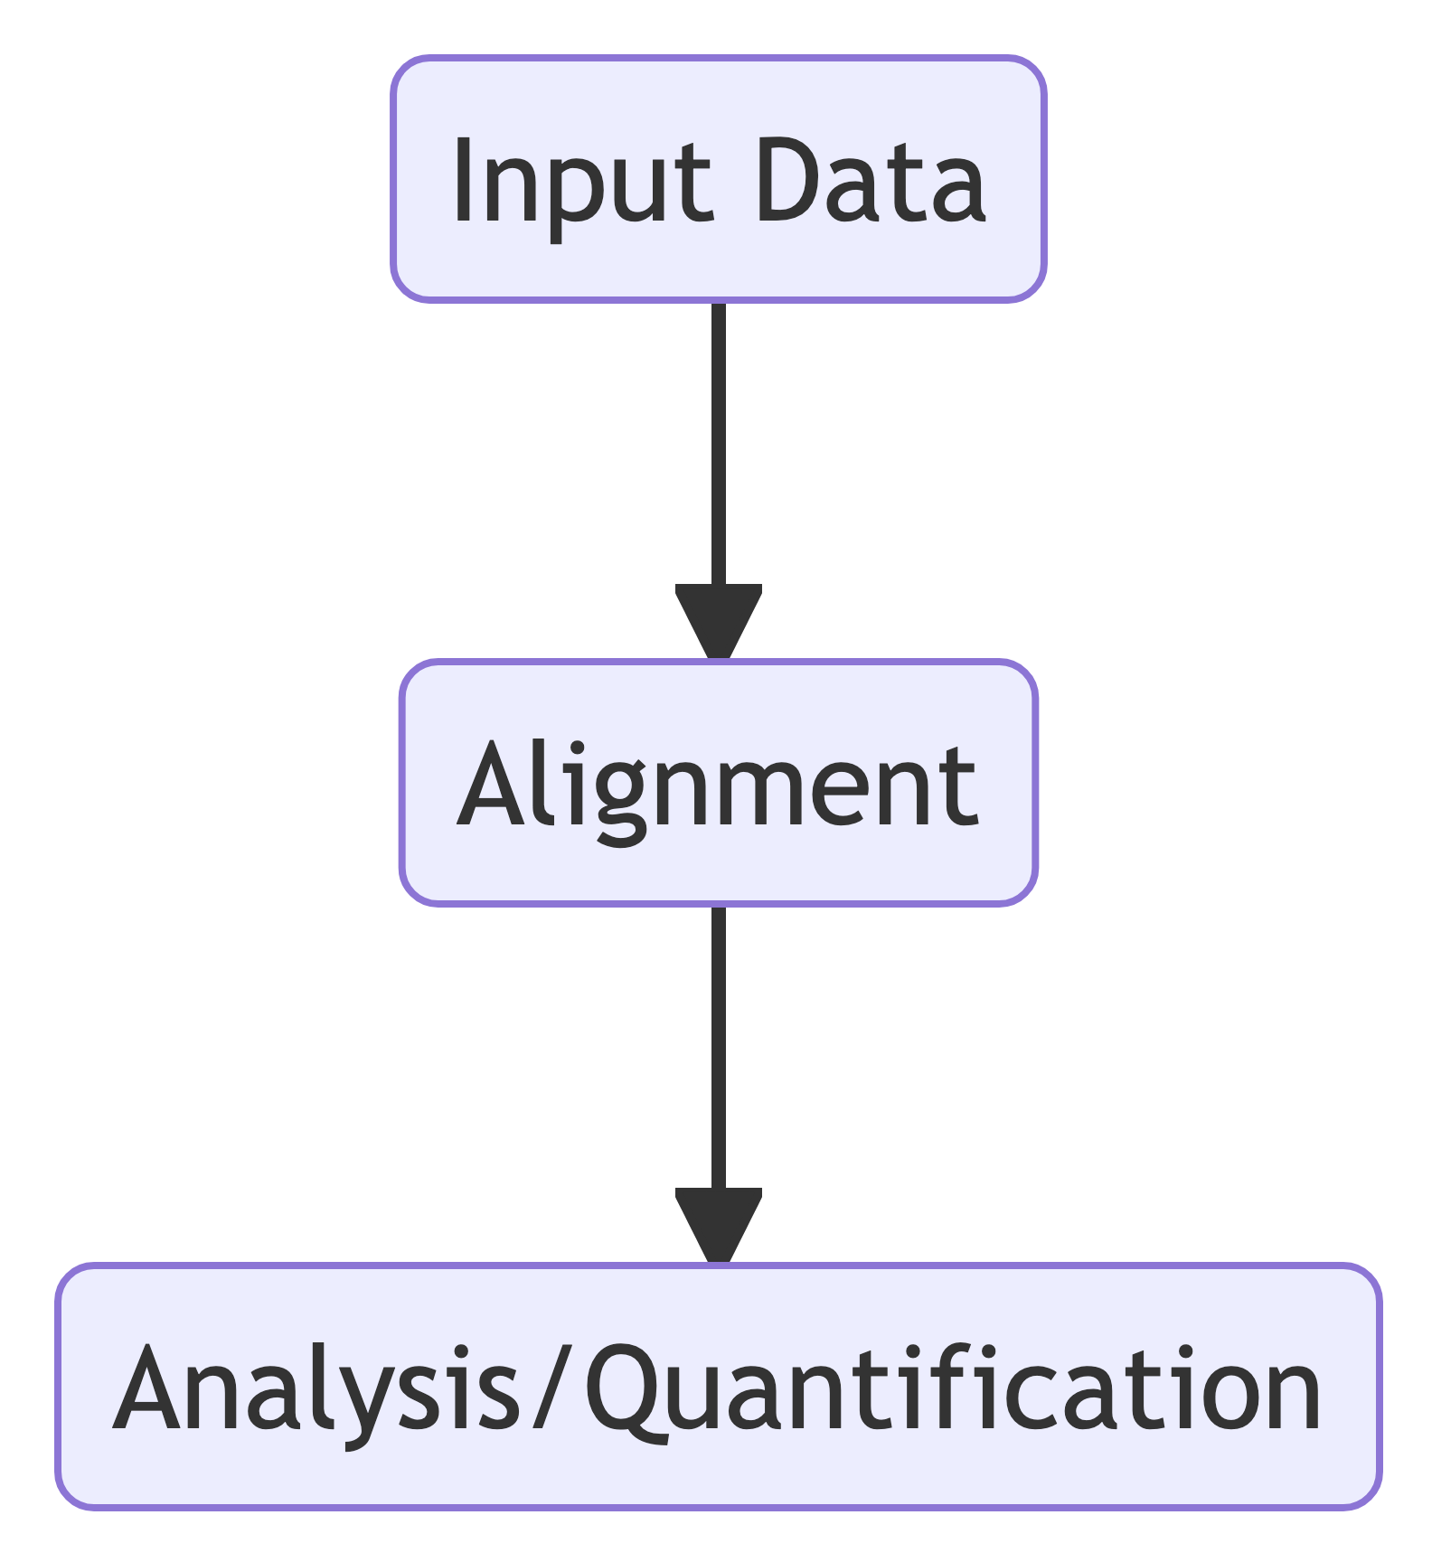
Analysis pipeline
There are a number of steps that need to be taken before you may use an analysis tool such as DESeq2. These steps largely depend on your data source and analysis goals.

Slide 7
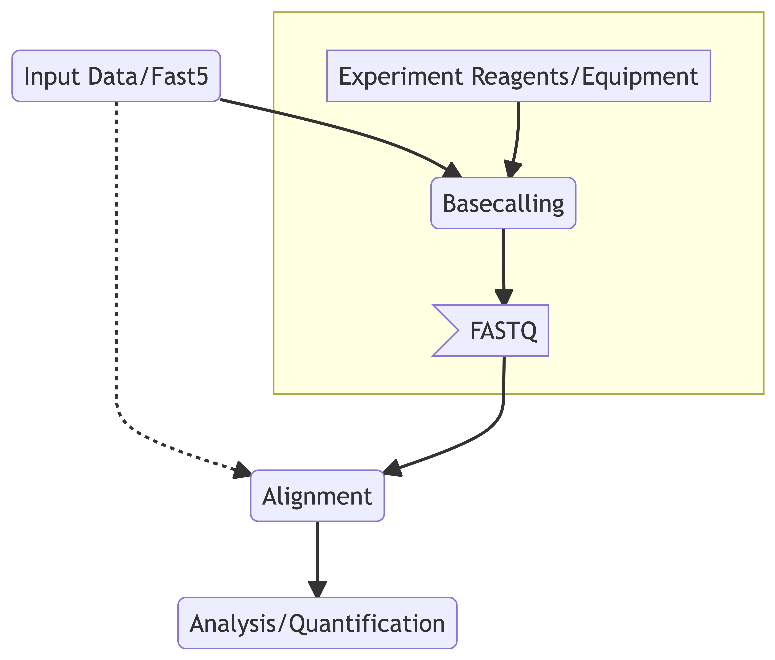
Input Data
The data we have found is from Oxford Nanopore sequencer. The data that was uploaded to the SRA is not a standard sequence format, but instead as a fast5 directory. Before we can do an alignment we must perform basecalling.
At its essence, the Data generated from a Nanopore sequencer is a sequence of current measurements called “squiggles”. This data needs to be passed into a Neural Network basecaller to generate the standard FASTQ formats.
Discerning the correct configuration for the basecaller also depends on the instrument used as well as the reagents such as the flow cell.

Slide 8
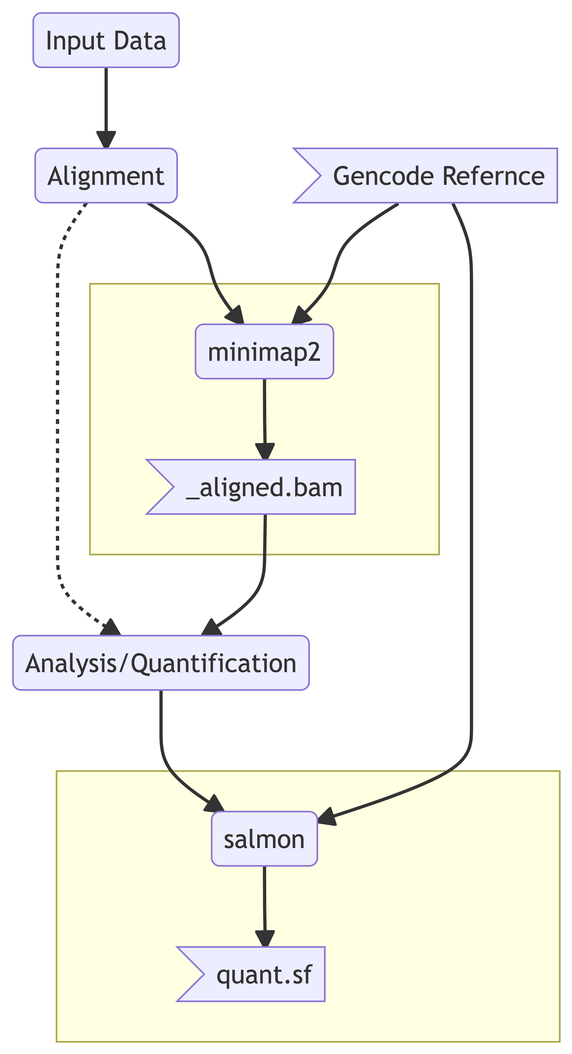
Alignment & Quantification
There were more headaches in converting nanopore data into a usable format than actually running the next two steps. Alignment was done with minimap2, and quantification was done with salmon.
Both Bioinformatic softwares have Oxford Nanopore aware configuration options.

Slide 9
The last step
The final step would be to read all the quant.sf data into R and perform some Differential Expression analysis. I unfortunately did not get to this point in my rotation, but all of the steps to perform basecalling and generate the quant.sf files have been documented.

Slide 10
Part 2 - Tree Climbing

Slide 11
Motivation
Long read sequencing allows for less ambiguity in alignments and quantification steps, which implies these methods do not need to infer as much which gene isoforms are present in RNAseq analysis.
However, Long Read Sequencing comes generally the expense of read depth. Thus we would like to also increase our power.
Suppose that there is differential expression and that some subset of isoforms within a gene are modulated together. Can we find an optimal node of a clustering tree to merge data?

Slide 12
Clustering Algorithm
Before we can find a node, we must generate a tree. There are two main methods to consider.
hierarchical clustering on count data
Data Dependent
Biases p-values in merges
hierarchical clustering on pairwise exon similarity measures
Biologically intuitive - similar transcripts may be regulated together
deterministic (per gtf file)
Potential for many ‘tied’ transcripts due to no overlap

Slide 13
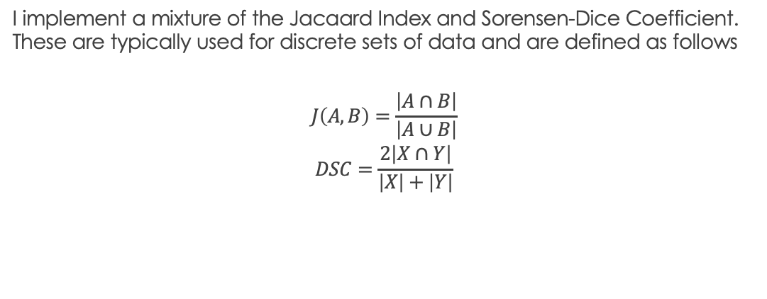
Pairwise Exon Similarity Measure
I implement a mixture of the Jacaard Index and Sorensen-Dice Coefficient. These are typically used for discrete sets of data and are defined as follows
$$\begin{matrix}J\left(A,B\right)=\frac{\left|A∩B\right|}{\left|A∪B\right|} \\ DSC=\frac{2\left|X∩Y\right|}{\left|X\right|+\left|Y\right|}\end{matrix}$$

Slide 14
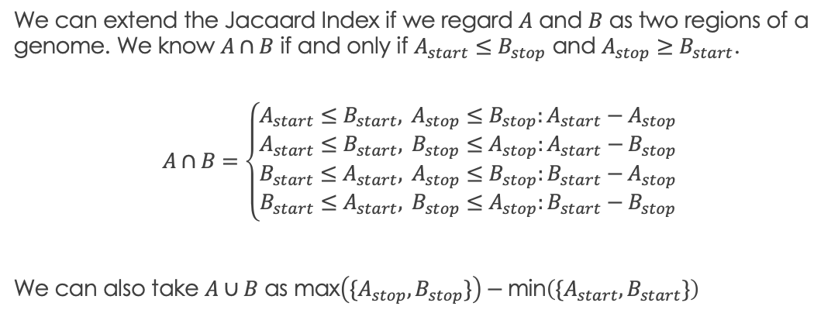
Extending Jacaard to basepair similarities
We can extend the Jacaard Index if we regard $A$ and $B$ as two regions of a genome. We know $A∩B$ if and only if $A_{start}≤B_{stop}$ and $A_{stop}≥B_{start}$.
$$A∩B=\left\{\begin{matrix}A_{start}≤B_{start}, A_{stop}≤B_{stop}:A_{start}−A_{stop} \\ A_{start}≤B_{start}, B_{stop}≤A_{stop}:A_{start}−B_{stop} \\ B_{start}≤A_{start}, A_{stop}≤B_{stop}:B_{start}−A_{stop} \\ B_{start}≤A_{start}, B_{stop}≤A_{stop}:B_{start}−B_{stop}\end{matrix}\right.$$
We can also take $A∪B$ as $\text{max}\left(\{A_{stop},B_{stop}\}\right)−\text{min}\left(\{A_{start},B_{start}\}\right)$

Slide 15
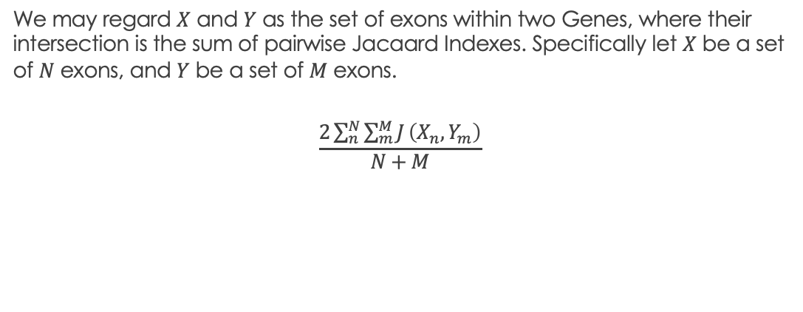
Extending Sorensen-Dice Coefficient
We may regard $X$ and $Y$ as the set of exons within two Genes, where their intersection is the sum of pairwise Jacaard Indexes. Specifically let $X$ be a set of $N$ exons, and $Y$ be a set of $M$ exons.
$$\frac{2\sum_{n}^{N}{\sum_{m}^{M}{J}}\left(X_{n},Y_{m}\right)}{N+M}$$

Slide 16
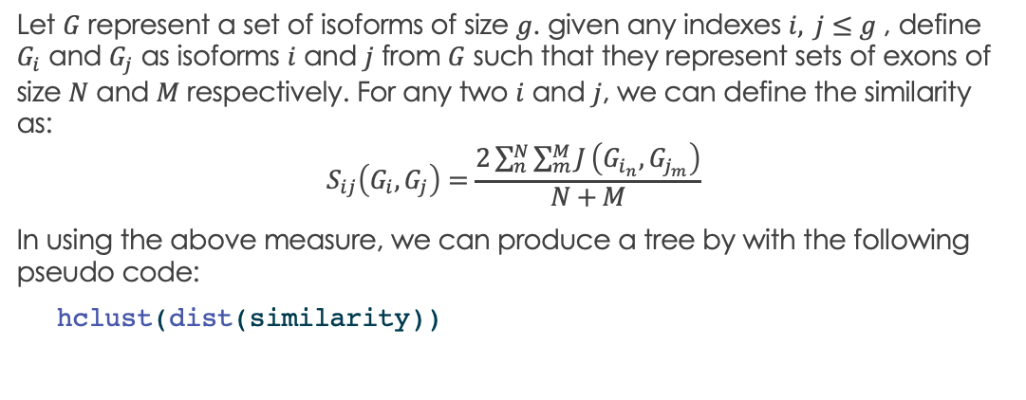
Final Similarity Measure
Let $G$ represent a set of isoforms of size $g$. given any indexes $i, j≤g$ , define $G_{i}$ and $G_{j}$ as isoforms $i$ and $j$ from $G$ such that they represent sets of exons of size $N$ and $M$ respectively. For any two $i$ and $j$, we can define the similarity as:
$$S_{ij}\left(G_{i},G_{j}\right)=\frac{2\sum_{n}^{N}{\sum_{m}^{M}{J}}\left(G_{i_{n}},G_{j_{m}}\right)}{N+M}$$
In using the above measure, we can produce a tree by with the following pseudo code:
hclust(dist(similarity))

Slide 17
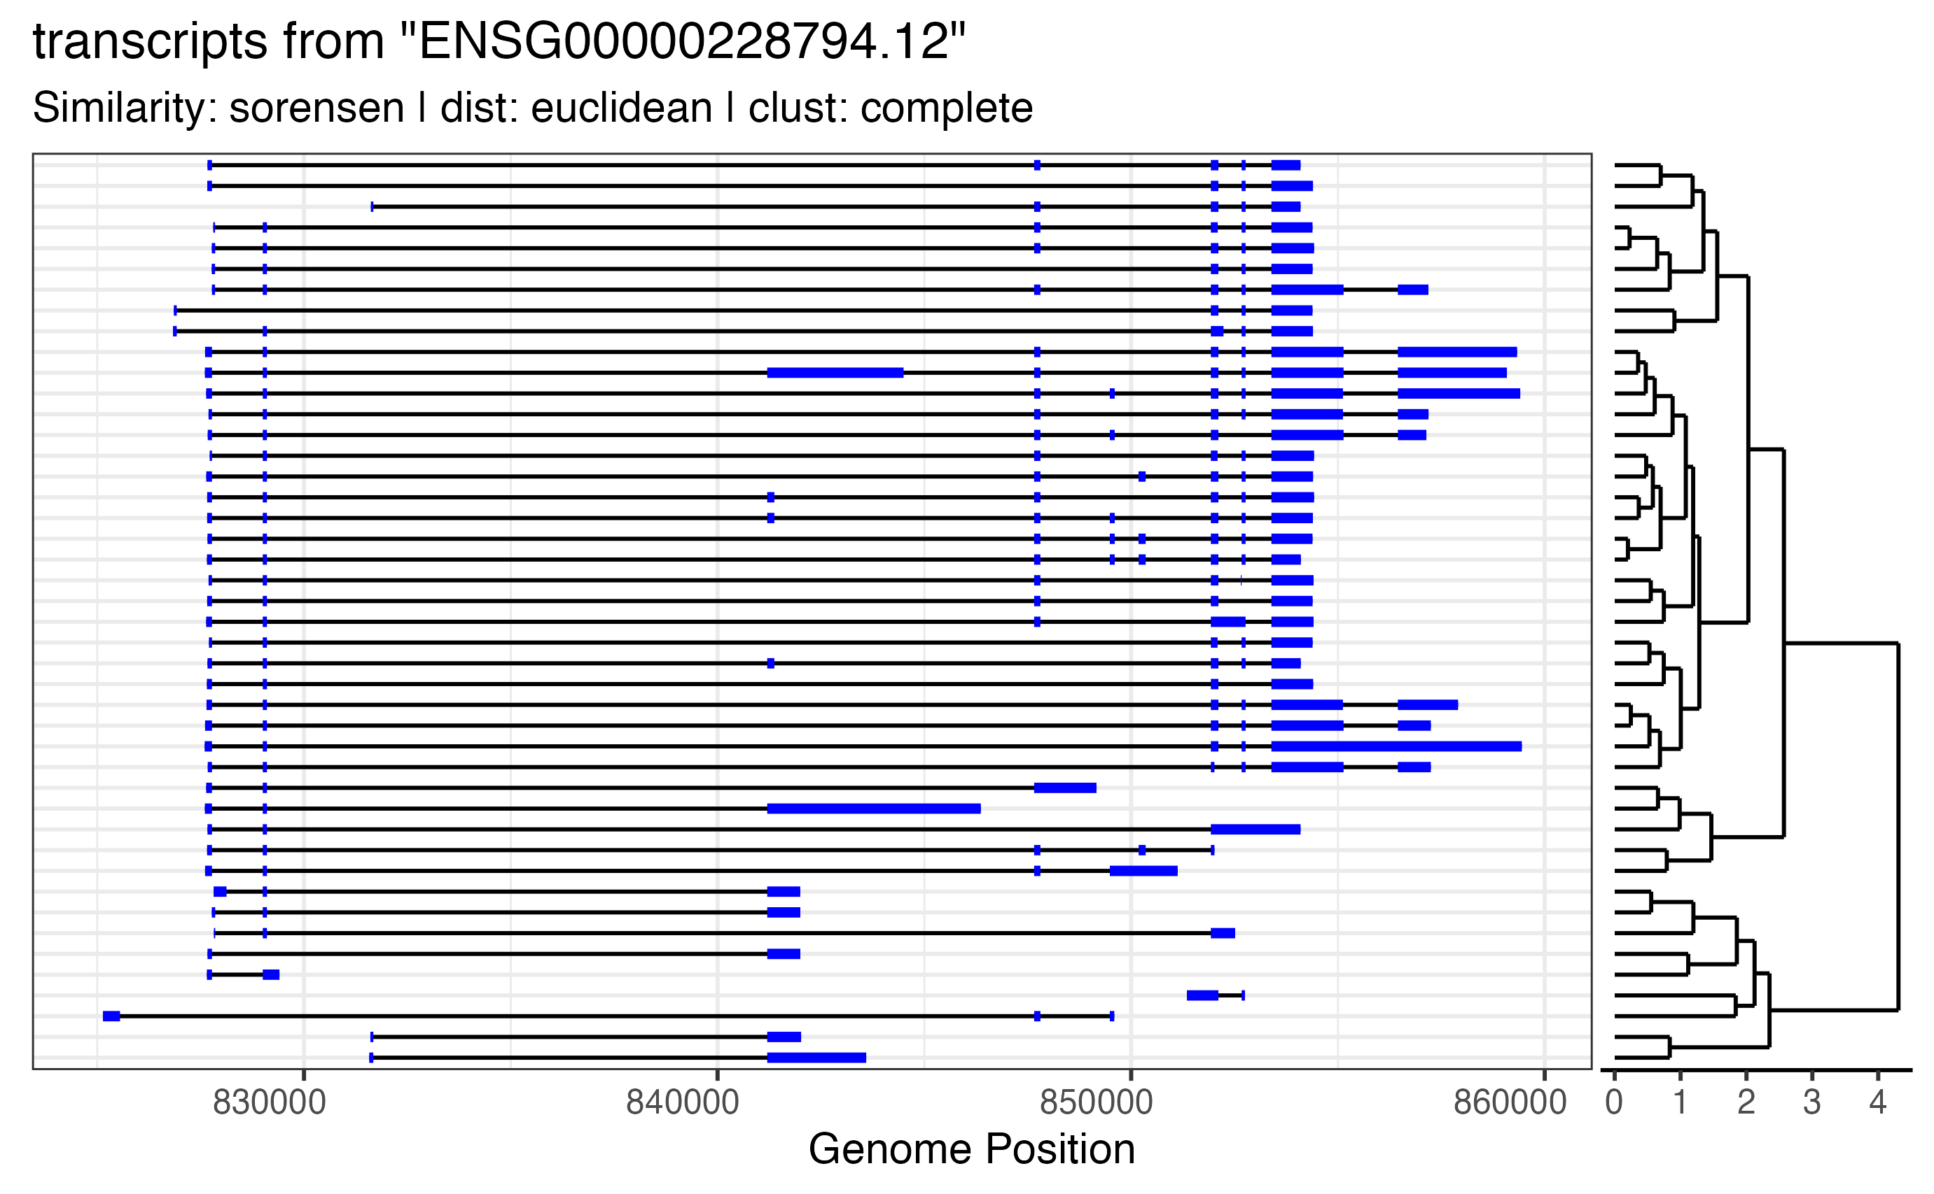
Clustering Result

Slide 18




Contrived Experiment
Group 1
Group 2
$$μ_{0}+ δ$$
Choose an inner node within the tree and shift the mean of all leaves for a particular group by some delta. We can evaluate our Tree climbing algorithm based on how well it accurately chooses the known perturbed nodes.
$$μ_{0}$$
$$\}$$
$$X_{ij}\sim NBin(μ_{ij}, α=100)$$

Slide 19
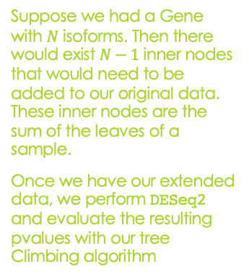
Formulating Inner Node Data
Suppose we had a Gene with $N$ isoforms. Then there would exist $N−1$ inner nodes that would need to be added to our original data. These inner nodes are the sum of the leaves of a sample.
Once we have our extended data, we perform DESeq2 and evaluate the resulting pvalues with our tree Climbing algorithm

Slide 20
Algorithm 1 - Bottom Up
initialize all leafs as the set of possible nodes to keep.
Order p-values of inner nodes by their hclust height.
For an inner node, climb to that node if and only if both descendant’s p-value is greater than the parent’s p-value.
If so, remove children from set and add this node.
if not, flag this node as the highest for any ancestor.
continue until all inner nodes have been assessed.

Slide 21
Algorithm 2 - Top Down
Order all nodes (leaves and inner) by their p-values in ascending order.
For each node
record all descendants
add this node to the set of merge points if and only if its descendants are disjoint from the set of descendants of the current set of merge points.
repeat until all leaves have been recorded.

Slide 22
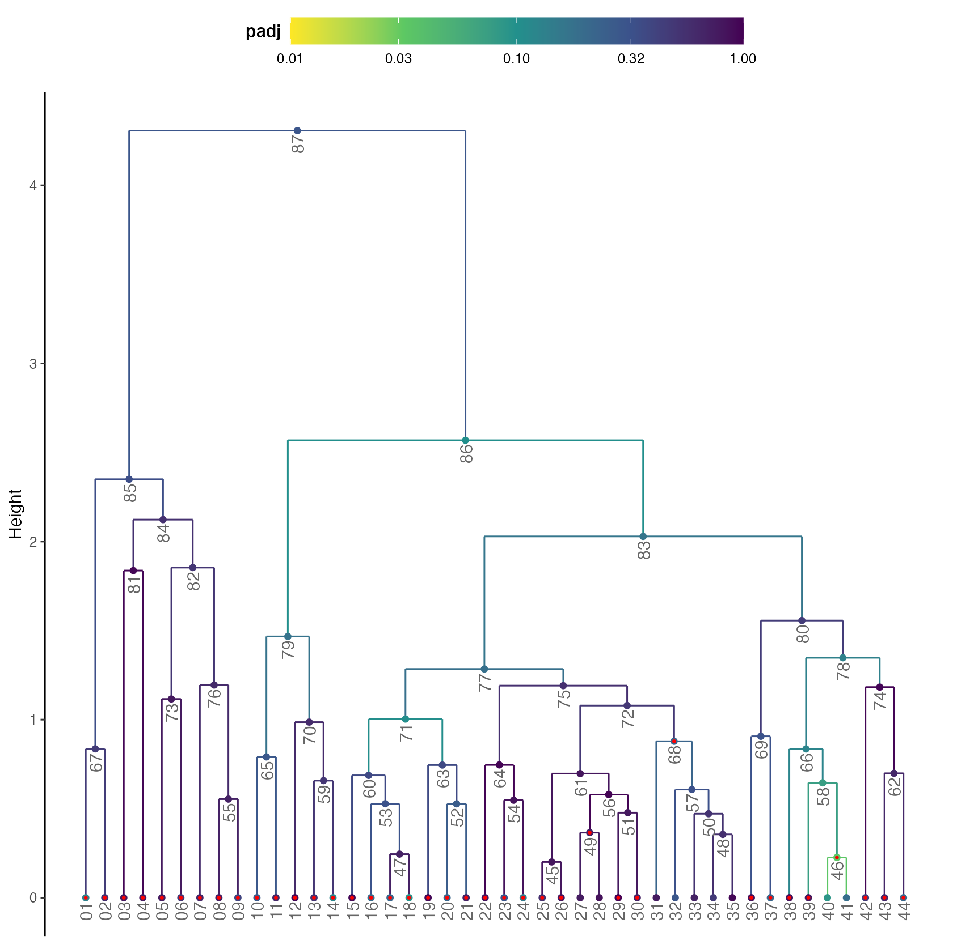
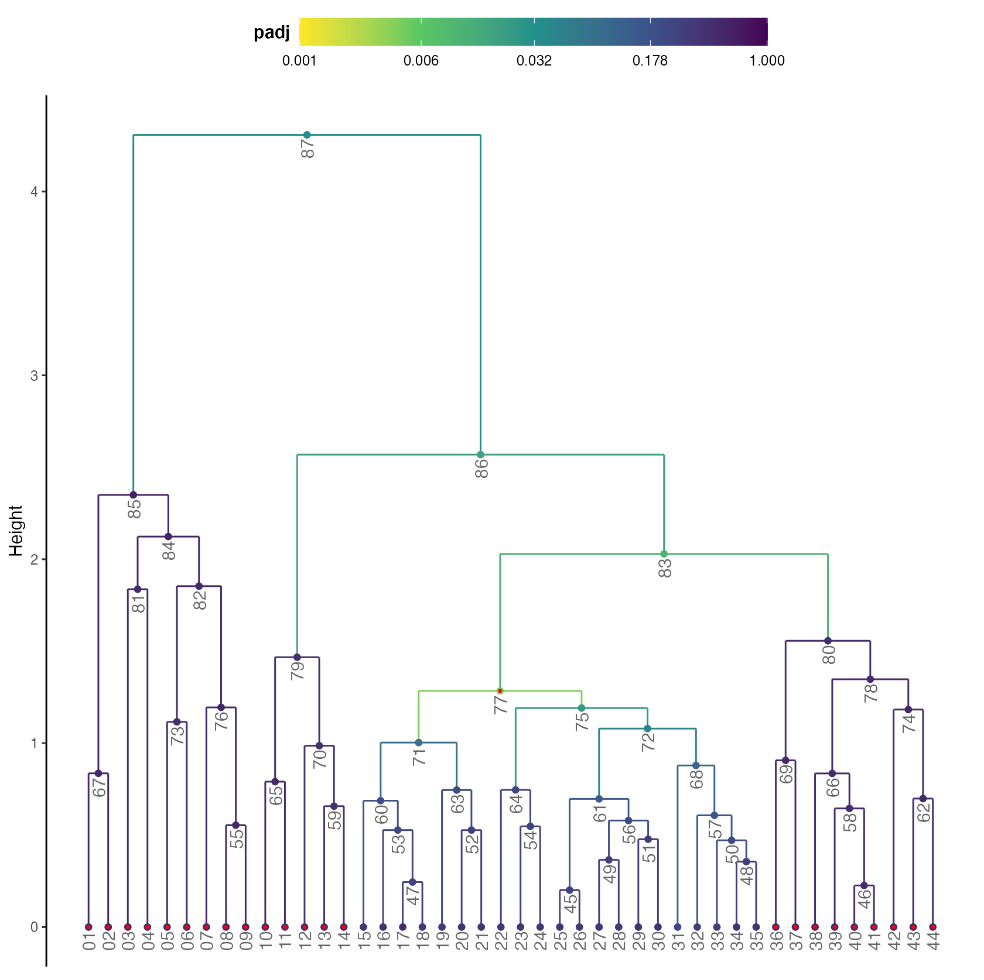
Example: Imperfect Sim. Vs. Perfect Sim.
FN
FN
TP
TP
FP

Slide 23
Algorithm Assessment
Evaluating our algorithm through simulations

Slide 24
Part 3 - Error Control

Slide 25
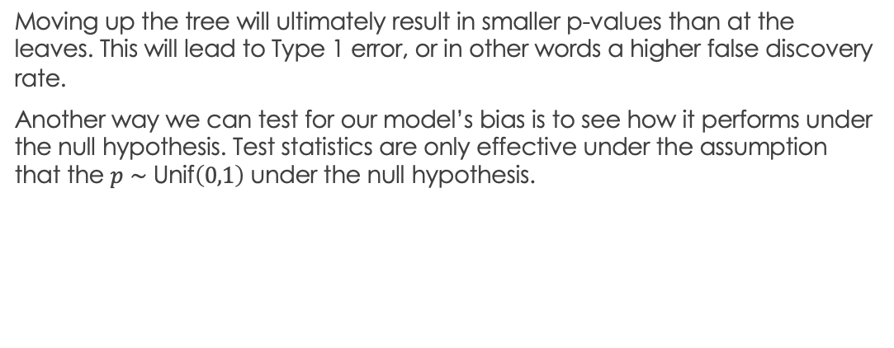
Motivation
Moving up the tree will ultimately result in smaller p-values than at the leaves. This will lead to Type 1 error, or in other words a higher false discovery rate.
Another way we can test for our model’s bias is to see how it performs under the null hypothesis. Test statistics are only effective under the assumption that the $p∼\text{Unif}\left(0,1\right)$ under the null hypothesis.

Slide 26
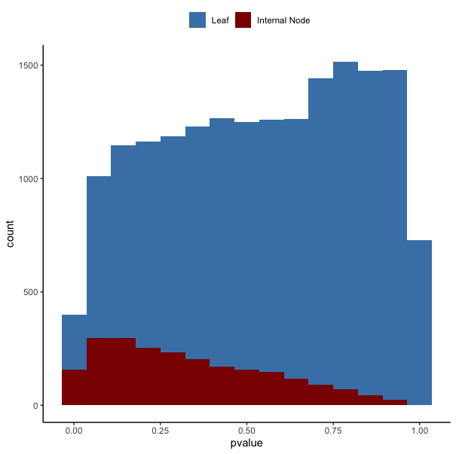
Simulating Under the Null

Slide 27
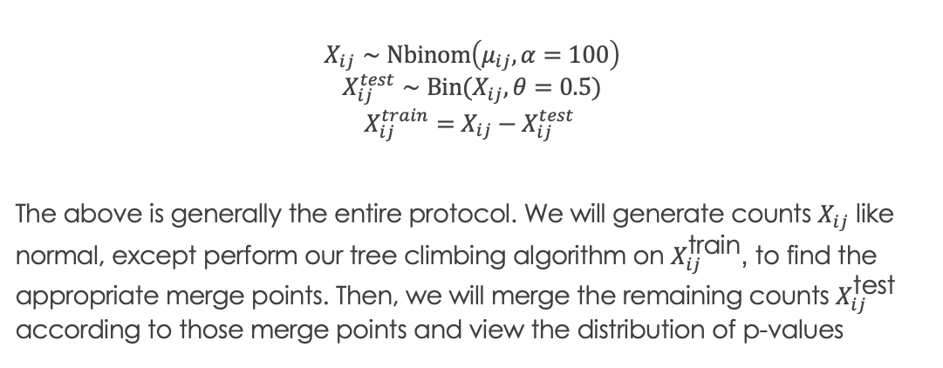
Count Splitting
$$X_{ij}∼Nbinom\left(μ_{ij}, α=100\right)$$
$$X_{ij}^{test}∼\text{Bin}\text{(}X_{ij},θ=0.5)$$
$X_{ij}^{train}=X_{ij}−X_{ij}^{test}$
The above is generally the entire protocol. We will generate counts $X_{ij}$ like normal, except perform our tree climbing algorithm on $X_{ij}^{\text{train}}$, to find the appropriate merge points. Then, we will merge the remaining counts $X_{ij}^{\text{test}}$ according to those merge points and view the distribution of p-values

Slide 28
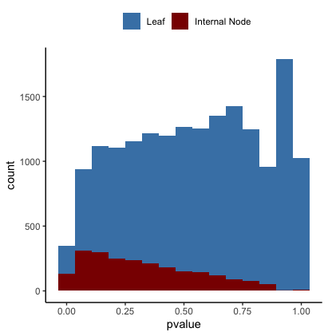
Training Set

Slide 29
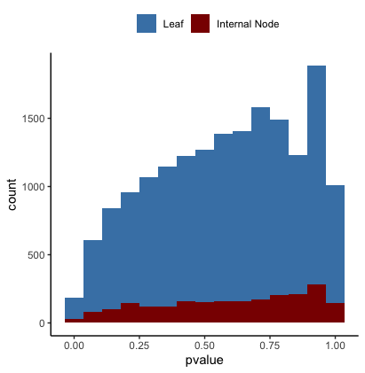
Test Set

Slide 30
Part 4 - Real Data Application

Slide 31
Programming woes
In the last week, I was trying to tackle the Tequila-seq data in hopes to add it to my poster. This meant shifting much of the code base focusing around simulations and managable in memory objects to the common Bioconductor data structures. Changes included:
Reading GTF into a GenomicRanges data type
Converting similarity matrix calculations to use “Sparse Matrices” from the Matrix package.
Shifting functions to expect a TreeSummarizedExperiment object

Slide 32
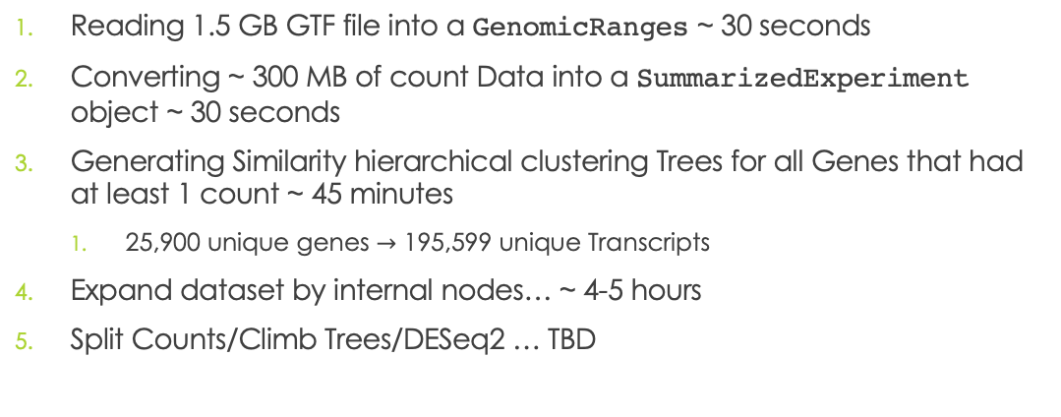
Programming woes - continued
Reading 1.5 GB GTF file into a GenomicRanges ~ 30 seconds
Converting ~ 300 MB of count Data into a SummarizedExperiment object ~ 30 seconds
Generating Similarity hierarchical clustering Trees for all Genes that had at least 1 count ~ 45 minutes
25,900 unique genes $→$ 195,599 unique Transcripts
Expand dataset by internal nodes… ~ 4-5 hours
Split Counts/Climb Trees/DESeq2 … TBD

