Slide 1
Medical Image Viewer Release 1
Brendan Kirby, Artur Braga, Michael Surdouski, William Dougherty

Slide 2
Review of Requirements
Display images in a study
Two display modes
Scroll through images
Persist display state
Save a study
Exit program

Slide 3
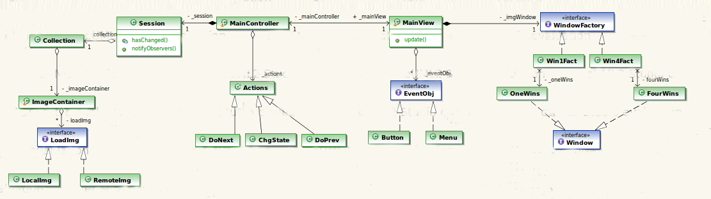
M
C
V

Slide 4
Model-View-Controller Pattern
Model
Defines structure and lower-level logic
Session - Holds display and image information
Collection - Defines behavior for image and display manipulation
Uses Strategy Design Pattern to choose paths
Uses Observer Design Pattern to listen for changes in Session

Slide 5
Model-View-Controller Pattern
View
Handles visualization of displays in Windows
MainView - Primary display used to fill the viewers display
WindowFactory - Creates window views based on the display state
Window - Displays images, changes display state
Uses Observer Design Pattern to update view based on changes in Session
Uses Factory Design Pattern to create window views based on the display state

Slide 6
Model-View-Controller Pattern
Controller
Contains higher-level logic needed to use View
Controls the running of the program
Contains references to Model and View
Main - Allows access to main controller and handles termination
MainController - Holds a reference to Session, contains logic for user actions
Actions - An interface that a user action must implement

Slide 7
M
C
V

Slide 8
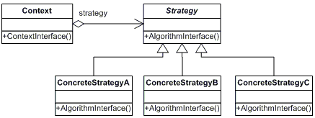
Strategy

Slide 9
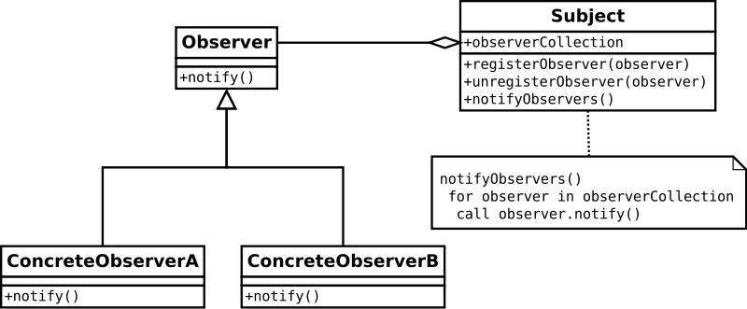
Observer Pattern

Slide 10
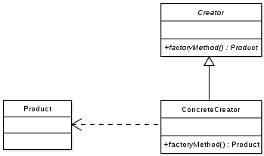
Factory Pattern

Slide 11
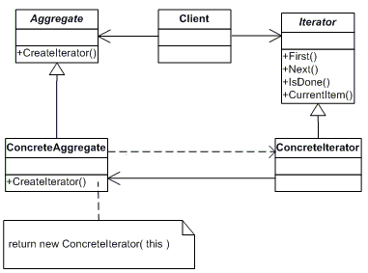
Iterator Pattern

Slide 12
Strengths
Model and View are decoupled
Design Patterns used with the thought of changing requirements
ex: Factory not very useful unless files are loaded from non-local sites
View and Controller are very abstract!
Extensible, maintainable
Changes to displays and images can easily be implemented

Slide 13
Weaknesses
View knows about Controller
Controller is too abstract?
No separation of loading the files versus iterating through them
(both functions are located in the same place)
Too modular for the simple functionality of the design

Slide 14
Difficulties Encountered
Setting up GitHub
Meeting together
Interpreting requirements
Finding a good balance between coupling and cohesion
Distancing ourselves from the code to complete a design

Slide 15
Questions?

