Slide 1

CS 134 Computer Game Design
Instructor: Kevin M. Smith

Slide 2
We Learn how to make video games from the “ground-up”
Learn what it takes to write a game virtually from scratch
Focus on both 2D and 3D games (you’ll develop one of each)
Learn computer graphics/interaction techniques for gaming
Workshop style class
Fun – but it is hard work !
From Wikipedia

Slide 3
K.M. Smith: Short Bio
Thirty Years R+D experience in graphics for feature film, VFX, games and product design visualiation.
Currently: Principal/Owner – Motion Picture Research, LLC. VFX, VR, Computer Graphics Consulting. Consulting for Unity and others.
Director of Engineering – Autodesk (formerly Alias). Resonsible for Media, Entertainment and Visualization Consulting Groups.
Director of Engineering – Alias. Responsible for development of key components of Maya
Commodore – Early days during college (worked on tech support hotline for commodore 64 when released)

Slide 4
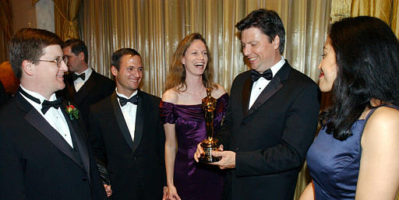
“In the future, everyone will be world-famous for 15 minutes”….Andy Warhol

Slide 5
Grade Weighting:
Mid-term Project (30%)
Labs/Homework (30%)
Build skills for projects
Engagement (10%)
Attending/participating in class and presentations
Final Project (30%)
Includes presentation and code prototype

Slide 6
Syllabus:
Good programming skills are essential for this class.
Good structure and design
C++ (not required but you must be willing to learn – it is the preferred core language of computer graphics/games dev).
Intermediate level C++ used
Academic Honesty
Must sign the code you write by putting your name in a comment header.
Usual university rules apply.
Course materials are copyrighted. Please do not reuse without my permission or take photographs. (although you can photograph whiteboard.).

Slide 7
Syllabus:
Class Protocol
Please feel free to ask questions.
Please feel free to use your laptops for taking notes or for in-class exercises (if given).
No mobile phone use in class for voice or texting (please turn off cell phones)
Please attend all classes

Slide 8
“90 percent of success is showing up.”
Woody Allen

Slide 9

Text Book (Optional):
By Jason Gregory
We will be using the book as more of a “handbook” than a sequential guide. Many of the chapters stand alone as topics.

Slide 10
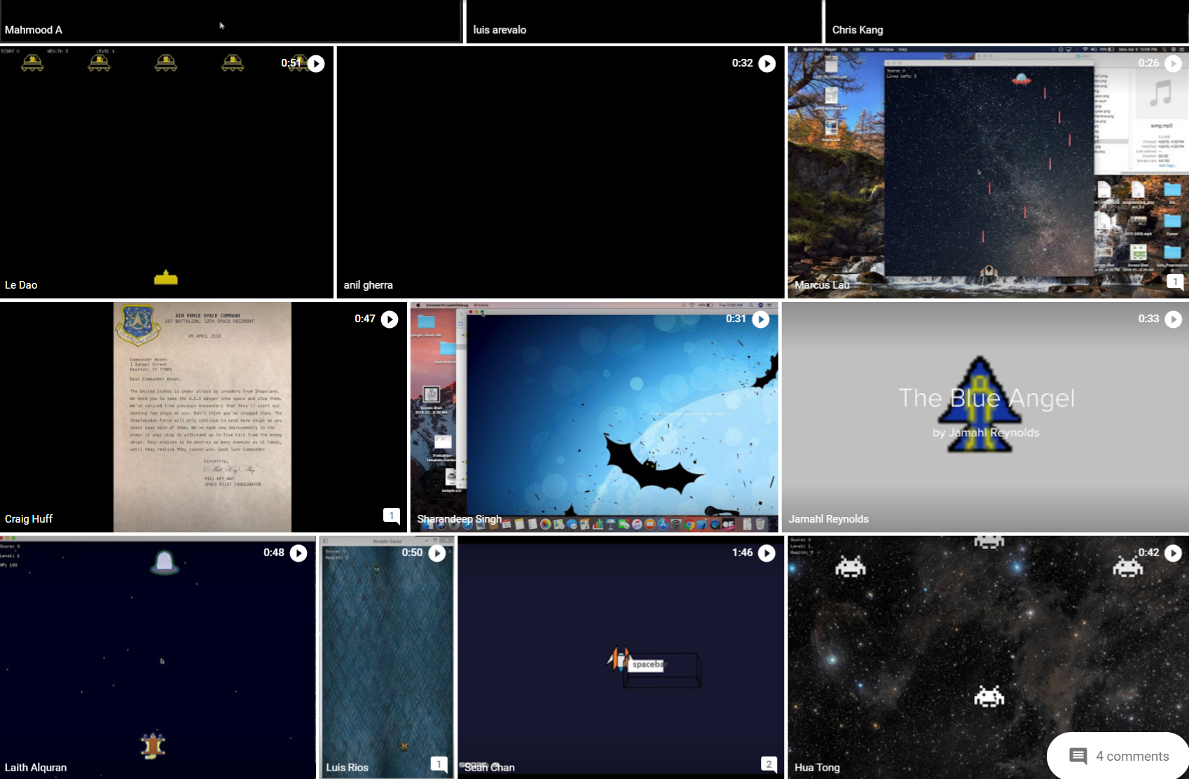
Class Gallery (CS 134)

Slide 11
What do we cover in the class?

Slide 12
What this class is NOT about
Learning a specific game engine like Unity or UE4
There are other classes, books or online courses where you can learn that
Learning to program in C++ - it is expected that you are already a proficient programmer and can learn C++ on your own. We use a simplified C++ syntax (ie ”C with classes”).
Game Art/Content development - you’ll have to develop some of your own sprites and models but not the focus of this class.
From Wikipedia

Slide 13
Topics Covered for CS134
Basic Game Mathematics (mostly Vectors)
2D Game Interactivity/Graphics
Rendering
Animation
Game Design – Vintage Arcade Shooting Game
Physics
Physics Engine Basics
Trajectory, Ballistic Motion, Integration
Particle Systems, Collision Detection
3D Computer Grames
Basic 3D game graphics (3D viewing/transformations/animation)
Building a basic 3D Simulation/Flying Game (using Physics)

Slide 14

Intro to Field: Who makes video games?

Slide 15
Video Game Production Departments
Programming
Art
Design
Production
QA
Publishing
Community

Slide 16
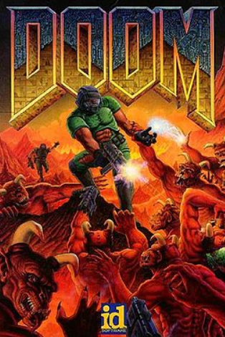
Game Team Composition
Programming, Design, Art, and Production make up the ”Core Team”
Common ratios are 3 Prog : 4 Design : 4 Art (for a smaller title)
5 – 10 people (for a smaller title)
30-50 people (for a larger title)
Classic Doom's team (1993):
Programming: John Carmack, John Romero, Dave Taylor
Design: John Romero, Sandy Peterson, McGee, Green
Art: Adrian Carmack, Kevin Cloud,
Don Ivan Punchatz, Gregor Punchatz

Slide 17
Who makes video games?
Programming
Engine programmer
Networking programmer
Graphics programmer
Gameplay programmer
Tools programmer
Server programmer
AI programmer
User Interface Programmer
VR/AI Programmer
Sound/Audio Programmer
Experience in CS 134

Slide 18
Who makes video games?
Art
Concept artist
Environment artist
Character artist
User Interface Artist
Animator
Art Director
Other
Motion Capture Technical Director
Sound Designer

Slide 19
Tools you will use for CS134
C++ (using Visual Studio or Xcode for IDE/Debugger)
C++ class library for UI and OpenGL (OpenFrameworks)
Maya (only basic features for polygon/subd modeling)
Screen recording or screen capture software of your choice
Video editing software of your choice (for final project trailer)

Slide 20
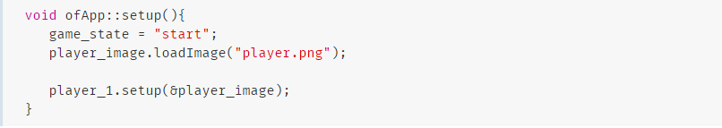
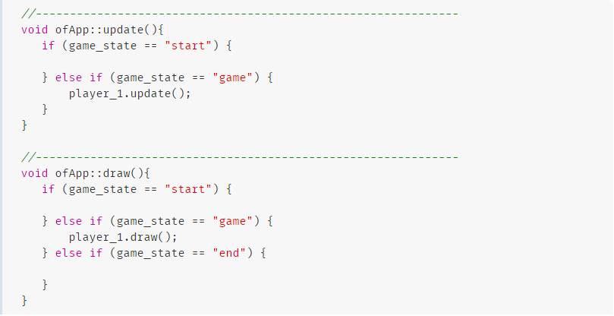
Example: OpenFrameworks

Slide 21
For Next Time:
Next Topic: Vector Math Review, Dev tools overview
Homework: Install development tools (for PC or Mac). See assignment in Canvas

