Slide 1

CS 134 Computer Game Design
Instructor: Kevin M. Smith

Slide 2
CS 134 Course Outline
Physics and Simulation
3D Game Design
Game Engine Development (UE4)
Team Project
2D Game Design
Introduction to Game Engines

Slide 3
Quick Review From Last Time

Slide 4
Quick Review From Last Time
Particles
Have mass, velocity, acceleration and potential forces that act upon them
Trajectory
We can write an integrator to compute a new particle position based on velocity and it’s new velocity based on acceleration – at each time step dt.
For single particle, this produces a ballistic trajectory.
Force
We can apply external forces to particles to affect their motion
Example forces: gravity, drag, turbulence, magnetic, repulsion
An elegant fact is that the force acting on a particle is the vector sum of all the forces applied.
Force on a particle : F = ma or a = 1/m * F

Slide 5
Basic Particle Structure (now adding force)
Class Particle {
ofVec3f position; // position of the particle in world space
ofVec3f velocity; // current velocity of particle
ofVec3f accel; // current acceleration of particle
float damping; // damping
float mass; // mass
ofVec3f force; // total accumulated force on particle
}
We will use the “force” vector in the integration step

Slide 6
Force Computation
Force on particle is initialized to zero (0).
At each update (time step) BEFORE integration
The forces are applied to every particle
If there is more than one force applied, it is ADDED to the force vector for that particle.
At integration, we add a new step to incorporate the forces into the acceleration total.
We the “zero” the force in each particle at the end of each step (force gets recalculated every frame).
Why ?

Slide 7
Integrator Steps (adding in Forces)
Position, Velocity and Acceleration are vectors
dt is a scalar . We can use the time interval between each frame
Damping is a scalar.
// Basic Algorithm for Simple Particle Integrator
//
At each frame , update each Particle:
Compute new position of particle based on velocity and time step
position = position + velocity * dt;
Compute the acceleration from forces on particle using a = (1/m) * f
Add that to the existing particle acceleration
Compute new velocity of particle based on total acceleration and time step
Velocity = velocity + acceleration * dt;
Damp Velocity
Velocity = velocity * damping
Set forces on particle to zero // we recompute every step

Slide 8
Particle System Architecture
Particle System
A cloud of particles and all the operations you can do on them. (A “cloud” is a set of one or more particles)
Emitter
The object that emits a cloud of particles
There are different types.
Forces
We need an interface to add new types of forces to particles

Slide 9
Particle System Architecture
Particle System
A cloud of particles and all the operations you can do on them. (A “cloud” is a set of one or more particles)
Emitter
The object that emits a cloud of particles
There are different types.
Forces
We need an interface to add new types of forces to particles
Ex: Wind, turbulence etc.

Slide 10
Particle System Architecture
Collision
Collision between particles and other objects.
Collision between particles (can be expensive and often not used except for sprite applications)
Repulsive forces can be used to simulate collision. Will show an example later.

Slide 11
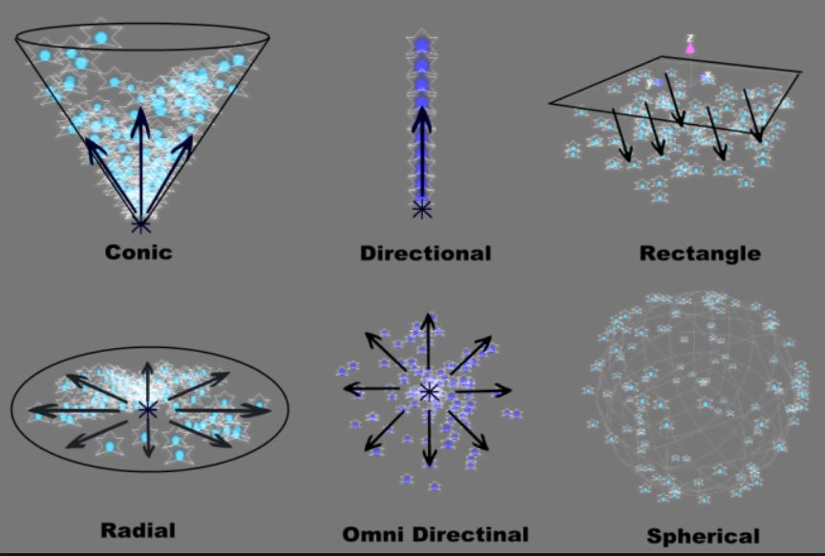
Basic Emitter Types
Emitter Types
Different types of emitters release particles in different patterns.
The emitter controls this by setting:
Initial position
Initial velocity
Using these parameters for each particle, an emitter can control the release geometry.

Slide 12
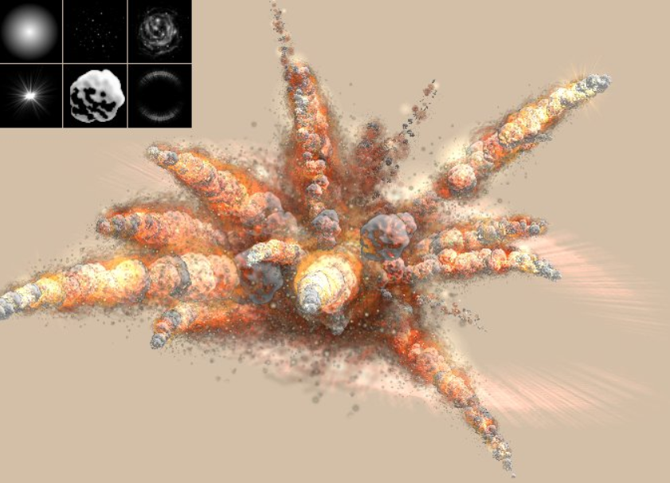
Particle Effects

Slide 13
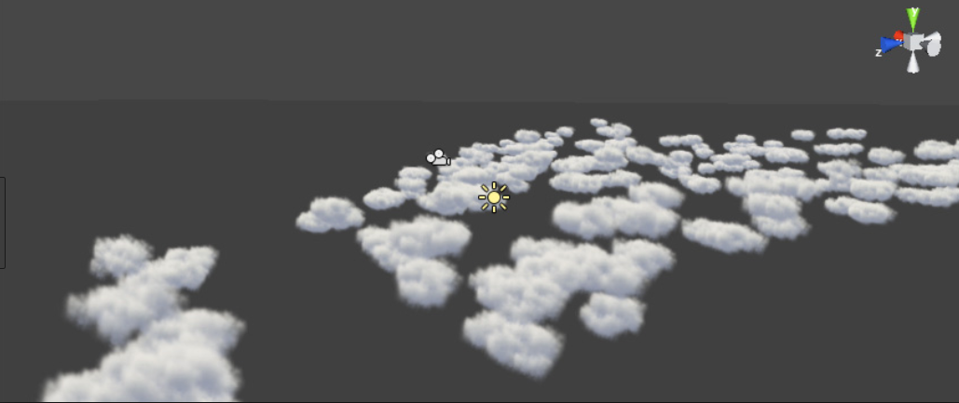
Particle Effects

Slide 14
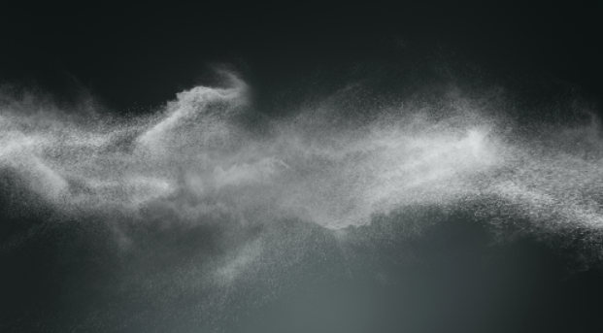
Particle Effects

Slide 15
In Class Exercise
Preparation
Create a new project with the ofxGui add-in
Replace the source files with the files in this project:
particlesTemplate.zip (in FILES/examples)
Compile/Run
This should show an empty 3D scene with a grid. Become familiar with moving the camera with the mouse.

Slide 16
In Class Exercise
Coding:
Add an emitter to your app
Modify your ofApp.h to create a new Emitter by declaring one:
Emitter emitter;
Be sure you have your emitter draw() and update() itself in ofApp.cpp. Make sure to call emitter->start() in setup.
What do you see ?
Connect the lifespan, rate, velocity and radius sliders to your Emitter.
Example: In ofApp::update() call:
emitter->setRate(rate) before
emitter->update();

Slide 17
In Class Exercise
Coding:
Lets add some forces
Add gravity
emitter.sys->addForce(new GravityForce(ofVec3f(0, -gravity, 0)));
Put this in your ofApp::setup() method.

Slide 18
In Class Exercise
Coding:
Lets add some forces
Add some Turbulence
emitter.sys->addForce(new TurbulenceForce(ofVec3f(-2, -1, -3), ofVec3f(1, 2, 5)));
Put this in your ofApp::setup() method.
Try different Values for Turbulence min and max vectors.

Slide 19
Homework (for next class)
Finish what you did not complete in class AND THEN ---
Modify your program to use sliders (6) for the Turbulence parameters (min, max). How ? Hints:
Add new method TurbulenceForce::set(min, max);
When you create your turbulence force, you need to save a pointer to it so you can dynamically set the values in the update.
Bonus:
Create a new Particle Force, called NoiseForce using ofNoise functions.
Connect with similar sliders and show results
Post Movie

