Slide 1

CS 134 Computer Game Design
Instructor: Kevin M. Smith

Slide 2
CS 134 Course Outline
Physics and Simulation
3D Game Design
Game Engine Development (UE4)
Team Project
2D Game Design
Introduction to Game Engines

Slide 3
Mid-Term Exam
Code Development Problem
Focus will be on physics/animation
Important: Understand Particle Physics – know emitters, particles, forces (code examples) inside out.
Will be due 48 hours after midnight of day it is handed hout
Exam is independent – not a group exercise

Slide 4
Quick Review From Last Time

Slide 5
Particle System Architecture
Particle System
A cloud of particles and all the operations you can do on them. (A “cloud” is a set of one or more particles)
Emitter
The object that emits a cloud of particles
There are different types.
Forces
We need an interface to add new types of forces to particles

Slide 6
Particle System Architecture
Particle System
A cloud of particles and all the operations you can do on them. (A “cloud” is a set of one or more particles)
Emitter
The object that emits a cloud of particles
There are different types.
Forces
We need an interface to add new types of forces to particles
Ex: Wind, turbulence etc.

Slide 7
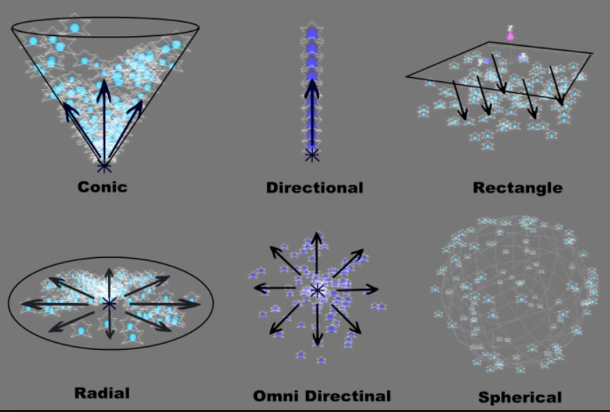
Basic Emitter Types
Emitter Types
Different types of emitters release particles in different patterns.
The emitter controls this by setting:
Initial position
Initial velocity
Using these parameters for each particle, an emitter can control the release geometry.

Slide 8
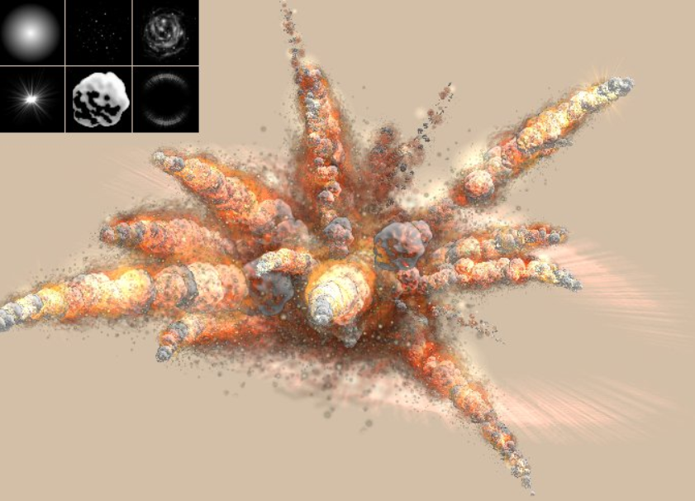
Particle Effects

Slide 9
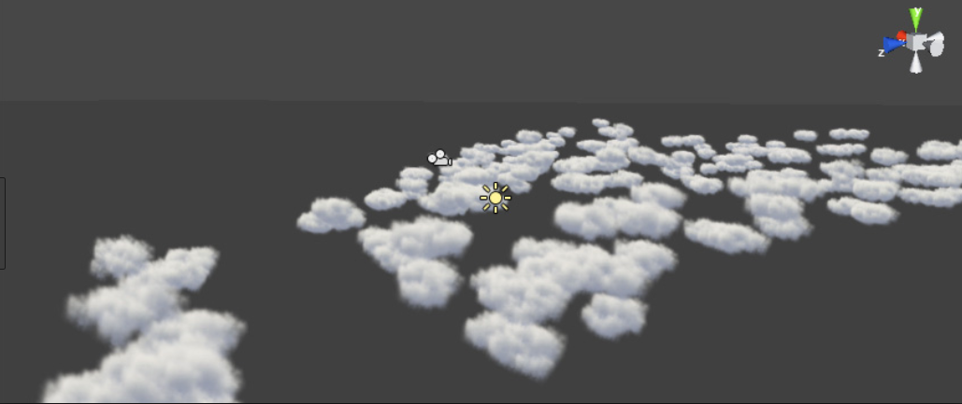
Particle Effects

Slide 10
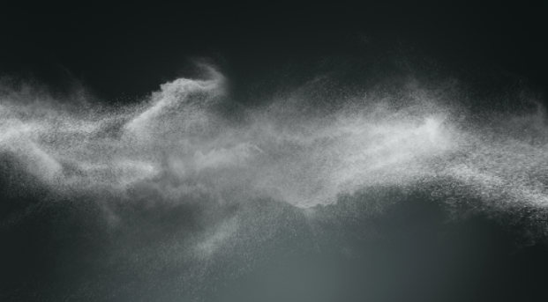
Particle Effects

Slide 11
Particles Effects in Real-Time for Games
How do we create a simulated particle effect such as an explosion in real-time ?
Needs lots of particles (10-20K)
Needs to create them very fast - particle grouping
Radial emitters can emit particles in a radial
Need forces to provide motion
Radial forces provide radial distribution
Forces have to be impulse type
=> Large amount of force applied in a very short duration.

Slide 12
Particles Effects in Real-Time for Games
Grouping (or sometimes Clustering)
At 1/60 second framerate, if we create one new particle each frame, we only create 60 particles/second.
Not enough
We add a groupSize element to our emitter that we can chance.
So we are able to create as many particles as we want (system performance limited) at each frame.

Slide 13
Particles Effects in Real-Time for Games
Radial Emission
We want particles to be rapidly distributed in a radial pattern
For each particle emitted, set it’s initial velocity by:
Create a randomized direction vector for the particle
dir = ofVec3f(ofRandom(-1,1), ofRandom(-1,1), ofRandom(-1,1))
Compute speed (how ?)
Magnitude of initial velocity
New velocity = speed * dir;
Now each particle has a new initial velocity with same speed but in a random direction pointing radially outward from emitter.

Slide 14
Particles Effects in Real-Time for Games
Radial Emission
Some additional techniques to add interest:
Add some randomness to speed (within a margin)
Add some randomness to the lifespan of the particles (within a margin)
Velocity Vector
Particle
Emitter

Slide 15
Particles Effects in Real-Time for Games
Radial Impulse Forces
Another technique that can be used effectively is an impulse force applied to all particles emitted.
Force is applied only once, not every step (impulse)
For each particle emitted (applied ONCE):
Create a randomized direction vector for the particle
dir = ofVec3f(ofRandom(-1,1), ofRandom(-1,1), ofRandom(-1,1))
Magnitude is an input to Force equation.
Particle force + = magnitude * dir;
Now each particle has an impulse force which is applied at integration step.

Slide 16
Particles Effects in Real-Time for Games
Radial Impulse Force
Some additional techniques to add interest:
Add some randomness to magnitude (within a margin)
Add control to distribution pattern (ex: limit “y” component to produce more of a “ring” distribution.
Add some randomness to lifespan
Force Vector
Particle
Emitter

Slide 17
In-Class Workshop
Use Example Code Provided in Class
Create an explosion effect with two (2) emitters triggered at the same time.
First emitter
Create a radial distribution in all directions (sphere like)
Second emitter
Create ring distribution using Radial Force
Suggestions
Experiment with sliders to modify/add randomness/variance to various parameters (you may have to extend my classes to get access)
Experiment with gravity – maybe first emitter has rising particles and second emitter has zero gravity.
Make a movie and hand in code

