Slide 1

CS 134 Computer Game Design – 3D Graphics
Instructor: Kevin M. Smith

Slide 2
CS 134 Course Outline
Physics and Simulation
3D Game Design
Game Engine Development (UE4)
Team Project
2D Game Design
Introduction to Game Engines

Slide 3

“Eighty percent of success is showing up.”
Woody Allen

Slide 4
3D Selection
3D Selection ( “picking”) is a good place to start learning 3D
We learn about cameras, spaces, transformations, geometry
Learn how to interact with objects in the 3D world

Slide 5
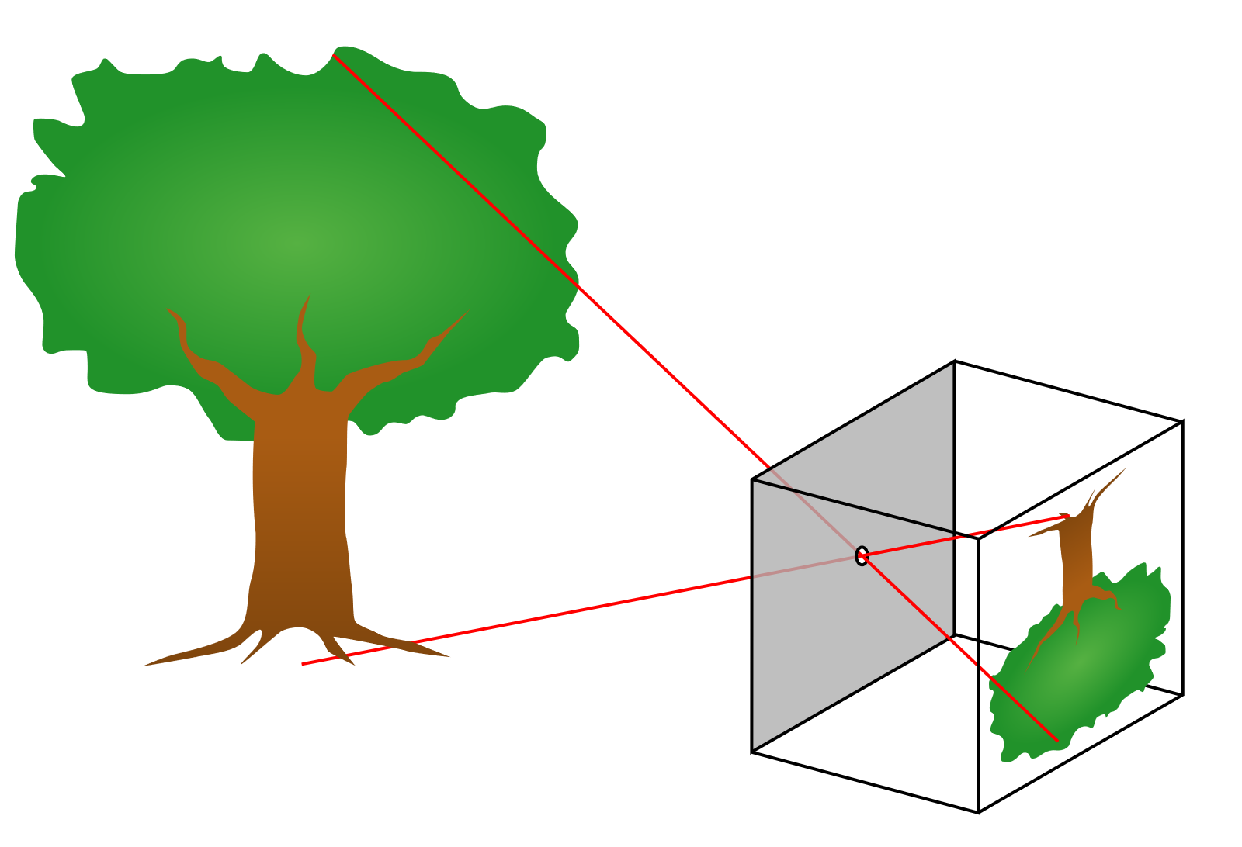
Pinhole Camera (primitive photography)

Slide 6
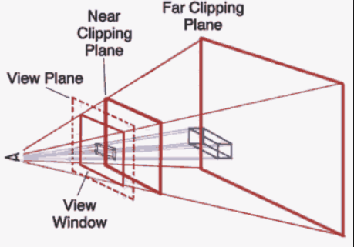
View Frustum (3D Camera Model)
Clip planes are “adjustable”
Viewport is in front of near clip
Camera can move freely in space
Rotate, translate, scale
The frustum angle is the FOV
Objects that are not in the frustum
are not rendered/drawn (typically).
*openFrameworks camera supports
all of these elements.

Slide 7
View Frustum (with View Plane)
The View Plane is “in front of” the near clipping plane.
Can think of it like a “view finder” in a camera.
2D projection of the 3D scene .
*openFrameworks camera supports
all of these elements.

Slide 8
3D Selection
What are some “things” that can be selected ?
Entire Object - ex: character rig, complete model etc.
Part of an Object hierarchy – ex: wheel of a car
Visible objects in 3D are typically represented by Geometry
Geometry – ex: polygons, NURBS surfaces, SUBD surfaces
Geometry – we can select:
Faces (Polygon models)
Edges (Polygon models)
Vertices or Points
Control Vertices (for surfaces)
Maya demo

Slide 9
3D Selection
Three very different mechanisms for 3D selection
Ray selection (related to ray tracing)
Screen-space selection
Hardware Selection (ex: OpenGL)

Slide 10
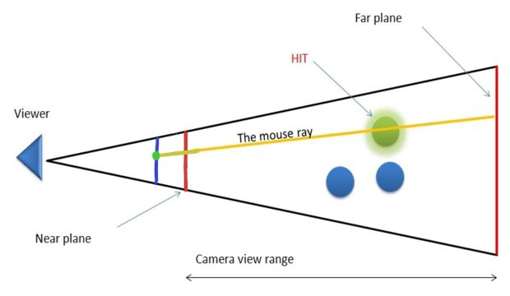
3D Ray Selection
Start with Mouse position in screen coordinates
Convert to a ray (having position and direction)
in world space.
Check if ray intersects object (if yes, then selected)
Advantages
General solution, hardware/device independence.
Disadvantages:
Requires ray intersection testing
Requires scene level optimization to make it go fast. (space partitioning algorithm)
*openFrameworks camera supports
all of these elements.
Mouse Point
Screen
screen

Slide 11
3D Ray Selection
Ray intersection Testing – A Few Example Algorithms
Ray-sphere
Ray-plane
Ray-box
Ray-cylinder
Ray-cone
Very well studied area from field of Ray Tracing
Amazing site:
http://www.realtimerendering.com/intersections.html

Slide 12
Two Other Selection Methods
We will not use in this class for 3D but worth mentioning..
Screen-space selection
Hardware Selection (ex: OpenGL)

Slide 13
Screen Space Selection
To Test if a 3D Point is selected in Screen space
Convert the value of the 3D point to 2D Point in Screen Space
Compute the 2D distance of the point to the mouse point
If d < delta (a predetermined distance), we deem it to be selected
Advantages
Simple to implement/code for simple objects (like points)
Can be optimized using 2D partitioning (box or sphere tree)
Disadvantage
Doesn’t handle general geometric intersection.
Requires Z-depth to select occluded objects.
Can be slow for “heavy” objects with a lot of vertices/points.

Slide 14
Hardware Selection
3D Hardware Selection Methods
Uses the Graphics API/GPU to select/pick objects
Example: OpenGL
OpenGL requires a separate selection test rendering pass where
each object/primitive is tagged with an unique ID.
OpenGL returns a test of ID’s that intersect with a mouse ray
or sub-frustum.
Advantages
Can be fast
Fairly easy to implement in OpenGL for simple scenes
Disadvantages
API-Dependent (requires OpenGL or similar API that supports it)
Requires render selection pass (like color selection method we used)
May not address selection of all 3D object types in a general way

