Slide 1

CS 134 Computer Game Design – 3D Graphics
Instructor: Kevin M. Smith

Slide 2
3D Selection
What is different about 3D vs 2D selection (which you’ve done) ?
Selecting “things” from a 3D scene (“things” can be 3D objects)
“Things” can be in front of other things (occlusion)
“Things” that you select have potential to be complex in structure.
Visual cues such as highlighting and affordances can have more complexity
The task of 3D selection requires higher cognitive load (than 3D)
Camera/View Navigation, mouse/pointer handling etc.

Slide 3
3D Selection
What are some “things” that can be selected ?
Entire Object - ex: character rig, complete model etc.
Part of an Object hierarchy – ex: wheel of a car
Visible objects in 3D are typically represented by Geometry
Geometry – ex: polygons, NURBS surfaces, SUBD surfaces
Geometry – we can select:
Faces (Polygon models)
Edges (Polygon models)
Vertices or Points
Control Vertices (for surfaces)
Maya demo

Slide 4
3D Selection
Three very different mechanisms for 3D selection
Ray selection (related to ray tracing)
Screen-space selection
Hardware Selection (ex: OpenGL)

Slide 5
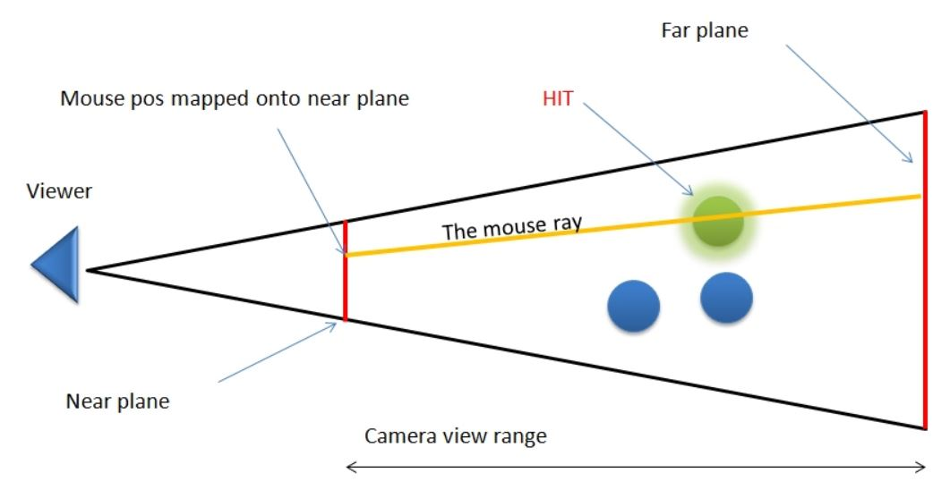
3D Ray Selection
Start with Mouse position in screen coordinates
Convert to a ray (having position and direction)
in world space.
Check if ray intersects object (if yes, then selected)
Advantages
General solution, hardware/device independence.
Disadvantages:
Requires ray intersection testing
Requires scene level optimization to make it go fast. (space partitioning algorithm)
*openFrameworks camera supports
all of these elements.
screen

Slide 6
3D Ray Selection
Ray intersection Testing – A Few Example Algorithms
Ray-sphere
Ray-plane
Ray-box
Ray-cylinder
Ray-cone
Very well studied area from field of Ray Tracing
Amazing site:
http://www.realtimerendering.com/intersections.html

Slide 7
Screen Space Selection
To Test if a 3D Point is selected in Screen space
Convert the value of the 3D point to 2D Point in Screen Space
Compute the 2D distance of the point to the mouse point
If d < delta (a predetermined distance), we deem it to be selected
Advantages
Simple to implement/code (Homework 5) for simple objects (like points)
Can be optimized using 2D partitioning (box or sphere tree)
Disadvantage
Doesn’t handle general geometric intersection.
Requires Z-depth to select occluded objects.
Can be slow for “heavy” objects with a lot of vertices/points.
Related Method: Color-based Selection (from Assignment 3).

Slide 8
Hardware Selection
3D Hardware Selection Methods
Uses the Graphics API/GPU to select/pick objects
Example: OpenGL
OpenGL requires a separate selection test rendering pass where
each object/primitive is tagged with an unique ID.
OpenGL returns a test of ID’s that intersect with a mouse ray
or sub-frustum.
Advantages
Can be fast
Fairly easy to implement in OpenGL for simple scenes
Disadvantages
API-Dependent (requires OpenGL or similar API that supports it)
Requires render selection pass (like color selection method we used)
May not address selection of all 3D object types in a general way

Slide 9
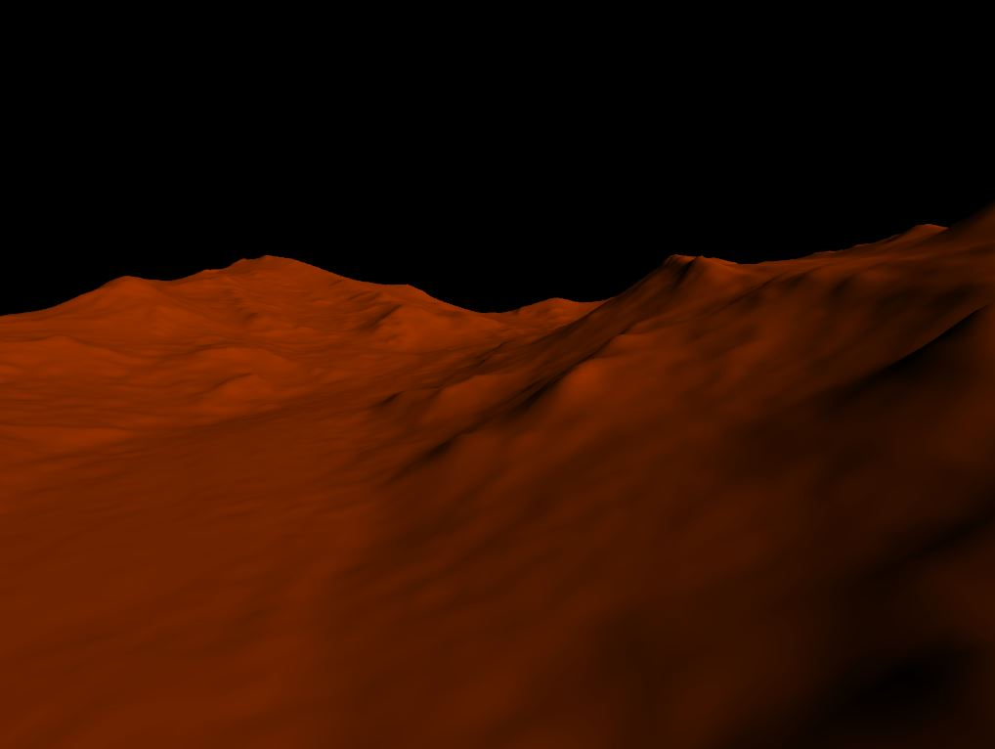
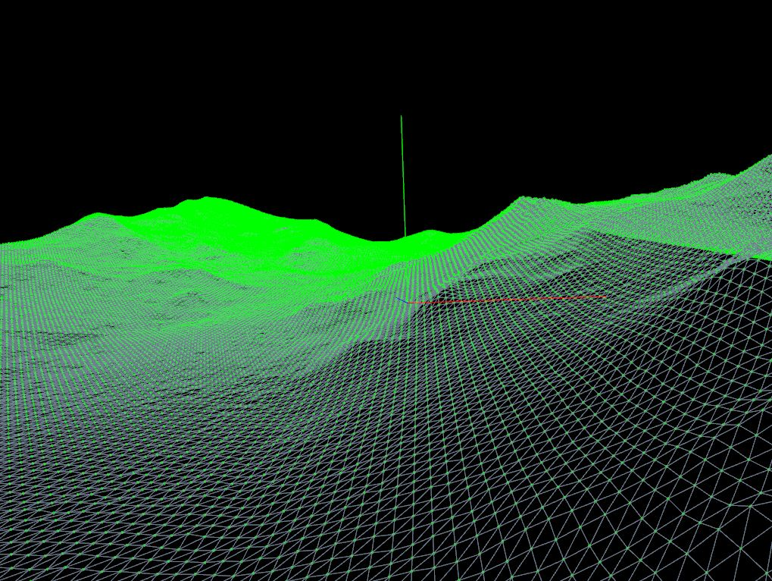
Project 2 – Landing Simulation Game
Mars Terrain views in class openFrameworks project – terrain model generated from HiRis photogrammetry

Slide 10
Terrain Data for Project 2
To familiarize yourself with the subject matter for Terrain
Learn about the HiRise Project at the Lunar and Planetary LAB
https://www.uahirise.org//dtm/
Look specifically at DTM’s (digital terrain model section)
For more info on the Mars Reconnaissance Orbiter and HiRise Camera
Start with: https://en.wikipedia.org/wiki/Mars_Reconnaissance_Orbiter

Slide 11
3D User Interface – 3D Navigation
Basic Types of Camera Motion
Free
Aim (or Target)
Maya demo

Slide 12
3D User Interface – 3D Navigation
Constrained Navigation
Restricting Movement (ex: 3D car website)
https://www.porsche.com/microsite/911/usa.aspx#showroom/911-carrera-s/3/3/50/0/0
First Person Navigation
Constrained (forward, back, left, right)
Motion Path
Camera can be moved along fixed path (usually a 3D curve)
Animated variations
“fly-through”
“teleportation” (with movement)

Slide 13
3D User Interface – 3D Navigation
Demo Examples:
Second Life
Maya - https://www.youtube.com/watch?v=ZdiKmm1_gu4

