Slide 1

CS 134 Computer Game Design – 3D Graphics
Instructor: Kevin M. Smith

Slide 2
Today
Lecture: Spatial Partitioning – Using Octrees
In-Class Exercise - Ray Selection and Bounding Boxes

Slide 3
CS 134 Course Outline
Physics and Simulation
3D Game Design
Game Engine Development (UE4)
Team Project
2D Game Design
Introduction to Game Engines

Slide 4
Spatial Partitioning
Spatial Partitioning
A method to partition (divide up) your scene to enable fast searching for objects. Example Object Types:
Points
Polygons
Higher-Level geometry
Example Workflows
Selecting points, polygons, geometry (with intersection testing)
Determine if an object is in close proximity to another object
Collision Detection
In short:
Any time you need to search information that is spatially organized, it helps to use spatial partitioning to enable fast searching of that data.

Slide 5
Types of Spatial Partitioning (that we will cover)
Quadtree (2D Data)
Octree (3D Data)

Slide 6
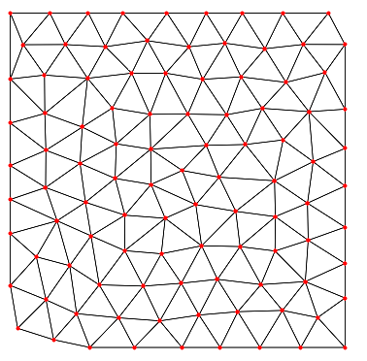
How a Quadtree Works

Slide 7
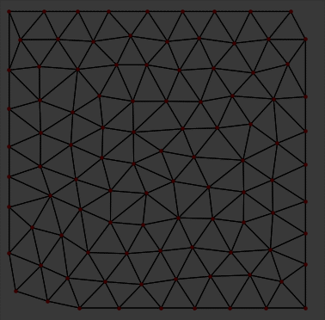
How a Quadtree Works

Slide 8
How a Quadtree Works

Slide 9
How a Quadtree Works

Slide 10
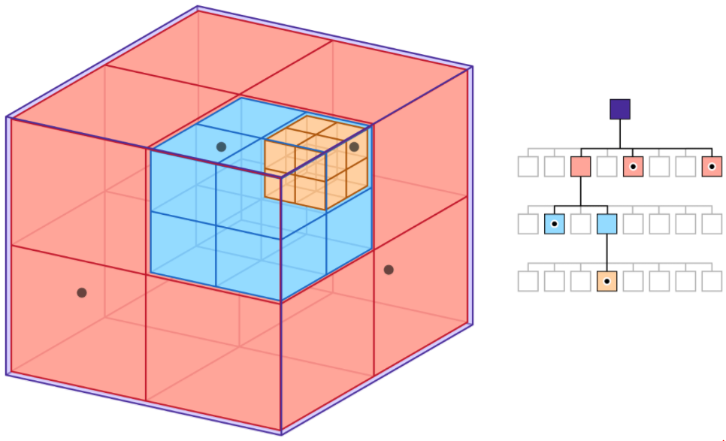
Octree Partitioning
Same as Quadtree
Boxes instead of squares
For 3D geometry

Slide 11
3D Ray Selection using an Octree
Basic Algorithm (Top Level):
Assume we have a mesh with a list of 3D points which can be indexed by i.
Create an Octree data structure of the geometry where we store point indices from the geometry into the hierarchical octree boxes. The smallest box will contain one point.
For a selection ray, R :
Recursively traverse the Octree testing for intersection with a box. If the box is hit go to the next level down.
Repeat until we find a box that contains only one point (this is the selection)
Edge Cases
It is possible to intersect multiple boxes on the same level (think selecting front or side view). If you want to support multiple selection with one ray, you would have to traverse two trees OR traverse only the closest one to the eye (camera). (For class project, chose the closet one).

Slide 12
3D Ray Selection using an Octree
Creating an Octree from Mesh – Basic Algorithm
Assume we have a mesh with points indexed by 1. Starting condition is that the entire mesh is in a bounding box (the smallest box containing all points)
Subdivide
Create a node for the box containing:
List of point indices
List of child boxes
Subdivide the box into 8 equally sized boxes
Create a node for each of the 8 child boxes
For all indices in the box, add to an index list in each child node if the point is in the child box.
If a child box is not empty, add to the parent list of child boxes;
If there is more than one vertex stored in a child:
Call Subdivide (recursively)

