Slide 1

CS 134 Computer Game Design
Instructor: Kevin M. Smith

Slide 2
CS 134 Course Outline
Physics and Simulation
3D Game Design
Final Project
2D Game Design
Introduction to Game Engines

Slide 3
Quick Review From Last Time

Slide 4
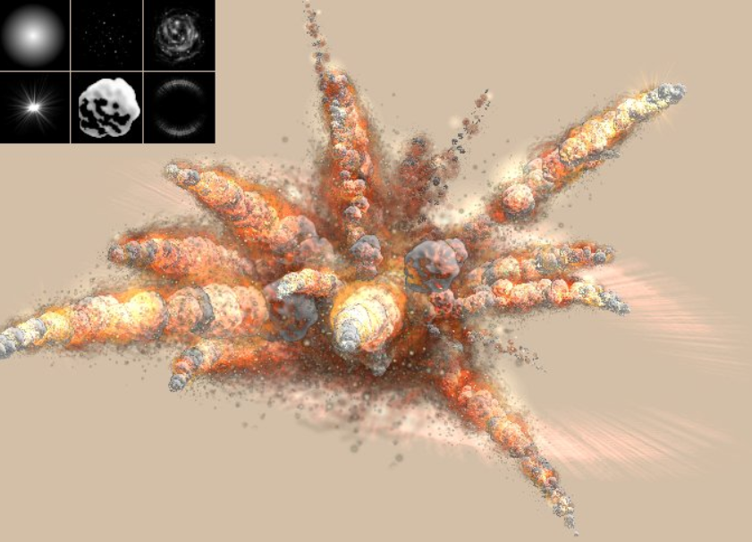
Particle Effects

Slide 5
Particles Effects in Real-Time for Games
How do we create a simulated particle effect such as an explosion in real-time ?
Needs lots of particles (10-20K)
Needs to create them very fast - particle grouping
Radial emitters can emit particles in a radial
Need forces to provide motion
Radial forces provide radial distribution
Forces have to be impulse type
=> Large amount of force applied in a very short duration.

Slide 6
Particle Rendering
How to get more than just Spheres to make our simulations look more realistic ?
Technique used:
We render a texture (or image) at each particle instance
We use an OpenGL pipeline with shaders to do that
We can use the same image for each particle (and perhaps vary the size)
We can use different images on different particles to achieve more complex effects (ex: fire)

Slide 7


Particle Textures - Examples

Slide 8
Particle Rendering – Using Simple Drawing
For each Particle in the System (loop):
Draw the instance of Particle at it’s Position (x, y, z)
Can be drawn as a shape, point or 3D geometry
Sufficient for some needs (low particle count, cartoon-like look)
Can be slow because we are potentially drawing many individual particles in separate OpenGL calls.
May not provide detail/realism required

Slide 9
Particle Rendering – Using Rendering
We preload any textures needed to render particles in setup.
For each Particle in the System (loop):
We save the position and size of the particle in a storage array called a Vertex Object Buffer (VBO).
We bind the textures to the VBO (using texture->bind())
We then tell OpenGL to draw then entire buffer using a shader with one call.
The VBO leverages the GPU/hardware to draw
Usually much faster for drawing many points.
OF has a nice interface on OpenGL to make code cleaner than using plain C. (OpenGL is a “C” API).

Slide 10
Shader Terminology (Very Basic)
Rasterization – The process of computing the pixels of a final image based on the 3D data describing the scene in which the image is composed of.
Graphics Pipeline - The software/hardware process of going from geometry (vertices, triangular meshes) with a textures to a fully rasterized picture on your screen.
Vertex Shader - Computes output values for vertices for the rasterizer.
Fragment Shader – Takes input from Vertex Shader. Is called for every pixel drawn. Outputs color/depth values for each pixel. Does texture mapping (mapping of images to geometry) and lighting.
GLSL - Graphics Language Shading Language - Language that shaders are written in.

Slide 11
Shader Terminology (Very Basic)
Framebuffer – the actual buffer in your graphics card where final rasterized image gets drawn.
Per Fragment Ops - specific operations on a per fragment basic. Things like discarding pixels that cannot be seen because of depth/occlusion or transparency

Slide 12
Two Important Shader Parts – Vertex and Fragment
Vertex Shader – called for each vertex. Input is a vertex. This shader outputs the desired position of the vertex in screen space. The vertex shader can modify the position for each vertex. Can also set variables that are passed to the Fragment Shader.
Fragment Shader – called AFTER vertex shader. (fragment means “pixel”) It’s primary role is to set the color of the pixel on the screen.

Slide 13
Vertex and Fragment Shaders
Vertex and Fragment shaders each have their own source file (*.frag and *.vert)
These Source files are stored in the “data” directory of your app, usually under a directory called “shaders”.
When your app “loads” the shader. (in OF this is done with a “shader.load()” call), it sends the text strings for the shader source code to your GRAPHICS driver. (Ex: NVidia). The graphics driver will then “compile” the shader so that the shaders are ready in object code for the GPU to execute.
An app can have many shaders.

Slide 14
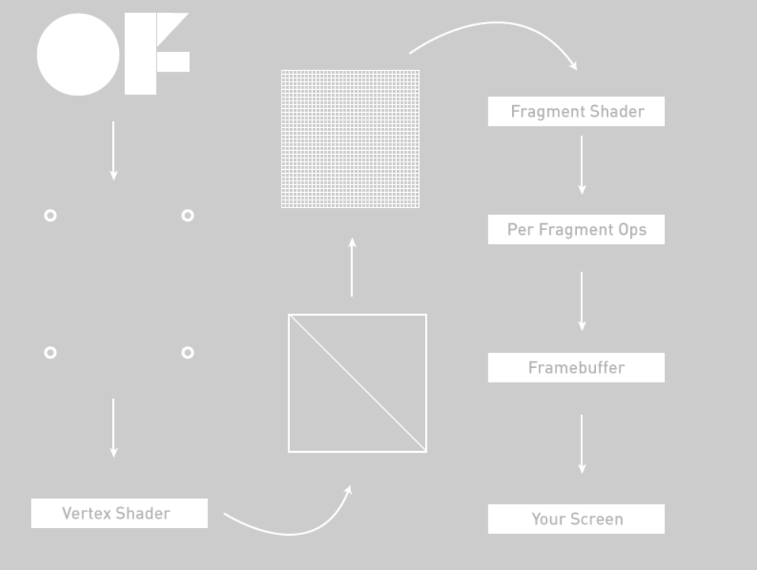
Shader Pipeline

Slide 15
Shader Code Example - Vertex Shader
void main() {
gl_Position = gl_ModelViewProjectionMatrix * gl_Vertex;
}

Slide 16
Shader Code Example - Fragment Shader
uniform sampler2D tex;
void main (void) {
gl_FragColor = texture2D(tex, gl_TexCoord[0].st) * gl_Color;
}

Slide 17
Shader Scope
These are just the basic concepts of shaders to provide you an overview. More details are in the realm of a computer graphics or rendering course.
Will show a demo using particles using these very basic shaders..
For your 2D video Game project, you can choose shader or simple drawing method to represent your particles.
We may explore shaders in the 3D section of the class
For further reading:
http://openframeworks.cc/ofBook/chapters/shaders.html

