Slide 1

CS 134 Computer Game Design – 3D Graphics
Instructor: Kevin M. Smith

Slide 2
Today
More on Octree Visualization
Big Viking Games
Lecture: CG Lighting (OpenGL)
In-Class Exercise – 3 Point Lighting

Slide 3
CS 134 Course Outline
Physics and Simulation
3D Game Design
Game Engine Development (UE4)
Team Project
2D Game Design
Introduction to Game Engines

Slide 4
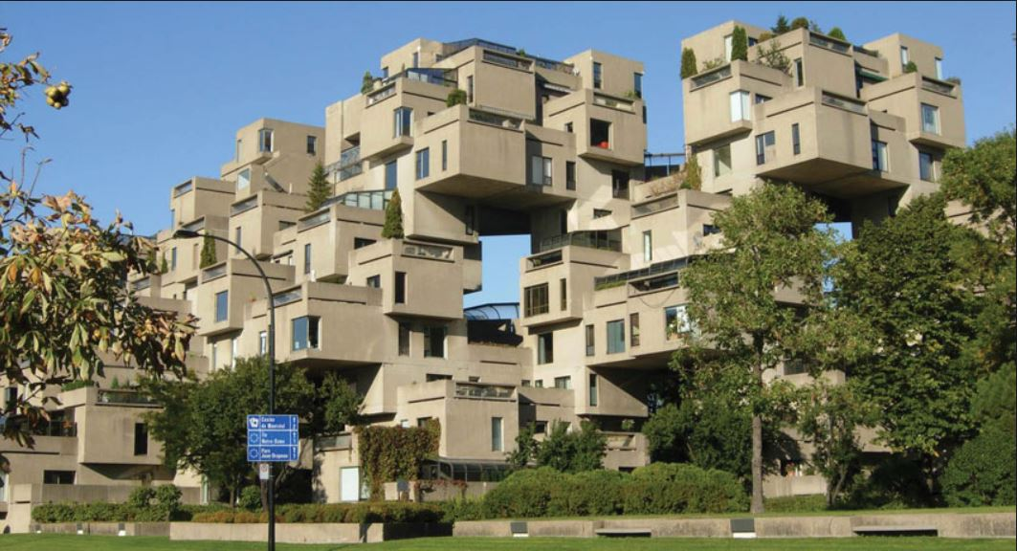
Habitat, Montreal – Architect: Moshe Safdie

Slide 5
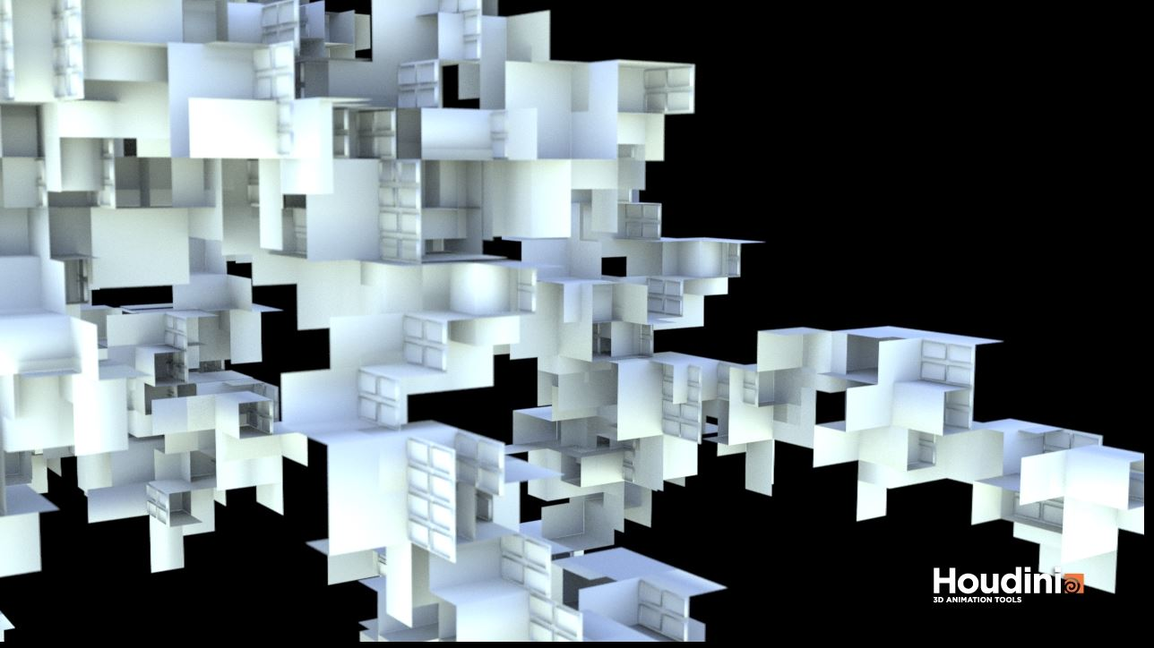
Computer Generated Design using L-Systems
Image: Kevin M. Smith – generated using L-Systems in Houdini

Slide 6
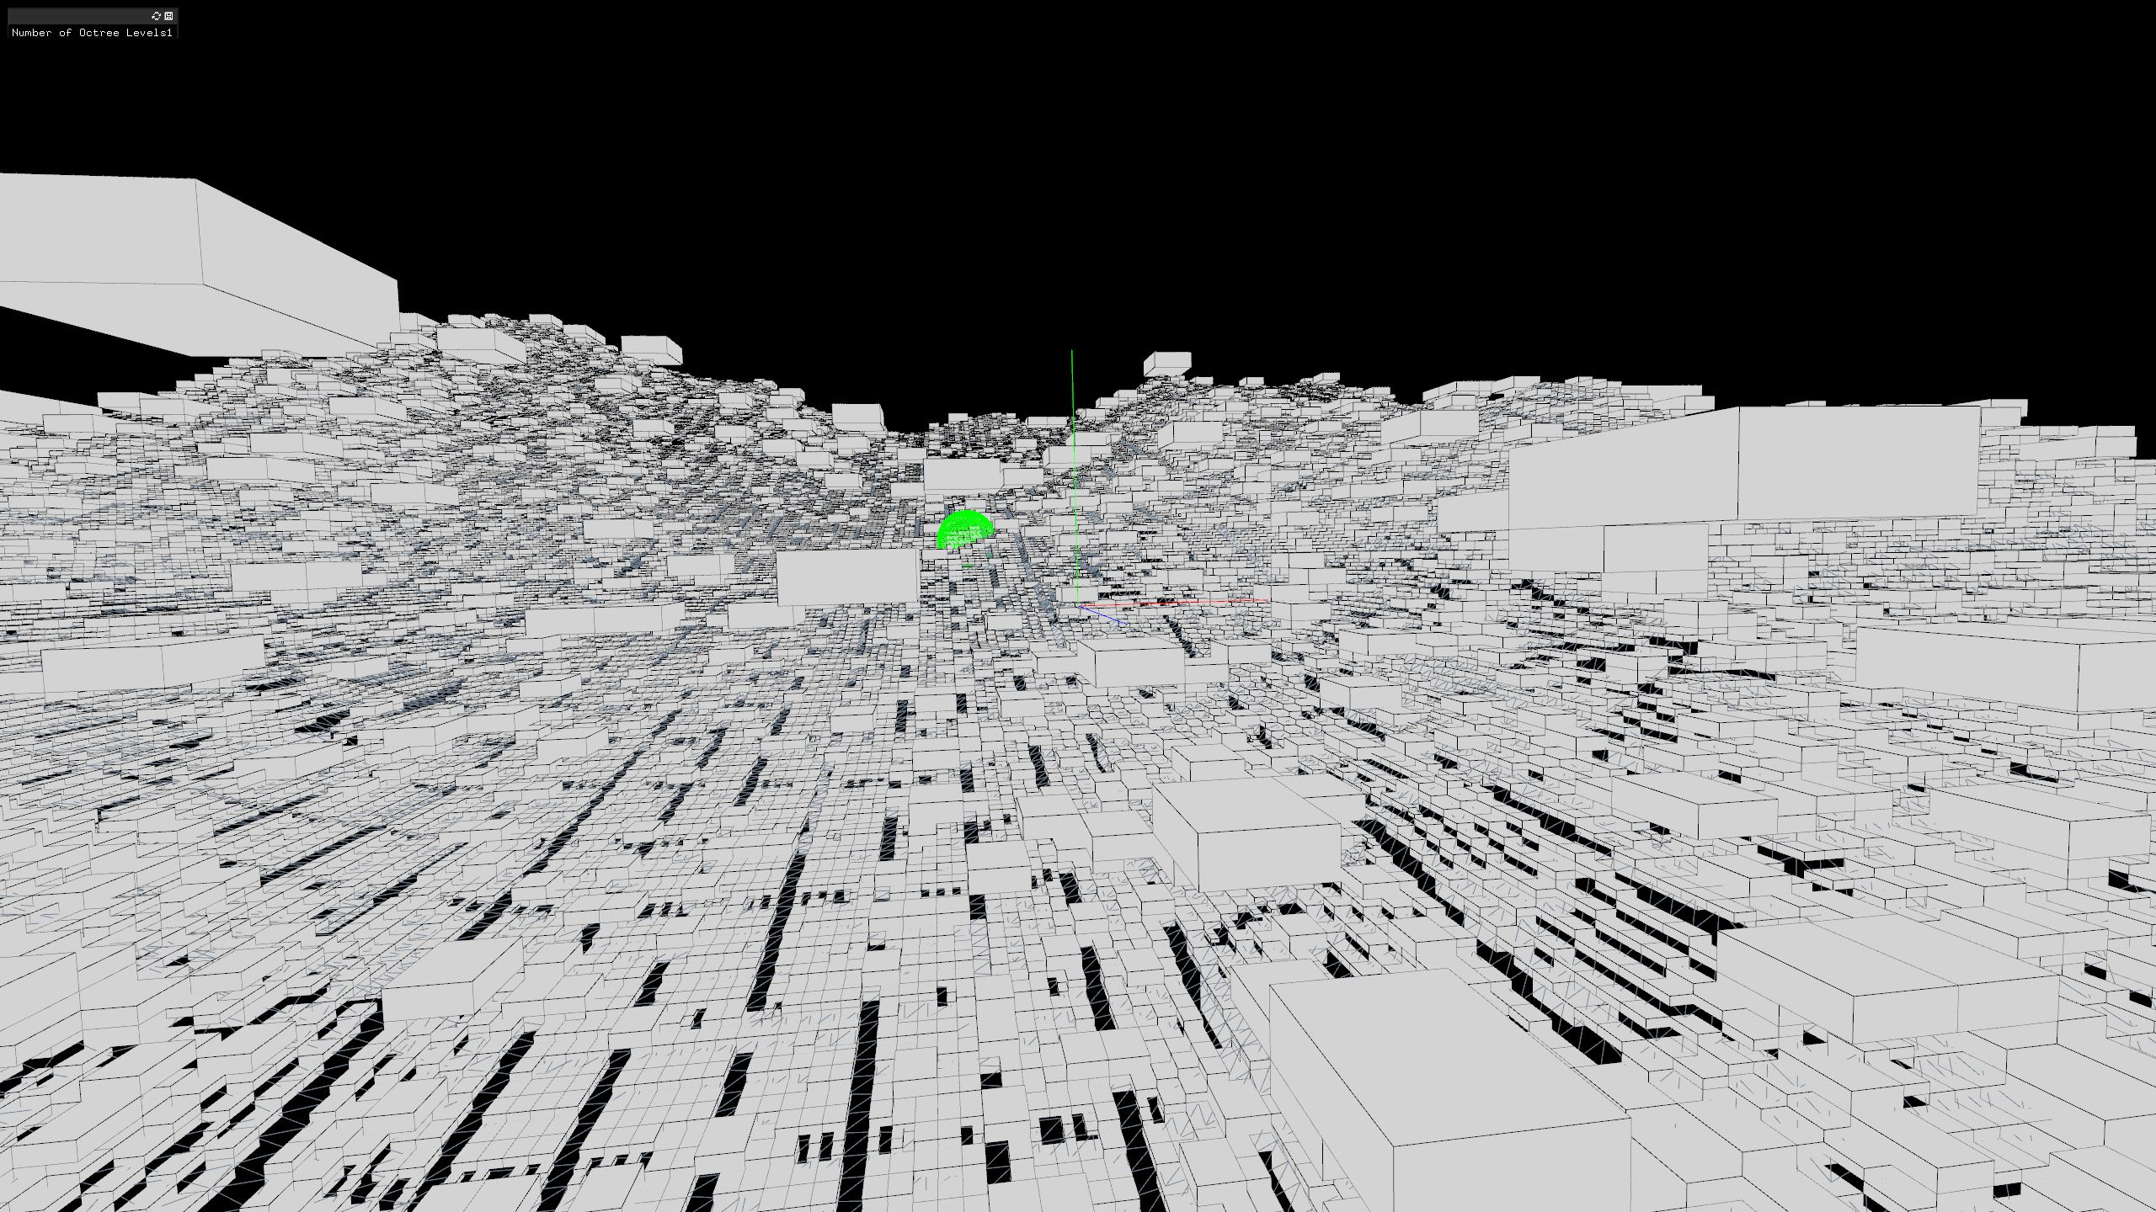
More on Octree Visualization

Slide 7
Octree Papers
http://research.nvidia.com/publication/efficient-sparse-voxel-octrees
http://physbam.stanford.edu/~fedkiw/papers/stanford2004-02.pdf
http://www.cs.umd.edu/~hjs/pubs/Samettfcgc88-ocr.pdf

Slide 8
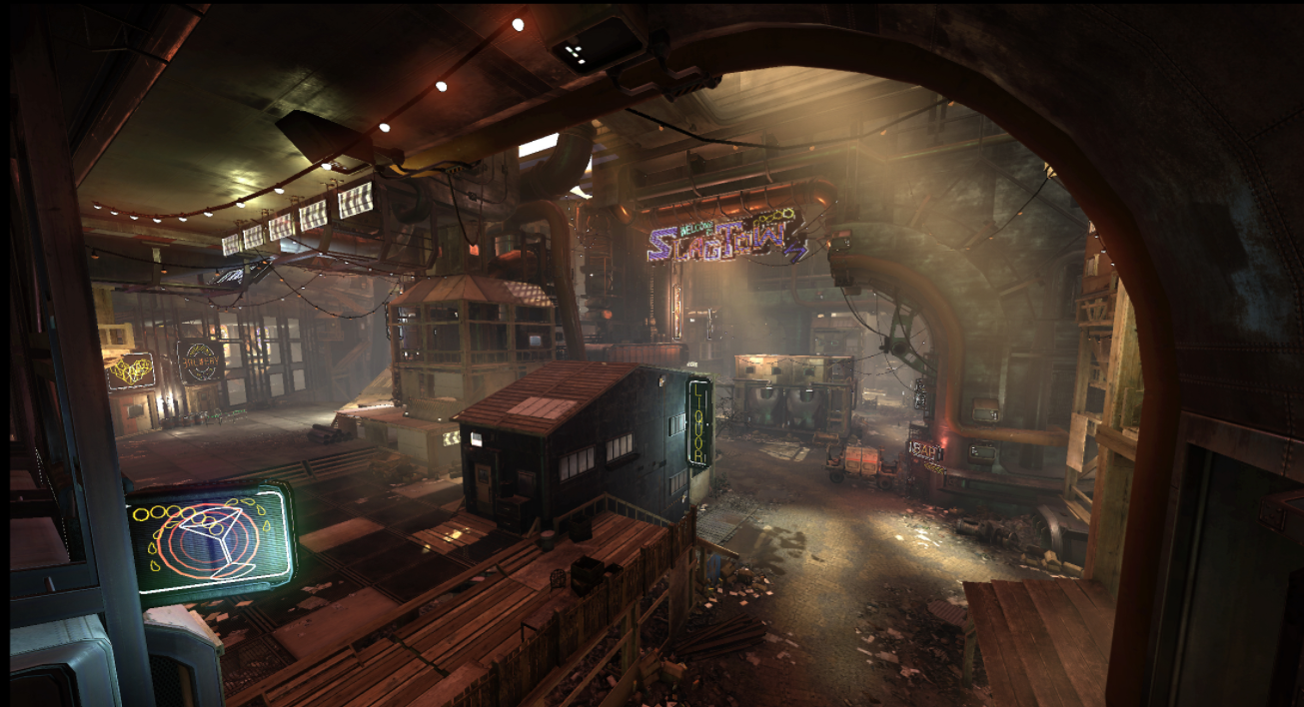
CG Lighting - Intro
Lighting is an important component of CGI, especially in games
Provides realism
Helps to tell add to the narrative and tell the story
Mood/Atmosphere
Control visibility of objects
Establish time of day
Weather
Interior/Exterior

Slide 9
CG Lighting - Intro
Lighting is an important component of CGI, especially in games
Provides realism
Helps to tell add to the narrative and tell the story
Mood/Atmosphere
Control visibility of objects
Establish time of day
Weather
Interior/Exterior
Scene from game: EVOLVE

Slide 10
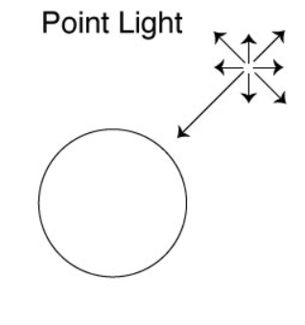
Basic CG Lighting - Types
Point Light
Light emanates from all directions from a single point
Simplest type

Slide 11
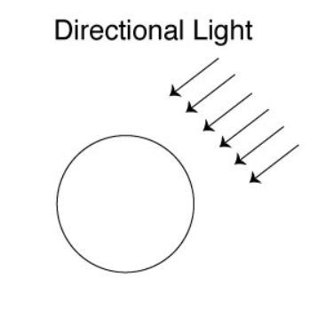
Basic CG Lighting - Types
Directional
Light travels in one direction as if it is emitted from an infinite plane
An area light is a type of directional that is emitted from a finite size plane.
In some systems an area light can emit from a circle or other shape.

Slide 12
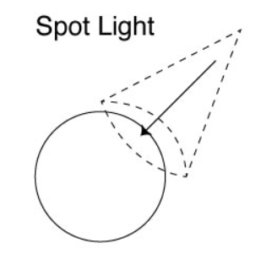
Basic CG Lighting - Types
Spot Light
Specialized type of Point Light
Instead of ray emanating from all directions, a spotlight’s ray are constrained by a cone.
The cone has different parameters to let you adjust size and angle.

Slide 13
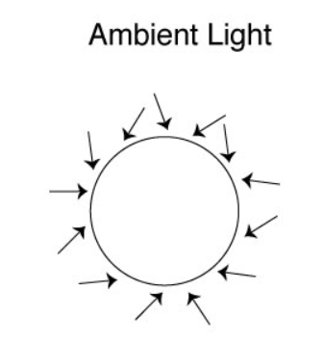
Basic CG Lighting - Types
Ambient Light
Light already present in the scene that illuminates all objects.
For example, if one turns out all the lights in a room, there is still some ambient light in the room.
Ambient light is light provided to all objects without adding any other additional lights.
Has no direction or location

Slide 14
Lights: Positioning and Transforming
Positioning/Transformation
All Lights can be moved to any location (X, Y, Z)
Moving an ambient light around in the scene should have no effect
Easy to see effect of moving spotlights, point lights and area/directional lights.
Lights can be rotated
Most commonly done with spot light and area/directional lights
Rotating a point light/ambient light will not have any effect unless the point light has a cutoff (which makes it a spotlight).
Lights can be scaled
Can do with a spotlight to scale size of cone
Can do with an area light to scale size of emission plane

Slide 15
Lights: C++ Interface
OpenGL
Ex: glEnable(GL_LIGHTING), glEnable(GL_LIGHT0);
OpenFrameworks
ofLight Class
Object-oriented layer on top of OpenGL – make OpenGL lighting calls
With both ofLight and OpenGL, you can have up to 8 lights turned on in the scene.
We will use ofLight for class examples as it is a more friendly interface.

Slide 16
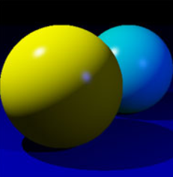
Lights: Common Attributes for All Lights
Specular Highlight Color
The color of the “bright spot” reflected off of a shiny/reflective object:
Specular Highlights

Slide 17
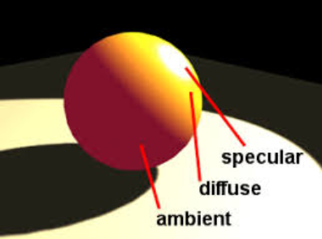
Lights: Common Attributes for All Lights
Ambient Color
The color that is reflected by an object when it is illuminated by ambient light. The color of the object when it has no direct, point or spotlights on it.

Slide 18
Lights: Common Attributes for All Lights
Diffuse Color – the color that the object reflects when it is illuminated. The true color of an object is it’s diffuse color when reflected by a pure white light.

Slide 19
Materials and Lighting
The Lighting Model is a function/interaction of the attributes of both the Light and the Materials on the object being illuminated.
The final image you see will be computed using a combination of the Light properties and Material Properties.
Materials also have these properties:
Specular
Diffuse
Ambient
Emissive Color - self illuminating color (color with no lighting)
Shininess – affects specular highlights
The ofMaterial class allows control of these attributes and you can apply materials to objects in OF using this class. (will show example)

Slide 20
Lighting: An Artform
The art of lighting a scene is a hybrid artistic/technical profession and requires a lot of creativity and skill.
A CG “Lighter” is a career path/specialty you will find in the film an games industry.
It can take many years to develop the skills to necessary to create a high quality lighting environment for a game.
Lighters also tend to work with Materials and Shaders.

Slide 21
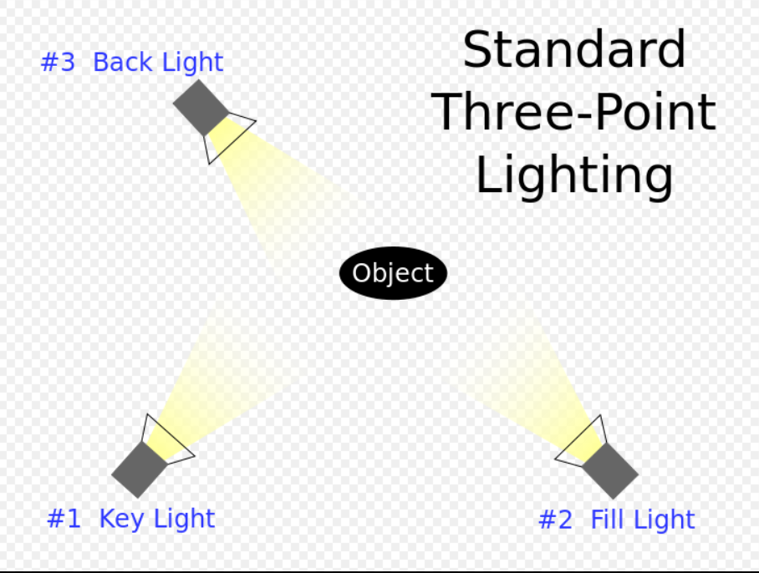
Lighting: The 3 – Point System
This is a basic lighting setup (3 lights) that most lighters learn early in their education.
Usually used to light characters or a small number of objects in a closeup or medium camera shot.
Stage/Theatrical Lighting
Consists of 3 Lights
Key Light – provides main source of light off the front
Fill Light – usually placed a little lower than key. Balances or “fills in” some shadows created by the key light.
Back Light or Rim Light – adds a halo around object.
Image: Wikipedia

Slide 22
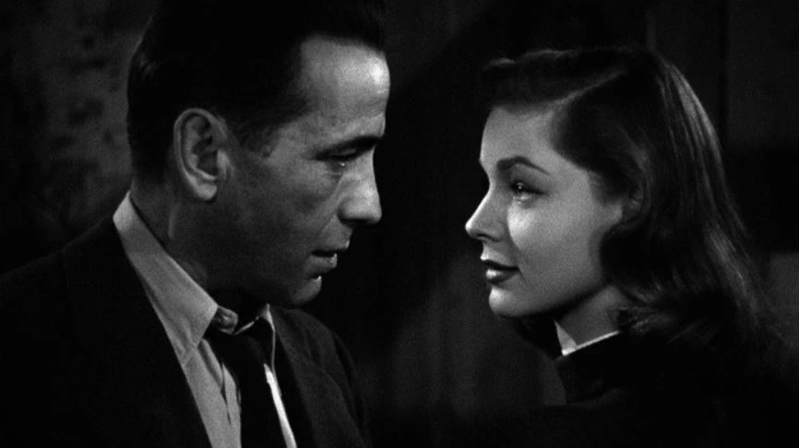
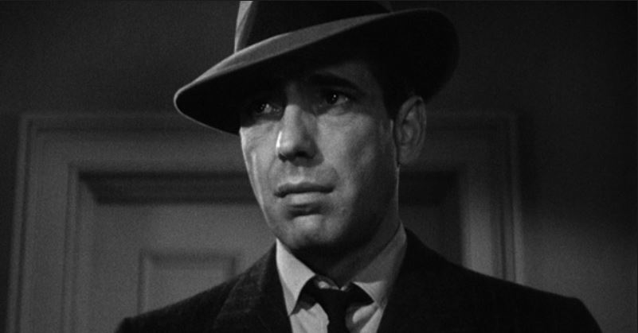
Lighting: Examples of 3 – Point Lighting

Slide 23
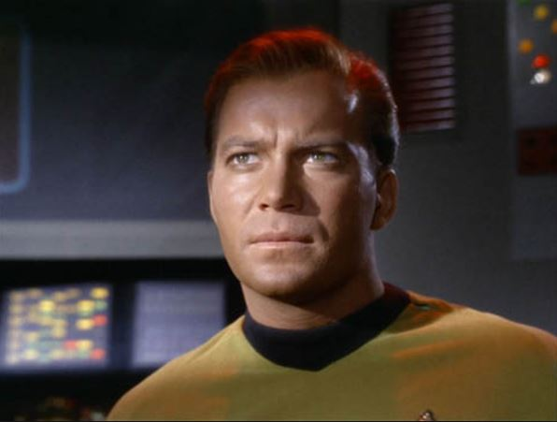
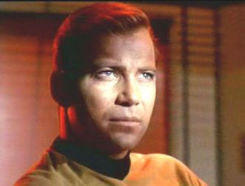
Lighting: Examples of Lighting
More Dramatic: Not much fill…back lighting has color

Slide 24
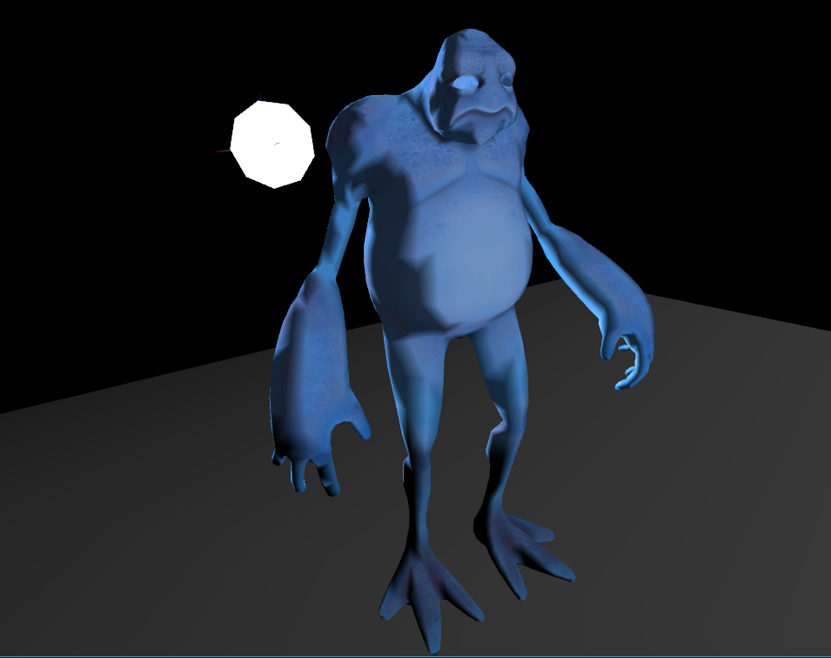
Lighting: Class Exercise – Lets Play
Get Source files in lighting101.zip
Make sure to put model files (obj and mtl) in bin/data/geo
Modify some of the lighting parameters in the code. See what it does. Move the lights around a little at a time to change reflections.
Change material attributes on ground plane. See the effect.
Make 3-4 sliders to control attributes of each light to make the process easier.
Submit your best image of the scene to the gallery provided.

