Slide 1

CS 116B Advanced Computer Graphics – Subdivision Surfaces
Instructor: Kevin M. Smith

Slide 2
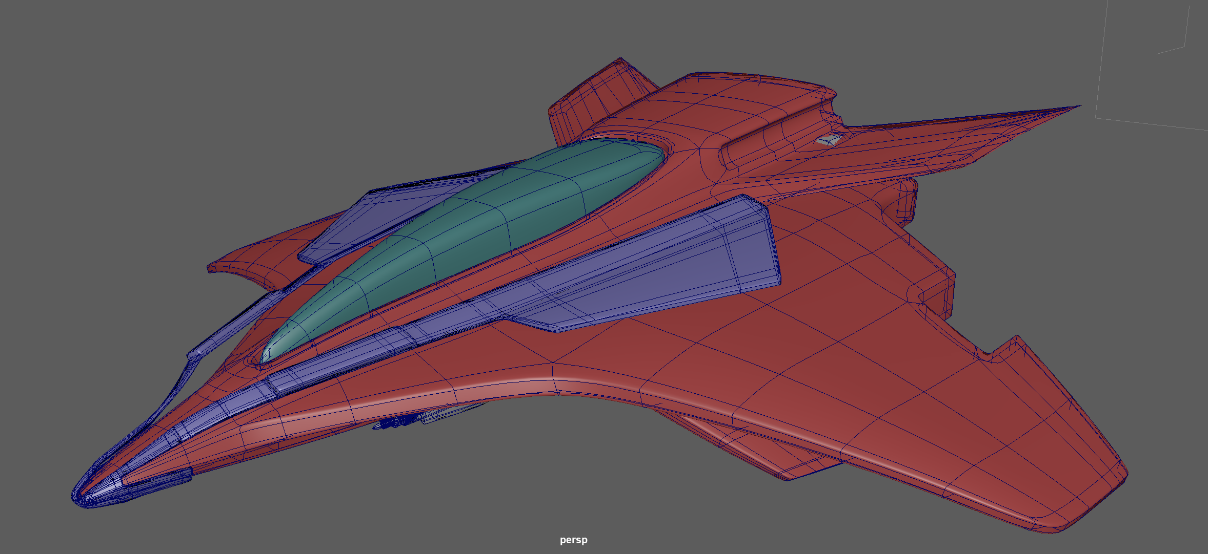
Subdivision Surfaces
A way of representing smooth surface with a course mesh.
Recursive process where a course “control” mesh is sequentially subdivided to multiple levels create a smooth mesh.
Catmull-Clark credited in 1978. (paper on Canvas)
Jos Stam developed a way to evaluate the limit surface directly 1998.
Now used extensively as a modeling and rendering technique
Catmull and Stam won Academy Award for their contribution in 2019.
Model: Kevin Smith

Slide 3
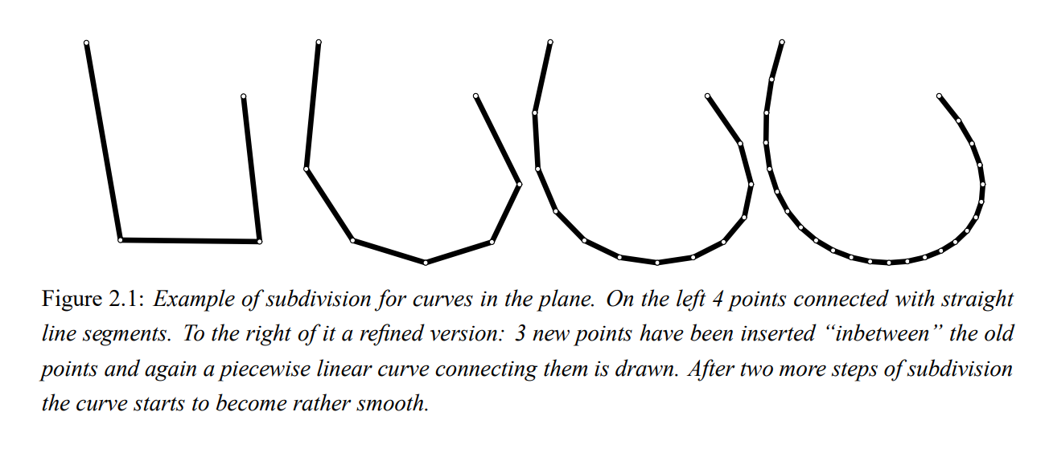
Subdivision Surfaces – Progressive Refinement
The idea behind Subd surfaces is that you start out with a simple cage and progressively refine it (automatically via the subd algorithm.
At each step in the “refinement process” , the object is further subdivided and points are “moved” based on their relationship to neighbor points.
Example of 2D subdivision on the right. We start out with a connected line segment (3 pieces) and generate a smooth curve over three levels of refinement.
Figure: Siggraph 2000 course notes

Slide 4
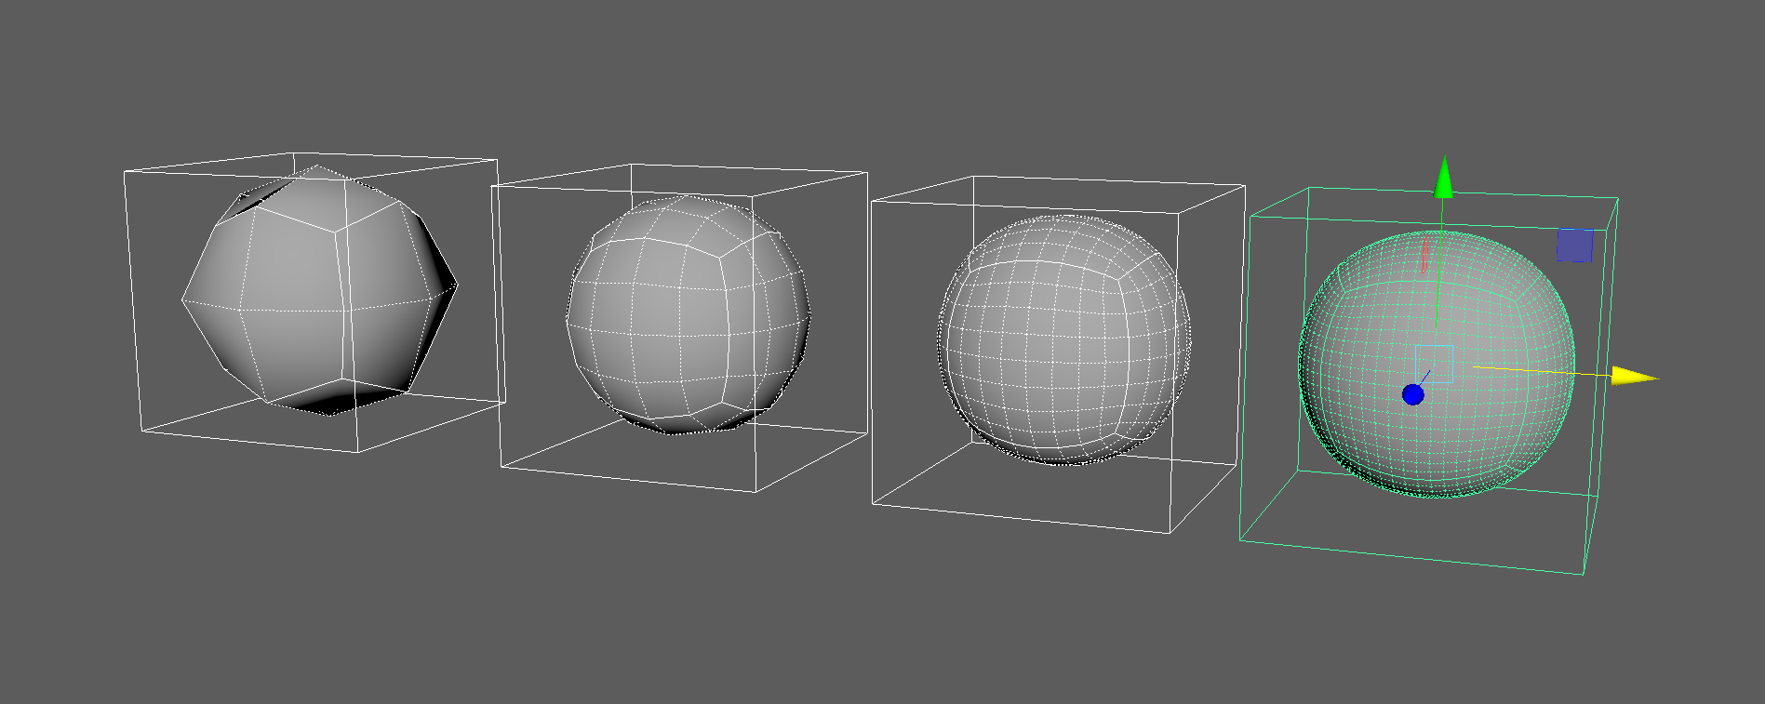
Subdivision Surfaces – Progressive Refinement
For 3D Surfaces faces are “split in to sub-faces. The vertices are repositioned based on averaging the positions of neighbor vertices and faces.
The process continues recursively to the desired level.
If the process continued to infinite levels, the surfaces reaches a “limit surface”.
Typically, we don’t need that many levels to achieve a shape that we want.
Figure: Maya Example (K.Smith)
Subdivision Level 1 to 4 (left to right)

Slide 5

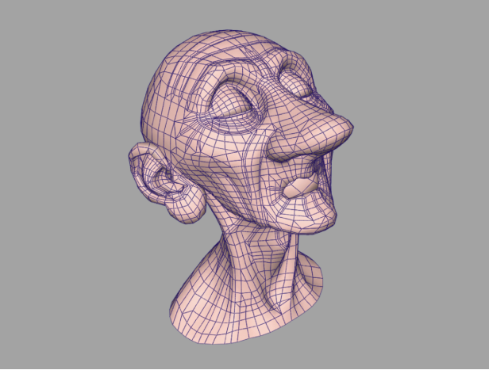
Subdivision Surfaces – Why is this useful ?
Subd surfaces can create very nice looking smooth meshes from simpler geometry that you model.
For example, Pixar uses Subd surfaces for most of their character modeling.
Show Maya Example
From “Subdivision Surfaces in Character Animation” by DeRose, Kass and Truong.
Film: Geri’s Game

Slide 6
Subdivision Surfaces – Different Types
There are several types of Subdivision Surfaces in use. Two of the most popular:
Catmull-Clark
Uses quads (and triangles)
Good technique for surface modeling where quads is the preferred geometry.
Loop
Uses triangles
Good technique for creating smooth meshes for rendering where triangles is the required geometry.

Slide 7
Basic Math Concept Behind Technique
Point Averaging (board discussion)
Weighted Point Averaging
Example: Barycentric Coordinates

Slide 8
Basic Math Concepts Behind Technique
Point Averaging (board discussion)
Weighted Point Averaging
Example: Barycentric Coordinates

Slide 9
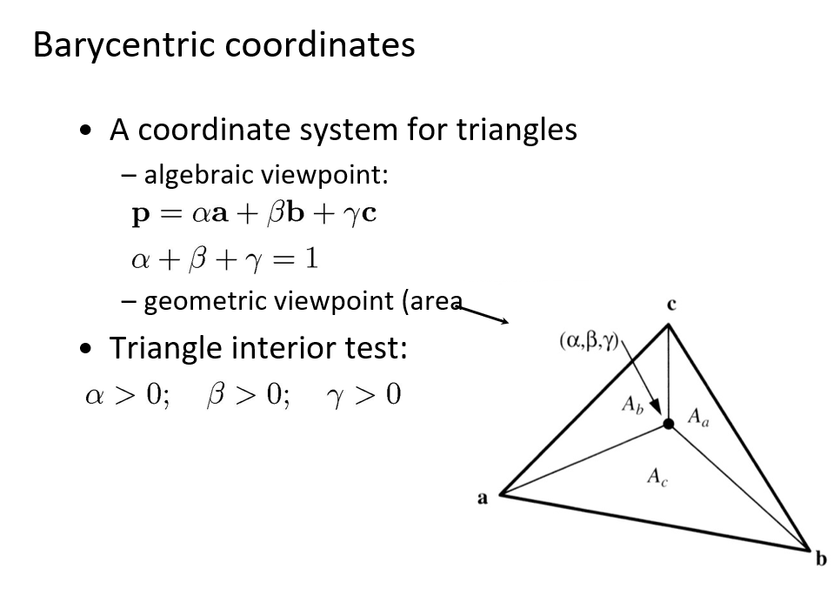

Slide 10
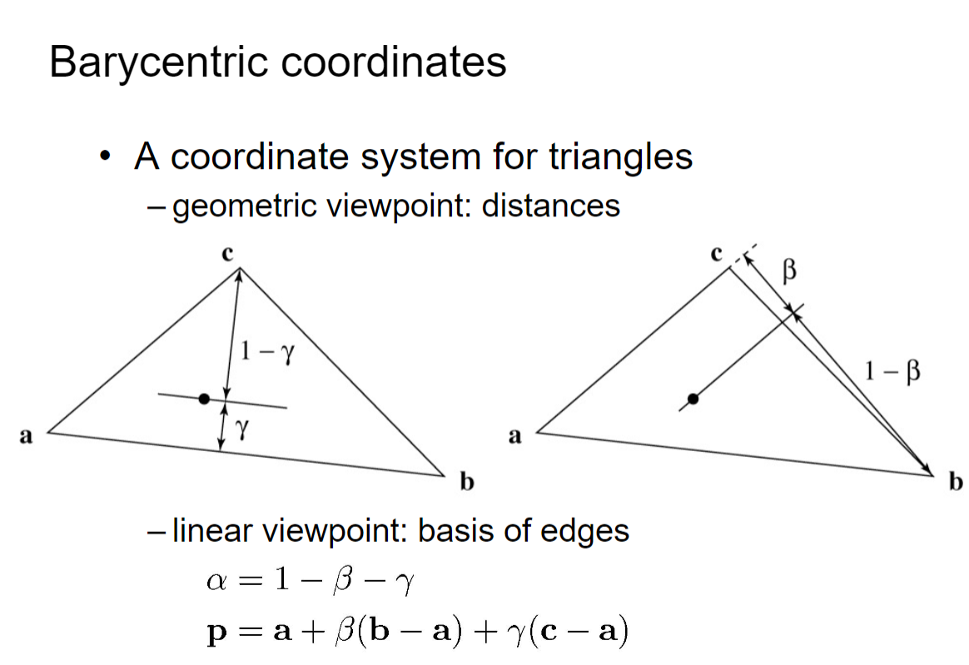

Slide 11

Catmull-Clark Subdivision Surfaces – Summary
Subdivision Surfaces are created with a recursive refinement scheme
Start with a mesh of quads (called “the cage”)
Add new face points to each face based on average of each original point on face.
For each edge add an edge point based on averaging two neighboring face points and the midpoint of the edge.
For each original point (P), take the average (F) of all face points for faces touching P and take the average R of all n edge midpoints for original edges touching P (not to be confused with edge points created above in 2nd step.
Move each original point to the new vertex point:
Barycenter of P,R and F with respect to weights (n-3), 2 and 1

Slide 12
Catmull-Clark Subdivision Surfaces – Summary
5. Final Step – Connect Edges - Connect each new vertex point to new edge points - Define new faces by enclosed edges.
Repeat to smooth another level. Let’s do an example…..

Slide 13
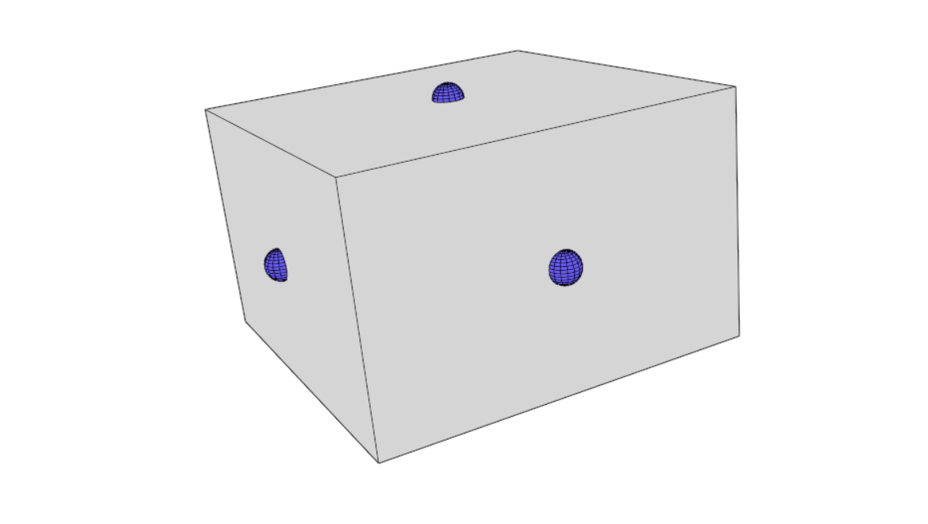
Catmull-Clark Subdivision Surfaces – Example
Face points are blue spheres
Add new face points to each face based on average of each original point on face (average of face vertices).
Pictures from Wikipedia

Slide 14
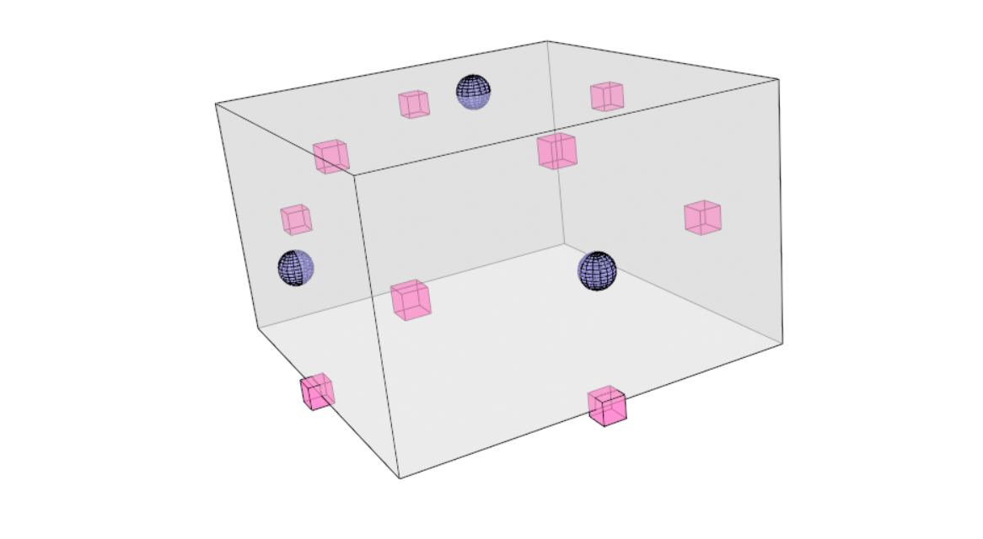
Catmull-Clark Subdivision Surfaces – Example
Edge Points are Magenta Cubes
For each edge add an edge point based on averaging two neighboring face points and the midpoint of the edge. ( AE + ME ) / 2.

Slide 15
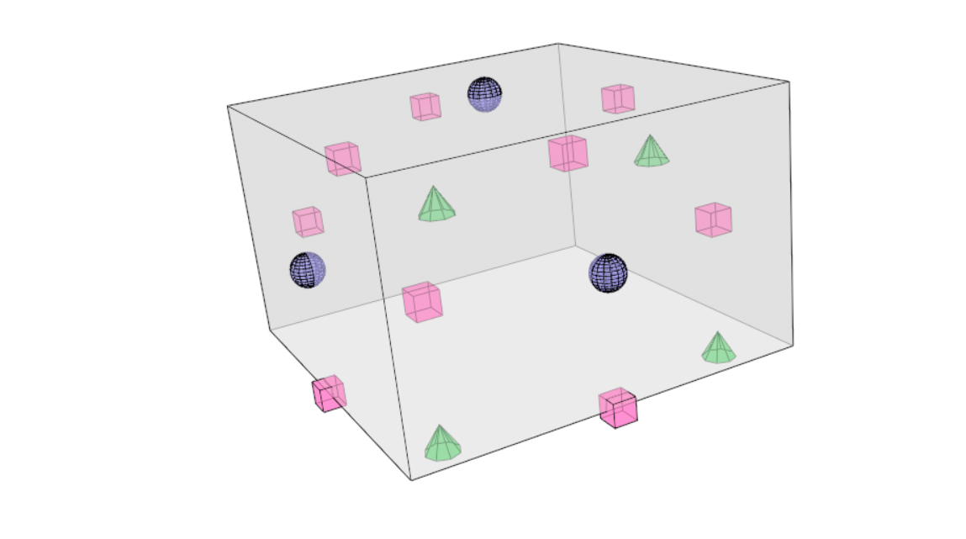
Catmull-Clark Subdivision Surfaces – Example
New Vertex Points are Green Cones
For each original point (P), take the average (F) of all face points for faces touching P and take the average (R) of all n edge midpoints for original edges touching P (not to be confused with edge points created above in 2nd step.
Move each original point to the new vertex point:
Pictures from Wikipedia

Slide 16
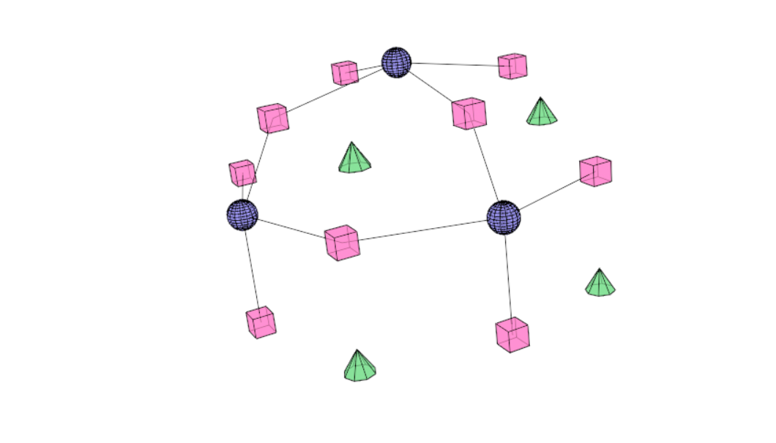
Catmull-Clark Subdivision Surfaces – Example
Connect each new face point to the new edge points
Pictures from Wikipedia

Slide 17
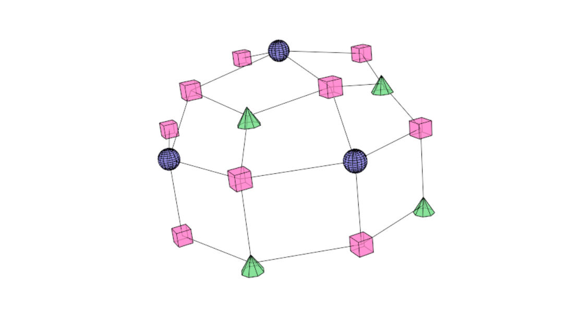
Catmull-Clark Subdivision Surfaces – Example
Connect each new vertex point to new edge points
Pictures from Wikipedia

Slide 18
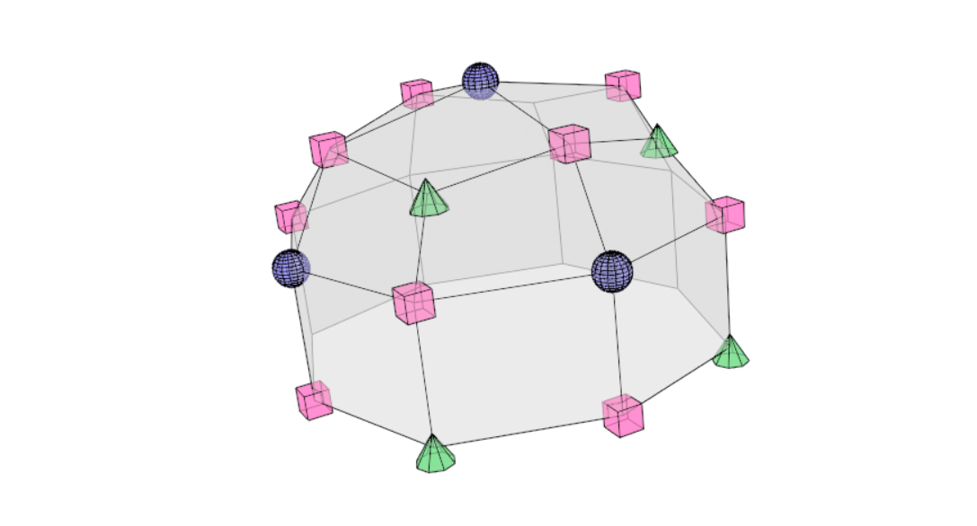
Catmull-Clark Subdivision Surfaces – Example
Define new faces by enclosed edges to complete one iteration in process of subdivision.
Pictures from Wikipedia

Slide 19
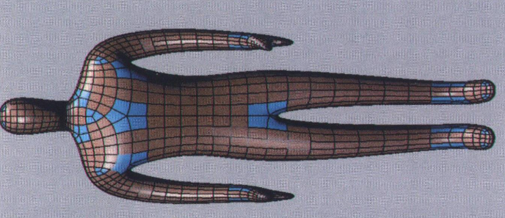
Catmull-Clark Subdivision Surfaces – “Smoothness”
Limit surface obtained by the subdivision process has been shows to be continuous everywhere.
At least C(1) continuity at extraordinary vertices. C(2) continuity a regular vertices.
Extraordinary vertices have a valence > 4.
For C(n), “n” indicates how many derivatives are continuous. (differential class)
Pictures from Wikipedia

