Slide 1

CS 134 Computer Game Design – 3D Graphics – Introduction to 3D Characters
Instructor: Kevin M. Smith

Slide 2
CS 134 Course Outline
Physics and Simulation
3D Game Design
Team Project
Game Engine Case Studies
2D Game Design
Introduction to Game Engines

Slide 3
Game Engine Case Studies
To date, we’ve written most of our own game code in C++ on a fair low-level object-oriented API on OpenGL (OpenFrameworks)
For the rest of the course, we will look at a commercial game engine(s) to explore some advanced features found in modern games.
CG characters with Motion Capture Data
Advanced Lighting/Rendering
More – if time permits

Slide 4
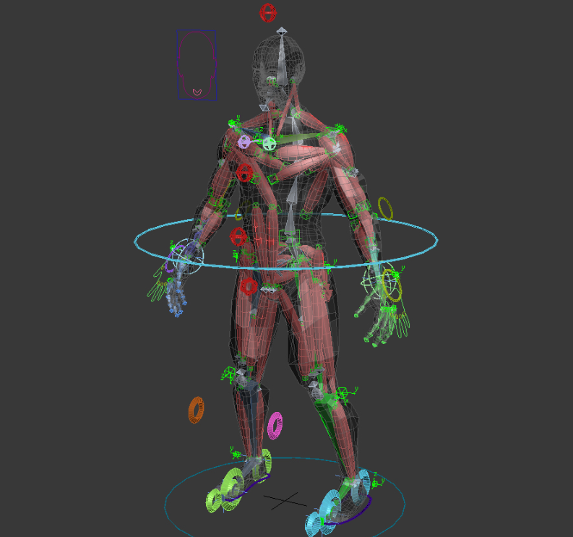
Character Animation Basics
3D Characters for Games and Film
Have an “anatomy” that has some correspondence to their “real” counterparts. They have components like:
Skin
Bones/Skeleton
Joints
Muscles

Slide 5
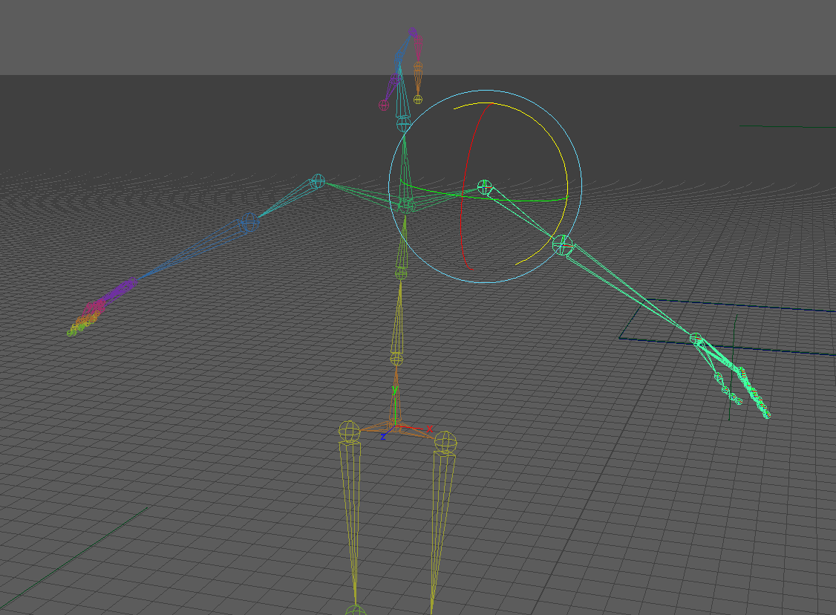
Character Animation: Skeleton
Skeleton :
Is a hierarchical structure consisting of bones and joints.
Joints provide rotations so that the bones hinge/move with respect to each other.
Demonstration
Joints also have these attributes so that you can control the way the skeleton moves:
Limits – ex: you may want to limit rotation angle of an elbow to 0-180.
Stiffness – provides stiffness or drag coefficients when IK system is active (more later).
Orientation – can change the orientation (local coordinate frame) of the joint.
Degrees of Freedom (DOM) – allowing you to select directions (x,y,z) that joint is permitted to rotate.

Slide 6
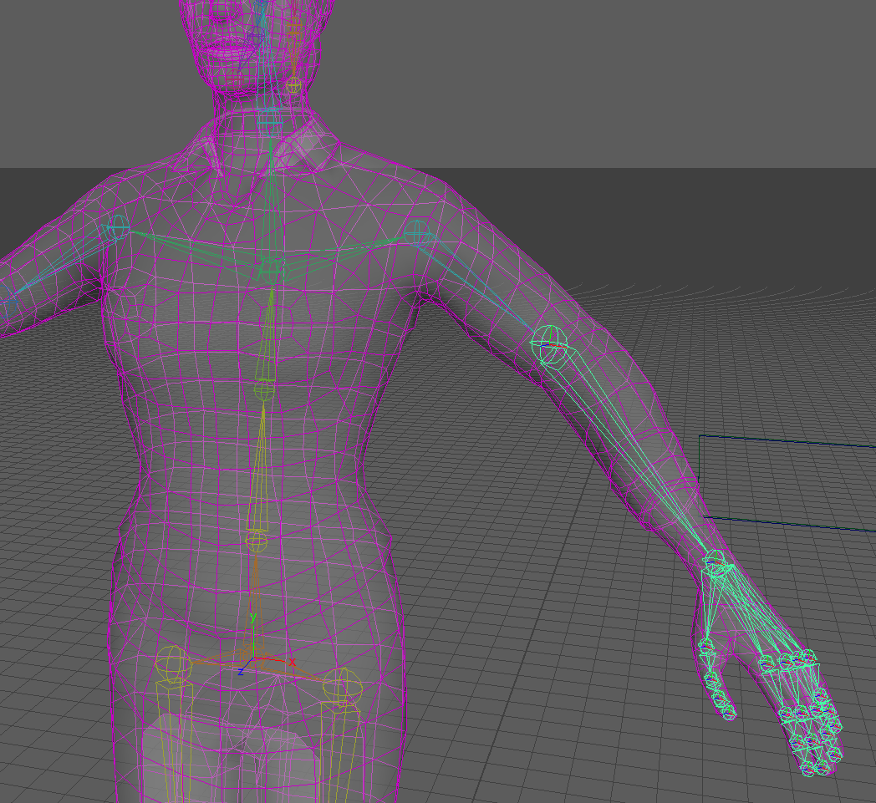
Character Animation: Skin
Skin :
A character skin is usually a mesh (for games, polygonal).
The skin is bound to the skeleton.
When the skeleton moves, the skin is deformed by the skeleton and moves with it.
Demonstration
The process of animating character skin using deformations is complex. For games characters, we use a simple “bind skin” method (or smooth skin)
This method is optimized in game engines

Slide 7
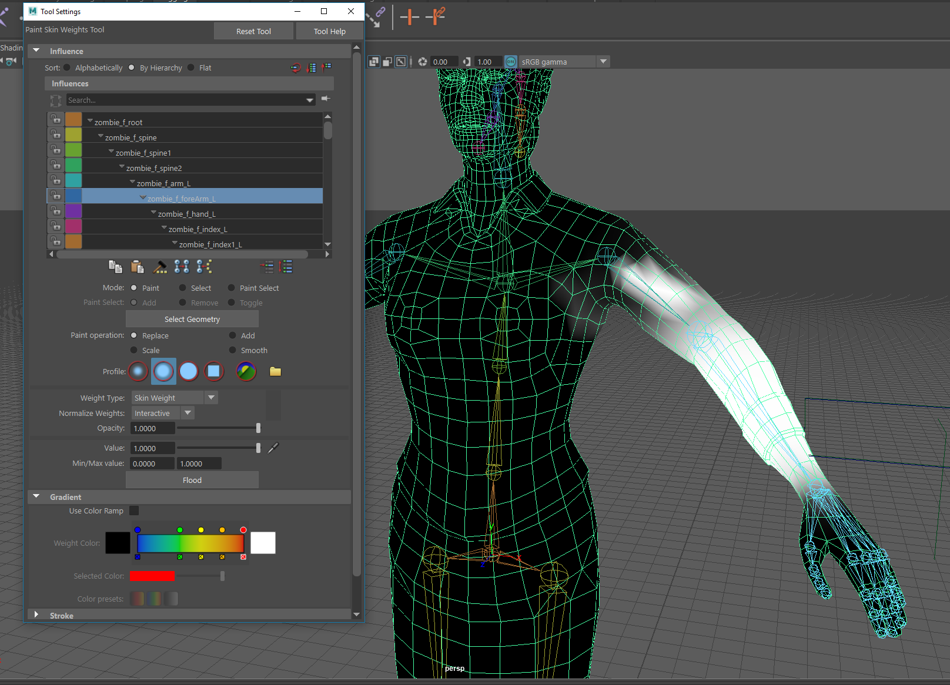
Character Animation: Skin Weights
Skin Weights:
During animation of the skin, each vertex in the mesh is displaced or moved.
The direction/magnitude of vertex displacement is influenced by the rotation and movement of the joints/bones
The amount of influence can be controlled on a per vertex basis using skin weights.
Skin weights are a value associated with each vertex.
All the weights for a mesh are saved in a weight map.
Skin weights can be easily modified by the artist/animator using a paint tool.
Demonstration

Slide 8
Character Animation: Skeletal Animation
Skeletal Animation:
There are two primary types of character animation with skeletons:
Forward Kinematics
Inverse Kinematics

Slide 9
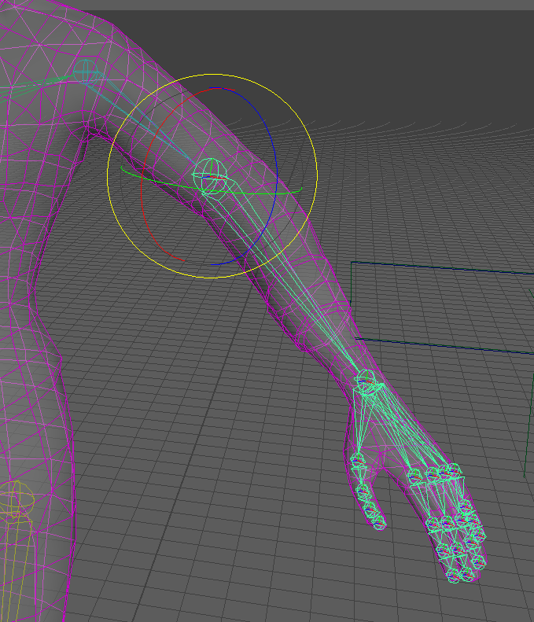
Character Animation: Forward Kinematics
Forward Kinematics:
Is the simplest type of skeletal animation and is what is typically used in games
The joint rotations are animated directly over time.
This is analogous to “posing” the character by directly bending all of the joints to the desired position.

Slide 10
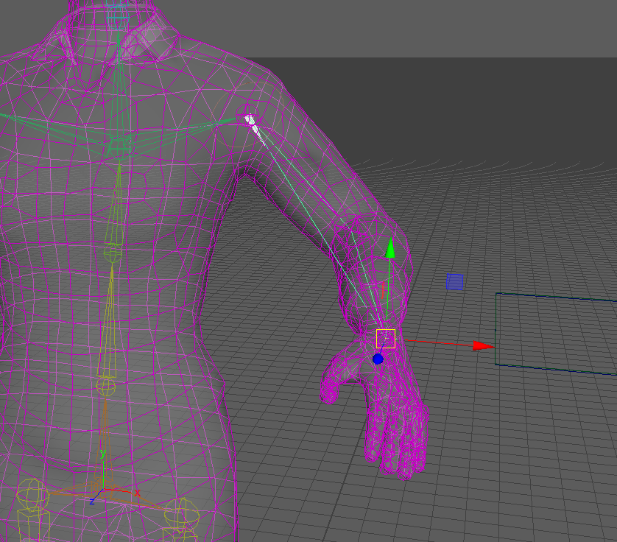
Character Animation: Inverse Kinematics
Inverse Kinematics:
Is a bit more complicated
Requires the use of an IK Solver.
An IK Handle is placed through a chain of joints.
The IK Handle can moved/rotated/positioned by the animator.
The IK Solver automatically solves for the rotations of the joints in the chain.
Demonstration
Very powerful because it provides the animator with a higher level of control (rather than having to rotate each individual joint).

Slide 11
Character Animation: Types of Animation
Two Primary types of 3D character animation techniques are used in Gaming
Keyframe Animation
An animator sets “key poses” of the character as specific frames.
The system interpolates the motion between the key frames.
Motion Capture
The motion of a real live actor is captured using a motion capture system.
The data is recorded.
The motion is applied to the CGI character.

Slide 12
Character Animation: Types of Animation
Two Primary types of 3D character animation techniques are used in Gaming
Keyframe Animation
An animator sets “key poses” of the character as specific frames.
The system interpolates the motion between the key frames.
Motion Capture
The motion of a real live actor is captured using a motion capture system.
The data is recorded.
The motion is applied to the CGI character.

Slide 13
Character Animation: Game Pipeline (Typical)
Polygonal Geometry (Scanned or Modeled in Maya
Rigging (Skinning, Muscles, IK/Joint Setup
Export to Game Engine
Adjust Muscle/Skinning Parameters
Apply Animations Clips (Motion Capture or Keyframed)

Slide 14
Unity Animation Tools - Mechanim
Easy workflow and setup of animations on humanoid characters.
Animation retargeting - the ability to apply animations from one character model onto another.
Simplified workflow for aligning animation clips.
Convenient preview of animation clips, transitions and interactions between them. This allows animators to work more independently of programmers, prototype and preview their animations before gameplay code is hooked in.
Management of complex interactions between animations with a visual programming tool.
Animating different body parts with different logic.
Source: Unity Documentation

