Slide 1

CS 134 Computer Game Design
Instructor: Kevin M. Smith

Slide 2
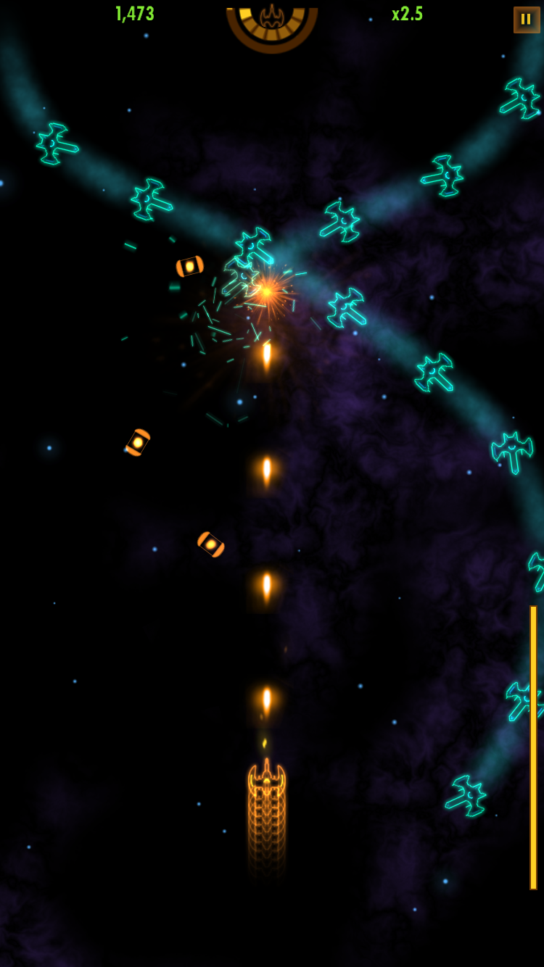
Anatomy of a Vintage Arcade “Shooter” Game
Movable turret for firing “weapon”
Stream of “missiles” fired individually or automatically
Enemy targets attach in various formations and patterns of movement
Generally, gameplay proceeds through more complex levels

Slide 3
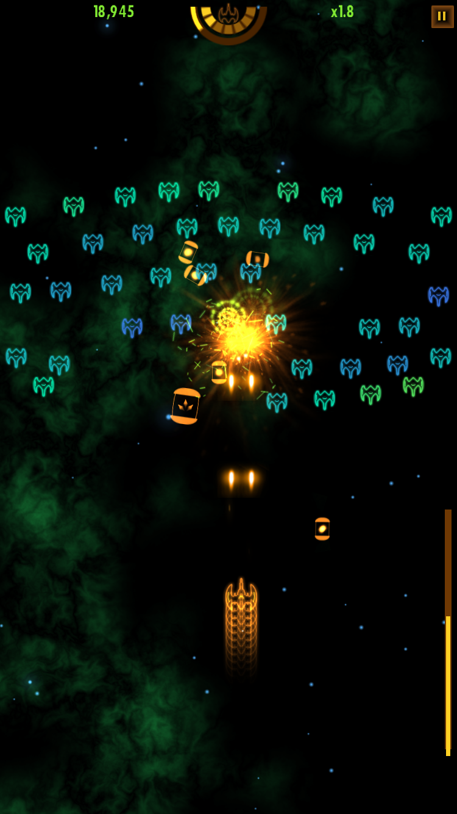
Game Engine Elements of Vintage Arcade “Shooter” Game
Ability move control gun/turret with mouse/touch/keyboard
Enemy targets need to be created and destroyed
Ability provide animation for Enemy targets
Enemy targets can be animated along paths
Missiles are animated as they move toward target
Image sprites to represent player and enemy (various)
Visual effects (when target is hit)
Sound (background music, missile firing and its)
UI - mostly “heads-up” display on scoring/level
Game State (what state is the game in ? - level
Details – startup and end screens (images)

Slide 4
What are the basic animation requirements ?
Ability move control gun/turret with mouse/touch/keyboard
Enemy targets can be animated along paths
Missiles are animated as they move toward target
Image sprites to represent player and enemy (various)
Visual effects (when target is hit)
Game objects move over a background
In some games, the backgrounds scroll (pan) – more later
A level (2D game) – a background and player/object configuration

Slide 5
Frame Rates
During animation (which includes player movement) the “scene” (includes player, background, animated objects) is re-drawn at the game frame rate.
For our purposes the default is 60 fps (frames per second) or 60 Hz.
OpenFrameworks allows you to set frame rate with ofSetFrameRate() (default is 60).
Program attempts to run at specified frame rate if it can.
What can cause frames to “drop” (ie not keep up) ?
Scene too complex and takes longer to draw than 1/60 second.
Latency in other parts of the system (calculations, physics, user input )
If frames drop, we need to know when last frame was actually completed, so that we can adjust accordingly (more later).
Frame dropping will likely not be a problem for this example game.

Slide 6
Animation
What is Animation ?
Animation involves drawing an object repeatedly over time
Draw per frame
Position may change over each frame to animate movement
Shape may change over each time to deform character/object.
Flipbook: https://www.youtube.com/watch?v=CSj0lajQBrM
The more the change in position per frame, the faster the character will appear to move.

Slide 7
Drawing Layers
Animations is typically drawn in layers
In our game, we will have 3 basic layers
Background
Scene (Players, Enemies, Missiles etc.)
User Interface (Overlay text for scoring and other game state)
The game window is drawn from background to foreground – background, scene and UI – in that order.
This method is called “The Painter’s Algorithm”
https://en.wikipedia.org/wiki/Painter%27s_algorithm

Slide 8
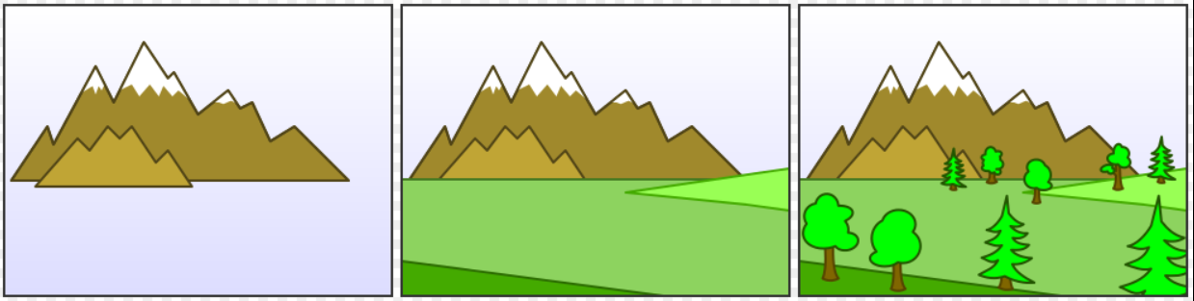
Painters Algorithm (from Wikipedia)
https://en.wikipedia.org/wiki/Painter%27s_algorithm

Slide 9
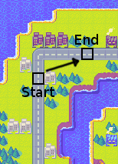
Recall Problem
Assume 60 fps redraw
Example: How to animate motion so that I move from start to end in 5 seconds ?

Slide 10
Lets look at the Math
Assume that the distance we want to travel from start to end is 600 pixels
Assume our frame rate is 60 fps.
We want to traverse it in 5 seconds
What is the speed required in pixels per second (pixel/sec) ?
600 pixels/ 5 sec = 120 pixels/sec;
If our scene is drawn 60 times per second, how many pixels do I need to move in 1/60 sec ?
120 pixels/sec * 1/60 sec = 2 pixels per refresh.
Example Animation Demo in OpenFrameworks

