Slide 1

CS 134 Computer Game Design
Instructor: Kevin M. Smith

Slide 2
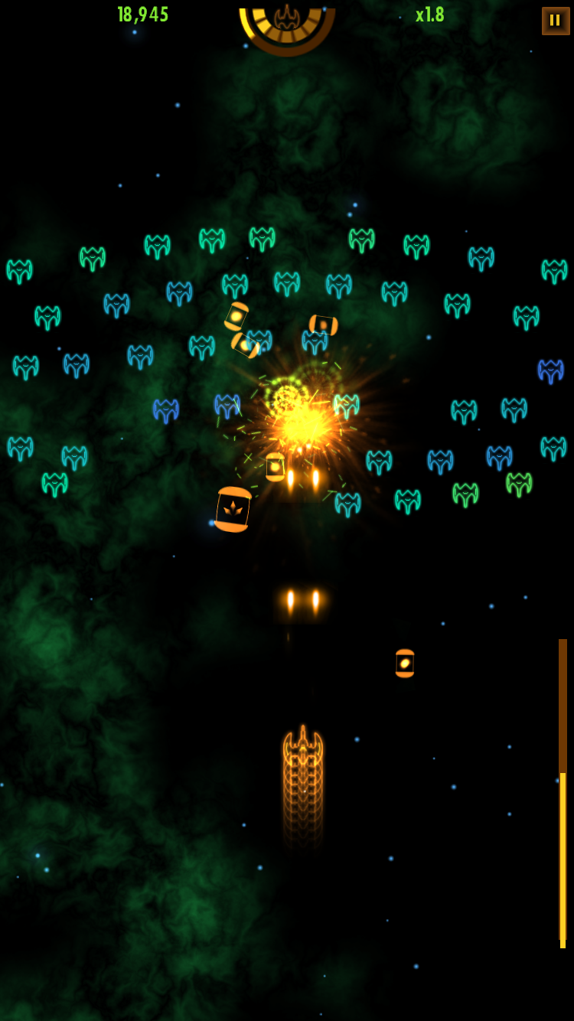
What are the basic animation requirements ?
1 Ability move control gun/turret with mouse/touch/keyboard
Animate using direct manipulation (ex: mouse drag example)
2 Missiles are animated as they move toward target
Animation along straight line with possible acceleration.
3 Image sprites to represent player and enemy (various)
Sprite animation
4 Enemy targets can be animated along paths or straight line
Requires procedural animation along curve (with rotation)
5 Visual effects (when target is hit)
Could use physics (particles) or possibly sprite animation
Game objects move over a background
In some games, the backgrounds scroll (pan) – more later
A level (2D game) – a background and player/object configuration

Slide 3
Speed and Velocity
We can look at every game object having it’s own speed or velocity
What is difference between speed and velocity ?
Speed is a scalar quantity (ex: miles per hour)
Velocity has direction and magnitude (vector).

Slide 4
Speed and Velocity
In a simple game (such as our arcade game), if an object is moving at the same speed in all directions , we can just store a scalar speed value. (which we can vary, but is the same for all directions.
For advanced animations (such as particle effects or physics), velocity is more important because we need to store a vector indicating direction of travel.
We could use a velocity vector in all cases, but for now lets just look at speed (for Part 1) to keep things simple.

Slide 5
Speed and Velocity
In a simple game (such as our arcade game), we can store a single speed value.
For advanced animations (such as particle effects or physics), velocity is more important because we need to store a vector indicating direction of travel.
We could use a velocity vector in all cases, but for now lets just look at speed (for Part 1) to keep things simple.

Slide 6
Speed
In World Space (3D) speed/velocity is in real-world units (ex: m/sec, ft/sec etc.)
In Screen Space (our 2D world for Arcade games), is in units close to the size of a pixel. (but in floating point).
Speed = units/sec = approx. pix/sec (Screen Space)
Recall:
To travel 600 pixels in 5 seconds, we need to travel 120 units/sec.
At 60 Hz that is 120 * 1/60 = 2 units per update().

Slide 7
Speed
Storing a value for speed (or velocity) is useful because we can vary the speed of each object independently while the game is running.
Can vary linearly or non-linearly
Linear
We can simply update speed by setting it’s value or updating it incrementally.
Non-linear
Apply mathematical expressions using functional programming

Slide 8
Speed
Functional Programming Example:
Create a function that given a distance return a modulated value between 1 to 10 based on sin wave shape from 0 to PI
float ofApp::modulateAccel(float dist) {
return sin(dist * PI) * 5.0 + 1.0;
}
Use the function to modulate the distance to travel per frame to create an acceleration effect.:
dir = ofVec3f(0, -dist * modulateAccel(frac), 0);
sprite.trans += dir;

Slide 9
Demonstration

Slide 10
Sprites
Just another term for an image (in game vernacular)
A game object can have a list of sprites that are displayed in sequence to create an animation. (recall superman flipbook)
Sprites are created in a paint program (like photoshop) and usually have transparent sections (which are masked by an “alpha” channel).
Optimizations for Sprites:
Sprite Sheets – multiple sprites stored in one images (ie tiles)
Compression/dithering techniques.
We will be using simple (non-animated sprites) for Project 1 –Part
We may employ some animated sprites in Part 3 for VFX.

Slide 11




Sprites
Like in any animation, speed of movement depends on how much image changes per frame (each 1/60 sec)
1 2 1 3 4 3
100ms 100ms 100ms 100ms 100ms

