Slide 1
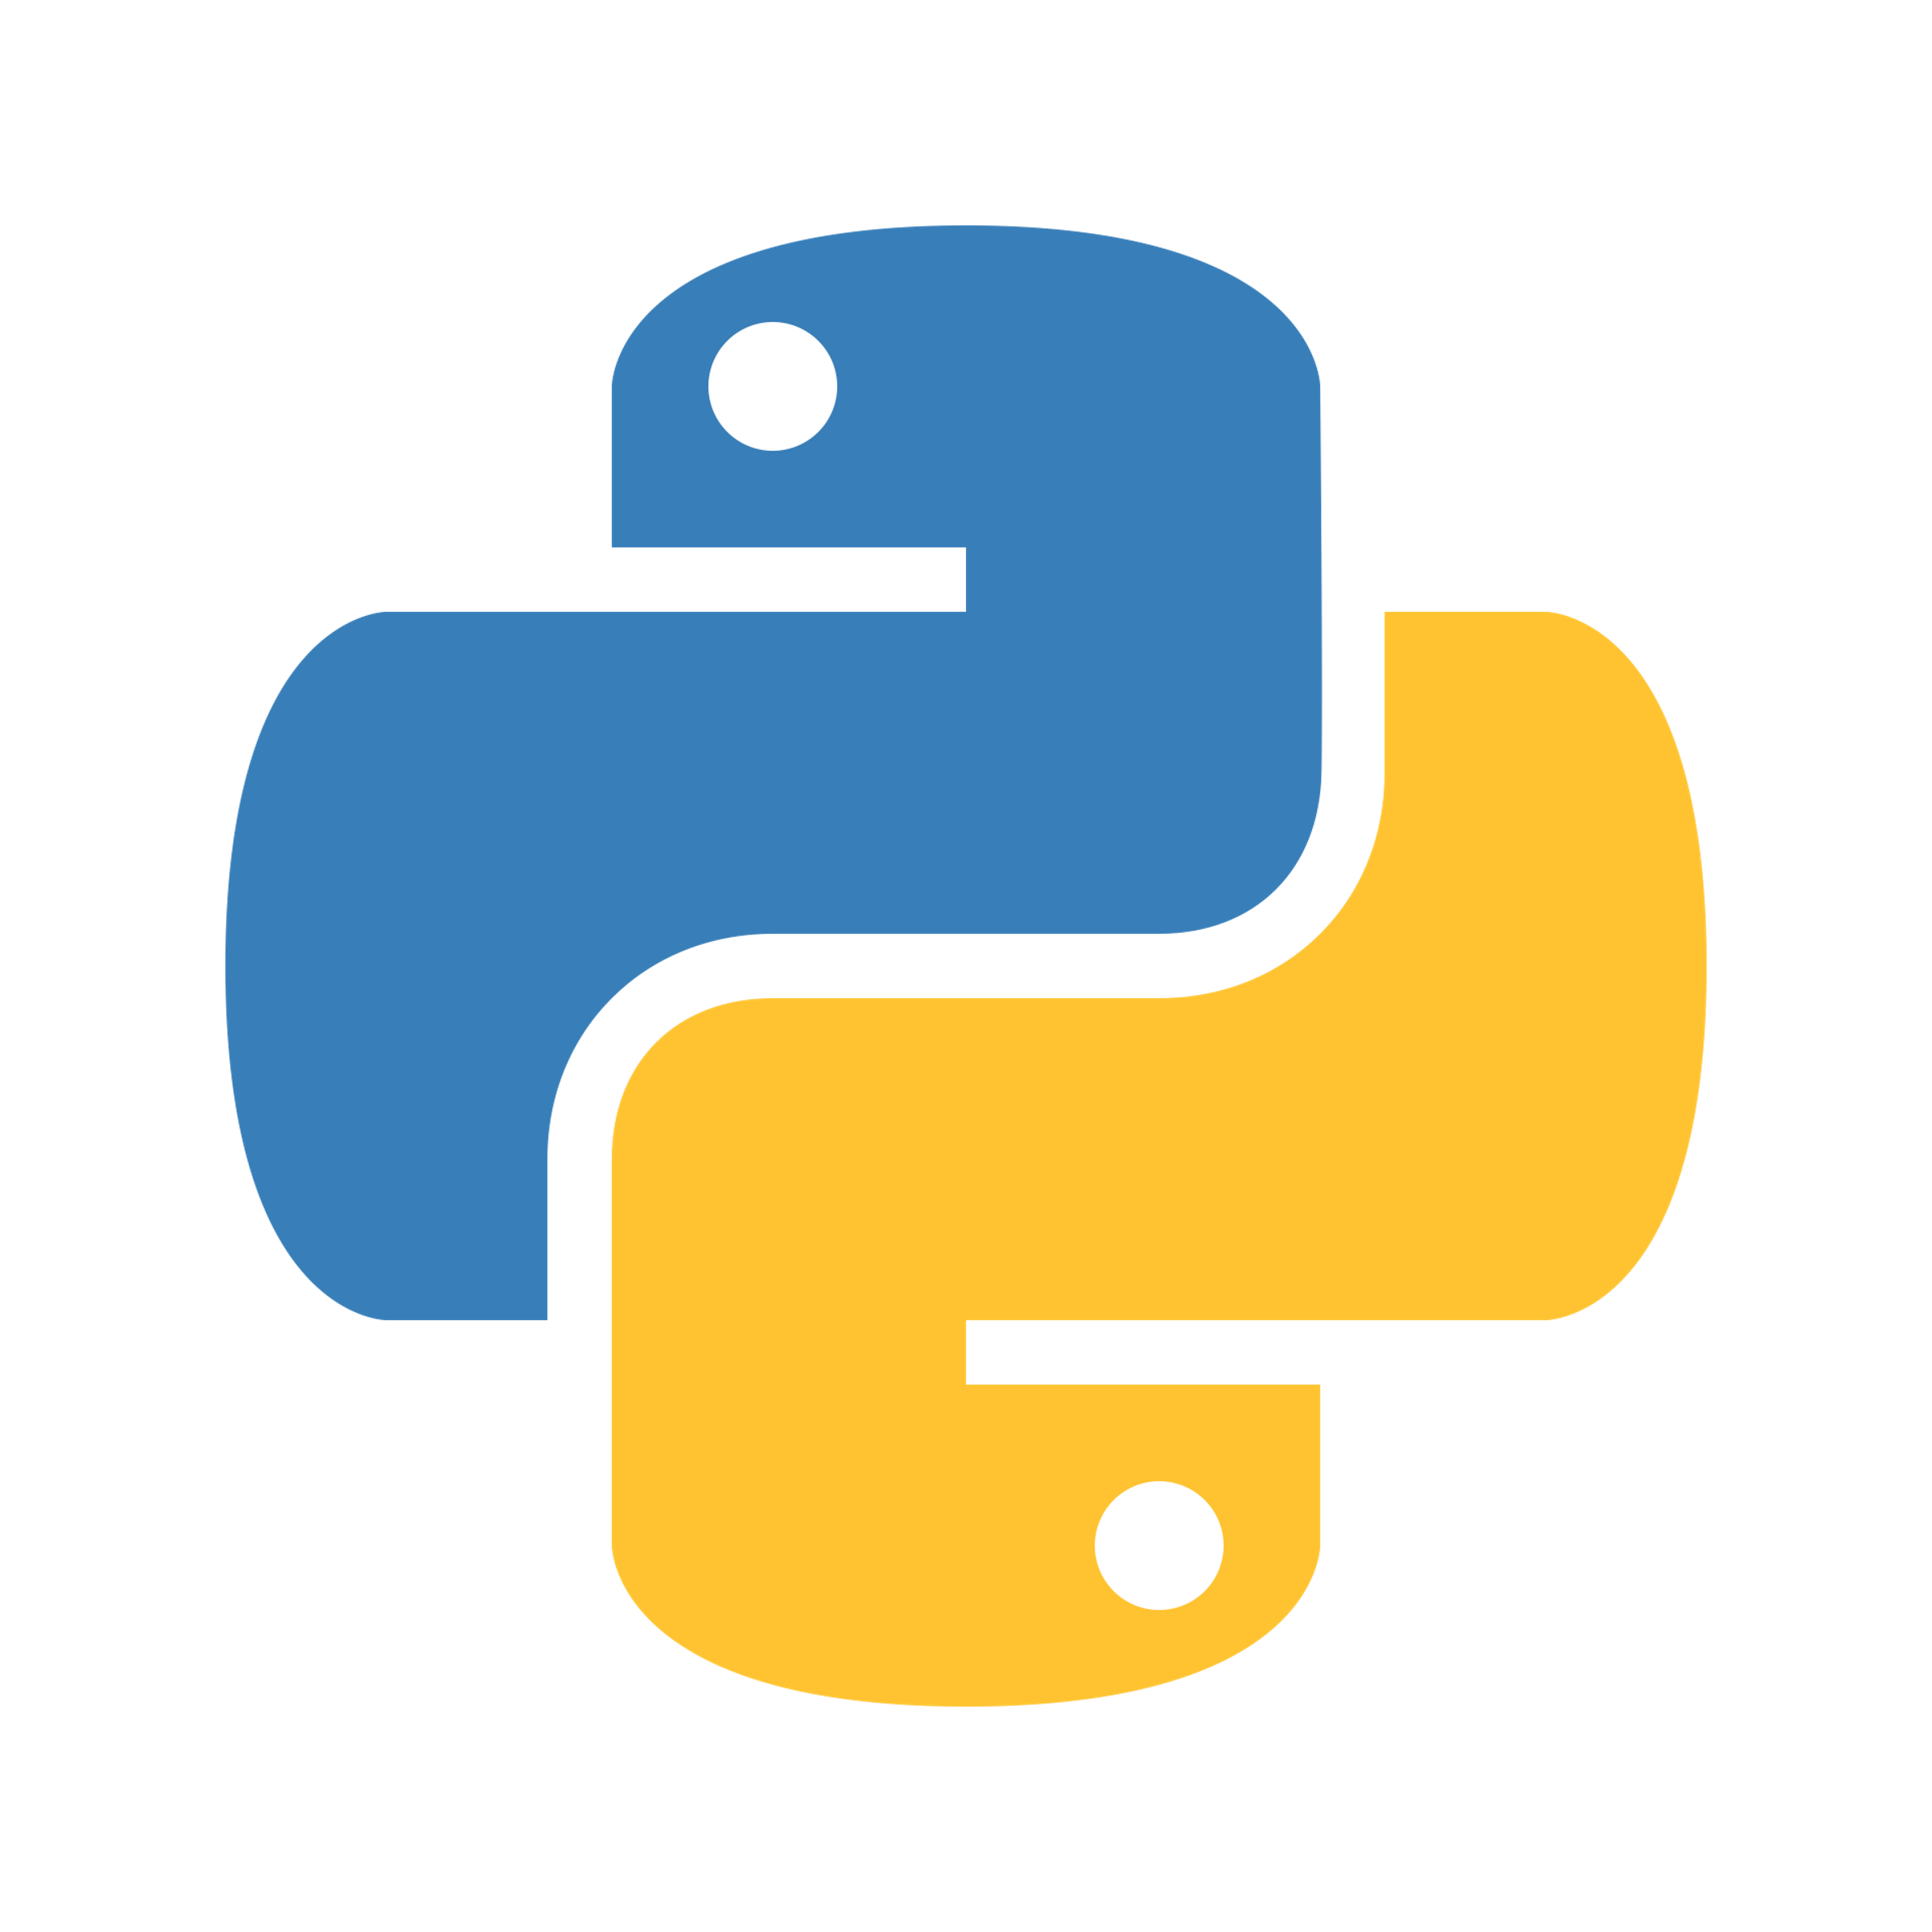
Python programming and data visualization for beginners Dr Joel Martin

Slide 2
Week 1
Interpreted language
Parser – tokens – lexical analyszer
Structure of a program – logical lines
Syntax, data types, and built-in functions
What is the syntax of a programming language?
Python’s syntax
Comments, variables, keywords, and whitespace
Built-in data types
numbers, booleans, strings, lists, tuples, dictionaries
Built-in functions
e.g., print(), input(), len(), range(), round(), del()

Slide 3
Syntax
What is it?
Subject/Verb phrase
Syntax
noun
1. The arrangement of words and phrases to create well-formed sentences in a language.
Prepositional Phrase
Noun Phrase
Noun Phrase
Article
Noun
Verb
Prep.
Article
Noun
The cat sat on the mat.

Slide 4
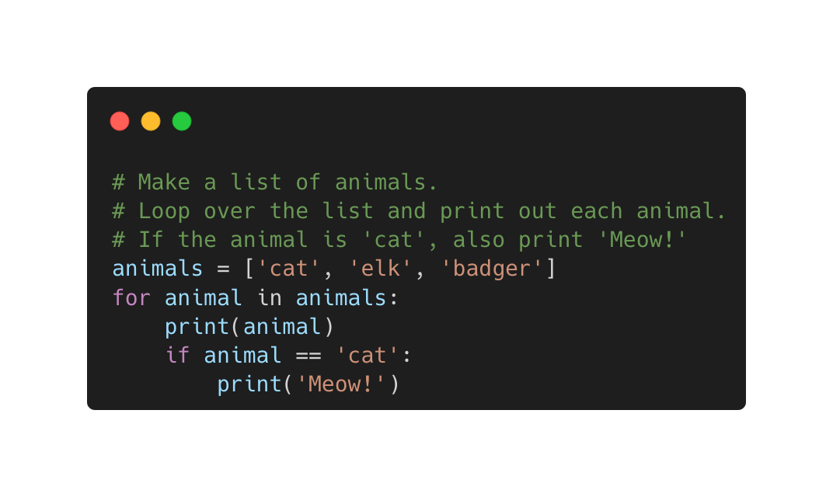
Syntax
What is it?
Syntax
noun
1. The arrangement of words and phrases to create well-formed sentences in a language.
2. The structure of statements in a computer language.
String
Comment
Variable name
list
For loop
Conditional statement
Indentation

Slide 5
Python’s syntax
Python has a clear, concise and readable syntax
Syntax highlighting is a useful feature of integrated development environments like Jupyter and Spyder
String
Comment
Variable name
list
For loop
Conditional statement
Indentation

Slide 6
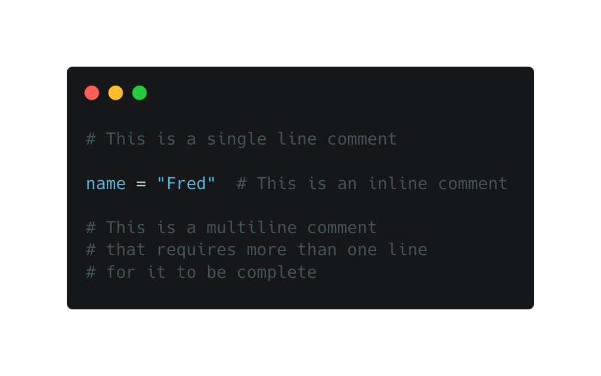
Python’s syntax
Comments
Bits of text that don’t get executed when the code is run
May explain what the code does or why it was written that way
Purely for the benefit of the human reading the code (i.e., future you, or a colleague)
Anything following a # (hash) is a comment
Can be single line, inline, multiline

Slide 7
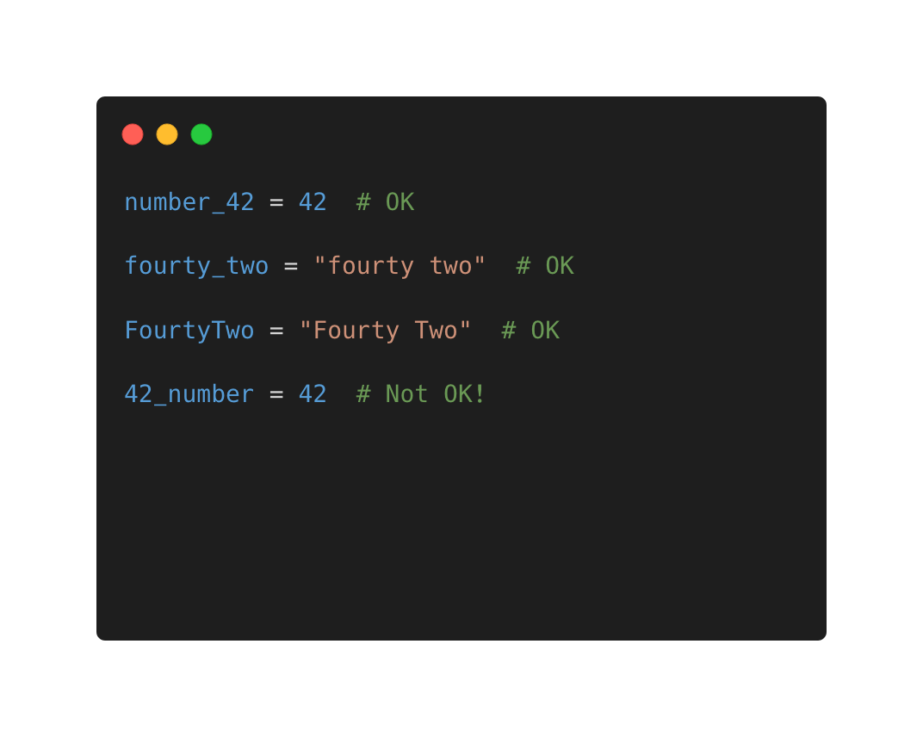
Python’s syntax
Variables
Values are assigned to variables with the assignment operator (=)
<variable_name> = <value>
Variable names can use lower [a-z] and uppercase [A-Z] letters, the underscore character [_] and digits [0-9]
But they can not start with digits!

Slide 8
Python’s syntax
Keywords
False break for not None class from or True continue global pass def if raise and del import return as elif in try assert else is while async except lambda with await finally nonlocal yield
Python has a set of keywords
In the latest version of Python (3.10) there are 35 keywords (shown right)
These are reserved words, which means they cannot be used as names for variables, classes or functions
Each has its own special meaning and together they help define the Python syntax
Don’t worry about learning all of them! We will focus mainly on the ones in bold

Slide 9
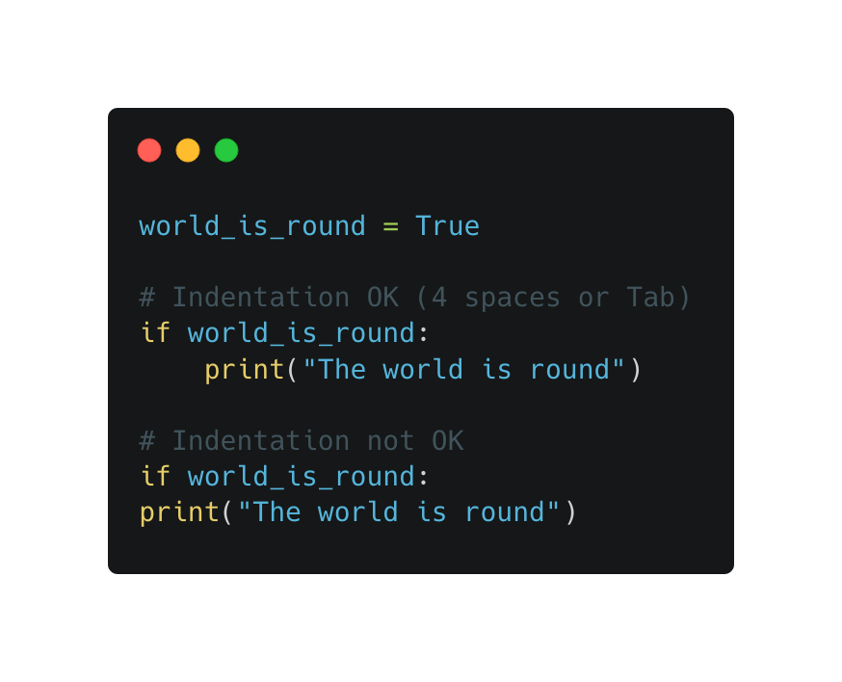
Python’s syntax
Whitespace
An important feature of the Python syntax!
Whitespace indentation is used to denote blocks of code following control statements (e.g., if, for, while)
Use 4 spaces (preferred) or a Tab for indentation

Slide 10
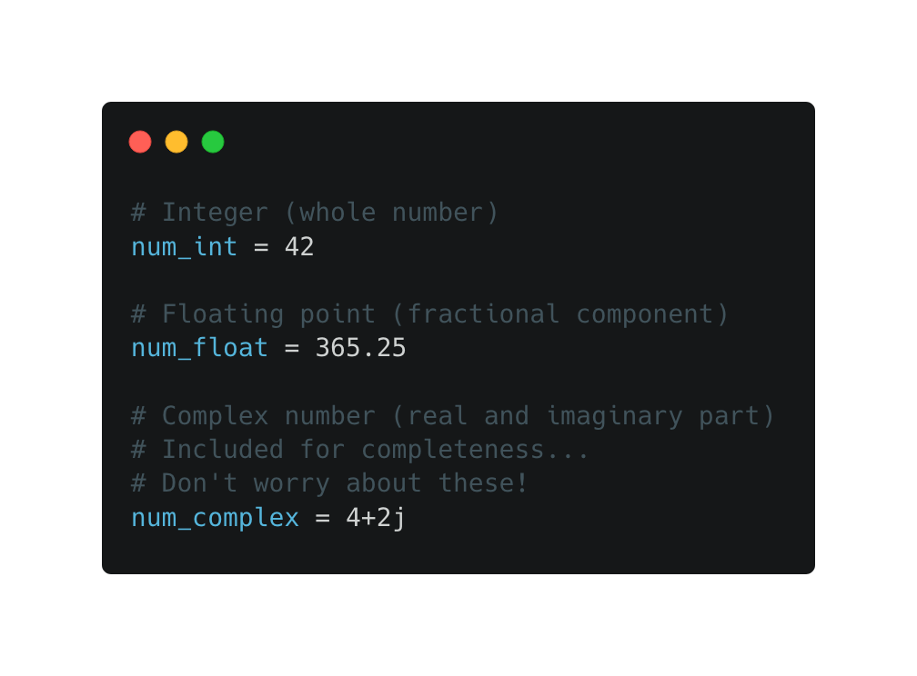
Python’s data types
Numbers
Integers are whole numbers
Floating point numbers have a fractional component
Complex numbers have a real and imaginary part
int(), float(), complex()

Slide 11
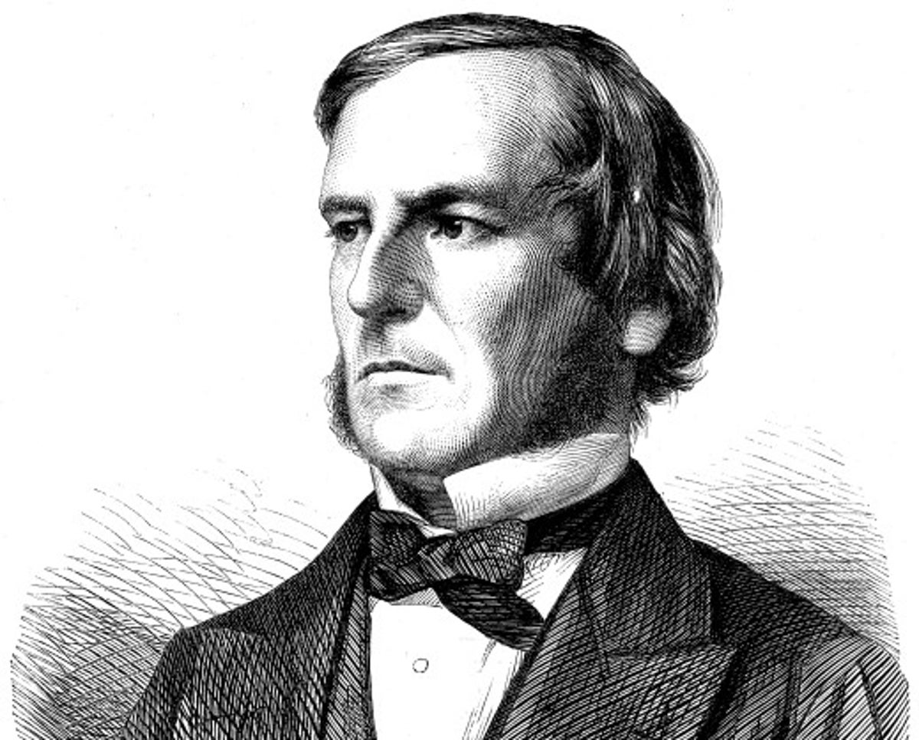
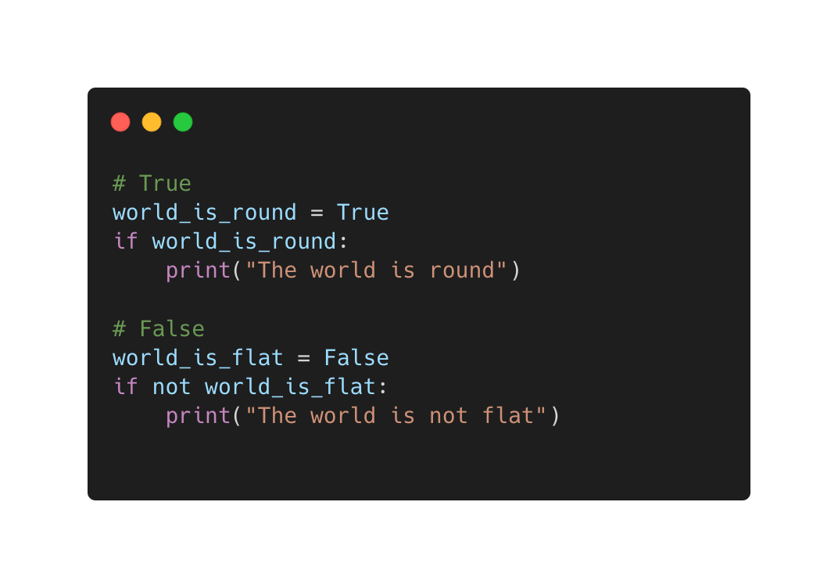
Python’s data types
Booleans
Two possible values
True
False
In Python, bool is a subclass of int
True is equal to 1
False is equal to 0
Pictured top-right: George Boole (1815 - 1864), who first defined an algebraic system of logic

Slide 12
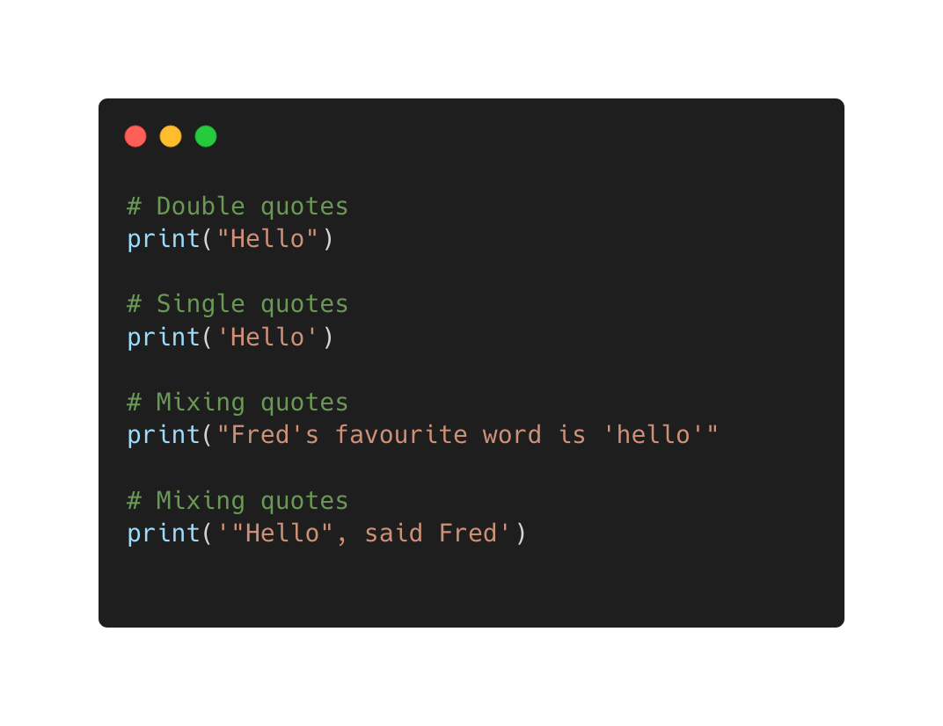
Python’s data types
Strings
A sequence of values represented by Unicode points
Can be expressed using double or single quotes
Strings are immutable, which means they can not be modified once they have been created
Various string methods available (e.g., .format(), .upper(), .replace())

Slide 13
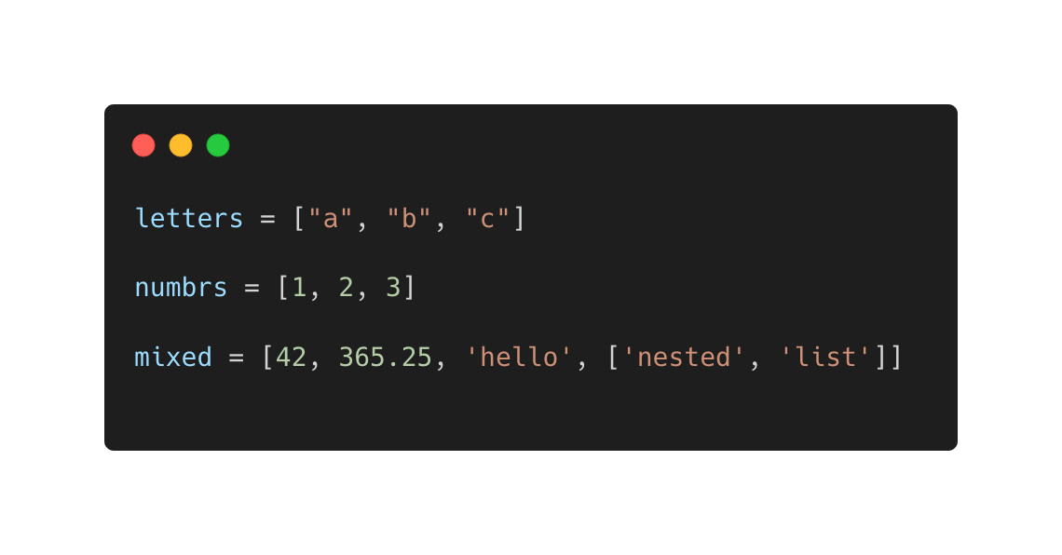
Python’s data types
Lists
A compound data type for grouping other values together
May contain items of different types, including other lists!
Defined with square brackets and commas separating each item
my_list = [item, item, …, item]
Support indexing, assignment, concatenation, iteration
Built-in list methods (e.g., .pop(), .append(), .sort())

Slide 14
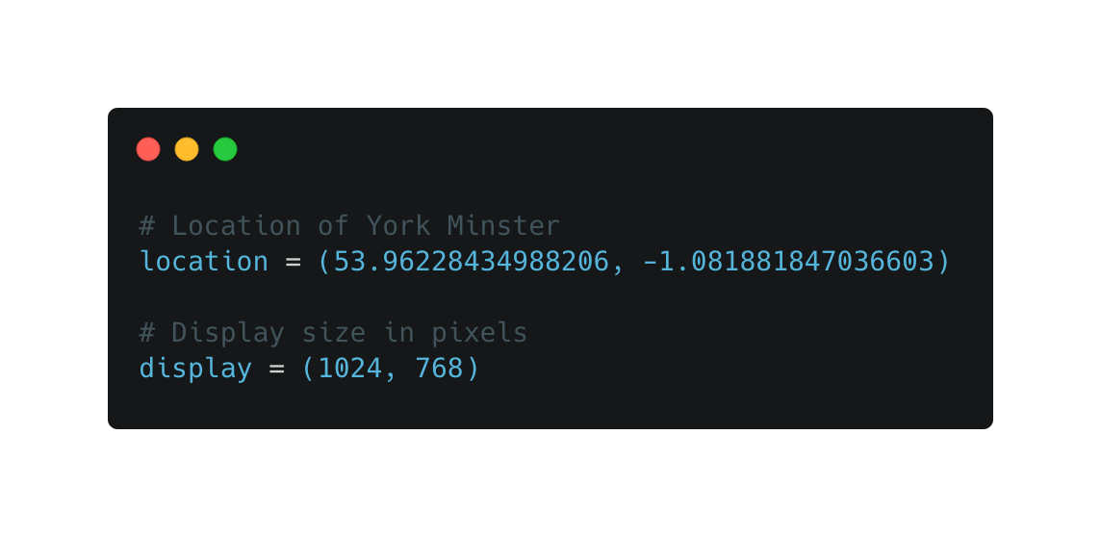
Python’s data types
Tuples
Like lists, but they are immutable!
i.e., a tuple can not be changed after it has been created
Smaller memory footprint than lists
Defined with curly brackets and commas between each item
my_tuple = (item, item, …, item)

Slide 15
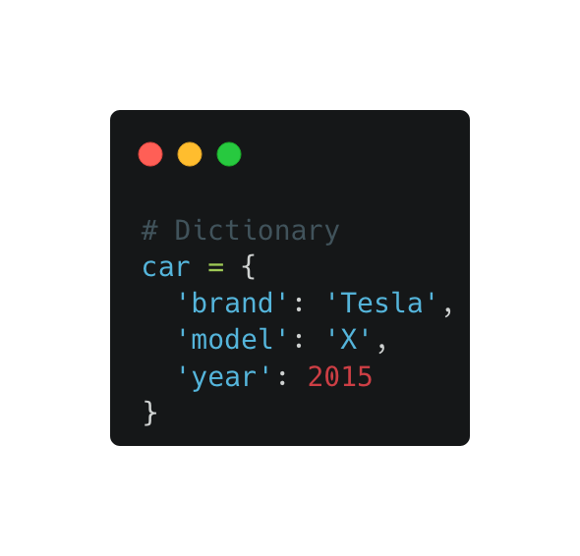
Python’s data types
Dictionaries
Collections of objects stored in key-value pairs
Defined with curly braces, a colon between keys and values, and commas to separate key-value pairs
my_dict = {key: value, …, key: value}
Access values by key
e.g., car[‘brand’]
Built-in dictionary methods (e.g., .keys(), .values(), .items(), .get())

Slide 16
Python’s built-ins
Python has a set of built in functions that are always available
Some are more obscure than others!
We will mainly encounter the ones in bold
abs()
aiter()
all()
any()
anext()
ascii()
bin()
bool() breakpoint() bytearray() bytes() callable()
chr() classmethod() compile() complex() delattr()
dict()
dir()
divmod() enumerate() eval()
exec() filter() float() format() frozenset() getattr() globals() hasattr() hash()
help()
hex()
id()
input()
int() isinstance() issubclass() iter()
len()
list()
locals()
map()
max() memoryview() min()
next()
object()
oct()
open()
ord()
pow()
print() property() range()
repr() reversed() round()
set() setattr() slice()
sorted() staticmethod()
str()
sum()
super()
tuple()
type()
vars()
zip()

