Slide 1

Python programming and data visualization for beginners Dr Joel Martin

Slide 2
Week 2
Interpreted language
Parser – tokens – lexical analyszer
Structure of a program – logical lines
Operators, control flow statements, defining functions
Operators
Logical, arithmetic, assignment, comparison, membership, identity, bitwise
Control flow statements
if, while, for
Defining functions
def
Notes:
Arithmetic operators.
Assignment operators.
Comparison operators.
Logical operators.
Identity operators.
Membership operators.
Bitwise operators.

Slide 3
Operators
What are they?
Operands
Special symbols designating some sort of computation to be performed
Python has the following kinds of operator:
Logical (e.g., and, or, not)
Arithmetic (e.g., +, -, /, *)
Assignment (e.g., =)
Comparison (e.g., ==, >, <)
Membership (in, not in)
Identity (is, is not)
Bitwise (e.g., &, |, ~)
10 + 20
Operator

Slide 4
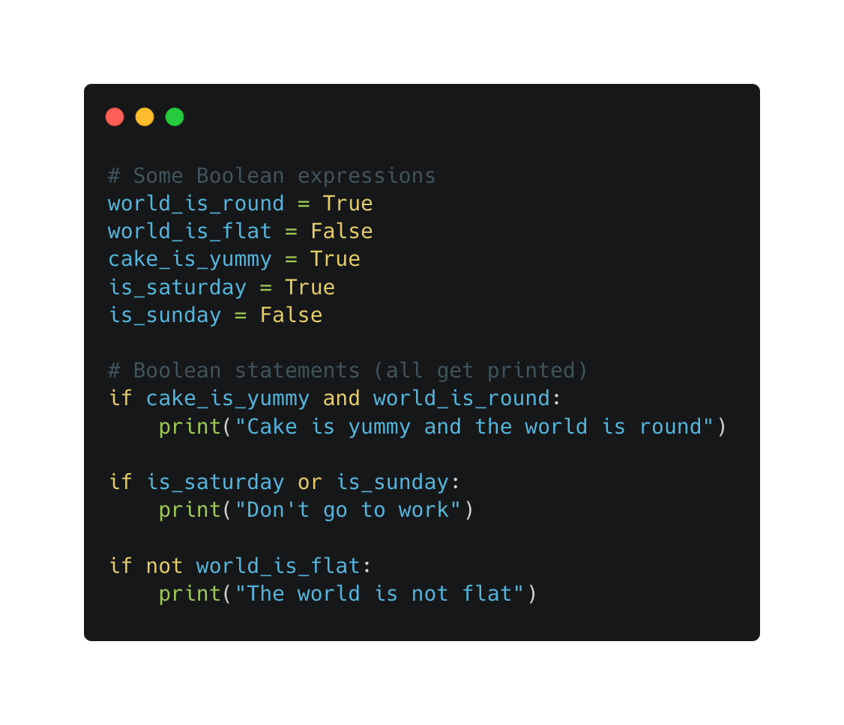
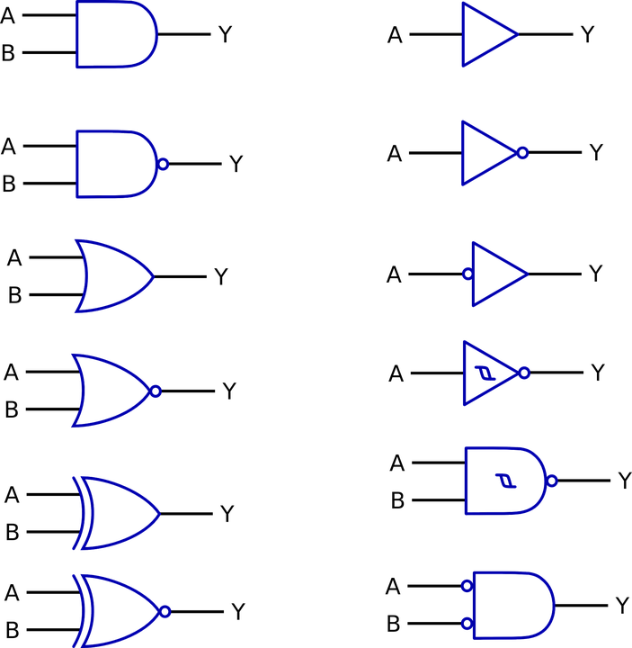
Operators
Logical
Used to join expressions in a Boolean context
not
Return False if the result is True (i.e., reverse the result)
and
Return True if both statements are True
or
Return True if at least one statement is True

Slide 5
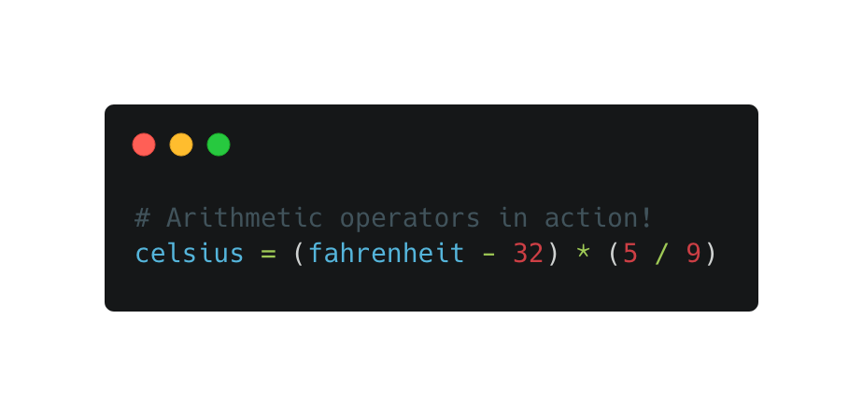
Operators
Arithmetic
For performing mathematical computations
Modulo returns the remainder of a division
10 % 6 = 4
42 % 8 = 2
Floor division returns the largest integer less than or equal to the result of a division
10 // 6 = 1
42 // 8 = 5
Operator | Name | Example
+ | Addition | a + b
- | Subtraction | a - b
* | Multiplication | a * b
/ | Division | a / b
% | Modulo | a % b
** | Exponentiation | a ** b
// | Floor division | a // b

Slide 6
Operators
Operator | Example | Equivalent
= | a = 10 | a = 10
+= | a += 6 | a = a + 6
-= | a -= 6 | a = a - 6
*= | a *= 6 | a = a * 6
/= | a /= 6 | a = a / 6
%= | a %= 6 | a = a % 6
//= | a //= 6 | a = a // 6
**= | a **= 6 | a = a ** 6
&= | a &= 6 | a = a & 6
|= | a |= 6 | a = a | 6
^= | a ^= 6 | a = a ^ 6
>>= | a >>= 6 | a = a >> 6
<<= | a <<= 6 | a = a << 6
Assignment
Used to assign values to variables
= is the main assignment operator
The rest are augmented assignment operators, which are simply a shorthand for updating a variable value in-place
For now, stick with whichever approach makes the most sense to you

Slide 7
Operators
Comparison
Used to compare object equality
Typically used in a Boolean context to control the flow of of a program
Outcome of a comparison depends on the nature of the data being compared
Some types can not be compared (e.g., int and str)
Operator | Name | Example
== | Equal | a == b
!= | Not equal | a != b
> | Greater than | a > b
< | Less than | a < b
>= | Greater than or equal to | a >= b
<= | Less than or equal to | a <= b

Slide 8
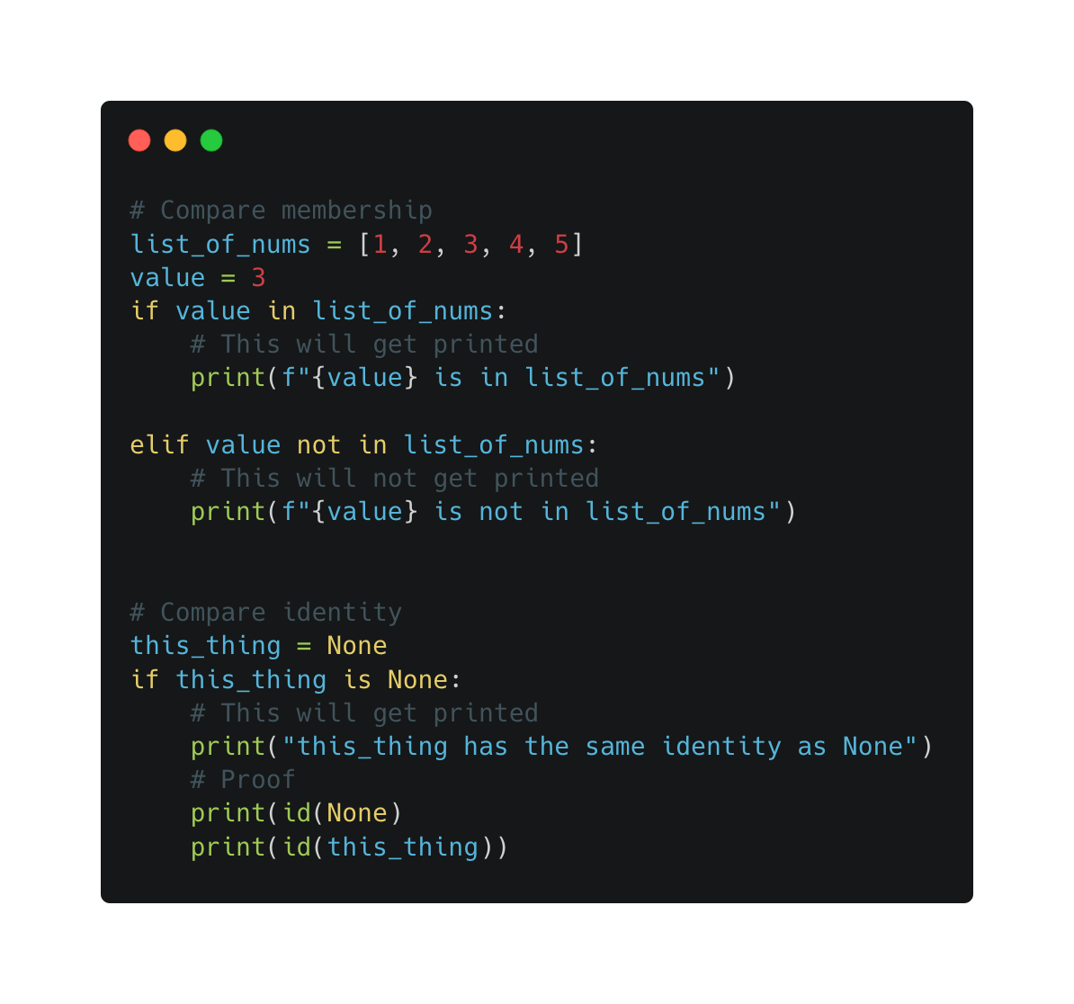
Operators
Membership and identity
Use in and not in to check whether a specified value is a constituent member or element of a sequence
Use is and is not to check whether two variables have the same identity (i.e., they refer to the same object in memory)
Note that identity and equality are not the same thing

Slide 9
Operators
Bitwise
Operator | Name | Example
& | Bitwise AND | a & b
| | Bitwise OR | a | b
^ | Bitwise XOR (exclusive OR) | a ^ b
~ | Bitwise NOT | a ~ b
<< | Bitwise left shift | a << b
>> | Bitwise right shift | a >> b
Used to perform Boolean logic on individual bits
Good to know about, safe to forget (for now)
Possible to use them in place of logical operators (and, not, or)
But this is less readable and may not work as expected in all cases

Slide 10
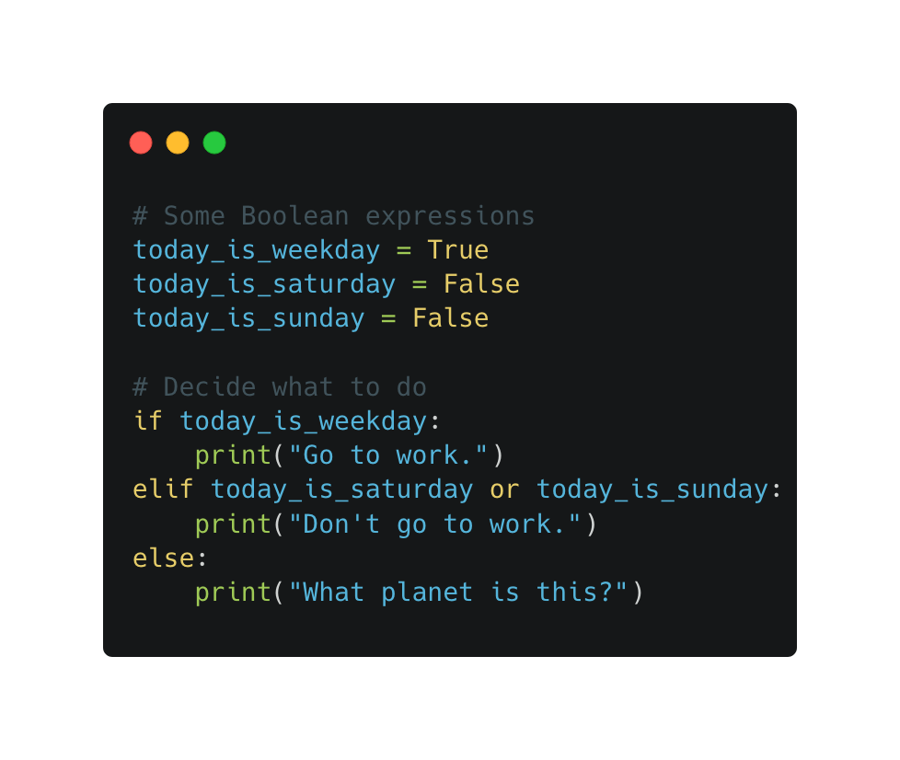
Control flow statements
if / elif / else
Used for conditional execution
if statements can be extended with any number of elif (‘else if’) clauses and optionally ended with an else clause
Short circuit evaluation – as soon as a true statement is found, the relevant code is executed, and the program continues

Slide 11
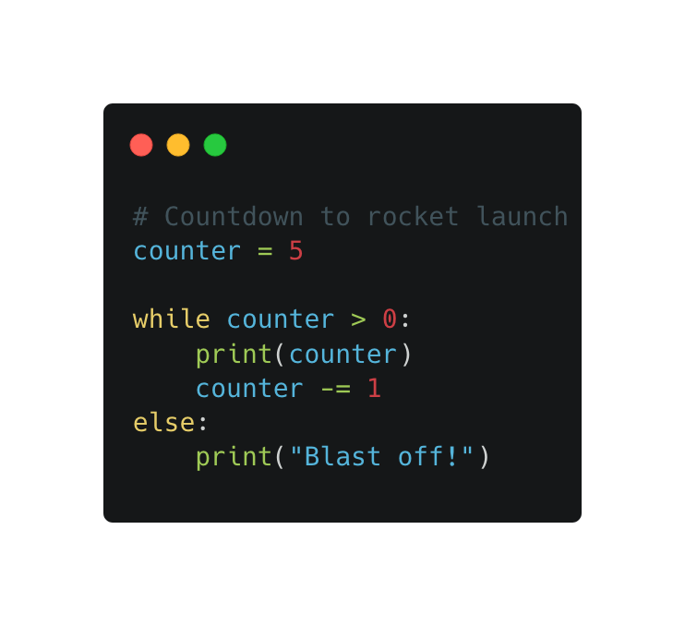
Control flow statements
while
Used for repeated execution for as long as a condition remains true
May include the break and continue statements (not shown here)
break terminates the loop without executing the else clause (if present)
continue skips the rest of the code for the current iteration and goes back to testing the initial expression

Slide 12
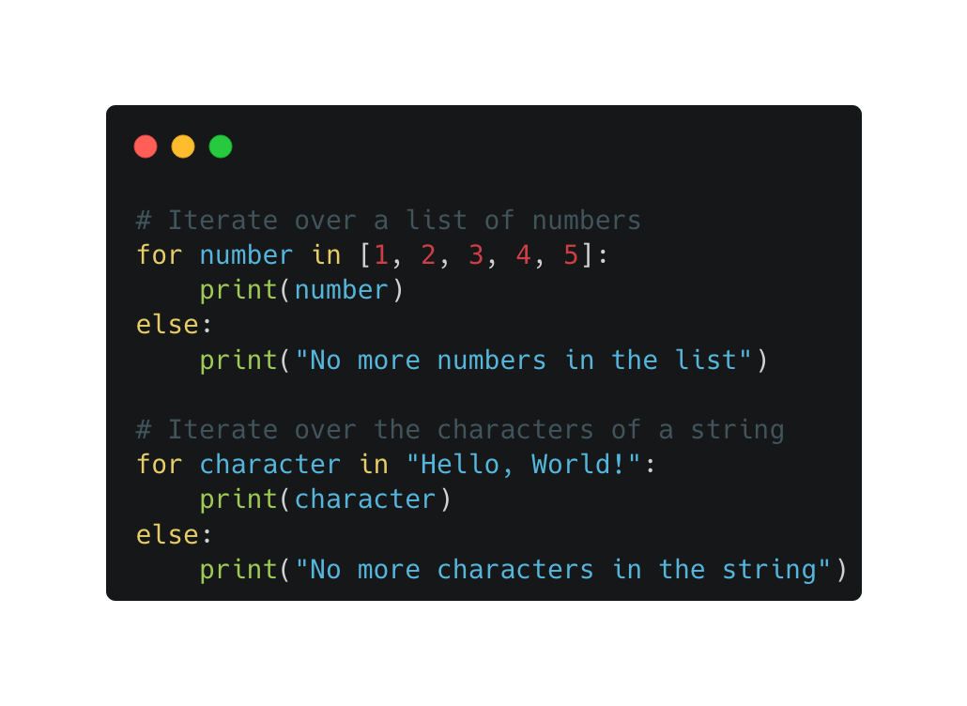
Control flow statements
for
Used to iterate over the elements of a sequence (or some other iterable object) in the order that they appear
At each iteration the current value from the sequence is assigned to a target variable
Optional else to be executed when the sequence is exhausted
May also include the break and continue statements (not shown here)

Slide 13
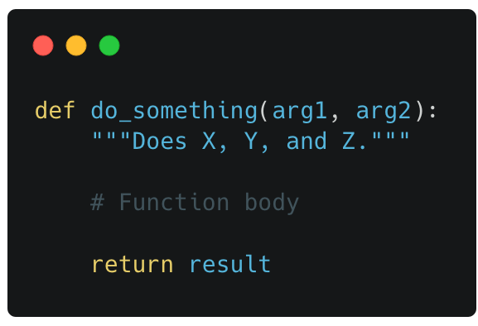
Defining functions
def
Function name
Parentheses to delimit (possibly empty) parameter list
Functions are self-contained blocks of code that encapsulate a specific task or related group of tasks
They typically take a list of arguments, perform some sort of operation, and then return a result
Use the keyword def to define a function
If you find that you are repeating the same bits of code over and over again, define a function!
Function definition keyword
Docstring (brief function explanation)
Parameter list (comma-separated)
Return statement
Function body (code that does something)

