Slide 1
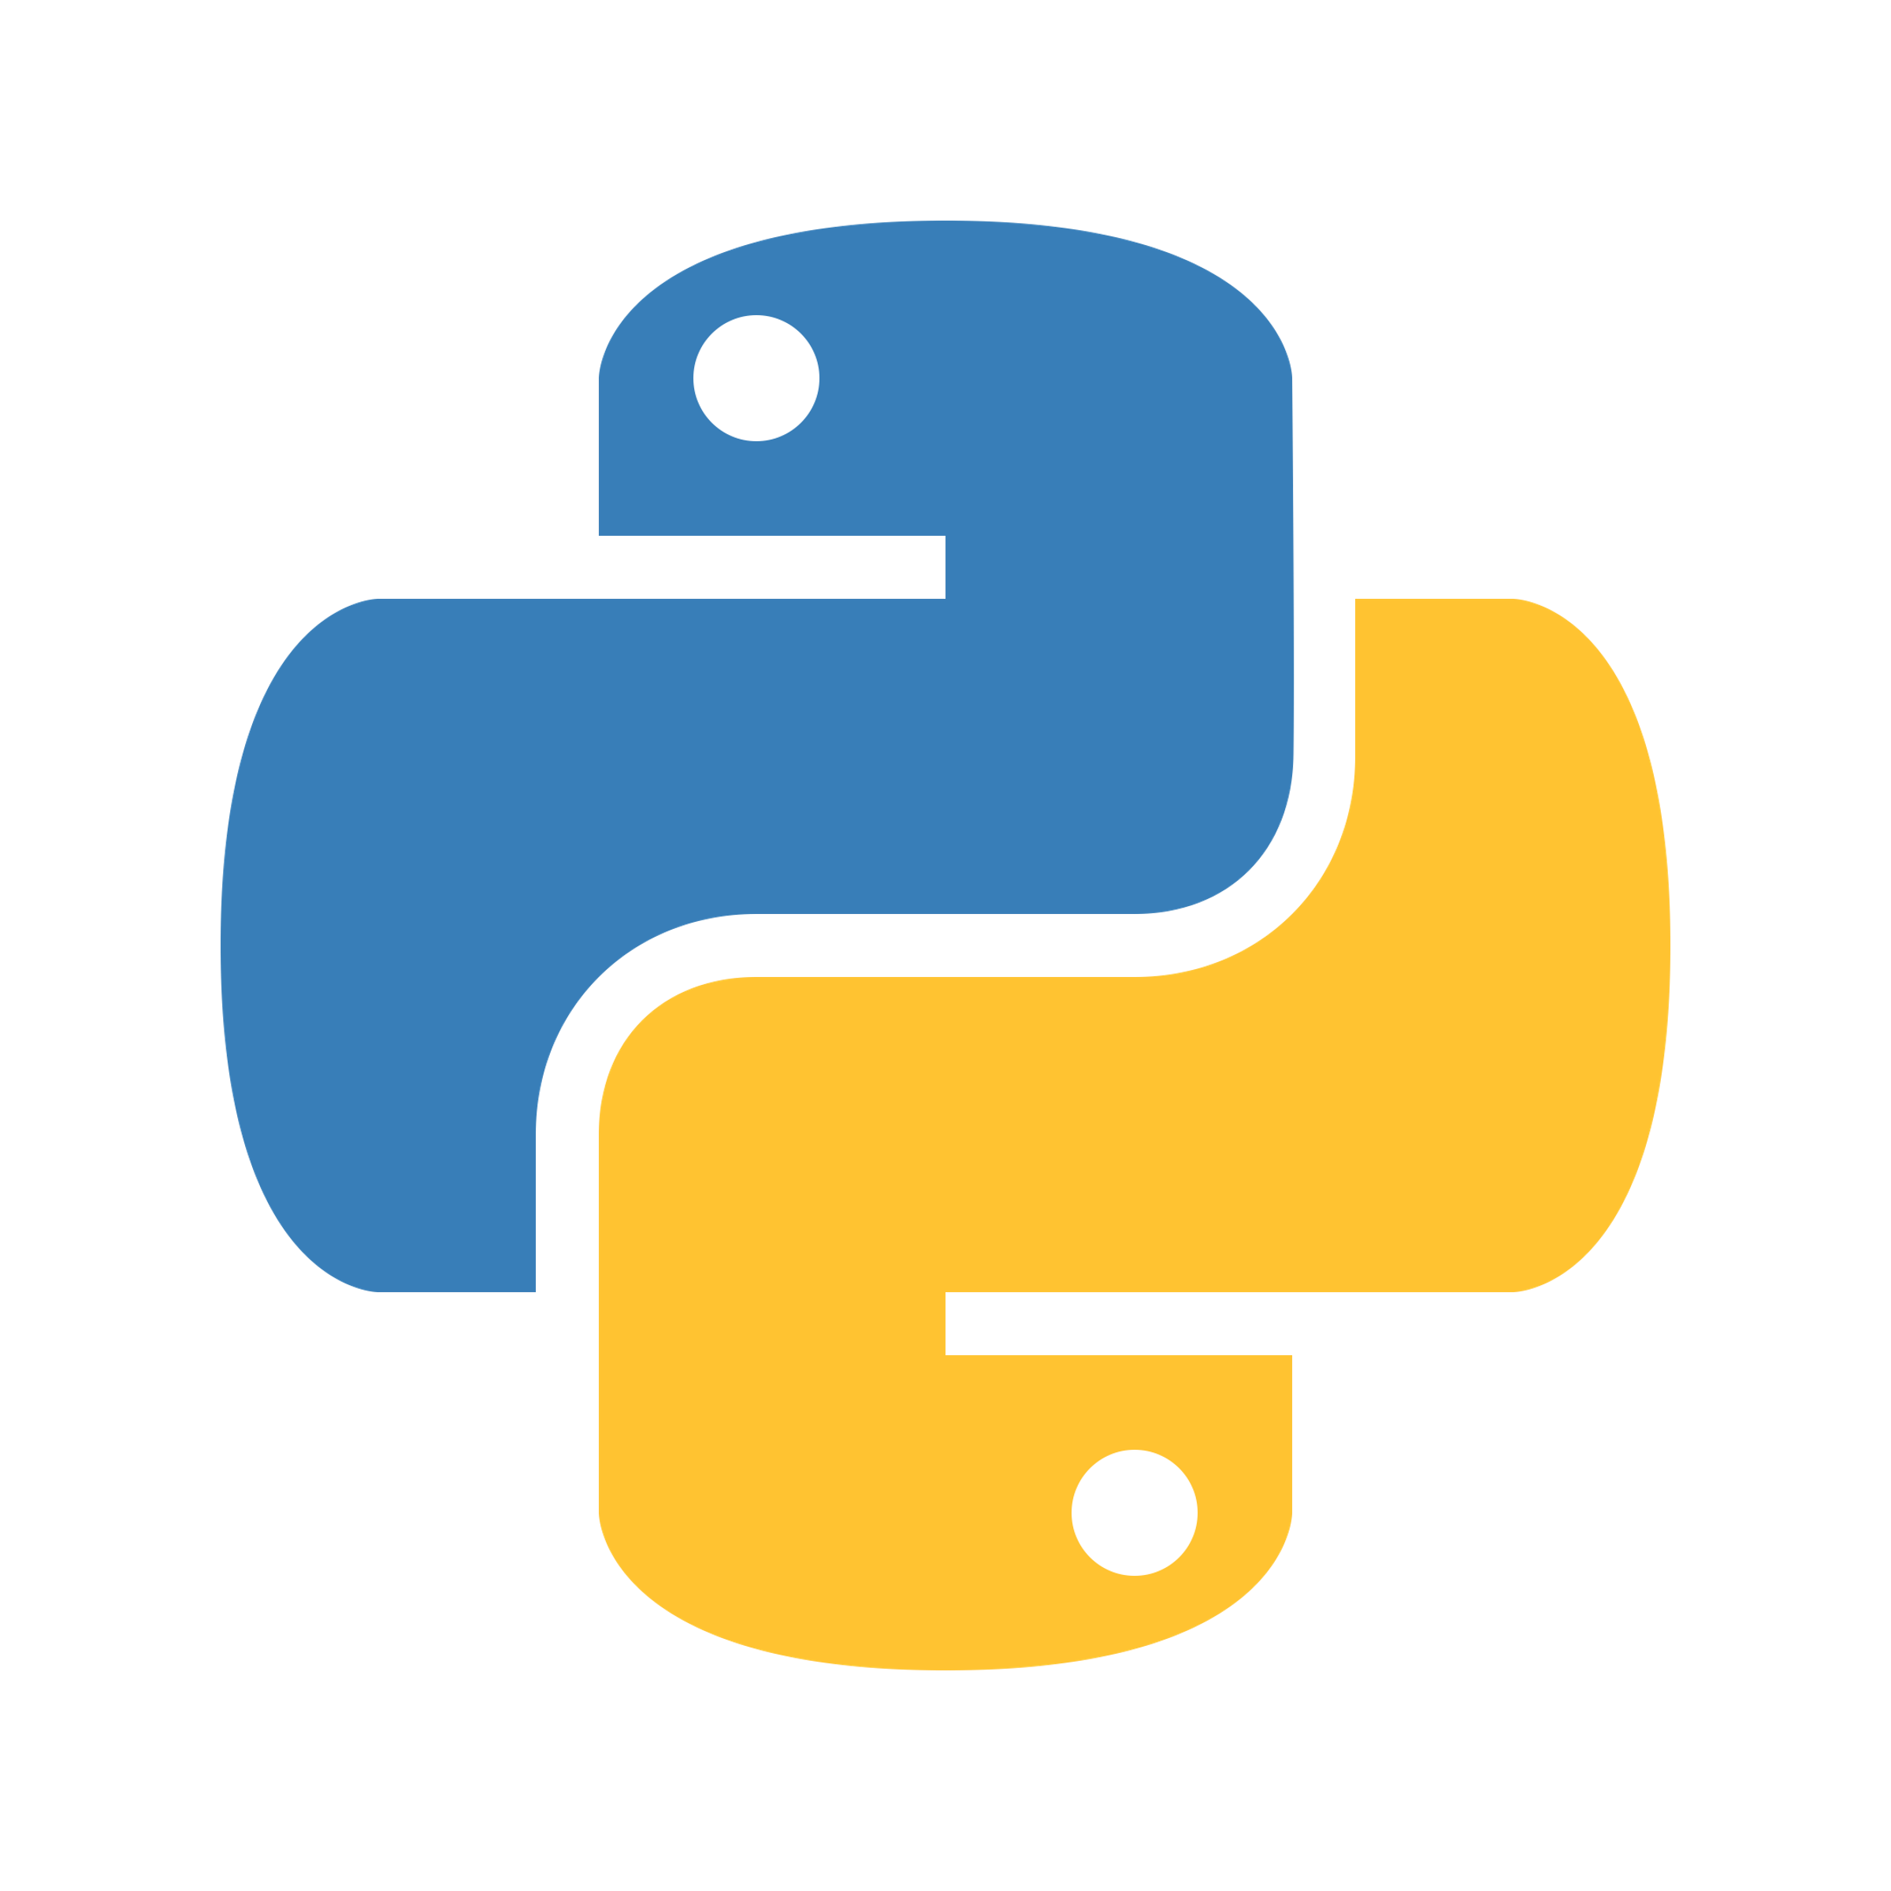
Python programming and data visualization for beginners Dr Joel Martin

Slide 2
Week 2
Interpreted language
Parser – tokens – lexical analyszer
Structure of a program – logical lines
Imports, the standard library, and third-party libraries
Python’s import statement
The standard library
Useful / common libraries
random, os, glob, datetime, sys, re, math, statistics, csv, json
Third-party libraries
PyPI – The Python Package Index
numpy, matplotlib, pandas
Notes:
Arithmetic operators.
Assignment operators.
Comparison operators.
Logical operators.
Identity operators.
Membership operators.
Bitwise operators.

Slide 3
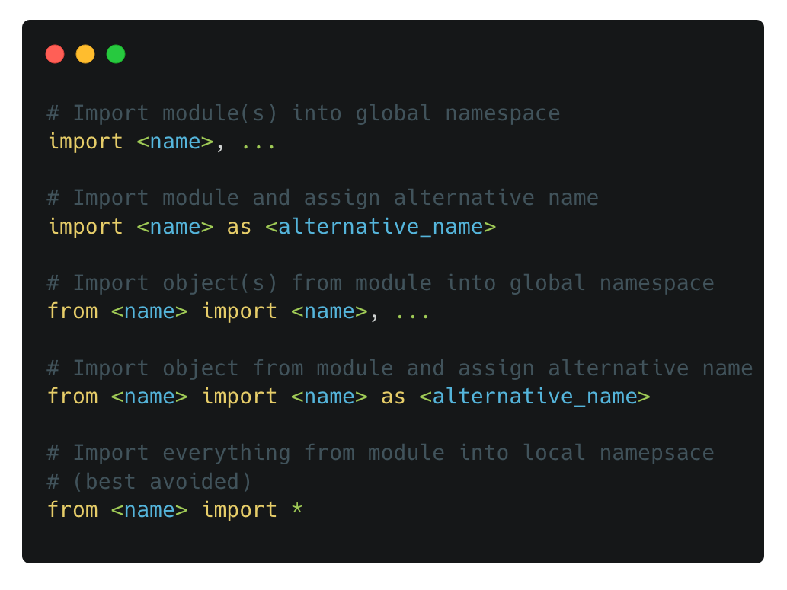
Importing libraries
import
Python code is organized into modules
To access functionality from another module, we must import the module using the import statement
By convention, imports happen at the top of a script
Right: different ways of using the import statement

Slide 4
The Standard Library
Python
Python ships with 200+ libraries designed to help with tasks in many different problem domains
Some examples are shown to the right
Python Standard Libraries
Mathematics
File system
Data types
math
random
os.path
gzip
array
datetime
statistics
pathlib
calendar
Text processing
File formats
Operating system
string
re
configparser
os
io
readline
csv
platform

Slide 5
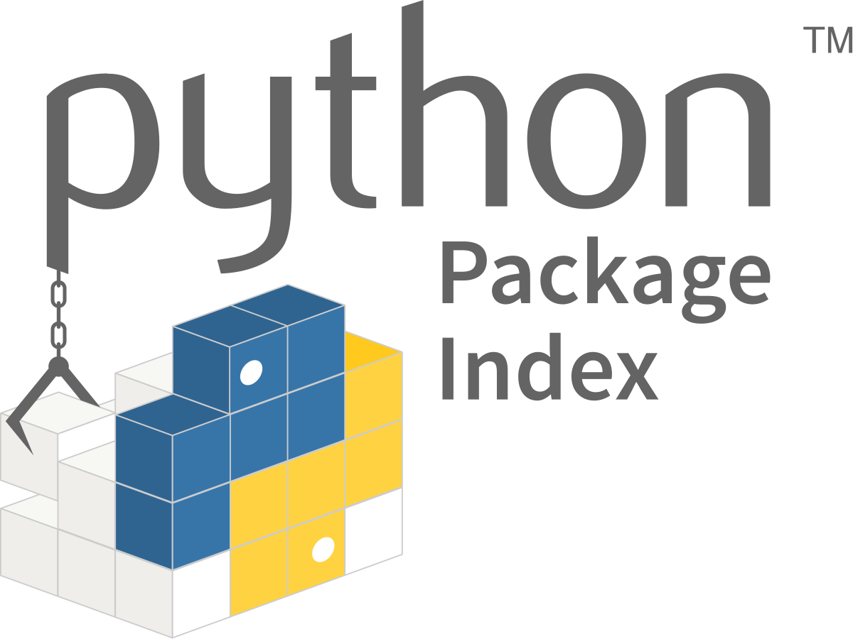
Third-party libraries
PyPI – The Python Package Index
Home to over 400k projects from the wider Python community
Many problems have already been solved – check PyPI before reinventing the wheel
Install packages using the pip packaging tool
Or an alternative package manager such as conda

Slide 6



Third-party libraries
numpy, matplotlib, pandas
Core libraries for scientific Python ecosystem
Install with Anaconda Navigator
Fluency with these libraries is a skill within a skill
These are very powerful tools for working with data

