Slide 1

Python programming and data visualization for beginners Dr Joel Martin

Slide 2
Week 4
Interpreted language
Parser – tokens – lexical analyszer
Structure of a program – logical lines
Data visualization with NumPy and matplotlib
Data visualisation
Edward Tufte
Misleading charts
NumPy
Matplotlib
Notes:
Arithmetic operators.
Assignment operators.
Comparison operators.
Logical operators.
Identity operators.
Membership operators.
Bitwise operators.

Slide 3
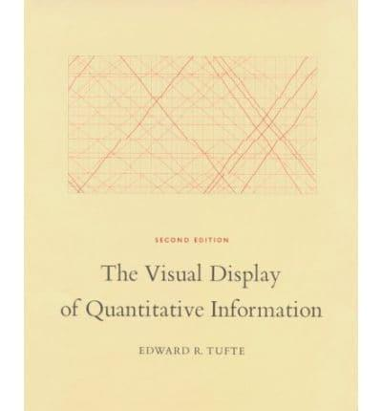
Data visualisation
Guiding principles
Edward Tufte
Leading expert on data visualisation
Book: The Visual Display of Quantitative Information
Key concepts:
Chartjunk: Useless, non-informative, or information-obscuring elements of quantitative information displays
Lie factor: The relation between the size of effect shown in a graphic and the size of effect shown in the data
Data-ink ratio: Use ’ink’ for data, avoid unnecessary decorations
Data density: Number of data points divided by size of graphic (maximise, within reason)

Slide 4
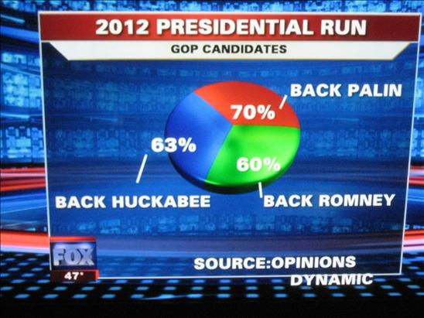
Data visualisation
Misleading charts
Fox News
What is wrong with this chart?

Slide 5
Data visualisation
Misleading charts
Fox News
What is wrong with this chart?
Percentages do not add up to 100%
Pointless 3D serves only to make some slices look bigger than they are

Slide 6
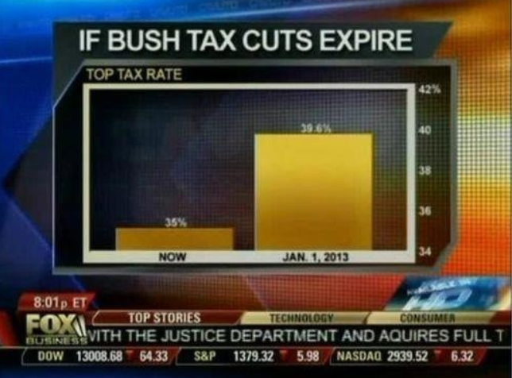
Data visualisation
Misleading charts
Fox News
What is wrong with this chart?

Slide 7
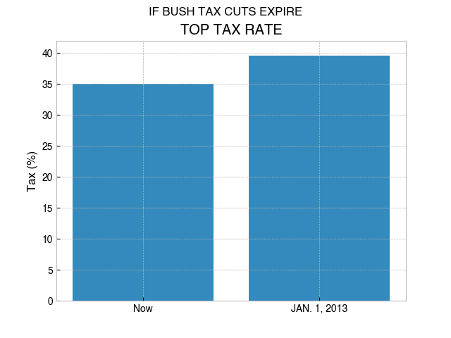
Data visualisation
Misleading charts
Fox News
What is wrong with this chart?
Scale of y-axis is misleading

Slide 8
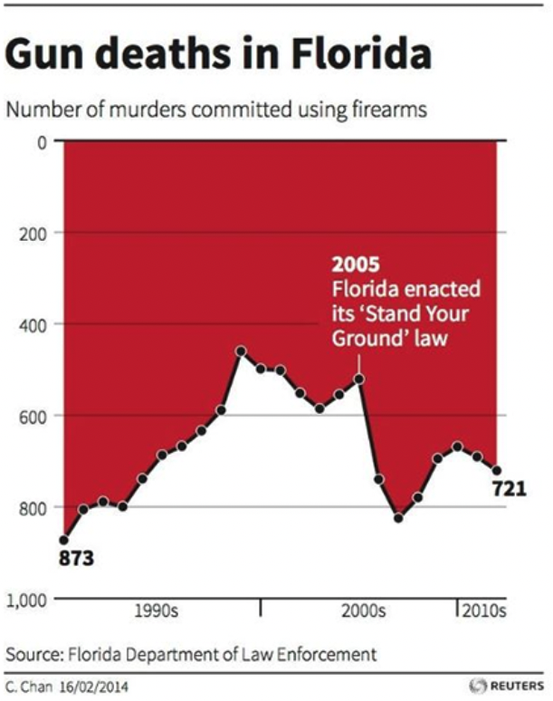
Data visualisation
Misleading charts
Florida Department of Law Enforcement
What is wrong with this chart?

Slide 9
Data visualisation
Misleading charts
Florida Department of Law Enforcement
What is wrong with this chart?
Inverted Y-axis!
Cynical attempt at misleading people into thinking that the ‘Stand Your Ground’ law led to a reduction of gun deaths in Florida
What that data really show →
800
600
400
2005
Florida enacted its ‘Stand Your Ground’ law
200
0

Slide 10
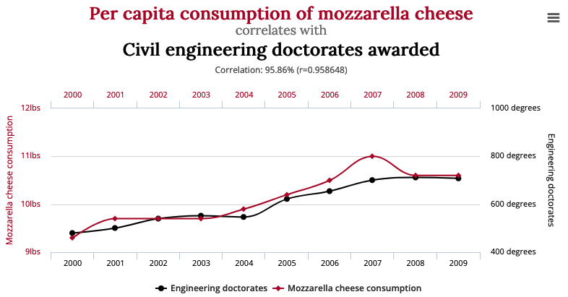
Data visualisation
Misleading charts
From the www.tylervigen.com
What’s wrong with this chart?

Slide 11
Data visualisation
Misleading charts
From the www.tylervigen.com
What’s wrong with this chart?
Twin axis scaling gives the impression of a causal relationship for two unrelated variables
Correlation does not imply causation!
More examples at https://tylervigen.com/spurious-correlations

