Slide 1
MULTIMODAL-BIO-FUSION · PROGRESS UPDATE
Stage 1 with DNA, RNA, and Protein
One coding sequence, eight frozen foundation models. What each model already knows, how their representations relate, and how much of that relationship is just sequence composition.
DNA · NT 500M, NT v2, DNABERT-2
RNA · RNA-FM, mRNA-FM
Protein · ESM-2 8M, 35M, 150M
Julian McKinley and Chase Di Maria Breisinger | MSDA AI Track, UCF | Meeting with Mina Basirat, October 7, 2026
Notes:
Stage 1 sends each coding sequence to eight frozen models, two or three per modality. Following BioLangFusion, the DNA models read it in DNA letters, the RNA models read it in RNA letters, and the protein models read its translation. Today: what each model knows, how they relate, how much of their agreement is sequence composition, and which pairing looks most promising for fusion.

Slide 2
STAGE 1 SETUP
One coding sequence, eight frozen encoders
DNA
RNA
PROTEIN
NT 500M · NT v2 · DNABERT-2
RNA-FM · mRNA-FM
ESM-2 8M · 35M · 150M
Nucleotide Transformer 500M human-ref (human genome) and v2 100M multi-species (BioLangFusion's DNA encoder) read 6-mer tokens; DNABERT-2 reads byte-pair tokens. All three read the full sequence.
RNA-FM (non-coding RNA, BioLangFusion's RNA encoder) reads one nucleotide per token, first 1,022 nt only. mRNA-FM (messenger RNA coding sequences) reads one token per codon and sees the full sequence.
UniRef50 proteins. All three read the translated protein, one token per amino acid. 8M is BioLangFusion's protein encoder and 150M is IsoFormer's.
Why the same sequence eight ways: the stability data hold only the coding sequence, so, as in BioLangFusion, a modality is defined by the encoder. Differences between encoders reflect pretraining and tokenization, not new biological input. Two or three encoders per modality show how much encoders of one modality agree with each other.
981 of 1,000 sampled mRNA stability sequences retained (964 distinct). All encoders frozen; mean-pooled final layer. One notebook: Code/Stage1_analysis.ipynb.
Notes:
Each retained sequence is embedded by every encoder. Comparing two encoders of the same modality gives the reference for how much encoders that read the same input type agree. RNA-FM's limit of 1,022 nucleotides matters: 610 of the 981 sequences are longer, so it reads only their beginning. Every other encoder reads each sequence in full; mRNA-FM fits because each token covers three nucleotides.

Slide 3
TRACK A · DECODABILITY
Protein and codon-level RNA predict stability best
Linear probe, mean R² | Stability (fold SD) | 10 splits | GC | GC3
NT 500M human-ref | 0.032 (0.043) | 0.046 | 0.985 | 0.968
NT v2 100M multi-species | 0.080 (0.032) | 0.074 | 0.991 | 0.986
DNABERT-2 | 0.054 (0.031) | 0.057 | 0.990 | 0.948
RNA-FM | 0.052 (0.032) | 0.046 | 0.951 | 0.917
mRNA-FM | 0.127 (0.032) | 0.110 | 0.951 | 0.946
ESM-2 8M | 0.127 (0.044) | 0.131 | 0.679 | 0.379
ESM-2 35M | 0.114 (0.049) | 0.123 | 0.686 | 0.387
ESM-2 150M | 0.144 (0.035) | 0.142 | 0.708 | 0.436
Length only (baseline) | 0.003 (0.009) | 0.004
0.144
ESM-2 150M, the best single encoder. mRNA-FM, which reads codons, reaches 0.127; the other nucleotide encoders reach 0.03 to 0.08.
−0.27 to −0.30
Protein R² drop from GC to GC3: translation loses codon choice. Nucleotide encoders keep it (GC3 0.92 to 0.99).
Ridge probes over 5 folds that keep identical sequences together; folds pinned by a sequence hash. "10 splits" is the mean over 10 further fold assignments.
Notes:
The protein encoders explain about 12 to 14 percent of stability variance, and mRNA-FM, which reads one token per codon, comes close. The other nucleotide encoders reach 3 to 8 percent even though they read every letter. Length alone predicts nothing. GC3 is where the nucleotide models carry information protein cannot: synonymous codon choice. The Nussinov pairing proxy is weak for every encoder, 0.05 to 0.13 over the 10 splits, and 200 rows cannot separate them. All scores are low partly because identical sequences in the file carry different labels, with a median within-sequence standard deviation of 0.49.

Slide 4
TRACK A · CONCATENATION
mRNA-FM plus a protein encoder is the one clear gain
Pair | Mean gain | Range over 10 splits | Splits with a gain
mRNA-FM + ESM-2 35M | +0.022 | +0.014 to +0.031 | 10 of 10
mRNA-FM + ESM-2 150M | +0.015 | +0.007 to +0.025 | 10 of 10
mRNA-FM + ESM-2 8M | +0.012 | +0.004 to +0.023 | 10 of 10
NT 500M + DNABERT-2 | +0.008 | +0.001 to +0.022 | 10 of 10
Other 24 pairs | −0.015 to +0.006 |  | 0 to 9 of 10
+0.01 to +0.02
Gain of mRNA-FM with each protein encoder over the better of the two, on every fold split.
Combination | R² | Best member alone | Difference
All DNA encoders | 0.062 | 0.080 | −0.018
All RNA encoders | 0.115 | 0.127 | −0.012
All protein encoders | 0.136 | 0.144 | −0.008
One per modality | 0.109 | 0.114 | −0.005
All eight encoders | 0.124 | 0.144 | −0.020
0.164
Best pair on the pinned folds: mRNA-FM + ESM-2 150M. Larger combinations at best match ESM-2 150M alone.
Gain = concatenated pair's R² minus the better single encoder's R², on the same folds. Larger combinations use the pinned folds.
Notes:
Linear concatenation is a cheap synergy check. Only mRNA-FM paired with a protein encoder improves on the better encoder under every fold assignment, by about 0.01 to 0.02 of label variance. mRNA-FM sees synonymous codon choice, which protein encoders cannot, so the two may carry complementary signal; this probe shows the gain but not its source. NT 500M with DNABERT-2 also gains every time, by less than 0.01. Bigger concatenations add hundreds of columns for 981 rows and do not help. This is a linear baseline: it neither rules out nor promises gains from a trained fusion model.

Slide 5
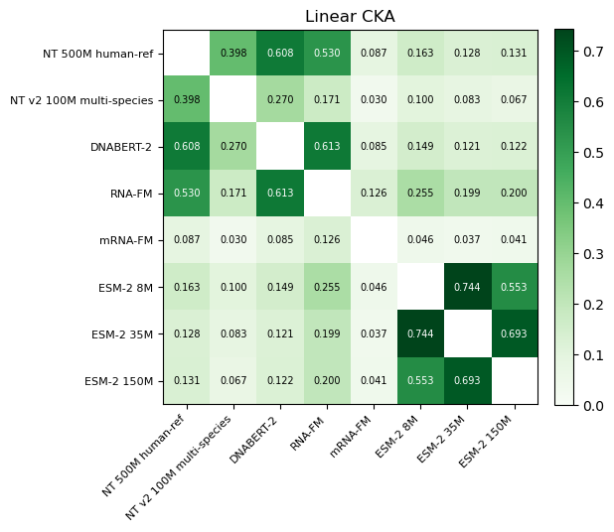
TRACK B · CROSS-MODAL GEOMETRY
Agreement follows tokenization more than modality
Encoder pairs | Linear CKA | Mutual k-NN | Recall@1
Within protein | 0.553 to 0.744 | 0.297 to 0.443 | 94 to 97%
Within DNA | 0.270 to 0.608 | 0.152 to 0.201 | 70 to 78%
DNA with RNA-FM | 0.171 to 0.613 | 0.106 to 0.138 | 55 to 61%
RNA-FM with mRNA-FM | 0.126 | 0.081 | 32%
mRNA-FM with DNA | 0.030 to 0.087 | 0.078 to 0.093 | 39 to 49%
mRNA-FM with protein | 0.037 to 0.046 | 0.093 to 0.113 | 46 to 49%
DNA or RNA-FM with protein | 0.067 to 0.255 | 0.058 to 0.082 | 22 to 58%
NT 500M, DNABERT-2 and RNA-FM agree whatever their modality label. mRNA-FM, reading codons, agrees globally with no one, yet finds a sequence's protein partner about half the time.
Ranges over the pairs in each group. Chance: k-NN 0.010, Recall@1 0.34% (295 held-out rows). CCA's first canonical correlation is 0.91 to 0.99 for every pair.
Notes:
The ESM-2 models, which share architecture and training data, agree most. Among nucleotide encoders, tokenization matters more than the DNA or RNA label: NT 500M, DNABERT-2 and RNA-FM organize sequences similarly, while the two NT models agree only moderately despite sharing a tokenizer. mRNA-FM has the lowest CKA with everyone, including RNA-FM, but after fitting CCA it retrieves its protein partner as often as any nucleotide encoder except NT v2. Layer-wise, the highest agreement sits in early layers; mRNA-FM's early layers resemble the protein encoders' early layers (CKA 0.65 to 0.69) while its final layers agree least. RSA ranks pairs much like CKA, and the Mantel test is significant for every pair except mRNA-FM with ESM-2 150M (p = 0.056).

Slide 6
TRACK B · COMPOSITION CONTROL
Most nucleotide agreement is composition
Share of each embedding explained by GC, GC3, length, 64 codon and 20 amino-acid frequencies (chance about 9%):
Encoder pairs | CKA before | CKA after | Recall@1 before | Recall@1 after
Within protein | 0.553 to 0.744 | 0.376 to 0.643 | 94 to 97% | 67 to 87%
Within DNA | 0.270 to 0.608 | 0.038 to 0.113 | 70 to 78% | 6 to 12%
DNA with RNA-FM | 0.171 to 0.613 | 0.044 to 0.164 | 55 to 61% | 9 to 11%
mRNA-FM with protein | 0.037 to 0.046 | 0.021 to 0.028 | 46 to 49% | 8 to 10%
DNA or RNA-FM with protein | 0.067 to 0.255 | 0.013 to 0.085 | 22 to 58% | 2 to 5%
Removing composition cuts CKA by 38% to 90% for every pair with a nucleotide encoder. Agreement among the protein encoders survives, and mRNA-FM keeps the most protein correspondence: 23 to 30 times chance in retrieval.
Linear residualization on 87 standardized composition features, all 981 rows; same PCA-CCA pipeline and held-out rows as the retrieval test.
Notes:
Letter, codon and amino-acid frequencies alone explain 61 to 80 percent of the DNA embeddings and of RNA-FM's, and 44 to 48 percent of the protein embeddings. mRNA-FM is the exception at 30 percent. Regressing composition out removes most agreement involving a nucleotide encoder, while the three ESM-2 models still agree strongly because they share far more than amino-acid counts. The pairing that keeps the most is mRNA-FM with a protein encoder, still 8 to 10 percent Recall@1. The control is linear, so nonlinear composition could still sit in what survives.

Slide 7
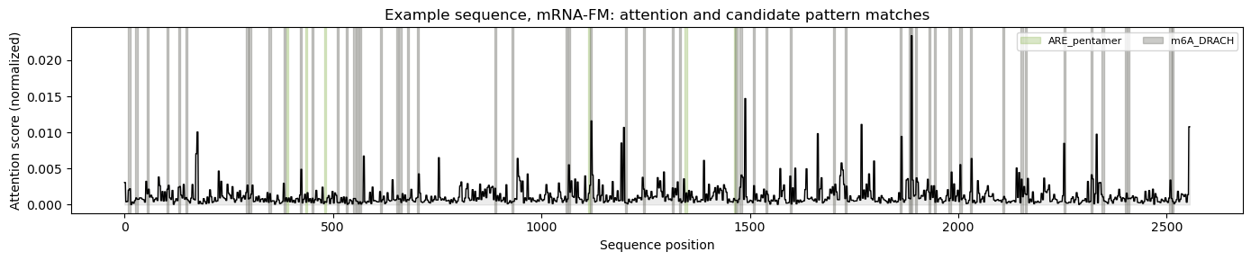
TRACK C · ATTENTION AND DIAGNOSTICS
Attention hints need stronger controls
Motif test, 100 sequences
Alignment vs. error
Nominal p < 0.05 at ARE and m6A matches: NT 500M 7%, RNA-FM 9%, NT v2 15%, mRNA-FM 93% (chance 5%). mRNA-FM's mean gap is only +0.0015; NT v2 attends most to the sequence start.
Spearman ρ from −0.156 to +0.117 across the 28 pairs. Five are nominally below 0.05; none survives the correction for 28 pairs (0.0018).
Plot: mRNA-FM on one example sequence (2,556 nt). DNABERT-2 returns no attention weights. Coding sequence only, so UTR-enriched motifs are under-represented.
Notes:
NT 500M and RNA-FM show no extra attention at AU-rich elements or m6A sites: their pass rates are near chance and their gaps slightly negative. Two encoders depart from chance, and both need controls before any biological reading. NT v2 gives more attention to ARE matches in 14 of 41 sequences, but its attention is highest over the first 200 or so nucleotides, so position alone can produce this. mRNA-FM passes in 93 of 100 sequences, almost all through DRACH matches, but the shift is tiny, and DRACH matches constrain which codons they overlap. The next test is a null that keeps position or codon composition. Per-sample alignment does not predict prediction error for any pair.

Slide 8
DEFINING ALIGNMENT
What Stage 1 means for alignment
Raw similarity is a weak target
Encoders are not interchangeable
Composition alone reproduces most agreement involving a nucleotide encoder. Every alignment claim should report agreement before and after a composition control.
RNA-FM and mRNA-FM agree less (CKA 0.126) than many DNA, RNA and protein pairs. Tokenization shapes the geometry as much as modality does.
No explicit alignment loss
A clear first candidate for fusion
Per-sequence alignment does not predict error for any of the 28 pairs. The fusion model should learn any useful interaction itself.
mRNA-FM with a protein encoder is the only pairing whose linear concatenation gains 0.01 or more on every fold split. Fusion must beat ESM-2 150M alone (R² 0.144) and concatenation plus MLP.
Notes:
Four takeaways. First, raw similarity between frozen pooled embeddings is a weak alignment target, because counts reproduce most of it. Second, encoders of one modality are not interchangeable; tokenization shapes their geometry. Third, alignment does not track prediction error, so we propose no explicit alignment loss in Stage 2. Fourth, mRNA-FM with a protein encoder is the pairing to test first in fusion, and any fusion model has to beat ESM-2 150M alone and the concatenation plus MLP baseline.

Slide 9
NEXT STEPS
Next steps and open questions
Next steps
Open questions
Add IsoFormer's GTEx data, where DNA is a distinct input: a new loader and dataset setting
Test the NT v2 and mRNA-FM attention results against positional and codon-composition nulls
Reproduce BioLangFusion's single-encoder and fusion baselines on the official split
Confirm the dataset version: this CSV has 65,356 rows vs. BioLangFusion's 41,123
Is the agreement that survives the control shared biology, or nonlinear composition?
What does mRNA-FM's codon view add that the protein encoders lack?
Stability as the Stage 4 benchmark, or alongside IsoFormer's GTEx task?
Build a deduplicated, sequence-disjoint split before scaling up?
Fusion candidates: Coupled Mamba first, then IsoFormer-style cross-attention; concatenation plus MLP as the baseline.
Notes:
Next is IsoFormer's GTEx data, where DNA carries promoter context the protein lacks; that needs a loader and support for rows with separate DNA, transcript and protein inputs. The NT v2 and mRNA-FM attention results need positional and codon-composition nulls. The audit shows our CSV is not the version BioLangFusion used and its supplied splits overlap, so we need a clean split before benchmarking. Questions for Mina: what the surviving agreement means, what mRNA-FM's codon view adds, which benchmark to commit to, and whether to build the deduplicated split first.

