Slide 1
multimodal-bio-fusion · Meeting with Mina Basirat · November 7, 2026 · since the October 27 discussion
Progress since October 27: completed swaps, clearer comparisons, and the next tests
The seed-0 encoder grid is complete. We can now separate the value of a stronger encoder, the value of combining inputs, and the value of the fusion operation. Code repairs make the next comparisons safer to run; the next dataset should test a stated expectation.
Completed
All eight stability replacements; paired comparisons
Prepared
Matched probes; reliable reading and reuse
For discussion
Compute, dataset choice and the paper’s contribution
Julian McKinley and Chase Di Maria Breisinger | MSDA AI Track, UCF | Previous results are retained and labeled; new work is distinguished in the notes
Notes:
This is an update of the presentation used on October 27, although that file is named October 22. Start with what is new: completing stability seed-0 coverage, comparing retained predictions under explicit reference rules, repairing execution and evaluation boundaries, and preparing focused probes. The evidence does not yet establish a general biological rule for fusion. We retain the familiar comparison graphics and exact tables so the meeting can examine all cases rather than selected successes.
Sources
D:/academic/UCF/2026_fall/Capstone Project CAP6942/Research/genomics-multimodal-fusion/docs/notes/Progress_Since_2026-10-27.md
D:\academic\UCF\2026_fall\Capstone Project CAP6942\Research\genomics-multimodal-fusion\Code\stage4\results\phaseB\analyses\paired-report-v1\fungal_expression__d2173df49ec55ed37414.json
D:\academic\UCF\2026_fall\Capstone Project CAP6942\Research\genomics-multimodal-fusion\Code\stage4\results\phaseB\analyses\paired-report-v1\cov_vac_degradation__9c0f130491382c1bc2ad.json
D:\academic\UCF\2026_fall\Capstone Project CAP6942\Research\genomics-multimodal-fusion\Code\stage4\results\phaseB\analyses\paired-report-v1\ecoli_proteins__e9027c8e90be4c415cb3.json
D:\academic\UCF\2026_fall\Capstone Project CAP6942\Research\genomics-multimodal-fusion\Code\stage4\results\phaseB\analyses\paired-report-v1\mrna_stability__d703113ac8fcdabfd4bd.json

Slide 2
Since October 27 · coverage of the configured replacement encoders
The missing stability swaps are complete at seed 0
What changed
Five stability replacements are newly complete.
The other three benchmarks were already complete at seed 0.
Seeds 1 and 2 remain incomplete.
Next: the complete encoder and fusion comparisons, using the same benchmark order and color meanings as the previous presentation.
Notes:
Coverage means each of the eight configured replacement encoders has its requested seed-0 fits, not that all scientific follow-ups or training repeats are complete. The newly completed stability replacements are NT 500M, HyenaDNA, RiNALMo, ESM-2 35M and ProtBERT. Four saved reports were produced November 6. Three contain 72 stored per-seed contrasts; fungal contains 66 because six native-single replacement contrasts lack historical original prediction arrays. All fusion-versus-selected-single and method-versus-concat contrasts are present. This corrects the earlier blanket statement that every report had 72. No fits are repeated to recover missing arrays.
Sources
D:/academic/UCF/2026_fall/Capstone Project CAP6942/Research/genomics-multimodal-fusion/Code/stage4/tier2_encoder_swaps.ipynb
D:\academic\UCF\2026_fall\Capstone Project CAP6942\Research\genomics-multimodal-fusion\Code\stage4\results\phaseB\analyses\paired-report-v1\fungal_expression__d2173df49ec55ed37414.json
D:\academic\UCF\2026_fall\Capstone Project CAP6942\Research\genomics-multimodal-fusion\Code\stage4\results\phaseB\analyses\paired-report-v1\cov_vac_degradation__9c0f130491382c1bc2ad.json
D:\academic\UCF\2026_fall\Capstone Project CAP6942\Research\genomics-multimodal-fusion\Code\stage4\results\phaseB\analyses\paired-report-v1\ecoli_proteins__e9027c8e90be4c415cb3.json
D:\academic\UCF\2026_fall\Capstone Project CAP6942\Research\genomics-multimodal-fusion\Code\stage4\results\phaseB\analyses\paired-report-v1\mrna_stability__d703113ac8fcdabfd4bd.json

Slide 3
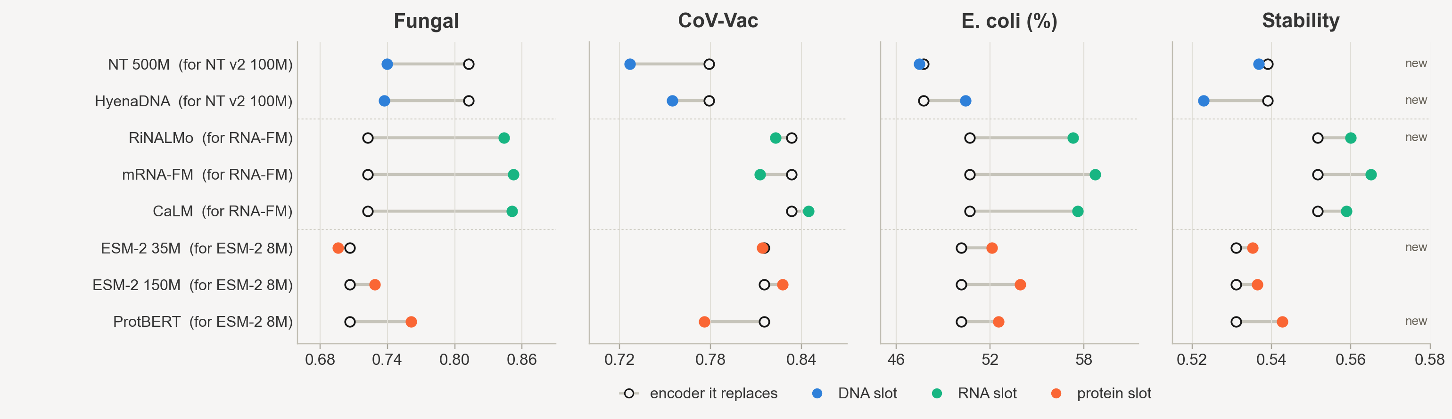
Phase B · the encoder question · complete seed-0 coverage
The strongest replacement depends on the task; all eight stability singles are now visible
Swapped in, alone (replaces) | NT 500M | HyenaDNA | RiNALMo | mRNA-FM | CaLM | ESM-2 35M | ESM-2 150M | ProtBERT
Fungal | 0.740 (0.813) | 0.737 (0.813) | 0.844 (0.722) | 0.852 (0.722) | 0.851 (0.722) | 0.696 (0.706) | 0.729 (0.706) | 0.761 (0.706)
CoV-Vac | 0.727 (0.779) | 0.755 (0.779) | 0.823 (0.833) | 0.812 (0.833) | 0.844 (0.833) | 0.814 (0.815) | 0.827 (0.815) | 0.776 (0.815)
E. coli (%) | 47.5 (47.8) | 50.4 (47.8) | 57.3 (50.7) | 58.7 (50.7) | 57.6 (50.7) | 52.1 (50.1) | 53.9 (50.1) | 52.5 (50.1)
Stability | 0.537 (0.539) | 0.523 (0.539) | 0.560 (0.552) | 0.565 (0.552) | 0.559 (0.552) | 0.535 (0.531) | 0.536 (0.531) | 0.543 (0.531)
Filled: replacement read alone; open: replaced encoder. Parentheses show the reference. Seed 0; E. coli accuracy %, others Spearman. “New” marks the five added stability cases. Fungal RNA/protein reference intervals are unavailable; the protein reference is corrected to the verified 0.706 source.
Notes:
Read across all four panels before selecting examples. RNA replacements have large gains on fungal expression and E. coli, but not the same ordering or size on stability and CoV-Vac. This is descriptive performance of each replacement alone, not the best constituent selected within its fusion triple. The table preserves the old layout and completes the five missing stability entries. Native-single scores and references are copied from current report values or the exact source fit JSONs whose hashes match the report identity. Six fungal replacement contrasts cannot be bootstrapped because original native RNA/protein fallback files lack targets/predictions. Their aggregate scores remain readable; we do not invent intervals or rerun them. The fungal original protein reference is 0.706285 in the verified report source, whereas the old slide displayed 0.698. This is a reference correction, not a new fit or change to the saved result. The next slide asks whether fusion improves on a constituent selected by validation.
Sources
D:\academic\UCF\2026_fall\Capstone Project CAP6942\Research\genomics-multimodal-fusion\Code\stage4\results\phaseB\analyses\paired-report-v1\fungal_expression__d2173df49ec55ed37414.json
D:\academic\UCF\2026_fall\Capstone Project CAP6942\Research\genomics-multimodal-fusion\Code\stage4\results\phaseB\analyses\paired-report-v1\cov_vac_degradation__9c0f130491382c1bc2ad.json
D:\academic\UCF\2026_fall\Capstone Project CAP6942\Research\genomics-multimodal-fusion\Code\stage4\results\phaseB\analyses\paired-report-v1\ecoli_proteins__e9027c8e90be4c415cb3.json
D:\academic\UCF\2026_fall\Capstone Project CAP6942\Research\genomics-multimodal-fusion\Code\stage4\results\phaseB\analyses\paired-report-v1\mrna_stability__d703113ac8fcdabfd4bd.json

Slide 4
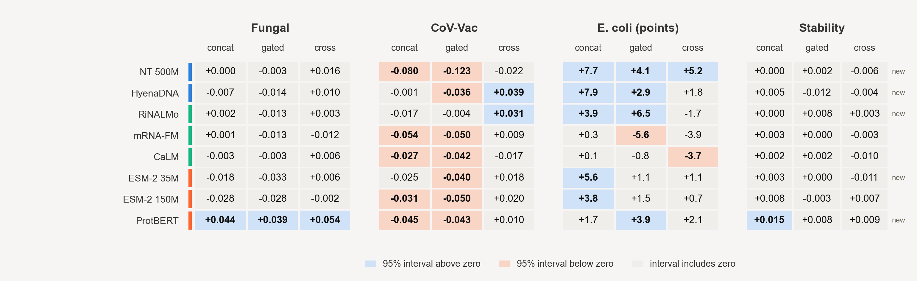
Phase B · the fusion question · all 96 head-versus-single comparisons
Fusion gains depend on the task and reference; a stronger single can account for an apparent gain
Illustrative comparison | Benchmark | Head | Gain (95% interval) | Score reached
HyenaDNA replacement | CoV-Vac | Cross | +0.039 [0.012, 0.066] | 0.872
RiNALMo replacement | E. coli | Gated MIL | +6.46 pp [3.37, 9.55] | 62.50%
mRNA-FM replacement | Fungal | Concat | +0.001 [−0.014, 0.016] | 0.853; single 0.852
ProtBERT replacement | Stability | Concat | +0.015 [0.002, 0.028] | 0.558; original concat 0.558
Each cell is head − validation-selected single in that encoder triple. Blue/peach: 95% interval excludes zero; gray: includes zero, not equivalence. All 96 comparisons are shown: 16 above, 14 below, 66 spanning zero. Seed 0; unadjusted. These are exploratory comparisons, not independent confirmations.
Notes:
All updated swap grids use retained seed-0 fits. Intervals are the stored 95% intervals from 2,000 paired exact-sequence-group bootstrap draws, conditional on the fitted model and unadjusted for multiple comparisons. They do not quantify training-seed variability, establish equivalence when crossing zero, or remove training/test overlap. Seeds 1 and 2 are incomplete. The selected single can be a native or codon-grid control; it is named in the complete score tables in the appendix. The matrix preserves every replacement instead of selecting favorable examples. The original-encoder difference row from the old slide is not merged into this updated grid because its reference/analysis procedure differs. Its absolute head scores are retained in the appendix, and Phase A remains a separate reference. Positive cells do not imply that a configuration beats the strongest encoder across every replacement. In particular, fungal ProtBERT fusion is below mRNA-FM alone. Stability ProtBERT concat beats its selected single yet essentially matches original concat. The table is illustrative; the full matrix and appendix define the comparison set.
Sources
D:\academic\UCF\2026_fall\Capstone Project CAP6942\Research\genomics-multimodal-fusion\Code\stage4\results\phaseB\analyses\paired-report-v1\fungal_expression__d2173df49ec55ed37414.json
D:\academic\UCF\2026_fall\Capstone Project CAP6942\Research\genomics-multimodal-fusion\Code\stage4\results\phaseB\analyses\paired-report-v1\cov_vac_degradation__9c0f130491382c1bc2ad.json
D:\academic\UCF\2026_fall\Capstone Project CAP6942\Research\genomics-multimodal-fusion\Code\stage4\results\phaseB\analyses\paired-report-v1\ecoli_proteins__e9027c8e90be4c415cb3.json
D:\academic\UCF\2026_fall\Capstone Project CAP6942\Research\genomics-multimodal-fusion\Code\stage4\results\phaseB\analyses\paired-report-v1\mrna_stability__d703113ac8fcdabfd4bd.json

Slide 5
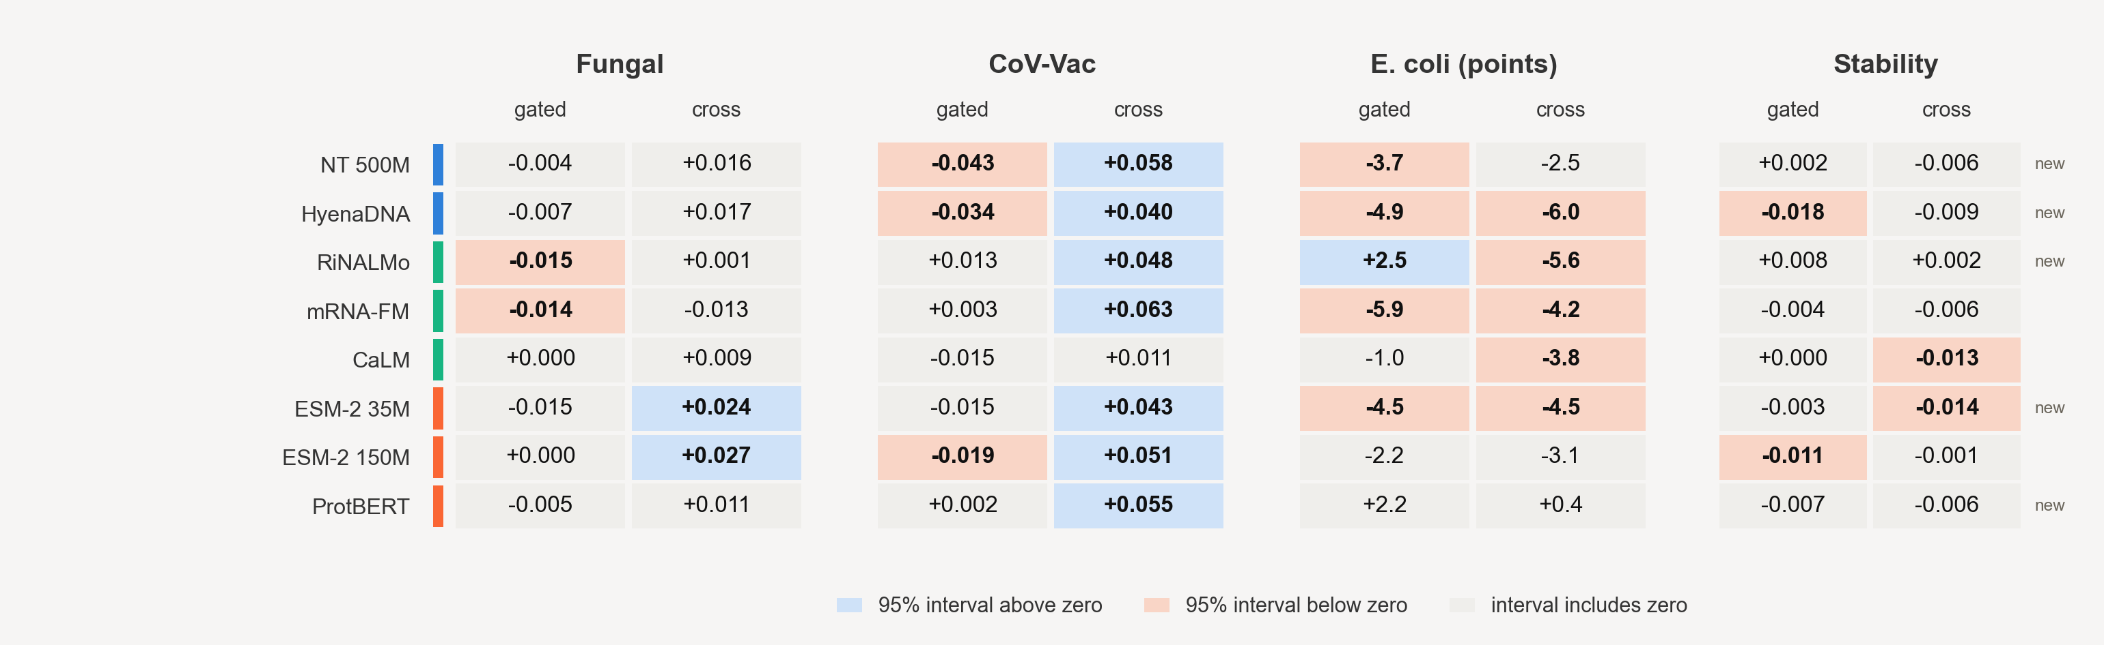
New paired analysis · the operation question
Does gating or cross-attention improve on concatenation of the same inputs?
CoV-Vac
E. coli and fungal
Stability
Cross > concat in 7/8 swaps; only 2/8 also clear the selected single.
Gating helps RiNALMo in E. coli. Two fungal cross gains still do not clear their singles.
None of the 16 method intervals is wholly above zero.
Same stored interval procedure as the preceding grid. A configuration gain cannot be attributed to attention alone: projections, normalization and residual paths also differ.
Notes:
All updated swap grids use retained seed-0 fits. Intervals are the stored 95% intervals from 2,000 paired exact-sequence-group bootstrap draws, conditional on the fitted model and unadjusted for multiple comparisons. They do not quantify training-seed variability, establish equivalence when crossing zero, or remove training/test overlap. Seeds 1 and 2 are incomplete. This is the genuinely new matched operation comparison: each head is compared with concat under the same encoder replacement. Seven of eight CoV-Vac cross configurations beat their concat counterparts under the stored intervals, but only HyenaDNA and RiNALMo also beat the selected single. On fungal, ESM-2 35M and 150M cross exceed concat while not establishing gain over the selected single. In E. coli only RiNALMo MIL has a positive method interval excluding zero. None of the sixteen stability intervals does. Across all64 comparisons there are10 above zero,18 below and36 including zero. This distinction is more informative than saying combination sometimes helps: architecture should be justified against both a strong single and same-input simple fusion.
Sources
D:\academic\UCF\2026_fall\Capstone Project CAP6942\Research\genomics-multimodal-fusion\Code\stage4\results\phaseB\analyses\paired-report-v1\fungal_expression__d2173df49ec55ed37414.json
D:\academic\UCF\2026_fall\Capstone Project CAP6942\Research\genomics-multimodal-fusion\Code\stage4\results\phaseB\analyses\paired-report-v1\cov_vac_degradation__9c0f130491382c1bc2ad.json
D:\academic\UCF\2026_fall\Capstone Project CAP6942\Research\genomics-multimodal-fusion\Code\stage4\results\phaseB\analyses\paired-report-v1\ecoli_proteins__e9027c8e90be4c415cb3.json
D:\academic\UCF\2026_fall\Capstone Project CAP6942\Research\genomics-multimodal-fusion\Code\stage4\results\phaseB\analyses\paired-report-v1\mrna_stability__d703113ac8fcdabfd4bd.json

Slide 6
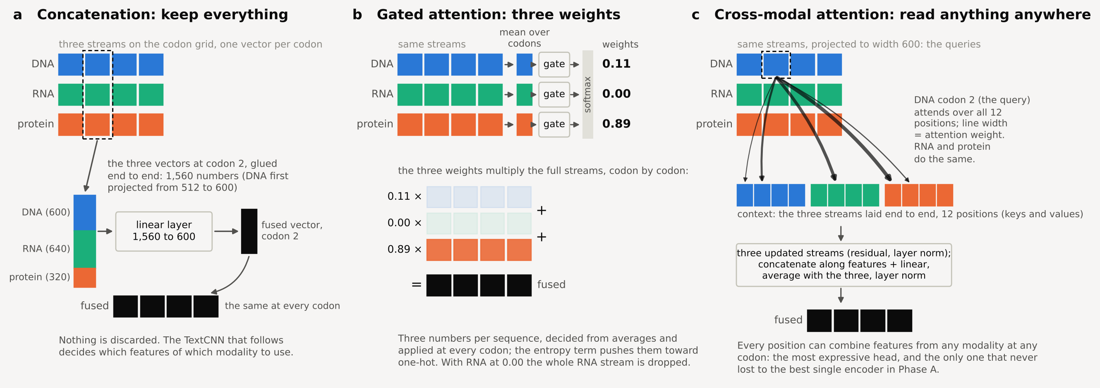
BioLangFusion reminder · original operations and measured Phase A gates
The same three heads test feature joining, sequence-level weighting and cross-token interaction
Measured gated weights | Entropy weight | DNA | RNA | Protein
Fungal | 0.01 | 0.20 / 0.16 / 0.14 | 0.20 / 0.25 / 0.26 | 0.61 / 0.59 / 0.60
CoV-Vac | 0.01 | 0.83 / 0.92 / 0.94 | 0.01 / 0.03 / 0.00 | 0.16 / 0.05 / 0.06
E. coli | 0.01 | 0.11 / 0.18 / 0.10 | 0.00 | 0.89 / 0.82 / 0.90
Stability | 0.01 | 0.28 | 0.00 | 0.71
Higher entropy weight | 0.5 or 1.0 | One input takes 1.00*
Previously presented test means; seeds 0/1/2 where shown. Gates weight the whole sequence, not individual codons. *At higher entropy weight, one input takes 1.00 and the others 0.00, except fungal at 0.5: DNA/RNA/protein = 0.00/0.28/0.72. These weights do not identify the biological cause of a score.
Notes:
Retain this familiar diagram as a reminder for interpreting the two preceding matrices. Concatenation joins aligned feature channels. The MIL head calculates sequence-level modality weights from pooled representations and applies them across positions. Cross-attention reads from the joint token context, with additional projections, residual paths and normalization. The gate table is the previously presented Phase A evidence, not newly measured swap weights. A concentrated gate does not prove that the discarded input contains no useful biology, or that optimization necessarily took an easier protein shortcut. Those remain hypotheses requiring controlled tests.
Sources
D:/academic/UCF/2026_fall/Capstone Project CAP6942/Research/genomics-multimodal-fusion/Code/shared_code/fusion/heads.py
D:/academic/UCF/2026_fall/Capstone Project CAP6942/Research/genomics-multimodal-fusion/docs/notes/Slides/Mina_Progress_Slides_2026-10-22.pptx

Slide 7
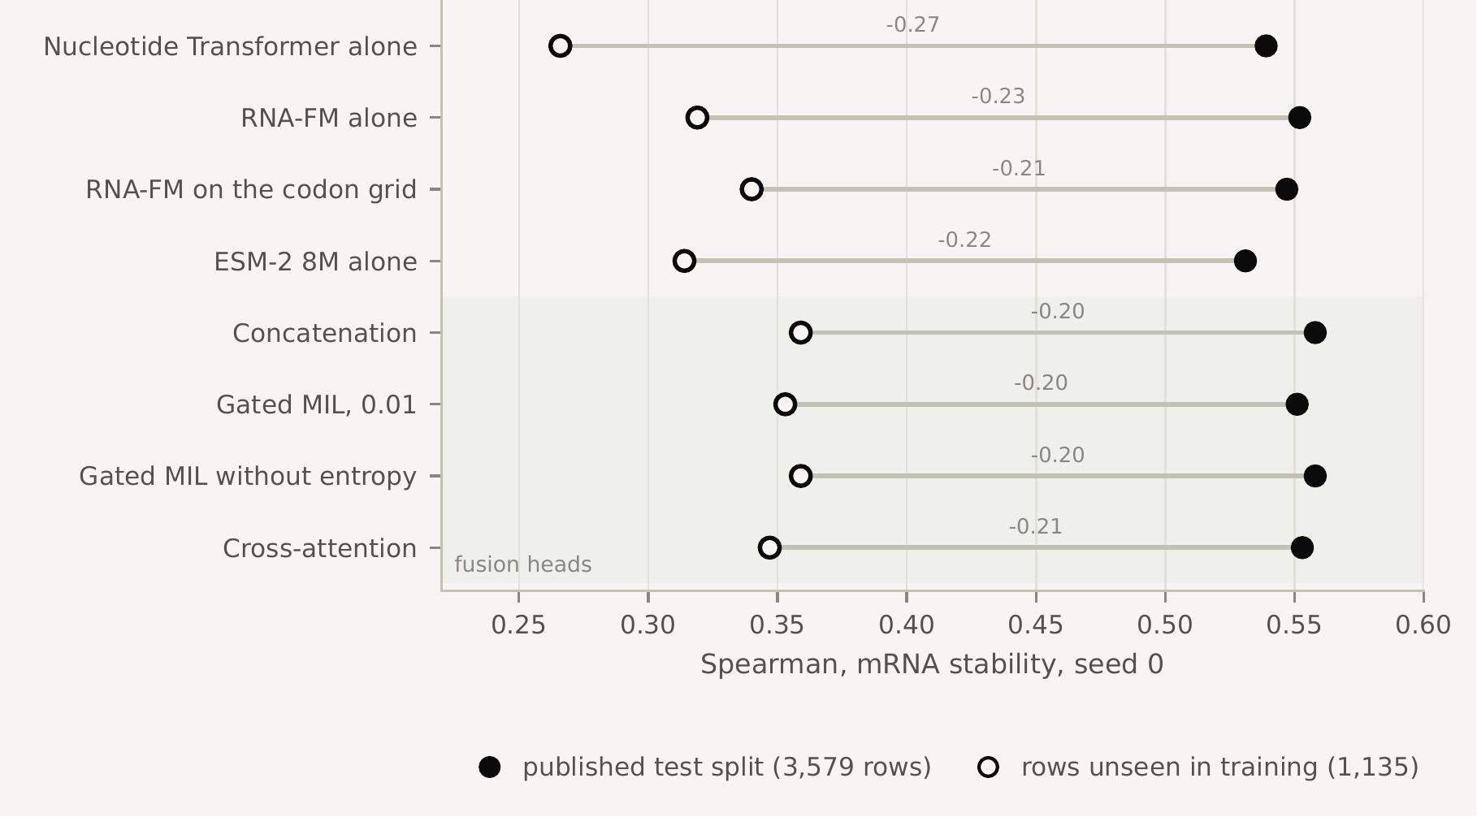
Stability · the known overlap now has a clearer target interpretation
The supplied split repeats whole sequences across partitions; it does not test only unseen sequences
2,444 / 3,579
Test rows reuse a training sequence. The source combines nine species/cell/assay profiles; the same sequence can have different context-dependent scores. The released CSV omits profile IDs.
1,135 unseen
The old diagnostic rescored these same models on unseen-sequence rows. Scores are lower, but the evaluated population also changes: this does not identify a causal “memorization penalty.”
Keep the supplied split for comparison with the published benchmark, with this limitation stated. A separately defined sequence-, family-, condition- or species-held-out test asks a different question. Grouped bootstrap handles repeated test rows; it does not remove training exposure.
Notes:
This issue was already presented October27 and is not a new discovery. The source trace explains why identical coding sequences may carry different targets: the source includes nine experimental profiles, and decay slopes were harmonized and standardized within profile. Cellular context can differ; the released file omits those identifiers. We cannot assign a specific profile to every duplicated local row from the four-column release. Exact full-input reuse across training and test prevents describing the supplied split as an unseen-sequence test. Ordinary shared codons do not constitute this overlap. 2,360/3,608 validation rows also reuse a training sequence. The retained plot scores the same historical fitted models on the full test population and the1,135-row unseen subset. That is a diagnostic association, not a controlled estimate of the causal impact of overlap, because the population changes too. Repeats and bootstrap do not repair it. Preserve the published-split evidence and agree a distinct biological generalization claim before a new split.
Sources
D:/academic/UCF/2026_fall/Capstone Project CAP6942/Research/genomics-multimodal-fusion/docs/methods/data-and-targets.md#mrna-stability-standardized-decay-profiles
D:/academic/UCF/2026_fall/Capstone Project CAP6942/Research/genomics-multimodal-fusion/Code/stage3/01_blf_datasets.ipynb

Slide 8
Code changes since October 27 · problems addressed
Reading, continuation and evaluation now have explicit checks
What could go wrong | Change made | Practical consequence
Readers mix recipes, seeds or modalities | Explicit identity and coverage checks | Missing work is visible; incompatible results are not averaged.
Run All starts expensive or duplicate work | Reading mode; separate missing-work plan | Completed results are preserved; new fits require explicit execution mode.
Malformed inputs or impossible best epoch pass | Full-transcript gate; epoch bound repair | Fail before expensive work; valid experiment settings stay the same.
A filename looks reusable despite changed data | Input/split/cache/settings identities; recovery checks | New runs reject mismatched reuse and retain their producer details.
A stronger encoder looks like better fusion | Separate replacement, combination and method contrasts | The complete result grids answer three different questions.
Verified with 504 automated software tests; completed research artifacts were preserved.
These checks establish software behavior on tested cases. They do not supply missing historical provenance or demonstrate biological validity.
Notes:
These are concrete preparation changes, not new research fits. November2 reader repair distinguishes six canonical IsoFormer modality records, accepts explicitly supported legacy naming, and checks duplicate/missing entries. Reading mode was added across the six Stage4 notebooks; encoder swaps additionally plans only missing requested fits and same-seed references. November5 repaired the full-transcript input gate and zero-based best-epoch validation, with cohort checks before subsequent producers and input-bound in-memory handoffs. New fit identities and recovery checks cover ordered inputs, targets, partitions, cache evidence and effective model/loader settings, while host and software details are separate producer evidence. November6 added the matched saved-prediction reports and cache-only ridge routes. Synthetic tests validate these boundaries. They are not504 training experiments, and earlier memory-loading fixes are not counted as new this week without a dated record.
Sources
D:/academic/UCF/2026_fall/Capstone Project CAP6942/Research/genomics-multimodal-fusion/Code/stage4/RUNBOOK.md#concrete-repair-list
D:/academic/UCF/2026_fall/Capstone Project CAP6942/Research/genomics-multimodal-fusion/docs/run-records.md
D:/academic/UCF/2026_fall/Capstone Project CAP6942/Research/genomics-multimodal-fusion/tests/README.md

Slide 9
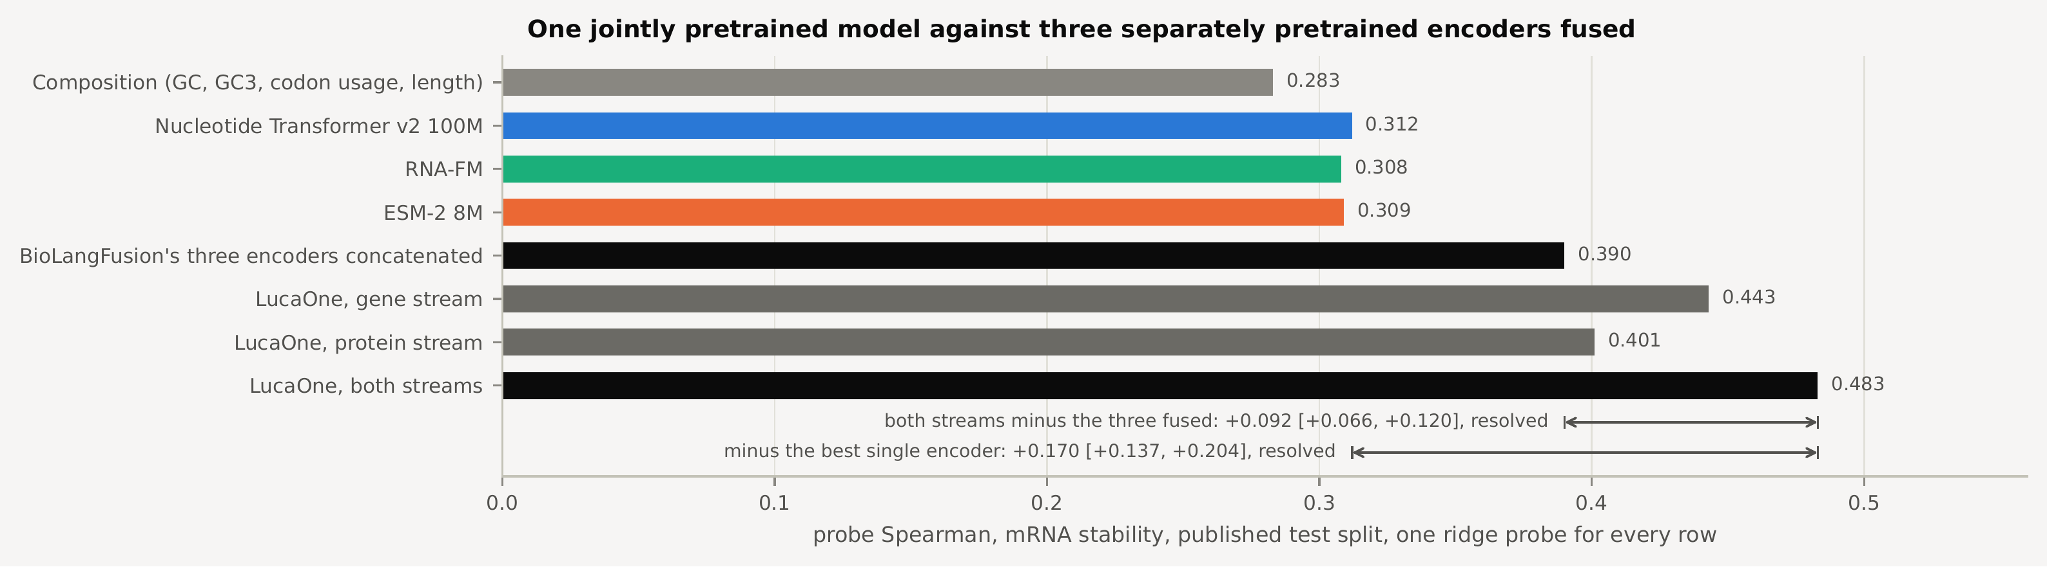
LucaOne · retained result, with a more precise next comparison
The earlier LucaOne gain motivates a matched gene-versus-protein-versus-combined test
Previously presented: LucaOne both streams 0.483 versus pooled BioLangFusion concat 0.390. This changes the encoder family and model size; it does not isolate the benefit of combining LucaOne’s own streams. Prepared, not yet run: gene alone, protein alone and their concatenation with validation-selected ridge penalties on the same partitions. The supplied stability overlap remains.
Notes:
The historical graphic is retained. It compares frozen pooled representations under ridge probes, not the trained token-level BioLangFusion head. LucaOne as loaded is substantially larger than the three original encoders combined. The earlier strongest-single reference was selected by test score, so it is not equivalent to the current validation-selected swap references. The new focused route compares fixed gene-only, protein-only and combined LucaOne inputs with the same supplied partitions and validation-based penalty selection. It reads existing caches and writes a new result identity; it is implemented and synthetically checked but has no completed research artifact. No new extraction is needed if compatible caches exist. Runtime and peak RAM remain unmeasured. Expansion to other benchmarks is a separate decision.
Sources
D:/academic/UCF/2026_fall/Capstone Project CAP6942/Research/genomics-multimodal-fusion/Code/stage4/RUNBOOK.md#run-focused-reports-and-cpu-probes
D:/academic/UCF/2026_fall/Capstone Project CAP6942/Research/genomics-multimodal-fusion/Code/shared_code/matched_probes.py

Slide 10
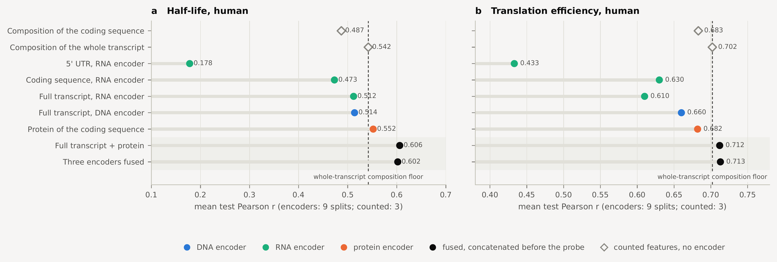
Full-transcript half-life and TE · retained table, matched follow-up prepared
The earlier full-transcript gains need matched partitions and paired comparisons
Representation | Half-life (r) | Translation efficiency (r)
Composition of the coding sequence (no encoder) | 0.487 | 0.683
Composition of the whole transcript (no encoder) | 0.542 | 0.702
5' UTR, RNA encoder | 0.178 | 0.433
Coding sequence, RNA encoder | 0.473 | 0.630
Full transcript, RNA encoder | 0.512 | 0.610
Full transcript, DNA encoder | 0.514 | 0.660
Protein of the coding sequence | 0.552 | 0.682
Full transcript + protein | 0.606 | 0.712
Three encoders fused | 0.602 | 0.713
Historical means: RNA + protein exceeds the best single by 0.053 / 0.030. Those differences have no matched paired interval yet.
Prepared: RNA, protein, concat and composition on the same nine actual grouped assignments, with validation-only penalty selection.
Half-life asks about RNA persistence; TE here is RNA-adjusted ribosome occupancy, not lifetime protein yield.
Human results retained. New matched probes have not run; mouse completion is not established by the inspected records.
Notes:
The original table and plot remain as historical evidence; no means have been recomputed. Encoder results used nine grouped assignments while historical composition controls used three. The new calculation matches the actual partitions and applies training-only scaling during validation-based ridge selection, then refits on train plus validation. It will retain predictions for paired comparisons. This is a separate analysis rather than a correction silently applied to old results. Full-transcript composition is a strong reference, especially for TE. Half-life and translation efficiency are distinct: longer persistence can permit more translation events without increasing the translation rate. Here the supplied half-life target is a standardized consensus and the TE target is an RNA-abundance-adjusted ribosome-occupancy measure. A biological hypothesis needs this target definition, not only the task name.
Sources
D:/academic/UCF/2026_fall/Capstone Project CAP6942/Research/genomics-multimodal-fusion/docs/methods/data-and-targets.md
D:/academic/UCF/2026_fall/Capstone Project CAP6942/Research/genomics-multimodal-fusion/Code/stage4/RUNBOOK.md#run-focused-reports-and-cpu-probes

Slide 11
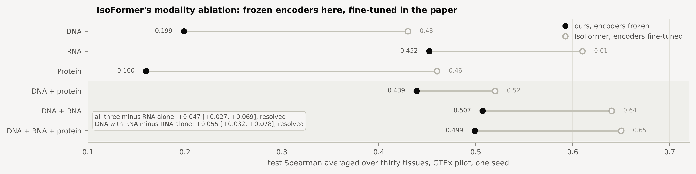
GTEx / IsoFormer · retained pilot and paper context, not a matched reproduction
The GTEx pilot motivates understanding the fusion block, rather than a full replication
Modalities | Our frozen pilot (seed 0) | Paper context (unmatched)
DNA (6,000-nt genomic window) | 0.199 | 0.43
RNA (transcript) | 0.452 | 0.61
Protein | 0.160 | 0.46
DNA + protein | 0.439 | 0.52
DNA + RNA | 0.507 | 0.64
DNA + RNA + protein | 0.499 | 0.65
What the pilot supports: adding genomic context improves on RNA alone in this retained cohort. What it cannot isolate: the cause of the gap to the paper, or why fusion helps. Encoder identity, sequence context, cohort, normalization and training differ. The next question is a matched block comparison on the same frozen inputs—not an assumed benefit from fine-tuning.
Notes:
The six-modality table and plot are the earlier pilot, not new GTEx runs. The local metric is mean per-tissue test Spearman across30 tissues. The paper column is context and does not establish a controlled frozen-versus-fine-tuned contrast. The prior claim that the gap measures the cost of freezing was too strong. The paper studies NT-based configurations, while the released reference we inspected uses Enformer DNA features. Cohort, normalization, batch size, context and training differ too. Genomic context and untranslated RNA regions can add inputs beyond the CDS; translating a CDS gives a derived representation rather than an independent molecule’s measurement. The proposed next comparison holds the frozen inputs and evaluation fixed while testing what the local interaction block adds beyond pooling/concatenation. It remains a proposal, not implemented or run. Fuller replication is deferred.
Sources
D:/academic/UCF/2026_fall/Capstone Project CAP6942/Research/genomics-multimodal-fusion/Code/stage4/RUNBOOK.md#isoformer-reproduction-specification
D:/academic/UCF/2026_fall/Capstone Project CAP6942/Research/genomics-multimodal-fusion/Code/stage4/RUNBOOK.md#current-investigation-scope

Slide 12
Chase’s IsoFormer work · preparation and interpretation
The source review and cache repairs narrow what should be tested next
Area | What changed | Status / remaining limit
Paper → released code → local pilot | Mapped Enformer/NT, pooling, masks, normalization and training differences | Method understanding documented; not an exact reproduction.
Result reader | Keeps six modality configurations distinct; checks seeds and recipe | Historical scores can be read without conflating configurations.
GTEx cache reuse | Fresh metadata used automatically; scoped record only for the inspected old caches | No re-embedding. Historical seed-0 producer linkage still unproven.
Scope of the next experiment | Full replication deferred; same-input attention/block comparison proposed | Control design and compute still need agreement; no new GTEx fit.
Keep the useful method investigation; spend compute on the comparison that answers a question.
The local notebook remains a frozen pilot and LucaOne workflow. Recovery records do not turn it into the released model’s full training pipeline.
Notes:
This is Chase’s continuing IsoFormer work, supported by the dated source review and code repairs. The initial paper-based NT reproduction proposal was replaced by the released Enformer reference, then the project direction was narrowed to understanding the method and focused comparisons. Unsupported30-epoch and five-patience proposals were withdrawn, not treated as paper settings. The cache recovery record checks only the exact historical GTEx files reconstructed and reviewed. Fresh caches use their own metadata; malformed or mismatched modern metadata cannot fall back to the legacy path. This preserves caches and avoids recomputing embeddings, but it cannot prove which matrices an undocumented old fit used. The next attention/block comparison needs a concrete control and isolated destination. New GTEx training has not begun.
Sources
D:/academic/UCF/2026_fall/Capstone Project CAP6942/Research/genomics-multimodal-fusion/Code/stage4/RUNBOOK.md#released-computation-and-proposed-notebook
D:/academic/UCF/2026_fall/Capstone Project CAP6942/Research/genomics-multimodal-fusion/Code/stage4/RUNBOOK.md#current-investigation-scope
D:/academic/UCF/2026_fall/Capstone Project CAP6942/Research/genomics-multimodal-fusion/Code/stage3/gtex_cache_recovery.json

Slide 13
Newton preparation · a notebook can run inside a scheduled job
Use nbconvert within Slurm; rewriting the notebooks as .py files is optional
Existing .ipynb
Slurm GPU job
nbconvert executes
→
→
Explicit seed and execution settings
Verified kernel, environment and paths
Separate executed notebook + logs
Already available in the project | Still needed before a Newton run
CUDA selection, portable project paths, saved-result reading | Confirmed Newton access/allocation and compatible Linux/PyTorch environment
Reusable caches and missing-work planning | Transfer ignored caches/weights; prepare Slurm resources, logs and output paths
Identity and recovery checks for new computations | A small matched verification and actual runtime/RAM/GPU-memory measurements
Execution route identified, not deployed or cluster-tested. Existing Stokes access did not establish Newton access. Completed desktop results remain evidence.
Notes:
The package discussed in the November2 chat was Jupyter nbconvert, not Papermill. It can execute an existing notebook and save inputs and outputs in a separate .ipynb. Slurm allocates the GPU/CPU/memory/walltime; nbconvert is the notebook runner inside the job, not a scheduler. No project Slurm script, Newton launcher or verified cluster environment was found, and no job was submitted. ResearchIT directed the access request to arcc-request@ucf.edu; the user had Stokes access but received access denied on Newton. Current successful Newton access remains unverified. Git does not carry ignored caches or large weights, so those need an explicit transfer plan. Do not automatically rerun every completed experiment because hardware changed: preserve prior evidence and first verify a small matched configuration; complete planned repeats under a recorded comparable environment. The proposed allocation priority is a meeting decision, not an instruction to launch.
Sources
https://github.com/jupyter/nbconvert/blob/main/docs/source/execute_api.rst
https://arcc.ist.ucf.edu/docs/scheduler/
D:/academic/UCF/2026_fall/Capstone Project CAP6942/Research/genomics-multimodal-fusion/Code/stage4/RUNBOOK.md

Slide 14
Research direction · Chase’s reading and the decision for Mina
A rigorous fusion study can lead to a focused new method—without requiring one first
Evidence before architecture
State what the inputs add → predict when fusion should help → test against a strong single and simple same-input fusion → evaluate transfer.
Question to settle | Current position to discuss
Main contribution | Methodological rigor across biological tasks, with explicit limits; deeper mechanistic explanation may be a separate study.
Coupled Mamba and simple baselines | Julian was asked to develop a notebook. Compare fairly before claiming a biological advantage; our concat head is not SimBaMM.
Efficiency and missing inputs | Measure cost for matched comparisons. Add missing-modality tests only when the biological missing-input scenario is meaningful.
Fusion or Confusion? informs the comparison discipline. Architectural novelty, publishability and a biological mechanism are not established by isolated gains.
Notes:
Chase’s reading shifted the emphasis toward rigorous evaluation rather than adding architecture for its own sake. Fusion or Confusion studies separate pretrained representations and strong controls; its SimBaMM uses projected representations with a Transformer head, so calling our concat head SimBaMM would be inaccurate. Coupled Mamba is a motivating candidate, not evidence of a biological advantage here. Chase reports assigning its notebook to Julian; no completed implementation/result is claimed. The meeting should decide whether the paper focuses on rigorous biological fusion evaluation or attempts deeper mechanistic interpretation. Efficiency can be measured alongside any matched comparison. Missing a translated view when the coding sequence is already available is not equivalent to a missing experimental assay.
Sources
https://arxiv.org/html/2512.22991v4
https://proceedings.neurips.cc/paper_files/paper/2024/hash/6e09c213ac18d6375704a4f3ea75c4f8-Abstract-Conference.html
D:/academic/UCF/2026_fall/Capstone Project CAP6942/Research/genomics-multimodal-fusion/docs/notes/Mina_Meeting_Notes.md

Slide 15
Additional datasets · fungal interest and a plant contrast
Choose what should generalize before choosing another fusion architecture
Candidate | Question it could test | What must be resolved
Yeast 3′ isoform half-lives Geisberg et al., 2023 | Does transcript-end context help predict stability across growth conditions? | Join isoforms and conditions. Identical sequences need condition information to distinguish their targets.
Mushroom development atlas Krizsán et al., 2019 | Do useful representations transfer across species or developmental stages? | Align orthologs, stage definitions and batches. Retain the metadata needed for the held-out unit.
Plant promoter MPRA Jores et al., 2021 | Does regulatory-sequence prediction transfer across source species and assay hosts? | Separate source species from assay host. The common reporter protein is not a variable protein input.
Mina’s decision: prioritize a fungal question, a contrasting plant task, or both in a staged evaluation?
Reading/data leads only: no candidate has been adopted or prepared as a benchmark. More organisms alone do not establish independent or complementary inputs.
Notes:
Chase explicitly favors condition- or species-held-out evaluation and is interested in fungi beyond yeast, with plants as a contrasting biological setting. These three candidates address distinct mechanisms and metadata needs. Yeast3′ isoforms offer a focused regulatory-context and condition question. Mushroom development offers the most direct mushroom/fungal interest but requires substantial biological annotation harmonization. Plant promoter MPRA supplies controlled regulatory sequence and host context, not a natural RNA/protein fusion simply because a reporter produces protein. Human–fungal phylogenetic proximity versus plants does not by itself predict encoder transfer; that should remain a testable expectation. Read the source datasets and construct a feasible row/input/target mapping before adopting any. Sean Moore’s UCF profile and full NCBI bibliography remain a separate potential data/collaboration lead, with no contact or new dataset acquisition claimed.
Sources
https://doi.org/10.1073/pnas.2301117120
https://www.ncbi.nlm.nih.gov/geo/query/acc.cgi?acc=GSE191091
https://www.ncbi.nlm.nih.gov/geo/query/acc.cgi?acc=GSE228123
https://doi.org/10.1073/pnas.1817822116
https://www.ncbi.nlm.nih.gov/geo/query/acc.cgi?acc=GSE125200
https://doi.org/10.1038/s41477-021-00932-y
https://www.ncbi.nlm.nih.gov/myncbi/1L3dkwginJK5-/bibliography/public/

Slide 16
Additional datasets · independent partners and distinct measured outcomes
These candidates change what “two inputs” and “better prediction” mean
Candidate | Inputs → measured outcome | Why it differs / main check
RNAcompete / EuPRI Sasse et al. | RNA sequence + separately assayed RNA-binding protein → binding preference | Independent partner. Select measured targets; keep inferred motifs separate. Group related proteins.
Arabidopsis DAP-seq O’Malley et al., 2016 | DNA region + transcription-factor protein → in-vitro binding | Plant two-partner task. Construct negatives, group related TFs/regions and retain assay context.
Synthetic E. coli library Cambray et al., 2018 | Designed sequences → several molecular/production outcomes | Compare tasks within a controlled design collection. Verify assay coverage and group related designs.
The dataset collection now separates six existing source papers and six candidate papers.
These are six candidate papers, not six ready-to-run datasets. Source/data links are organized in Zotero; no candidate training or benchmark construction has begun.
Notes:
These alternatives broaden the investigation beyond coding-sequence views without adding arbitrary domains. RNAcompete/EuPRI and DAP-seq provide separately specified interacting molecules. That can test a different kind of complementarity from translating one CDS into another alphabet. EuPRI includes inferred motifs as well as measured evidence; a target must be chosen accordingly. DAP-seq is an in-vitro binding assay, not cellular expression ground truth. Cambray’s synthetic library offers distinct outcomes within related constructs, so the assay definition and design-family grouping matter more than the headline244,000 count. The bibliography contains six source papers for existing datasets plus six candidates, each assigned one primary group. The new candidate PDFs were not downloaded and no local processing is claimed.
Sources
https://doi.org/10.1038/s41587-025-02733-6
https://hugheslab.ccbr.utoronto.ca/supplementary-data/RBPZoo/
https://doi.org/10.1016/j.cell.2016.04.038
https://www.ncbi.nlm.nih.gov/geo/query/acc.cgi?acc=GSE60141
https://doi.org/10.1038/nbt.4238

Slide 17
Decisions for Mina · contribution, evidence and resources
Use the completed comparisons to choose the next evidence
What is ready to continue
What we want Mina to help decide
Run the prepared LucaOne constituent and matched half-life/TE CPU comparisons using existing caches.
Complete seeds 1 and 2 under recorded settings; decide compute priority from effect size and uncertainty.
Use the IsoFormer source map to specify one same-input method comparison. Full replication remains deferred.
Qualify candidate datasets through inputs, measured targets, metadata and a proposed held-out unit.
Paper scope: rigorous biological fusion evaluation, deeper mechanism, or a staged contribution?
Generalization: conditions, species or protein/gene families—and which fungal/plant/binding task?
Method study: what should Julian’s Coupled Mamba and Chase’s IsoFormer comparisons isolate?
Compute: allocate Newton to seed confirmation, focused methods or new data; add cost/missingness tests where meaningful.
Julian: earlier BioLangFusion baseline implementation. Chase: encoder-swap continuation and IsoFormer preparation. Coupled Mamba: assigned to Julian, completion unverified. Gantt tasks 19, 20–21, 24, 28–29, 38, 41–42 and 44.
Notes:
This updates the previous conclusion without presenting the old proposed calendar as current authorization. The two CPU probe routes are implemented and unrun. Three-seed swap summaries need the missing fits; GPU cost must be measured rather than guessed. The same-input IsoFormer block study is still a proposal. New datasets are qualified leads, with fungal/condition/species interest prominent. Ask Mina to decide contribution, biological claim, acceptable departures and compute allocation. The personal division is Chase continuing IsoFormer investigation and Julian having done the earlier BioLangFusion baseline; this does not establish a new Julian deliverable. The local Git history after October27 shows Julian’s November2 combined meeting-notes commit, but no additional BioLangFusion code/results commit. Unpushed work on his device is unknown. User-reported Coupled Mamba assignment is not completion evidence. The Gantt workbook has dated windows and stale coverage counts; this deck identifies relevant tasks without rescheduling or launching them.
Sources
D:/academic/UCF/2026_fall/Capstone Project CAP6942/Research/genomics-multimodal-fusion/docs/Research_Project_Plan_Gantt.xlsx
D:/academic/UCF/2026_fall/Capstone Project CAP6942/Research/genomics-multimodal-fusion/Code/stage4/RUNBOOK.md
D:/academic/UCF/2026_fall/Capstone Project CAP6942/Research/genomics-multimodal-fusion/docs/notes/Mina_Meeting_Notes.md

Slide 18
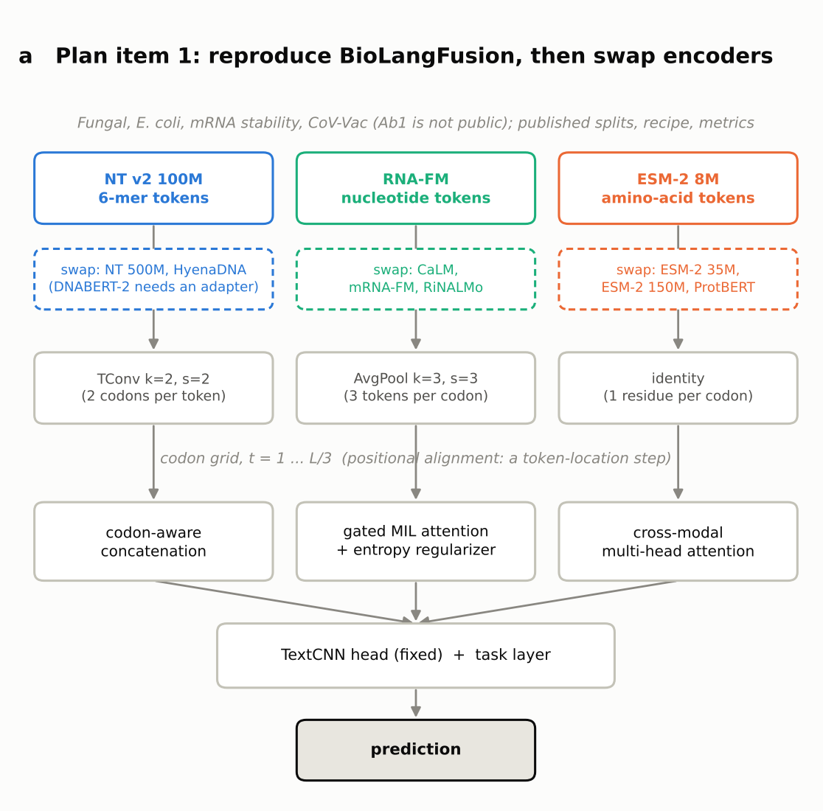
Reference · retained Stage 3 pipeline
The frozen-encoder pipeline used for the BioLangFusion comparisons
How the pipeline works
1. Frozen NT v2 100M, RNA-FM and ESM-2 8M read DNA, RNA and translated-protein views of the coding input.
2. Protein defines the codon grid; RNA is averaged three nucleotides to one position; DNA 6-mers are upsampled with a learned transposed convolution.
3. The fusion head combines the aligned streams, then a fixed TextCNN predicts the target.
Implementation choices retained
The local length filter reproduces the released row counts, but matching counts does not recover undocumented author preprocessing.
Equation 1’s DNA upsampling is used. An impulse test showed a positional difference from the appendix setting; it did not establish which implementation produced every published score.
Previously built pipeline: frozen encoders → codon-grid alignment → fusion head → TextCNN. Saved predictions support paired evaluation where row arrays are available. Current swaps retain this experiment while changing one encoder.
Notes:
Reference to the local pipeline already presented in October. The retained diagram shows frozen encoders, a common codon grid, three heads and a TextCNN. The present encoder swaps hold this declared pipeline fixed. Local filtering matches benchmark row counts, which is useful implementation evidence but does not reconstruct unknown historical bytes or prove exact authors’ preprocessing. The Equation1 upsampler and appendix setting differ under an impulse test; this is an operational distinction, not proof of which one generated every paper result. Cross-attention uses all positions in its context while outputs remain on the grid. CoV-Vac translation is a computational fragment representation without a validated biological frame. Some historical fit records lack per-row predictions, so not every aggregate score can receive a new paired interval.
Sources
D:/academic/UCF/2026_fall/Capstone Project CAP6942/Research/genomics-multimodal-fusion/Code/shared_code/fusion/
D:/academic/UCF/2026_fall/Capstone Project CAP6942/Research/genomics-multimodal-fusion/Code/stage3/01_blf_datasets.ipynb

Slide 19
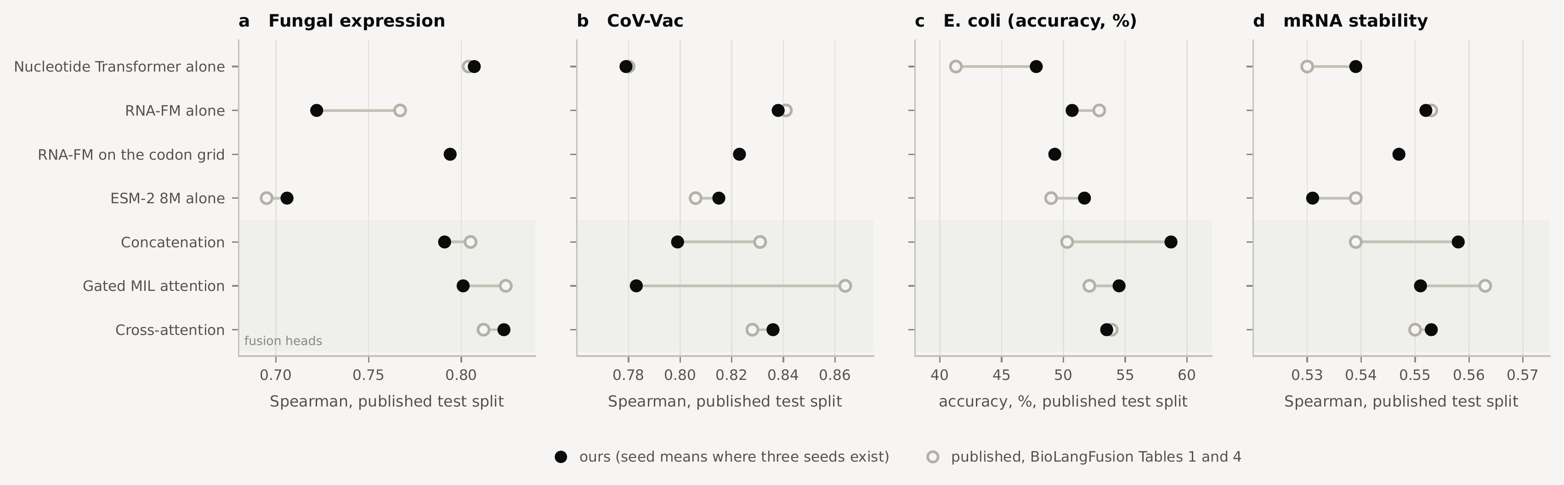
Reference · previously presented Phase A reproduction
Several single-encoder and cross-attention scores are close to the paper; some heads differ
Model | Fungal | CoV-Vac | E. coli (acc., %) | Stability
Nucleotide Transformer alone | 0.807 (0.804) | 0.779 (0.780) | 47.8 (41.3) | 0.539 (0.530)
RNA-FM alone | 0.722 (0.767) | 0.838 (0.841) | 50.7 (52.9) | 0.552 (0.553)
RNA-FM read on the codon grid | 0.794 | 0.823 | 49.3 | 0.547
ESM-2 8M alone | 0.706 (0.695) | 0.815 (0.806) | 51.7 (49.0) | 0.531 (0.539)
Concatenation | 0.791 (0.805) | 0.799 (0.831) | 58.7 (50.3) | 0.558 (0.539)
Gated MIL attention | 0.801 (0.824) | 0.783 (0.864) | 54.5 (52.1) | 0.551 (0.563)
Gated MIL without entropy | 0.802 (0.826) | 0.792 (0.854) | 55.8 (52.0) | 0.558 (0.556)
Cross-attention | 0.823 (0.812) | 0.836 (0.828) | 53.5 (53.9) | 0.553 (0.550)
The paper's Table 1: head minus its best single
 | CoV-Vac | Fungal | E. coli | Stab. | Ab1
Concatenation | -0.010 | +0.001 | -2.67 | -0.014 | +0.021
MIL + entropy | +0.023 | +0.020 | -0.84 | +0.010 | +0.017
Cross-attention | -0.013 | +0.008 | +0.98 | -0.003 | +0.022
Nine wins and six losses in fifteen comparisons, with no interval anywhere in the paper. The claim "fusion consistently outperforms unimodal baselines" holds only by taking the best head per task after seeing the test scores, and a different head wins on different tasks. E. coli in accuracy points. All three heads are ahead only on fungal, by +0.001 to +0.020, and on Ab1, the one task not in the public release.
Historical table: ours (paper), with seed means where three seeds exist. Shading marks a numerical discrepancy greater than 0.01 for correlation scores. Agreement is a build check, not proof of identical implementation or statistical equivalence.
Notes:
The PhaseA table and figure are retained from the October presentation. They report the declared local recipe and available seed means against published numbers. Several scores are close; others differ, particularly some concat/gated cases and fungal RNA-FM. Numerical proximity alone does not prove exact method equivalence. The paper’s table of head-minus-best-single values has positive and negative entries and no corresponding intervals; it cannot establish uniform fusion benefit. Three-seed PhaseA means must not be confused with the seed0 swap overview. This is historical reference evidence, not a new PhaseA run or a recalculated table.
Sources
D:/academic/UCF/2026_fall/Capstone Project CAP6942/Research/genomics-multimodal-fusion/Code/stage4/tier2_blf_phaseA.ipynb
D:/academic/UCF/2026_fall/Capstone Project CAP6942/Research/genomics-multimodal-fusion/docs/notes/Slides/Mina_Progress_Slides_2026-10-22.pptx

Slide 20
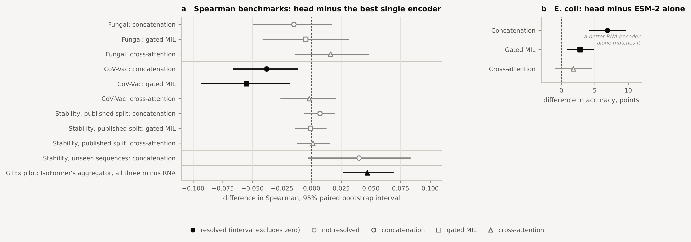
Reference · previously presented Phase A paired comparisons
Fusion against the best single encoder: two resolved wins and two resolved losses in twelve comparisons
Head − best single | Fungal | CoV-Vac | E. coli (points) | Stability
Concatenation | -0.015 [-0.049, +0.017] | -0.038 [-0.066, -0.012] | +6.9 [+4.2, +9.6] | +0.007 [-0.006, +0.019]
Gated MIL | -0.005 [-0.041, +0.031] | -0.055 [-0.093, -0.019] | +2.8 [+0.9, +4.8] | -0.001 [-0.014, +0.012]
Cross-attention | +0.016 [-0.014, +0.048] | -0.002 [-0.026, +0.020] | +1.8 [-0.9, +4.5] | +0.001 [-0.012, +0.015]
Historical 95% paired intervals from 4,000 resamples of the published test rows, retained unchanged. An interval crossing zero does not establish equivalence. These use the earlier comparison rules and are separate from the updated seed-0 sequence-group swap reports.
Notes:
These historical paired comparisons are retained as a reference to the previous meeting. The table uses the earlier reference selection and4000-row-resample procedure, not the new immutable swap report procedure. An interval wholly above or below zero supports a directional difference conditional on the retained models and evaluation; an interval spanning zero does not prove equality. These unadjusted comparisons do not quantify all sources of model-selection or training uncertainty and do not remove stability overlap. The unseen-subset and GTEx contrasts shown in the old plot are context with distinct populations/configurations, not additional rows of the new four-benchmark swap grid.
Sources
D:/academic/UCF/2026_fall/Capstone Project CAP6942/Research/genomics-multimodal-fusion/docs/notes/Slides/Mina_Progress_Slides_2026-10-22.pptx
D:/academic/UCF/2026_fall/Capstone Project CAP6942/Research/genomics-multimodal-fusion/docs/run-records.md

Slide 21
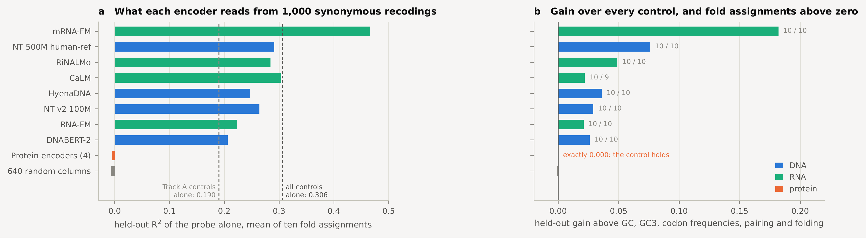
Reference · mRFP synonymous control, previously presented
Same protein, different codons: nucleotide embeddings add predictive value beyond the selected controls
The protein input is invariant across these 1,000 synonymous variants. The target is ln(red fluorescence normalized against GFPuv), not a direct protein-synthesis rate. Example: 100/50 and 200/100 both give ln(2); 200/50 gives ln(4). Retained gains are above the chosen sequence/folding controls; they do not establish a measured RNA mechanism.
Notes:
The original control figures are retained, not newly calculated. Synonymous variants encode the same protein, so protein inputs cannot distinguish the rows. Nucleotide encoders may expose sequence patterns beyond the selected controls. The new documentation traces Value to natural-log-transformed GFPuv-normalized red fluorescence. The arithmetic example uses invented values:100/50=2 and200/100=2, whereas200/50=4. The log maps a twofold ratio increase to ln2. Normalization can account for shared variation to the extent the reference tracks it; it does not remove all biological/technical differences. Folding summaries are sequence-derived proxies, not measured intracellular structures. The historical results and fold design have not been rerun.
Sources
D:/academic/UCF/2026_fall/Capstone Project CAP6942/Research/genomics-multimodal-fusion/docs/methods/data-and-targets.md#mrfp-synonymous-variants-and-fluorescence
D:/academic/UCF/2026_fall/Capstone Project CAP6942/Research/genomics-multimodal-fusion/Code/stage4/tier1_mrfp_control.ipynb

Slide 22
Reference · complete seed-0 scores · Spearman correlation
Fungal: every replacement, single reference and fusion head
Replacement | Replacement alone | Selected single (identity) | Selected score | Concat | Gated MIL | Cross
NT 500M | 0.740 | grid rna | 0.794 | 0.794 | 0.791 | 0.810
HyenaDNA | 0.737 | grid rna | 0.794 | 0.786 | 0.780 | 0.804
RiNALMo | 0.844 | native rna | 0.844 | 0.846 | 0.831 | 0.847
mRNA-FM | 0.852 | native rna | 0.852 | 0.853 | 0.839 | 0.840
CaLM | 0.851 | native rna | 0.851 | 0.848 | 0.848 | 0.857
ESM-2 35M | 0.696 | native dna | 0.813 | 0.795 | 0.780 | 0.819
ESM-2 150M | 0.729 | native dna | 0.813 | 0.784 | 0.784 | 0.811
ProtBERT | 0.761 | native prot | 0.761 | 0.805 | 0.800 | 0.816
Original encoder head scores: concat 0.793; gated 0.802; cross 0.824.
“Replacement alone” is not always the validation-selected single. DNA/RNA/protein identities refer to the constituent in that replacement triple.
Notes:
All updated swap grids use retained seed-0 fits. Intervals are the stored 95% intervals from 2,000 paired exact-sequence-group bootstrap draws, conditional on the fitted model and unadjusted for multiple comparisons. They do not quantify training-seed variability, establish equivalence when crossing zero, or remove training/test overlap. Seeds 1 and 2 are incomplete. The replacement alone reads the substituted modality natively. The selected single can instead be another constituent or a codon-grid control; selection was fixed using seed0 validation, not by the highest test score shown here. Original encoder head scores are descriptive retained values, not an added row of matched confidence intervals. Six native-single replacement intervals are unavailable because historical original RNA/protein prediction arrays are missing; aggregate scores remain visible. The table copies saved scores and does not rescore any predictions.
Sources
D:\academic\UCF\2026_fall\Capstone Project CAP6942\Research\genomics-multimodal-fusion\Code\stage4\results\phaseB\analyses\paired-report-v1\fungal_expression__d2173df49ec55ed37414.json

Slide 23
Reference · complete seed-0 scores · Spearman correlation
CoV-Vac: every replacement, single reference and fusion head
Replacement | Replacement alone | Selected single (identity) | Selected score | Concat | Gated MIL | Cross
NT 500M | 0.727 | native rna | 0.833 | 0.753 | 0.710 | 0.811
HyenaDNA | 0.755 | native rna | 0.833 | 0.832 | 0.797 | 0.872
RiNALMo | 0.823 | native rna | 0.823 | 0.806 | 0.819 | 0.854
mRNA-FM | 0.812 | native rna | 0.812 | 0.759 | 0.762 | 0.822
CaLM | 0.844 | native rna | 0.844 | 0.817 | 0.802 | 0.828
ESM-2 35M | 0.814 | native rna | 0.833 | 0.808 | 0.793 | 0.851
ESM-2 150M | 0.827 | native rna | 0.833 | 0.802 | 0.783 | 0.853
ProtBERT | 0.776 | native rna | 0.833 | 0.788 | 0.791 | 0.843
Original encoder head scores: concat 0.801; gated 0.783; cross 0.832.
“Replacement alone” is not always the validation-selected single. DNA/RNA/protein identities refer to the constituent in that replacement triple.
Notes:
All updated swap grids use retained seed-0 fits. Intervals are the stored 95% intervals from 2,000 paired exact-sequence-group bootstrap draws, conditional on the fitted model and unadjusted for multiple comparisons. They do not quantify training-seed variability, establish equivalence when crossing zero, or remove training/test overlap. Seeds 1 and 2 are incomplete. The replacement alone reads the substituted modality natively. The selected single can instead be another constituent or a codon-grid control; selection was fixed using seed0 validation, not by the highest test score shown here. Original encoder head scores are descriptive retained values, not an added row of matched confidence intervals. The table copies saved scores and does not rescore any predictions.
Sources
D:\academic\UCF\2026_fall\Capstone Project CAP6942\Research\genomics-multimodal-fusion\Code\stage4\results\phaseB\analyses\paired-report-v1\cov_vac_degradation__9c0f130491382c1bc2ad.json

Slide 24
Reference · complete seed-0 scores · accuracy (%)
E. coli: every replacement, single reference and fusion head
Replacement | Replacement alone | Selected single (identity) | Selected score | Concat | Gated MIL | Cross
NT 500M | 47.5 | native prot | 50.1 | 57.9 | 54.2 | 55.3
HyenaDNA | 50.4 | native prot | 50.1 | 58.0 | 53.1 | 52.0
RiNALMo | 57.3 | grid rna | 56.0 | 60.0 | 62.5 | 54.4
mRNA-FM | 58.7 | native rna | 58.7 | 59.0 | 53.1 | 54.8
CaLM | 57.6 | native rna | 57.6 | 57.7 | 56.7 | 53.9
ESM-2 35M | 52.1 | native prot | 52.1 | 57.7 | 53.2 | 53.2
ESM-2 150M | 53.9 | native prot | 53.9 | 57.7 | 55.5 | 54.6
ProtBERT | 52.5 | native prot | 52.5 | 54.2 | 56.5 | 54.6
Original encoder head scores: concat 60.7; gated 54.4; cross 53.8.
“Replacement alone” is not always the validation-selected single. DNA/RNA/protein identities refer to the constituent in that replacement triple.
Notes:
All updated swap grids use retained seed-0 fits. Intervals are the stored 95% intervals from 2,000 paired exact-sequence-group bootstrap draws, conditional on the fitted model and unadjusted for multiple comparisons. They do not quantify training-seed variability, establish equivalence when crossing zero, or remove training/test overlap. Seeds 1 and 2 are incomplete. The replacement alone reads the substituted modality natively. The selected single can instead be another constituent or a codon-grid control; selection was fixed using seed0 validation, not by the highest test score shown here. Original encoder head scores are descriptive retained values, not an added row of matched confidence intervals. The table copies saved scores and does not rescore any predictions.
Sources
D:\academic\UCF\2026_fall\Capstone Project CAP6942\Research\genomics-multimodal-fusion\Code\stage4\results\phaseB\analyses\paired-report-v1\ecoli_proteins__e9027c8e90be4c415cb3.json

Slide 25
Reference · complete seed-0 scores · Spearman correlation
Stability: every replacement, single reference and fusion head
Replacement | Replacement alone | Selected single (identity) | Selected score | Concat | Gated MIL | Cross
NT 500M | 0.537 | native rna | 0.552 | 0.552 | 0.553 | 0.545
HyenaDNA | 0.523 | native rna | 0.552 | 0.557 | 0.539 | 0.548
RiNALMo | 0.560 | grid rna | 0.556 | 0.556 | 0.564 | 0.558
mRNA-FM | 0.565 | native rna | 0.565 | 0.568 | 0.565 | 0.562
CaLM | 0.559 | native rna | 0.559 | 0.561 | 0.561 | 0.548
ESM-2 35M | 0.535 | native rna | 0.552 | 0.554 | 0.551 | 0.541
ESM-2 150M | 0.536 | native rna | 0.552 | 0.559 | 0.549 | 0.559
ProtBERT | 0.543 | native prot | 0.543 | 0.558 | 0.550 | 0.551
Original encoder head scores: concat 0.558; gated 0.551; cross 0.553.
“Replacement alone” is not always the validation-selected single. DNA/RNA/protein identities refer to the constituent in that replacement triple.
Notes:
All updated swap grids use retained seed-0 fits. Intervals are the stored 95% intervals from 2,000 paired exact-sequence-group bootstrap draws, conditional on the fitted model and unadjusted for multiple comparisons. They do not quantify training-seed variability, establish equivalence when crossing zero, or remove training/test overlap. Seeds 1 and 2 are incomplete. The replacement alone reads the substituted modality natively. The selected single can instead be another constituent or a codon-grid control; selection was fixed using seed0 validation, not by the highest test score shown here. Original encoder head scores are descriptive retained values, not an added row of matched confidence intervals. The table copies saved scores and does not rescore any predictions.
Sources
D:\academic\UCF\2026_fall\Capstone Project CAP6942\Research\genomics-multimodal-fusion\Code\stage4\results\phaseB\analyses\paired-report-v1\mrna_stability__d703113ac8fcdabfd4bd.json

