Slide 1
MULTIMODAL-BIO-FUSION · PROGRESS UPDATE
Stage 1: twelve encoders, two datasets
Four frozen foundation models per modality on mRNA stability and GTEx expression: what each one knows, how they relate, how much of that is sequence composition, and what it means for alignment and fusion.
DNA · NT 500M, NT v2, DNABERT-2, HyenaDNA
RNA · RNA-FM, RiNALMo, mRNA-FM, CaLM
Protein · ESM-2 8M, 35M, 150M, ProtBERT
Julian McKinley and Chase Di Maria Breisinger | MSDA AI Track, UCF | Meeting with Mina Basirat, October 7, 2026
Notes:
Stage 1 now covers twelve frozen encoders, four per modality, on two datasets. On the mRNA stability data every encoder reads one coding sequence, as in BioLangFusion. On IsoFormer's GTEx data each encoder reads its own molecule: genomic DNA around the start site, the transcript, or the protein. Today: what each encoder knows, how they relate, how much of their agreement is composition, the published comparisons, and the proposed Stage 2 alignment decision.

Slide 2
STAGE 1 SETUP
Two settings, twelve frozen encoders
DERIVED INPUTS · mRNA STABILITY
DISTINCT INPUTS · GTEx EXPRESSION
981 coding sequences (964 distinct)
999 train and 996 test transcripts
Every encoder reads the same coding sequence: DNA letters, RNA letters, or its translation. Label: mRNA stability. Published comparison: BioLangFusion.
DNA encoders read 6 kb of genome around the start site, RNA encoders the transcript or its coding sequence, protein encoders the protein. Labels: expression in 30 tissues. Published comparison: IsoFormer.
DNA
RNA
PROTEIN
NT 500M human-ref · NT v2 100M · DNABERT-2 · HyenaDNA large
RNA-FM · RiNALMo 150M · mRNA-FM · CaLM
ESM-2 8M · 35M · 150M · ProtBERT
6-mer, byte-pair, and single-nucleotide tokens. HyenaDNA uses long convolutions, not attention, and is causal.
RNA-FM and RiNALMo read single nucleotides (first 1,022 only); mRNA-FM and CaLM read one token per codon.
One token per amino acid. ESM-2 8M is BioLangFusion's encoder, ESM-2 150M IsoFormer's; ProtBERT is outside the ESM-2 family.
All encoders frozen; mean-pooled final layer; ridge probes over gene- or sequence-grouped folds. One notebook: Code/Stage1_analysis.ipynb.
Notes:
Two settings. In the stability data a modality is defined by the encoder, because every encoder reads one coding sequence; differences between encoders reflect pretraining and tokenization, not new biology. In the GTEx pilot each modality is a different molecule, so the DNA input holds promoter sequence and the transcript holds untranslated regions that the protein lacks. Four encoders per modality show how much encoders of one modality agree with each other. RNA-FM and RiNALMo read only the first 1,022 nucleotides, so they see the start of most sequences.

Slide 3
TRACK A · mRNA STABILITY
Protein and codon-level RNA predict stability best
Encoder | Stability R² (SD) | 10 splits | GC R² | GC3 R²
NT 500M human-ref | 0.032 (0.043) | 0.046 | 0.985 | 0.968
NT v2 100M multi-species | 0.080 (0.032) | 0.074 | 0.991 | 0.986
DNABERT-2 | 0.054 (0.031) | 0.057 | 0.990 | 0.948
HyenaDNA large | 0.026 (0.017) | 0.019 | 0.997 | 0.896
RNA-FM | 0.052 (0.032) | 0.046 | 0.951 | 0.917
RiNALMo 150M | 0.078 (0.021) | 0.079 | 0.954 | 0.949
mRNA-FM | 0.127 (0.032) | 0.110 | 0.951 | 0.946
CaLM | 0.127 (0.058) | 0.132 | 0.984 | 0.982
ESM-2 8M | 0.127 (0.044) | 0.131 | 0.679 | 0.379
ESM-2 35M | 0.114 (0.049) | 0.123 | 0.686 | 0.387
ESM-2 150M | 0.144 (0.035) | 0.142 | 0.708 | 0.436
ProtBERT | 0.143 (0.041) | 0.135 | 0.700 | 0.440
Sequence length only | 0.003 (0.009) | 0.004
0.127 and 0.127
mRNA-FM and CaLM, two codon-level encoders from different groups, match the protein encoders (0.114 to 0.144). The other nucleotide encoders reach 0.026 to 0.080.
-0.26 to -0.30
Protein R² drop from GC to GC3: translation loses codon choice. Nucleotide encoders keep it (GC3 0.90 to 0.98).
Ridge probes over 5 folds that keep identical sequences together, pinned by a sequence hash; "10 splits" is the mean over 10 further fold assignments.
Notes:
The protein encoders explain about 11 to 14 percent of stability variance, and both codon-level encoders reach the same range, so that result does not depend on one model. Encoders reading single nucleotides, six-nucleotide tokens or byte-pair tokens reach 3 to 8 percent even though they read every letter; HyenaDNA is lowest. Length alone predicts nothing. GC3 is where the nucleotide models carry information protein cannot. HyenaDNA, a causal model, has the best GC probe but the largest GC3 drop and stands out on the Nussinov pairing proxy computed from the first 200 nucleotides, consistent with its pooled embedding over-weighting the sequence start. Identical sequences carry labels differing by a median standard deviation of 0.49, which caps every score.

Slide 4
TRACK A · CONCATENATION
Codon-level RNA plus protein is the consistent gain
Pair | Mean gain | Range, 10 splits | Splits with gain
mRNA-FM + ESM-2 35M | +0.022 | +0.014 to +0.031 | 10 of 10
mRNA-FM + ESM-2 150M | +0.015 | +0.007 to +0.025 | 10 of 10
mRNA-FM + ProtBERT | +0.014 | +0.003 to +0.025 | 10 of 10
mRNA-FM + ESM-2 8M | +0.012 | +0.004 to +0.023 | 10 of 10
CaLM + ESM-2 35M | +0.012 | +0.006 to +0.019 | 10 of 10
CaLM + ProtBERT | +0.010 | +0.004 to +0.017 | 10 of 10
CaLM + ESM-2 8M | +0.009 | +0.001 to +0.012 | 10 of 10
CaLM + ESM-2 150M | +0.008 | +0.001 to +0.013 | 10 of 10
Other 58 pairs | -0.015 to +0.011 |  | 0 to 10
8 of 8
pairings of a codon-level RNA encoder with a protein encoder gain under every fold assignment, by about 0.01 to 0.02. mRNA-FM with CaLM gains too.
0.132
All twelve encoders together, below ESM-2 150M alone (0.144): extra columns do not help a linear probe on 981 rows.
Combination | R², pinned | R², 10 splits | vs best member
All four protein encoders | 0.147 | 0.146 | +0.004
All twelve encoders | 0.132 | 0.141 | -0.012
Gain = concatenated pair's R² minus the better single encoder's R², on the same folds; 66 pairs, 10 further fold assignments.
Notes:
Every one of the 66 pairs was concatenated and probed on the same folds as the single encoders. Sixteen pairs gain under all ten further fold assignments, and the clearest group is the codon-level RNA encoders with the protein encoders: all eight such pairings gain every time, by about one to two hundredths of R squared. The two codon-level encoders also gain together, so they are not redundant. The other consistent gains are smaller. Larger concatenations do not help, because a ridge probe on 981 rows cannot use thousands of extra columns. These are concatenation baselines; they say nothing yet about a trained fusion model.

Slide 5
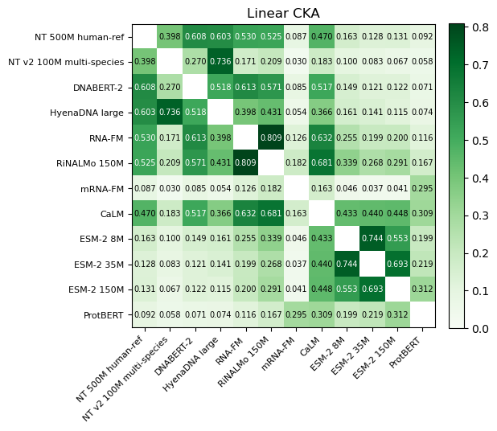
TRACK B · CROSS-ENCODER GEOMETRY
Agreement follows tokenization more than modality
Encoder pairs | Linear CKA | Mutual k-NN | Recall@1
RNA-FM with RiNALMo | 0.809 | 0.25 | 0.931
Within ESM-2 | 0.553 to 0.744 | 0.30 to 0.44 | 0.942 to 0.955
Within DNA | 0.270 to 0.736 | 0.15 to 0.21 | 0.591 to 0.773
DNA with RNA-FM or RiNALMo | 0.171 to 0.613 | 0.10 to 0.16 | 0.491 to 0.677
CaLM with protein | 0.309 to 0.448 | 0.16 to 0.25 | 0.794 to 0.866
ProtBERT with ESM-2 | 0.199 to 0.312 | 0.14 to 0.15 | 0.818 to 0.873
mRNA-FM with protein | 0.037 to 0.295 | 0.09 to 0.11 | 0.405 to 0.464
mRNA-FM with CaLM | 0.163 | 0.16 | 0.619
DNA with protein | 0.058 to 0.163 | 0.05 to 0.08 | 0.168 to 0.540
CaLM agrees with RNA-FM, RiNALMo, and every protein encoder. mRNA-FM agrees globally with almost nothing (at most 0.182, except ProtBERT at 0.295), yet still finds its protein partner 41% to 46% of the time.
Linear CKA and mutual k-NN (k = 10, chance 0.010) on all 981 rows; CCA fitted on 690 rows, Recall@1 on 291 held-out rows (chance 0.0034).
Notes:
The heatmap is final-layer linear CKA for all 66 pairs. Agreement follows tokenization and training more than the modality label: RNA-FM and RiNALMo agree most of any pair, then the ESM-2 models, and encoders reading single letters or short tokens of the same sequence agree whether they are called DNA or RNA. The two codon-level encoders differ sharply: CaLM looks like the single-nucleotide RNA encoders and the protein encoders, while mRNA-FM agrees with almost nothing. Retrieval after CCA separates pairs more clearly than CKA; CaLM finds its protein partner as often as ProtBERT finds an ESM-2 model's. Layer-wise, mRNA-FM's middle layers agree with the ESM-2 models at up to 0.69; its last blocks are what make it different.

Slide 6
TRACK B · COMPOSITION CONTROL
Most agreement involving DNA is composition
Share of each embedding explained by composition
Encoder pairs | CKA before | CKA after | R@1 before | R@1 after
Within ESM-2 | 0.553-0.744 | 0.376-0.643 | 0.942-0.955 | 0.701-0.869
ProtBERT with ESM-2 | 0.199-0.312 | 0.093-0.162 | 0.818-0.873 | 0.481-0.622
RNA-FM with RiNALMo | 0.809 | 0.378 | 0.931 | 0.704
CaLM with protein | 0.309-0.448 | 0.246-0.401 | 0.794-0.866 | 0.581-0.687
mRNA-FM with protein | 0.037-0.295 | 0.021-0.261 | 0.405-0.464 | 0.069-0.113
Within DNA | 0.270-0.736 | 0.038-0.113 | 0.591-0.773 | 0.103-0.162
DNA with RNA-FM, RiNALMo | 0.171-0.613 | 0.044-0.164 | 0.491-0.677 | 0.052-0.244
DNA with protein | 0.058-0.163 | 0.010-0.072 | 0.168-0.540 | 0.021-0.082
CKA falls 52% to 90% for every pair with a DNA encoder. CaLM still finds its protein partner 58% to 69% of the time, about 170 to 200 times chance; mRNA-FM keeps 7% to 11%.
Linear residualization on 87 composition features (GC, GC3, length, 64 codon and 20 amino-acid frequencies), all 981 rows; chance about 9%.
Notes:
We regress 87 composition features, GC, GC3, length, codon and amino-acid frequencies, out of every embedding and recompute agreement. Composition explains most of the variance of the DNA embeddings and the single-nucleotide RNA embeddings, up to 92 percent for HyenaDNA, and less for the codon-level and protein encoders. Removing it removes most agreement involving a DNA encoder. Three groups keep strong agreement: the protein encoders among themselves, RNA-FM with RiNALMo, and CaLM with the protein encoders. CaLM's residual correspondence with protein is the strongest evidence in Stage 1 that a nucleotide encoder represents something protein-like beyond counts. The control is linear, so nonlinear composition could remain.

Slide 7
TRACK B · HIGH- AND LOW-VARIANCE DIRECTIONS
Where composition, signal, and agreement sit
Encoder | Variance, top 10 | Composition, top | Composition, rest | R², top 10 | R², whole
NT 500M | 0.747 | 0.742 | 0.252 | 0.039 | 0.032
NT v2 | 0.891 | 0.858 | 0.356 | 0.057 | 0.080
DNABERT-2 | 0.715 | 0.764 | 0.224 | 0.039 | 0.054
HyenaDNA | 0.963 | 0.950 | 0.236 | 0.024 | 0.026
RNA-FM | 0.858 | 0.745 | 0.265 | 0.038 | 0.052
RiNALMo | 0.796 | 0.720 | 0.364 | 0.047 | 0.078
mRNA-FM | 0.606 | 0.369 | 0.182 | 0.061 | 0.127
CaLM | 0.548 | 0.647 | 0.259 | 0.066 | 0.127
ESM-2 8M | 0.625 | 0.575 | 0.319 | 0.108 | 0.127
ESM-2 35M | 0.648 | 0.534 | 0.285 | 0.107 | 0.114
ESM-2 150M | 0.698 | 0.500 | 0.292 | 0.095 | 0.144
ProtBERT | 0.818 | 0.453 | 0.246 | 0.086 | 0.143
Composition and signal sit on top
The top 10 components hold 55% to 96% of the variance and most of the composition. For ESM-2 8M and 35M they give 85% and 94% of the stability R²; the rest alone scores below zero for every encoder.
Agreement in both bands
CKA on the top block matches whole-embedding CKA within 0.035. The rest still agrees for ESM-2 (0.48 to 0.59) and CaLM with protein (0.39 to 0.41); mRNA-FM agrees with protein mainly there (0.29).
Each embedding split into its top 10 principal components and the rest (PCA on all 981 rows, no labels). Stability R² on pinned folds.
Notes:
Each embedding is split into its ten largest principal components and everything else. Composition, the stability signal a linear probe can reach, and most cross-encoder agreement all sit in the dominant directions. The low-variance directions are not empty: the ESM-2 models and CaLM with the protein encoders still agree there, and mRNA-FM is the case where they agree more than the top block, which explains how it can have low CKA with the protein encoders and still retrieve its partner under CCA. The rest blocks have nearly as many columns as rows, which inflates CKA, so compare them with each other, not with the top block.

Slide 8
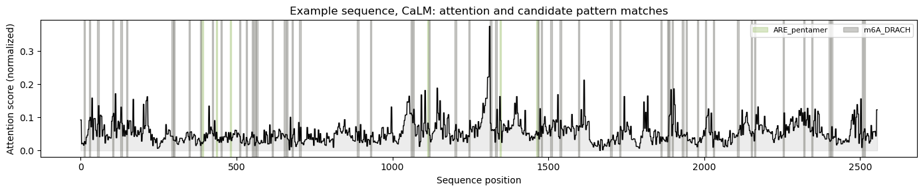
TRACK C · ATTENTION WITH CONTROLS
Codon context explains most attention hits
Encoder | Motif | Gap | Position null | Codon null
NT v2 100M | ARE pentamer | +0.011 | p = 0.014 | p = 0.200
RiNALMo 150M | ARE pentamer | +0.040 | p = 0.002 | p = 0.585
mRNA-FM | All pooled | +0.0014 | p = 0.002 | p = 0.072
mRNA-FM | DRACH | +0.0015 | p = 0.002 | p = 0.082
CaLM | ARE pentamer | +0.030 | p = 0.002 | p = 0.002
CaLM survives both nulls
Its ARE-pentamer gap keeps about half its size beyond codon, frame, and position (41 sequences). mRNA-FM's DRACH shift and RiNALMo's ARE gap vanish once codon context is held fixed.
Final layer, head-averaged incoming attention, first 100 sequences. Nulls shuffle motif labels within 100-nt bins (position) or among positions with the same codon and frame; 500 shuffles each.
Notes:
The plot is CaLM's attention on one example sequence with candidate pattern matches. The table lists the only rows with permutation p below 0.05. Position never explains them: each keeps its gap within 100-nucleotide bins. Codon context explains most: mRNA-FM's DRACH shift falls to 0.0001 and RiNALMo's ARE gap disappears when labels move only among positions with the same codon. CaLM's ARE-pentamer gap is the one result that survives both nulls, at the smallest p 500 shuffles allow; with 36 tests that cannot pass a Bonferroni correction, so it is a lead, not a finding. These sequences are coding-only; the GTEx data test the 3-prime UTR, where AU-rich elements act.

Slide 9
PUBLISHED SPLIT · BIOLANGFUSION
Frozen probes keep the order, well below trained fusion
Encoders | Spearman, all | Spearman, unseen | R², all
ProtBERT | 0.396 | 0.433 | 0.172
CaLM | 0.377 | 0.391 | 0.153
ESM-2 150M | 0.371 | 0.373 | 0.143
ESM-2 8M | 0.329 | 0.299 | 0.131
mRNA-FM | 0.328 | 0.326 | 0.120
RiNALMo 150M | 0.322 | 0.330 | 0.117
RNA-FM | 0.292 | 0.317 | 0.088
HyenaDNA large | 0.286 | 0.224 | 0.085
NT v2 100M multi-species | 0.275 | 0.290 | 0.080
mRNA-FM + ProtBERT | 0.392 | 0.417 | 0.166
BioLangFusion's three encoders | 0.364 | 0.351 | 0.146
All twelve encoders | 0.401 | 0.402 | 0.175
0.364 vs 0.539
BioLangFusion's three encoders concatenated here, against its published concatenation. Its best fusion reaches 0.563.
Not like for like
BioLangFusion trains a TextCNN head on token-level embeddings with 23,929 sequences; this is a linear probe on pooled vectors with 2,937 rows of a different file version.
Probe fit on 2,937 rows from the published train split, scored on 981 test rows; 295 test sequences never appear in training.
Notes:
On the published split the frozen encoders keep the cross-validation order: ProtBERT, CaLM and ESM-2 150M lead. Scores on test sequences absent from training are within 0.04 except HyenaDNA. Concatenating mRNA-FM with ProtBERT or ESM-2 150M scores about the same as the protein encoder alone, and all twelve encoders together reach 0.401. BioLangFusion's own three encoders reach 0.364 when concatenated here versus 0.539 in its paper; the gap bounds what a trained head, token-level inputs and ten times more data add together. Reproducing its head on these embeddings would separate those factors.

Slide 10
GTEx · DISTINCT INPUTS
Transcript lengths beat every single encoder
Encoder | R² (fold SD) | 10 splits | Published split R²
NT 500M human-ref | 0.034 (0.025) | 0.039 | 0.051
NT v2 100M multi-species | 0.036 (0.030) | 0.041 | 0.054
DNABERT-2 | 0.033 (0.028) | 0.047 | 0.034
HyenaDNA large | 0.031 (0.028) | 0.038 | 0.036
RNA-FM | 0.149 (0.037) | 0.161 | 0.151
RiNALMo 150M | 0.149 (0.047) | 0.150 | 0.150
mRNA-FM | 0.172 (0.044) | 0.176 | 0.204
CaLM | 0.120 (0.032) | 0.119 | 0.172
ESM-2 8M | 0.091 (0.022) | 0.099 | 0.113
ESM-2 35M | 0.104 (0.031) | 0.113 | 0.149
ESM-2 150M | 0.130 (0.043) | 0.138 | 0.179
ProtBERT | 0.163 (0.040) | 0.164 | 0.200
Lengths (4 features) | 0.242 (0.036) | 0.238
Composition (92 features) | 0.239 (0.011) | 0.244
0.242
Four length features (transcript, coding sequence, both UTRs) predict expression better than any encoder alone (best 0.172).
0.03 to 0.05
The four DNA encoders reading 6 kb around the start site. RNA and protein encoders reach 0.09 to 0.18.
999 train transcripts from 951 genes; gene-grouped folds; R² averaged over 30 tissues (tissue labels correlate at a median 0.91).
Notes:
On GTEx each encoder reads its own molecule, and the labels are expression in 30 tissues, which correlate strongly, so most of what is predictable is a transcript's overall level. RNA and protein encoders reach 9 to 18 percent of the variance; the DNA encoders reading six kilobases around the start site reach 3 to 5 percent. But four simple length features beat every single encoder. Mean pooling divides by the number of tokens, truncation caps what an encoder sees, and every DNA window has the same length, so pooled embeddings hide lengths that are known correlates of expression. The reference for an encoder on this task is 0.24, not zero.

Slide 11
GTEx · COMBINING MODALITIES
Distinct inputs: combining modalities helps broadly
Inputs | R² | Spearman | IsoFormer R²
DNA alone (NT v2) | 0.054 | 0.249 | 0.13
RNA alone (RNA-FM) | 0.151 | 0.396 | 0.36
Protein alone (ESM-2 150M) | 0.179 | 0.423 | 0.20
DNA + protein | 0.206 | 0.451 | 0.28
DNA + RNA (RNA-FM) | 0.173 | 0.432 | 0.39
DNA + RNA + protein (RNA-FM) | 0.232 | 0.484 | 0.43
DNA + RNA + protein (mRNA-FM) | 0.249 | 0.499
All twelve encoders | 0.269 | 0.522
47 of 66
pairs gain under all 10 fold assignments, against 16 on stability. Every DNA encoder gains with every protein and codon-level encoder.
0.239 vs 0.242
All twelve encoders concatenated, cross-validated, against four length features alone. On the published split the three-modality sets reach about half of IsoFormer's 0.43.
Published split: probe fit on the 999 train transcripts, scored on 996 test transcripts from other genes. DNA: NT v2 100M; protein: ESM-2 150M.
Notes:
Left: IsoFormer's modality combinations with frozen encoders and a linear probe on the published split. DNA alone is weakest, protein alone with IsoFormer's own protein encoder comes close to the published value, and RNA alone falls furthest short, which fits IsoFormer fine-tuning its RNA encoder. Adding modalities helps in IsoFormer's order. Right: under cross-validation, concatenation helps far more broadly than on stability, because the inputs are different molecules; the DNA window adds signal even though it predicts little alone. The exception is DNA with RNA-FM or RiNALMo, which partly read the same region. All twelve together only match the length features, so any fusion comparison on GTEx needs the length baseline.

Slide 12
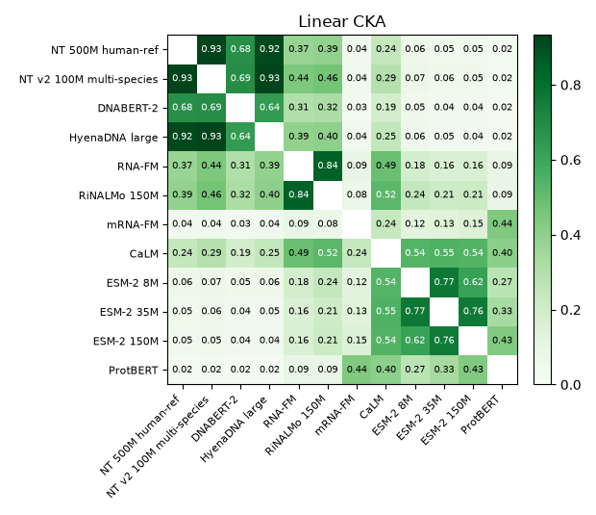
GTEx · GEOMETRY AND UTR ATTENTION
DNA barely corresponds to RNA or protein
DNA window against transcript and protein
Recall@1 at most 0.041 with any RNA or protein encoder, while the DNA encoders agree with each other at CKA 0.64 to 0.93. Different molecules, so this is expected, and the window still adds signal.
Coding encoders repeat the stability pattern
CaLM finds its protein partner 69% to 83% of the time and keeps 44% to 63% after the composition control; mRNA-FM 37% to 47%; RNA-FM and RiNALMo 9% to 26%.
Attention in 3' UTRs
RNA-FM shows no association. RiNALMo's ARE gap survives the position null but not a three-nucleotide-context null, matching its coding-sequence result.
999 train transcripts; CCA fitted on 680 and Recall@1 on 319 held-out transcripts (chance 0.0031); 3' UTR attention on 100 train transcripts.
Notes:
With distinct inputs the geometry changes as expected. The DNA encoders agree strongly with each other and barely at all with the RNA and protein encoders; a transcript's own DNA window is almost never ranked first. The encoders that read coding information behave as on the stability data, and CaLM again keeps the most correspondence with protein after the composition control. In the 3-prime UTRs, where AU-rich elements act, RNA-FM's attention shows nothing and RiNALMo attends to U-rich trinucleotides wherever they occur, not to the pentamer as a unit. Per-sequence alignment again has no relationship with prediction error.

Slide 13
STAGE 2 · DEFINING ALIGNMENT
Proposed decision: no explicit alignment loss
No explicit alignment loss
Codon grid only where biology supplies it
Per-sequence alignment never tracks error (66 pairs, both datasets), and most cross-modal agreement is composition. Fusion learns the interaction; an alignment-loss ablation runs on CaLM with protein, the one cross-modal pairing whose agreement survives the control.
Stability: DNA, RNA, and protein tokens share one codon grid, the step grid Coupled Mamba needs. GTEx: no position-by-position correspondence, so cross-attention or pooled fusion.
One encoder per redundant family
First pairings
One ESM-2 model per experiment, with ProtBERT as a separate candidate. RNA-FM and RiNALMo are nearly redundant (CKA 0.809).
Stability: mRNA-FM or CaLM with ESM-2 150M or ProtBERT, the consistent concatenation gains. GTEx: transcript and protein plus the DNA window, always against the length baseline.
Alignment here: agreement on held-out examples after the composition control, reported separately from predictive complementarity.
Notes:
Stage 2 is a decision, recorded in the Overleaf and the project notes, not a notebook. We define two encoders as aligned to the extent that their representations of the same inputs agree on held-out examples after the composition control, and we report that separately from complementarity, the concatenation gain, because Stage 1 shows the two need not coincide. In the decision tree the pairs fall in the mixed branch, so each pairing is decided on its own terms. The proposal is no alignment loss in the first fusion models, a shared codon grid only on the stability data, one encoder per redundant family, and codon-level RNA with protein as the first pairing. Any code this calls for is built and tested in Stage 3.

Slide 14
NEXT STEPS
Stage 3 plan and questions for Mina
Stage 3 next
Questions
Extract token-level embeddings; resample stability inputs to one codon grid
Baselines first: best single encoder, concatenation plus MLP, and the length baseline on GTEx
Coupled Mamba, then cross-attention, on codon-level RNA with protein
Alignment-loss ablation on CaLM with a protein encoder
Secure GPU access and scale from the pilots to full training sets
Does a per-pair alignment decision fit the lab's alignment study, or should one method cover all three modalities?
Should transcript length be a required control or input for GTEx fusion?
Stability, GTEx, or both as the Stage 4 benchmark?
Is CaLM's attention to AU-rich pentamers worth a follow-up with more sequences and permutations?
Fusion candidates: Coupled Mamba first, then IsoFormer-style cross-attention; concatenation plus MLP as the baseline every model must beat.
Notes:
Stage 3 starts with token-level embeddings, because pooled vectors cannot support positional fusion. Every fused model is compared with the best single encoder, concatenation plus an MLP, and on GTEx the length features. Coupled Mamba comes first, then IsoFormer-style cross-attention. The questions are where Mina's input changes what we build: whether per-pair decisions fit the lab's alignment work, how to treat length on GTEx, which benchmark Stage 4 uses, and whether the CaLM attention lead is worth pursuing.

