Slide 1
MINA PROJECT · PROGRESS UPDATE
Building an RNA and Protein Fusion Pipeline
RNA and protein are each read today by separate foundation models, even though they're two connected layers of the same underlying biology. This project tests whether fusing them captures real biological signal those models miss on their own, using a rigorous pipeline rather than picking an architecture and hoping it works.
RNA
PROTEIN
encoder
encoder
Julian McKinley | MSDA AI Track, UCF | Meeting with Mina Basirat, September 23, 2026
Notes:
Living things run on three connected layers: DNA, RNA, and protein. The models that read each layer are trained separately today. This project tests whether fusing them captures real biological signal none of them see alone, using a rigorous pipeline rather than guessing at an architecture.

Slide 2
PIPELINE ARCHITECTURE
Four Stage Pipeline
01
02
03
04
Representation Analysis
CURRENT
Fusion
Benchmarking
Check what the frozen encoders already know and how related they are.
Define Alignment
Build the architecture that combines the two modalities.
Test whether fusion beats the best single modality model.
Decide what a meaningful alignment target looks like, from Stage 1's findings.
Status: Stage 1 complete. RNA and protein encoders embedded, validated, and analyzed across probing (including codon usage bias and secondary structure), CKA, CCA, cross-modal retrieval, UMAP, and attention-motif interpretability. Now moving into Stage 2.
Notes:
The pipeline moves through four stages in order. Stage 1, representation analysis, is where I am now. Each stage's output feeds directly into the next stage's design decisions, so fusion architecture should not be picked before Stage 1 has something to say about it.

Slide 3
RELATED WORK
BioLangFusion
Isoformer
CDT
Coupled Mamba
Alignment Theory
How the Literature Shapes Our Architecture
Our encoders stay NT and ESM-2. Each paper contributes a design idea at the stage where it fits.
STAGE 1
Frozen Encoders
NT (RNA) + ESM-2 (protein)
STAGE 2
Align
Choose the alignment target
STAGE 3
Fuse
Cross-attention and Coupled-Mamba
STAGES 3 AND 4
Test
Ablation and benchmarking
Alignment Theory
Exit test: place the pair on the redundancy vs. uniqueness map
Alignment Theory
Alignment-performance slope: does an alignment loss help?
Isoformer
Cross-attention fusion, primary candidate
Isoformer
Drop-one-encoder ablation: score should fall if fusion uses both
BioLangFusion
Uses NT v2 + ESM-2 (plus RNA-FM), all kept frozen
BioLangFusion
Codon-grid resampling so RNA and protein positions line up
Coupled Mamba
Linear-cost fusion, no alignment loss, primary candidate
Isoformer
Uses NT v2 + ESM-2; trains only the fusion layer and head
CDT
Decide alignment per modality pair, not one method for all (Q2)
BioLangFusion
Concat + MLP, the baseline every model must beat
CDT
One-way DNA → RNA → protein attention, an interpretability idea
Our contribution is the method for deciding whether and how to fuse, not a new fusion model.

Slide 4
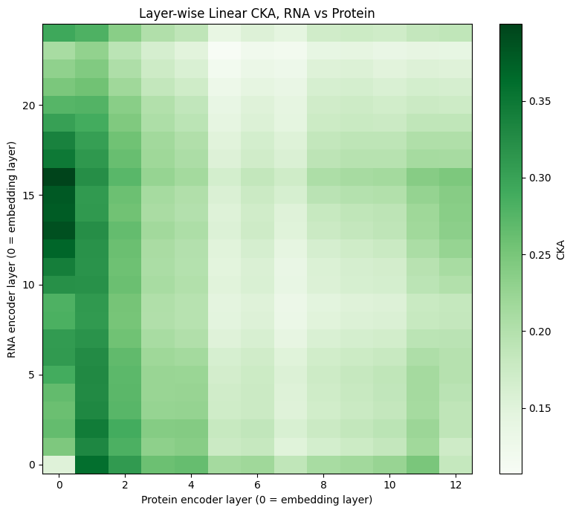
STAGE 1 RESULTS
What the Frozen Encoders Already Know, and How Related They Are
Track A: Decodability
Decodability test (mRNA stability): RNA R² = 0.015 · Protein R² = 0.103
GC content validity check: RNA R² = 0.986 · Protein R² = 0.678
Synergy check (concatenation): R² = 0.100, no gain over protein alone (0.103)
Track B: Cross-Modal Geometry
Geometry test: final-layer CKA: 0.128 · Mutual k-NN: 0.070 vs. 0.010 chance
Shared-subspace test (CCA): correlations up to 0.955 on held-out data
Cross-modal retrieval test: 36.6% top-1 recall vs. 0.3% chance
What This Means
The two embedding spaces mostly disagree as wholes, but share one strong, specific, learnable subspace, most likely reflecting genetic-code-linked composition rather than deep functional overlap. That subspace is evidence a trained fusion mechanism is worth building, and answers the alignment-definition question: high uniqueness with one narrow pocket of real redundancy.
Layer-wise CKA, RNA vs protein. Peak 0.400 pairs RNA layer 16 with the protein embedding layer.
Notes:
Stage 1 results. Protein embeddings predict mRNA stability better than RNA embeddings, and concatenating the two adds nothing. As whole spaces the two embeddings mostly disagree, but CCA and retrieval find one narrow, strong shared subspace, most likely genetic-code-linked composition.

Slide 5
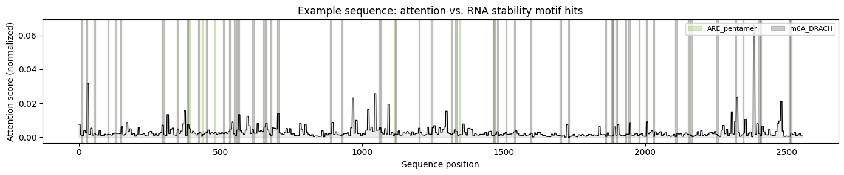
STAGE 1 RESULTS, CONTINUED
Track C: Does Attention Track Real Regulatory Motifs?
Attention-Motif Overlap
Motif-overlap test: across 100 sequences, 7% show higher attention at motifs (p < 0.05), near the 5% chance baseline
Mean attention gap at motifs: -0.0009, essentially zero
One example sequence: attention (line) vs. real ARE and m6A motif hits (shaded). Peaks and hits don't consistently line up.
Alignment–Error Association and RSA
Reading This Example
Alignment–error association: r = -0.013, p = 0.83, not significant
63 motif hits found (311 positions); mean attention 0.0031 at those positions vs. 0.0033 elsewhere, the opposite of the hypothesis.
Internal-structure test (RSA): r = 0.234, p < 0.001, consistent with Track B's shared subspace
These are real, literature-cited stability motifs (AU-rich elements, m6A DRACH), not generic transcription-factor sites, and neither motif class reaches significance on its own.
What This Means
Attention does not concentrate at literature-cited AU-rich-element and m6A motifs, so the encoder's attention is not tracking these known stability elements. The alignment–error association agrees with Track B: local alignment doesn't predict performance, so an explicit alignment loss likely won't help Stage 2's fusion design.

Slide 6
NEXT STEPS
Next Steps and Open Questions for Wednesday
Next Steps
Open Questions for Wednesday
No explicit alignment step: RNA and protein mostly carry different information, so forcing them to align could erase useful signal. The fusion model learns what they share.
01
Does mRNA stability become the confirmed Stage 4 benchmark, given DNA-optional scoping?
Fusion Candidates
02
Should Stage 2 use asymmetric, per-pair alignment decisions across modality pairs?
Cross-attention (Isoformer-style)
Mina's pick
Coupled Mamba
Mina's pick
03
Is the shared subspace compositional (GC-linked), or something more specific worth checking?
Concatenation + MLP
Baseline to beat
Cross-Mamba / BiMamba
Fallback
Mixture-of-experts fusion
Fallback
Once these are confirmed: Stage 2 formalizes the alignment decision, Stage 3 builds and benchmarks both fusion architectures at scale, and Stage 4 tests whether fusion beats the best single-modality model.

