Slide 1
Progress since October 7: what was built, what ran, and what it found
multimodal-bio-fusion · Meeting with Mina Basirat · October 22, 2026
Every item of the research plan now has results except the remaining encoder swaps. The reproduction holds where it should. The paper's fusion gains hold on fewer tasks than they appeared to, because a better single encoder closes the largest of them.
Priorities 1, 2, 5
Phase A, four swaps of Phase B, LucaOne, mRFP
Priorities 3 and 4
half-life and translation efficiency, gate passed
Left to run
the other encoder swaps, and stability

Slide 2
Seven steps in thirteen days, in the research plan's order
Since the last meeting · October 7 to 20
Oct 9 to 15
Research plan adopted and placed first Her seven items slotted into the Gantt chart under their numbers; Coupled Mamba and cross-attention move to January, scored against every baseline at once.
Oct 15 to 19
Stage 3 round 1 built BioLangFusion's benchmarks, embeddings, codon grid, three heads and TextCNN; IsoFormer's aggregator; LucaOne's input limit; one training loop with seeds and a paired bootstrap.
Oct 17 to 18
BioLangFusion reproduced on fungal Single encoders reproduce; no fusion head beats the best one at 95%; the paper's head ordering is reversed; its appendix convolution misaligns the DNA stream.
Oct 18 to 19
IsoFormer on GTEx; LucaOne ruled out With frozen encoders, fusion beats RNA alone by +0.047, resolved. LucaOne's 1,280-token context admits none of the GTEx windows.
Oct 19
mRFP synonymous control Protein encoders invariant, as they should be; every nucleotide encoder predicts expression beyond composition and folding; mRNA-FM by far the most.
Oct 19 to 20
Phase A on CoV-Vac, E. coli and stability 27 hours on a laptop. Singles and cross-attention reproduce; the gated head does not; fusion appeared to win on E. coli, which Phase B then revised.
Oct 21 to 22
Phase B, LucaOne, half-life and TE run Four encoder swaps on a GPU, LucaOne frozen on stability, and the human half-life and translation-efficiency probes. The swaps change what Phase A's E. coli result meant.
Every step has a run record in docs/run-records.md and a result file beside its notebook. Ab1, the fifth BioLangFusion benchmark, is not public.

Slide 3
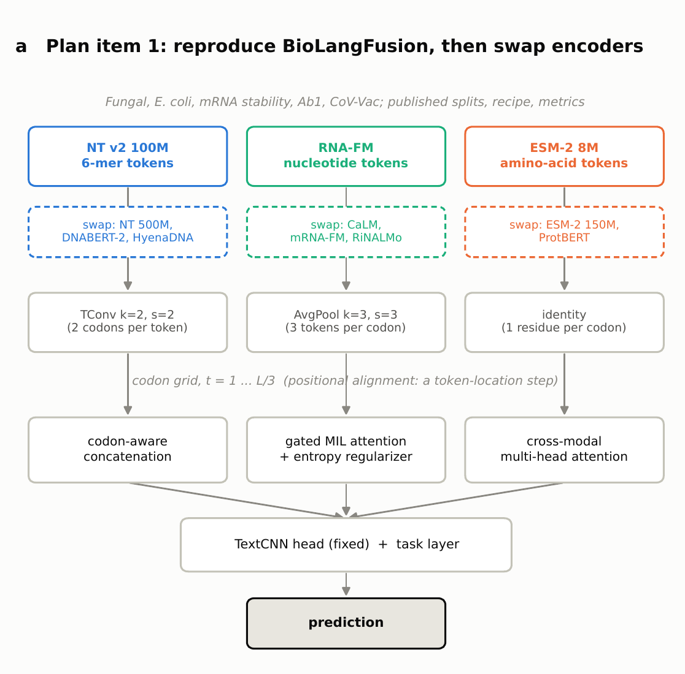
BioLangFusion rebuilt from the paper, with two of its inconsistencies settled by measurement
Stage 3, round 1 · what exists in code
Three frozen encoders on one codon grid. NT v2 100M 6-mers upsampled by a transposed convolution, RNA-FM averaged three to one, ESM-2 8M one residue per codon.
Three heads, one TextCNN, the paper's recipe. Concatenation, gated MIL attention with its entropy term, cross-modal attention; Adam at 3e-5, early stopping on validation, best epoch restored.
Preprocessing, settled. The paper says it truncates at 999 nt, but only dropping those sequences reproduces its own row counts, on all four benchmarks.
The convolution, settled. The paper specifies the DNA upsampling twice; the appendix setting places the stream two codons out of register. Equation 1 is used.
Error bars from the start. Every run saves per-row test predictions, so any two models are compared by a paired bootstrap, seeds averaged inside each draw. The paper reports none.
Also built: IsoFormer's aggregator with memory-safe batching; the grid generalized so any Stage 1 encoder but DNABERT-2 can take any slot.
Everything lives in Code/shared_code/fusion/ and is imported by the Stage 4 notebooks, so an experiment runs exactly what was checked. Token embeddings: 34 GB in float16, kept off Git.

Slide 4
The single encoders and cross-attention reproduce; the gated head does not
Phase A · reproduction
Model | Fungal | CoV-Vac | E. coli (acc., %) | Stability
Nucleotide Transformer alone | 0.807 (0.804) | 0.779 (0.780) | 47.8 (41.3) | 0.539 (0.530)
RNA-FM alone | 0.722 (0.767) | 0.838 (0.841) | 50.7 (52.9) | 0.552 (0.553)
RNA-FM read on the codon grid | 0.794 | 0.823 | 49.3 | 0.547
ESM-2 8M alone | 0.706 (0.695) | 0.815 (0.806) | 51.7 (49.0) | 0.531 (0.539)
Concatenation | 0.791 (0.805) | 0.799 (0.831) | 58.7 (50.3) | 0.558 (0.539)
Gated MIL attention | 0.801 (0.824) | 0.783 (0.864) | 54.5 (52.1) | 0.551 (0.563)
Gated MIL without entropy | 0.802 (0.826) | 0.792 (0.854) | 55.8 (52.0) | 0.558 (0.556)
Cross-attention | 0.823 (0.812) | 0.836 (0.828) | 53.5 (53.9) | 0.553 (0.550)
Within 0.01
of the paper for every single encoder on CoV-Vac and stability, and for NT and ESM-2 on fungal. Fungal RNA-FM matches only on the codon grid; E. coli is within noise.
3 of 4
benchmarks where cross-attention beats its published value; on E. coli it is half a point under. The gated head, the paper's best on three, is the best on none.
Ours (published), Spearman except E. coli (accuracy, %). Means over three seeds on fungal, CoV-Vac and E. coli; stability is one seed. Published values from BioLangFusion Table 1 and Table 4.

Slide 5
Does fusion beat the best single encoder? On two benchmarks out of four
Phase A · the paper's central claim
Benchmark | Best single encoder | Best head minus it, 95% interval | Verdict
Fungal expression | NT, 0.807 | +0.016 [-0.014, +0.048] | tie; the paper's +0.020 sits inside the interval
CoV-Vac | RNA-FM, 0.838 | -0.002 [-0.026, +0.020] | tie; concatenation and the gated head are significantly worse
E. coli (accuracy) | ESM-2, 51.7 | +6.9 [+4.2, +9.6] | fusion won here, until Phase B changed the single encoder
Stability, published split | RNA-FM, 0.552 | +0.007 [-0.006, +0.019] | tie; the split repeats training sequences in 68% of test rows
Stability, unseen sequences | RNA-FM, 0.319 | +0.040 [-0.003, +0.083] | leans fusion; one seed, not yet resolved
GTEx pilot, IsoFormer's aggregator | RNA, 0.452 | +0.047 [+0.027, +0.069] | fusion wins
See next slide
This is the table as Phase A left it. Phase B swapped one encoder and the E. coli row did not survive it.
The question
Not whether fusion beats the encoders the paper happened to pick, but whether it beats the best encoder available for the task.
Paired bootstrap over each published test split, 4,000 draws, seeds averaged inside each draw, repeated sequences resampled together. The best single encoder is the one validation chose.

Slide 6
The gated head is a modality selector, and on CoV-Vac it selects against the best encoder
Phase A · why the gated head does not reproduce
Benchmark | Entropy weight | DNA | RNA | Protein
Fungal | 0.01 | 0.20 | 0.20 | 0.60
CoV-Vac | 0.01 | 0.83 / 0.92 / 0.94 | 0.01 / 0.03 / 0.00 | 0.16 / 0.05 / 0.06
E. coli | 0.01 | 0.11 / 0.18 / 0.10 | 0.00 | 0.89 / 0.82 / 0.90
Stability | 0.01 | 0.28 | 0.00 | 0.71
Any benchmark | 0.5 or 1.0 | one modality takes 1.00
0.783 vs 0.864
The gated head on CoV-Vac, ours against published: the largest miss anywhere in the reproduction.
0.801 to 0.812
What the paper says the weights are: how much each modality is used per sequence, an interpretability output.
What they are here: which modality the head kept. RNA is at zero on all three Phase A benchmarks. On CoV-Vac, where RNA-FM is the strongest single encoder (0.838), the head puts 0.83 to 0.94 on DNA and scores like a DNA-only model: 0.783 against DNA alone at 0.779.
The fungal gated head at 100 and then 1,280 channels, against 0.824 published. Width is half its gap; the other benchmarks at 1,280 are the last check.
Attention weights averaged over each test split; three values are seeds 0, 1 and 2. The entropy term never helps: on all four benchmarks the head without it scores at or above the head with it.

Slide 7
The published stability split is mostly memorization: every model drops 0.2 on unseen sequences
Phase A · mRNA stability
0.53 to 0.56
The published range for every model, ours and the paper's, is carried by the 2,444 test rows that repeat a training sequence.
+0.03 to +0.04
The fusion heads above RNA-FM on the clean rows, just short of resolving at one seed. A sequence-grouped re-split with seeds would settle it.
Seed 0, the same trained models scored on the whole published test split (3,579 rows) and on its 1,135 rows whose sequence never appears in training. Validation leaks too (2,360 of 3,608 rows), so early stopping still watched a leaky split.

Slide 8
Every nucleotide encoder carries codon information beyond composition and folding; mRNA-FM carries by far the most
Plan item 5 · the mRFP synonymous control
10 of 10
fold assignments in which each nucleotide encoder beats the Track A controls (GC3, codon use, Nussinov). The protein encoders add exactly nothing: the control holds.
First 60 nt
The one structure feature that matters is folding energy after the start codon (R² 0.11; a weaker fold, higher expression), as Kudla et al. 2009 found. The Nussinov proxy carries nothing.
1,000 synonymous recodings of one gene, Stage 1's pooled embeddings. Gain in held-out R² when an encoder is stacked on GC, GC3, the 64 codon frequencies, a pairing proxy and two folding energies (together R² 0.306); mean over ten grouped fold assignments.

Slide 9
A better RNA encoder raises the single-encoder score by 8 points and erases the fusion gain
Priority 1, Phase B · one encoder swapped at a time
Encoder in the RNA slot | CoV-Vac: alone | concat | E. coli: alone | concat
RNA-FM (the paper's own) | 0.833 | 0.801 | 50.7 | 60.7
mRNA-FM | 0.812 | 0.759 | 58.7 | 59.0
CaLM | 0.844 | 0.817 | 57.6 | 57.7
+8.0 points
mRNA-FM alone over RNA-FM alone on E. coli. The mRFP control predicted exactly this encoder, on exactly this kind of task.
What changed. On E. coli, mRNA-FM alone scores +8.0 [+4.0, +11.8] above RNA-FM alone, resolved, and CaLM +6.9 [+2.8, +10.8]. Concatenation with mRNA-FM then beats its own best single encoder by +0.3 [-2.9, +3.7], which does not resolve. Phase A's +6.9 was fusion compensating for a weak RNA encoder, not fusion adding information. On CoV-Vac the swap does not help: concatenation and the gated head with mRNA-FM resolve worse than the originals.
Half right
The information the control found is real and it is in the encoder. It does not become a fusion gain, which is a sharper finding than either outcome alone.
Seed 0, Equation 1's convolution, 100 channels, everything else held at Phase A's settings. Paired bootstrap on the same test rows; run on Chase's GPU and scored independently twice. Four of the eight swaps; the rest follow.

Slide 10
On mRNA stability the jointly pretrained model beats all three separately pretrained encoders fused
Priority 2 · LucaOne, one jointly pretrained model
+0.092
LucaOne's two streams over the three BioLangFusion encoders concatenated, [+0.066, +0.120]: resolved. Over the best single encoder, +0.170.
One caveat
This is the published stability split, the one with repeated sequences. Grouping them in the bootstrap does not remove the overlap with training, so read it beside the leak slide.
Ridge probe on frozen pooled vectors, identical for every row, on the benchmark's published split. LucaOne is 1.8B parameters against 108M for the three BioLangFusion encoders combined, so this compares representations, not matched budgets.

Slide 11
Outside the coding sequence there is real signal, and fusing it with the protein helps on both tasks
Priorities 3 and 4 · full transcripts
Representation | Half-life (r) | Translation efficiency (r)
Composition of the coding sequence | 0.487 | 0.683
Composition of the whole transcript | 0.542 | 0.702
5' UTR, RNA encoder | 0.178 | 0.433
Coding sequence, RNA encoder | 0.473 | 0.630
Full transcript, RNA encoder | 0.512 | 0.610
Protein of the coding sequence | 0.552 | 0.682
Full transcript + protein | 0.606 | 0.712
Three encoders fused | 0.602 | 0.713
+0.053
Full transcript with protein over the best single encoder on half-life; +0.030 on translation efficiency.
Not yet proof
Mean and standard error over nine splits, with no per-split predictions retained, so these are not paired intervals. The two fused rows are within each other's error.
The protein encoder is the best single representation on both tasks, which is not what a transcript-level task would predict. Fusing it with the full transcript gains +0.053 on half-life and +0.030 on translation efficiency. Note what the composition row says: counted features of the whole transcript already reach 0.542 and 0.702, so an encoder has to clear that, not zero.
Human only; mouse is embedded and not yet scored. Frozen encoders, windowed pooling, ridge probes, nine gene-grouped splits. The gate passed on all four primary datasets before any of this ran.

Slide 12
On physically distinct molecules, with no codon grid, fusion wins clearly
Baseline · IsoFormer on GTEx (Gantt 44)
Modalities | Ours, frozen | IsoFormer, fine-tuned
DNA | 0.199 | 0.43
RNA | 0.452 | 0.61
Protein | 0.160 | 0.46
DNA + protein | 0.439 | 0.52
DNA + RNA | 0.507 | 0.64
DNA + RNA + protein | 0.499 | 0.65
Why this one is different
Every benchmark where fusion failed gives all three encoders the same coding sequence, so the modalities are three readings of one molecule. GTEx gives them a genomic window, a transcript and a protein: three different molecules, no shared grid, and the largest resolved gain in the project. Stage 1 found alignment lowest exactly here.
+0.047
All three modalities minus RNA alone, [+0.027, +0.069]: resolved. DNA with RNA minus RNA alone +0.055 [+0.032, +0.078]. Protein adds nothing measurable.
3 of 4
of the paper's orderings reproduce: RNA is the strongest single modality, all three beat the best single one, DNA with RNA beats DNA with protein.
IsoFormer's six-row modality ablation on the 2,000-transcript GTEx pilot, split by gene, Spearman over thirty tissues, one seed. IsoFormer fine-tunes its encoders and we freeze them, so the gap to its absolute values is what freezing costs.

Slide 13
The reproduction is faithful; the paper's fusion gains mostly do not survive a stronger single encoder
What it adds up to · and what we need from you
What it adds up to
Questions for you
The build is right. Single encoders within 0.01 of the paper, cross-attention within 0.01 of its published value on all four benchmarks.
The encoder matters more than the fusion. Swapping one encoder moved E. coli by 8 points, and the fusion gain it was compensating for disappeared.
Fusion still wins where the modalities are different molecules: GTEx, +0.047 resolved, and the full-transcript tasks, +0.053 and +0.030.
One jointly pretrained model beats three fused ones on stability, +0.092 resolved, though on the leaky split.
The gated head is a selector, not a mixer, and the paper reports no error bars that would show which of its gains resolve.
The headline finding: a better encoder beat the fusion it was feeding. Does that become the project's result, with the method test asking which encoder to pick rather than whether to fuse?
Ab1: the fifth benchmark is Yazdani-Jahromi et al. (UCF) and not public. Can it be obtained?
Is seeds plus a paired bootstrap the reporting standard for everything that follows? The swaps are one seed so far.
Does the alignment framing (agreement on what the central dogma shares, beyond composition) match what the plan means?
GPU access: Coupled Mamba needs CUDA. Chase has a desktop GPU; is the cluster available too?
Distillation teachers: which two DNA encoders and which RNA encoder join the twelve?
Open, in order: the remaining four swaps and stability; the gated head at 1,280 channels; the sequence-grouped stability re-split; seeds on the swaps that matter; the mouse half-life and translation-efficiency scores.

