Slide 1
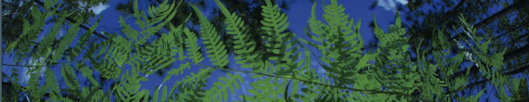

Phylogenetic Diversity
University of Florida

Slide 2
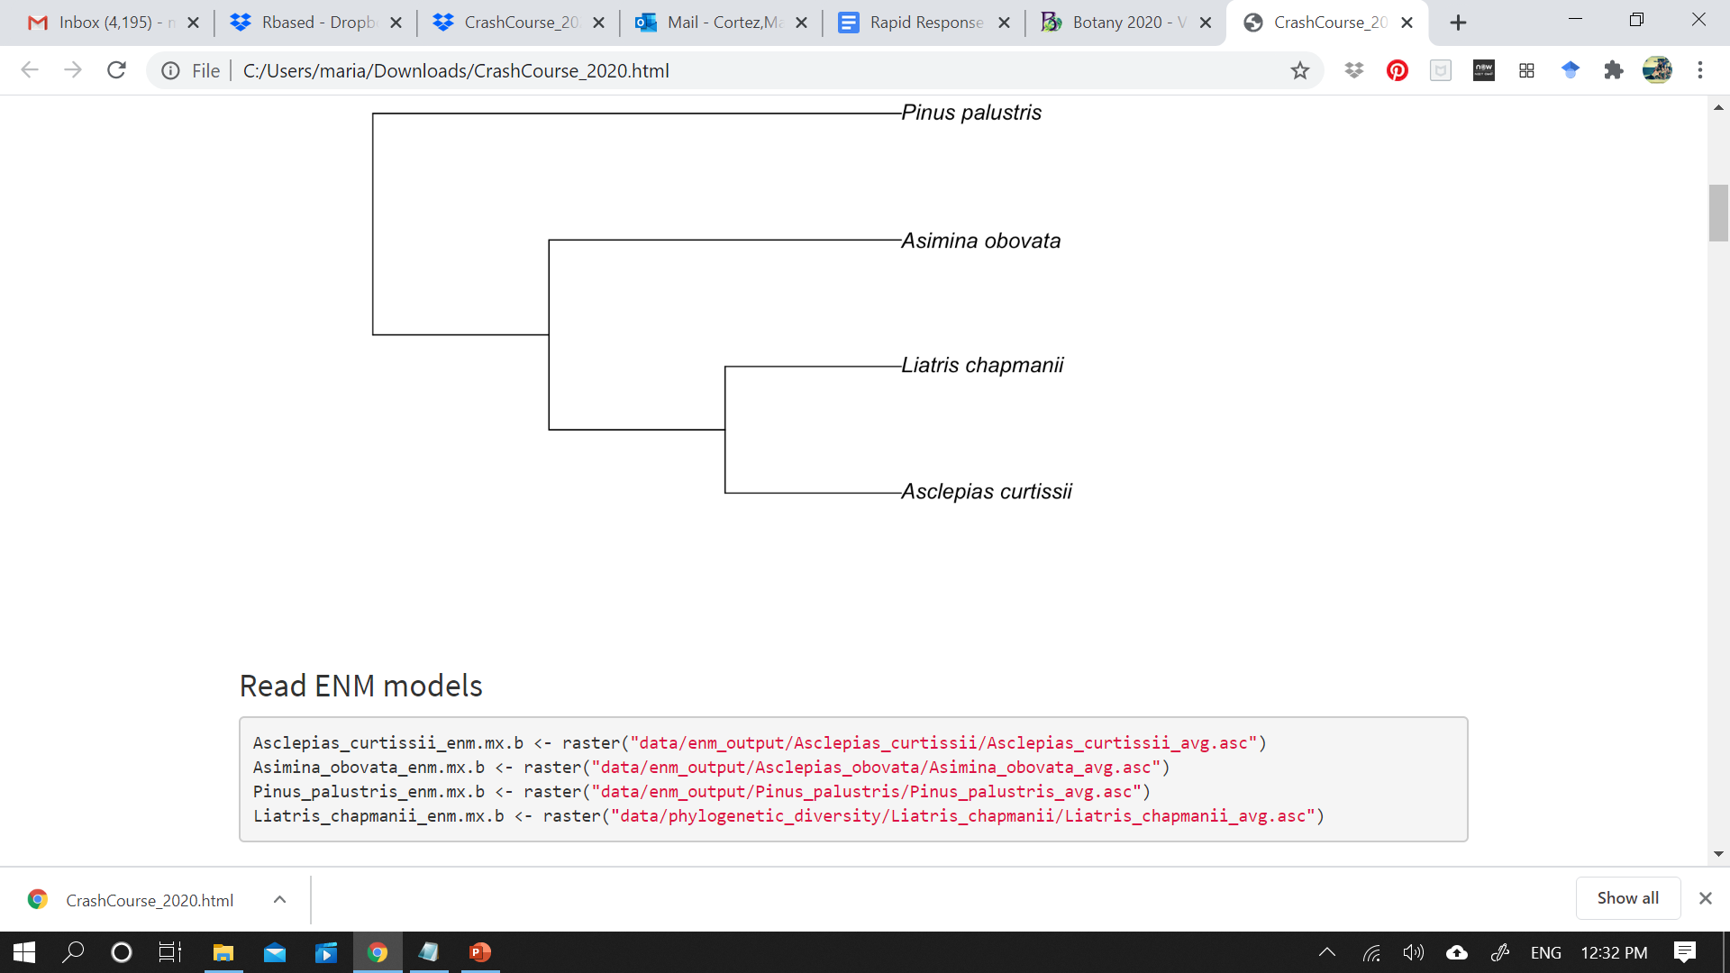
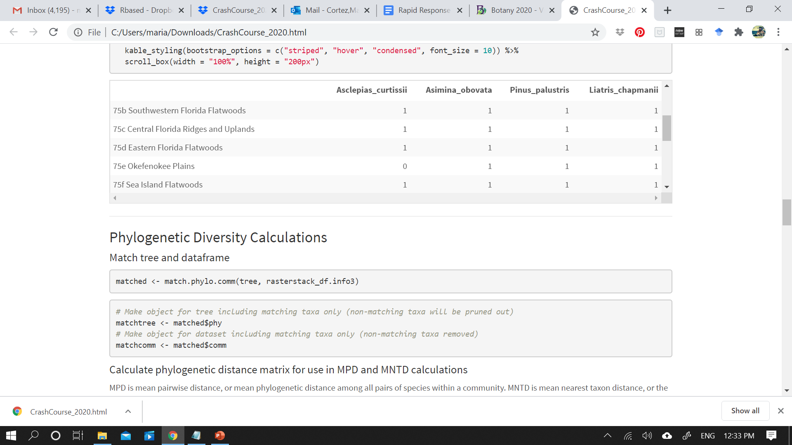
Testing if the assemblage of different communities in a region correlates to phylogenetic history
Tree
Community matrix
R based
“Demo/Rbased/CrashCourse/CrashCourse_2020.Rproj”
Navigate to Phylogenetic_Diversity.R

Slide 3
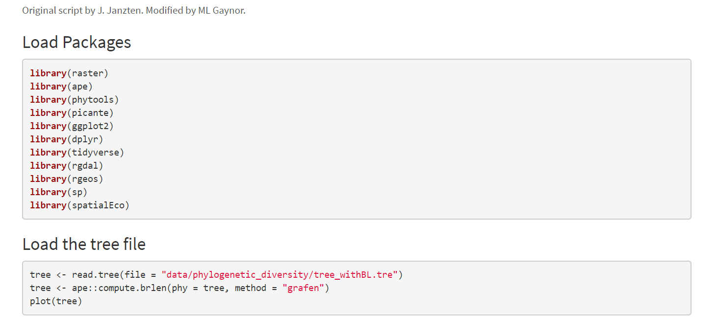

Tree

Slide 4

We can use our niche modelling data to define communities according to ecotypes!
Community matrix

Slide 5
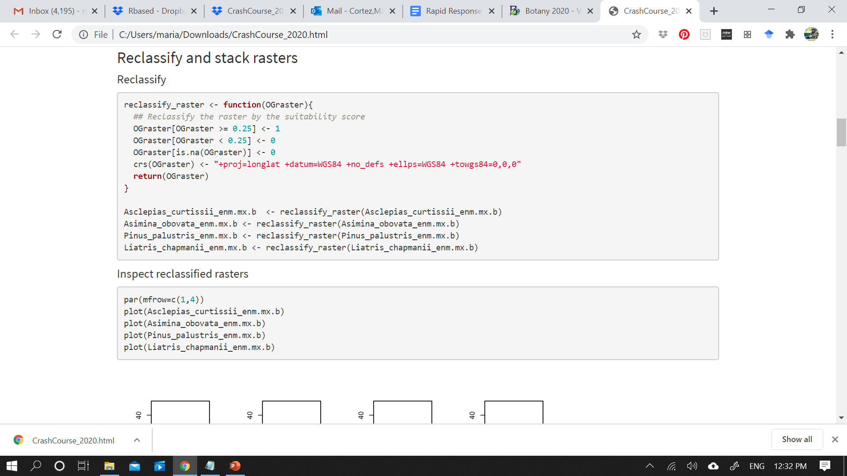
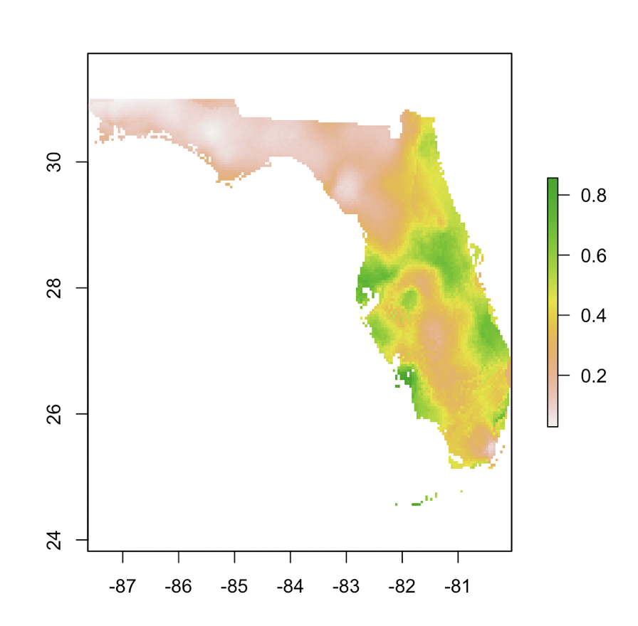
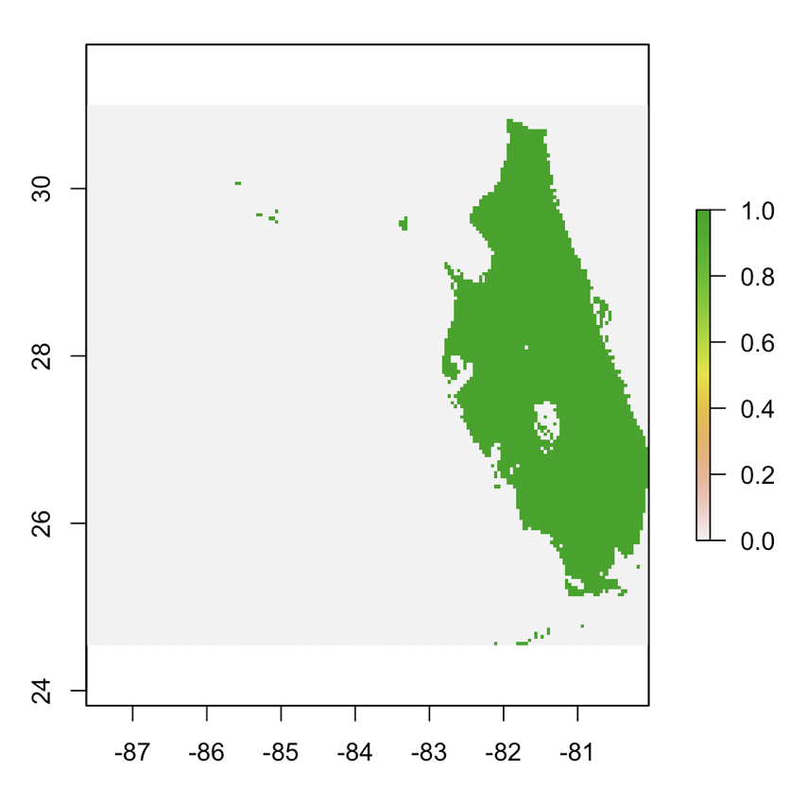
All values higher than 0.25 are considered presence
Average Suitability
Presence/Absence
Reclassify

Slide 6
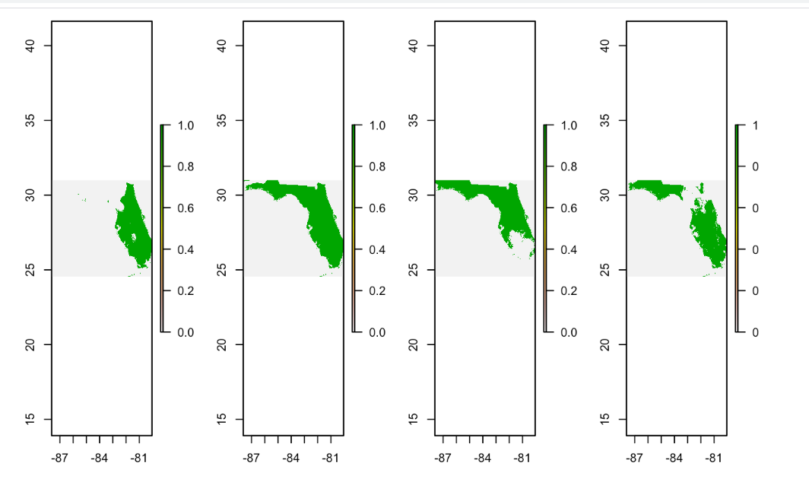
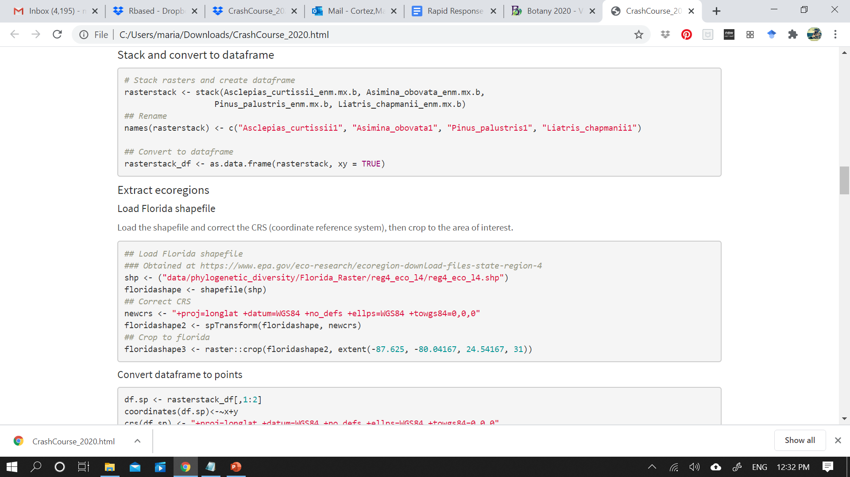
Create a
data frame

Slide 7
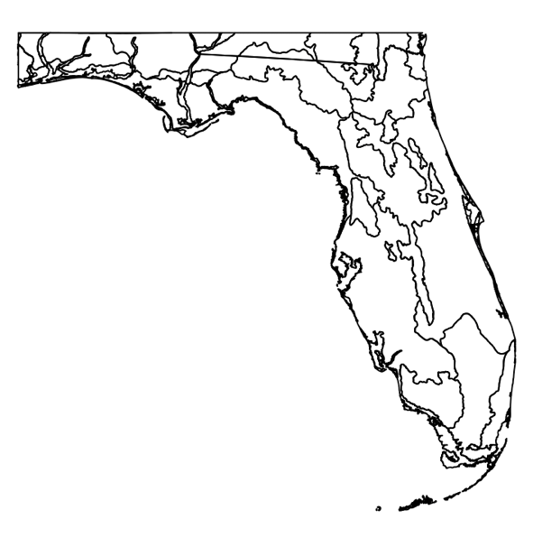
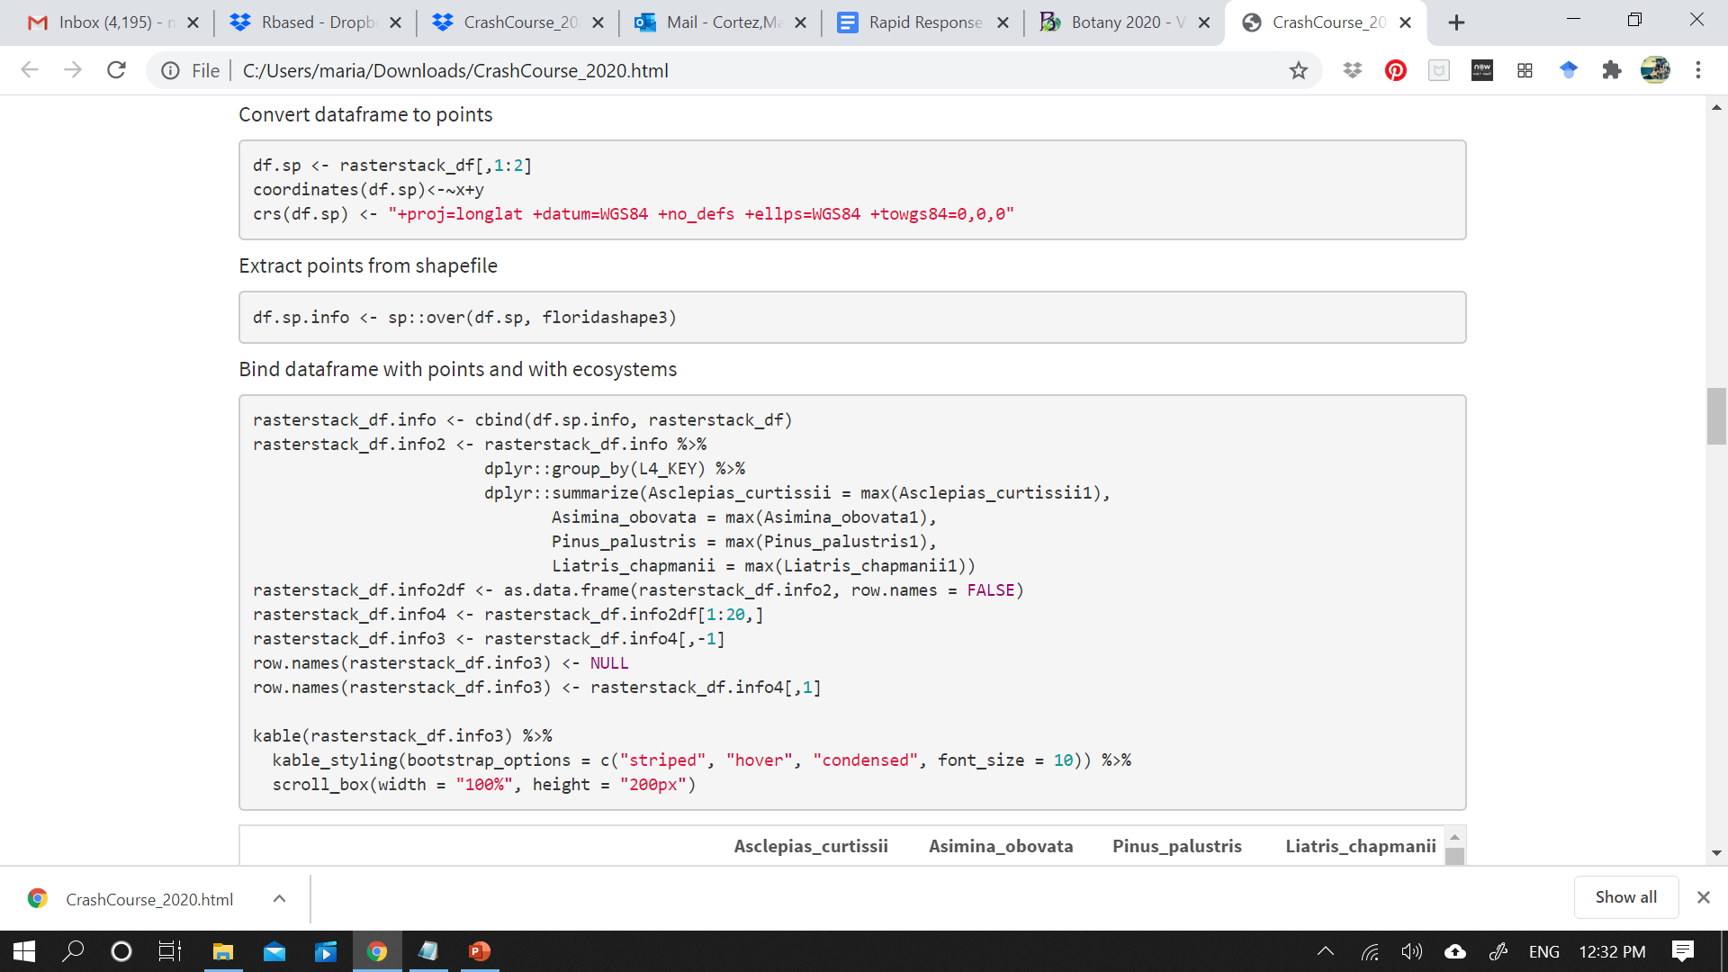
Data frame
Convert
to points
Match points to different ecotypes

Slide 8

Matched points to different ecoregions
Dataframe from stacked rasters (species names and lat/long)
Community matrix

Slide 9
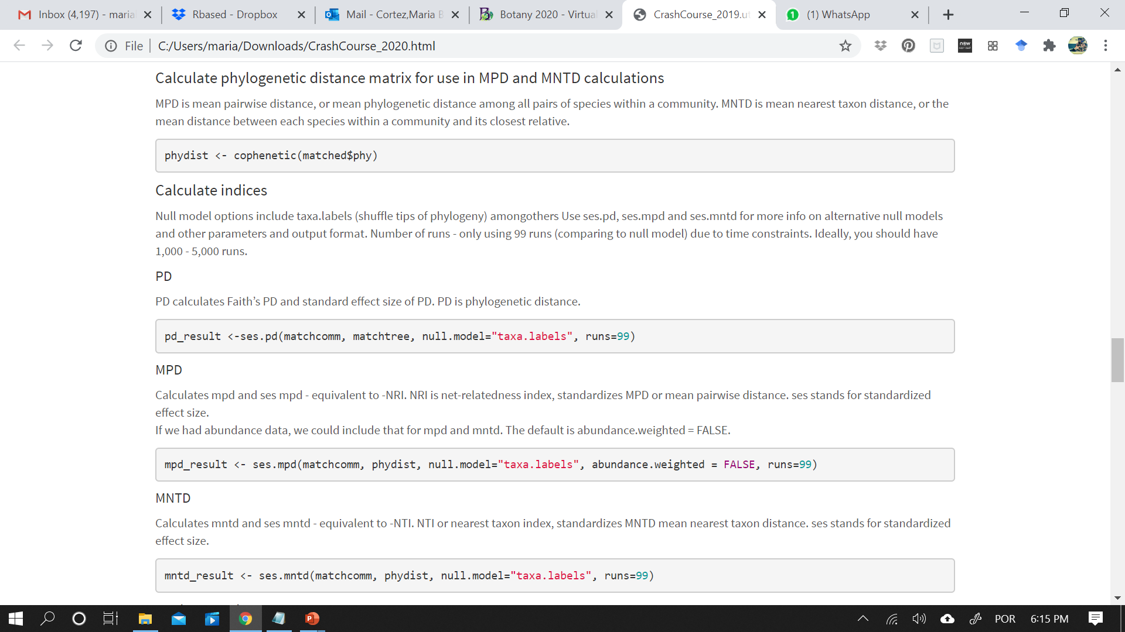
Very important that tree and matrix match!!!!

Slide 11
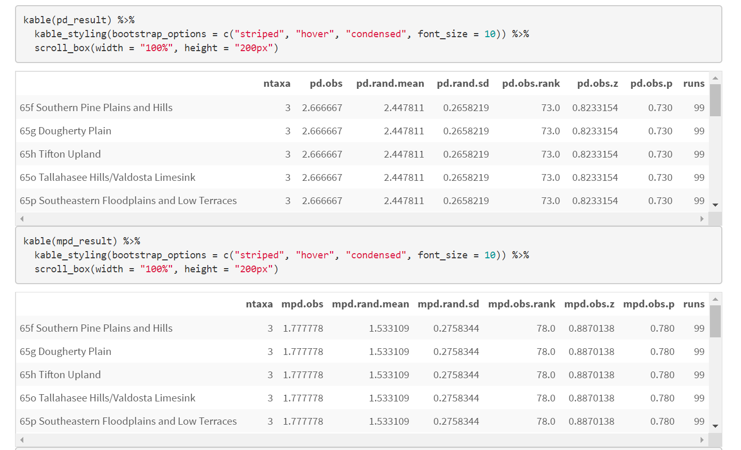
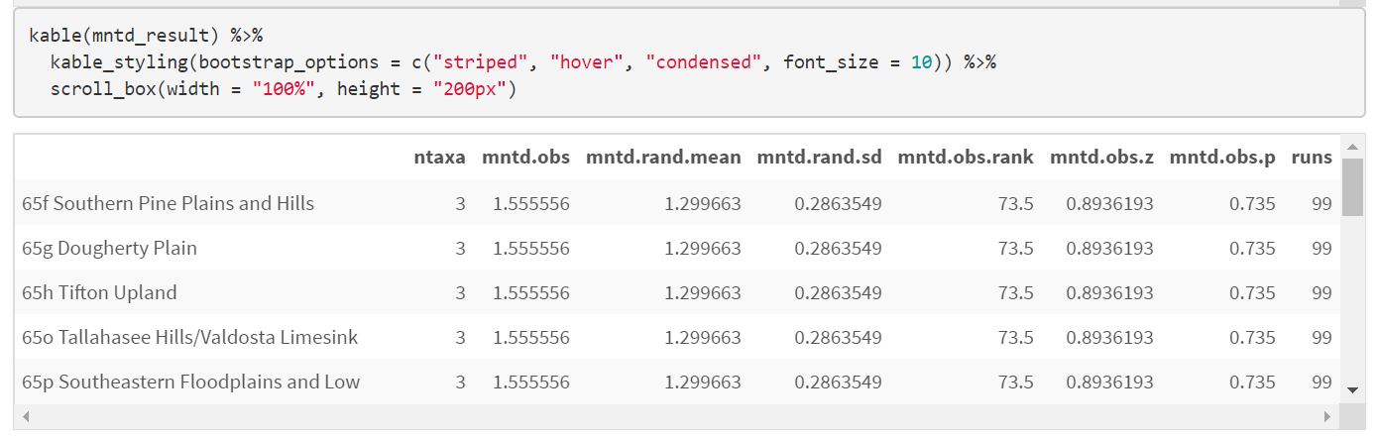
Look at results
Positive ses values (obs.z values) and p values > 0.95 → OVERDISPERSION
Negative ses values (obs.z values) and p values < 0.05 → UNDERDISPERSION

Slide 12
