Slide 1
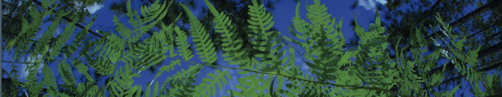
Introduction to Ecological Niche Modeling

Slide 2
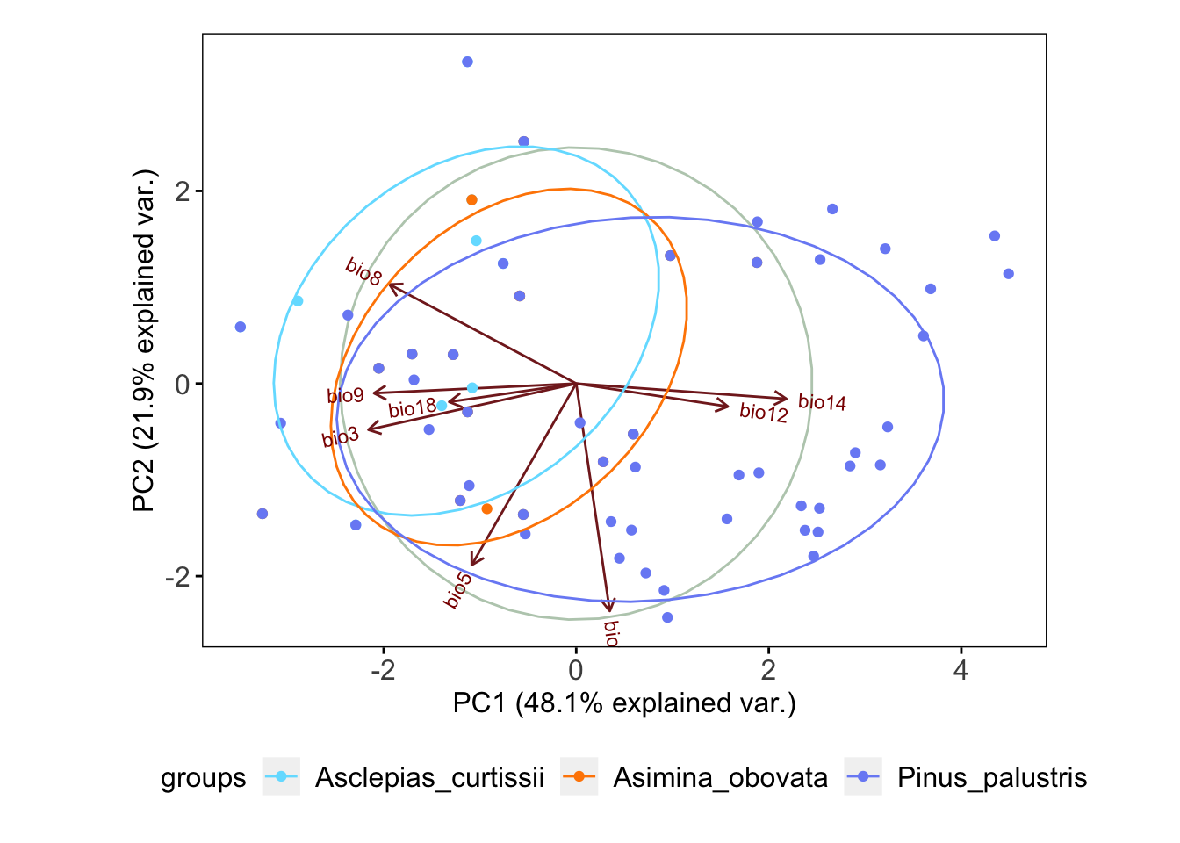
Ecological Niche
Realized Niche
abiotic conditions that a species can occupy with the presence of biotic interactions
Fundamental Niche
abiotic conditions a species could potentially occupy in the absence of biotic interactions

Slide 3
Ecological Niche
Principal Component Analysis (PCA)
Realized Niche
abiotic conditions that a species can occupy with the presence of biotic interactions

Slide 4
Before projecting to novel environment…
Do a Multivariate Environmental Surface Similarity (MESS) analysis
Or calculate Mahalanobis distances

Slide 5
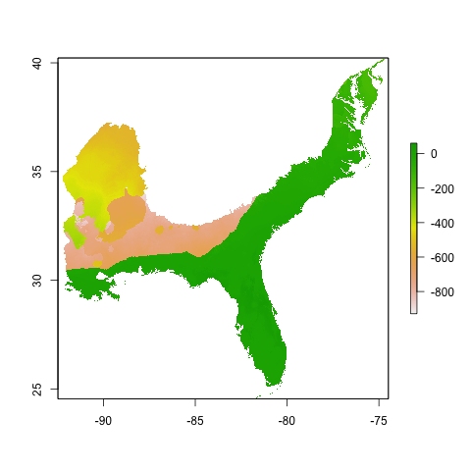
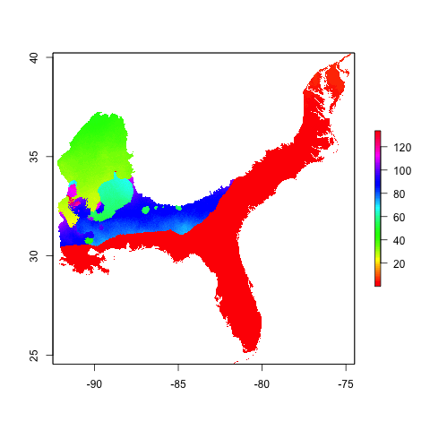
Differences in projection regions
MESS
Mahalanobis distance

Slide 6
Differences in projection regions
MESS
Mahalanobis distance
Fine to train in FL and project to outer parts of coastal plains!

Slide 7
MESS
more negative the score, the more likely you are to project into novel environments.
Mahalanobis distances
higher the distance, the more likely you are to project into novel environments.
MESS
Mahalanobis distance

Slide 8
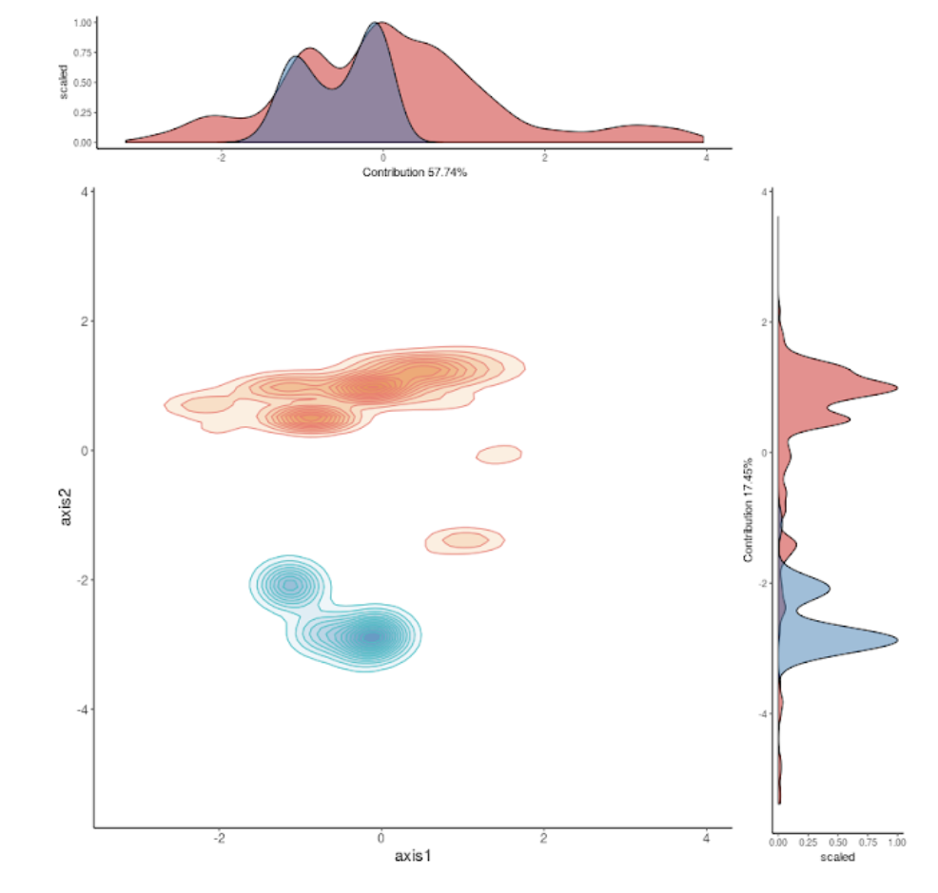
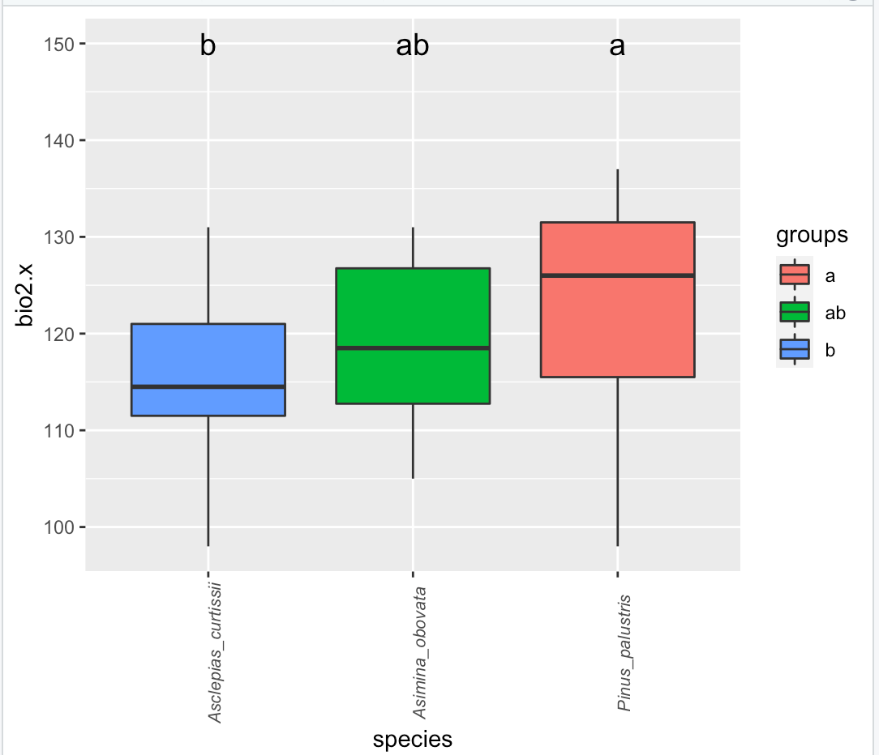
Ecological Niche
ANOVA
PCA + Niche Overlap
niceOverPlot

Slide 9
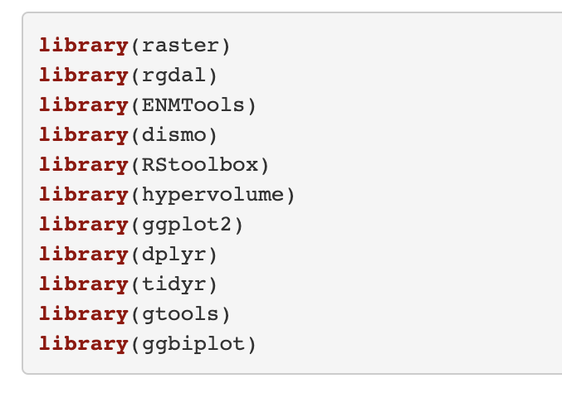
Load Packages

Slide 10
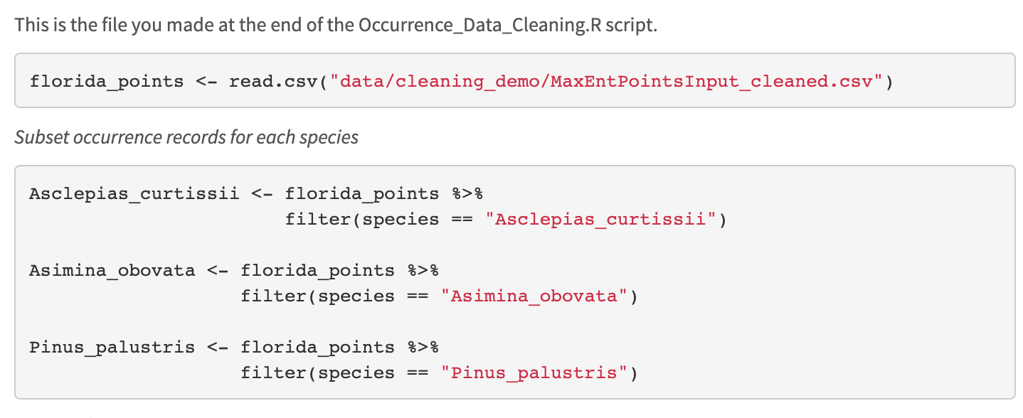
Load Datafile

Slide 11
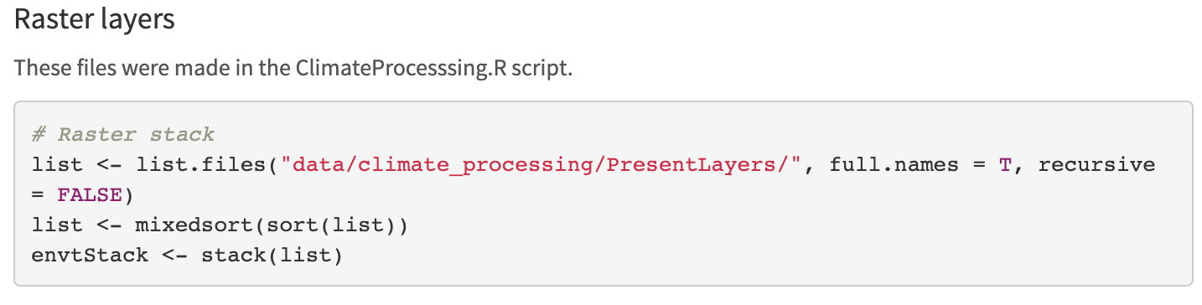
Load Climatic Layers

Slide 12
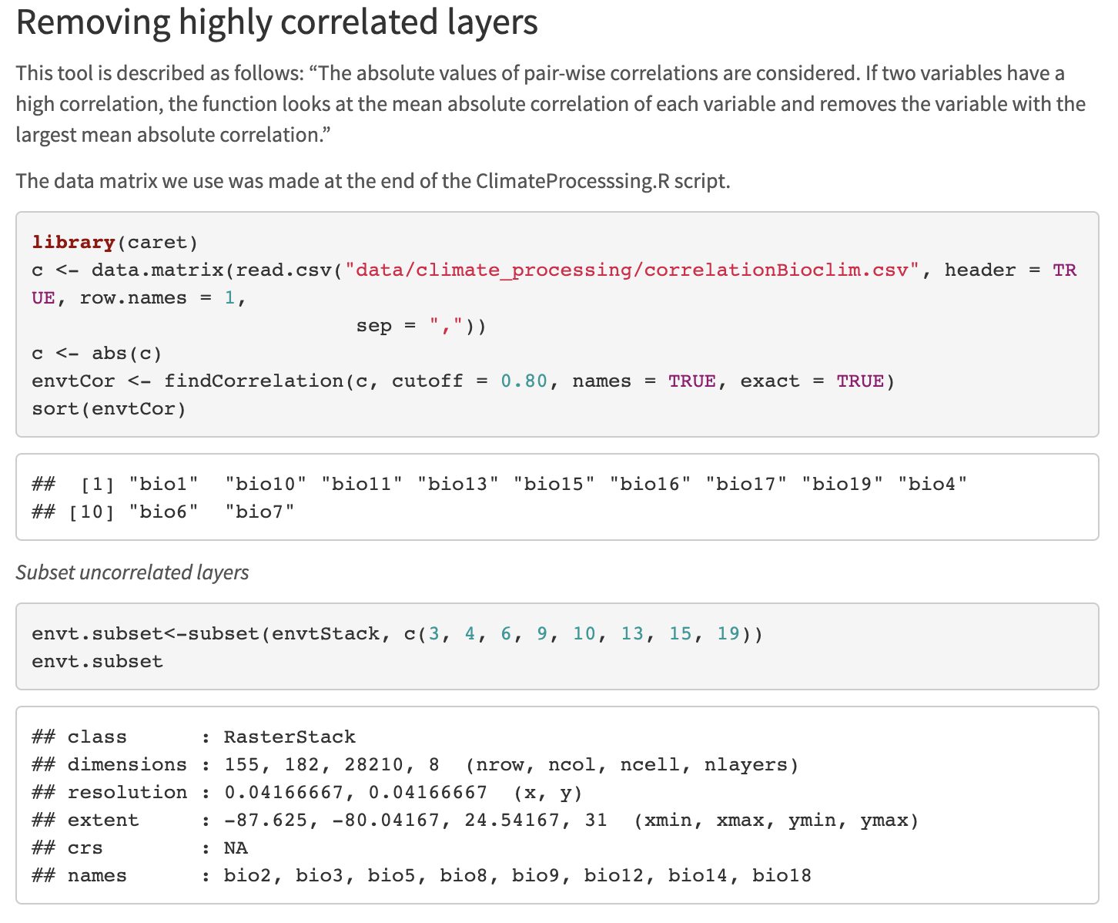

Slide 13
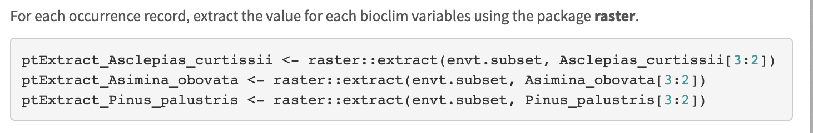

Slide 14
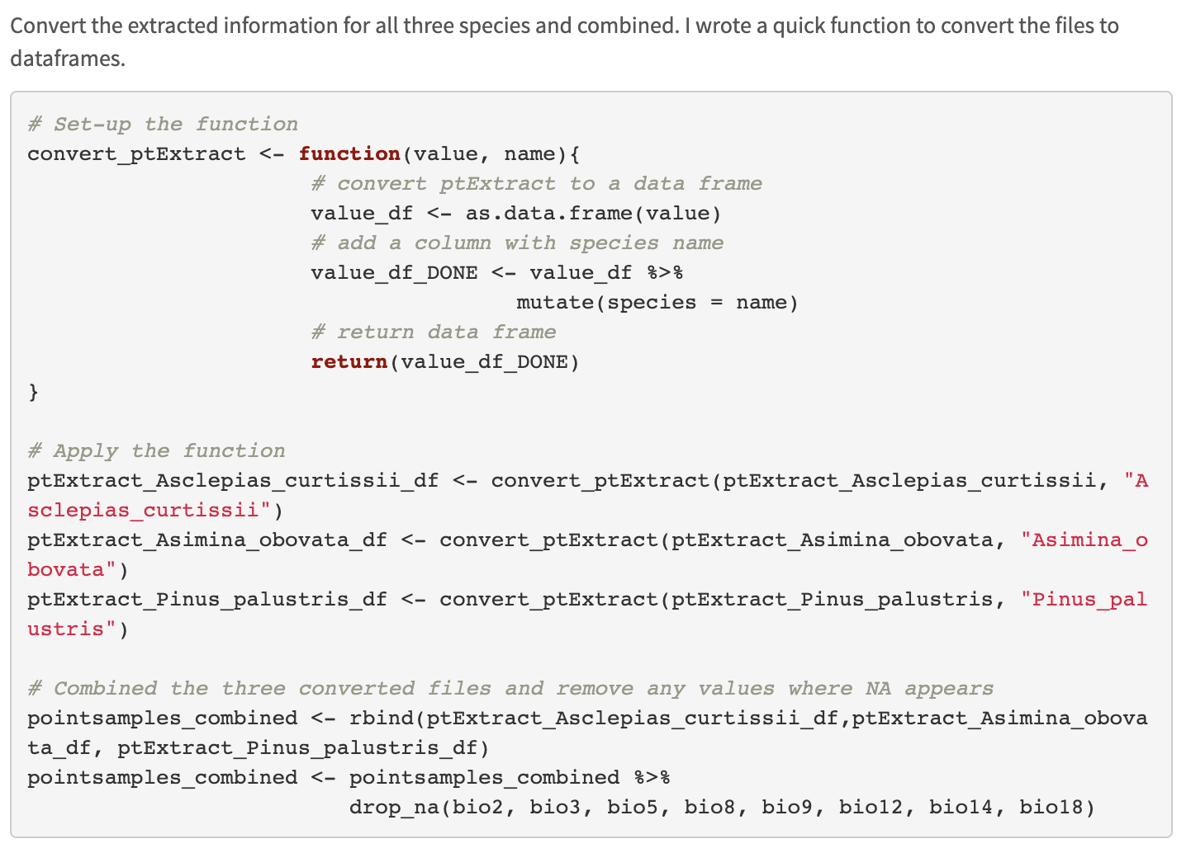

Slide 15
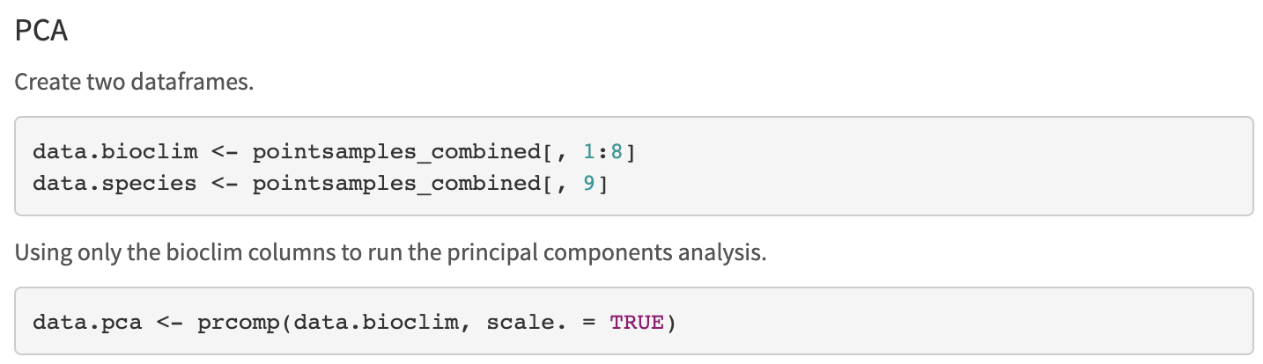
Principal Component Analysis (PCA)

Slide 16
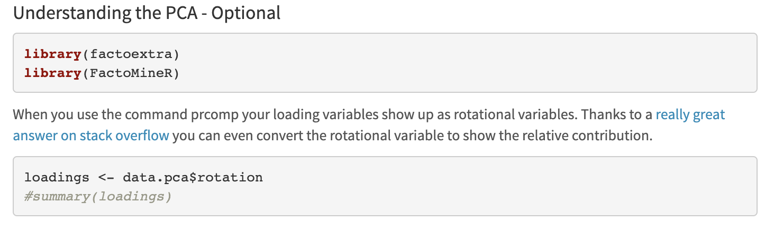
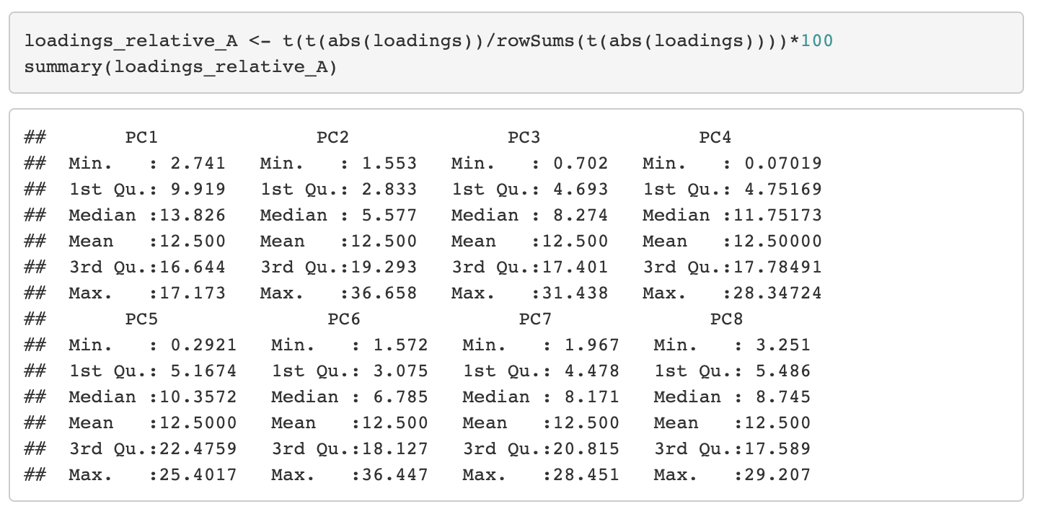
Principal Component Analysis (PCA)

Slide 17
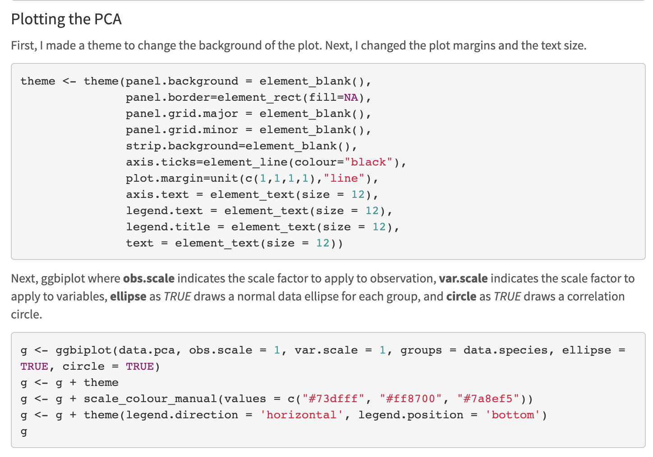
Principal Component Analysis (PCA)

Slide 18
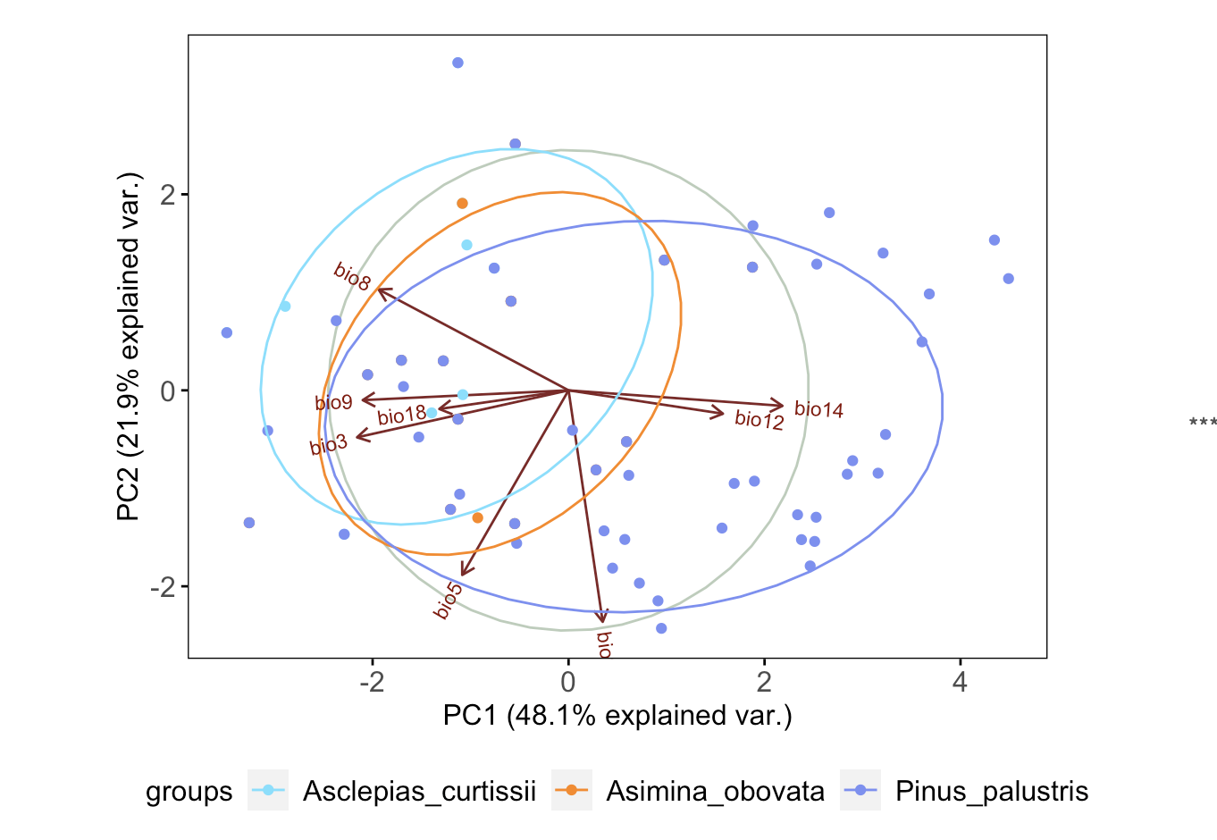
Principal Component Analysis (PCA)

Slide 19
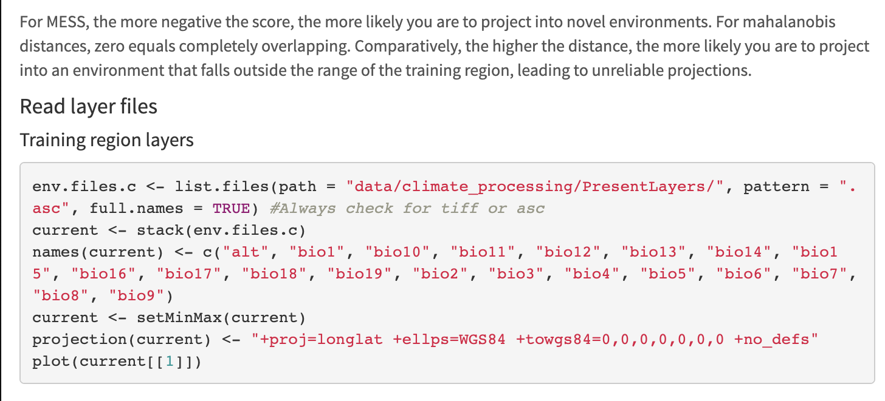
Multivariate environment similarity surface (MESS) analysis
& Mahalanobis distances

Slide 20
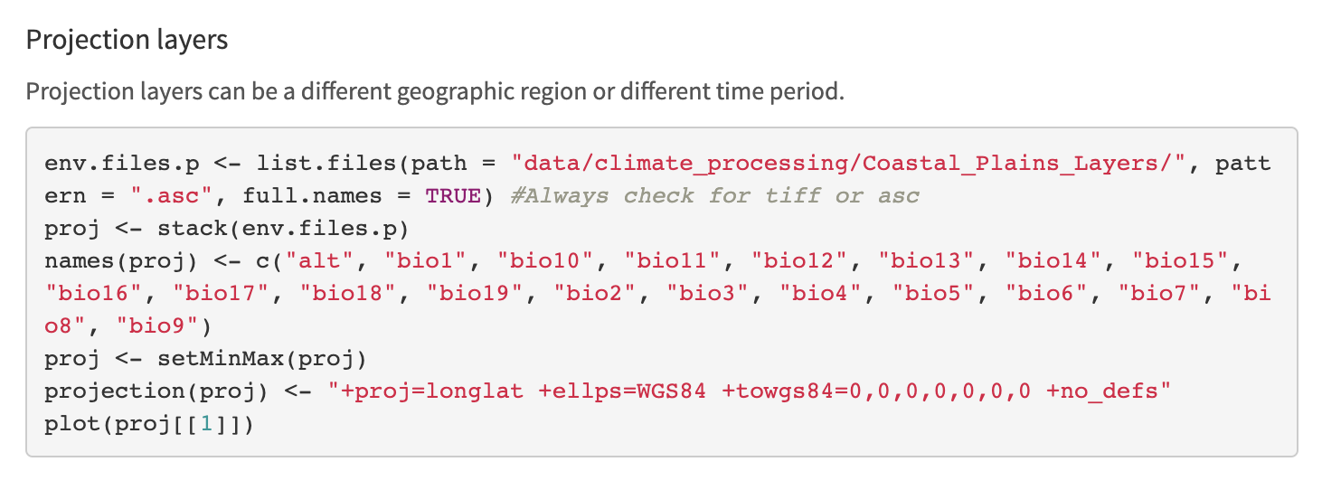
Multivariate environment similarity surface (MESS) analysis
& Mahalanobis distances

Slide 21
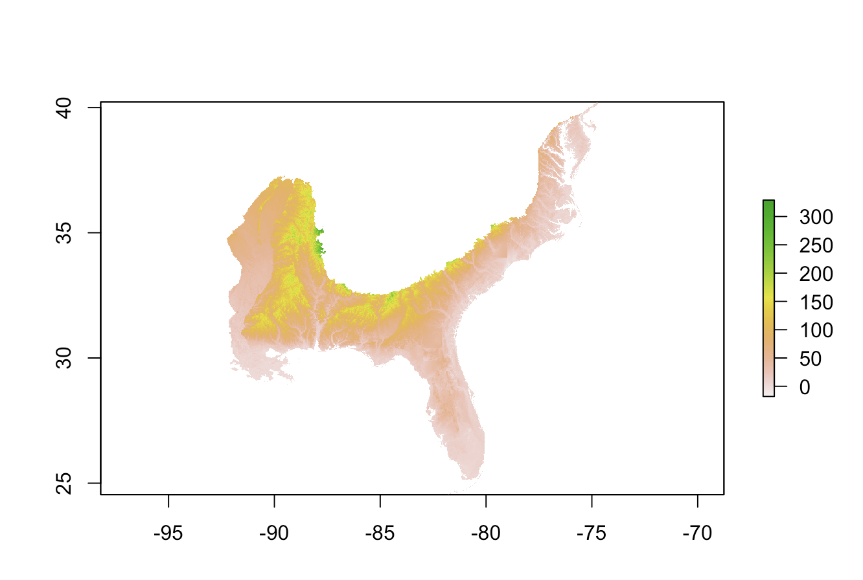

Slide 22
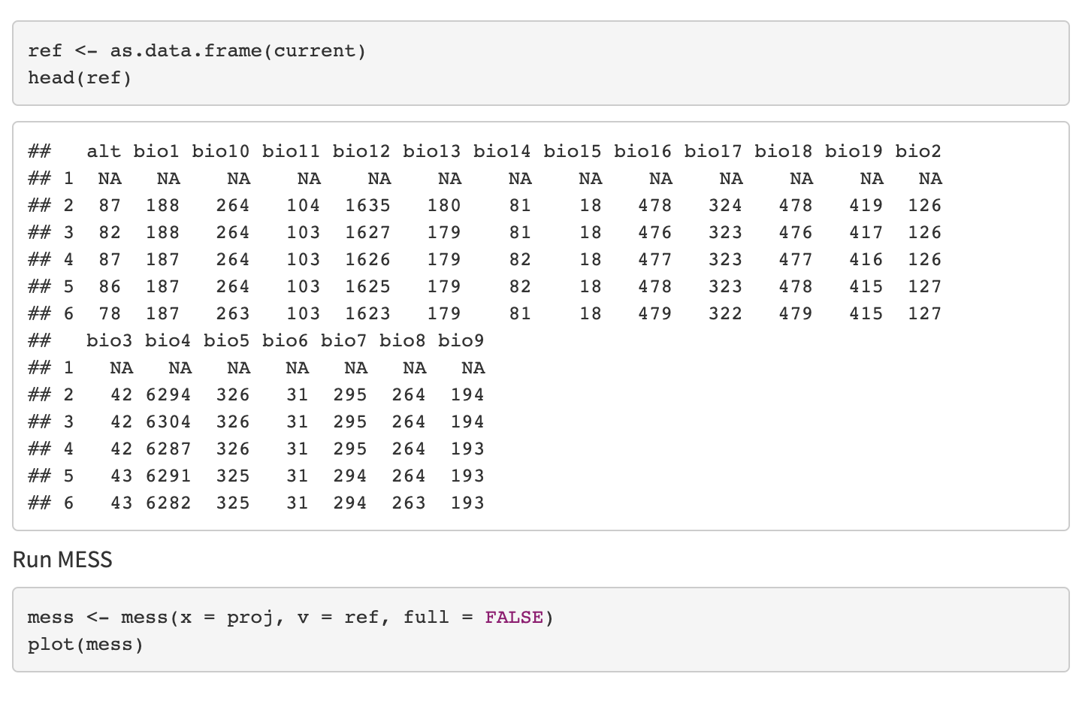
Multivariate environment similarity surface (MESS) analysis

Slide 23
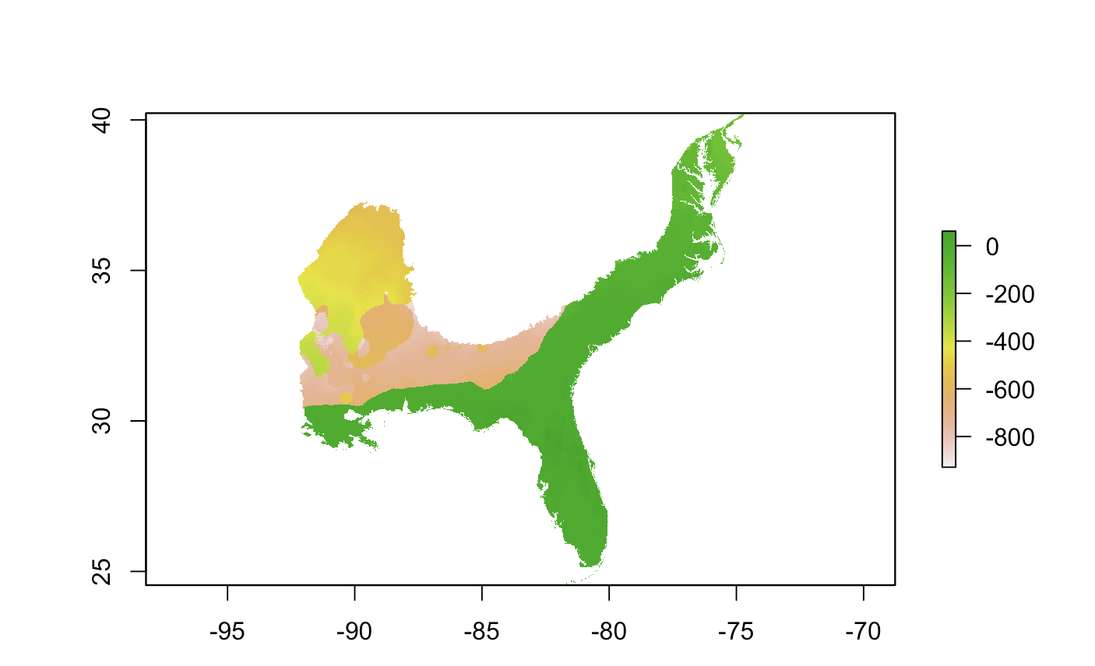
Multivariate environment similarity surface (MESS) analysis

Slide 24
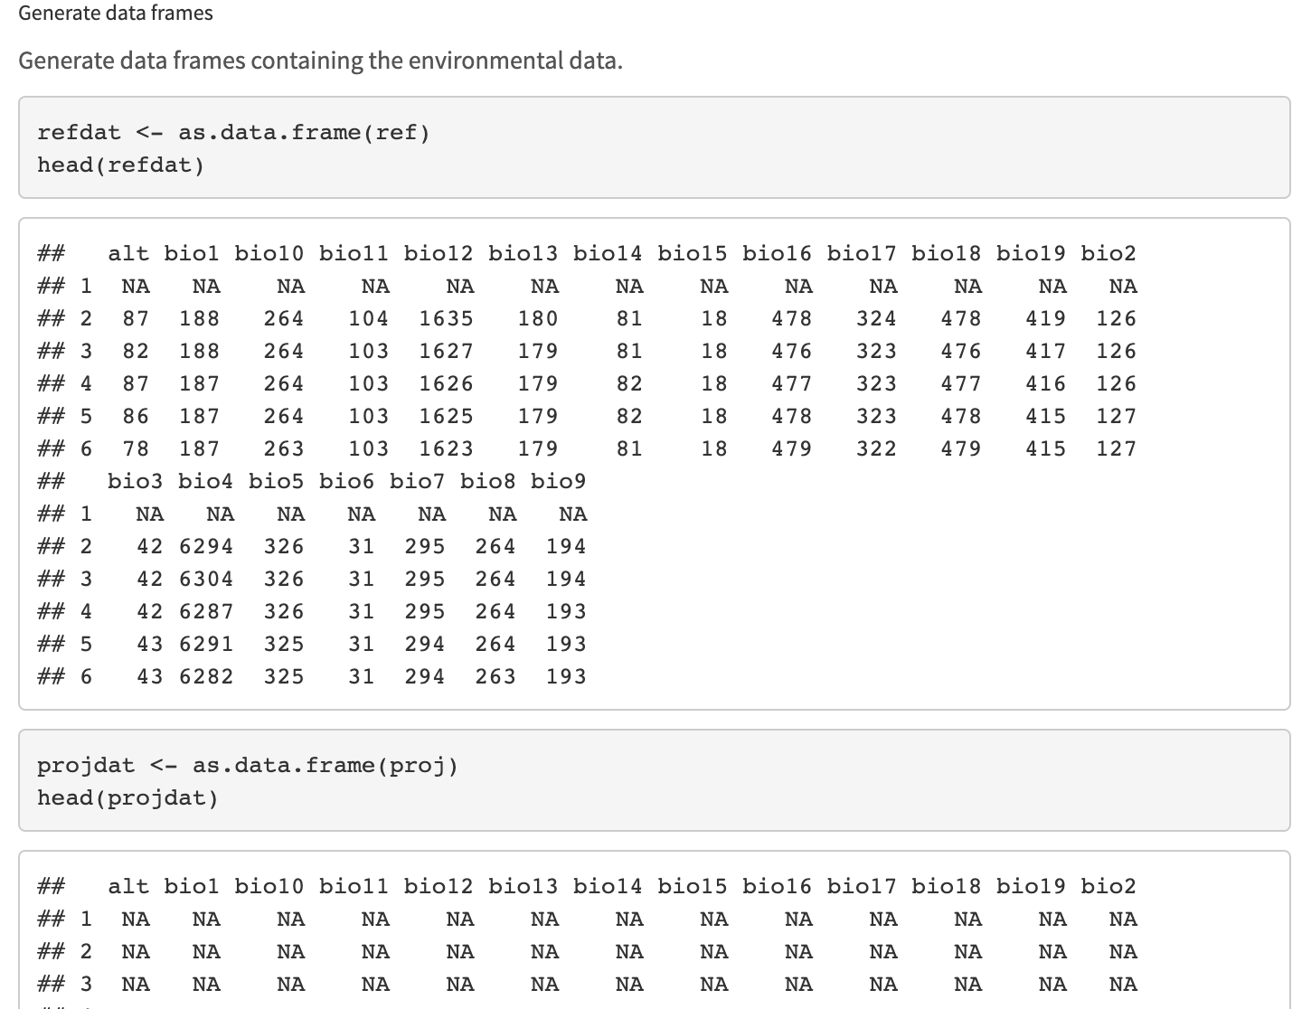
Mahalanobis distances

Slide 25
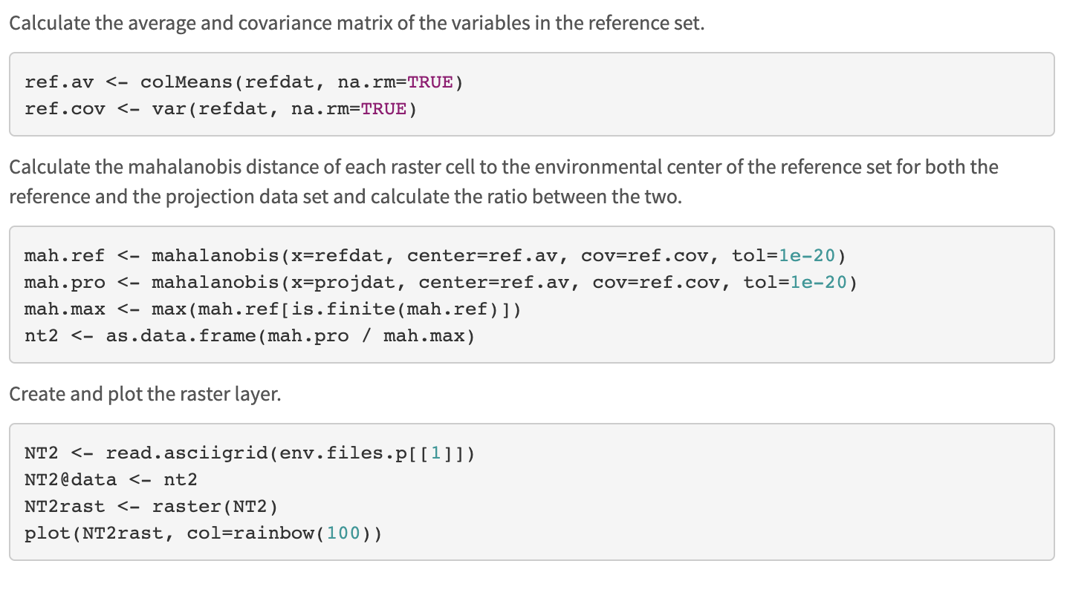
Mahalanobis distances

Slide 26
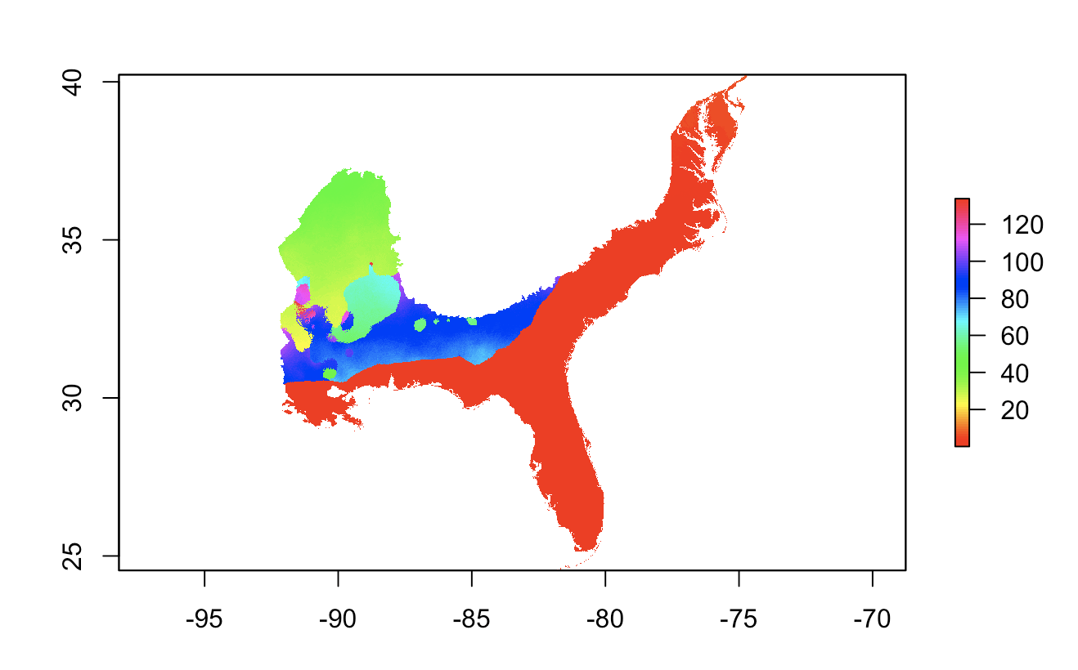
Mahalanobis distances

