Slide 1
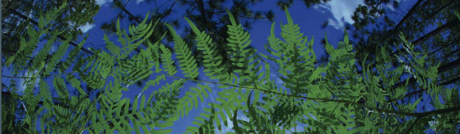

Post-ENM
University of Florida

Slide 2
Post-ENM
Analysis without ENMs
Overview of commonly used post-modeling analysis.
Niche Breadth
Niche Overlap
Geographic Overlap
Niche Identity and Background test
Age overlap correlation test

Slide 3
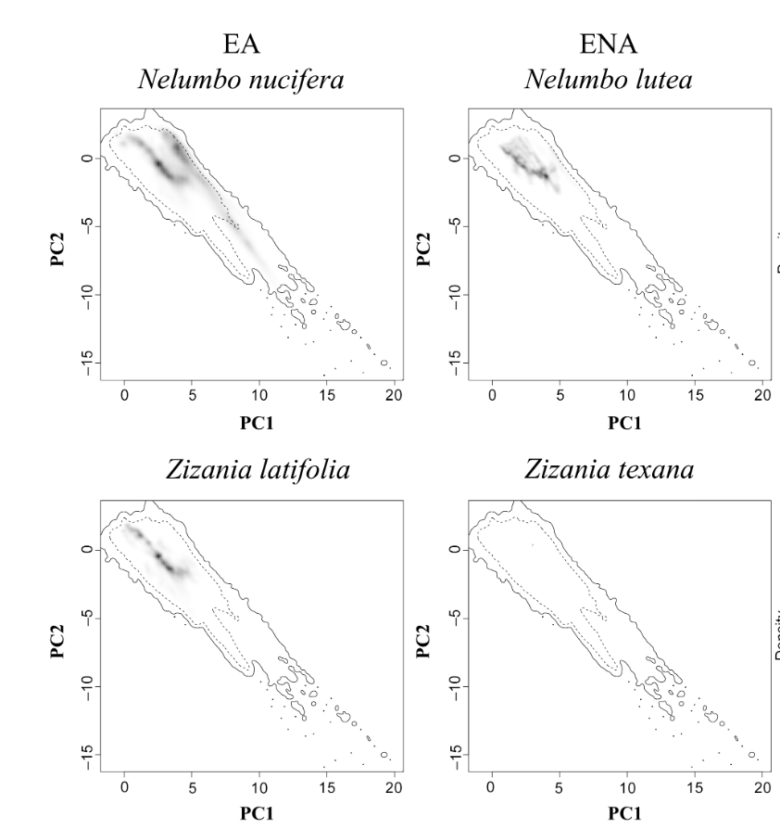
Analysis without ENMs
niche area = 27.3
Niche area calculations based on ‘ecospat’ R package.
Niche area is equal to the variance of ecological space along PC1 × variance of ecological space along PC2
Larger niche area = more suitable area
The solid line represents the total niche area within the study area, and the dotted line represents 50% of the niche area within the study.
niche area = 1.35× 10−5
Melton et al. 2022. Global Ecology and Biogeography.

Slide 4
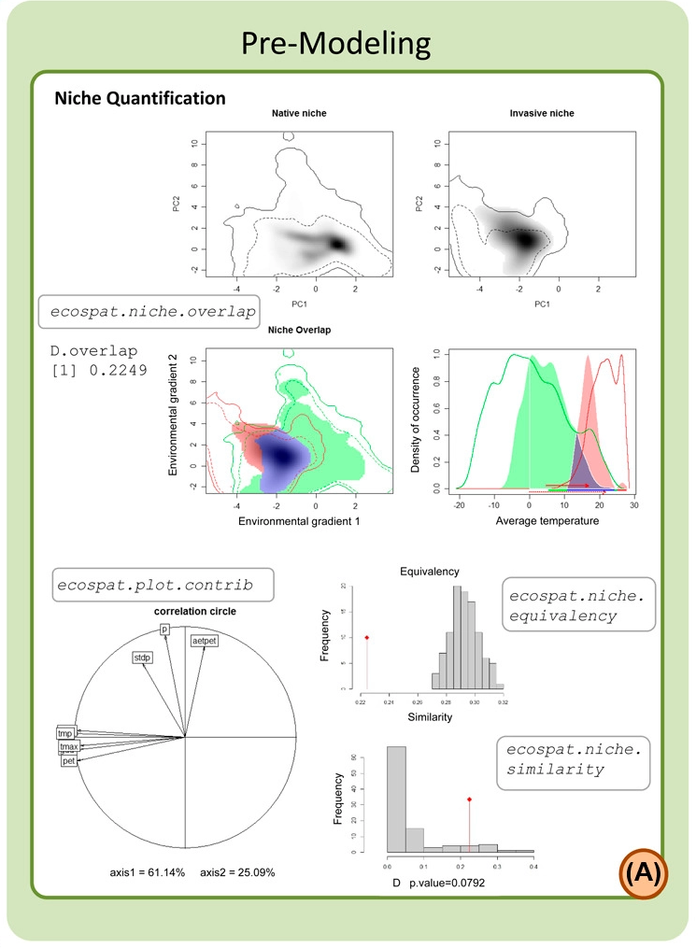
ecospat
Niche occupancy
Niche overlap based on Schoener’s D
Ranges from 0 to 1
0 represents no niche similarity between the models
1 represents completely identical niches
Correlation circle
Plots contribution of initial variables to variation seen in the data.
Niche Equivalency (Graham et al. 2004)
Are the niche of two species indistinguishable?
Niche Similarity (Peterson et al. 1999)
Can the niche of one species predicted that of another?
Di Cola et al. 2017. Ecography.

Slide 5
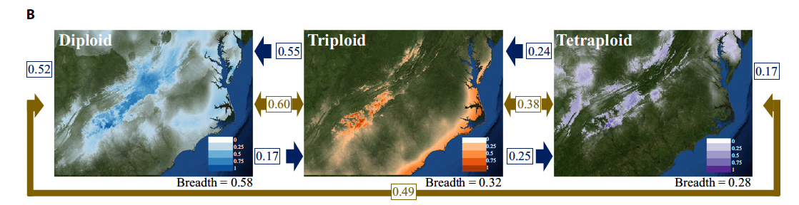
Post-ENM: Niche Breadth
Niche breadth:
is a means of calculating the breadth of suitable climatic factors for a species, providing a value ranging from 0 to 1.
larger values represent more generalist species with wider climatic tolerances
smaller values represent more specialized species with more narrow tolerance
Gaynor et al. 2018. American Journal of Botany.

Slide 6
Post-ENM: Niche Overlap
Niche overlap (gold):
Schoener’s D ranges from 0 to 1
0 represents no niche similarity between the models
1 represents completely identical niches
Geographic Overlap (blue):
percentage of points found in the models A distribution relative to those in the model Bs distribution.
Gaynor et al. 2018
Gaynor et al. 2018. American Journal of Botany.

Slide 7
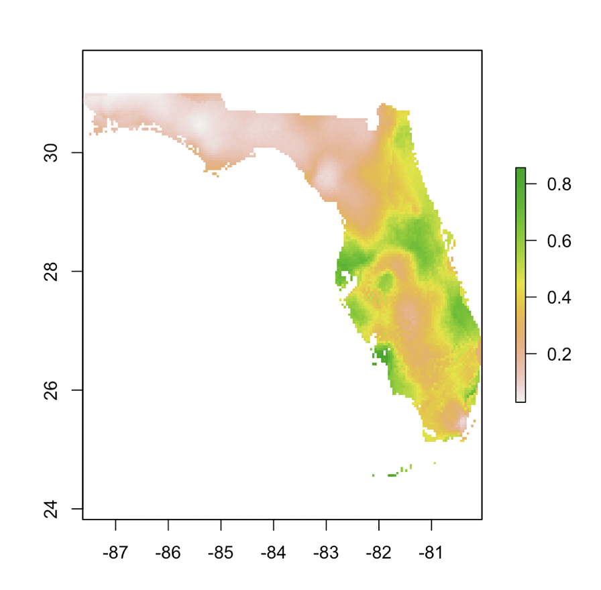
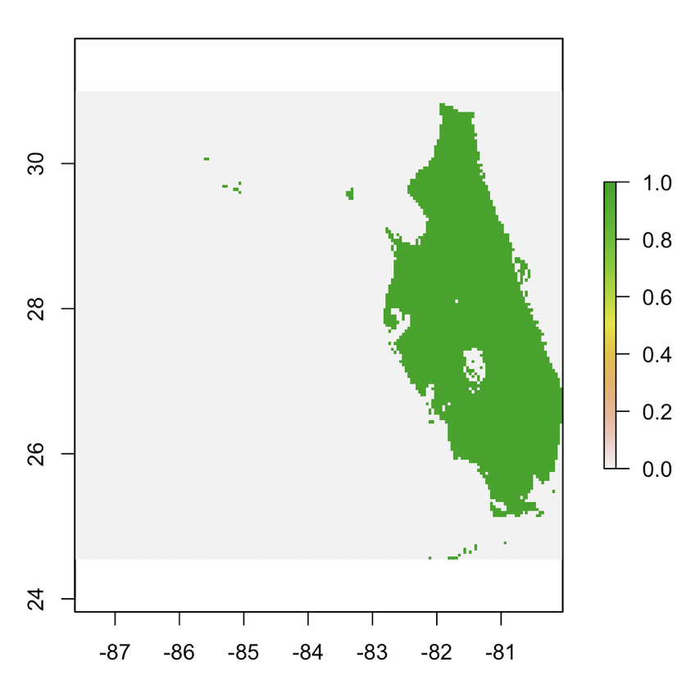
Post-ENM
Geographic Overlap
Reclassify

Slide 8
Post-ENM: Geographic Overlap
Geographic Overlap (blue):
percentage of points found in the models A distribution relative to those in the model Bs distribution.
Gaynor et al. 2018
Gaynor et al. 2018. American Journal of Botany.

Slide 9
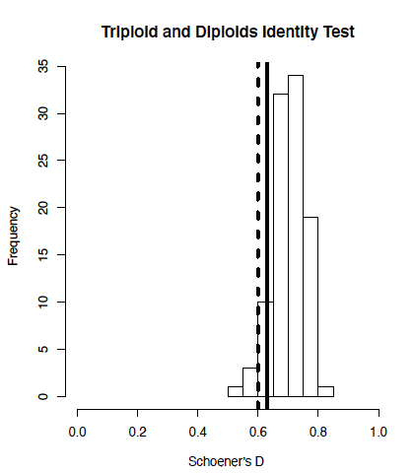
Niche Identity and Background Test
Niche Identity Test:
Niche Equivalency (Graham et al. 2004)
Are the niche of two species indistinguishable?
Compares niche models with the same number of occurrence records as the original models, but with randomly distributed localities x 100
Niche Background Test:
Niche Similarity (Peterson et al. 1999)
Can the niche of one species predicted that of another?
Warren et al. 2010. ENMTools: a toolbox for comparative studies of environmental niche models

Slide 10
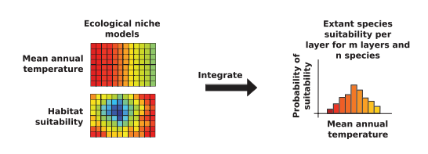
Niche and Phylogenetics
Point-Based
Principal Component Analysis (PCA)
Age-overlap correlation test:
Range &point based
Model-based
Phylogenetic PCA (pPCA)
Blomberg’s K statistic and Pagel’s lambda
Ecological Niche Shifts
R package l1ou
Predicted Niche Occupancy
Folk et al. 2018. The American Naturalist.

Slide 11
Niche and Phylogenetics
Point-Based
Principal Component Analysis (PCA)
Age-overlap correlation test:
Range &point based
Model-based
Phylogenetic PCA (pPCA)
Blomberg’s K statistic and Pagel’s lambda
Ecological Niche Shifts
R package l1ou
Predicted Niche Occupancy
Folk et al. 2018. The American Naturalist.

Slide 12
Age overlap correlation test
identical niches
1
Ecological Niche Overlap
Schoener’s D
no overlap
0
Age (MYA)

Slide 13
Age overlap correlation test
identical niches
1
Ecological Niche Overlap
Schoener’s D
no overlap
0
Age (MYA)
Mode of Speciation | Intercept | Slope
Sympatric | > 0.5
Allopatric | < 0.5 | positive
Parapatric | < 0.5 | near or below 0
Fitzpatrick & Turelli. 2006. Evolution.

Slide 14
Age overlap correlation test
Range Overlap
Point Overlap
Local
co-occurrence
Allopatric
Allopatric
Sympatric
Sympatric
Cardillo and Warren. 2016. Global Ecology and Biogeography.

Slide 15
Age overlap correlation test
Point-based
Galax urceolata
0.233
0.890
Pyxidanthera barbulata
Pyxidanthera brevifolia
0.068
0.213
Ecological overlap
Shortia sinensis
0.000
0.000
Shortia uniflora
0.000
0.000
0.000
0.000
Shortia rotundifolia
0.003
0.000
Shortia galacifolia
0.026
0.033
Age (MYA)
0.216
0.670
Schizocodon soldanelloides
Range-based
Schizocodon ilicifolius
0.002
0.009
Diapensia wardii
0.093
0.068
0.350
0.339
0.211
0.269
Diapensia obovata
Diapensia lapponica
Ecological overlap
0.006
0.017
0.377
0.394
Diapensia purpurea
Diapensia himalaica
Berneuxia thibetica
Gaynor et al. 2020. Journal of Systematics and Evolution.
Age (MYA)
Notes:
Both suggested lots of instances of Parapatric, which has been associated with phylogenetic niche divergence

Slide 16
Age overlap correlation test
Point-based
Galax urceolata
0.233
0.890
Pyxidanthera barbulata
Allopatric
Pyxidanthera brevifolia
0.068
0.213
Ecological overlap
Shortia sinensis
0.000
0.000
Shortia uniflora
0.000
0.000
0.000
0.000
Shortia rotundifolia
0.003
0.000
Shortia galacifolia
0.026
0.033
Age (MYA)
0.216
0.670
Schizocodon soldanelloides
Allopatric
Range-based
Schizocodon ilicifolius
0.002
0.009
Diapensia wardii
0.093
0.068
0.350
0.339
0.211
0.269
Diapensia obovata
Parapatric
Diapensia lapponica
Ecological overlap
0.006
0.017
0.377
0.394
Diapensia purpurea
Parapatric
Diapensia himalaica
Berneuxia thibetica
Gaynor et al. 2020. Journal of Systematics and Evolution.
Age (MYA)

Slide 18
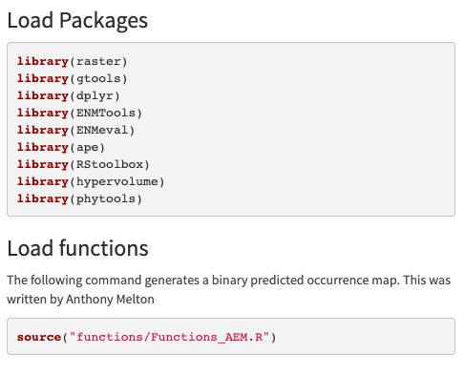
Load Packages and Functions

Slide 19
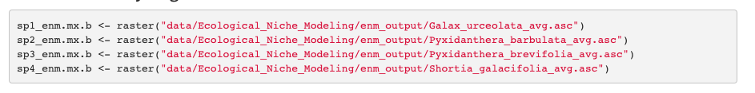
Load ENM Models

Slide 20
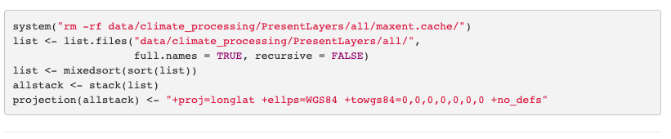
Load Bioclim layers

Slide 21
ENM Breadth
Niche breadth is the breadth of environmental factors for a species’ niche, ranging from 0 to 1.
When breadth is closer to 1 the more generalist species with wider tolerances.
Values closer to 0 indicate a more specialized species.
The raster.breadth command in ENMTools measures the smoothness of suitability scores across a projected landscape. The higher the score, the more of the available niche space a species occupies.

Slide 22
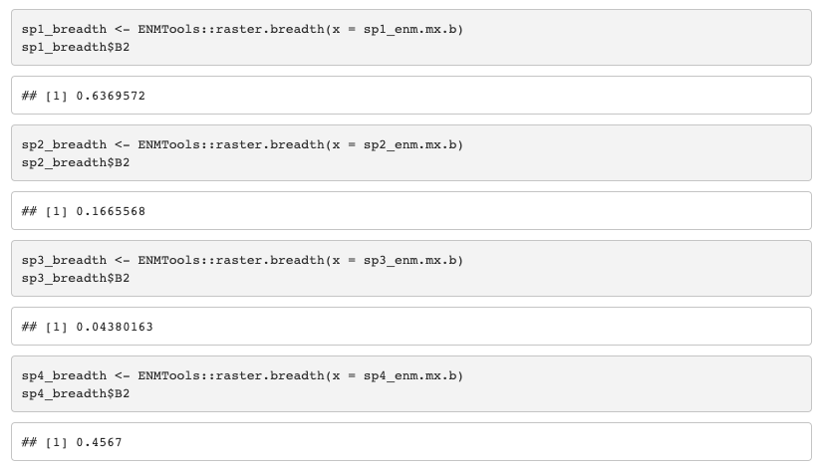
ENM Breadth

Slide 23
ENM Overlap
Calculating niche overlap:
Schoener’s D, with ENMEval - Schoener’s D ranges from 0 to 1
0 represents no similarity between the projections
1 represents completely identical projections.

Slide 24
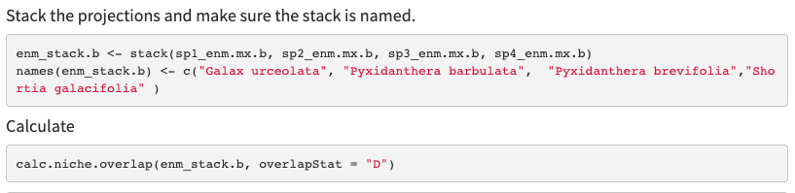
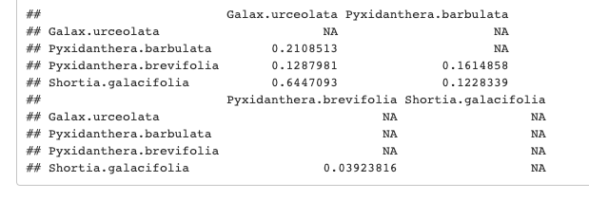
ENM Overlap

Slide 25
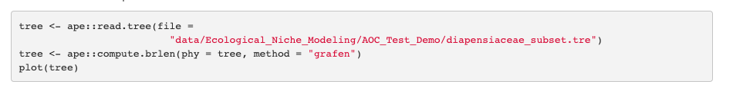
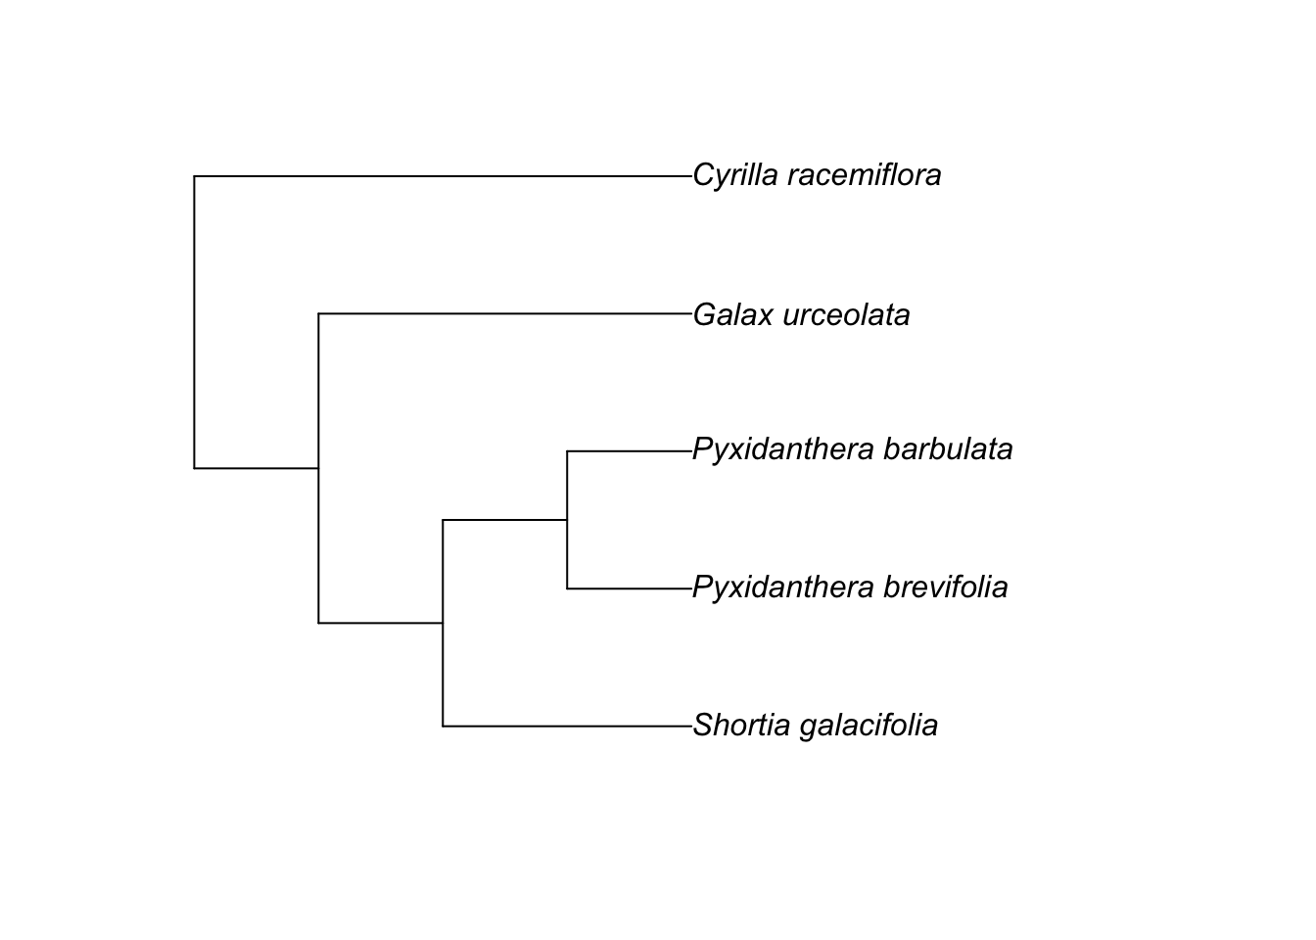
Phylogenetic correlation

Slide 26

Phylogenetic correlation

Slide 27
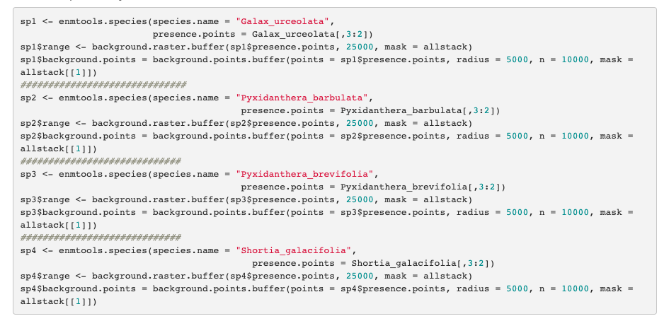
Phylogenetic correlation

Slide 28

Phylogenetic correlation

Slide 29
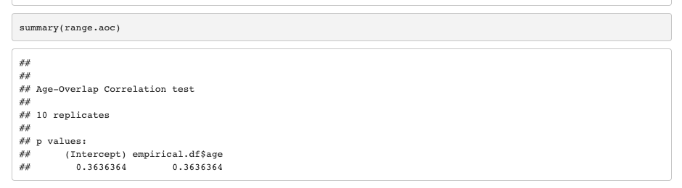
Phylogenetic correlation

Slide 30
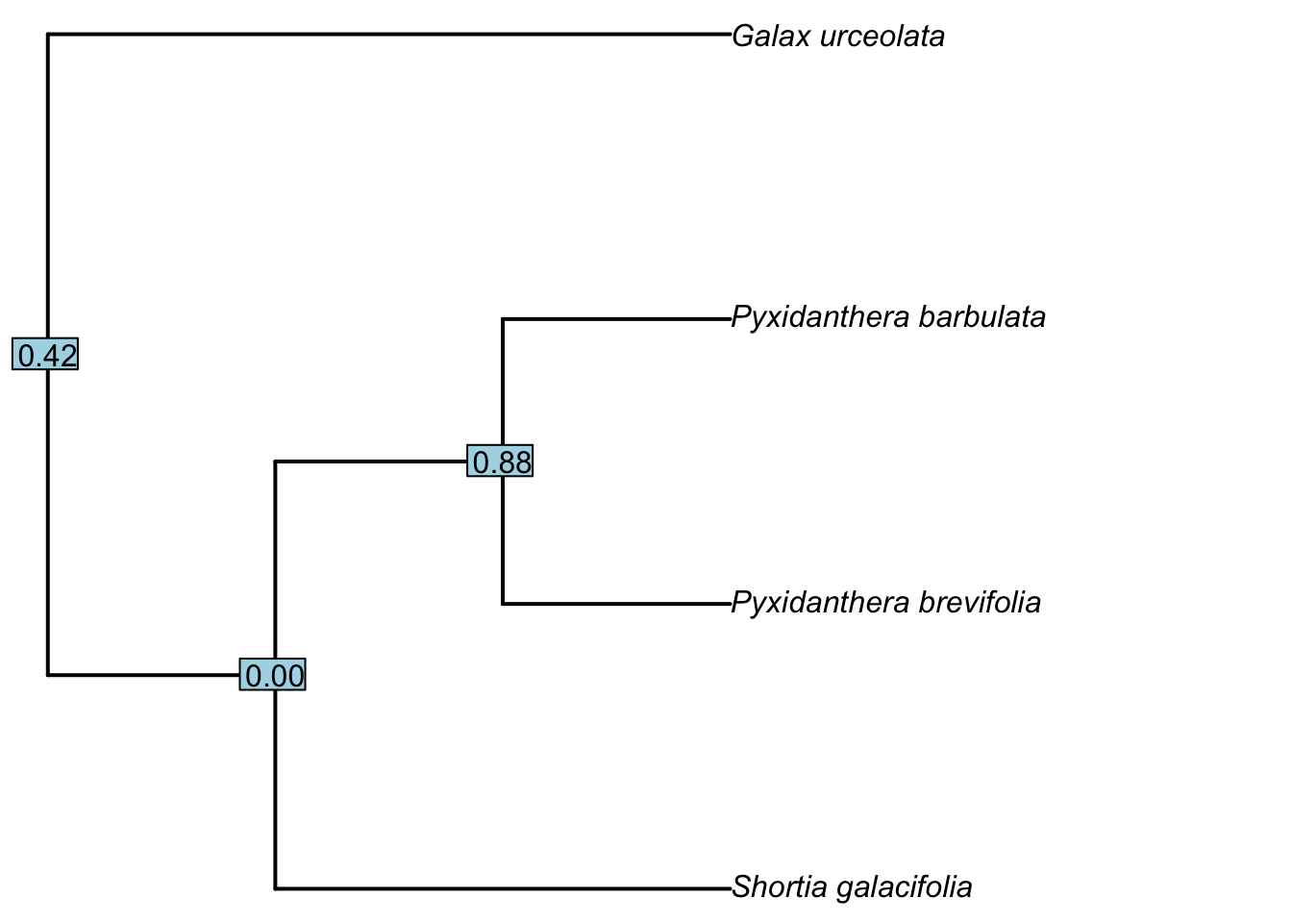
Phylogenetic correlation

Slide 31
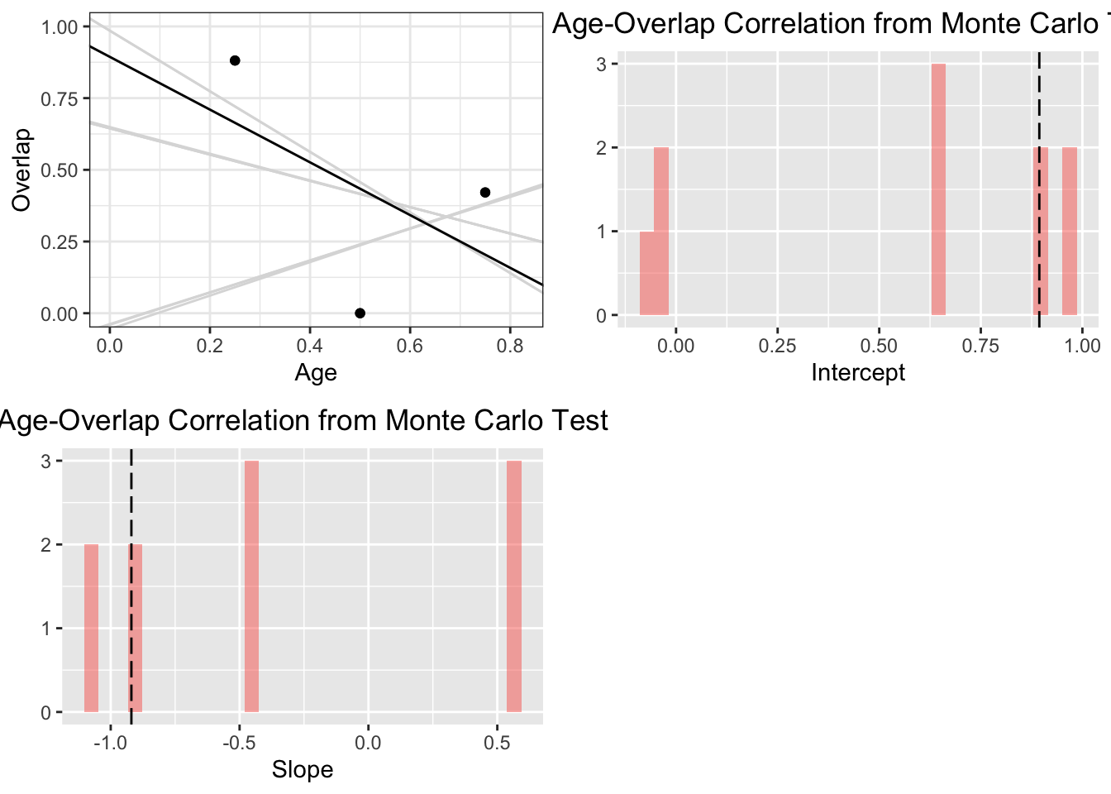
Phylogenetic correlation

Slide 32
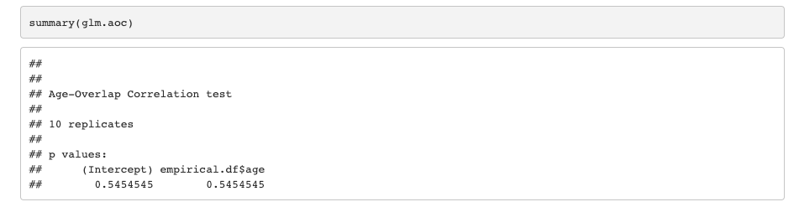
Phylogenetic correlation

Slide 33

Phylogenetic correlation

Slide 34
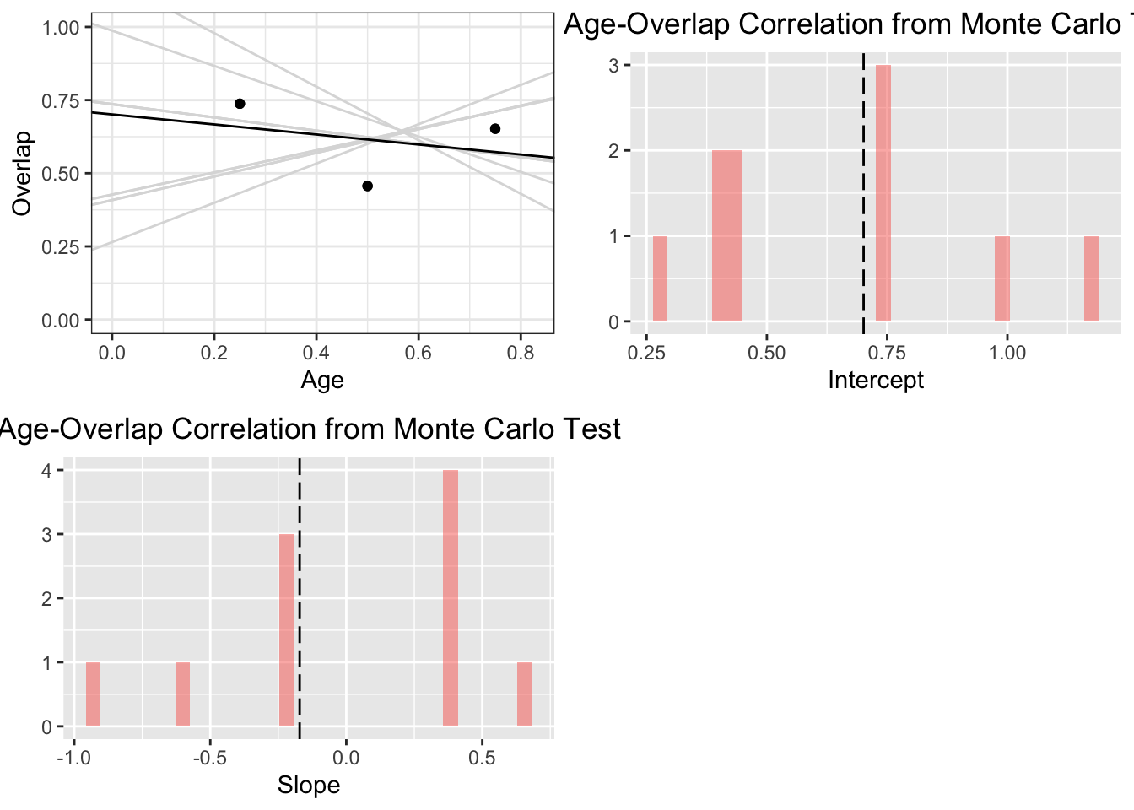
Phylogenetic correlation

Slide 35
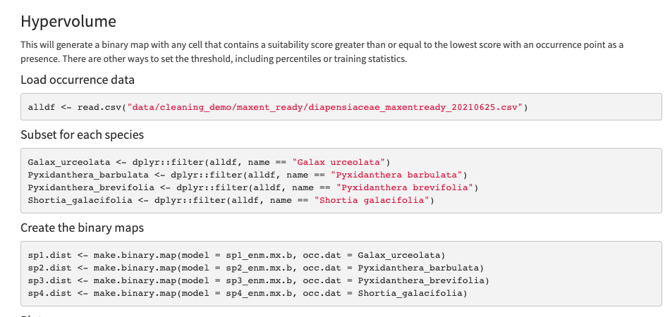
Hypervolume

Slide 36
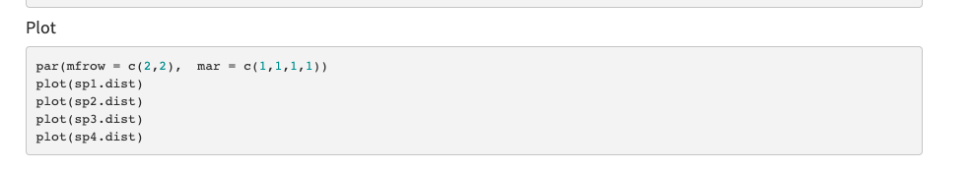
Hypervolume

Slide 37
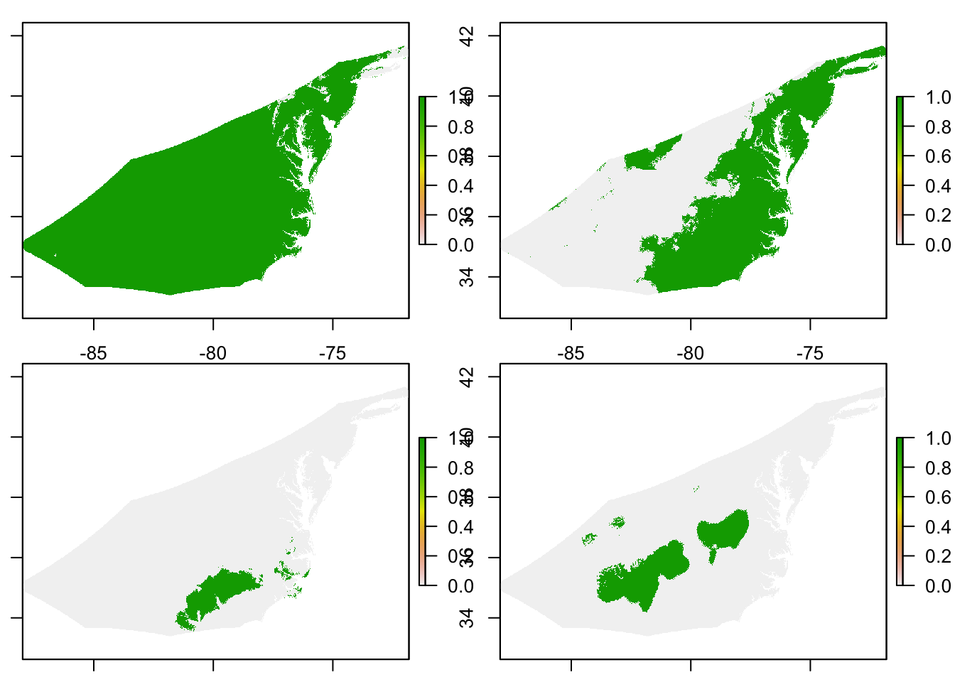

Slide 38
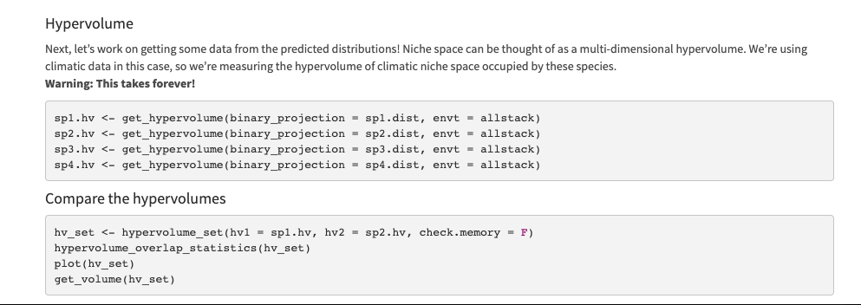
Hypervolume

