Slide 1
CAN Software
Spy & Echo Example
AT90CAN32/64/128

Slide 2
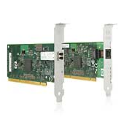
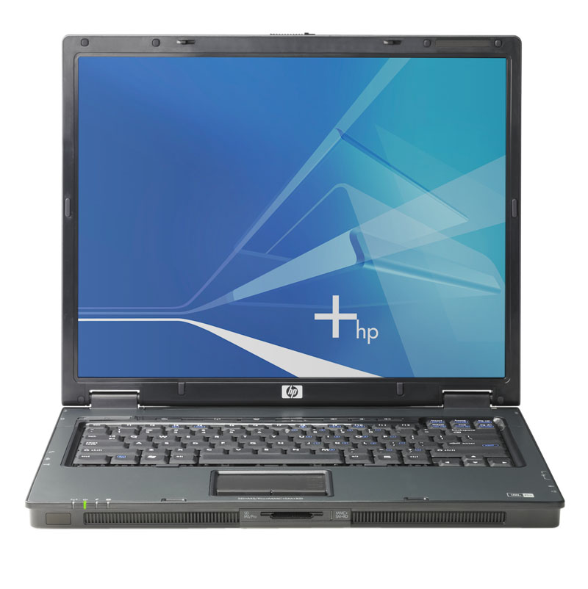

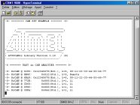
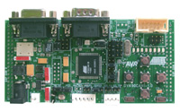
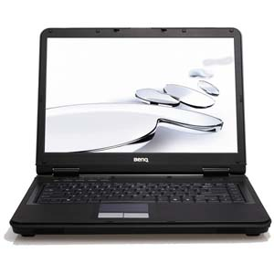
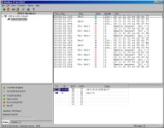

Demo. program
Spy:
All frames of the CAN bus (echo frames included) are sent on the RS232 serial links of the DVK90CAB1 board (UART_0 & UART_1).
«HyperTerminal» Windows can display them.
Other node(s)
‘‘Spy’’
‘‘Echo’’
DVK90CAN1
CAN bus
Terminal
‘‘can_spy_echo_example’’
Echo:
Each frame of the CAN bus (echo frames excepted) is re-sent with the following protocol:
- ID_{echo} = ID_{received} +1
- 8-byte data frame
- 2 last bytes = CAN-STAMP register
CAN node simulation
Notes:
Different RF-Solutions with different target markets,
however still a lack of a VERY LowCost consumer type application „simple cable replacement“
(Zigbee/Bluetooth/WLAN etc for many applications is an „overdrive“)

Slide 3



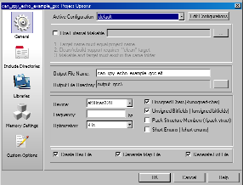



Demo. environment
IDE:
  AVR Studio 4.13.528 (or higher)
  AVRGCC plug-in
  CAN plug-in
C Compiler:
  WinAVR-20070122
Default target:
  DVK90CAN1 Atmel development board
Configuration:
  Software:
    Described in «config.h» in main root
  Hardware:
    Described in «..\libraries\lib_board\dvk90can_board.h» (called by «config.h»)
  Default setting:
    Microcontroller: AT90CAN128 at 8 MHz (external crystal - no internal RC)
    Both UART_0 & _1 available - baudrate: 38400 bds (8-bit, no parity, 1 stop-bit)
    CAN bitrate: automatic detection (both CAN 2.0A & 2.0B)
    Both Spy & Echo modes available

Slide 4
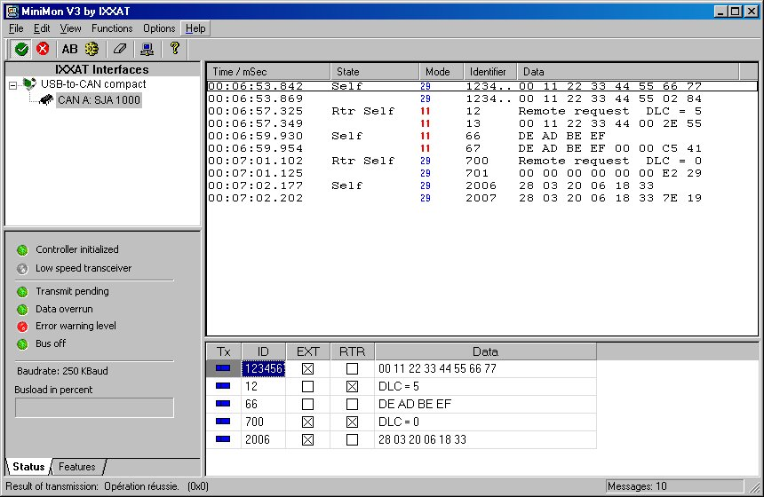
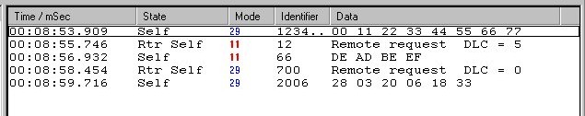

‘‘CAN Rx & Tx’’ screen shot example
If no key is pushed during RESET ➔ Spy & Echo mode
If some key is pushed during RESET ➔ Spy-only mode
CAN ID = 0 simulates a CAN Error
Spy & Echo
mode
Spy-only
mode

Slide 5

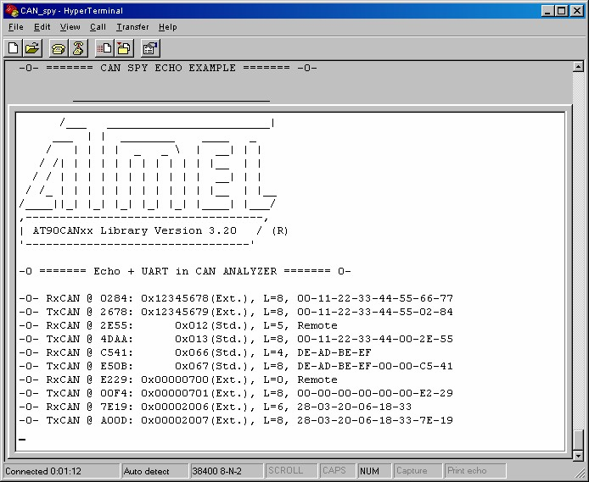
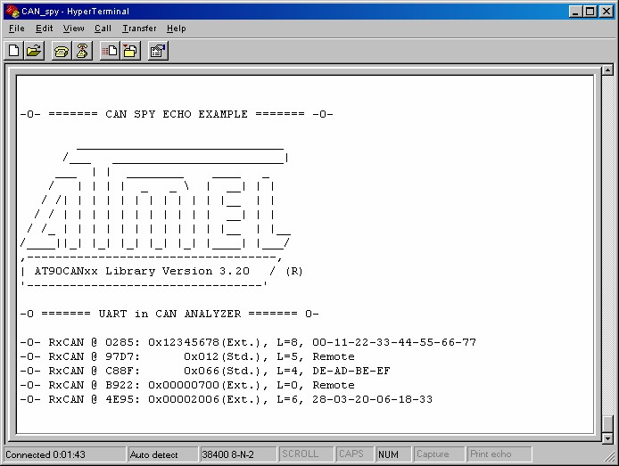
‘‘Spy’’ screen shot example
Spy & Echo mode
Spy-only mode

Slide 6
Atmel customer support
Atmel contact
Corporate Headquarters
2325 Orchard Parkway
San Jose, CA 95131,
USA
TEL: (1)(408) 441-0311
FAX: (1)(408) 487-2600
Asia
Room 1219
Chinachem Golden Plaza
77 Mody Road Tsimshatsui
East Kowloon
Hong Kong
TEL: (852) 2721-9778
FAX: (852) 2722-1369
Product Contact
La Chantrerie
BP 70602
44306 Nantes Cedex 3
France
TEL: (33) 2 40 18 18 18
FAX: (33) 2 40 18 19 60
E-mail
avr@atmel.com
Atmel products
Web site
www.atmel.com

