Slide 1
Cardiovascular Risk Prediction
- Supervised ML - Classification
Jeetendra Sarpe

Slide 2
Index
Introduction
Project understanding
Exploratory Data Analysis
Classification Model
Different Techniques
Final Model
Conclusion

Slide 3

Project Understanding
Heart Disease are now becoming a regular problem for people of all classes and age groups. Countering the threat of Cardia arrest or any Heart related problem will be a boon to the society. Hence under this study, we’re analyzing a data where we’ve details of few thousand candidates with their health records and whether they had a Coronary Heart disease (CHD) in the past 10 years.
From this study we’re going to predict whether a person is supposed to fall for a CHD depending on their health conditions. The Objective of this study is to help a person through the use of technology and data.

Slide 4
Coronary heart disease is the term that describes what happens when your heart's blood supply is blocked or interrupted by a build-up of fatty substances in the coronary arteries.

Slide 5
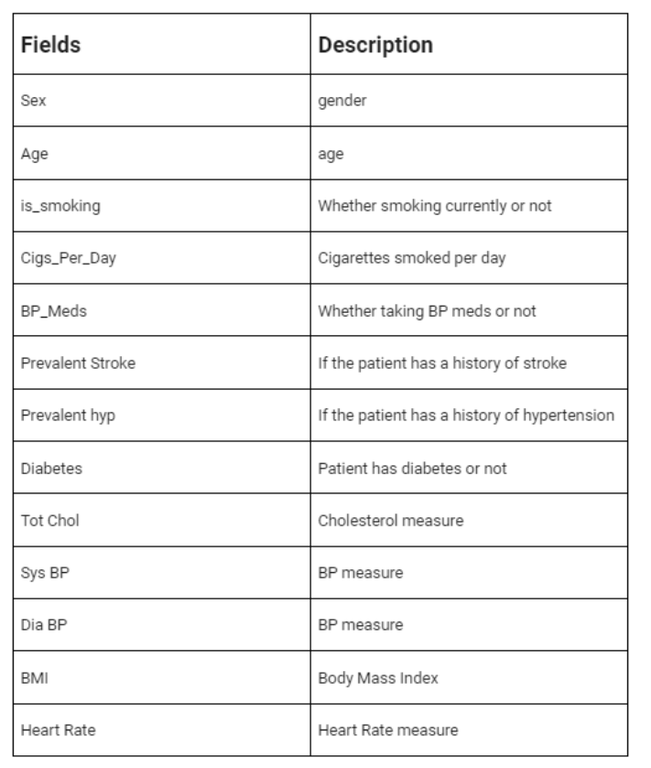
Data Understanding
The dataset consists of few thousands records with different medical details like gender, blood pressure, age, any medication etc. Since the data is a medical record, so manipulation is kept to minimum. Understanding different medical states is kept in mind while studying the data and developing the model.

Slide 6
Exploratory Data Analysis

Slide 7
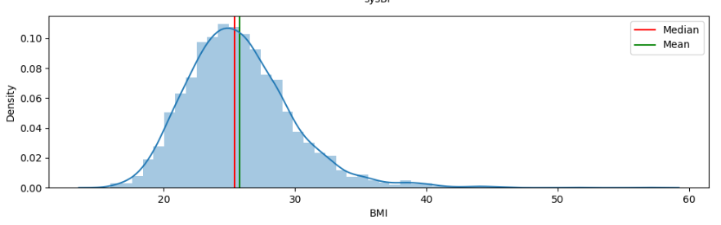
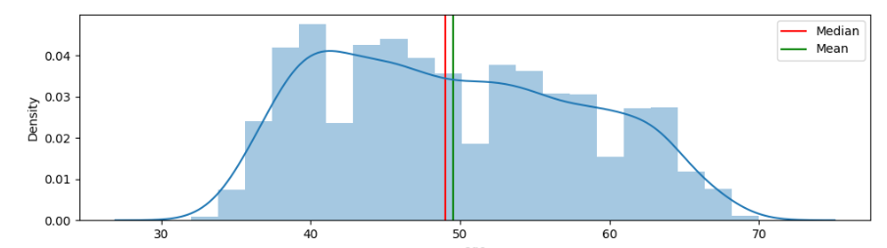
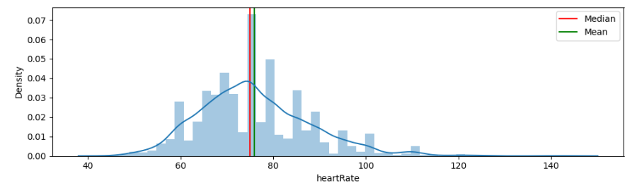
Body mass index is a value derived from the mass and height of a person.
A normal resting heart rate for adults ranges from 60 to 100 beats per minute.

Slide 8
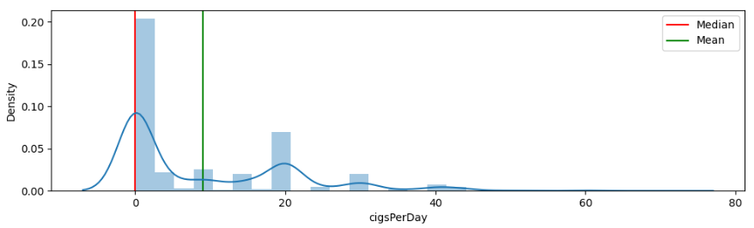
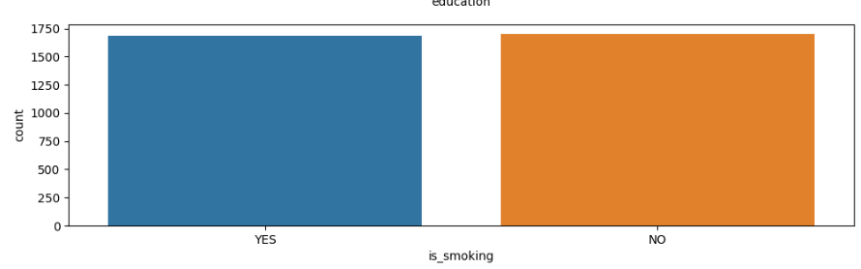
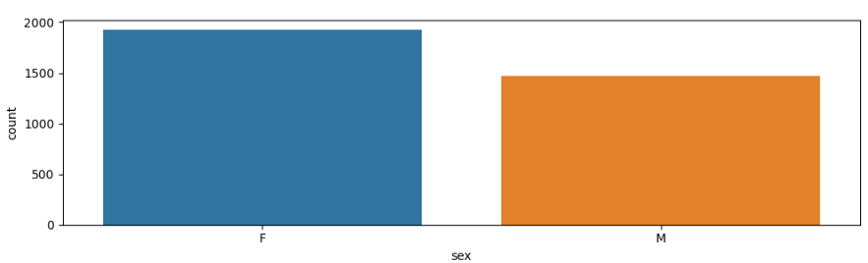
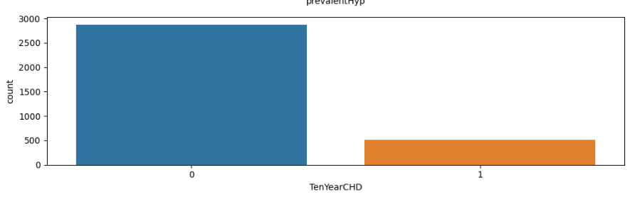

Slide 9
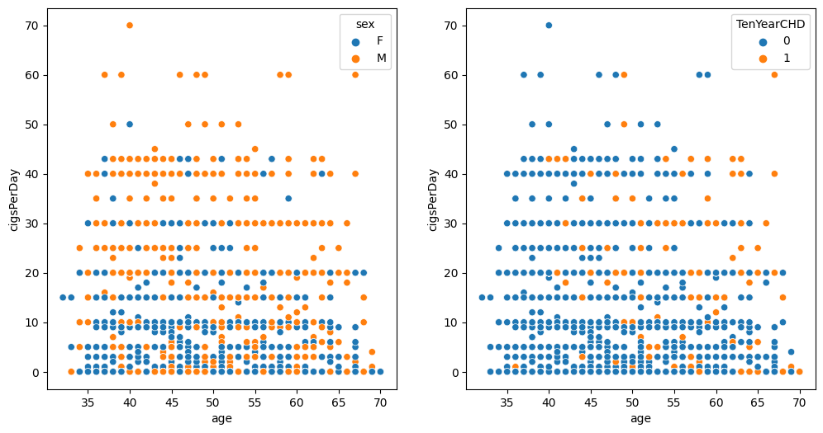
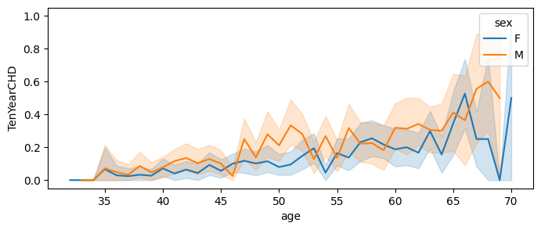

Slide 10
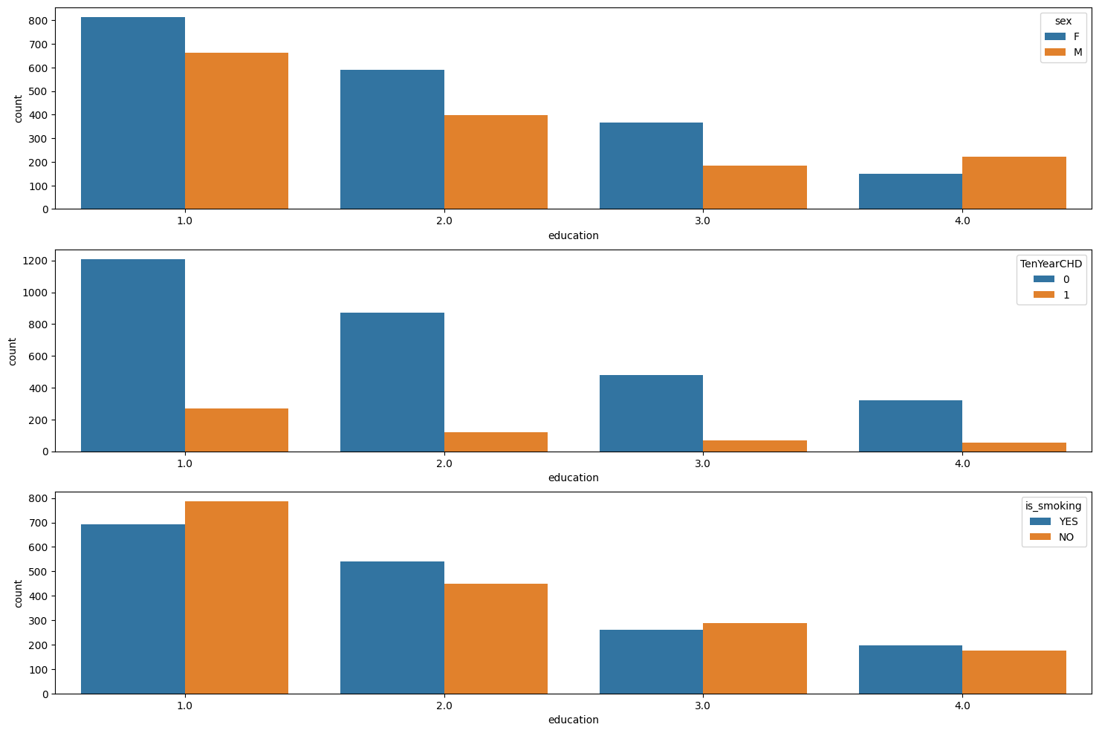

Slide 11
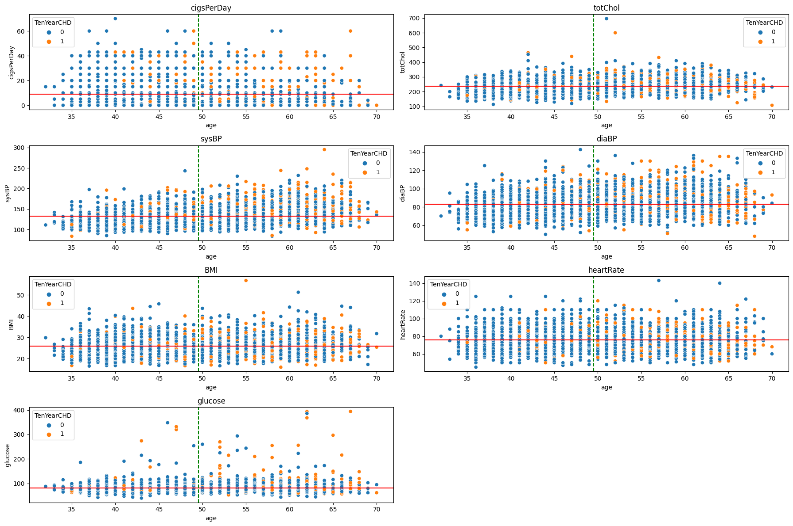

Slide 12
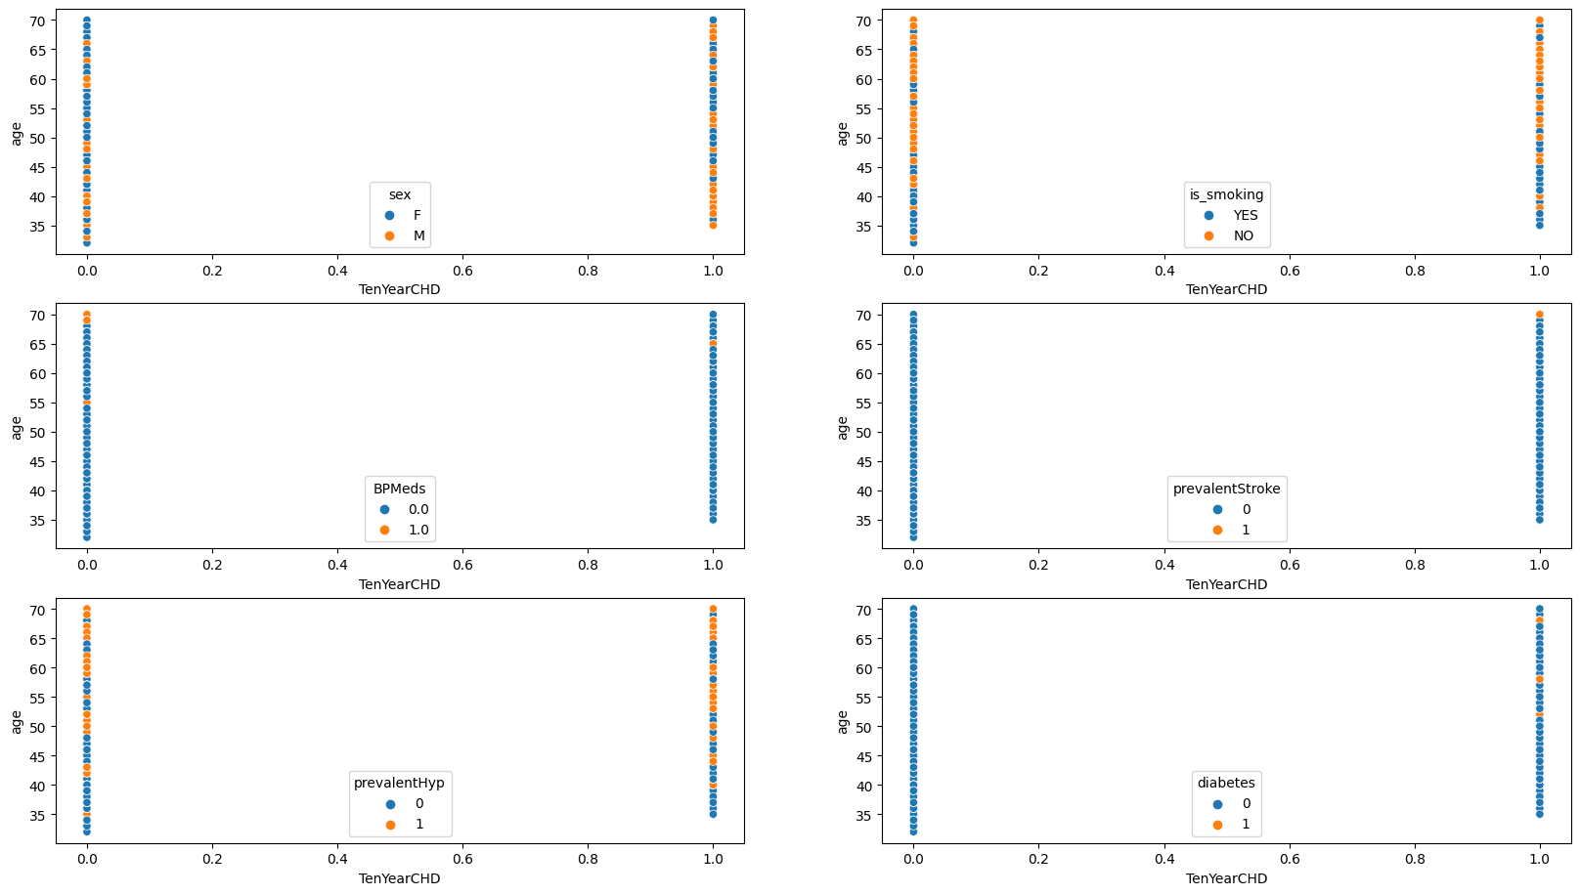

Slide 13
Classification Models

Slide 14
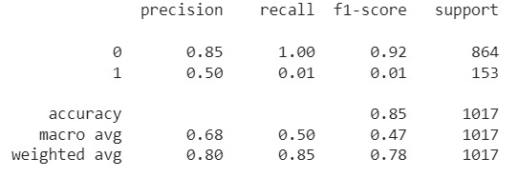
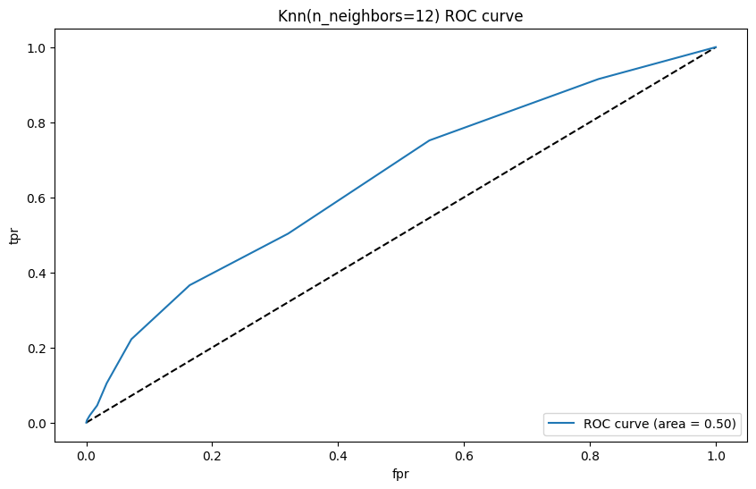
K-Nearest Neighbors Algorithm, is a supervised learning classifier, which uses proximity to make classifications or predictions about the grouping of an individual data point.
K Nearest Neighbors

Slide 15
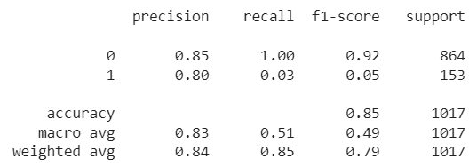
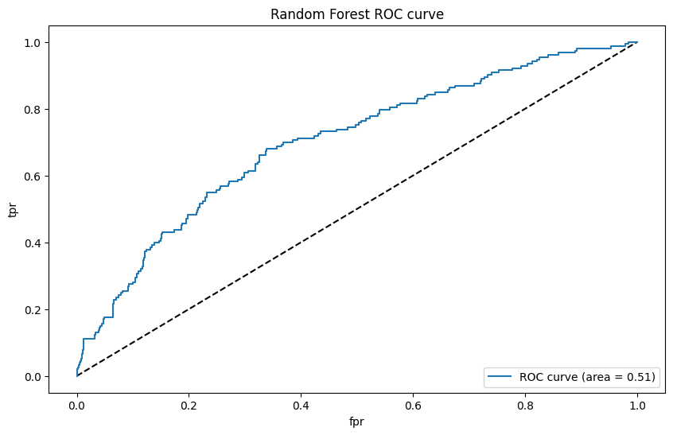
Random Forest
Random forest is a commonly-used machine learning algorithm which combines the output of multiple decision trees to reach a single result. Its ease of use and flexibility have fueled its adoption, as it handles both classification and regression problems.

Slide 16
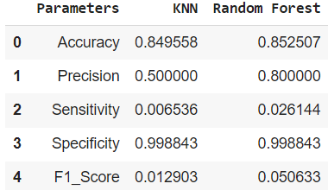
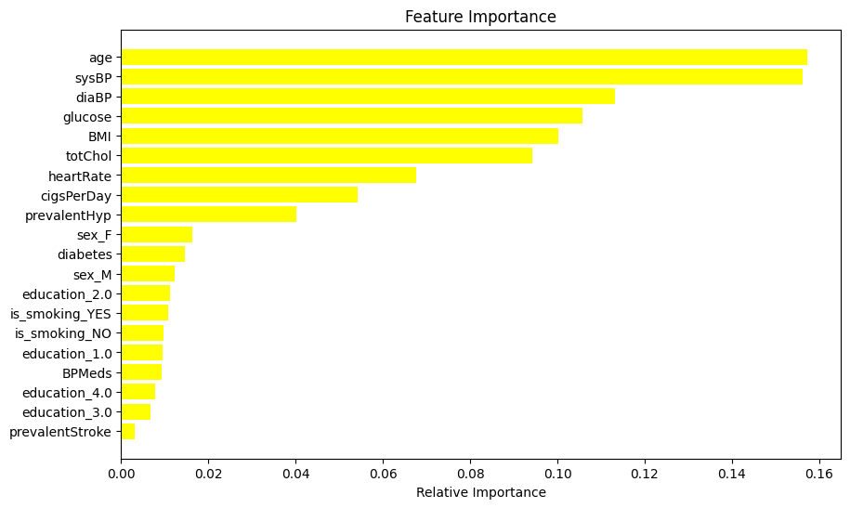

Slide 17
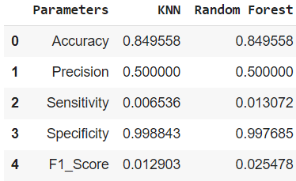
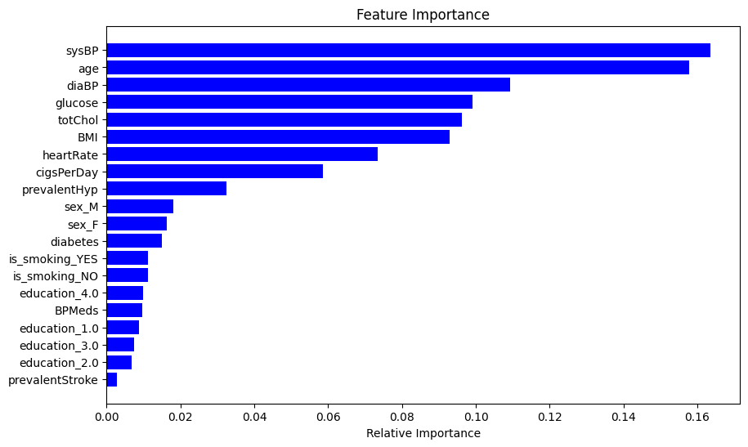

Slide 18
Conclusion
With age the severity to the CHD increases and also other factors such as heart rate, glucose, BMI and others interfere in pacing up/down the chances of a Heart Disease.
A Man is more likely to get prone to CHD which is mainly to due to the lifestyle one is leading. Habits like Smoking and other activities makes this gender more exposed to CHD.
Other medical conditions like Diabetes, BP and other medications acts as catalyst in health conditions related to Heart.

Slide 19
Have a Healthy Heart

