Slide 1
Global Terrorism
Exploratory Data Analysis
Capstone
Jitendra Sarpe

Slide 2
Index
Introduction.
Data summary and its understanding.
Insights from recorded data.
Stats from the numbers.
Conclusion.

Slide 3
Data Set
The Global Terrorism Database (GTD) is an open-source database that contains information on terrorist attacks from 1970 to 2017. The GTD now includes more than 180,000 attacks and includes systematic data on domestic and international terrorist incidents that occurred during this time period. The database is managed by researchers at the University of Maryland's National Consortium for the Study of Terrorism and Responses to Terrorism (START). Investigate and analyze the data to discover key findings about terrorist activities.

Slide 4
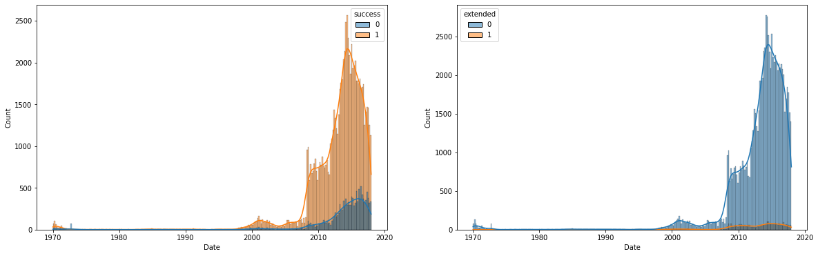
The data set keeps the record for terror activities for different Country and regions. It’s impact and the mind behind the crime, their intentions.
The data records killing happened and the type of the attack, Nationalities of the causalities.

Slide 5
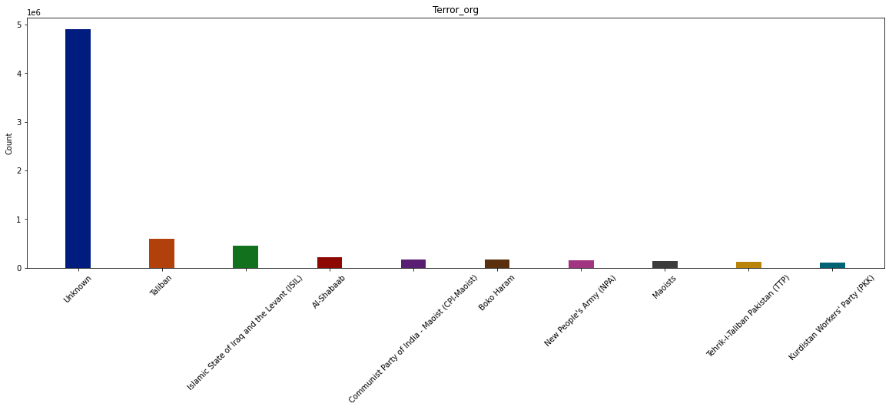

Slide 6
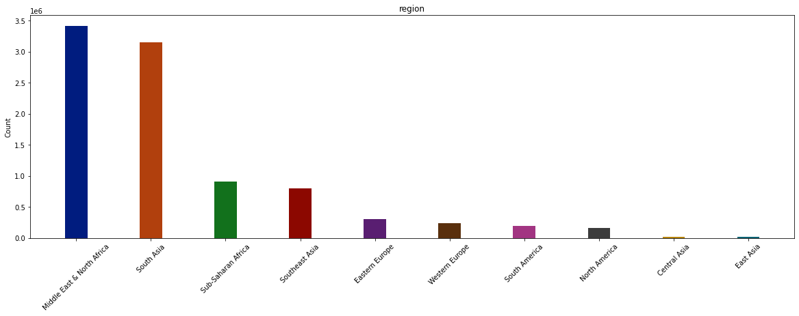
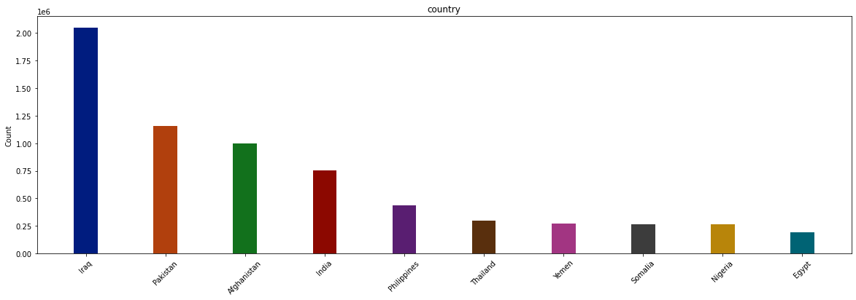
Impact of terrorism country and region wise

Slide 7
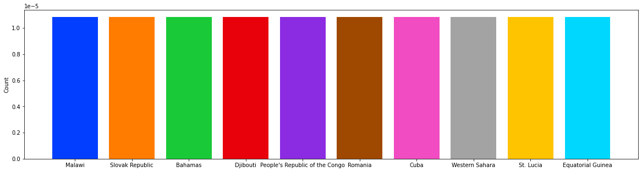
Least affected nation by terror attacks….

Slide 8
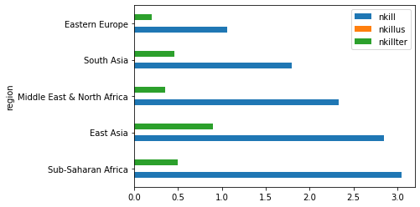
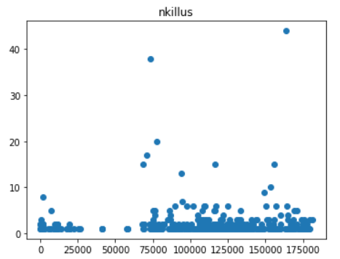

Slide 9
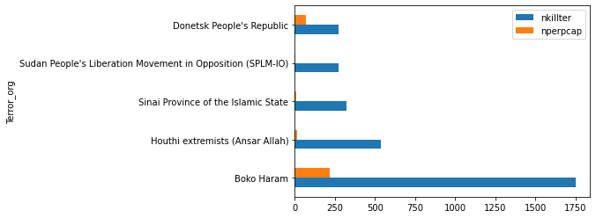
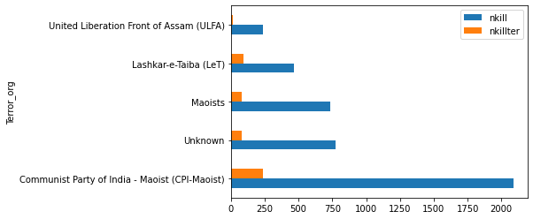
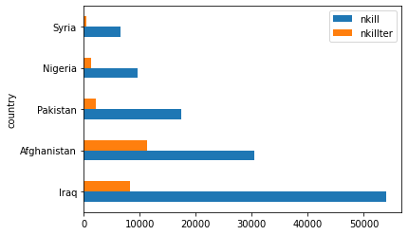

Slide 10
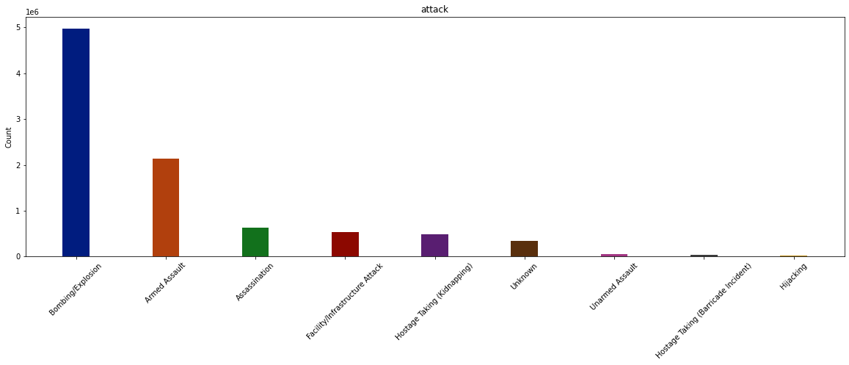
Attack types and its impact.

Slide 11
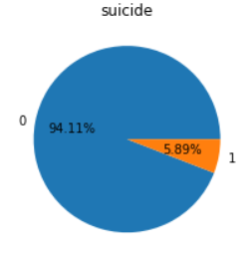
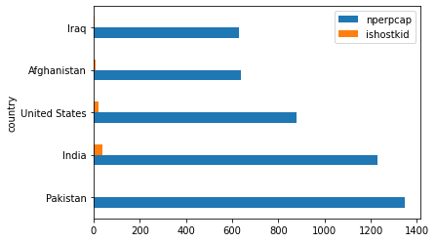
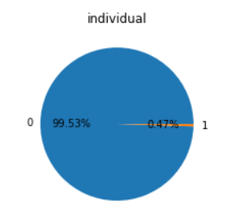
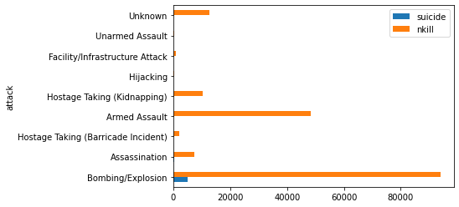

Slide 12
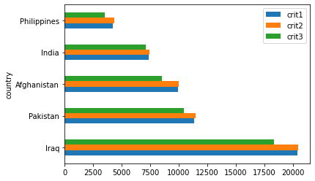
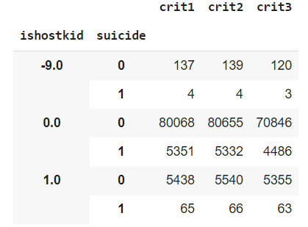

Slide 13
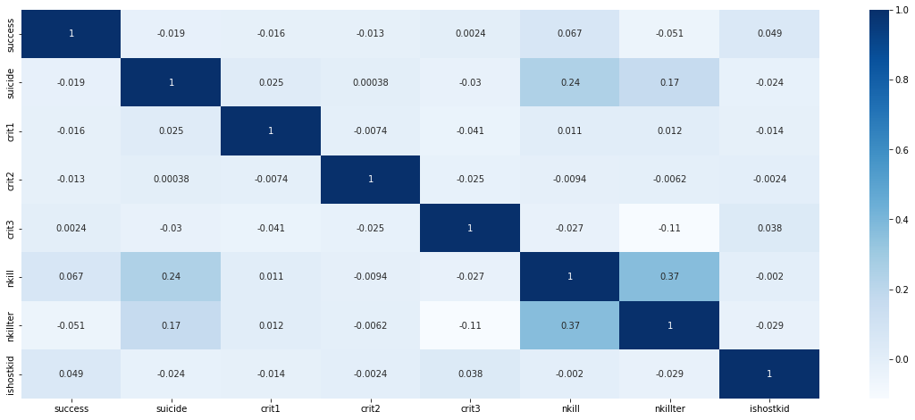

Slide 14
Success rate of the attack is high but also the capturing and killing of the Terrorist is on up side as the time proceeds.
Even the success of the attacks are high the time of the attack is restricted to just a day for maximum times. This is because of the efforts by the nation and its security forces.
Countries in the Middle east and South Asia are most affected. The intentions of the attack is to create a threat and sense of danger among the citizen.
Kidnapping hostages is observed to be low in numbers but have it is considerable high for countries like INDIA.
Killings by bombing and explosion is highest but the suicide attacks that include explosions have caused lesser causalities than Assassinations.
Weapons used for majority of attacks are Fire arms and explosives, use of biological or Radiological is low and only Taliban have been observed to make use of advance weapons and that on Afghanistan.

Slide 15
COMBAT TERRORISM

