Slide 1

Who Pays for the Cloud?
DS-TEAM2 · 2026 VIRGINIA DATATHON · ENERGY
$122M
a year for energy relief, from 20% of the data-center electricity tax
The Cloud Dividend: using Virginia's new data-center tax to protect the households least able to afford rising power bills
Notes:
SLIDE 1 of 9 | RAYHAN | 0:00-0:17 (42 words)
Virginia is the data-center capital of the world. So who pays for the cloud? We're DRHS Team 2, and our answer is the Cloud Dividend: use the data-center industry's new tax to protect the Virginians who can least afford rising power bills.
Hard cap 5:00. Checkpoints: start slide 6 by 2:35, start slide 8 by 4:05.

Slide 2

Data centers are pushing everyone's power costs up
THE TREND
+60%
commercial electricity sales since 2016, while homes stayed flat
+26%
Virginia residential price per kWh, 2022 → 2026
+$14–37
per month on a typical Dominion bill by 2040 from data-center growth alone (JLARC)
Sources: EIA retail sales via data.virginia.gov (Datathon 2026); EIA Electric Power Monthly 5.6.B (2026 = Jan–Jul YTD); JLARC Rpt. 598 (2024), Table 4-2.
Notes:
SLIDE 2 of 9 | RAYHAN | 0:17-0:49 (77 words)
Here's the trend. Since 2016, commercial electricity sales, where data centers are counted, are up 60 percent, while homes stayed flat. Building for that demand raises costs for everyone. Residential prices rose 26 percent from 2022 to 2026, and JLARC projects data-center growth alone could add 14 to 37 dollars a month to a typical Dominion bill by 2040. So we asked: who can least afford this, is aid reaching them, and where should help go first?
Hard cap 5:00. Checkpoints: start slide 6 by 2:35, start slide 8 by 4:05.

Slide 3

Low-income homes spend 7× more of their income on energy
WHO CAN'T ABSORB IT
14.3%
of income on home energy for households at or below 150% of poverty
2.1%
for the average Virginia household. 6% is the standard for “affordable.”
Source: DOE LEAD Tool 2022 (ACS 2018–22 microdata calibrated to utility bills), updated to 2026 EIA prices; 466,049 households ≤150% of poverty, all 133 localities.
Notes:
SLIDE 3 of 9 | IBRAHIM | 0:51-1:18 (64 words)
We used the Department of Energy's LEAD data, which breaks down all 133 localities by income, housing, and heating fuel. Households at or below 150 percent of poverty spend 14.3 percent of their income on home energy. The average household spends 2.1. That's seven times more. [CUT IF LATE: Below the poverty line it's 23 percent,] and with oil or propane heat it's 21 to 26 percent.
Hard cap 5:00. Checkpoints: start slide 6 by 2:35, start slide 8 by 4:05.

Slide 4

Closing the gap costs $749M a year, and existing aid covers 11%
THE GAP
$82M
paid by the Energy Assistance Program in 2025, about 11% of the gap
28%
of eligible households reached; only 14% in data-center localities
276,934
SNAP households, already income-verified by local DSS, got no energy aid
Sources: LEAD + EIA (gap = cost of bringing every household ≤150% FPL to 6% of income); JLARC 2040 scenarios; VDSS EAP FFY2025 & SNAP July 2026 (data.virginia.gov).
Notes:
SLIDE 4 of 9 | IBRAHIM | 1:18-1:45 (67 words)
Affordable is 6 percent of income. Getting every low-income household there costs 749 million dollars a year today, and up to 955 million under JLARC's 2040 scenarios. The Energy Assistance Program paid 82 million in 2025, about 11 percent of the gap, and reached only 28 percent of eligible households. Meanwhile, 276,934 SNAP households, already income-verified by their local DSS office, got no energy aid at all.
Hard cap 5:00. Checkpoints: start slide 6 by 2:35, start slide 8 by 4:05.

Slide 5

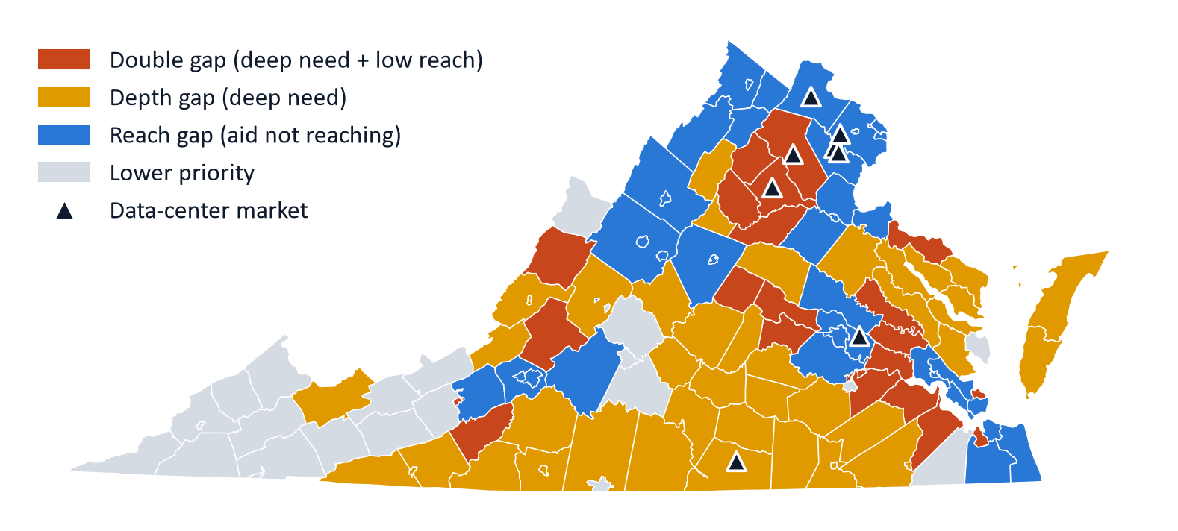
Two different problems need two different fixes
THE PATTERN
Sources: LEAD; VDSS EAP FFY2025; USDA ERS metro codes; data-center markets per JLARC 2024. Split at statewide medians of gap per household and EAP reach.
Notes:
SLIDE 5 of 9 | JAMES | 1:47-2:15 (66 words)
When we mapped it, Virginia split into two problems. In orange and gold, mostly rural Southside and the Northern Neck, need is deep: a 1,947-dollar gap per household, driven by oil, propane, and mobile homes. In blue, the metros, the gap is smaller, but aid reaches only 22 percent of eligible households, [CUT IF LATE: and just 14 percent in the data-center localities themselves.] Two problems need two fixes.
Hard cap 5:00. Checkpoints: start slide 6 by 2:35, start slide 8 by 4:05.

Slide 6




The Cloud Dividend: the industry driving costs helps pay
OUR SOLUTION
LEVER 1 · REACH
LEVER 2 · DEPTH
Auto-enroll
Weatherize + heat pumps
$122M
per year
VDSS matches SNAP rolls to utility customer files and enrolls households in EAP and PIPP (bills capped at 6% of income). No new application. New York already does this.
Upgrade 40,021 low-income oil, propane and mobile homes in priority localities, 1/5 per year, building on HB2 (2026). Pays for itself in about 6 years.
$58M/yr
$64M/yr
20% of the ~$600M/yr data-center electricity tax → an Energy Relief Fund
serves half of 276,934 SNAP households at the $415 avg. benefit
for 5 years at ~$8,000 per home; lowers bills permanently
Lever 3 · Target it: an open Energy Burden Priority Index, refreshed yearly on data.virginia.gov
Sources: 2026 Appropriation Act (data-center electricity tax, $0.011/kWh, ~$600M/yr); VDSS PIPP; HB2 (2026); NY utility data-match law; state WAP cost plans; ACEEE.
Notes:
SLIDE 6 of 9 | JAMES | 2:15-3:09 (131 words)
That's the Cloud Dividend. Virginia's new data-center electricity tax raises about 600 million dollars a year. We put 20 percent, 122 million, into an Energy Relief Fund. Lever one fixes reach: VDSS matches SNAP rolls against utility customer files and automatically enrolls households in EAP and the Percentage of Income Payment Program, which caps bills at 6 percent of income. New York already does this. Nobody has to apply. Serving half of those SNAP households costs 58 million a year. Lever two fixes depth: weatherization and heat pumps for 40,021 oil, propane, and mobile homes, a fifth each year, building on this year's HB2. That's 64 million a year, [CUT IF LATE: and the upgrades pay for themselves in about six years.] Lever three, our open priority index, tells both levers where to go.
Hard cap 5:00. Checkpoints: start slide 6 by 2:35, start slide 8 by 4:05.

Slide 7

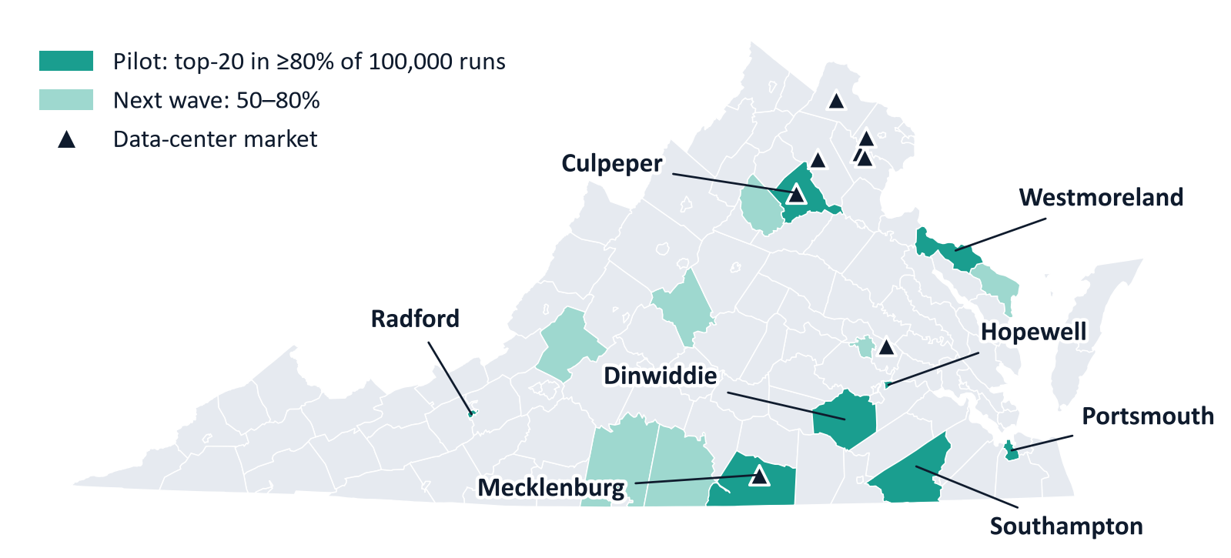
Eight localities stay top-20 in 80%+ of 100,000 simulations
WHERE TO START
~$10M/yr pilot in these 8 localities
24,017 low-income households · 16,477 SNAP households to auto-enroll · under 2% of the tax
Monte Carlo: 100,000 draws varying the 2040 price scenario, income growth, eligibility and index weights (severity, depth, scale, reach gap). Bars = % of draws in the top 20.
Notes:
SLIDE 7 of 9 | DYSON | 3:11-3:40 (70 words)
So where do we start? We didn't want the answer to hinge on one set of weights, so we ranked every locality across 100,000 Monte Carlo simulations, varying prices, incomes, eligibility, and weights. These eight stayed in the top 20 at least 80 percent of the time: Portsmouth, Westmoreland, Radford, Dinwiddie, Mecklenburg, Southampton, Hopewell, and Culpeper. A pilot there costs about 10 million dollars, under 2 percent of the tax.
Hard cap 5:00. Checkpoints: start slide 6 by 2:35, start slide 8 by 4:05.

Slide 8

Every piece already exists, so Virginia can start in 2027
FEASIBILITY
1
2027 session
2
Data-sharing
3
FY2028 pilot
4
FY2029 scale
Earmark 20% of the tax; extend it past its 2028 sunset
VDSS–Dominion/APCo customer match (NY model)
~$10M in the 8 priority localities
Statewide; track results with the open index
ALREADY IN PLACE
Funding: Data-center electricity tax, in effect since July 1, 2026
Delivery: VDSS already runs EAP + PIPP in every locality
Mandate: HB2 (2026) requires utilities to upgrade oil/propane homes
Targeting: Our open index, built only on public data
Data-center tax effective 7/1/2026 (sunsets 6/30/2028); EAP & PIPP administered by VDSS through local DSS offices; HB2 (2026); RGGI rejoined 7/1/2026 (DHCD efficiency funds).
Notes:
SLIDE 8 of 9 | DYSON | 3:40-4:08 (69 words)
And it's feasible now. The tax has been in effect since July. DSS offices already run EAP and PIPP. HB2 already requires utility upgrades. So in the 2027 session: earmark the dividend and extend the tax past its 2028 sunset, sign a data-sharing agreement, [CUT IF LATE: pilot in 2028, and scale in 2029.] And 122 million covers all of the low-case data-center increase and about 60 percent of the high case.
Hard cap 5:00. Checkpoints: start slide 6 by 2:35, start slide 8 by 4:05.

Slide 9
The industry driving costs up helps cover them
$122M/yr
Cloud Dividend for energy relief
276,934
SNAP households to auto-enroll
Start with a ~$10M pilot in 8 localities, then scale statewide with an open, yearly-updated priority index.
40,021
homes to weatherize or electrify
Thank you.
Notes:
SLIDE 9 of 9 | DYSON | 4:08-4:20 (27 words)
The industry driving costs up can help cover them. The Cloud Dividend protects the Virginians who can least afford the cloud. Thank you. We'd love your questions.
Hard cap 5:00. Checkpoints: start slide 6 by 2:35, start slide 8 by 4:05.

