Slide 1


Titolo presentazione sottotitolo
Modal Analysis of a Typical Power over Ethernet Configuration
Authors: Tomas Monopoli, Antonino Borgese, Xiaokang Liu, Flavia Grassi, Sergio Pignari
Milano, XX mese 20XX
Dept. of Electronics, Information and Bioengineering Politecnico di Milano Milan 20133, Italy

Slide 2
Introduction
Power over Ethernet (PoE) is the transmission of power over Ethernet cables.
- There is no need for the power chord to connect the device to the mains
MAIN ADVANTAGES:
Reduction of occupied space
Reduction of circuit costs.
Higher flexibility of network elements
No power port on the device.
APPLICATIONS: VoIP, IoT, LED …

Slide 3
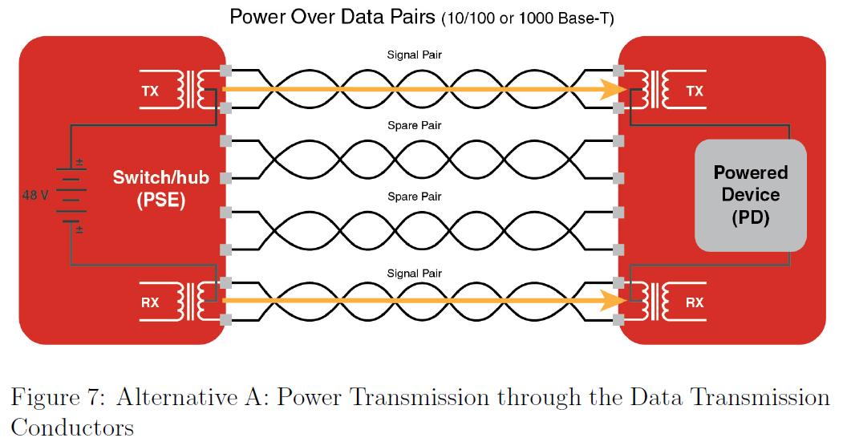
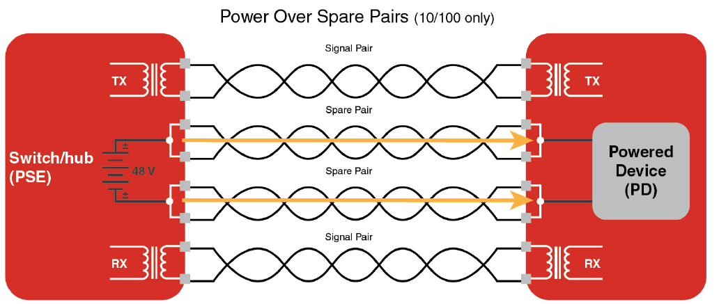
Introduction
PoE+ is the new standard (IEEE 802.3at/af) for greater power and data rate capacity.
APPLICATIONS: automotive and aerospace sectors
ALTERNATIVE A
ALTERNATIVE B

Slide 4
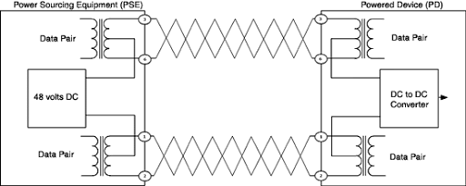
PoE Architecture under Analysis
DATA 1
POWER
DATA 2
POWER

Slide 5
Overview
The circuit is ideal and perfectly balanced:
Data signal transmission paths are independent from the power transmission path.
The data signal is immune to the noise originating in the converter.
Non ideal behaviour is introduced:
The dc/dc converter is asymmetrical
The balun centre taps are not perfectly balanced
They have coupling effect between the modes of the circuit.

Slide 6
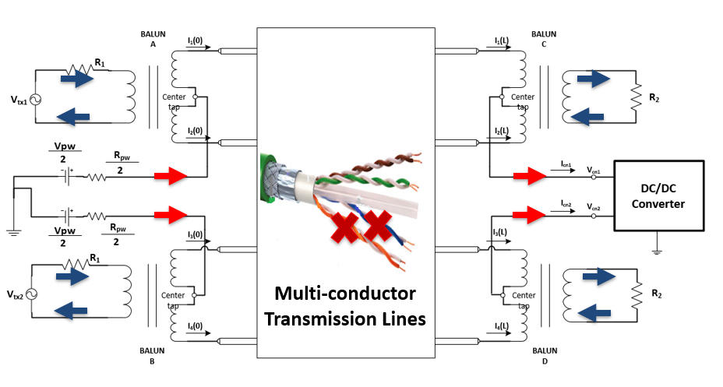
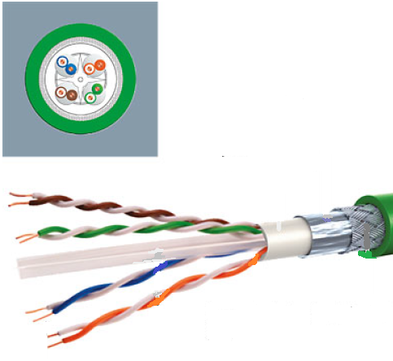
Circuit Under Analysis

Slide 7
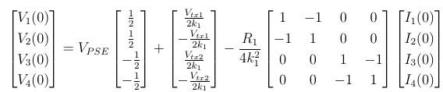

Circuit Under Analysis
V₁(0)
V₂(0)
V₃(0)
V₄(0)

Slide 8

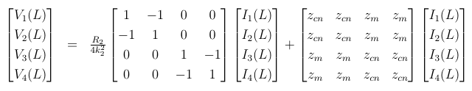

Circuit Under Analysis
The dc/dc converter is a purely passive with a completely balanced impedance matrix:
V₁(L)
V₂(L)
V₃(L)
V₄(L)

Slide 9

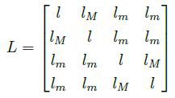
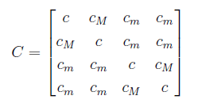
P.U.L. Parameters
Multi-conductor Transmission Lines
Considering perfect symmetry and balancing of the wires
twisting of the TWP
twisting of the wires
If the insulation is uniform
(or insulation is thick enough)
C has the same form

Slide 10
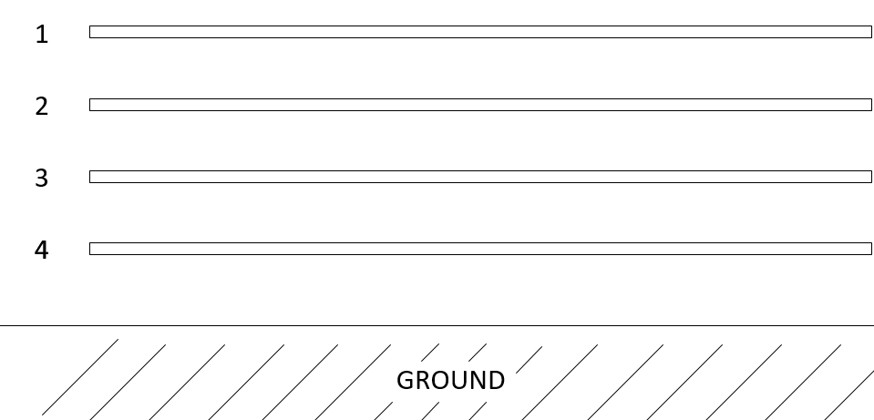



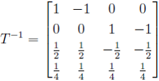
Modal Transformation
t1
pw
cm
t2

Slide 11
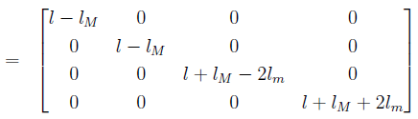
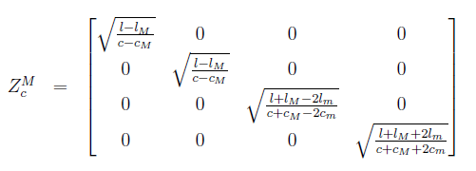

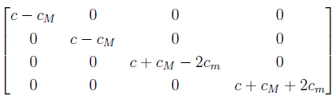


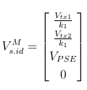
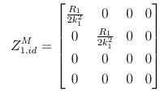
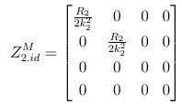
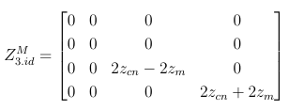
Modal Transformation
Thanks to the perfect symmetry supposed for the MTL, the transmission lines are uncoupled by the modal transformation:
4 independent TL
The impedance matrices of the ideal circuit are transformed into diagonal matrices by the modal transformation:

Slide 12
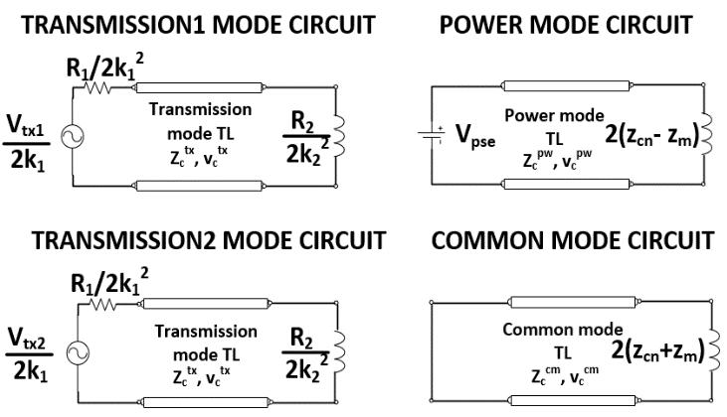
Modal Transformation
Modal Circuits in the Ideal Scenario are Independent

Slide 13
Modal Transformation
Modal Circuits in the Ideal Scenario are Independent

Slide 14
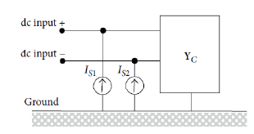



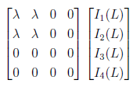
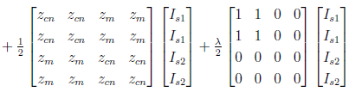
Non-Ideal dc/dc converter
The parameters λ and I_{CE} model the unbalance in the impedance matrix and the conducted emissions from the converter.
ideal scenario
effect of λ
effect of I_{CE}
mixed effect of λ and I_{CE}

Slide 15
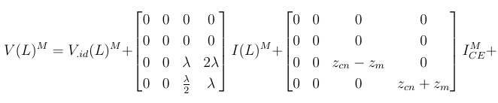
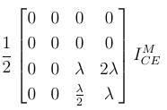
Non-Ideal dc/dc converter
effects of λ in the modal domain:
The effect of each asymmetry is an internal effect on the common modes
The transmission modes are protected from the converter noise even if said converter is asymmetrical

Slide 16
Equivalent Modal Circuits for Ideal Case
CE NOISE
CE NOISE

Slide 17
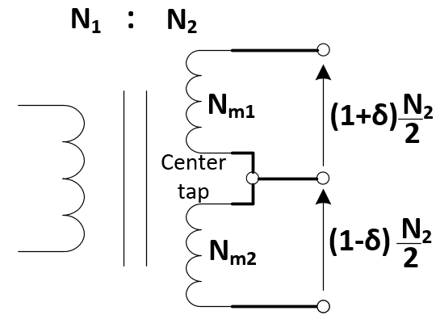


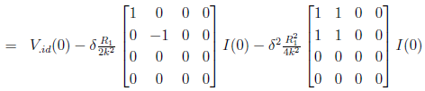


Unbanced Balun Centre-Tap
In real devices the centre-tap is not perfectly balanced!
Parameter δ models the unbalance on the centre-tap
The effect of δ on the signal voltage source
The effect of δ on the impedance!

Slide 18
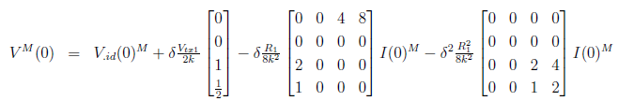
Unbanced Balun Centre-Tap
Effects of δ in the modal domain:
δ couples the data signal sources with the common modes
introduces off-diagonal elements that have coupling effect between the transmission modes and the common modes
internal effect between the common modes – negligible!

Slide 19
Coupling of the CE Noise
unbalance δ
UNBALANCED TRANSMISSION MODE
CE NOISE
CE NOISE

Slide 20
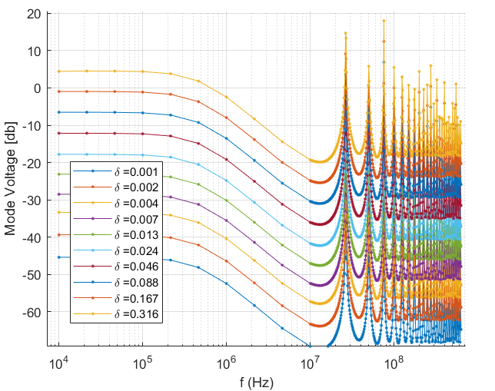
Sensitivity of the Transmission Modes Coupling
The model is developed to study the modal coupling:
The plot reports the voltage at the terminals of the transmission mode TL in the presence of a unit value current on the power mode for different values of delta.

Slide 21
Effect of Non-Ideal Behaviour Parameters
An unbalance in the dc/dc converter has a coupling effect between common mode and power mode. An internal coupling between common modes is not so troublesome for the correct circuit operation.
The unbalance of balun center-taps is a critical parameter to consider when designing a PoE circuit. It has a coupling effect between transmission modes and common modes, so it can introduce noise to the transmission path and high frequency harmonics to the converter.

Slide 22
Conclusions
The ideal circuit offers the opportunity of signal transmission without interference from the power sourcing equipment and the powered device.
As long as the balun transformers and the transmission lines remain balanced, the signalling paths remain protected from noise originating in the converter, even if said converter is unbalanced.
An unbalance of the centre-taps is damaging to the signal quality and integrity. Also it can represent a problem for irradiation limit compliance.

Slide 23

Thank You!

