Slide 1
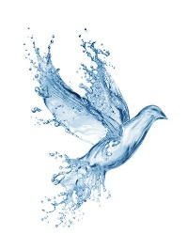
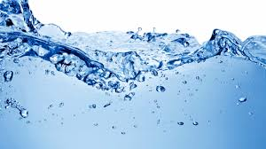
WANGRY : ARE WE ANGRY FOR WATER

Slide 2
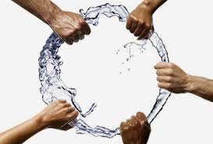
Agenda
Introduction & Problem Statement
Methods
Findings
Conclusions
Implications & Discussion

Slide 3
Introduction and Problem statement
Water conflict is a term describing a conflict between countries, states, or groups over an access to water resources
We wanted to find out the following:
How does climate change impact water access?
Do countries with low water access have higher instances of conflict?
What areas in the United States have less access to water?
Do these areas with low water in US have higher instances of conflict?

Slide 4

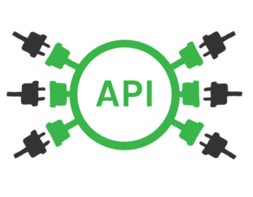

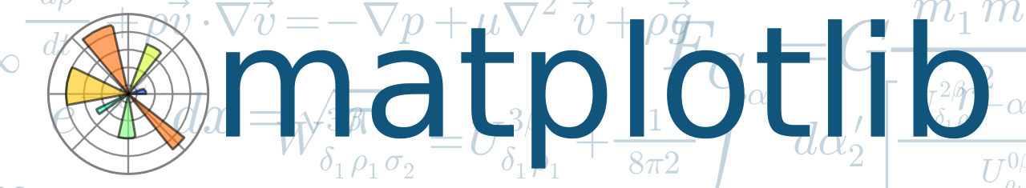

Methods
Open Weather Map API
FBI API
CDC DATA
Pandas DataFrame manipulations using merge
Plotting in Python using matplotlib
USGS Water Services
US census Data

Slide 5
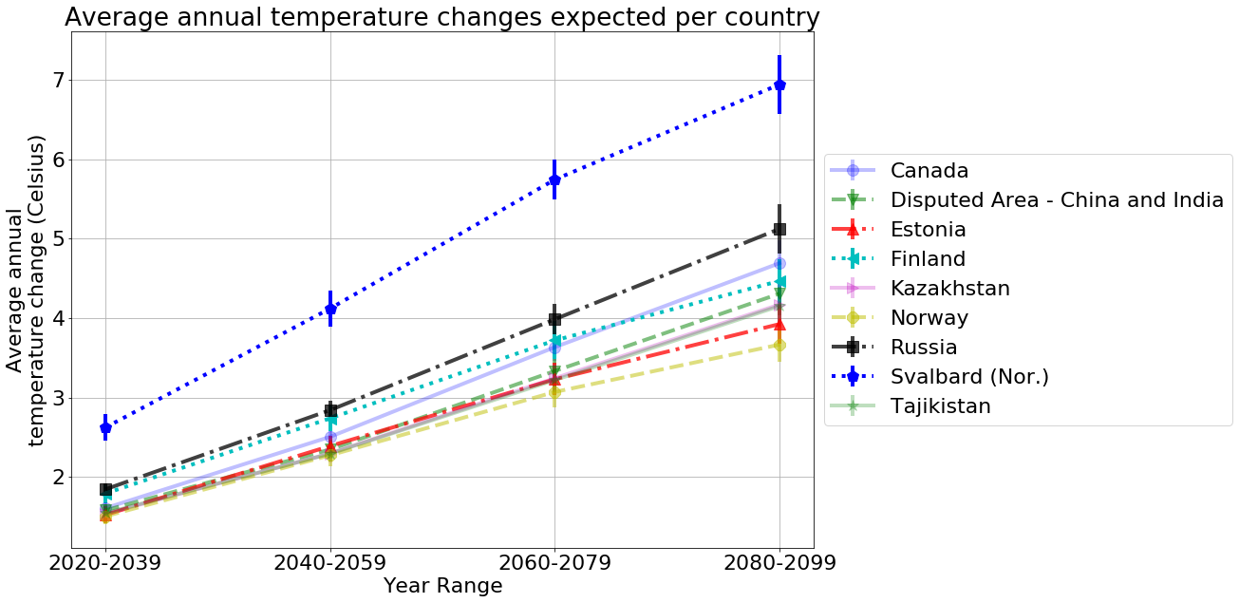
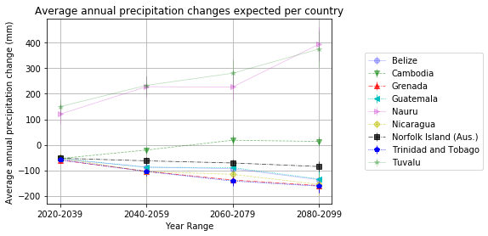
Findings
How does climate change impact freshwater access?

Slide 6
Findings Cont..
Do these countries with low water have higher instances of conflict?

Slide 7
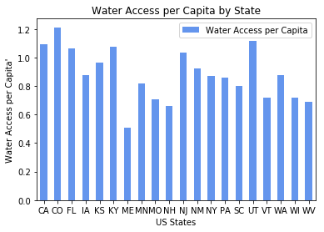
Findings Cont..
What areas in the United States have less access to water?
US states have adequate water available in almost all stores. Maine state seems to have less water access compared to population
*Population and water data are from different sources

Slide 8
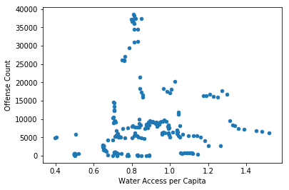
Findings Cont..
Do these areas with low water in US have higher instances of conflict?

Slide 9
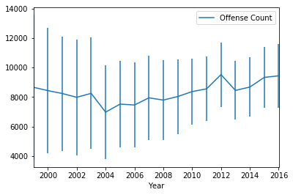
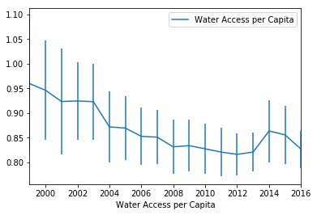
Findings Cont..
Do these areas with low water in US have higher instances of conflict?

Slide 10
Conclusions

Slide 11
Implications

