Slide 1
What Countries Are Predicted to be Most Influenced by Climate Change?
WANGRY Group
Swati Madan
Naim Panjwani
Mariaveronica Sayewich
Jose Tomines

Slide 2
Introduction and Problem Statement
How does climate change impact freshwater access?
Do areas with low freshwater access have higher instances of conflict?
What areas in the United States have less access to freshwater?
Do these areas with low freshwater have higher instances of conflict?

Slide 3
Materials & Methods - Data Sources
Climate Data API from the World Bank Group
Statistics are derived from 15 global circulation models (GCMs)
GCMs simulate response of global climate to greenhouse gas concentrations
Aggregated by country
Two basic world storylines/scenarios are considered:
A2: Heterogenous world with preservation of local identities
Slow tech development and little global economic changes
B1: Convergent world
Rapid changes in economic structures, tech development, clean, resource-efficient
Notes:
Scrap this slide

Slide 4
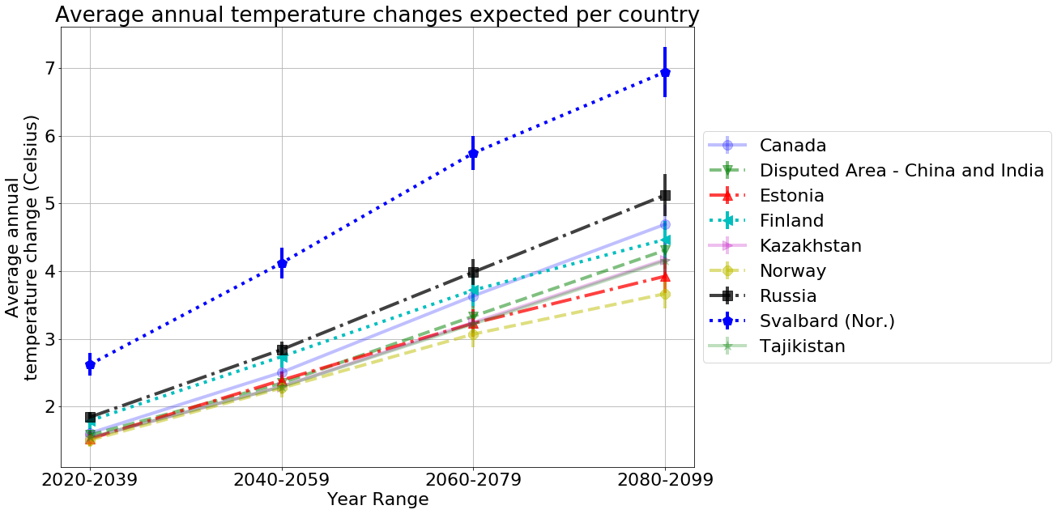
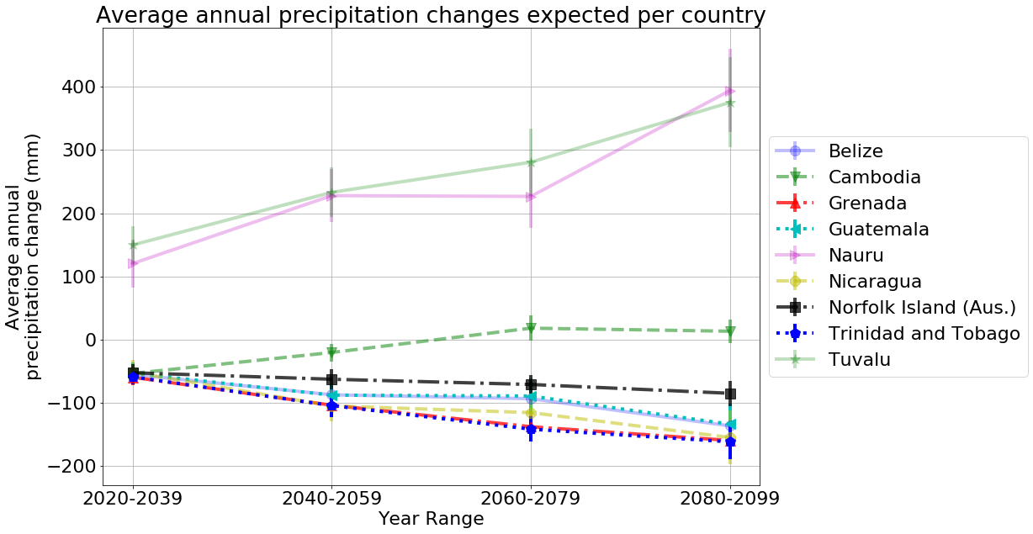
Results/Findings

Slide 5
Conclusions

Slide 6
Implications/Discussion

