Slide 1
Has polarization increased?

Slide 2
Polarization – what and why
It has been argued that polarization has increased lately.
Understanding the political climate is important for the voters
Functionality of parliamental decision making is also important.
Therefore we saw it important to analyse with actual data, if there has been any major shifts in the discussions in the parliament.

Slide 3
The method
Our data consisted of 130,000 plenary speeches from 2015 to 2026
We used AI (Claude) for analysing the data and to constract a model for guessing a speaker's party from a single speech, using only the words.
Logic of the model: If the guess gets easier over time, the parties are speaking more differently. We call this "separability", on a scale from 0, where parties are indistinguishable, to 1, where they are always distinguishable.

Slide 4
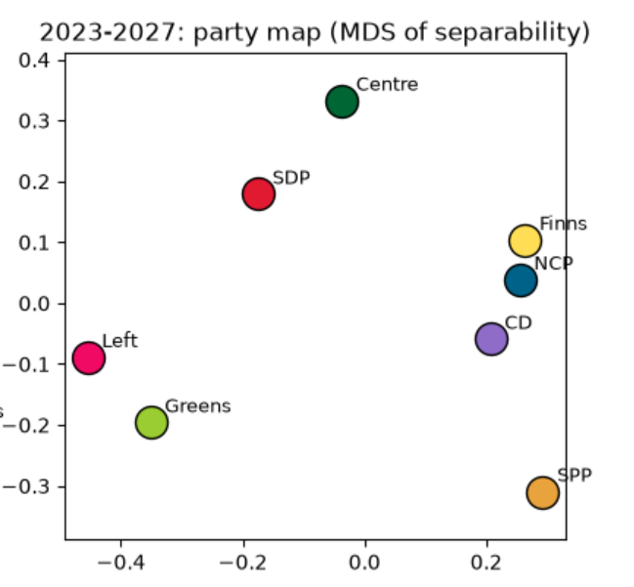
Preliminary results (1/2)
On the right hand side we have the parties mapped based on their distance from each other.
If the parties are close to each other, the model had difficulties to separate them. If they are far apart they were easy to separet from each other.
The National Coalition, the Finns Party and the Christian Democrats speak alike.

Slide 5
Preliminary results (2/2)
The Left Alliance, the Social Democrats and the Greens are close in views, but each has its own voice.
Swedish national party differs from all other parties.

Slide 6
Worth of noting
The parties may simply talk about different things. The Finns Party talks about immigration, the Greens about climate.
Three terms means three governments, so a trend can't be fully separated from who governs.
The study measures language, not opinions.
And today's parliament is far from the most divided in history, since a century-long study puts the peak in the 1970s. What the data show is a measurable, recent widening of the distance between Finnish parties, organised around two blocs.

