Slide 1






Keeping our customers coming back
FOR ELENA TARRANT, HEAD OF MARKETING, AND THE LEADERSHIP TEAM
Goal: keep customers engaged and booking again by offering each one the perk that matches how they actually travel.
QUESTION 1
QUESTION 2
Does the data back your five perks?
Which perk for each customer?
One likely favorite perk per customer, so the invitation email can lead with it
Free hotel meal
Free checked bag
No cancellation fees
Exclusive discounts
1 night free hotel with flight
Jacklynn Tong · Data Analytics · TravelTide Mastery Project · 6 Nov 2026
Notes:
[0:00 → 0:35 · 35 sec]
Before you start: Slide Show > Presenter View (Bildschirmpräsentation > Referentenansicht). The timer is at the top left of Presenter View. Reset it right before you start talking, and compare it with the times at the top of each slide's notes.
Good afternoon, Elena, and everyone from the leadership team. Thank you for having me.
Our goal is to keep customers engaged and booking again, by offering each one the perk that matches how they actually travel.
Your idea is that an invitation works best when it leads with the one perk a customer cares about most. So you asked me two questions. First: does our data show customers who are especially interested in your five perks? And second: which perk should each customer get?
Here's what I did, and what I found.
→ Next slide at 0:35

Slide 2
From 1 million users to one perk each
WHAT WE DID
1,020,926
all TravelTide users
1
Prepare
Cleaned the data and described each customer by party size, nights, distance, discounts and repeat cities
979,801
active since Jan 4, 2023
2
Find groups
Built 8 groups from clear habits, such as hotel-only stays, and tested each one: real habit or just luck?
5,998 customers
with more than 7 sessions
3
Double-check
A clustering algorithm (K-Means) that never saw our rules found 4 of the same groups on its own
83 %
in the USA
41
median age
49,211
sessions
15,489
kept trips
4
Assign perks
76 % get their group's perk. The 24 % without a clear habit get the perk they score highest on
Cohort as you suggested: sessions from Jan 4, 2023, users with more than 7 sessions · SQL and Python notebooks on GitHub
Notes:
[0:35 → 1:20 · 45 sec]
We started with all one million users and used the cohort you suggested: sessions since January 4th and more than seven sessions. That leaves 5,998 engaged customers, mostly in the US, with a median age of 41.
Then four steps.
One: we cleaned the data and described every customer with a few simple numbers, like party size or flight distance.
Two: we built eight groups from clear habits, like booking hotels without flights, and tested each one: is it a real habit, or just luck?
Three: a clustering algorithm searched for groups on its own, without our rules, and found four of the same ones.
Four: 76 % of customers get their group's perk. The 24 % without a clear habit get the perk they score highest on.
→ Next slide at 1:20

Slide 3






Your perks partly hold up, and every customer has one
THE SHORT ANSWER
ASK 1 · EVIDENCE FOR YOUR FIVE PERKS?
ASK 2 · A PERK FOR EACH CUSTOMER?
Partly yes
Yes, all 5,998
Backed by a habit
Free hotel meal, no cancellation fees, 1 night free hotel with flight
76 %
24 %
4,561 by a segment rule
1,437 by perk score
No clear habit, so test first
Exclusive discounts, free checked bag
9 customer groups share 6 perks
One perk per customer, no overlaps
New idea from the data
Extra-legroom seat for long-haul travelers
Saved for every customer
user_perks.csv, ready for the invitation emails
Next: how we got there, in the interactive story
Live demo in Tableau
Notes:
[1:20 → 1:50 · 30 sec]
So, the short answer. Your first question: partly yes. Three of your five perks match a real habit: the hotel meal, no cancellation fees and the free night. Discounts and the free checked bag don't show a clear habit, so we'd test those first. And the data points to one new perk: extra legroom for long-haul travelers.
Your second question: yes. Every one of the 5,998 customers has a perk. Let me show you how, live in Tableau.
SWITCH (0:10): Alt + Tab to the Tableau tab (opened, clicked through once and in full screen before the talk). If it isn't open, click "Live demo in Tableau".
TABLEAU DEMO, 2:00 → 4:40 (full script in the Tableau speaker notes):
1 Customers & trips (0:25): KPI tiles, then World ↔ North America. 99.2 % of flights stay in North America.
2 Nine groups (0:40): click Free hotel meal. 616 Hotel Stayers + 417 Family Crew by rule, 238 All-rounders by perk score. One sentence on the fixed rule order.
3 Habit or luck (0:40): shuffle test in one sentence. Hotel-only +26 %, packages +17 %, long distances +9 %. Dreamers 458 vs 236.
4 Perks & personas (0:25): perk bars, then click Long-haul Travelers (customer 521379, New York, 3,729 km). Back to Hotel Stayers.
5 Recommendation (0:30): launch 4 perks (4,769 customers, 80 %), test 2 (1,229, 20 %). Control group, baselines 33.1 % booking rate, 2.6 trips, 3.8 % cancellations.
BACK (at about 4:40): Alt + Tab to PowerPoint, press → for the closing slide.
7-minute version (+1:15): ML card on point 3 (0:30), Segment → family status on point 2 (0:20), Dreamers persona on point 4 (0:25).

Slide 4
Thank you for your trust
Two things to take away for our customer retention plan:
1
Lead with the right perk
Every customer has one perk. Four are backed by real habits and ready to launch: 4,769 customers, 80 %.
2
Test before you scale
A/B-test exclusive discounts and the free checked bag against a control group: 1,229 customers, 20 %.
Questions?
Jacklynn Tong · Data Analytics · notebooks, SQL and user_perks.csv on GitHub: github.com/jtong28/TravelTide
Notes:
[4:40 → 5:00 · 20 sec, right after Alt + Tab back from Tableau]
Elena, and the leadership team, thank you for your trust, and for the chance to help with our customer retention planning.
If you remember two things: lead every invitation with the perk that fits the customer's habit. Four perks are ready now. And test before you scale.
I'm happy to take your questions.
FOR QUESTIONS: the backup slides are 5 to 7. Type the number and press Enter to jump there (5 data fixes, 6 three checks, 7 machine learning), then 4 + Enter to come back here. Short answers for the perk score, City Stamp Card and Bring-a-friend are in the Tableau speaker notes.

Slide 5
What we fixed before counting anything
BACKUP · UNDER THE HOOD 1/3
Issue | What we did | Effect
Cancellations | A canceled trip is not travel, so its booking doesn't count | 610 trips out, 15,489 kept
Hotel nights | Raw nights counted 24-hour periods and had negative values, so we recalculated them from check-in and check-out dates | 421 bookings with invalid dates: spend left as unknown
Discount flags | Flags show what was offered, so a discount only counts on the part that was booked | 549 trips corrected: 26.3 % → 22.7 % discounted
Birth year 2006 | Placeholder birthdates: 233 users, almost all of the under-18s | Flagged; age plays no part in the perks
Time window | 7 canceled trips were booked before Jan 4, 2023 | Kept, no effect on the kept trips
Details: notebook 01 (EDA & cleaning) and sql/session_and_user_base.sql on GitHub
Notes:
[Only if asked · about 30 sec]
Before counting anything, we fixed five things in the data. The biggest one: the discount flags show what was offered in a session, not what was used. So we only count a discount on the part that was actually booked. That corrected 549 trips and moved the discounted share from 26 to 23 percent.
The other big one is hotel nights. The raw field counts 24-hour periods and even has negative values, so we recalculated the nights from the check-in and check-out dates.
→ 4 + Enter to go back to the closing slide

Slide 6
Three checks behind every perk
BACKUP · UNDER THE HOOD 2/3
50 ×
Habit or luck? Customers who match each rule, real data vs. chance
SHUFFLE TEST
Trips dealt out at random 50 times. 5 rules beat 95 % of the shuffles.
458 vs 236
CHANCE MODEL
Customers who never book vs. chance: the Dreamers are a real group.
|r| ≤ 0.12
REDUNDANCY
habit: beats 95 % of 50 shuffles
luck: inside the chance range
Perk scores barely overlap. The hotel perks reach opposite customers.
Details: notebook 03, sections 3 and 4.1 · % = customers above what chance alone gives
Notes:
[Only if asked · about 40 sec]
Every rule was checked against chance. We dealt the trips out again at random, 50 times. Patterns that survive the shuffle are habits we can build perks on.
The chart shows it: hotel-only stays are 26 % above chance, packages 17 %, long flights 9 %. Discounts, checked bags and weekend trips sit right at chance.
The same idea with a simple probability model shows the Dreamers are real: 458 customers never book, about twice what chance would give, which is 236.
And no two perk scores measure the same thing. The only notable pair, the hotel meal and the free night, is a mirror image (r = −0.52): one fits hotel-only travelers, the other package bookers.
→ 4 + Enter to go back to the closing slide

Slide 7
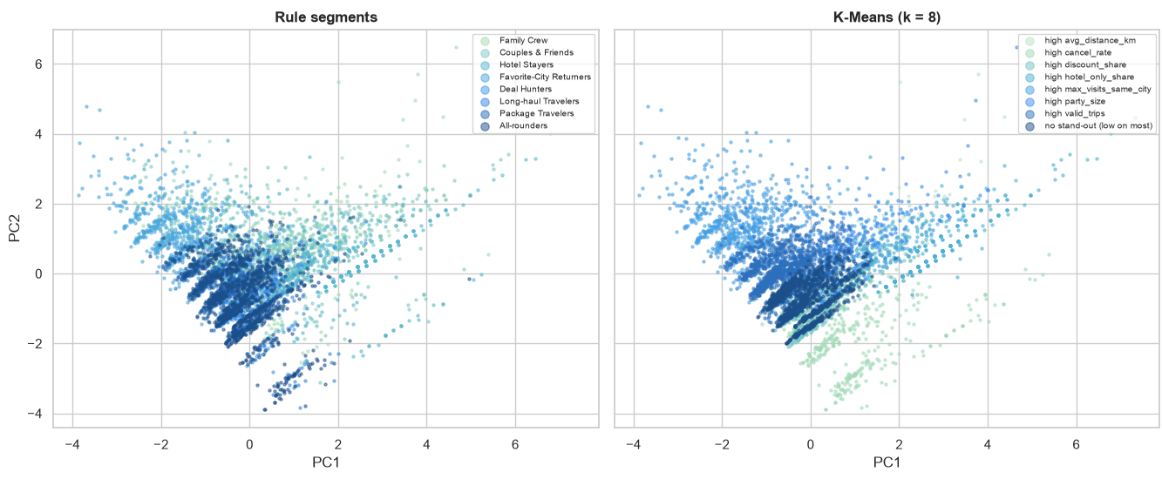
Machine learning as a cross-check
BACKUP · UNDER THE HOOD 3/3
4 of 7
Same customers, two views: our rule segments (left) and K-Means clusters (right)
K-MEANS (k = 8)
booker groups found on its own, most clearly Favorite-City and Hotel Stayers
97 %
DBSCAN
of the 115 most extreme customers flagged as outliers, like our own check
7 of 9
PCA
All 5,442 bookers on the first two PCA components. Behavior is one continuum, with a few groups that stand apart at the edges.
components needed for 80 % of the variance, so there's no shortcut
Clustering shows who is similar, the shuffle test shows whether it's a habit · details: notebook 03, sections 5–7
Notes:
[Only if asked, or in the 7-minute version · about 40 sec]
We also let three algorithms look at the customers without our rules. The picture is the same in all of them: one big continuum, with a few groups that clearly stand apart at the edges, like the Favorite-City Returners and the Hotel Stayers.
K-Means found four of our seven booker groups on its own, and DBSCAN flagged the same extreme customers as outliers that our own check did.
But clustering only shows who is similar, not whether it's a habit. K-Means even forms a discount cluster, although discount use is luck. That's why we assign perks with clear rules, launch a perk only if its behavior passes the shuffle test, and use the algorithms as a check.
→ 4 + Enter to go back to the closing slide

