Slide 1
Email Spam Detection
John T. O’Rourke

Slide 2
Dataset
Spam Emails from the Enron public email corpus.
Additional spam emails were introduced into each user’s email stream by the dataset maintainer.
This was done to have a sufficient number of spam examples.
The non-Spam emails are labeled “ham”.
File counts:
1,500 Spam files
Only GP (2 other groups)
3,672 Ham files
Only farmer (5 other groups)

Slide 3
Preprocessing and Cleaning
Generated tuples for each email list to include a new column titled `label` for classification purposes
Merged and shuffled tuples with the use of `random`
Added a column `length` that includes character count
Created 3 functions for cleaning:
elim_subject
Removes the “Subject: “ text from each email
elim_stop
Removes all stop words from the `email` field
elim_punc
Removes all punctuation from the `email` field
Naïve Bayes random state set at 17 for all 3 models
Test size for Naïve Bayes split at 0.3

Slide 4
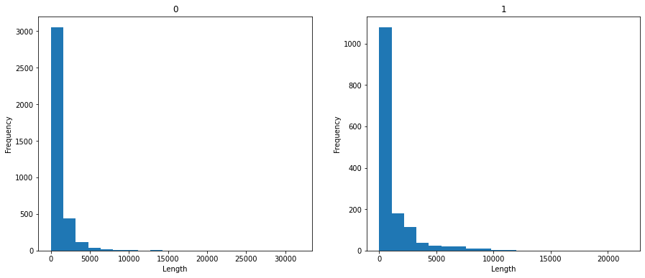
Descriptive Statistics - Email Length Comparison
Spam emails show a larger character count than legitimate emails
This analysis was completed prior to removing stop words to ensure email length was preserved.

Slide 5
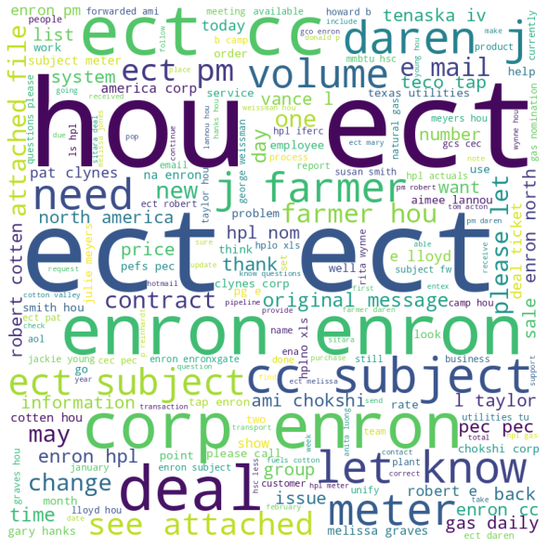
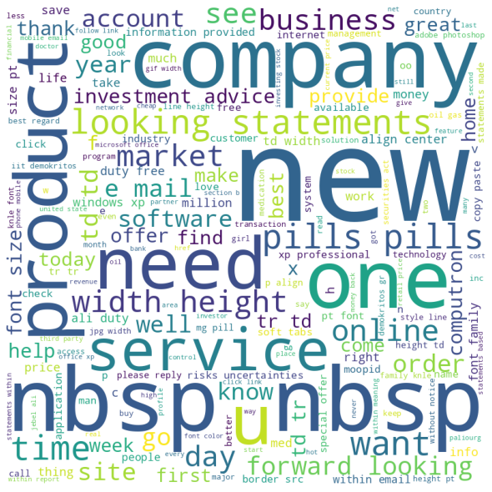
Descriptive Statistics - WordClouds
Ham data shows more emphasis on business-specific terminology and information
Enron
Employee Names
Corporate jargon such as “see attached”
Spam data shows a higher emphasis towards sales of a product or service with several buzzwords
Words like “Product”, “Company”, “Market”, “Software”, etc
No corporate specific information to Enron
Ham
Spam

Slide 6
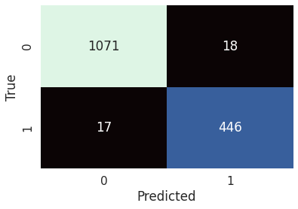

Model Development - Naive Bayes
Utilized scikit-learn’s `train_test_split` function to generate randomized training and testing data
Bag of Words feature matrix generated by `CountVectorizer`
`CountVectorizer` only accounts for the frequency of a word within a document, not the entire corpus.
Through the use of `MultinomialNB`, the model was a 97.74% accurate and correctly identified 1,517 of the 1,552 used documents

Slide 7
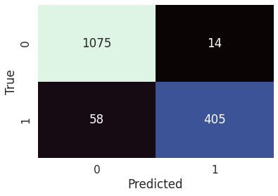
Model Development - Gaussian Naive Bayes + VADER
Gaussian Naive Bayes was utilized in order to account for the negative sentiment values introduced by VADER.
VADER is a sentiment lexicon that focuses on the positive and negative sentiment of language on a scale from -1 (negative) to 1 (positive).
Bag of Words feature matrix generated by `CountVectorizer`
Model accuracy was 95.36%
Correctly identified 1,480 out of 1,552 documents
Majority of inaccurate readings were due to false negatives indicating that the model classified a large number of “ham” as “spam”

Slide 8

Model Development - GNB, VADER, and TF-IDF
Similar construction to previous model with the only change being the inclusion of TF-IDF as the vectorization algorithm.
TF-IDF or Term Frequency-Inverse Document Frequency is similar to CountVectorizer
Provides a weighted value based on frequency for words within a document as well as within the corpus
Model accuracy was 94.65%
Correctly identified 1,469 out of 1,552 documents
Inaccuracies were more evenly spread between false positives and false negatives.

Slide 9
Overall Results
Naive Bayes
Model accuracy: 97.74%
Gaussian Naive Bayes + VADER
Model accuracy: 95.36%
Gaussian Naive Bayes + VADER + TF-IDF
Model accuracy: 94.65%
Possible causes for accuracy falloff:
Incompatibility of Features
Overfitting
Introduction of “Noise”
Usage of VADER and TF-IDF can create higher value in features that may not have required it.

Slide 10
Final Thoughts and Future Enhancements
Overall pleased with results and outcomes of the project
Testing/usage multiple modeling techniques/methods
Support Vector Machines
Random Forest
Gradient Boosting
Could prove especially useful when incorporating sentiment data from VADER
Increased pre-processing to possibly separate the subject line from the body of the email
Could be used for model development to determine spam based on subject alone

