Slide 1

Spotify Popularity Classification
By John O’Rourke, Michael Nunn, & Eugene Johnson

Slide 2
Dataset Summary
This dataset contains audio statistics of the top 2000 tracks on Spotify from 2000-2019.
The data contains 18 columns each describing the track and it's qualities.
These qualities offer insight into multiple different measures including popularity, danceability, and genre.
Issue this being a recent developed Streaming platform the data taken prior to 2006 may not be completely accurate.
The data given was more than likely during the beta stage which means not a lot of subscribers

Slide 3
Attributes - Categorical and Non-audio based data
artist - Name of the Artist(s)
song - Name of the Track
duration_ms - Duration of the track in milliseconds
explicit - Indicator of whether or not a song is suitable for children (T/F)
year - Release year of the track
popularity - Value of 0-89 of how popular the track is
genre - Genre of the Track

Slide 4
Attributes - Numeric data
danceability - describes how suitable a track is for dancing based on a combination of musical elements
energy - Energy is a measure of intensity and activity (0.0 - 1.0)
key - The key the track is in
loudness - The overall loudness of a track in decibels
mode - Indicates the modality of a track
speechiness - detects the presence of spoken words in a track
acousticness - A confidence measure from 0.0 to 1.0 of whether the track is acoustic
instrumentalness - Predicts whether a track contains no vocals
liveness - Detects the presence of an audience in the recording
valence - Describes the musical positiveness conveyed by a track
tempo - The overall estimated BPM of a track

Slide 5
Project Goals
Develop a functioning set of models that allows us to determine:
Which song attributes impact a songs popularity score.
What is the best possible grouping of attributes to determine if a song will be a top-hit for its given year.
Gain further understanding of modeling techniques, reporting, and data analytics through R.
Utilize project management techniques to effectively deliver a quality project.

Slide 6
First look at the data
This data has 0 missing values
There are 57 different genres
Spotify’s genre classification works differently than expected.
For example: Any given song can have up to three genres listed.
Blink-182’s “All The Small Things” has both rock and pop listed as the genre
The most frequent genre in the dataset is “pop” with 416 records.
This does not include all other references to “pop” for multi-genre songs.
2012 is the release year with the most frequency in the data (115 tracks)

Slide 7
Exploratory Data Analysis

Slide 8
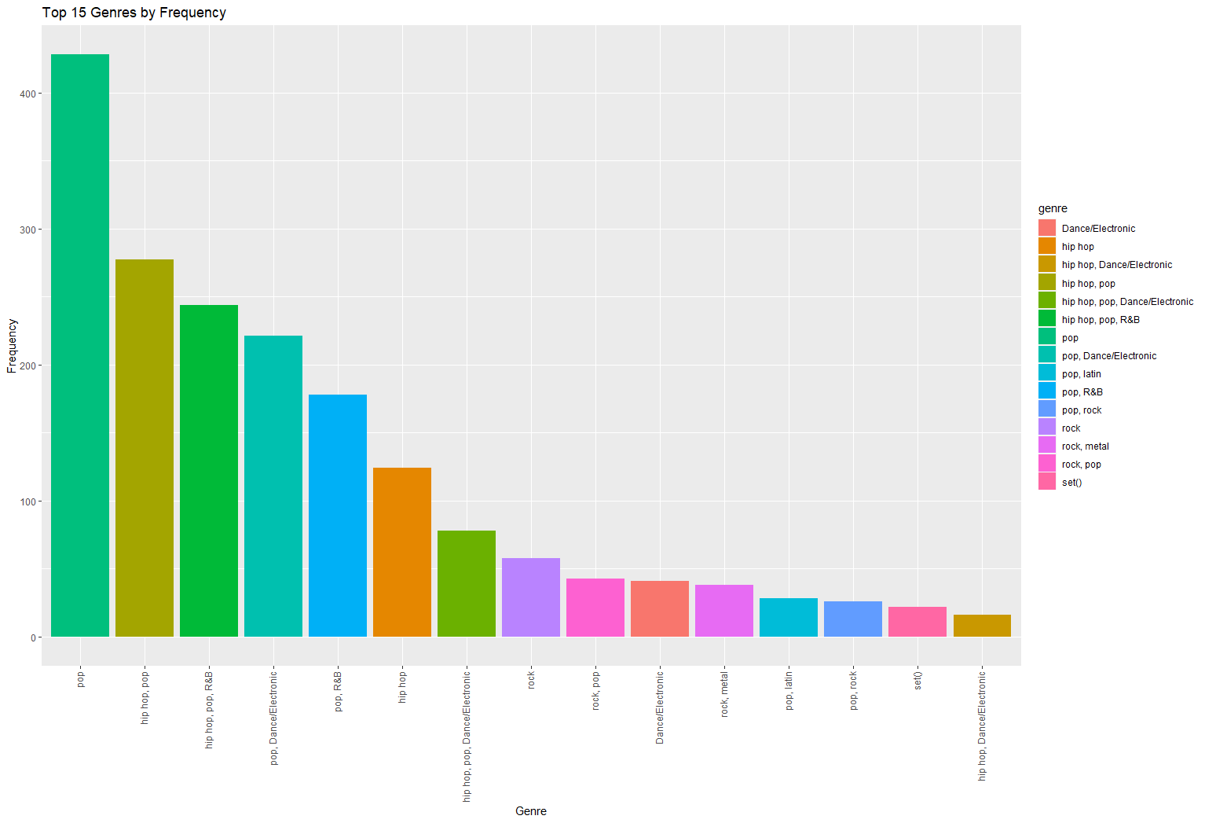
Top 15 Genres based on Frequency Bar Chart
Based on the analysis we see that the genre with the highest frequency is Pop
The lowest being a mixture of Hip-Hop and Dance/Electric

Slide 9
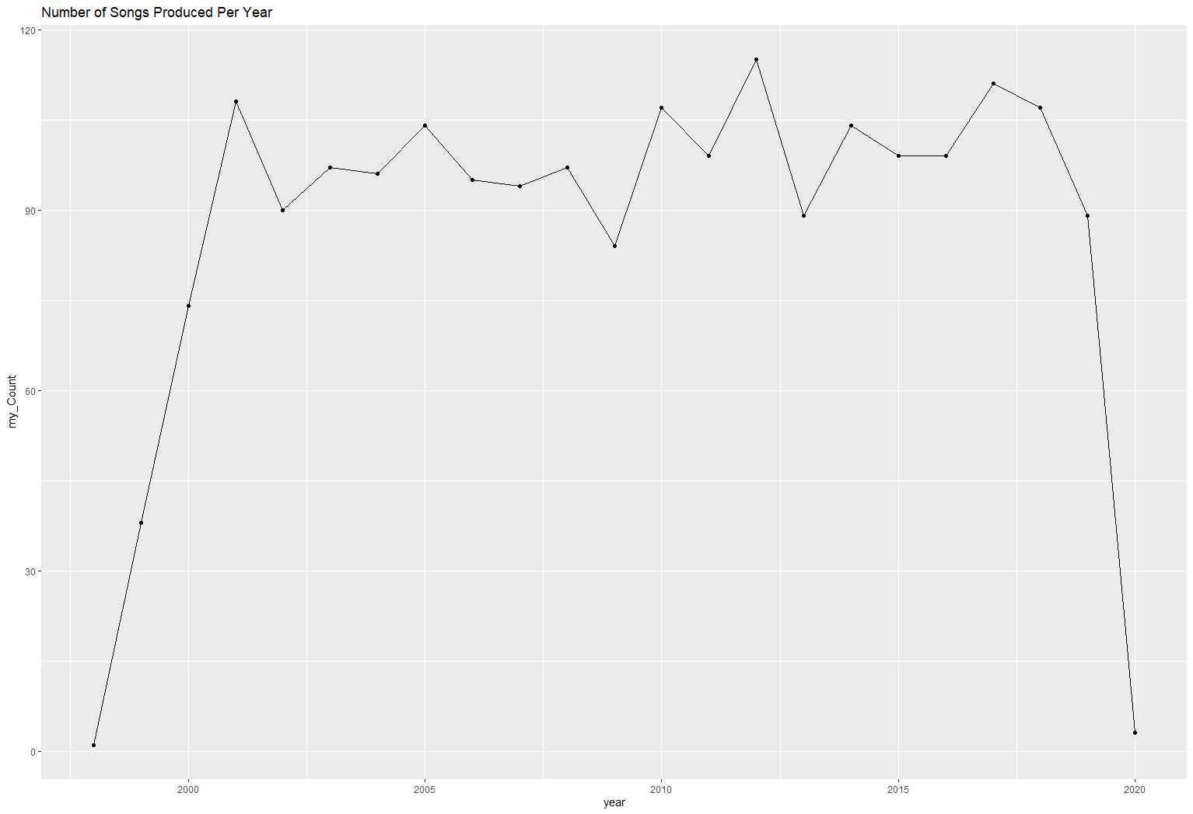
Amount of Songs by the Year
Grouping the amount of songs by year we see that the peak year was 2012 which was 115 songs that was produced.
The slowest year was 1998 with just one song being produce. This may be a lack of data due to Spotify not being created till 2006.

Slide 10
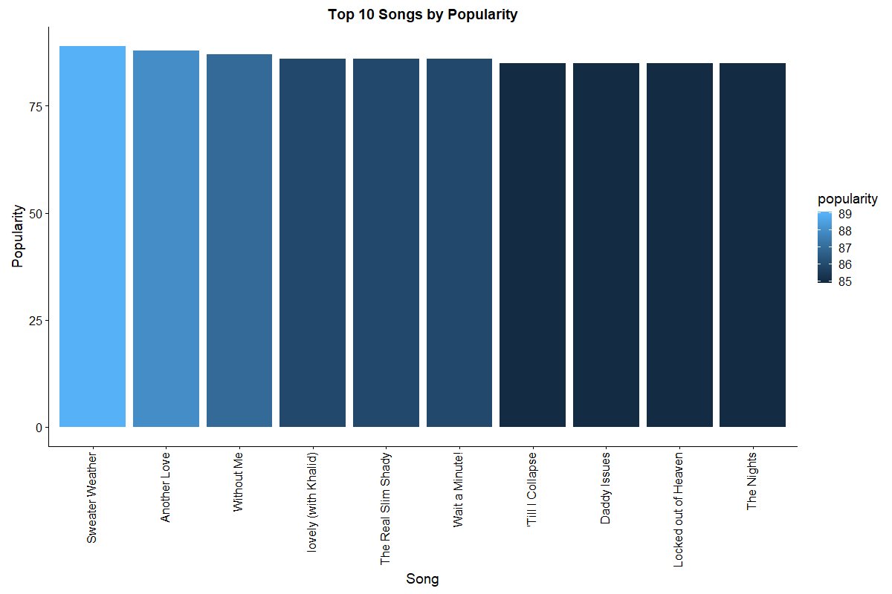
Top 10 Songs by Popularity
Based on the analysis we can determine that “Sweater Weather” by The Neighbourhood is the most popular song by score
Notes:
Popularity is determined by the total number of plays as well as how recent the plays were.
Dataset was updated 4 months ago.

Slide 11
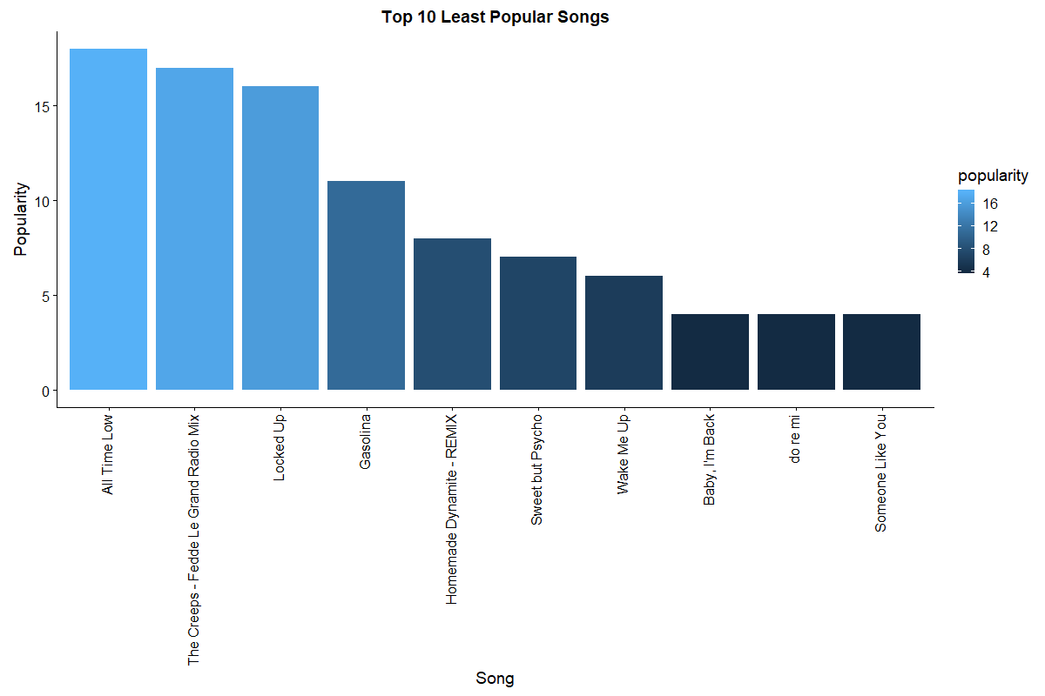
Top 10 Least Popular Songs
Based on the analysis we can determine that “Someone LIke You” by Adele is the least popular song by score

Slide 12
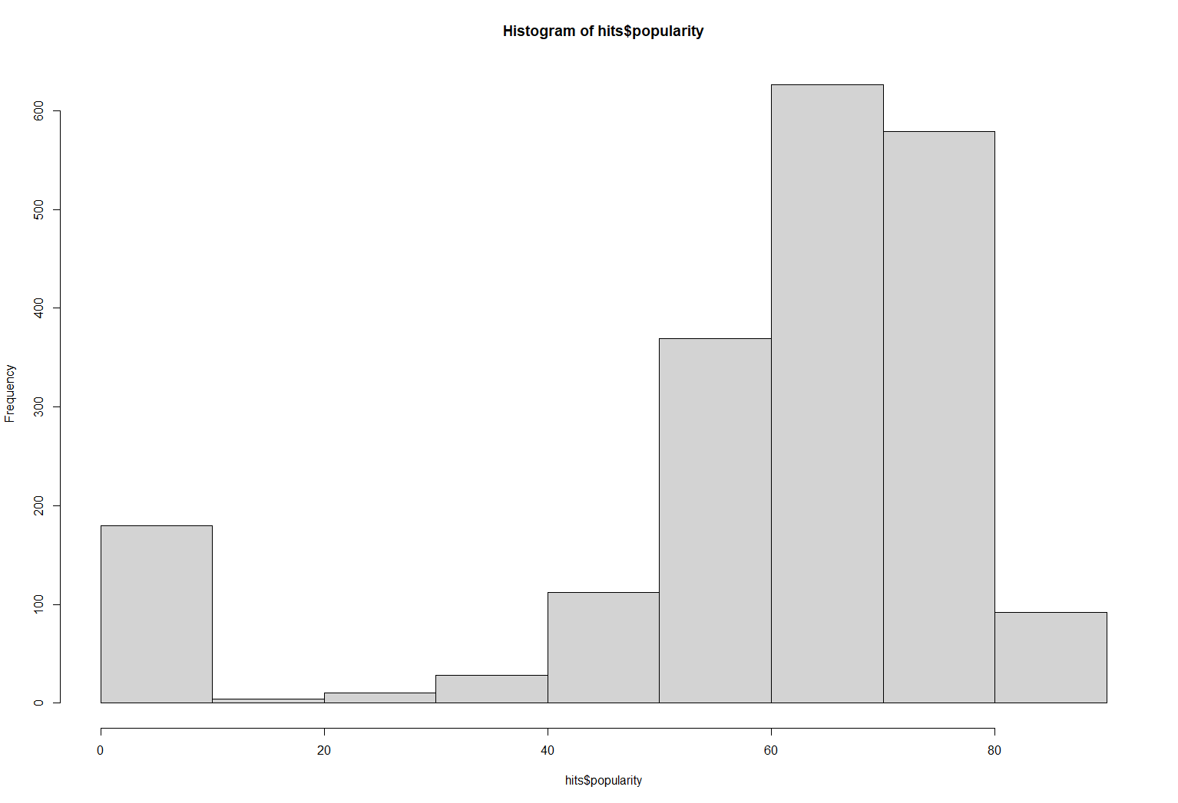
Histogram Popularity Breakdown
We can see that the “popularity” values are right skewed.
This fits the assumptions we have regarding the data as this is a “Top-hits” dataset.
“Popularity” as defined by Spotify is determined by total plays and how recent the plays were.

Slide 13
Model Development

Slide 14
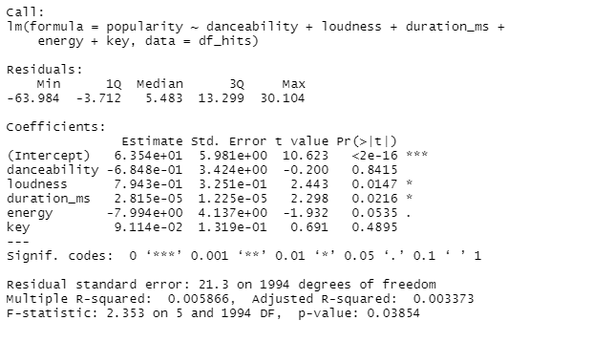
Linear Regression

Slide 15
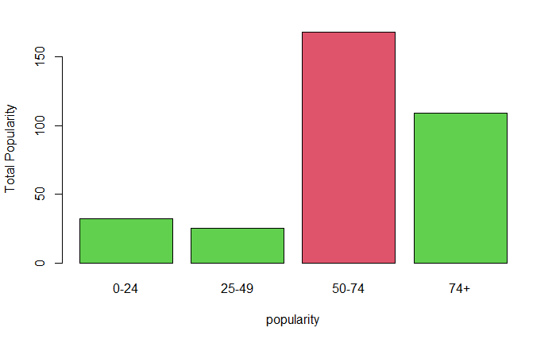
Naive Bayes

Slide 16
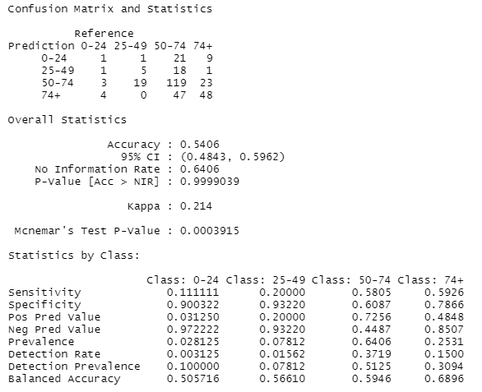
Confusion Matrix

Slide 17
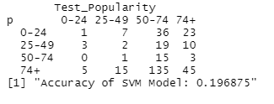
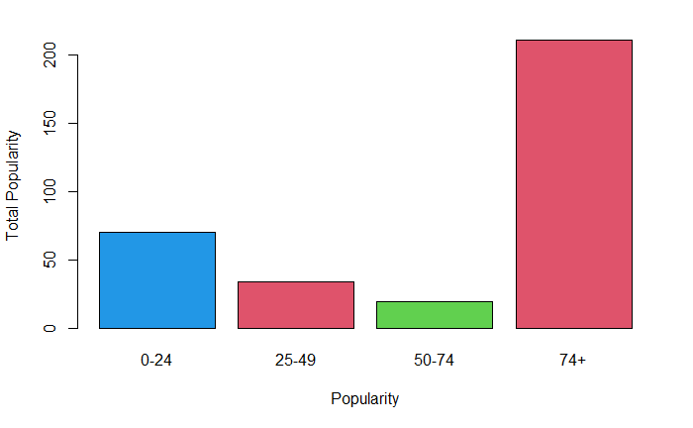
SVM
Notes:
Tuned for linear, radial and polynomial to determine the best cost.

Slide 18
Project Retrospective

Slide 19
What could be done to improve
Data set selection could be improved
Include more data than just top hits
Possibly pull data directly from the Spotify API
Sampling the data down further
Decision Trees taking in all numeric attributes were taking 16+ hours to complete
More usage of Project Management tools to determine task progress and assist where needed
Utilization of a formal shared repository for our code base

Slide 20
What went well
Team communication and understanding of roles
Gained further understanding of how to practically apply R
More specifically Naive Bayes, Decision Tree and SVM classification methods
The dataset did not have a lot of missing data and had limited duplicates
Spotify’s data collection is very strong compared to other services and allows for quality projects to be generated.

Slide 21
Continued Analysis
Branching out and using other classification methods.
Random Forest, kNN, and Ensembles
Bolster our overall Data Science knowledge by re-attempting this analysis within Python.
Perform more analysis and comparison to other attributes of the dataset for example the danceability compared to tempo. Will tempo play an effect on a person’s danceability to the song. Another example would be does speechiness affect the popularity of the song.

