Slide 1
Predicting a Drought in Continental US
Alfred Tinsley ❂ Eugene Johnson ❂ John O’Rourke ❂ Sophea Hummel

Slide 2
Specification: Specify the problem, hypotheses, and data for this analysis.
The main problems of this project are:
To combat droughts across the United States.
Effectively and efficiently predict where a drought may occur.
Predictive severity of the developing drought
The problems will be addressed using:
Forecasting models for the possibility to allow the government to setup programs that help combat areas affected by severe droughts based on weather and soil conditions observed and proactively avoid severe droughts in the future.
Nick

Slide 3
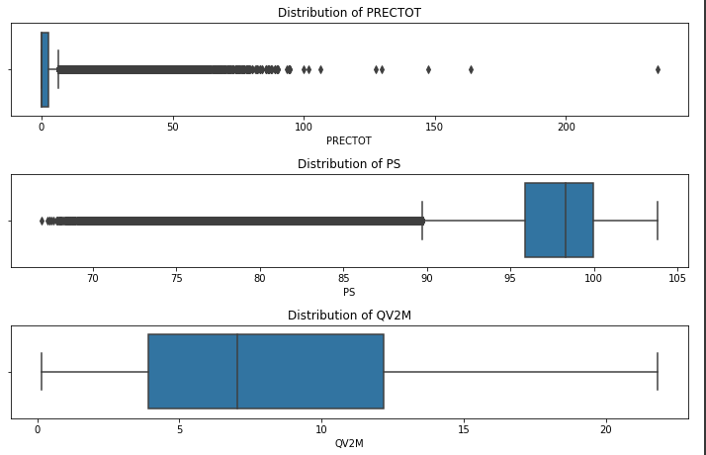
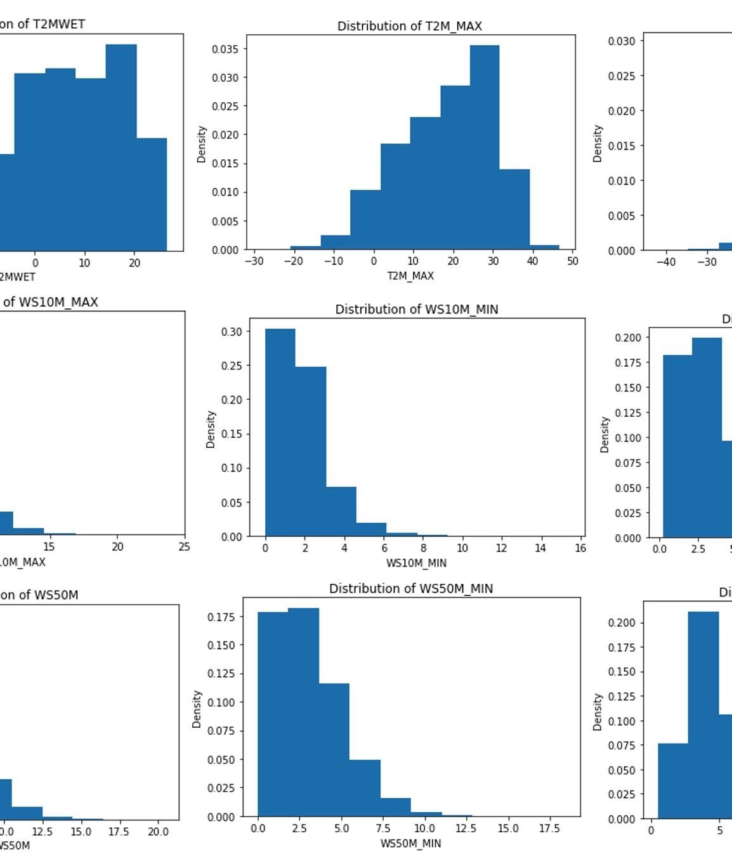
Observation: What can we conclude from your observation and visualization of the data?
The dataset was found to contain a score for every 7 days indicating the severity of a possible drought. This score was calculated within the provided dataset from the recorded variable values.
The scale of the score ranged from 0-4 with 0 being no drought and 4 being highly impactful drought.
The 7th day score was assumed to be the weekly score for that area. This was done throughout the dataset.
Eugene

Slide 4
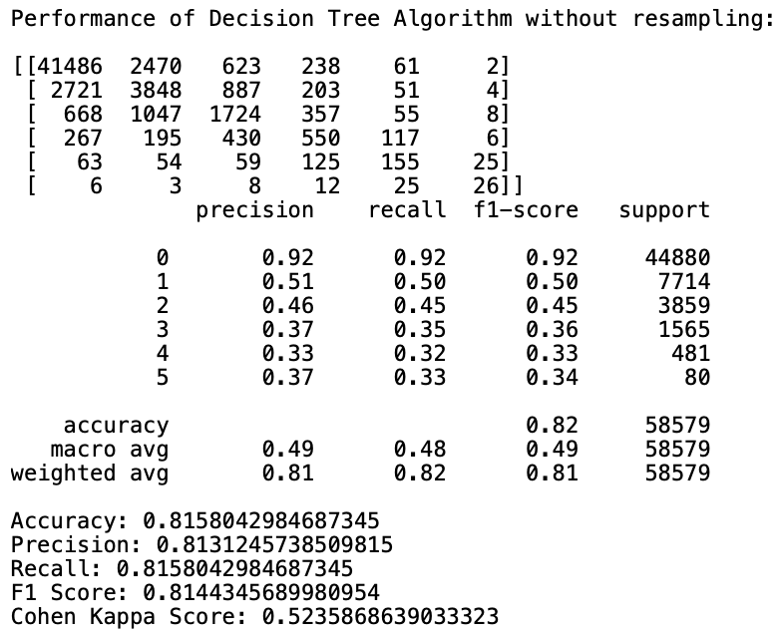
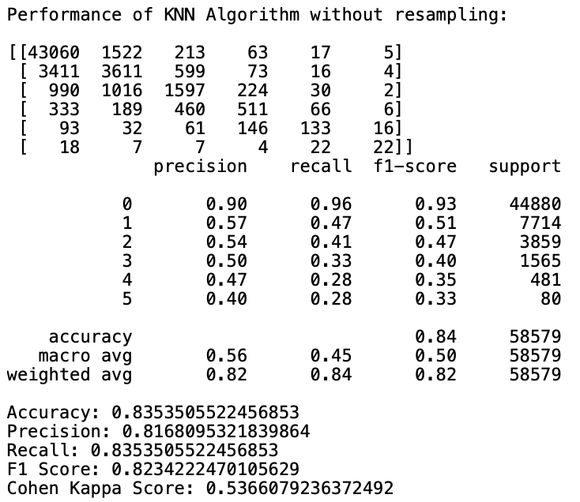
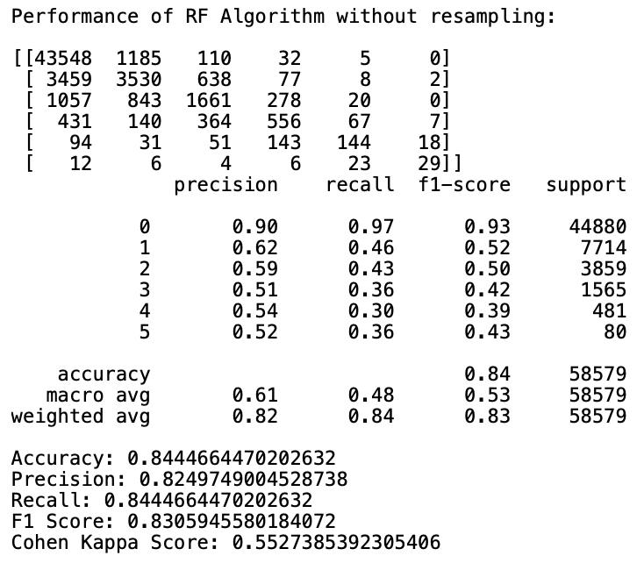
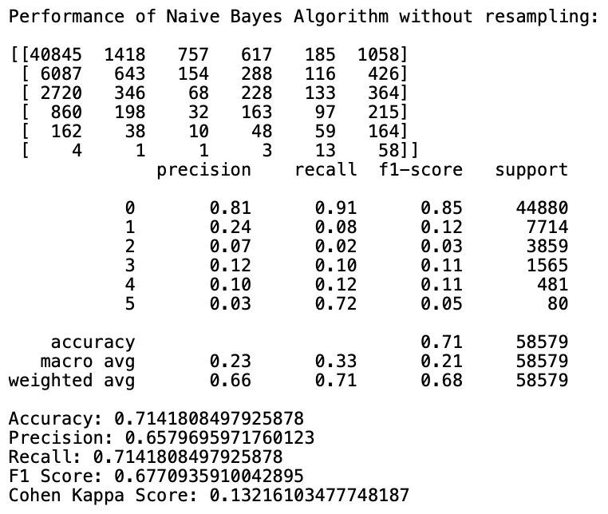
Implemented Models
Decision Tree & KNN
Applied multiple Decision Trees and KNN with different sampling sizes and fittings.
With all various versions of the Decision Tree and KNN run, the greatest accuracy was 82% & 84%, respectively.
RF & Naïve Bayes
Applied Naïve Bayes & Random Forest with different sampling sizes and fittings.
With one version of NB & RF run, the accuracy was 71% & 84%, respectively.
Sophea

Slide 5
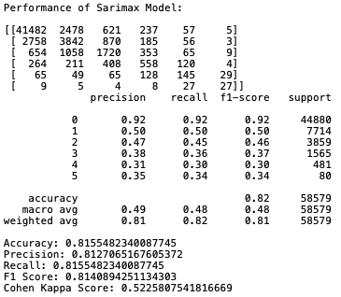
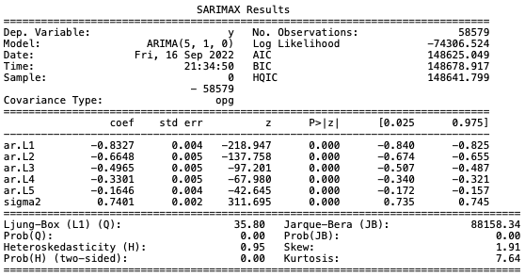
Analysis of the Chosen Model = SARIMAX
With our P-value being below the 0.05 alpha threshold, the model produced statistically significant information in order to reject the Null hypothesis.
Accuracy was calculated at 82%.
The range of probabilities are not crossing over zero further justifies rejecting the Null Hypothesis.
The Coefficient shows our model has a negative impact.
Sophea

Slide 6
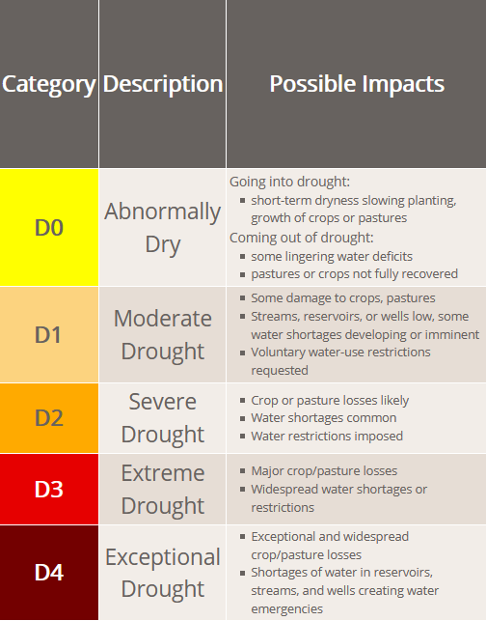
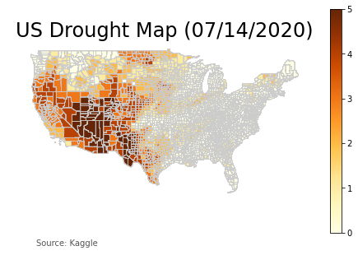
Interpreting the Results
John

Slide 7
Project Retrospective:
What can be improved:
We should have used R.
Understanding how size impacts analysis
Utilize down-sampling in the future
Attempt to understand libraries prior to implementation in the code base
Geopandas
Prediction Modeling and Timeseries
What went well:
Team Communication
Quality Dataset that allowed for different analysis options
Continued Analysis:
As we complete our report, we continue to use this dataset for future projects within the data science field
Possible addition to portfolios
More in-depth mapping and timeseries analysis
John

