Slide 1
Using Graph Statistics to Investigate the Properties of a Gene Regulatory Network that may Control the Cold Shock Response in Saccharomyces cerevisiae
Margaret J. ONeil
Department of Biology
Loyola Marymount University
Tri Beta Pacific District Conference
March 17, 2018

Slide 2
Outline
Yeast respond to cold shock by changing gene expression, though the transcription factors that regulate the response remain unknown
The dynamics of each gene in a candidate gene regulatory network were modeled using ordinary differential equations.
To determine which regulatory relationships were important, edges were deleted one at a time
Gephi was used to analyze connectivity and graph statistics of the edge deletion networks vs. the intact network
The property of eccentricity did not change between intact and edge deletion networks, shows that this value is uninformative in this case
Eigenvector centrality did significantly vary in the networks where the

Slide 3
Outline
Yeast respond to cold shock by changing gene expression, though the transcription factors involved remain unknown
The dynamics of each gene in each network were modeled using ordinary differential equations.
Edges were systematically deleted, one at a time, for the network, yielding 29 networks for analysis.
Gephi was used to analyze connectivity and graph statistics of nodes in the Δhap4 data-derived networks
Eccentricity and eigenvector centrality were investigated to determine the impact of edge deletion on network structure
Disruption of connections to a hub seem to cause the most disruption in the networks, indicating hubs such as MSN2 and CIN5 are highly important to network structure

Slide 4
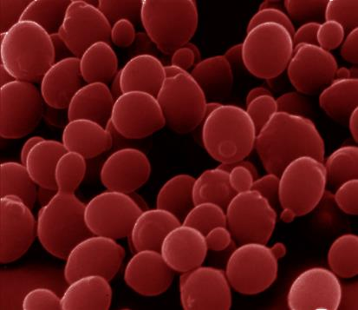
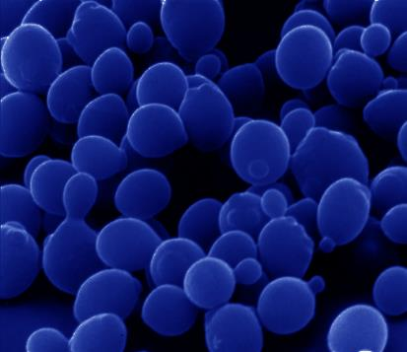
Saccharomyces cerevisiae is a model organism that can respond to environmental stressors
Heat shock
Cold shock
response very well-characterized
proteins denature due to heat
heat shock proteins (chaperonins) induced that assist with protein folding
conserved in all organisms (prokaryotes, eukaryotes)
response less well-characterized
membrane fluidity decreased
DNA and RNA secondary structures stabilized
ribosome function and protein synthesis impaired
enzymatic activities decreased
no equivalent set of cold shock proteins that are conserved in all organisms

Slide 5
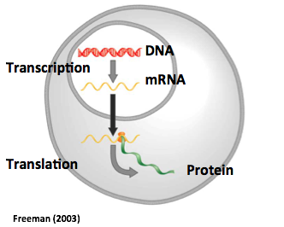
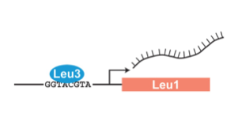
Yeast respond to cold shock by changing levels of gene expression
Transcription factors control gene expression by binding to regulatory DNA sequences
Activators increase expression while repressions decrease expression
Transcription factors are themselves proteins encoded by genes
Which transcription factors regulate the response to cold shock?
What are their relative level of influence?

Slide 6
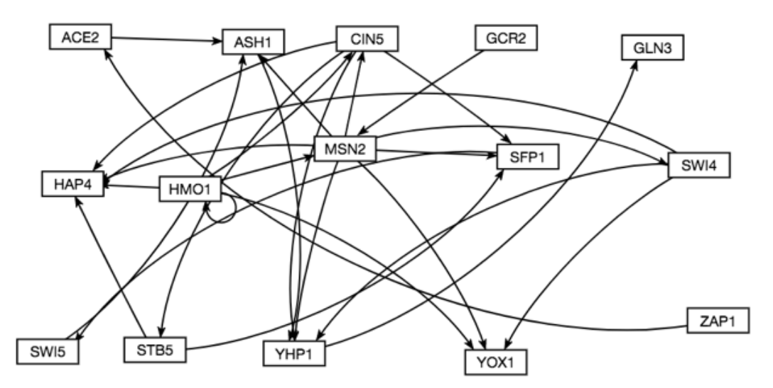
A Gene Regulatory Network (GRN) is a set of transcription factors that regulate the expression of other transcription factors
To better visualize relationships between transcription factors, networks or graphs can be created
They are similar in structure to a social network
Transcription factors are represented as rectangles called nodes
Regulatory connections between genes are shown as lines called edges
A candidate GRN for controlling the cold shock response was generated from Dahlquist Lab microarray data

Slide 7
GRNmap uses ordinary differential equations to model the dynamics of each transcription factor
[mRNA] for each gene
mRNA production rate
mRNA degradation rate
weight term
determines the level of activation or
repression
Unique threshold for each gene
The change in expression of one gene is production – degradation.
Weight parameter, w, gives the direction (activation or repression) and magnitude of regulatory relationship.
http://kdahlquist.github.io/GRNmap/
Notes:
Arrows need to be more accurate/put the box back → sized appropriately
Every gene in the network has an equation → go through the equation
P function modeled by sigmoidal curve for activation & repression; threshold for gene and then weights of regulation

Slide 8
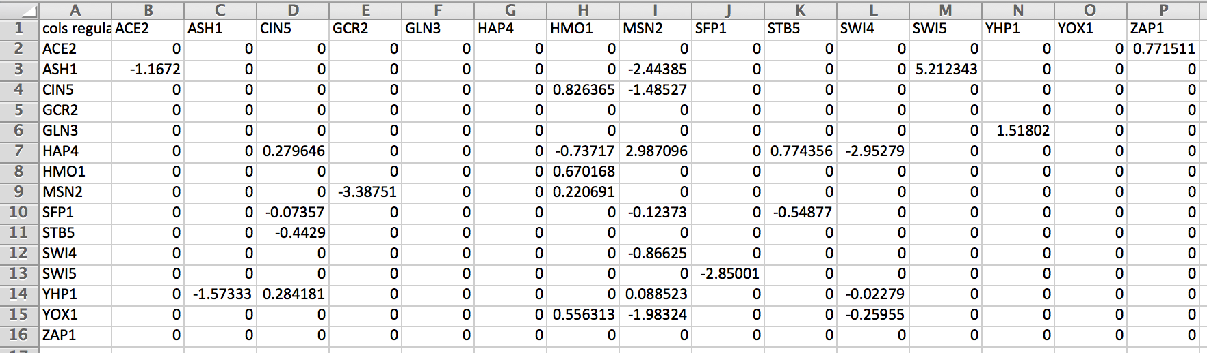
A penalized least squares error approach is used to estimate network parameters
Experimental
Theoretical
The experimental term represents the microarray data
The theoretical term is based on the solution to the differential equation (previous slide) using the estimation perameters
LSE or E value describes how well the overall GRN was modeled by GRNmap program
The LSE can be compared to the minimum theoretical LSE to compare goodness of fit across networks
http://kdahlquist.github.io/GRNmap/

Slide 9
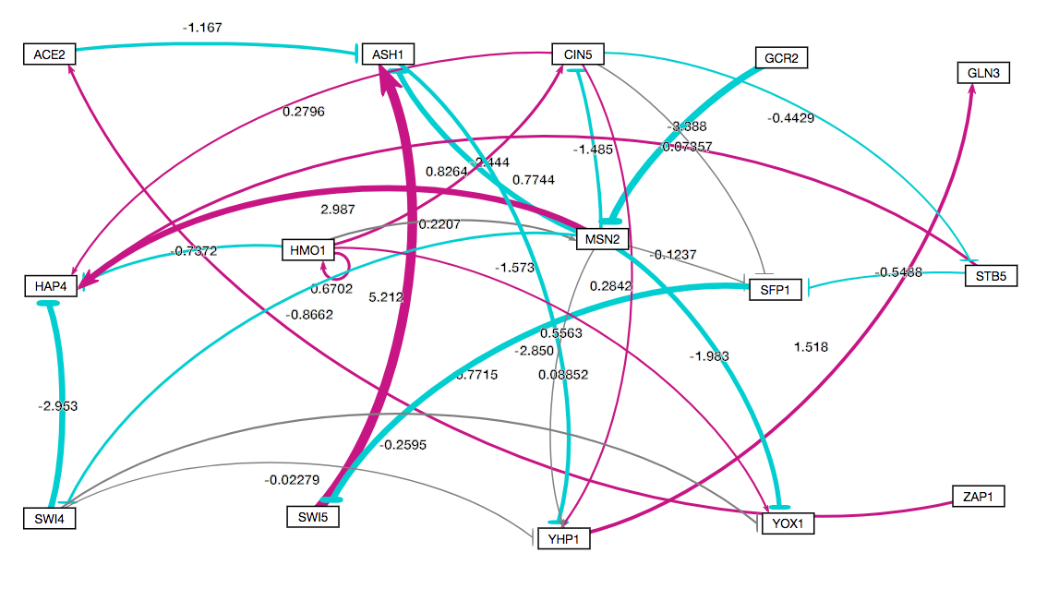
Visualizing the weight values show which regulatory relationships are strong or weak
Magenta → represent activate a target gene
Cyan --| represent repression of target gene
Thicker edges are stronger relationships
Thin grey edges represent weak relationships

Slide 10
GRNsight can be used to visualize GRNs and edge weights generated by GRNmap
Magenta → represent activation of target gene
Cyan --| represent repression of target gene
Thicker edges are stronger relationships
Thin grey edges represent weak relationships
Which of these edges are most important to the network?

Slide 11
Outline
Yeast respond to cold shock by changing gene expression, though the transcription factors involved remain unknown
The dynamics of each gene in each network were modeled using ordinary differential equations.
Edges were systematically deleted, one at a time, for the network, yielding 29 networks for analysis.
Gephi was used to analyze connectivity and graph statistics of nodes in the Δhap4 data-derived networks
Eccentricity and eigenvector centrality were investigated to determine the impact of edge deletion on network structure
Disruption of connections to a hub seem to cause the most disruption in the networks, indicating hubs such as MSN2 and CIN5 are highly important to network structure

Slide 12
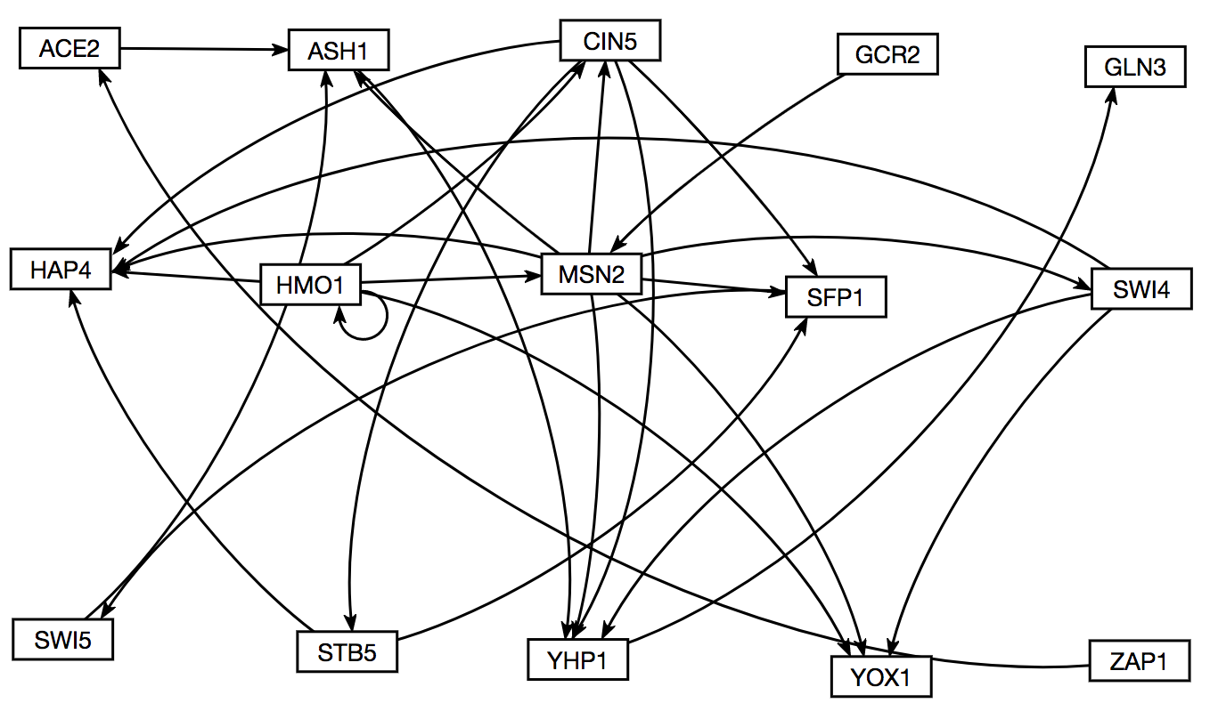
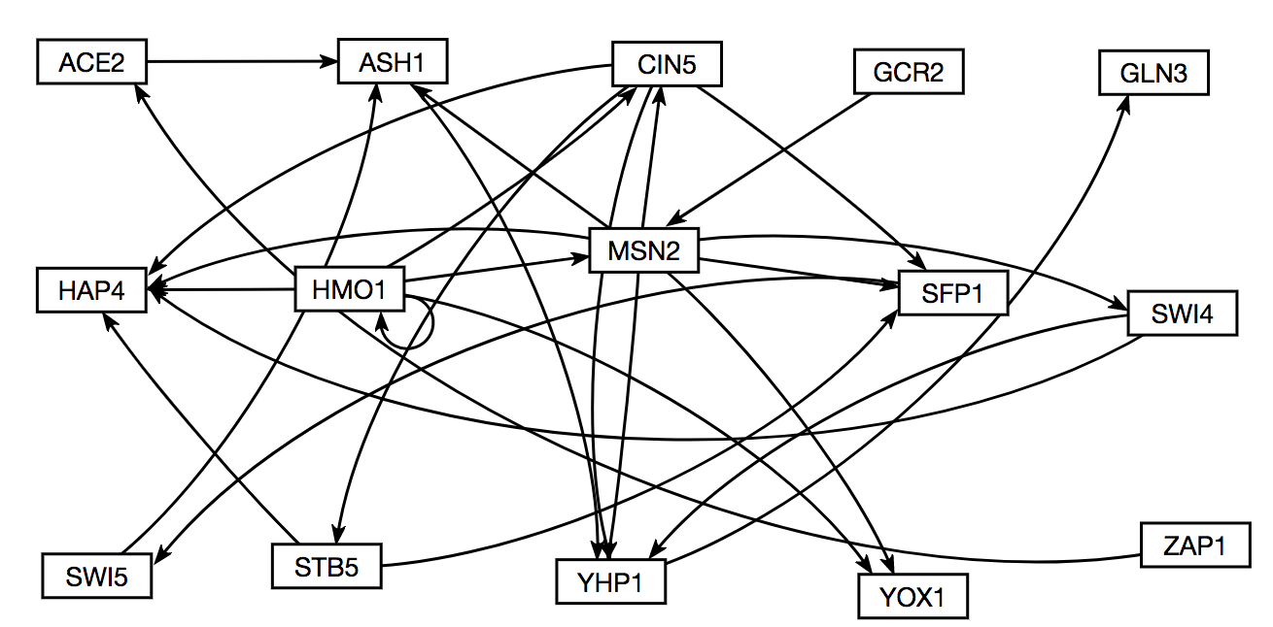
Edges were deleted one at a time to generate 28 additional GRNS
Intact network
15 nodes, 28 edges
SWI4→YOX1 deletion network
15 nodes, 27 edges

Slide 13
Edge deletion networks resulted in changes in LSE: minLSE ratios, which indicate which edges are important
Smaller LSE:minLSE values show edges that are not important to network
Bigger LSE:minLSE values show edges that are important to network

Slide 14
Gephi was used to analyze connectivity and graph statistics of nodes in the better and worse performing GRNs
Gephi was used to analyze connectivity and graph statistics of nodes in the better and worse performing GRNs
Eccentricity represents how connected a node is to the rest of the network, what the “reach” of the node is to the furthest node from it
Eigenvector Centrality represents the relative influence of the node over the rest of the network

Slide 15
However, paired t-tests show significant difference in eigenvector centrality between intact netowork and the edge deletion networks
 | ACE2àASH1 | ASH1àYHP1 | CIN5àHAP4 | CIN5àSFP1 | CIN5àSTB5 | CIN5àYHP1 | GCR2àMSN2 | HMO1àCIN5 | HMO1àHAP4 | HMO1àHMO1 | HMO1àMSN2 | HMO1àYOX1 | MSN2àASH1 | MSN2àCIN5 | MSN2àHAP4 | MSN2àSFP1 | MSN2àSWI4 | MSN2àYHP1 | MSN2àYOX1 | SFP1àSWI5 | STB5àHAP4 | STB5àSFP1 | SWI4àHAP4 | SWI4àYHP1 | SWI4àYOX1 | SWI5àASH1 | YHP1àGLN3 | ZAP1àACE2
Eccentricity |  | ⬇ |  |  |  |  |  |  |  |  |  |  |  |  |  |  |  |  |  |  |  |  |  |  |  |  | ⬇
Eigenvector Centrality | ⬆ |  |  |  |  | ⬆ |  |  |  | ⬆ |  |  | ⬆ |  |  |  |  | ⬆ |  |  |  |  |  | ⬆ |  |  |  | ⬇
Gephi was used to analyze connectivity and graph statistics of nodes in the better and worse performing GRNs
→ Indicates significant difference from intact network, and direction of variance (values go up of down)
■ Indicates no variance from intact network

Slide 16
Outline
Yeast respond to cold shock by changing gene expression, though the transcription factors involved remain unknown
The dynamics of each gene in each network were modeled using ordinary differential equations.
Edges were systematically deleted, one at a time, for the network, yielding 29 networks for analysis.
Gephi was used to analyze connectivity and graph statistics of nodes in the Δhap4 data-derived networks
Eccentricity and eigenvector centrality were investigated to determine the impact of edge deletion on network structure
Disruption of connections to a hub seem to cause the most disruption in the networks, indicating hubs such as MSN2 and CIN5 are highly important to network structure

Slide 17
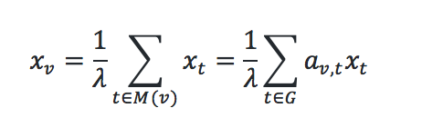
Eigenvector centrality represents the influence of a node on a network
Eigenvector centrality is calculated by using the adjacency matrix, where the relative centrality of a vertex v is defined as:

Slide 18
Eigenvector centrality shows the most variation between the edge deletion networks and the intact network
*
*
*
*
*
*
*
*

Slide 19
Edge deletion networks with a significant difference in eigenvector centrality values from db5 involve important hubs
*
*
*
*
*
*
*
*

Slide 20
Outline
Yeast respond to cold shock by changing gene expression, though the transcription factors that regulate the response remain unknown
The dynamics of each gene in a candidate gene regulatory network were modeled using ordinary differential equations.
To determine which regulatory relationships were important, edges were deleted one at a time
Gephi was used to analyze connectivity and graph statistics of the edge deletion networks vs. the intact network
The property of eccentricity did not change between intact and edge deletion networks, shows that this value is uninformative in this case
Eigenvector centrality did significantly vary in the networks where the

Slide 21



Acknowledgements
GRNsight: http://dondi.github.io/GRNsight/ GRNmap: http://kdahlquist.github.io/GRNmap/
GRNmap data analysis team: Lauren Kelly and Brandon J. Klein
GRNmap coding team: John Lopez and Justin Torres
GRNsight team: Eileen Choe, Mihir Samdarshi, and Jen Shin
Wet-lab team: Katherine Scheker and Nika Vafadari
Mentors: Dr. Kam Dahlquist and Dr. Ben Fitzpatrick

