Slide 1
Using Graph Statistics to Investigate the Properties of a Gene Regulatory Network that may Control the Cold Shock Response in Saccharomyces cerevisiae
Margaret J. ONeil
Department of Biology
Loyola Marymount University
Tri Beta Pacific District Conference
March 17, 2018

Slide 2
Outline
Yeast respond to cold shock by changing gene expression, though the transcription factors that regulate the response remain unknown.
The dynamics of each gene in a candidate gene regulatory network were modeled using ordinary differential equations.
To determine which regulatory relationships were important, edges were deleted one at a time.
Gephi was used to analyze connectivity and graph statistics of the edge deletion networks vs. the intact network.
Eccentricity and eigenvector centrality were investigated to determine the impact of edge deletion on network structure.
Disruption of connections to a hub seem to cause the most disruption in the networks, indicating hubs such as MSN2 and CIN5 are highly important to network structure.

Slide 3
Conclusion
Yeast respond to cold shock by changing gene expression, though the transcription factors that regulate the response remain unknown
The dynamics of each gene in a candidate gene regulatory network were modeled using ordinary differential equations.
To determine which regulatory relationships were important, edges were deleted one at a time
Gephi was used to analyze connectivity and graph statistics of the edge deletion networks vs. the intact network
Eccentricity and eigenvector centrality were investigated to determine the impact of edge deletion on network structure
Disruption of connections to a hub seem to cause the most disruption in the networks, indicating hubs such as MSN2 and CIN5 are highly important to network structure

Slide 4
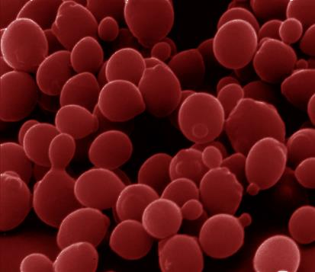
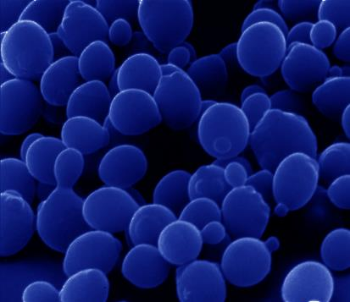
Saccharomyces cerevisiae is a model organism used to study response to environmental stressors
Heat shock
Cold shock
response very well-characterized
proteins denature due to heat
heat shock proteins (chaperonins) induced that assist with protein folding
conserved in all organisms (prokaryotes, eukaryotes)
response less well-characterized
membrane fluidity decreased
DNA and RNA secondary structures stabilized
ribosome function and protein synthesis impaired
enzymatic activities decreased
no equivalent set of cold shock proteins that are conserved in all organisms

Slide 5
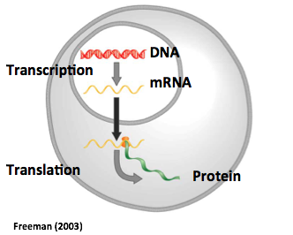
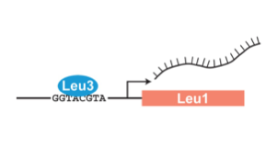
Yeast respond to cold shock by changing levels of gene expression
Transcription factors control gene expression by binding to regulatory DNA sequences.
Activators increase expression while repressions decrease expression.
Transcription factors are themselves proteins encoded by genes.
Which transcription factors regulate the response to cold shock?
What are their relative level of influence?

Slide 6
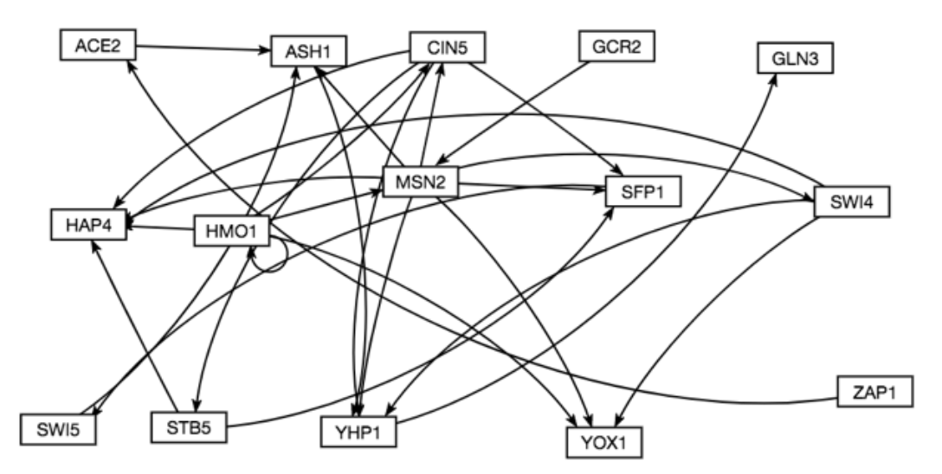
A Gene Regulatory Network (GRN) is a set of transcription factors that regulate the expression of other transcription factors
To better visualize relationships between transcription factors, networks or graphs can be created.
They are similar in structure to a social network.
Transcription factors are represented as rectangles called nodes.
Regulatory connections between genes are shown as arrows called edges.
A candidate GRN for controlling the cold shock response was generated from Dahlquist Lab microarray data.

Slide 7
GRNmap uses ordinary differential equations to model the dynamics of each transcription factor in the network
[mRNA] for each gene
mRNA production rate
mRNA degradation rate
weight term determines
the level of activation or repression
unique threshold for each gene
The change in expression of one gene is production – degradation.
Weight parameter, w, gives the direction (activation or repression) and magnitude of regulatory relationship.
Notes:
Arrows need to be more accurate/put the box back → sized appropriately
Every gene in the network has an equation → go through the equation
P function modeled by sigmoidal curve for activation & repression; threshold for gene and then weights of regulation

Slide 8
A penalized least squares error approach is used to estimate network parameters
Experimental
Theoretical
The experimental term represents the microarray data.
The theoretical term is based on the solution to the differential equation using the estimation parameters.
LSE or E value describes how well the overall GRN was modeled by GRNmap program.
The LSE can be compared to the minimum theoretical LSE to compare goodness of fit across networks.

Slide 9
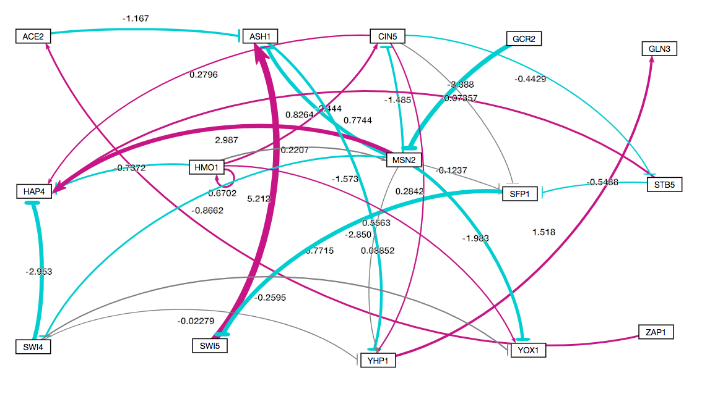
Visualizing the weight values show which regulatory relationships are strong or weak
Magenta → represent activation of the target gene
Cyan --| represent repression of the target gene
Thicker edges are stronger relationships.
Thin grey edges represent weak relationships.

Slide 10
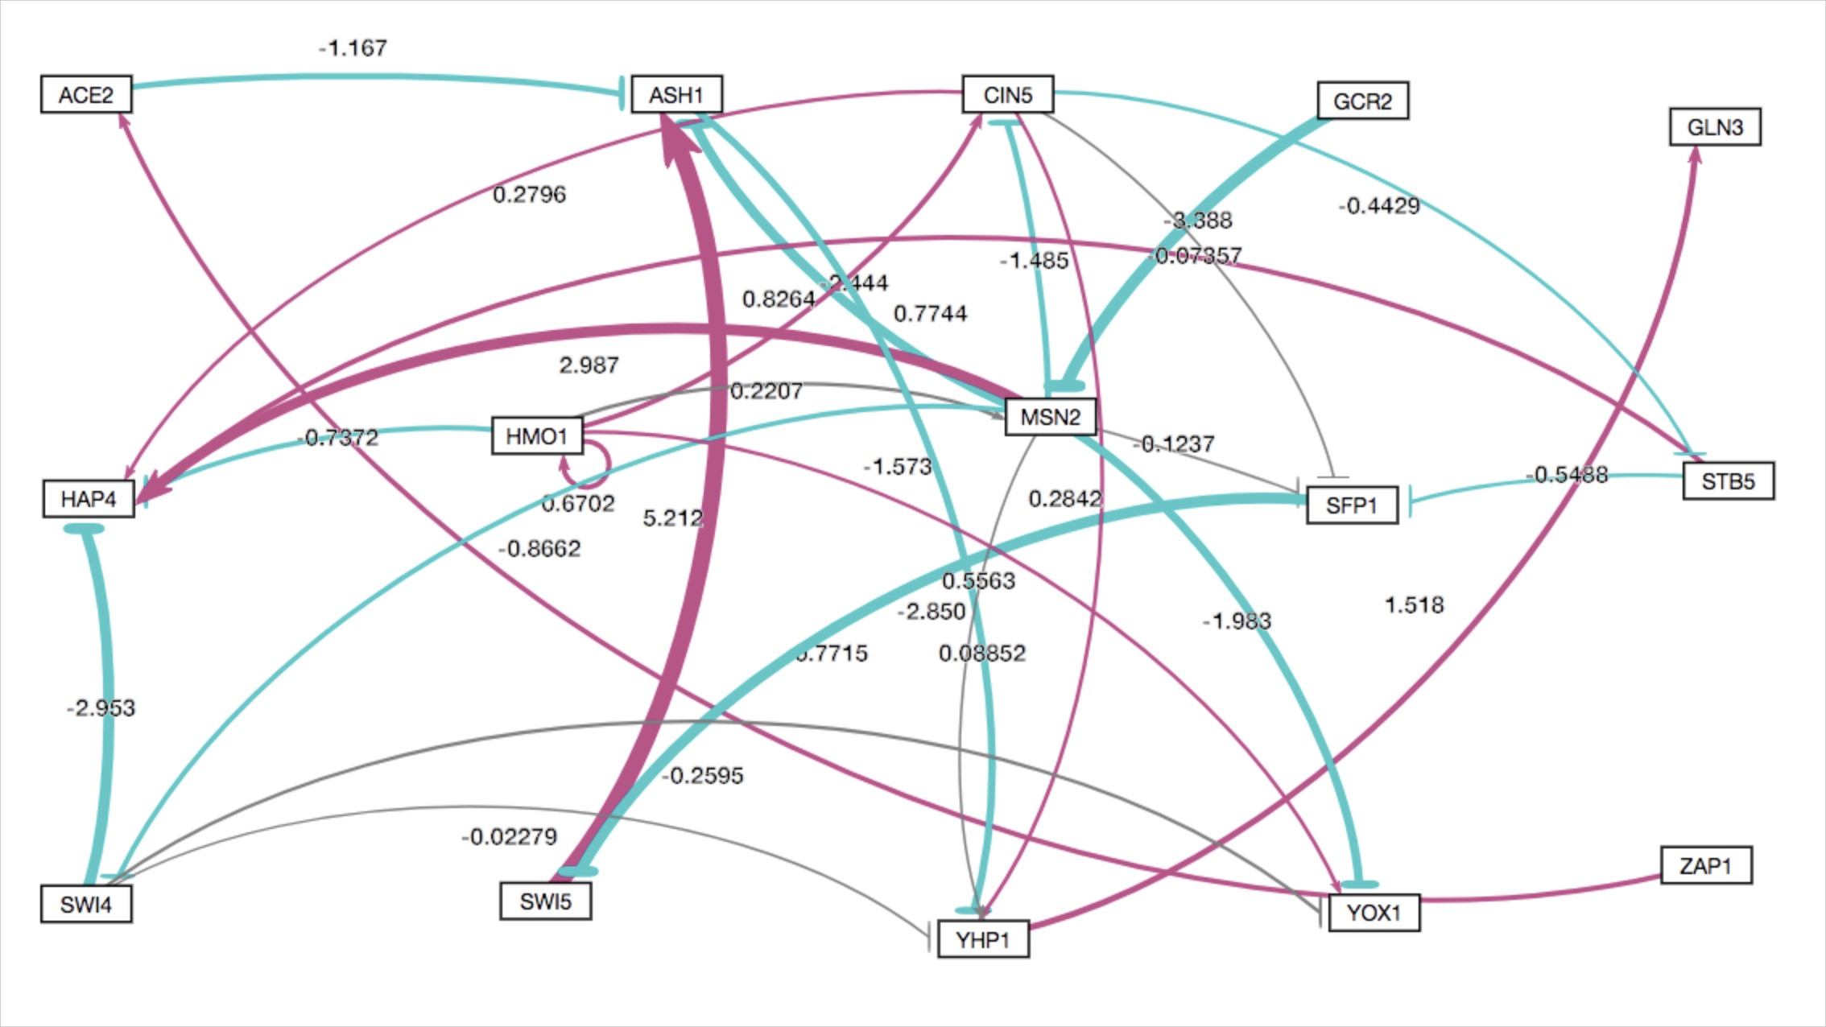
Investigating the nodes of the network raises questions about their connections to other nodes
Magenta → represent activation of the target gene
Cyan --| represent repression of the target gene
Thicker edges are stronger relationships.
Thin grey edges represent weak relationships.
Which of these edges are most important to the network?

Slide 11
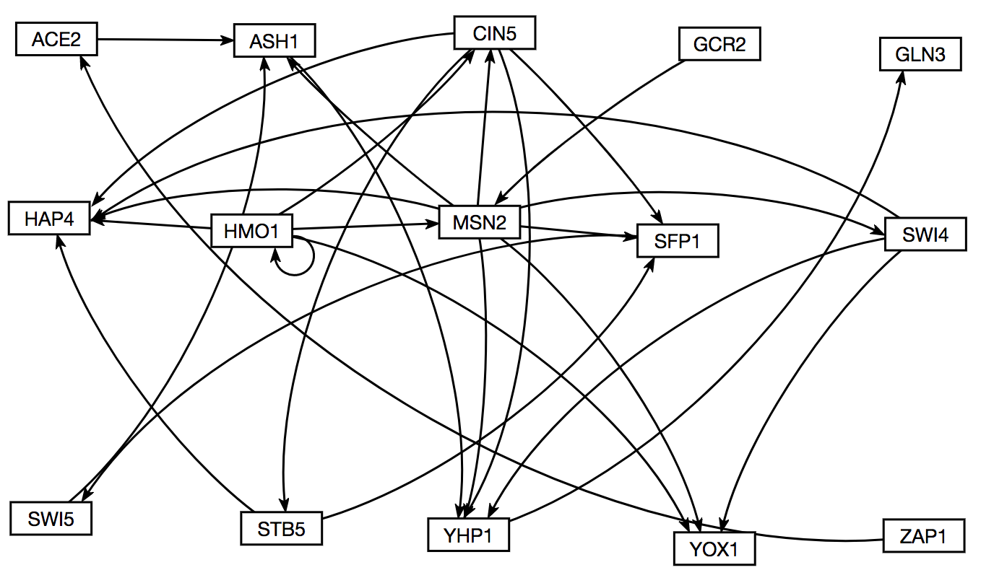
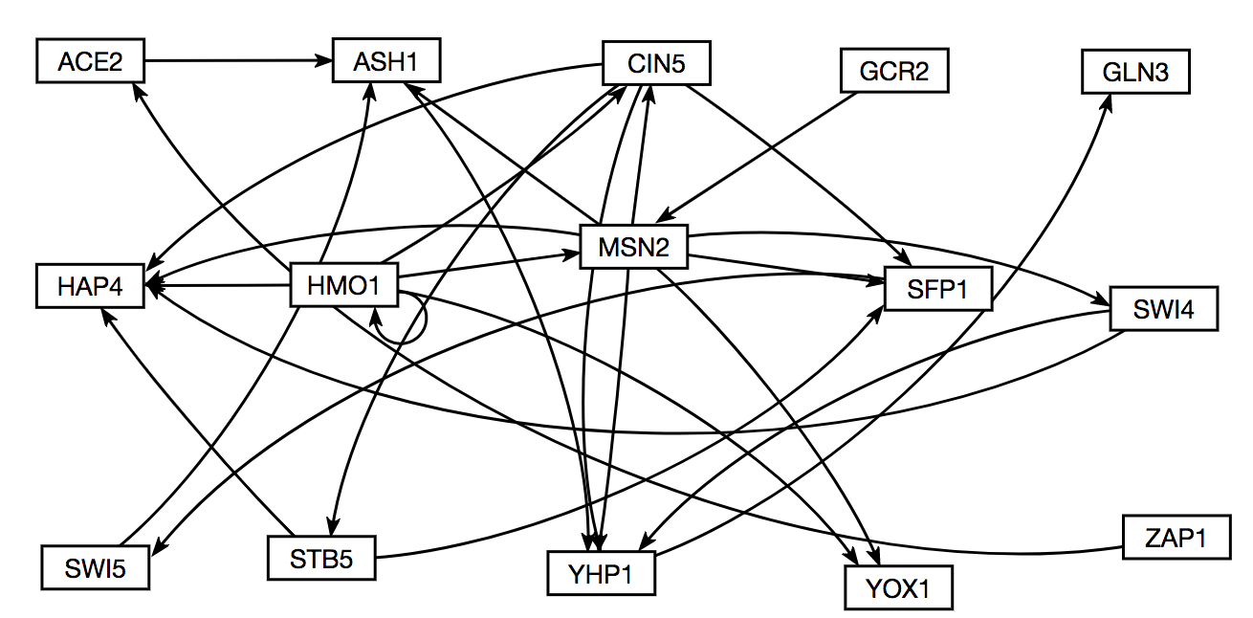
Edges were deleted one at a time to generate 28 additional gene regulatory networks derived from our intact network
Intact network
15 nodes, 28 edges
SWI4→YOX1 deletion network
15 nodes, 27 edges

Slide 12
Edge deletion networks resulted in changes in LSE: minLSE ratios, which indicate which edges are important
Smaller LSE:minLSE values may indicate edges that are not important to network
Bigger LSE:minLSE values may indicate edges that are important to network

Slide 13
Gephi was used to analyze connectivity and graph statistics of nodes in the better and worse performing GRNs
Graph statistics can be used to quantify the relationship a specific node has to the structure of the network.
Eccentricity represents how connected a node is to the rest of the network, what the “reach” of the node is to the furthest node from it.
Eigenvector Centrality represents the relative influence of the node over the rest of the network.

Slide 14
However, paired t-tests show significant difference in eigenvector centrality between intact network and the edge deletion networks
 | ACE2àASH1 | ASH1àYHP1 | CIN5àHAP4 | CIN5àSFP1 | CIN5àSTB5 | CIN5àYHP1 | GCR2àMSN2 | HMO1àCIN5 | HMO1àHAP4 | HMO1àHMO1 | HMO1àMSN2 | HMO1àYOX1 | MSN2àASH1 | MSN2àCIN5 | MSN2àHAP4 | MSN2àSFP1 | MSN2àSWI4 | MSN2àYHP1 | MSN2àYOX1 | SFP1àSWI5 | STB5àHAP4 | STB5àSFP1 | SWI4àHAP4 | SWI4àYHP1 | SWI4àYOX1 | SWI5àASH1 | YHP1àGLN3 | ZAP1àACE2
Eccentricity |  | ⬇ |  |  |  |  |  |  |  |  |  |  |  |  |  |  |  |  |  |  |  |  |  |  |  |  | ⬇
Eigenvector Centrality | ⬆ |  |  |  |  | ⬆ |  |  |  | ⬆ |  |  | ⬆ |  |  |  |  | ⬆ |  |  |  |  |  | ⬆ |  |  |  | ⬇
■ Indicates the values are identical to the intact network
Indicates significant difference from intact network, and direction of the change in value
☐Indicates the values are not significantly different from those of the intact network

Slide 15
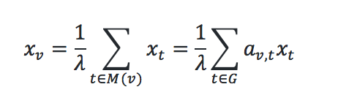
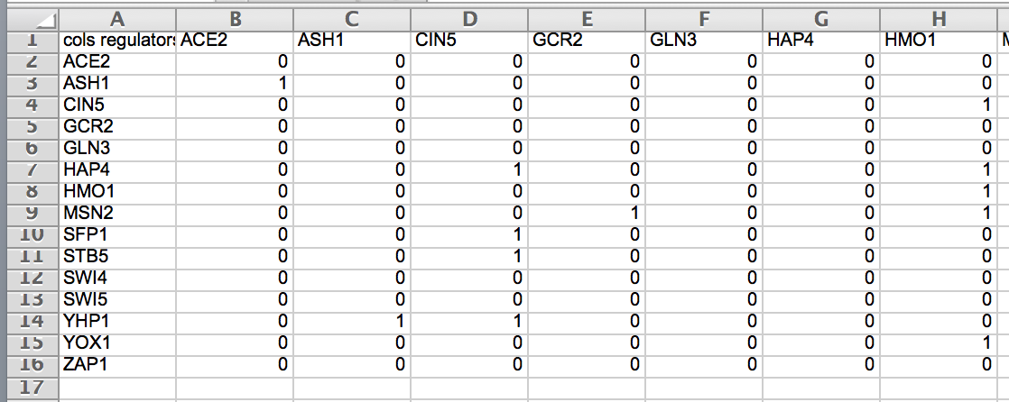
Eigenvector centrality represents the influence of a node on the rest of the gene regulatory network
Eigenvector centrality is calculated by using the adjacency matrix, where the relative centrality of a vertex v is defined as:

Slide 16
Generally, eigenvector centrality values are significantly different in networks with worse LSE:minLSE ratios than the intact network
*
*
*
*
*
*
*
*

Slide 17
Edge deletion networks with a significant difference in eigenvector centrality values from the intact network involve important hubs
*
*
*
*
*
*
*
*

Slide 18
Summary
Yeast respond to cold shock by changing gene expression, though the transcription factors that regulate the response remain unknown.
The dynamics of each gene in a candidate gene regulatory network were modeled using ordinary differential equations.
To determine which regulatory relationships were important, edges were deleted one at a time.
Gephi was used to analyze connectivity and graph statistics of the edge deletion networks vs. the intact network.
Eccentricity and eigenvector centrality were investigated to determine the impact of edge deletion on network structure.
Disruption of connections to a hub seem to cause the most disruption in the networks, indicating hubs such as MSN2 and CIN5 are highly important to network structure.

Slide 19



Acknowledgments
GRNsight: http://dondi.github.io/GRNsight/ GRNmap: http://kdahlquist.github.io/GRNmap/
GRNmap data analysis team: Lauren Kelly and Brandon J. Klein
GRNmap coding team: John Lopez and Justin Torres
GRNsight team: Eileen Choe, Mihir Samdarshi, and Jen Shin
Wet-lab team: Katherine Scheker and Nika Vafadari
Mentors: Dr. Kam Dahlquist and Dr. Ben Fitzpatrick

