Slide 1

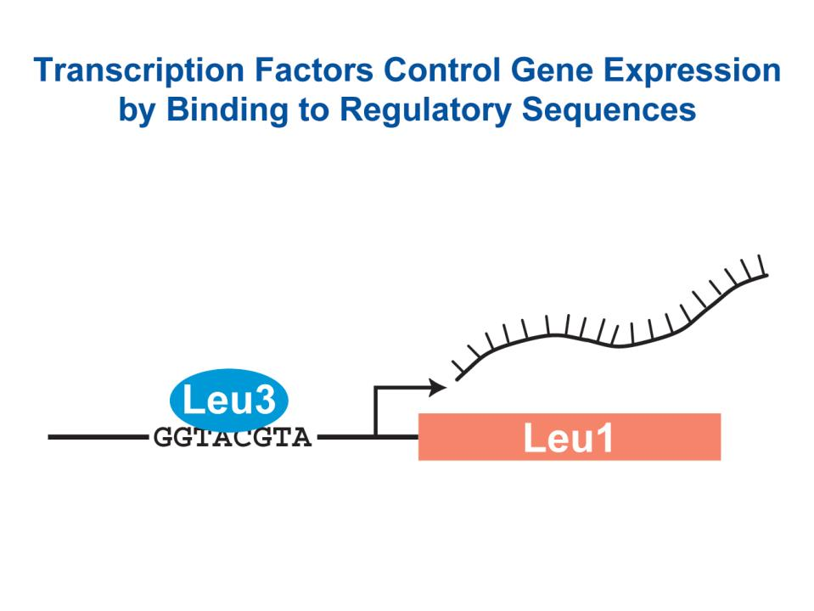
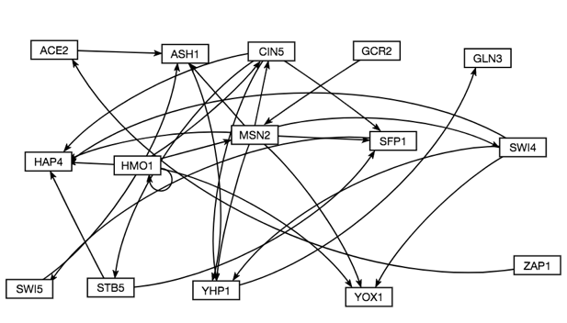
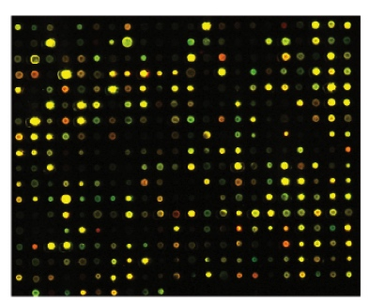
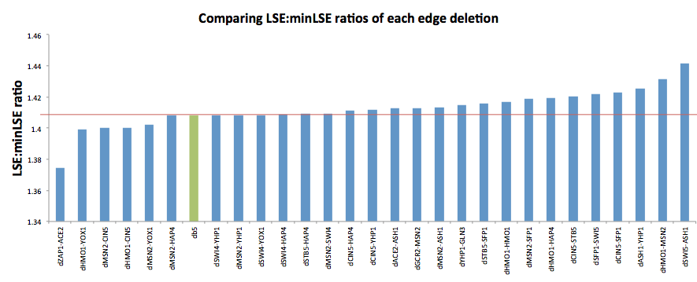
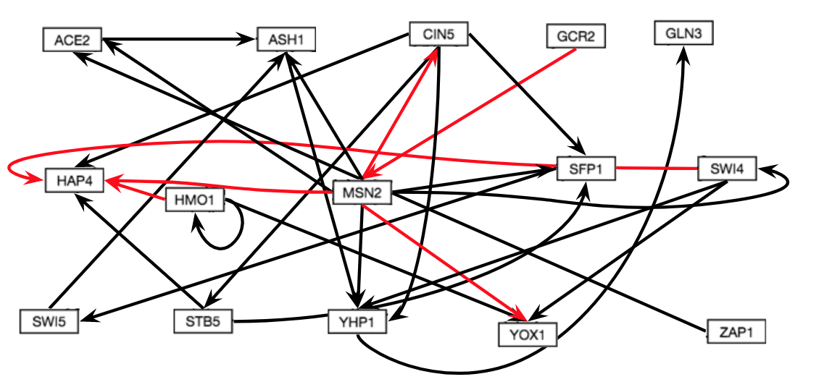
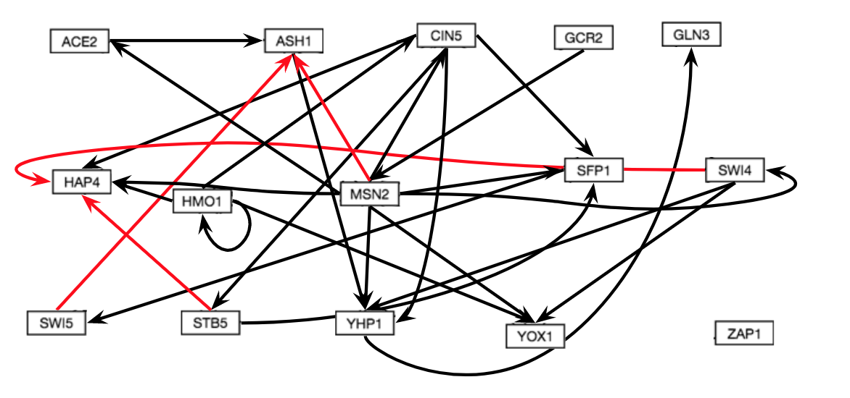
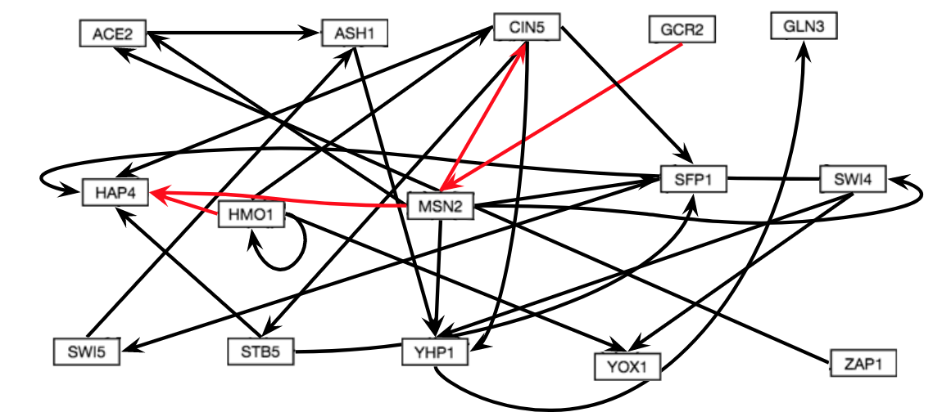
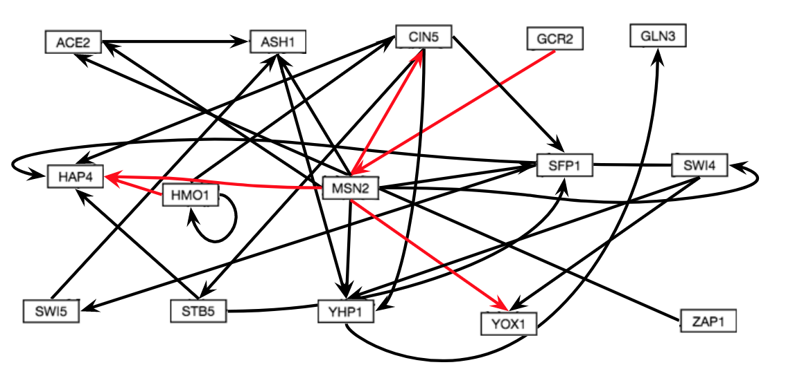
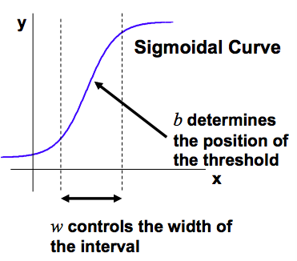
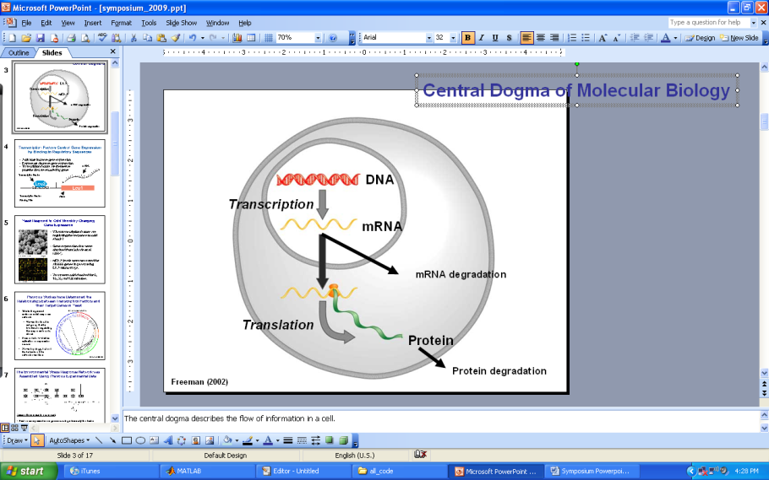
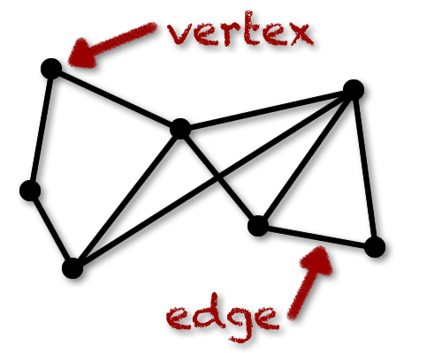
Modeling of Gene Regulatory Network Dynamics Predicts which Regulatory Relationships
are Important for Controlling the Cold Shock Response in Saccharomyces Cerevisiae
Lauren M. Kelly¹, Margaret J. O’Neil¹, Ben G. Fitzpatrick², and Kam D. Dahlquist¹
¹Department of Biology, ²Department of Mathematics
Loyola Marymount University, 1 LMU Drive, Los Angeles, CA 90045 USA
Transcription factors control gene expression by binding
to regulatory DNA sequences upstream of genes
Deletions cause downstream regulatory changes to other edges in the network
Heat map generated to visualize changes in regulation as a result of edge deletions
Activators increase gene expression.
Repressors decrease gene expression.
Transcription factors are themselves proteins that are encoded by genes.
A gene regulatory network (GRN) consists of a set of transcription factors that regulate the level of expression of a set of target genes, which can include other transcription factors.
The dynamics of a GRN is how the expression of genes in the network change over time.
1. Intact db5 network
 | db5 | dACE2-ASH1 | dASH1-YHP1 | dCIN5-HAP4 | dCIN5-SFP1 | dCIN5-STB5 | dCIN5-YHP1 | dGCR2-MSN2 | dHMO1-CIN5 | dHMO1-HAP4 | dHMO1-HMO1 | dHMO1-MSN2 | dHMO1-YOX1 | dMSN2-ASH1 | dMSN2-CIN5 | dMSN2-HAP4 | dMSN2-SFP1 | dMSN2-SWI4 | dMSN2-YHP1 | dMSN2-YOX1 | dSFP1-SWI5 | dSTB5-HAP4 | dSTB5-SFP1 | dSWI4-HAP4 | dSWI4-YHP1 | dSWI4-YOX1 | dSWI5-ASH1 | dYHP1-GLN3 | dZAP1-ACE2
ACE2-ASH1
ASH1-YHP1
CIN5-HAP4
CIN5-SFP1
CIN5-STB5
CIN5-YHP1
GCR2-MSN2
HMO1-CIN5
HMO1-HAP4
HMO1-HMO1
HMO1-MSN2
HMO1-YOX1
MSN2-ASH1
MSN2-CIN5
MSN2-HAP4
MSN2-SFP1
MSN2-SWI4
MSN2-YHP1
MSN2-YOX1
SFP1-SWI5
STB5-HAP4
STB5-SFP1
SWI4-HAP4
SWI4-YHP1
SWI4-YOX1
SWI5-ASH1
YHP1-GLN3
ZAP1-ACE2
This heat map visualizes the changes in regulation that occurred as a result the edge deletions.
The edge deletions that cause a lot of changes in regulation seem to be associated with central genes, like CIN5, HMO1, and MSN2. These genes have high in and out degrees, making them central hubs in the network
The location of certain genes in the network can also give insight into what this heat map is showing. HMO1-CIN5 and ZAP1-ACE2, for example, are both involved in long chains of regulation within the network.
Yeast respond to the environmental stress of cold shock
by changing gene expression
Little is known about which transcription factors regulate this response.
The Dahlquist Lab studies the global transcriptional response to cold shock using DNA microarrays, which measure the level of mRNA expression for all 6000 yeast genes.
We have collected expression data from the wild type strain and five transcription factor deletion strains (Δcin5, Δgln3, Δhmo1, Δzap1, Δhap4 ) before cold shock at 30°C and after 15, 30, and 60 minutes of cold shock at 13°C.
The Dahlquist Lab has shown that yeast deleted for the Hap4 transcription factor, a heme activator protein, show impaired growth at cold temperatures, implying that it is important for regulating the response to cold shock.
We use mathematical modeling to determine the relative influence of each transcription factor in the GRN that controls the cold shock response.
This unweighted, intact network was generated from the dhap4 strain microarray data and is labeled as db5. It has 15 nodes and 28 edges. It was the starting point for each of the 28 edge deletions.
The networks generated from each edge deletion were compared to the intact db5 network in order to determine which edges were important to the network.
It was found that certain edge deletions resulted in downstream changes in regulation, as shown below.
Certain edges changed from activation to repression, and vise versa.
Certain edge deletions caused changes in LSE:minLSE
Microarray at 60 minutes after cold shock
Microarray data from the Dahlquist lab was used to derive a family of related GRNs from the YEASTRACT database
2. dHMO1-CIN5 network
3. dZAP1-ACE2 network
Network Legend
Change in regulation
DNA microarray data for each of the six strains was analyzed to show which genes exhibited significant changes in expression during cold shock. The criteria for significance was a corrected Benjamini & Hochberg ANOVA p value < 0.05.
The genes with significant expression changes were submitted to the YEASTRACT database, which returned a list of transcription factors that could regulate those targets.
Transcription factors for which we had deletion strain microarray data were added to the list of the most significant regulators for each strain to generate six GRNs.
Transcription factors and edges were removed from each GRN in a stepwise fashion in order of least to most significant until the network was pared down to have fewer than 20 genes.
Each of the pared-down GRNs, labeled db1-db6, were input into the Dahlquist lab’s GRNmap program to model the dynamics of each gene’s expression in their respective networks.
Strain | Wild-type | ∆cin5 | ∆gln3 | ∆hap4 | ∆zap1
Significant genes | 1936 (31%) | 1683 (28%) | 1683 (28%) | 1794 (29%) | 1859 (30%)
4. dMSN2-YOX1 network
5. dHMO1-YOX1 network
The LSE:minLSE ratio describes how well the GRN was modeled by GRNmap and allows for the comparison of db5 to each of the deletion networks.
A lower LSE:minLSE ratio, or a ratio closer to 1, means that the GRN that resulted from the deletion is a better fit.
There were 5 edge deletions that improved the fit of the model: dHMO1-CIN5, dHMO1-YOX1, dMSN2-CIN5, dMSN2-YOX1, and dZAP1-ACE2. dZAP1-ACE2 resulted in the largest drop in LSE:minLSE ratio, therefore it is likely not a crucial edge in the network.
dSWI5-ASH1, dHMO1-MSN2, and dASH1-YHP1 all show increases in LSE:minLSE, which suggest that they are important to the db5 network.
Dynamical systems modeling was used to estimate weight parameters for each regulatory relationship
The model, called GRNmap (Gene Regulatory Network modeling and parameter estimation) was implemented in MATLAB (Dahlquist et al. 2015).
The MATLAB code and executable are available under an open source license at https://github.com/kdahlquist/GRNmap/.
Certain edge deletions caused changes in MSE:minMSE and Production Rates
Conclusions and Future Directions
Each gene has a differential equation that models the change in expression over time as production – degradation.
Degradation rates for each gene were taken from mRNA half life data from Neymotin et al. (2014).
We use a sigmoidal production function where:
P_{i} is mRNA production rate for gene i
d_{i} is the mRNA degradation rate for gene i
w is weight term, determining the level of activation or repression of j on i
b is a unique threshold for each gene
The production rate (P_{i} ), weight (w ), and threshold (b) values were estimated from DNA microarray data using a penalized least squares approach.
Edge Deletion
 | dSWI4-YHP1 | dMSN2-YHP1
MSE:minMSE | 0.00586 | 0.11980
Production rates | 0.00406 | 0.01205
MSE:minMSE and production rates for each deletion network were compared to the intact db5 network using a paired T-test.
Only two edges had significant p-values in either case, as shown in the table on the left.
MSE:minMSE and production rates of dSWI4-YHP1 were both significantly different from db5.
dMSN2-YHP1 only showed a significant change in production rates.
No other deletion networks were significantly different from db5.
In many cases, individual edge deletions caused changes in the rest of the GRN. The deletion of HMO1-CIN5, for instance, caused various downstream changes in regulation. Futhermore, the deletions of SWI4-YHP1 and MSN2-YHP1 caused significant changes in MSE:minMSE and production rates when comparing them to the intact db5 network.
According to the heat map, the edge deletions associated with central genes (CIN5, HMO1, MSN2) caused the most regulation changes. The edges that changed as a result of the deletion are likely unstable, while the deletions that caused the most changes are likely important edges.
LSE:minLSE can provide important insight into which edges are improving the fit of the model and which edges are not. ZAP1-ACE2, for example, is likely not an important part of the network.
dZAP1-ACE2, dHMO1-YOX1, dMSN2-CIN5, dHMO1-CIN5, and dMSN2-YOX1 each resulted in a lower LSE:minLSE ratio.
dHMO1-YOX1 and dMSN2-YOX1 resulted in the same downstream changes in regulation, but dHMO1-YOx1 did not cause any changes in the optimized expression of YOX1
Certain edge deletions caused changes in optimized expression over time
These graphs compare the optimized expression of genes as modeled by GRNmap (Dahlquist, et al. 2015) as a result of certain edge deletions compared to the intact db5 network.
These edge deletions were chosen based on the fact that they each caused a decrease in LSE:minLSE.
The optimized expression of MSN2 changes drastically when the HMO1-MSN2 edge is deleted.
This may be a result of the importance of MSN2 to the network. The changes in optimized expression compensate for the loss of an important edge.
The optimized expressions of CIN5, YOX1, and ACE2, however, do not change from db5 as a result of the deletions of HMO1-CIN5, HMO1-YOX1 and ZAP1-ACE2.
These edges may not be crucial to the integrity of the network.
E represents the error between estimated values and microarray data values.
θ is the penalty term, which is the combined w, P, and b parameter values.
(Freeman, 2002)
Statistics based in graph theory were used to analyze each network
Acknowledgments
A graph (GRN) is a collection of nodes (genes) that are connected by edges, similar to how a social network is visualized.
The GRN graphs are directed: edges only go in one direction.
The edges represent activation or repression of other genes in the network.
Positive weights to the edges represent activation, negative weights to edges represent repression.
The magnitude of the weight parameter represents the strength of the regulatory relationship.
Acknowledgments here
node
References
Dahlquist, K., Fitzpatrick, B., Camacho, E., Entzminger, S., & Wanner, N. (2015). Parameter Estimation for Gene Regulatory Networks from Microarray Data: Cold Shock Response in Saccharomyces cerevisiae. Bulletin Of Mathematical Biology, 77(8), 1457-1492. http://dx.doi.org/10.1007/s11538-015-0092-6.
Freeman, S. (2002). Biological science (First ed.). Prentice Hall.
GRNsight - Home. (n.d.). Retrieved March 10, 2016, from http://dondi.github.io/GRNsight/.
GRNmap – Home.. (n.d.). Retrieved March 10, 2016, from https://github.com/kdahlquist/GRNmap
Kdahlquist/GRNmap. (n.d.). Retrieved March 10, 2016, from https://github.com/kdahlquist/GRNmap
edge
http://world.mathigon.org/Graph_Theory

