Slide 1

Predicting Player Performance in Fantasy Premier League
By: Joakim Martin Torsvik
Field of study: Data Science (MSC)

Slide 2
Content
What is Fantasy Premier Leauge?
Previous Research in Fantasy Sports and Related Topics
The Dissertation Research Topic
Preliminary results from the research
DQN – If we have time?
Questions?

Slide 3
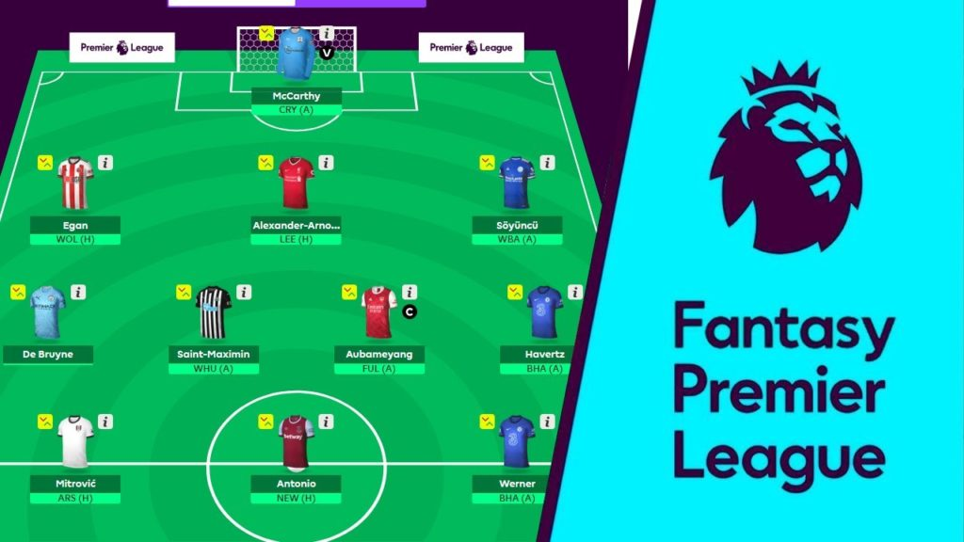
What is Fantasy Premier Leauge (FPL)?
Interactive, virtual game using real-life players to gain points from actual games
Points are derived from in-game statistics
Goals
Assists
Clean sheets
Etc.
Points are collected throughout the season and manager with most points at end of season wins
Statistics are provided to managers in order to help them with predicting player performances

Slide 4
Previous Research
Similar Research in Fantasy sports
Similar Research in other areas
A popular problem to be used as masters dissertation/thesis
Common to state problem as a TSA
Most common DL algorithms used:
Simple MLP/ANN
RNN
CNN
Traditional approaches to TSA:
ARIMA
Linear/Polynomial Regression
Support Vector Machine (SVM)
Most common DL algorithms:
RNN’s
Transformers
XGBoost
Autoencoders
Source site
TensorTrade implements DQN to predict stock-market prices https://www.tensortrade.org/en/latest/

Slide 5

Dissertation Research Topic
Goal of the research is to find a suitable ML-algorithm that is capable of predicting the next week(s) performance(s) in FPL
Using data from the official FPL database, downloading the last three seasons of player- and fixture data
Implement 4 ML algorithms of varying complexity:
ARIMA
SVM
XGBoost
DQN
Evaluate the models using (Root) Mean Squared Error (RMSE/MSE)

Slide 6
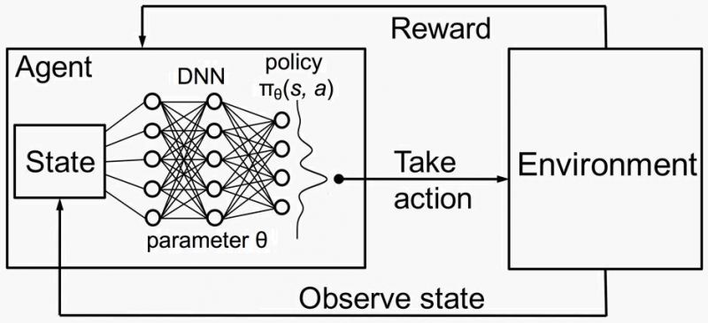
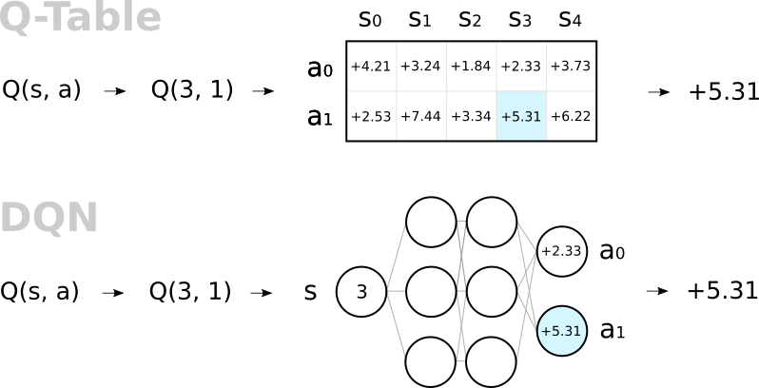
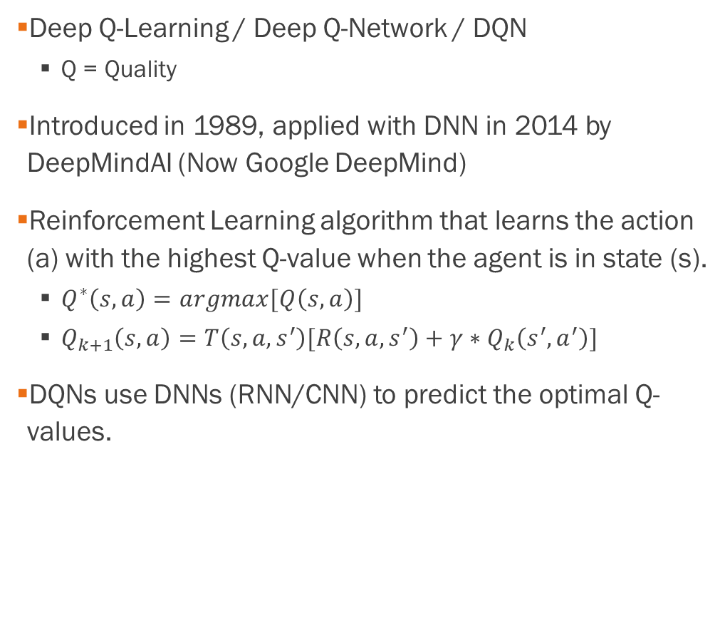
Deep Q-Learning What is it?
Deep Q-Learning / Deep Q-Network / DQN
Q = Quality
Introduced in 1989, applied with DNN in 2014 by DeepMindAI (Now Google DeepMind)
Reinforcement Learning algorithm that learns the action (a) with the highest Q-value when the agent is in state (s).
$Q^{∗}\left(s,a\right)=argmax[Q\left(s,a\right)]$
$Q_{k+1}\left(s,a\right)=T\left(s,a,s^{′}\right)[R\left(s,a,s^{′}\right)+γ∗Q_{k}\left(s^{′},a^{′}\right)]$
DQNs use DNNs (RNN/CNN) to predict the optimal Q-values.

Slide 7
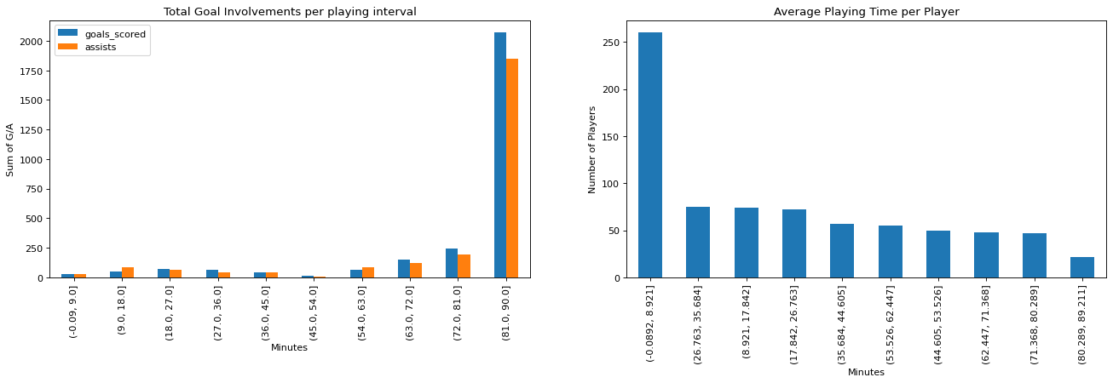
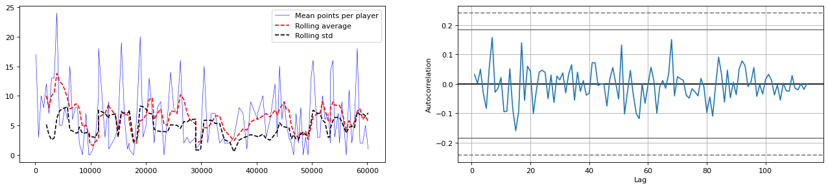
Preliminary Results
Initially 989 players from 23 teams, playing 1140 games.
Most players don’t play very much. Removing players with lower average playing time than 45 minutes leaves 216 players to predict.
Total points of players is not a stationary variable.
This makes it difficult to predict performance with ARIMA.

Slide 8
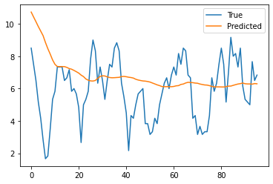
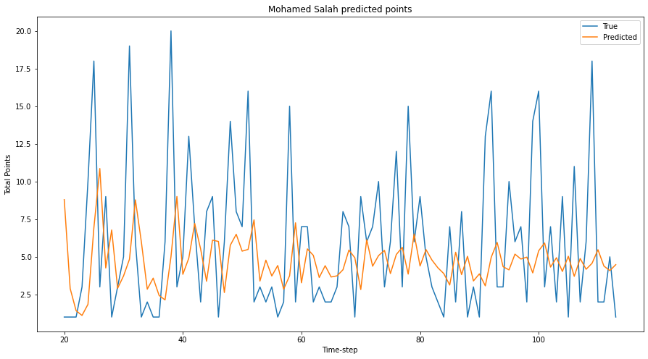
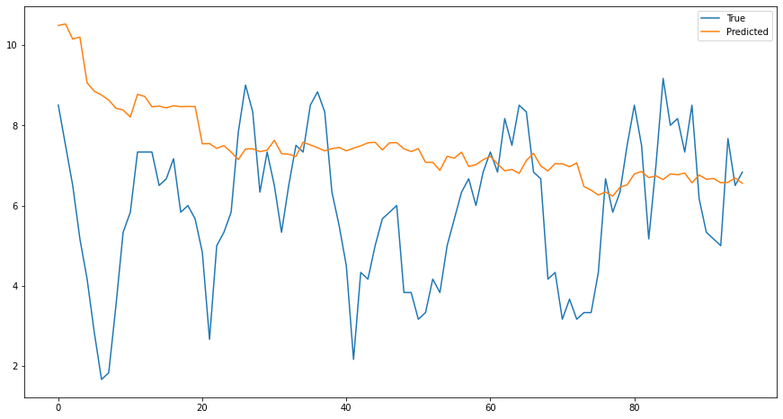
Preliminary Research cont.
Tuning parameters of ARIMA shows: MA(p) : 1 I(d) : 0 AR(q) : 1
MSE = 28.57
SVM:
MSE = 5.25
XGBoost:
MSE = 6.42

Slide 9

Questions?

