Slide 1
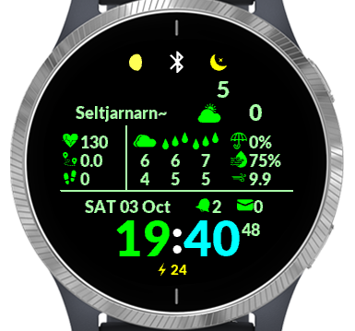
Left to right:
Lunar phase
Connection status
Do not disturb
Top: Current temp
Bottom: “Feels” temp
Icon: Current weather
Top: Weather icon
Middle: Temp max
Bottom: Temp min
Left to right:
Today, tomorrow, day after
City name OR
Weather advisory text
Activity Options
Date
Weather Options
Time
Left: Alerts
Right: Messages
Battery percent
Seconds OR
AM/PM

