Slide 1
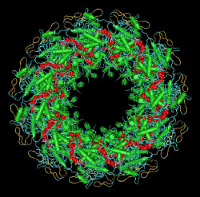
Enterprise software development
from a
biochemistry professor's
point of view
University of Montana
2019-09-13
John T. Prince

Slide 3
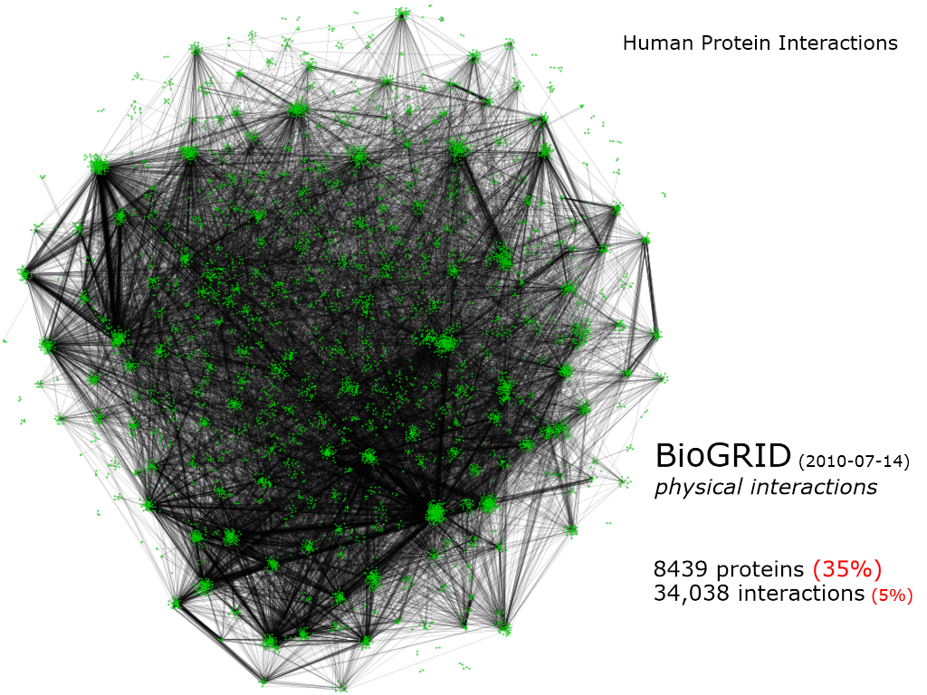
The real world is most like a network

Slide 4
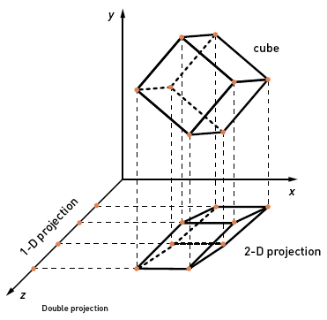
Modeling is the art of projection

Slide 5
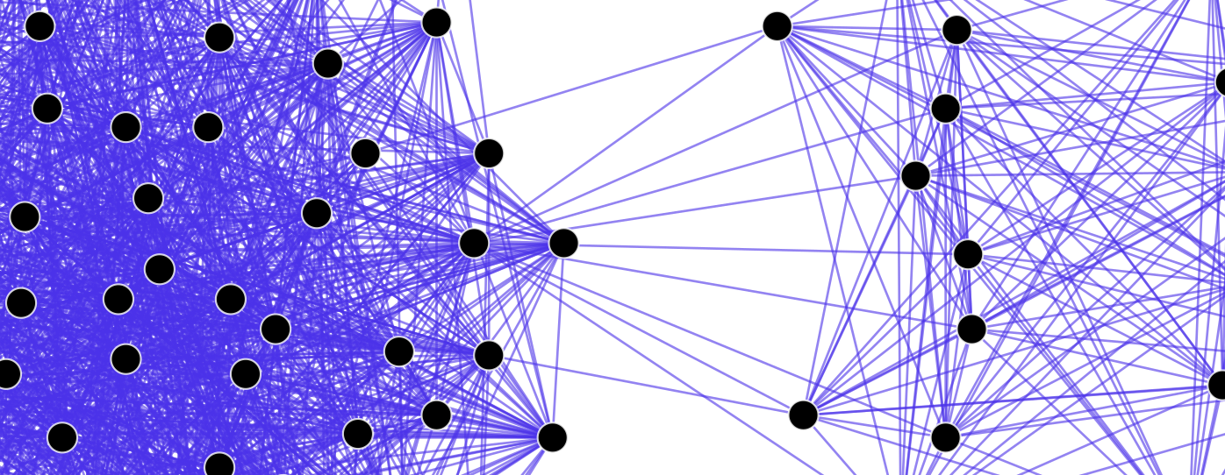
Reality is (typically) a network

Slide 6
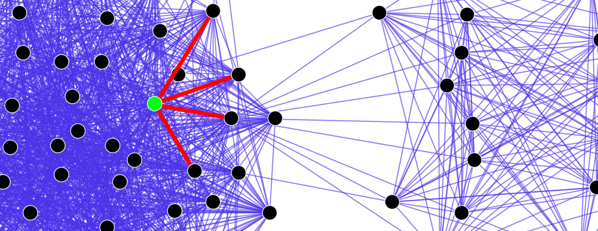
We emphasize certain relationships

Slide 7
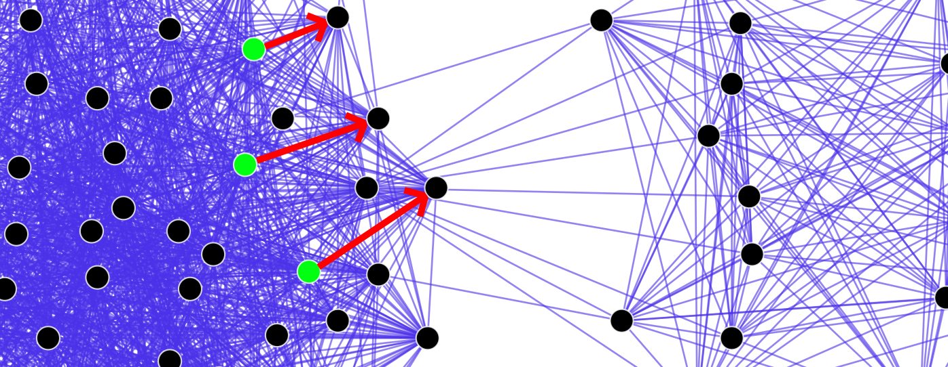
Restrictions limit complexity

Slide 8
