Slide 1
An Exploratory Analysis into Depression
Jialei Wang, Xiaoxin Xu, Ruxin Shen
Notes:
1.

Slide 2
Why
More than 300 million people worldwide suffer from depression
Low self-esteem, health issues, unsatisfying performances...
What causes people to feel depressed?
How can we help?

Slide 3
What we are looking for……
Factors that are correlated with depression
People’s choices
Constructive suggestions

Slide 4
Data & Sample Segmentation
Survey
How’re our people segmented

Slide 5
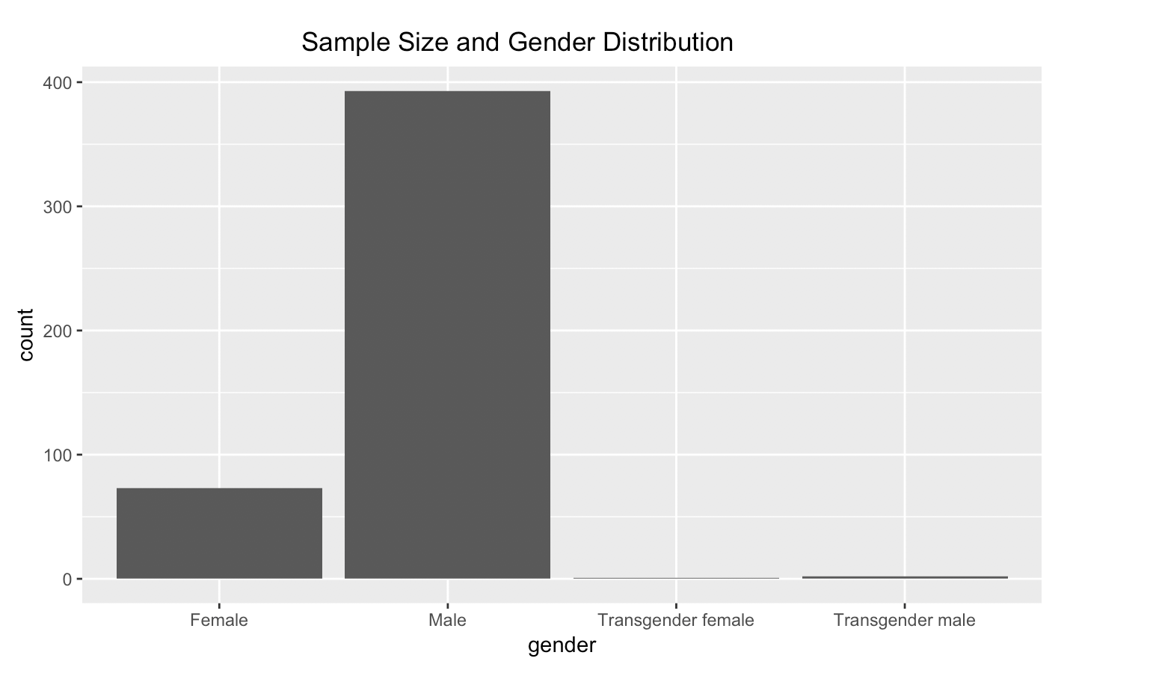
Some info of responders
Most samples are males
A couple of transgenders

Slide 6
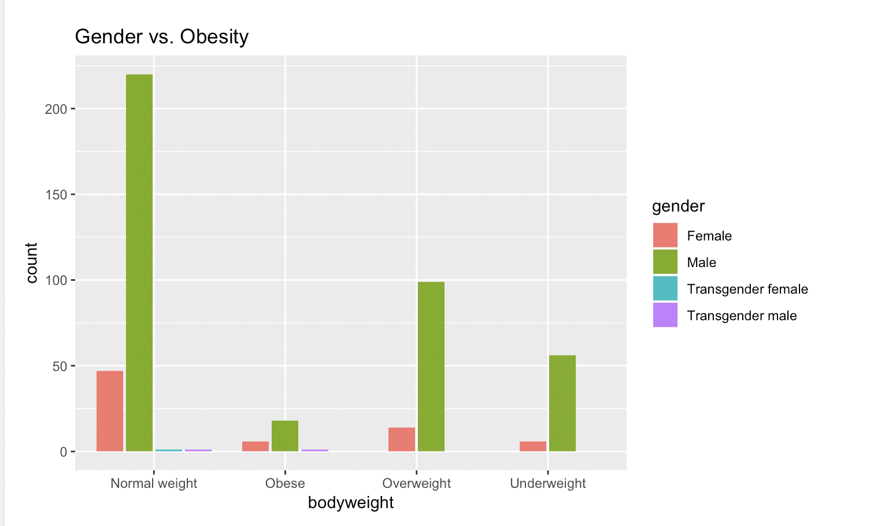
Some Relationships Between Some Variables

Slide 7
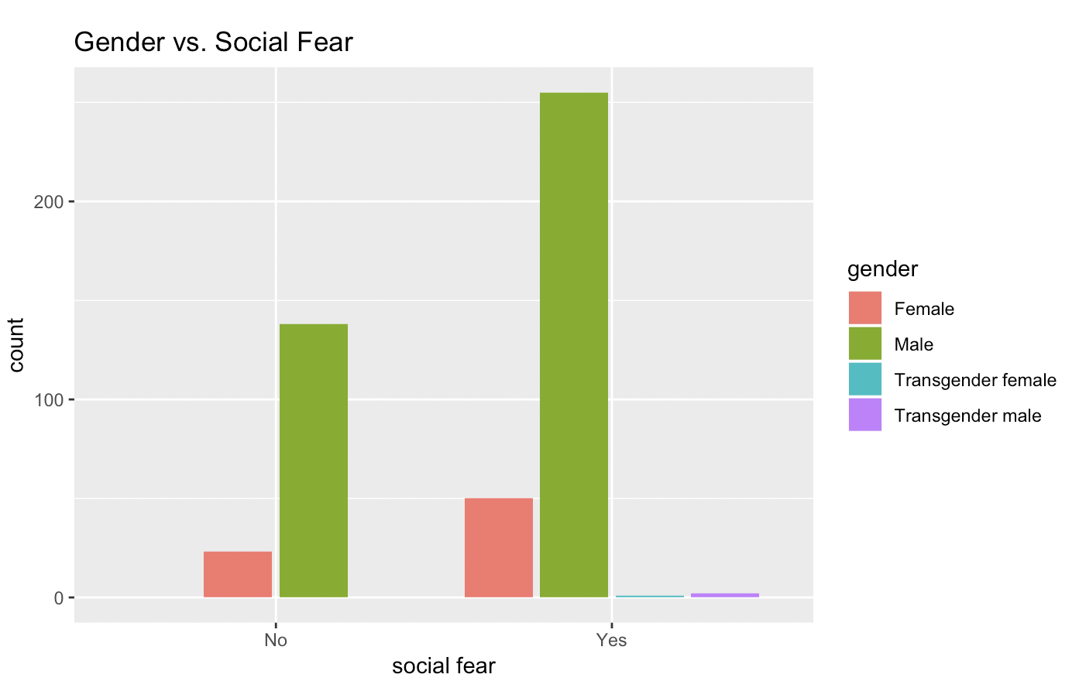
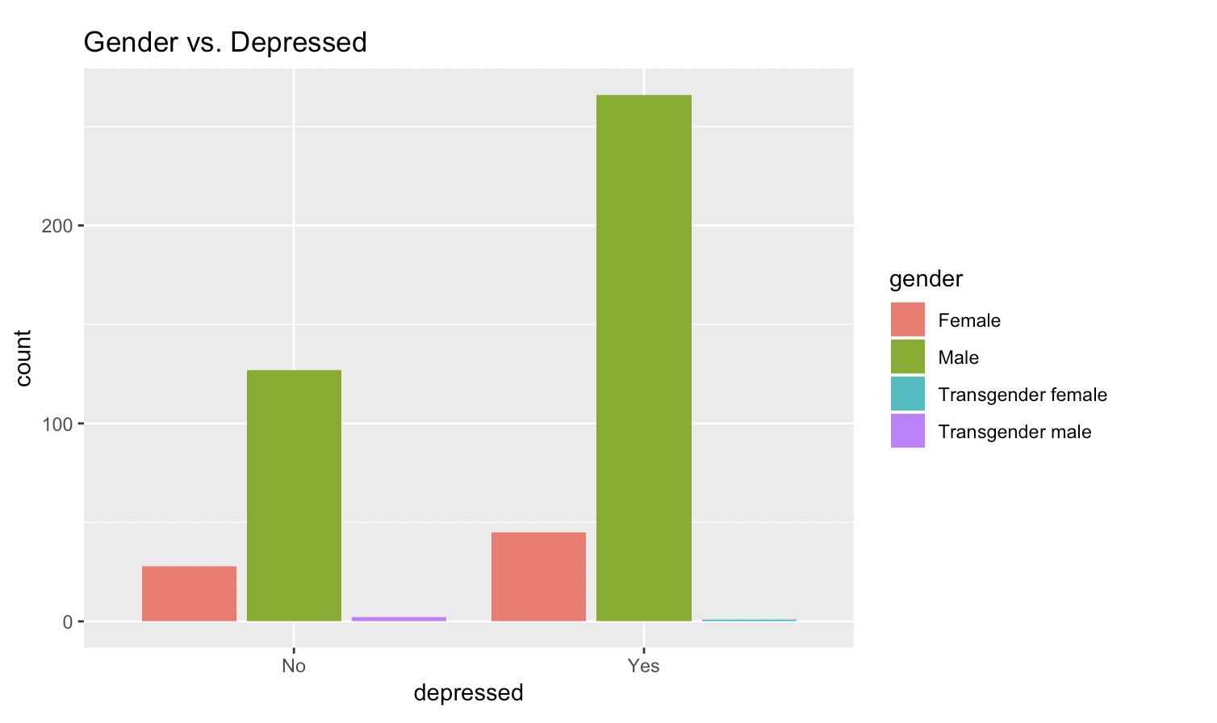
More percentage of females experience social fear and depression than males

Slide 8
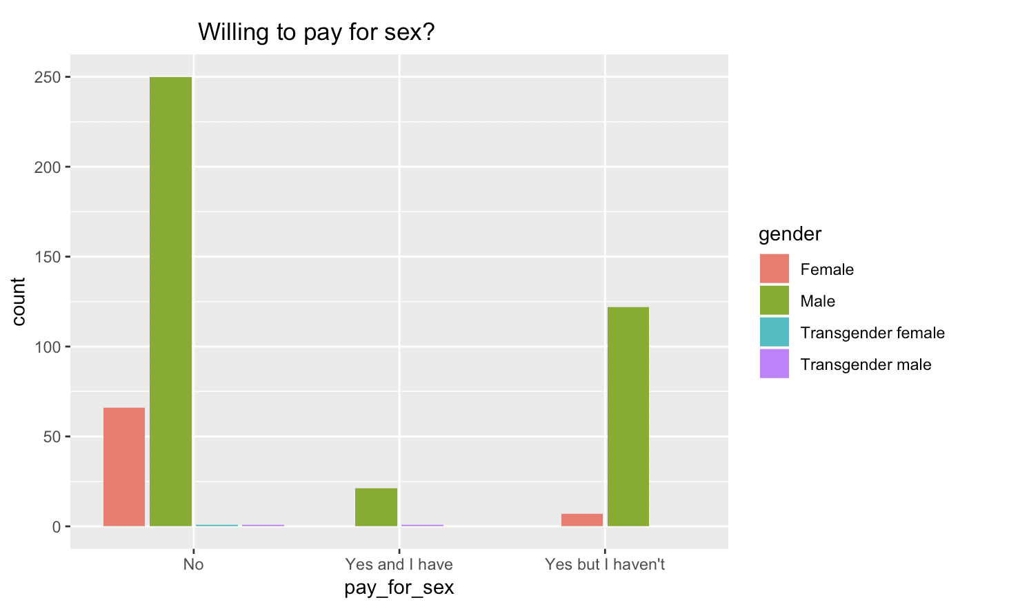
Some Interesting Facts

Slide 9
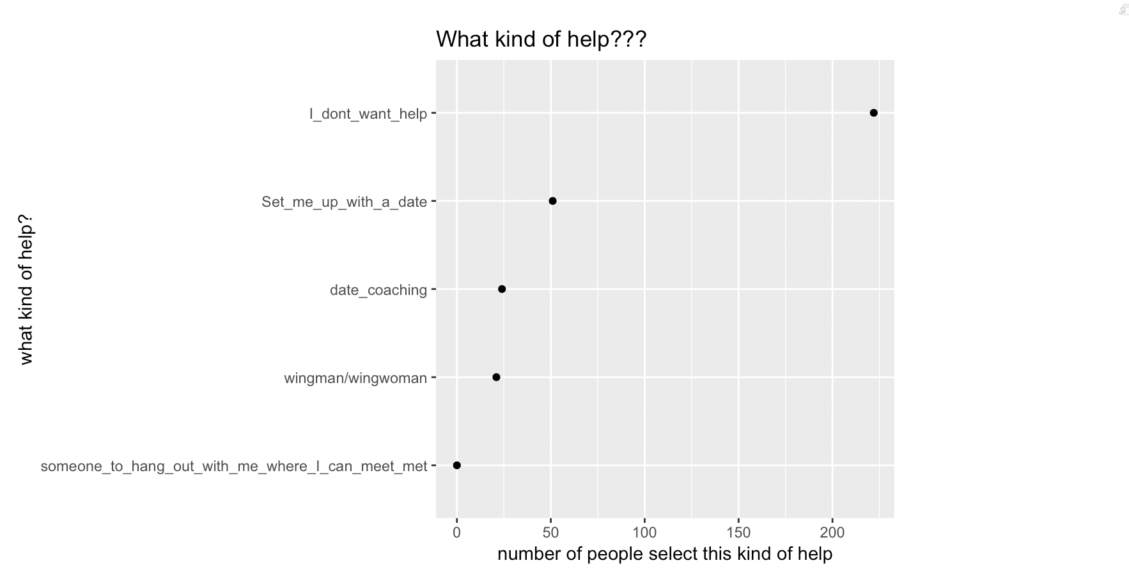
Most People Don’t Want Help!!

Slide 10
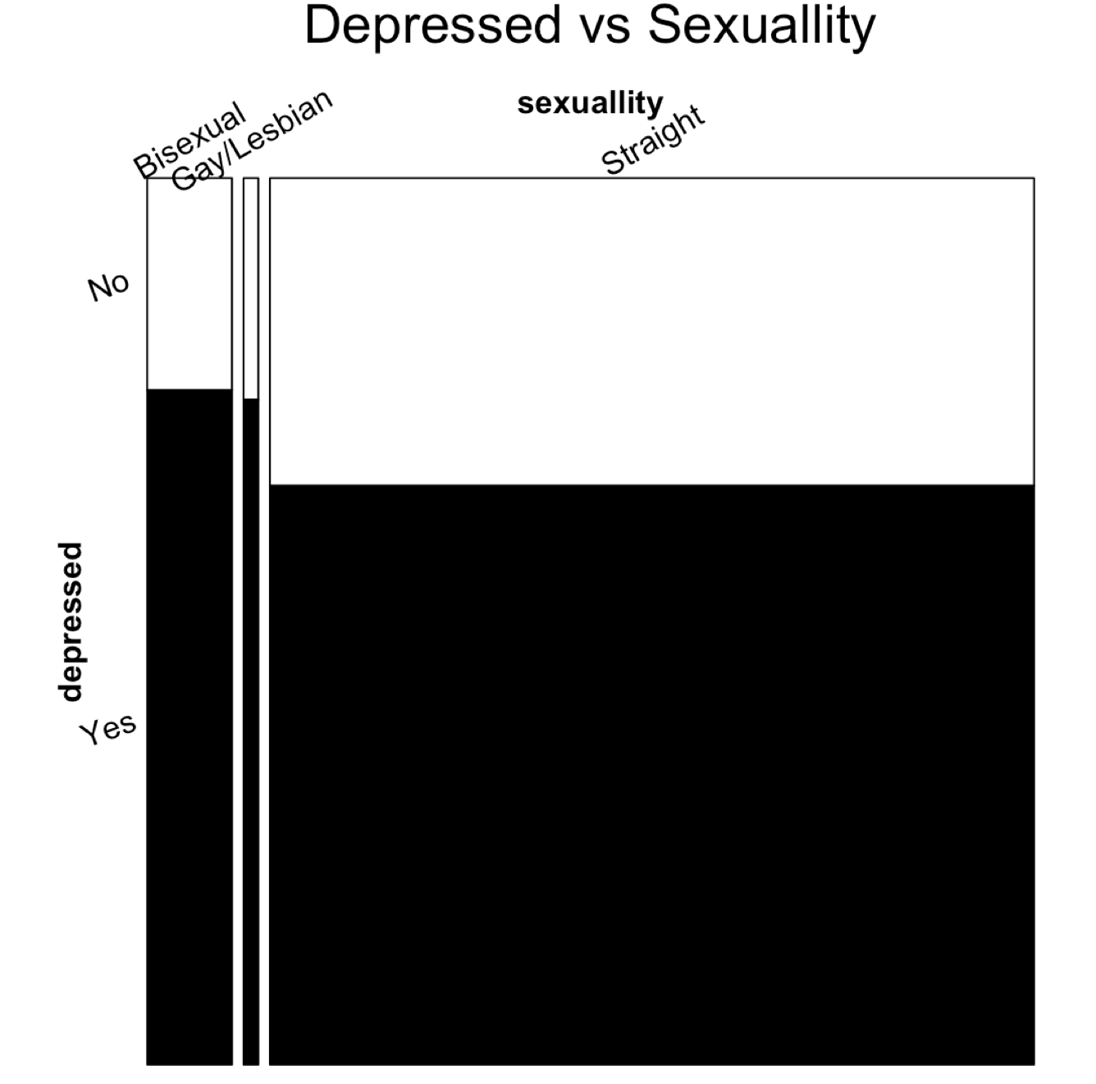
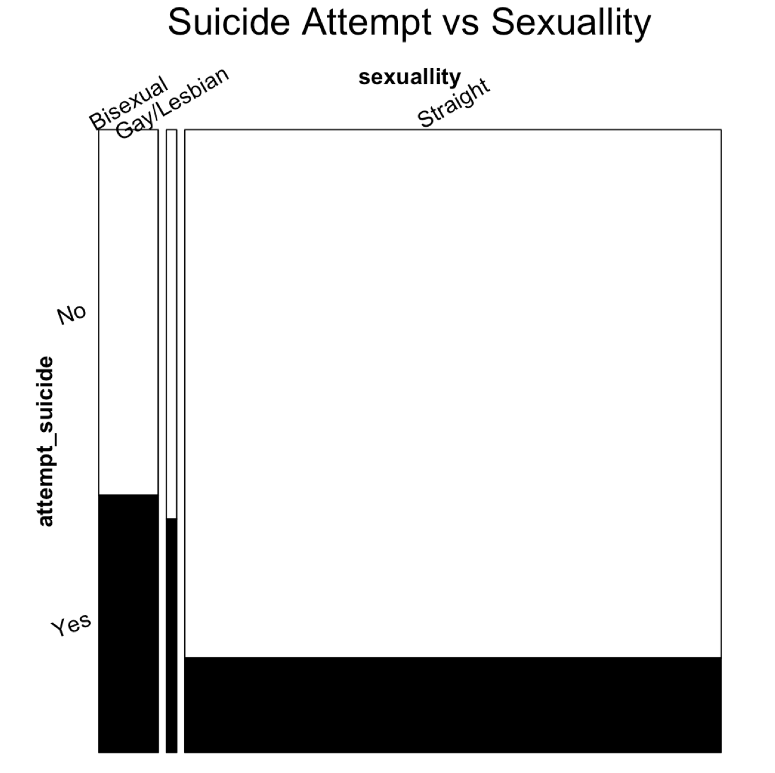
Sexuality
More bisexual, gay/lesbian experience depression and attempt to commit suicide than straight people

Slide 11
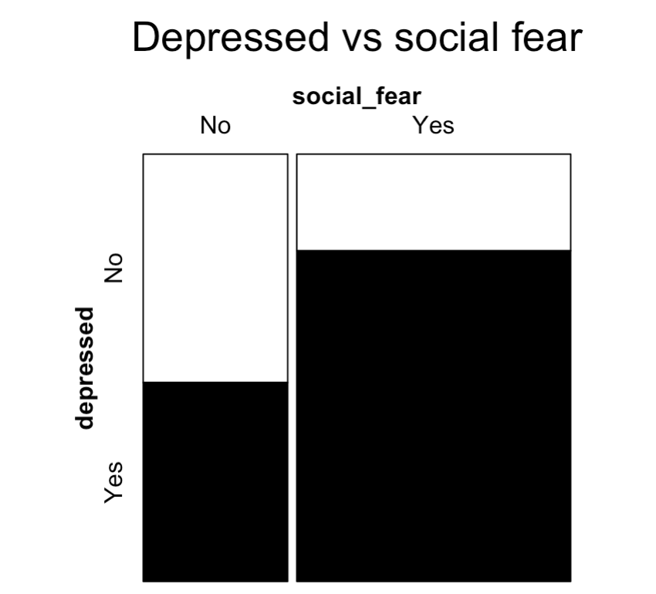
Social fear
Social fear is highly related to depression.

Slide 12
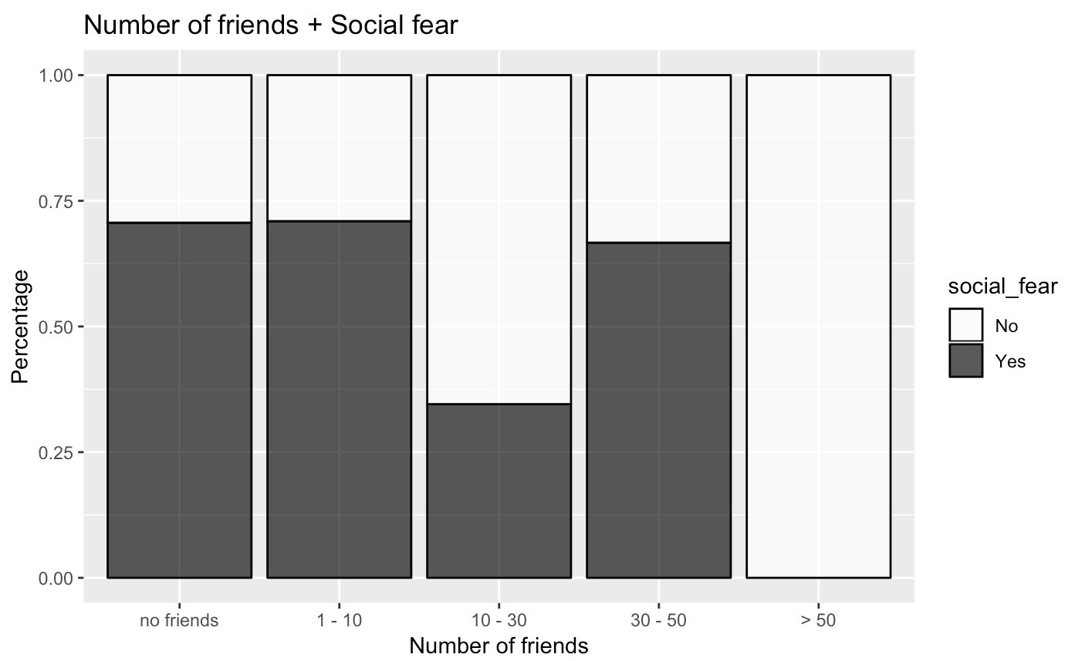
Social fear

Slide 13
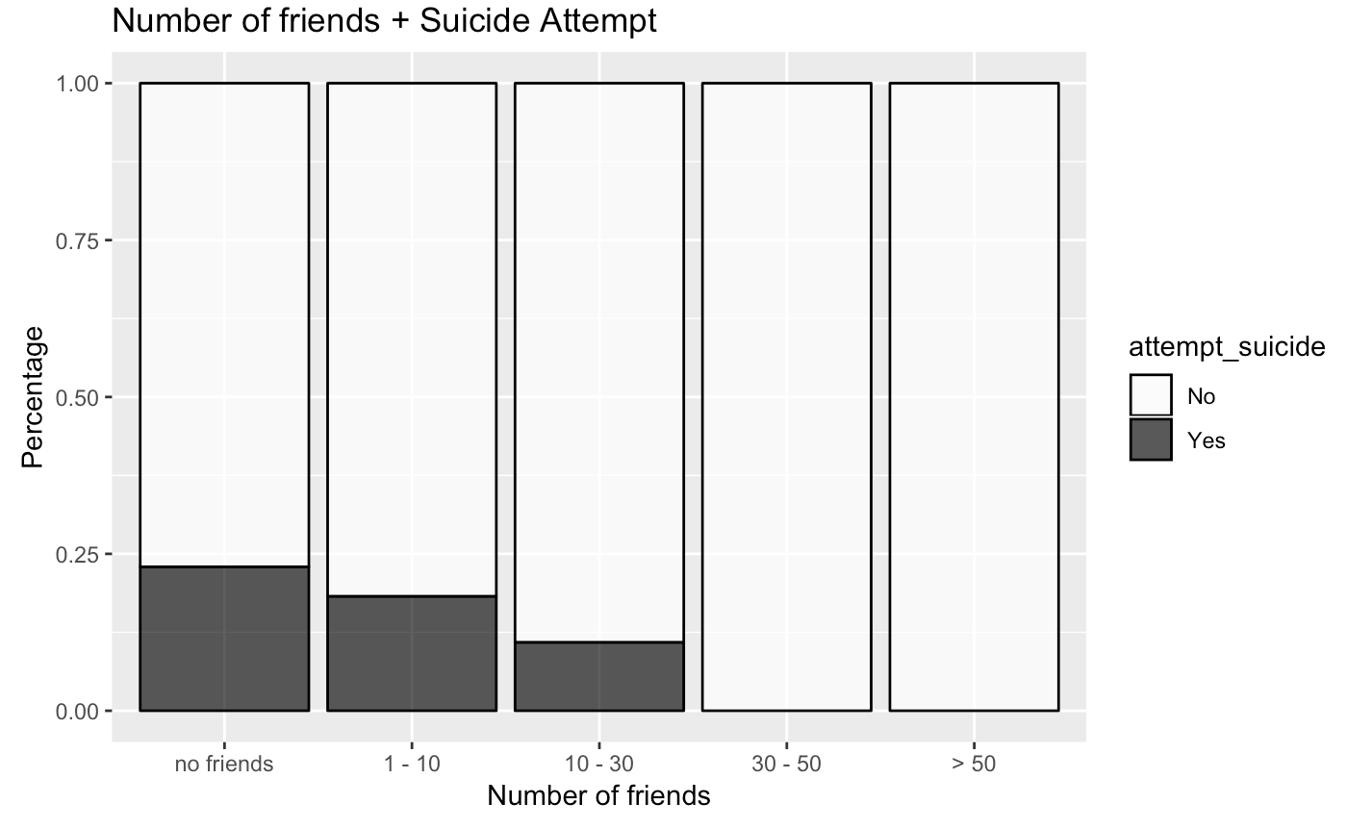
Number of friends

Slide 14
What makes people attempt to commit suicide?
>.<????

Slide 15
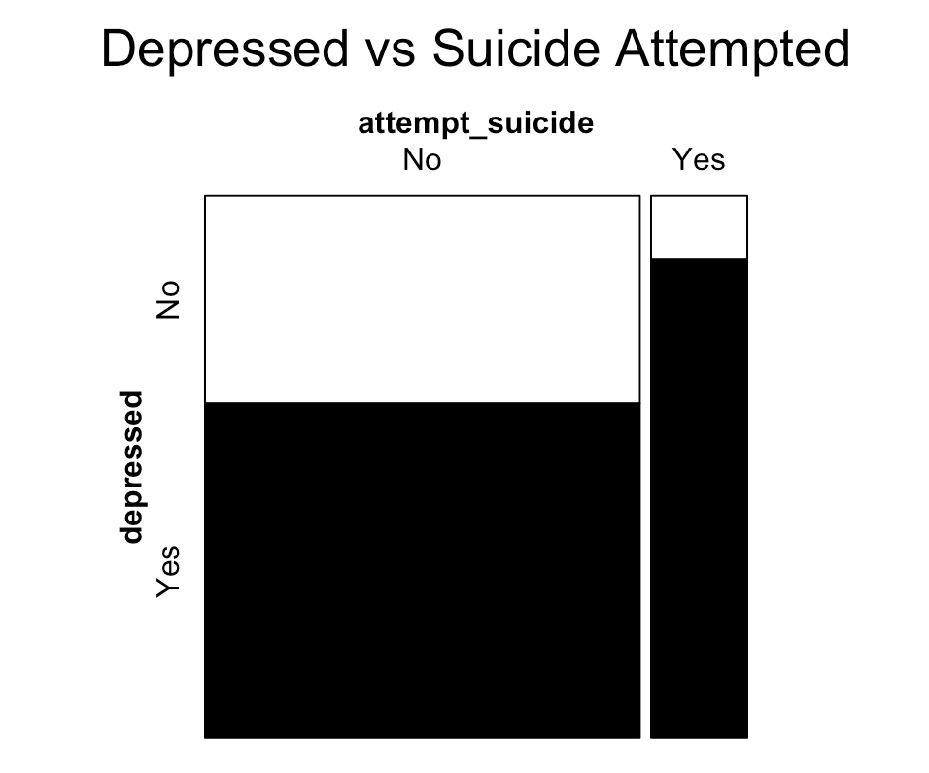
Depression
Depression and suicide attempt are highly related.

Slide 16
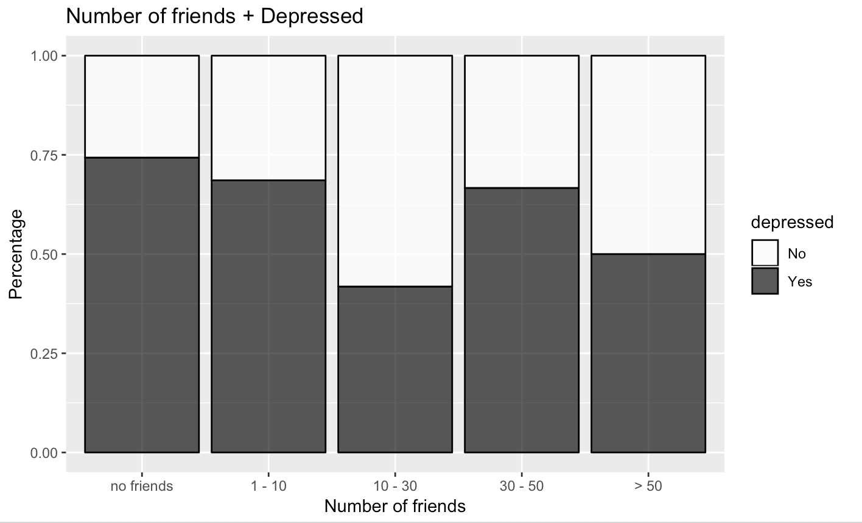
Number of friends

Slide 17
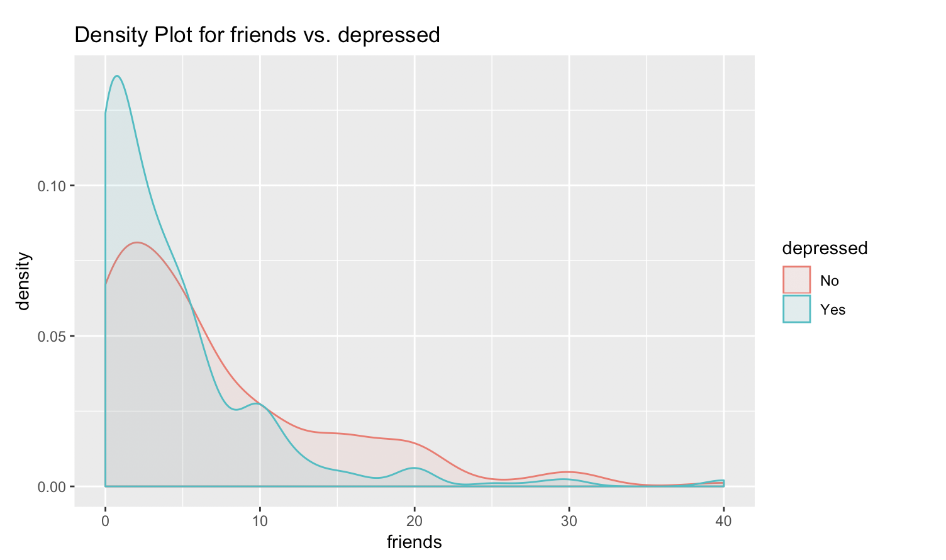

Slide 18
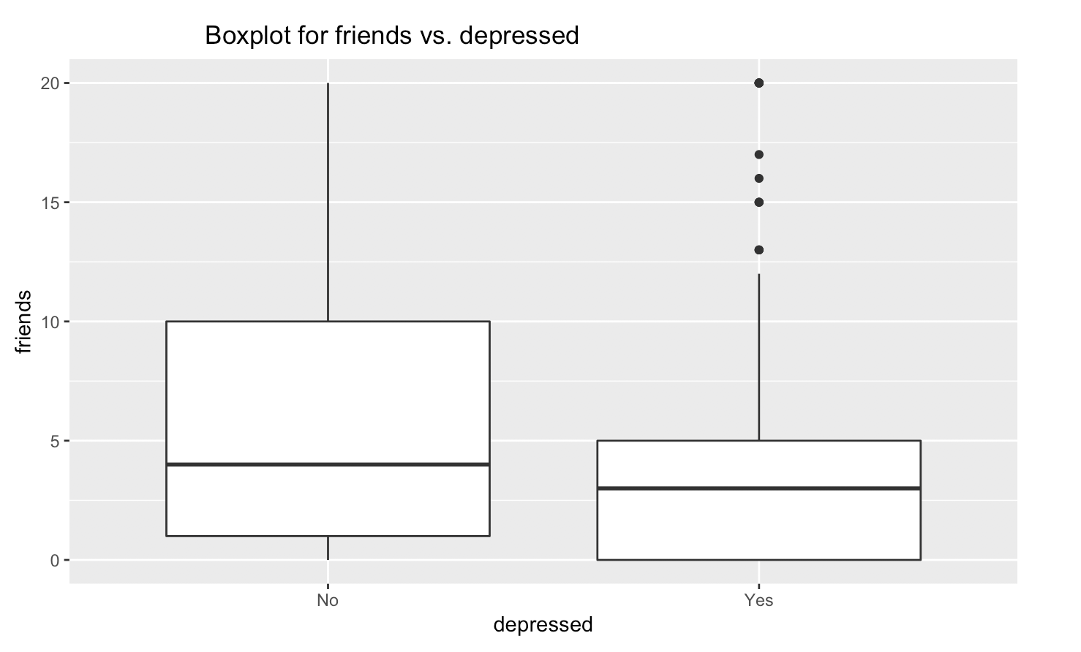

Slide 19
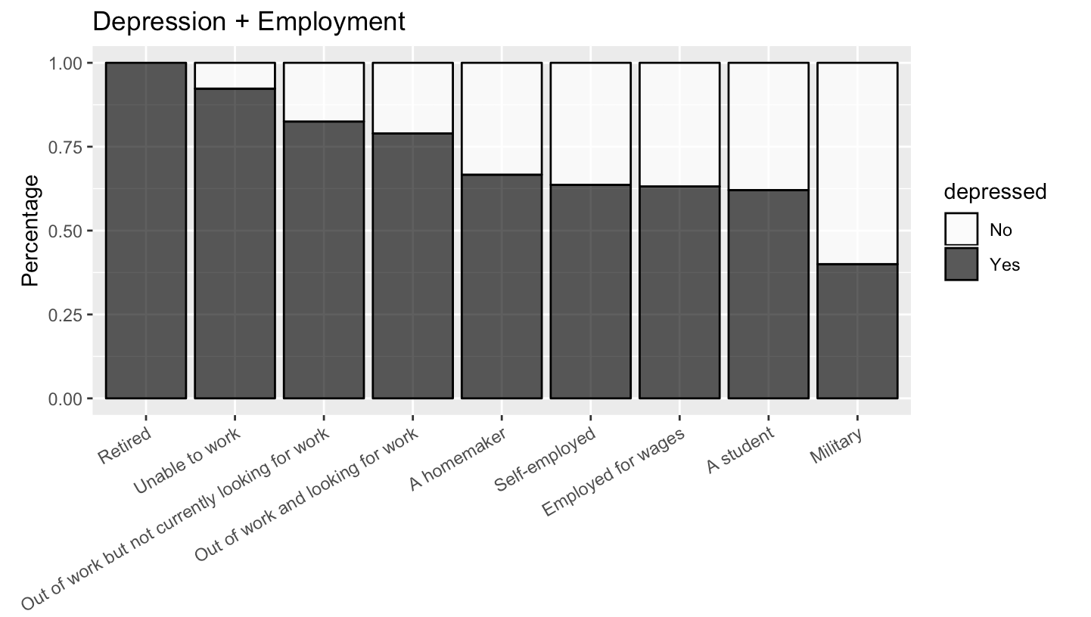
Employment
Retired and Unable to work people are mostly feeling depressed.
Students and military people are the least.

Slide 20
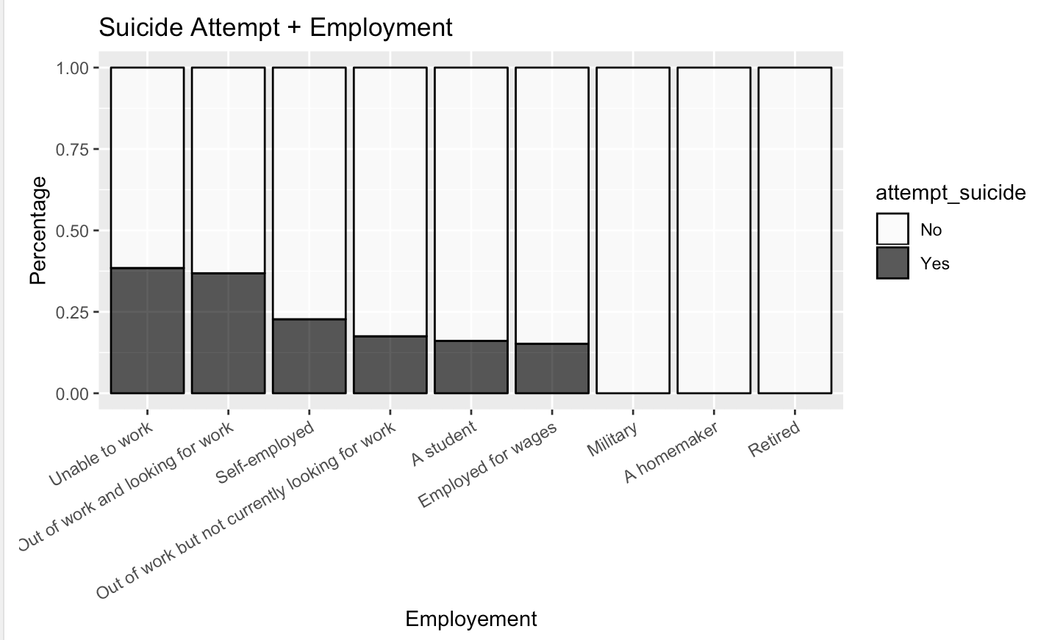
Employment
People who are unable to work have highest percentage of suicide attempt.

Slide 21
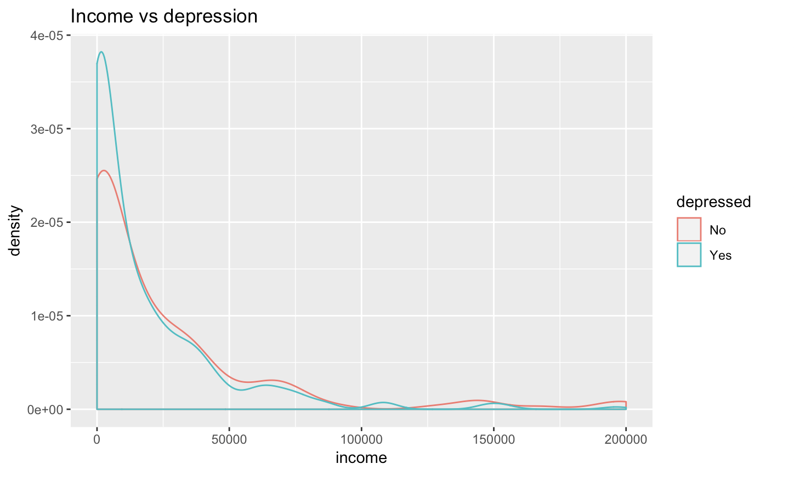
Income

Slide 22
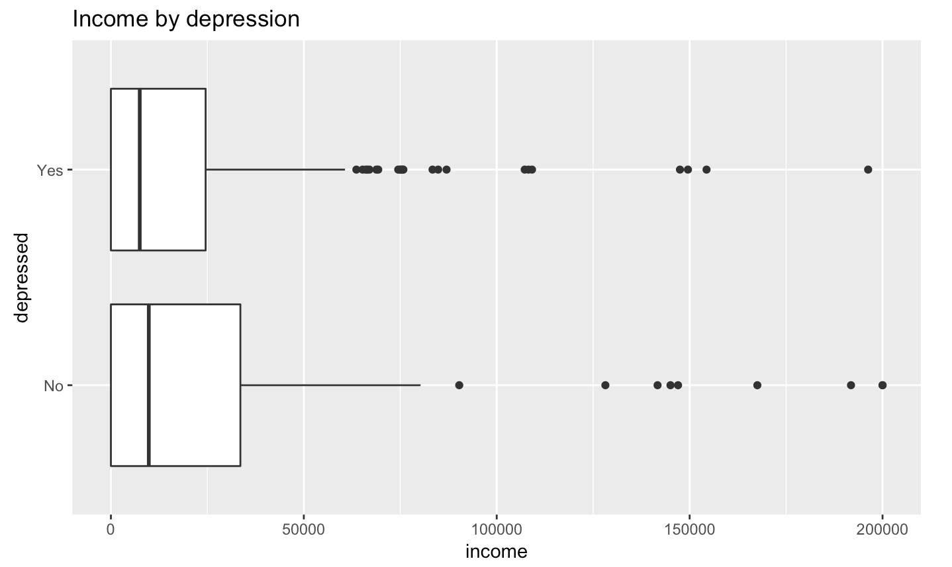
Income : slight difference…

Slide 23
Discoveries and key takeaways
Gender
Social fear
Suicide attempt
Number of friends
Employment
Education level

Slide 24
To audience
How depressed are you?
Would you like to quiz yourself?

Slide 25
Our web to test your happiness score

Slide 26
If time permits
Explore more related variables
Improvement on interactive plots

