Slide 1
Analyzing the Relationship Between Ethereum Price Movements and Reddit Sentiment
Presented by Johnny Tran

Slide 2
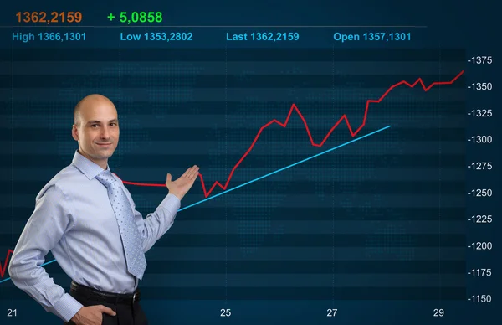
WELCOME
Objectives :
Why I chose this project
Data Selection and Cleaning
Analysis and Result
Key Takeaway and Next Step

Slide 3
Why I choose This Project

Slide 4

Curious if Reddit chatter moves crypto prices.
Learning opportunity
Cleaning messy data
Exploratory analysis
Get rich?

Slide 5
Quote
DATA SELECTION AND CLEANING

Slide 6
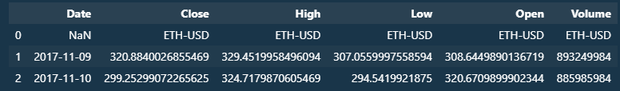
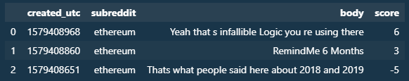
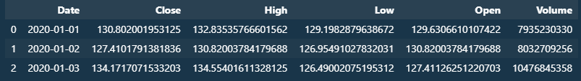
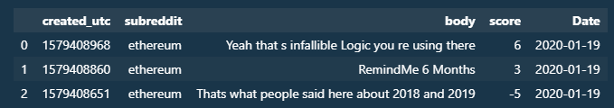
Data Selection
ETH price history from Kaggle
Reddit post/comments from r/Ethereum, also from Kaggle
Issues Found
Missing data in post data
Post uses timestamp
Shorter time frame for post dataset vs price history.
Cleaning Step
Converted timestamp to dates
Filter date range of Eth price to fit post date range
Removed data with empty “body” from post dataset.
Cleaned

Slide 7
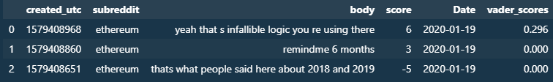
Vadar Sentiment Model
Purpose
Assign a sentiment score to each Reddit post (positive, neutral, negative)
Why VADER
Works well on social media text
Handles slang, emojis, punctuation.
Processing Steps
Cleaned text: lowercase
Applied VADER → compound sentiment score (-1 to +1)

Slide 8
Analysis and Result

Slide 9
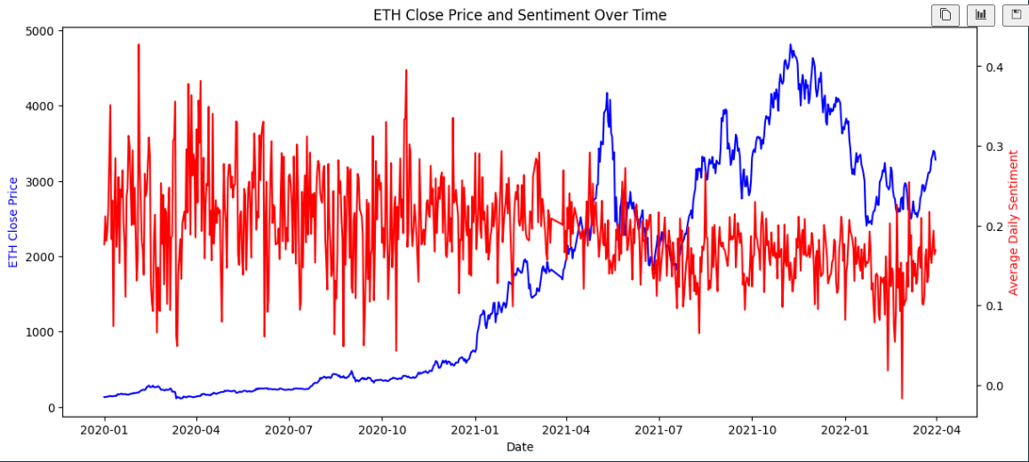
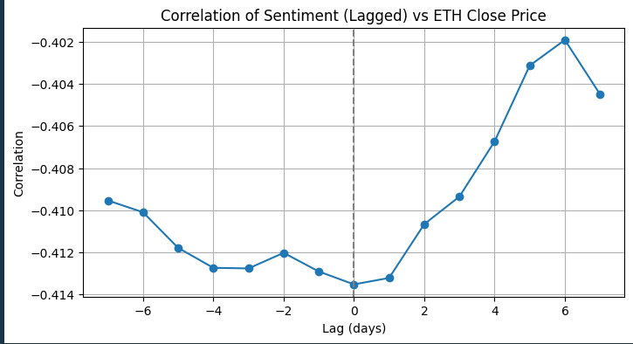
Analysis Performed
Correlation between Reddit sentiment and ETH Price
Lag Analysis
Key Result
Overall Correlation: Moderate negative (-0.41), when ETH rises, sentiment slightly negative
No significant signal from lag analysis
What Next?
No direct relationship where one consistently predicts the other
Third factor?
Explore extreme sentiment

Slide 10
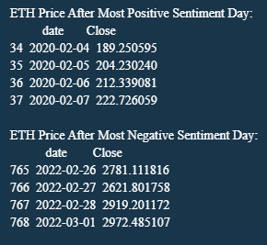
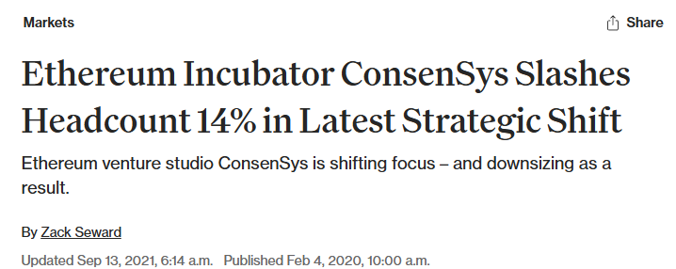
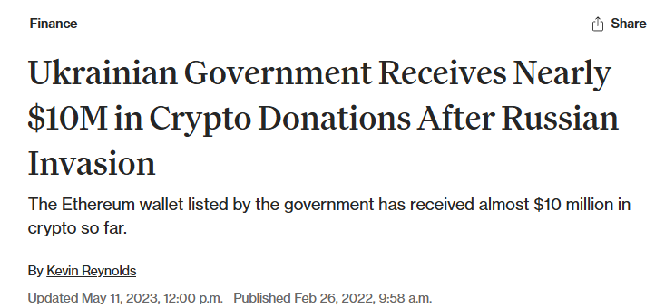
EXPLORING EXTREME SENTIMENT
What I Did
Found min and max sentiment.
Analyze ETH price movement 3+ following day
Key Finding
Price rose regardless of extreme sentiment value.
Interpretation
Extreme engagement, regardless of positive/negative, often precedes strong market movement

Slide 11
Key Takeaway and Next Step

Slide 12



Conclusion / Key Insights
Reddit sentiment alone doesn’t reliably predict ETH price.
Extreme sentiment days often coincide with strong market movements, highlighting engagement.
What I Learned
Handling messy, real-world data is not easy.
Feature engineering (lag) can change insights dramatically.
Next Steps / If I Had More Time
More data in terms of subreddit data as well as news data.
Build predictive models combining sentiment + price + news features.
Compare sentiment across other social platforms (Twitter, Discord).
MORE DATA

