Slide 1
THE
Housing Price
Prediction
2026 May 6
Jennifer Tran
Machine Learning

Slide 2
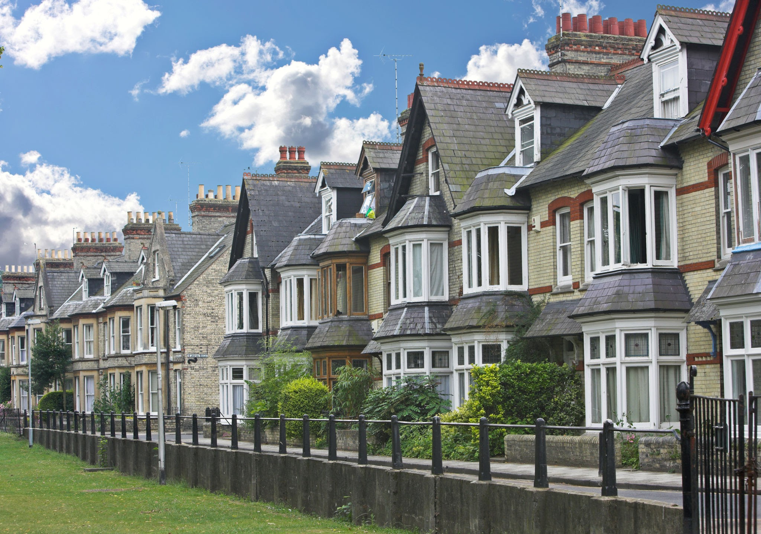


The Problem
The housing price prediction dataset I’ve chosen is used to predict the prices of houses in Kolkata. By predicting the prices, I’ll be able to learn about the regression of house prices based on features like location, sq ft, and price of each sq ft. The learning models I’ll be using is KNN, linear regression, Random Forest, XGBoost, and neural network to find what model is best suited for this housing prediction.
The Dataset:
https://www.kaggle.com/datasets/kuntalmaity/house-price/data
The Preprocessing Guide:
:https://www.kaggle.com/code/nagendrareddy777/data-preprocessing
2

Slide 3
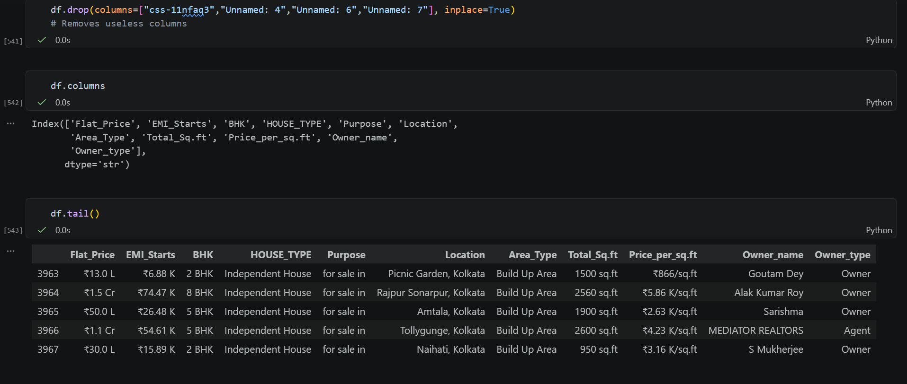
Data Preprocessing Stage
First, I dropped the columns that were not necessary and did not have unique values inside (repeating the same value).
3

Slide 4
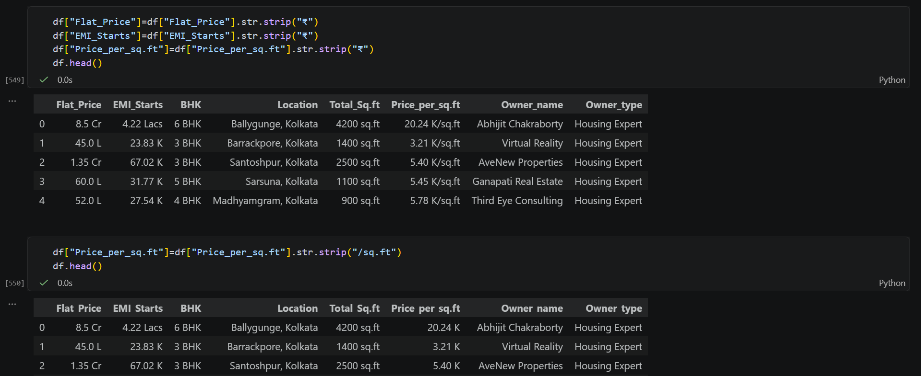
Data Preprocessing Stage cont.
Next, I started stripping strings from the numeric columns and additionally removing the word ‘Kolkata’ from the location column.
4

Slide 5
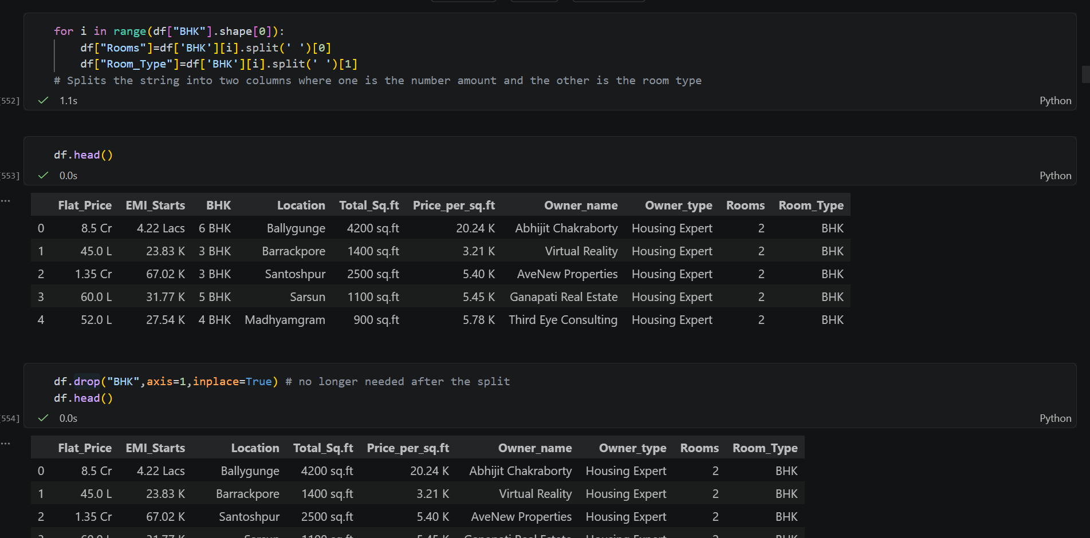
Data Preprocessing Stage cont.
More examples of splitting off the string.
5

Slide 6
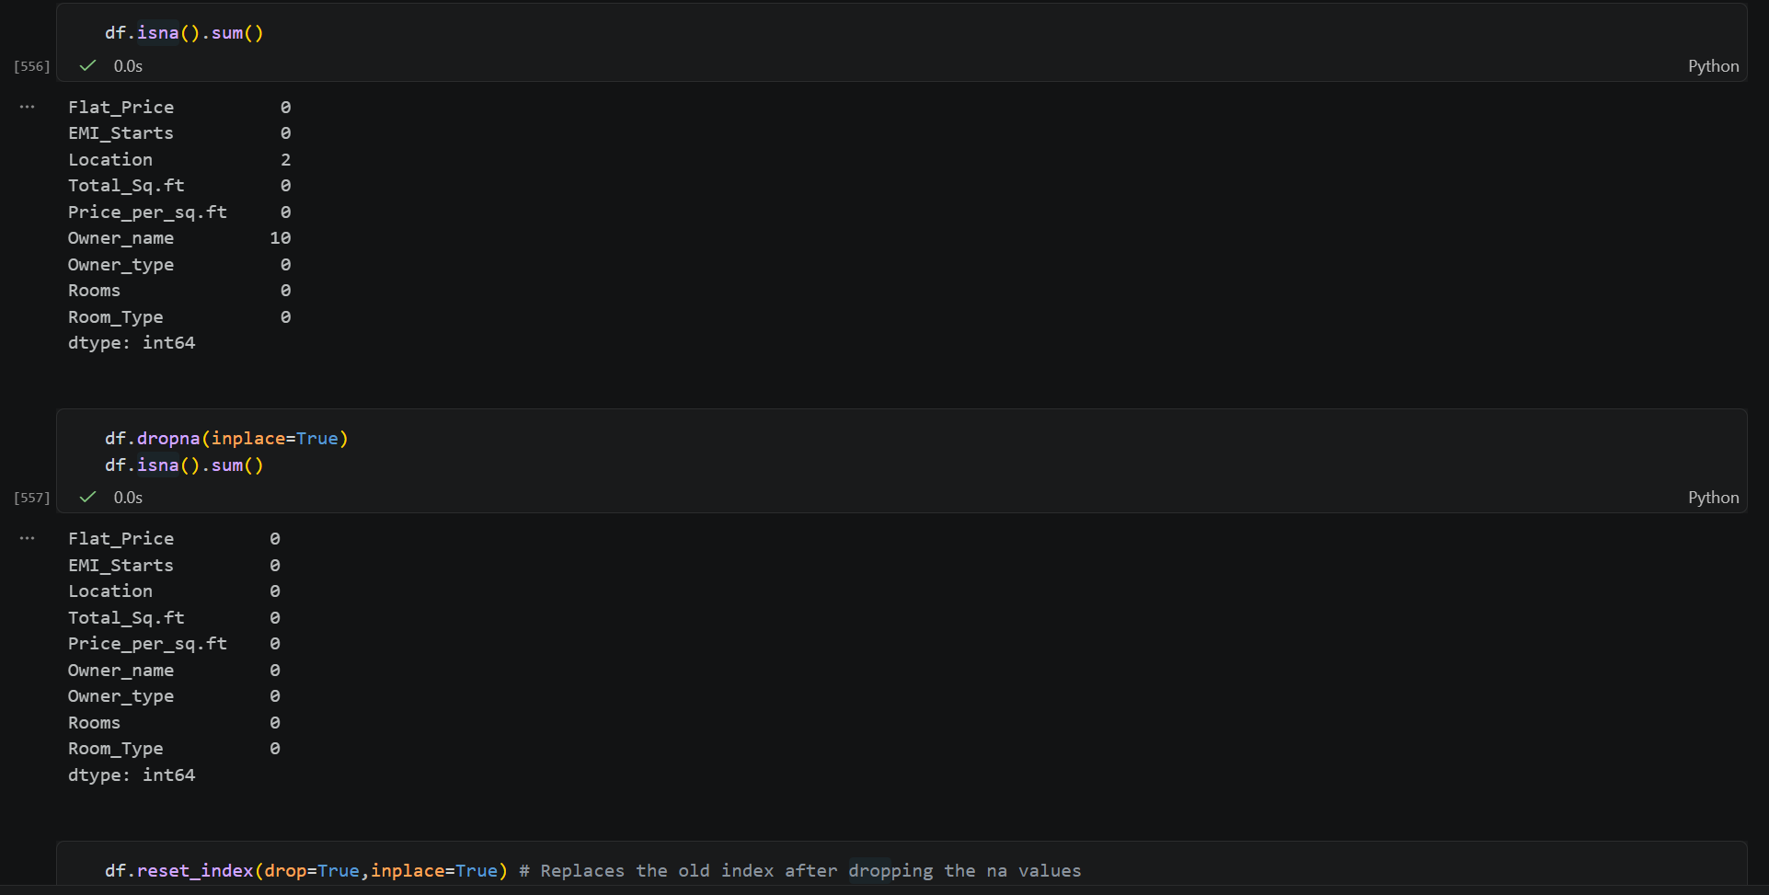
Data Preprocessing Stage cont.
Third, I checked for NaN values, dropped them, and resetted the index.
6

Slide 7
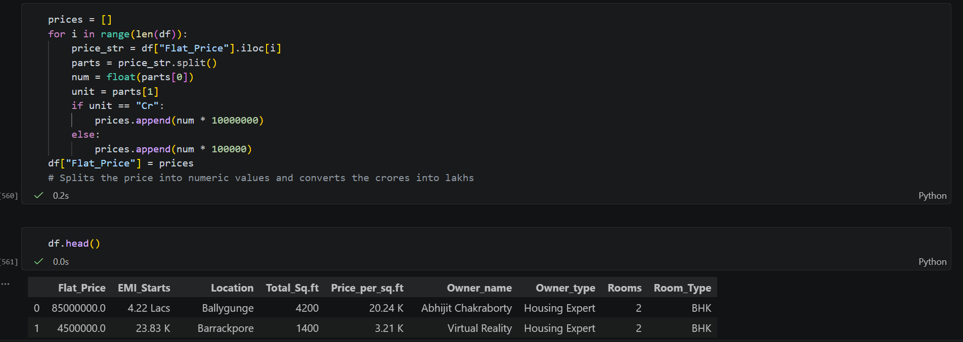
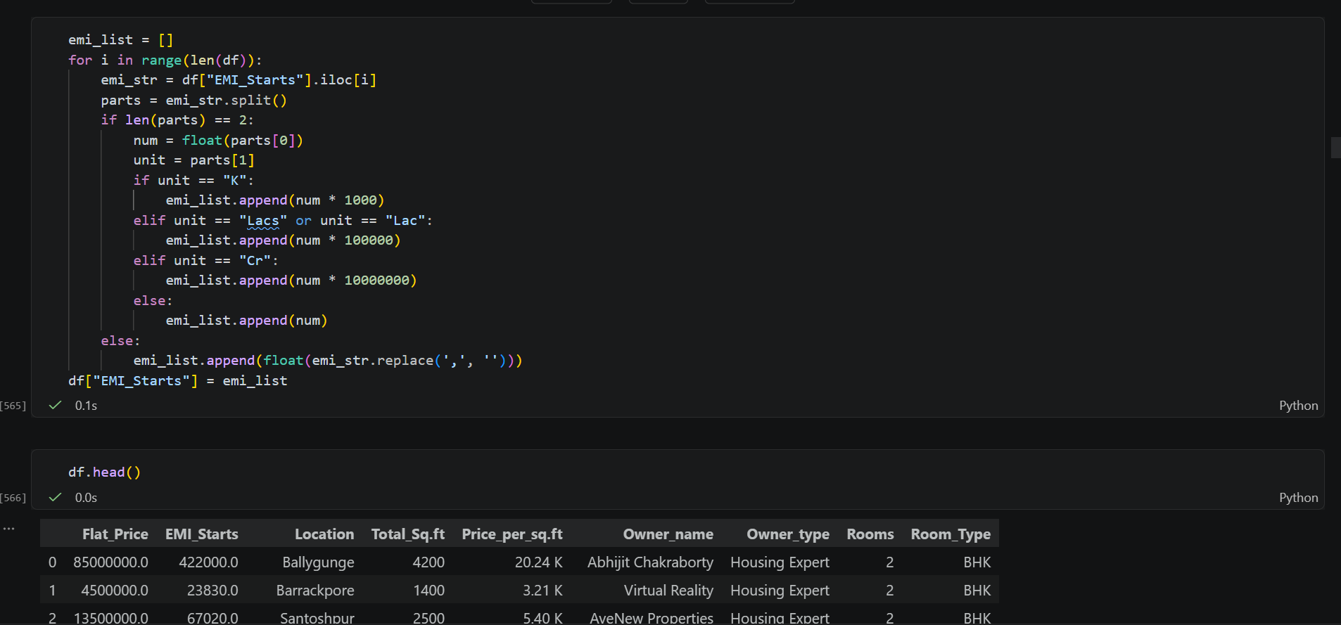
Data Preprocessing Stage cont.
Converting the money (crores, lakhs, K) into the same category of lakhs in order to make it consistent. (I did this as well for the price per sq ft)
7

Slide 8
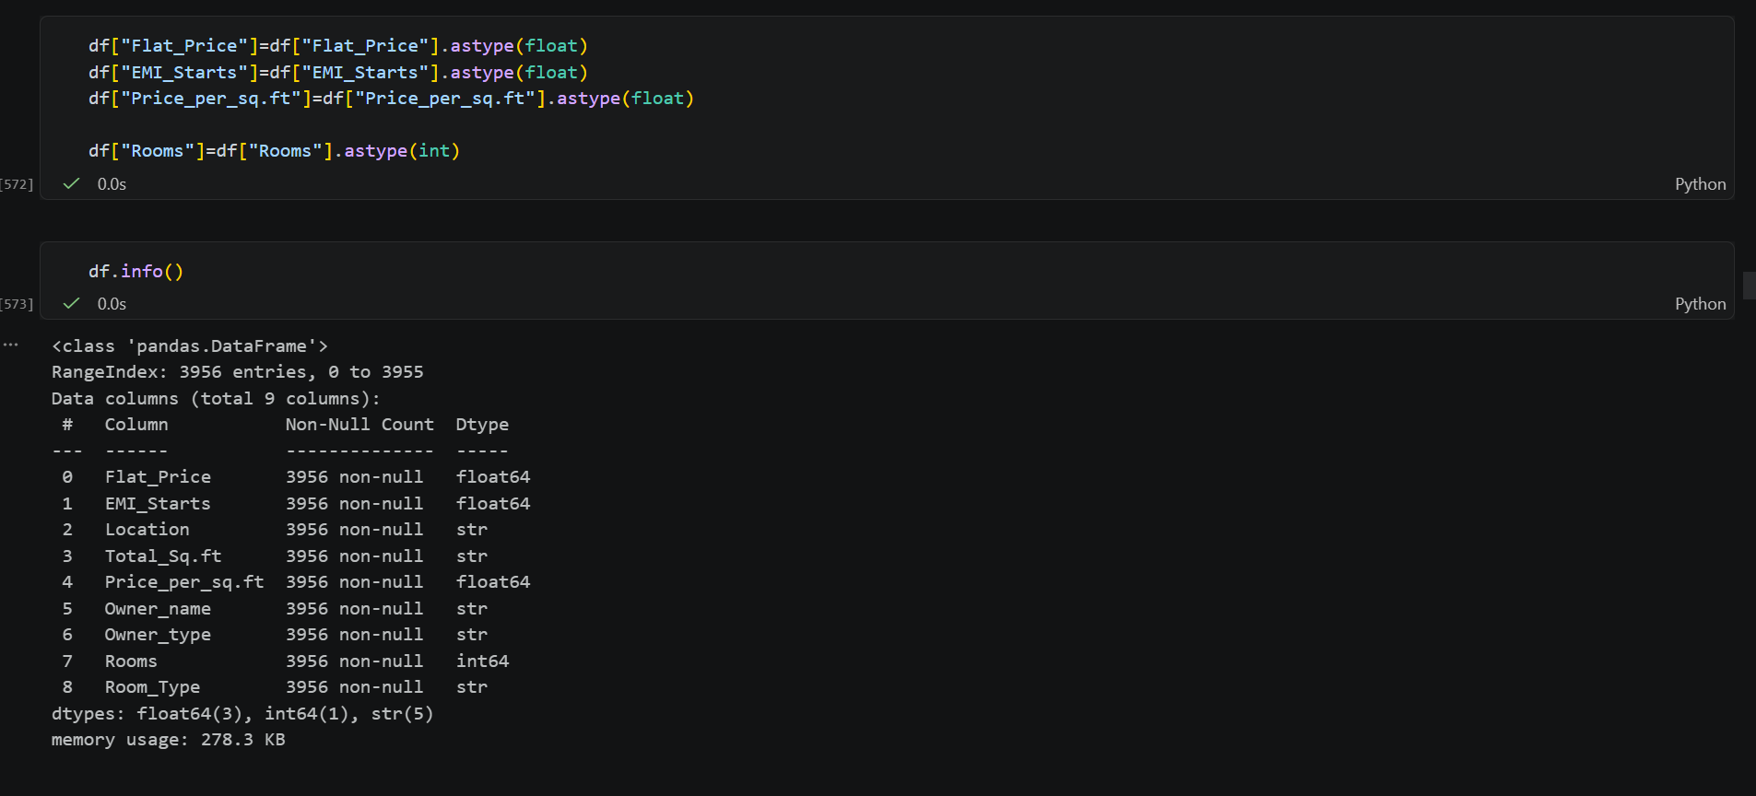
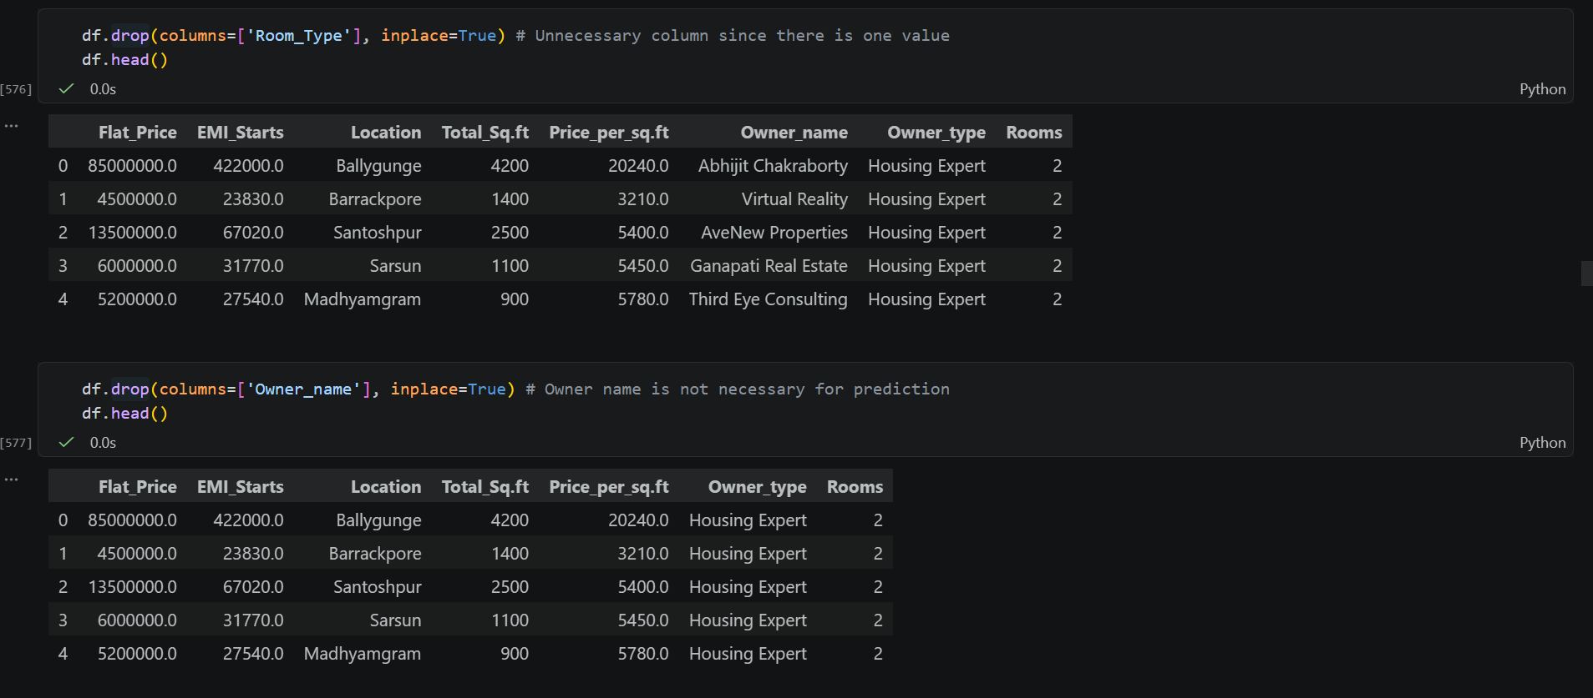
Data Preprocessing Stage cont.
After converting the numeric money feature, I converted the string values into float and int. (Total_Sq.ft was converted as well)
I dropped the Room_Type and Owner_name since it did not contribute to the data prediction.
8

Slide 9
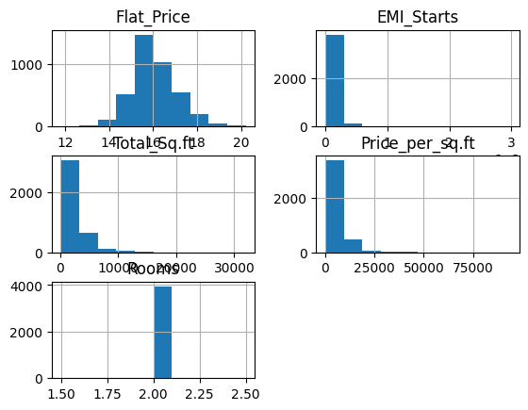
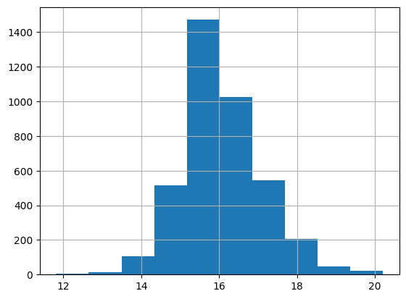
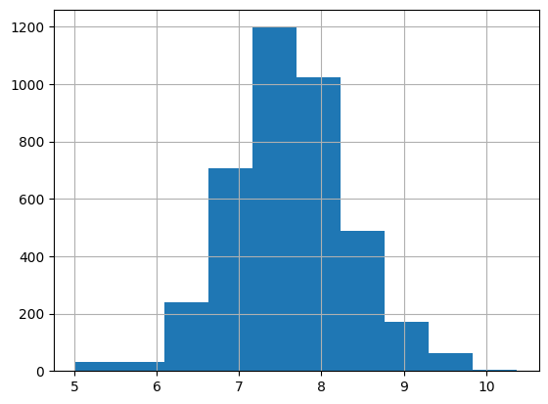
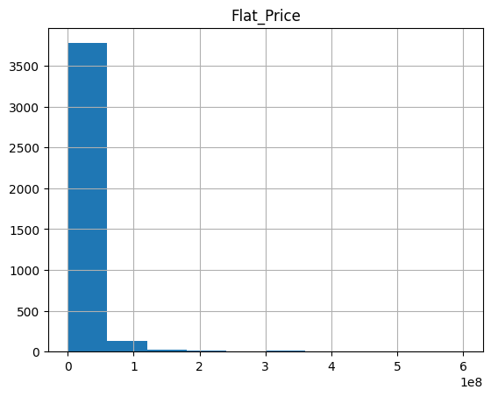
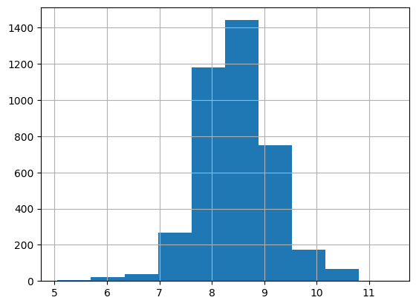
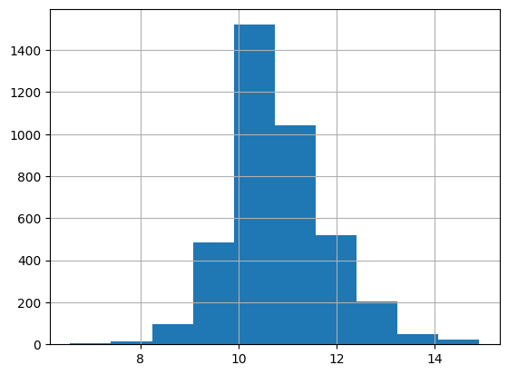
Fixing Data Right-Skewed
By checking the features by histogram, I was able to see that all the data was right skewed.
I used log transformations in order to make the data more evenly distributed into a more bell-shaped size. (In order: ‘Flat_Price’, ‘Total_Sq.ft’, ‘Price_per_sq.ft’, ‘EMI_Starts’) However, I had to drop ‘EMI_Starts’ due it being too closely correlated with ‘Flat_Price’
(1.0 -> 0.9977)
9

Slide 10
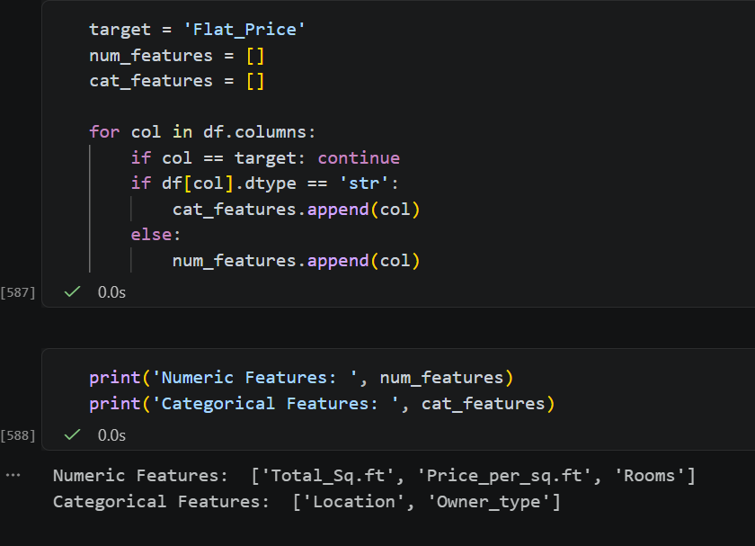
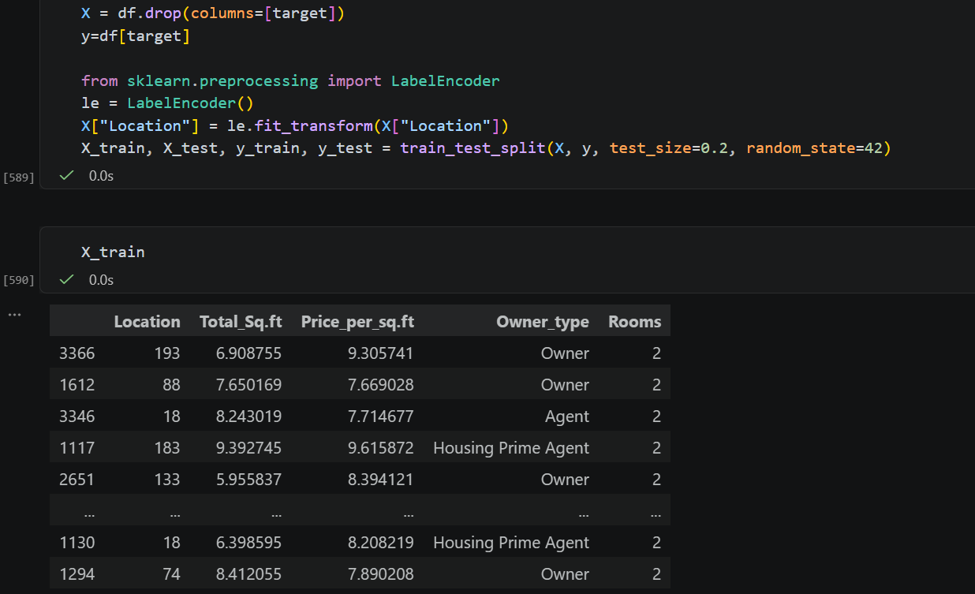
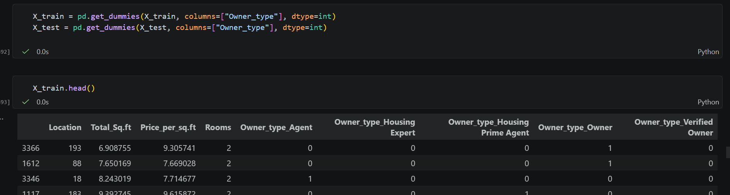
Categorical Features
Before splitting the data, I separated the features into numeric and categorical features for conversion and scaling.
Used Label Encoder for location (Hundred of unique values)
And used get_dummies to separate the ‘Owner_Type’ since there was only 4 types of values
10

Slide 11
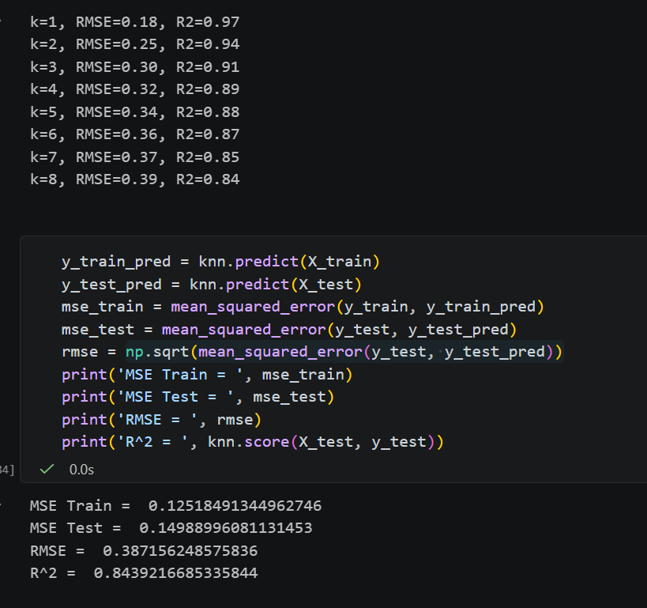
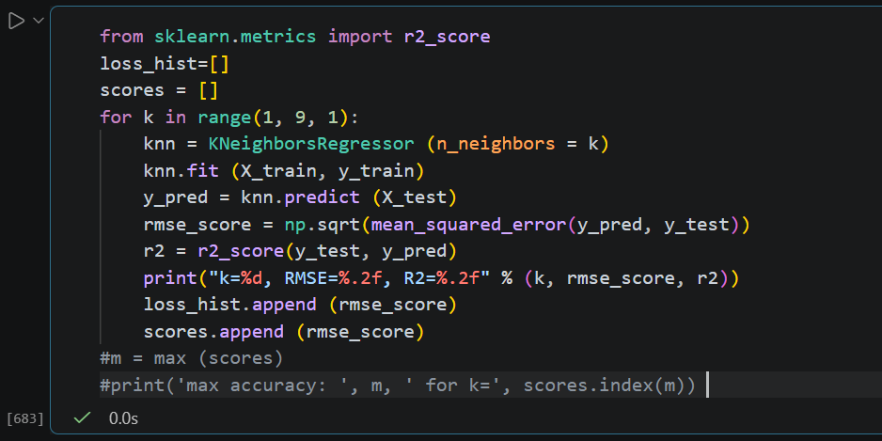
KNN (K-Nearest Neighbor)
For this dataset, I’ll be using Standard Scaler for the model. KNN is a learning model used to show the RMSE and r^2 for each k.
As k becomes larger the r^2 begins to slowly go down. This means that the model will stop fitting data well as the iterations of k continue.
11

Slide 12
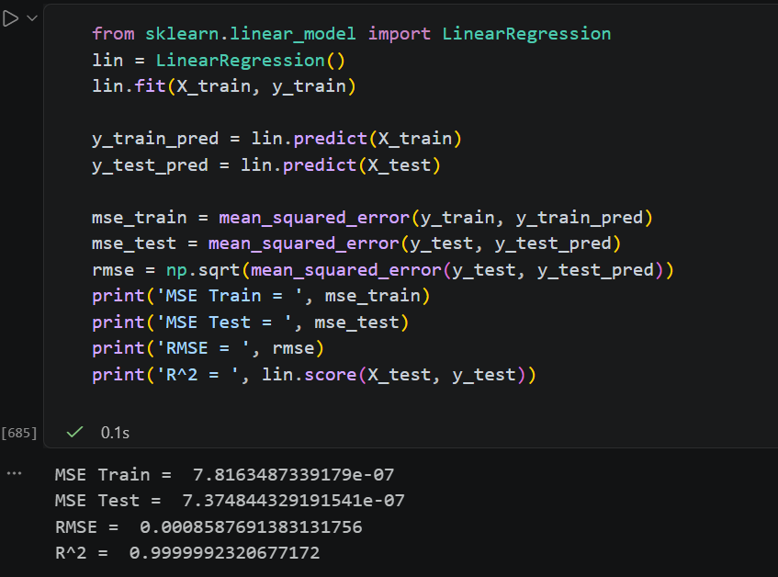
Linear Regression
Originally for the project, Logistic Regression was stated to be used in the project. However, Logistic regression is used for binary classification and not continuous numeric data like the housing predictions. I used Linear Regression instead to predict the data. After running the regression, the r^2 shows that the predicted data is very close to the actual dataset.
12

Slide 13
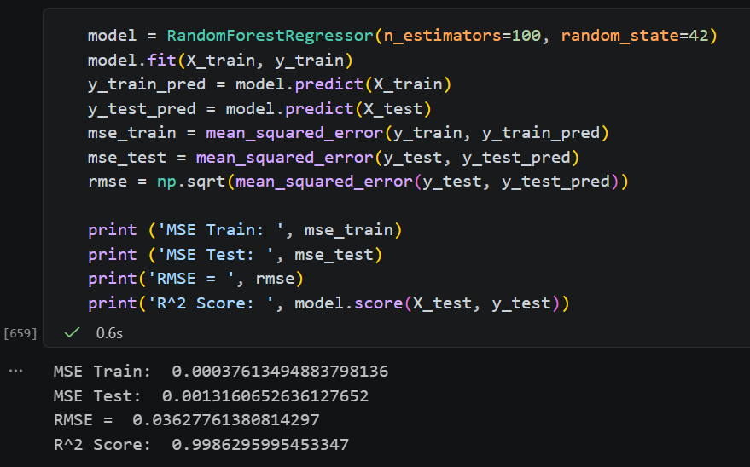
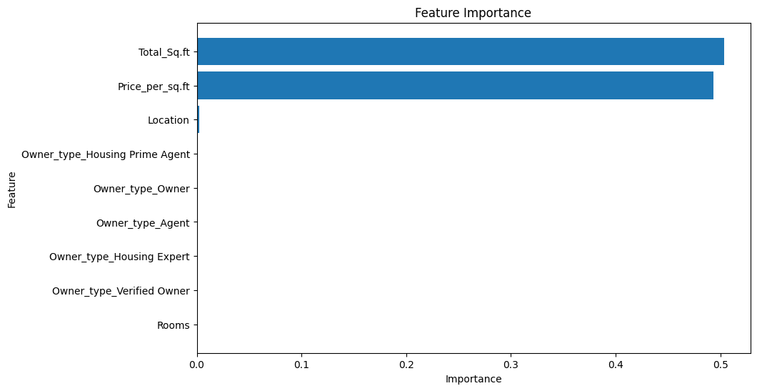
Random Forest Regressor
Random Forest Regressor uses decision trees to predict the ‘Flat_Price’ which would be considered a non-linear approach to modeling using 100 decision trees. The r^2 model fit is also very close to the Linear Regression. From looking at the feature importance chart, it shows what features were most important in the contribution in the model prediction. The most important features were ‘Total_Sq.ft’ and ‘Price_per_sq.ft’ while location has a small percentage of contributing to the prediction.
13

Slide 14
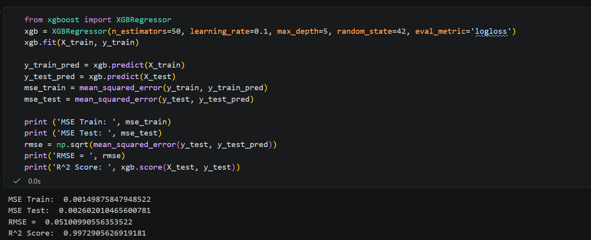
XGBoost Regressor
Extreme Gradient Boosting regression is a version of gradient descent that builds from weaker trees that adds another tree to correct the previous mistakes. In this model I used 50 trees with the max depth of 5 levels to see a more accurate prediction. The results of the model shows that the r^2 means it fitted to 0.9973~ and the RMSE was only 0.0510~ which is makes it also very close to the real data as well. The feature importance in XGBoost is basically the same as the Random Forest Regressor.
15

Slide 15
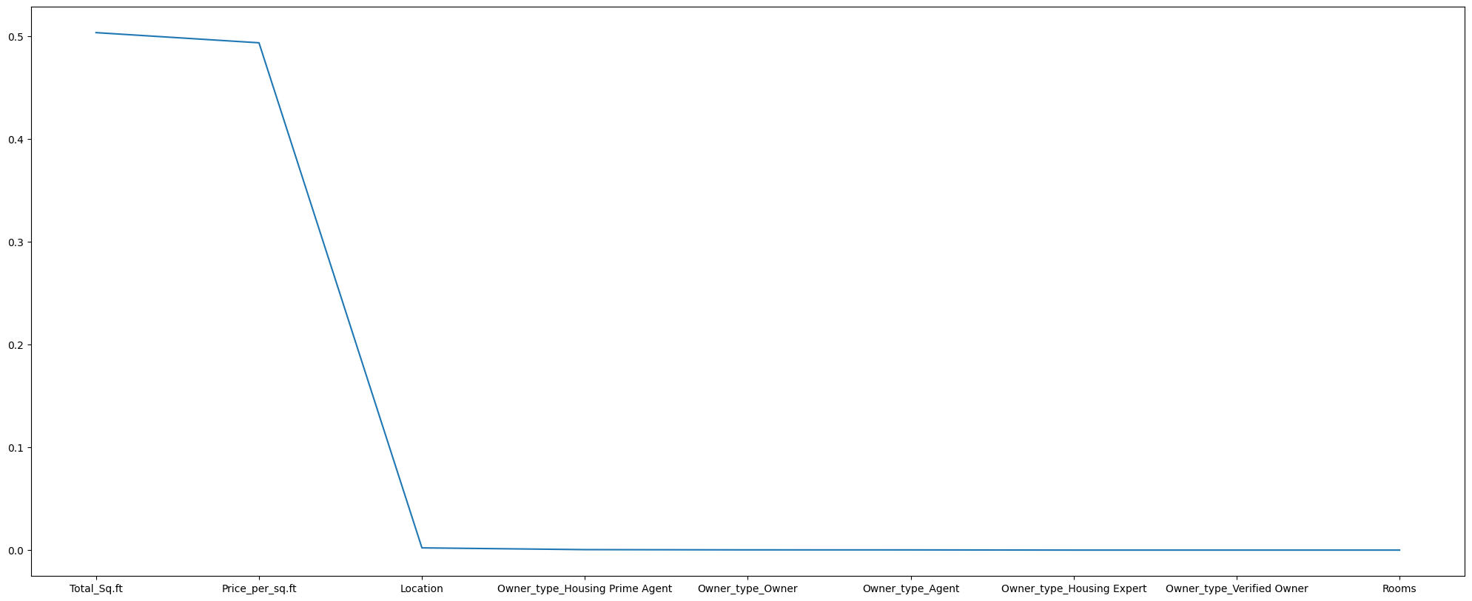
Another version of the Feature Importance
16

Slide 16
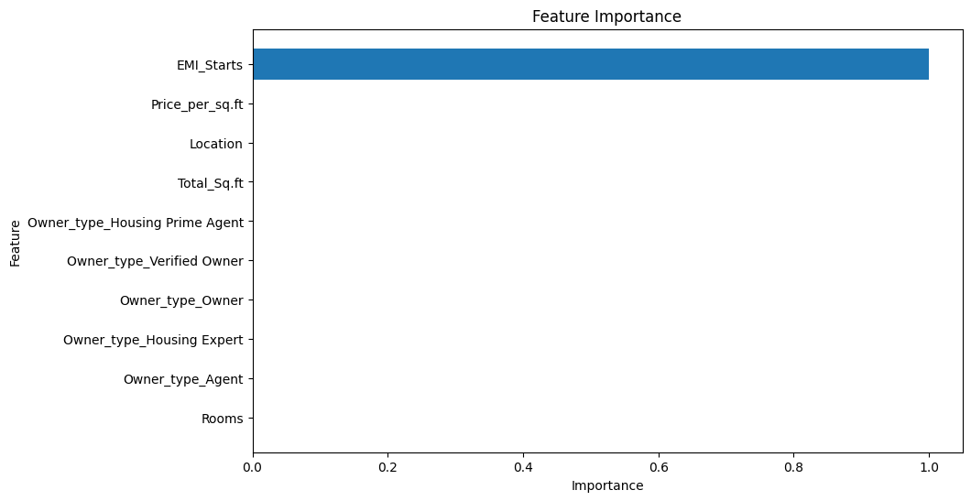
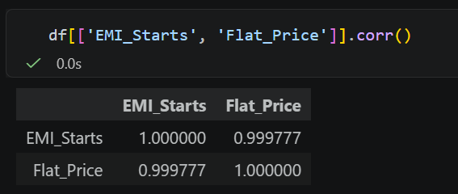
What would happen if I left ‘EMI_Starts’ in the Training?
When I had originally tested the models for its features importance. I found that the models were solely relying on ‘EMI_Starts’ to predict the data over the rest of the features. EMI stands for the equated monthly instalments which outlines the amount of money that is consistently paid for the house loan each month. Which meant that the models were using the monthly payments as a way to base off the monetary value of the housing instead of considering the other features of the house.
17

Slide 17
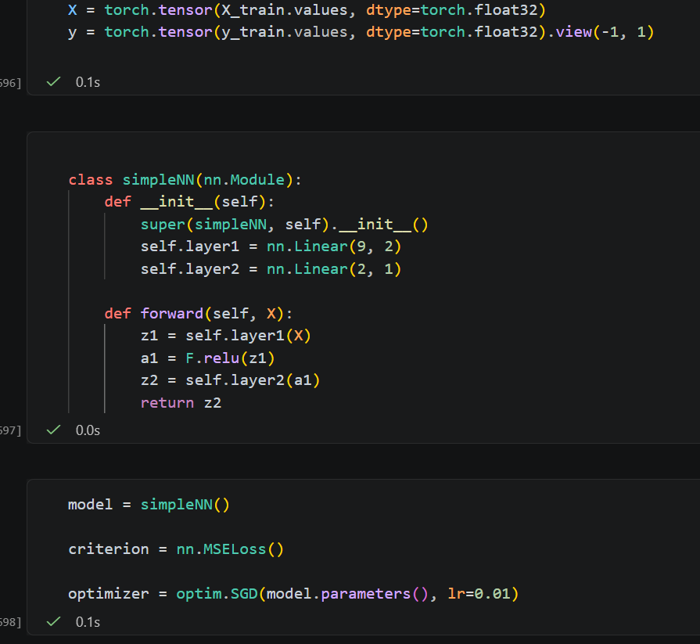
Neural Network Training
For the Neural Network training, I started by converting the x and y values of train into tensor to create arrays for the network then created the layers that takes 9 of the feature inputs and 2 outputs values. Using those 2 values, the second layer give the prediction. The forward function applies the first layer onto X_train values to transform it then uses ReLU and another layer to convert it to the final prediction.
18

Slide 18
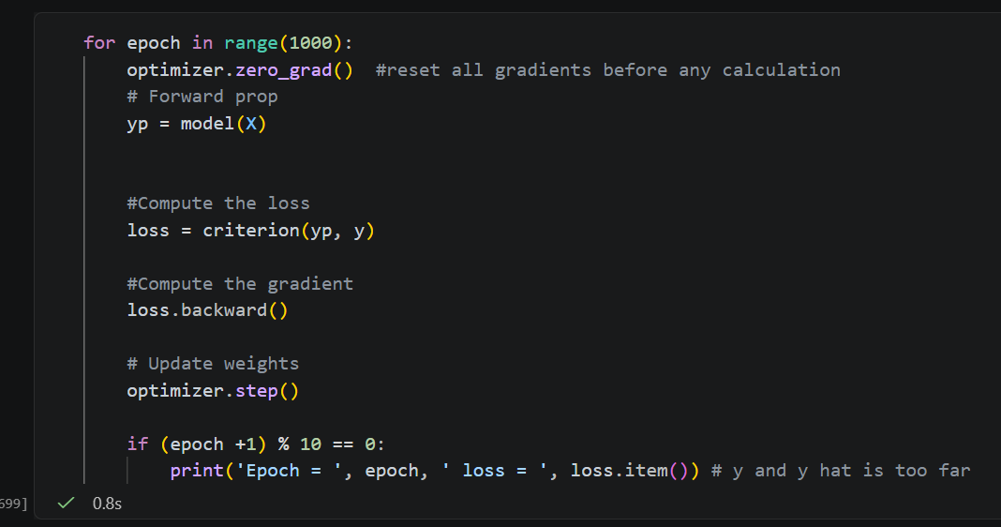
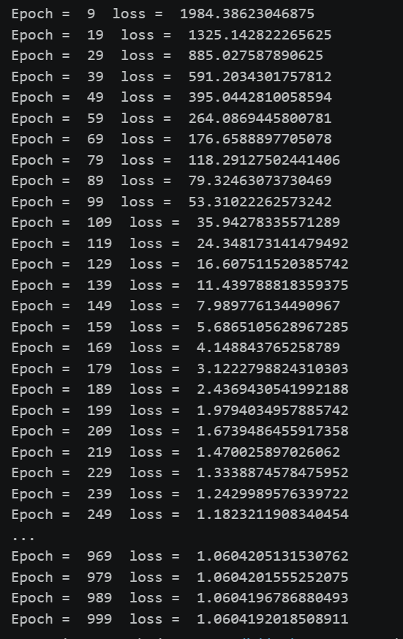
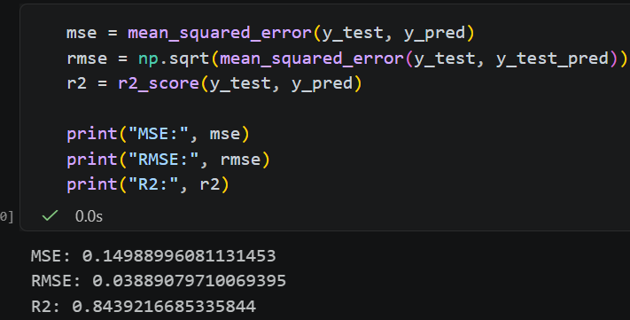
Neural Network Training cont.
The epochs is used in the function to repeat and update the weights to random values to improve its accuracy. From looking at the amount epochs used to get the loss to a very low value, this would show that the y hat and y are too far apart if the epochs stop drastically decreasing the loss by epoch 199. This model is rather less fitting to the dataset compared to the others since it also has a r^2 value of 0.844~.
19

Slide 19


Summary
After testing all the models (KNN, Linear Regression, Random Forest, XGBoost, and Neural Network), the best performing model based on low RMSE and high r^2 is Linear Regression and Random Forest Regressor for the Housing Prediction Dataset. Overall, the project helped predict the ‘Flat_Prices’ for Kolkata houses which had to be cleaned thoroughly before training the data on the sets.
20

Slide 20
THE END
THANK YOU FOR LISTENING
2026 May 6
Jennifer Tran

