Slide 1
Fourier Transform Model of Image Formation
Report 2
Jerico Miguel Rangel
2018-11666

Slide 2
Objectives
To understand the use of fourier transforms and the fourier space in image formation
Simulate Fraunhofer diffraction patterns using different apertures
Observe how convolution works in imaging systems
Correlate two images mathematically and understand it’s pitfalls

Slide 3
Results and Analysis:

Slide 4
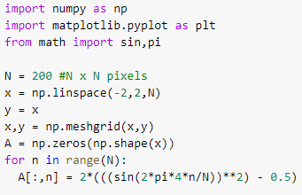

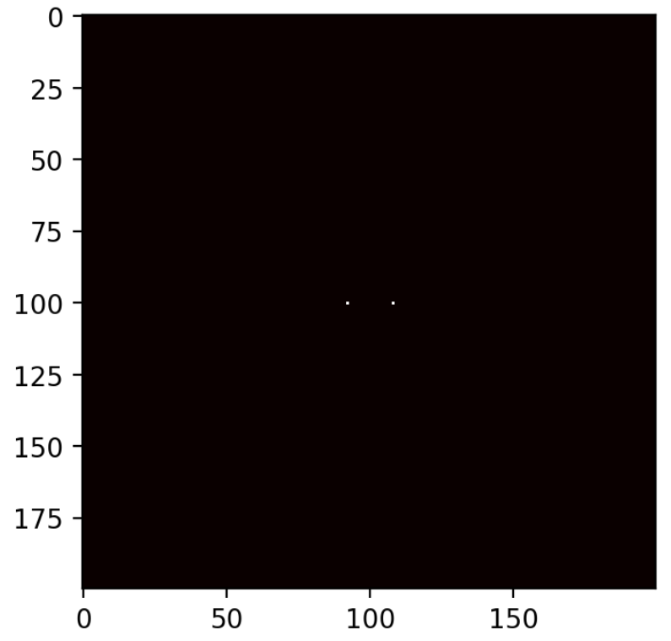
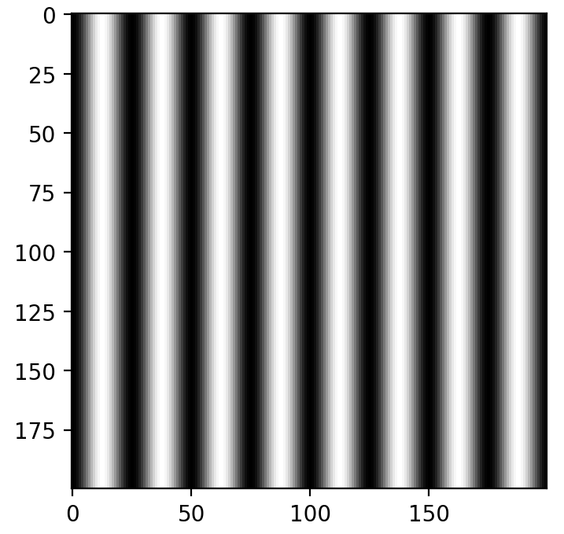
Results
a. Sine wave
Each aperture used is made in a 200x200 pixel meshgrid, shown in the code. The properties are then defined by 2d array functions. Such is seen for the sine wave aperture. The corresponding diffraction pattern is also shown below.
Activity 1: Familiarization with Discrete FT

Slide 5
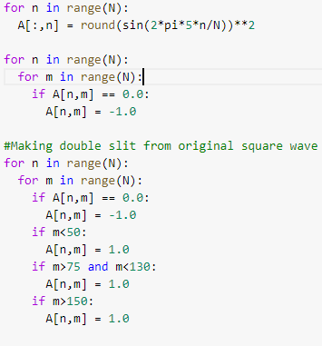
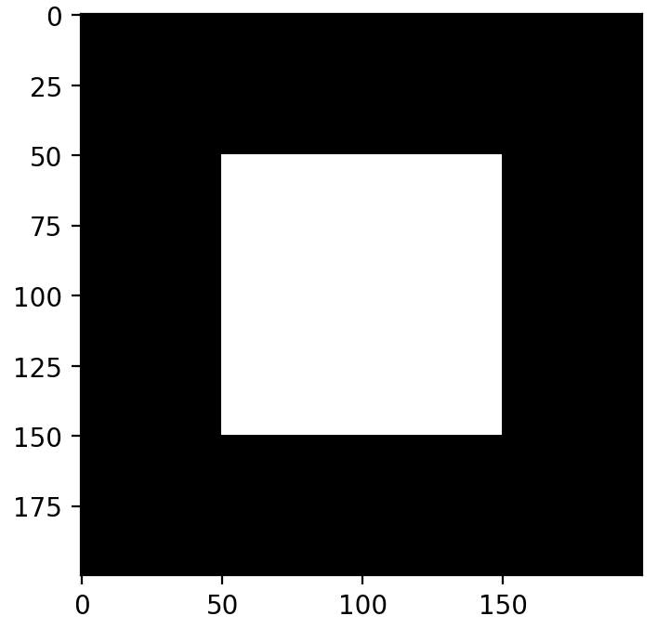
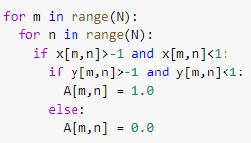
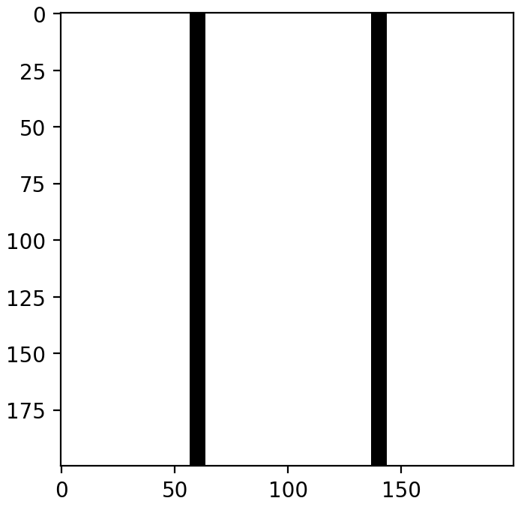
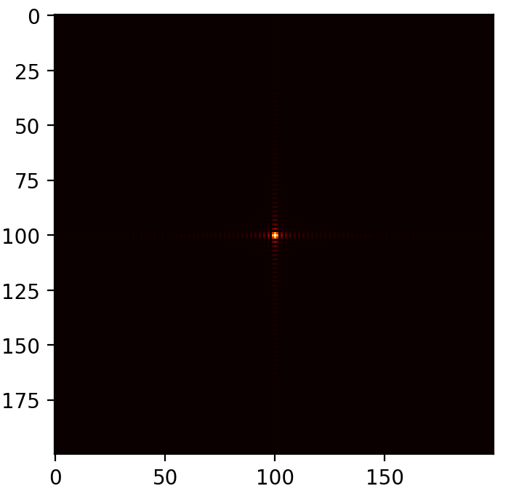
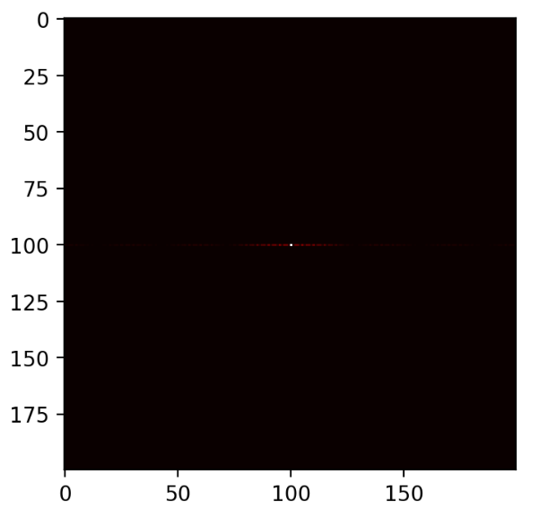
Apertures, their key code snippets and the corresponding diffraction pattern
b. Square aperture
c. Double Slit

Slide 6
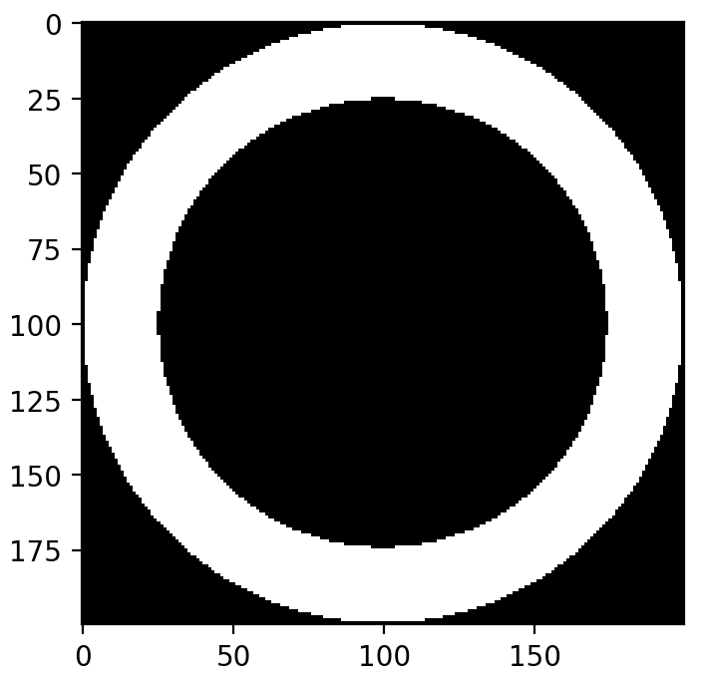
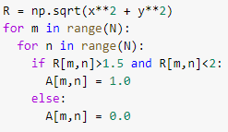
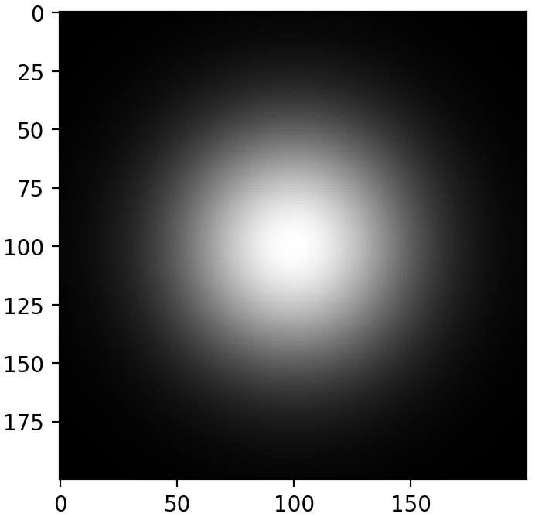
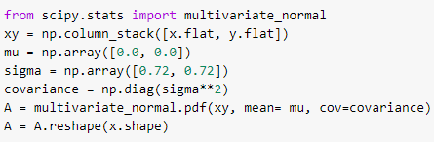
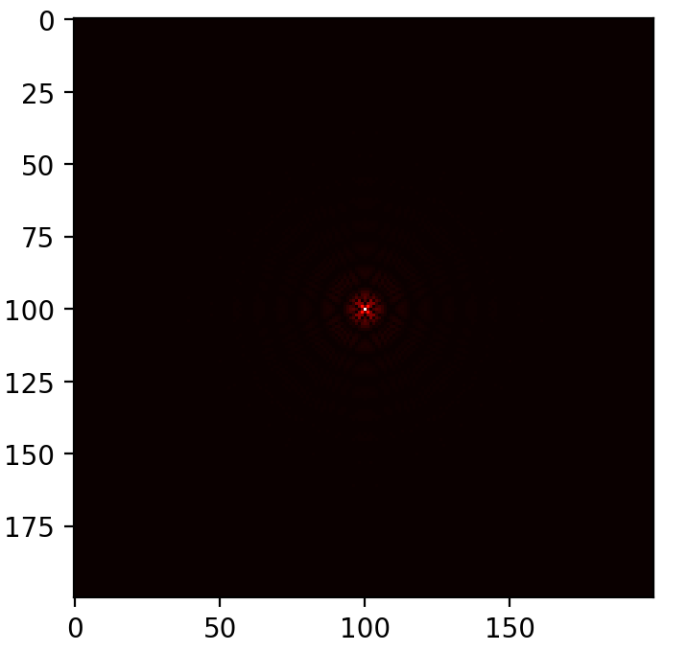
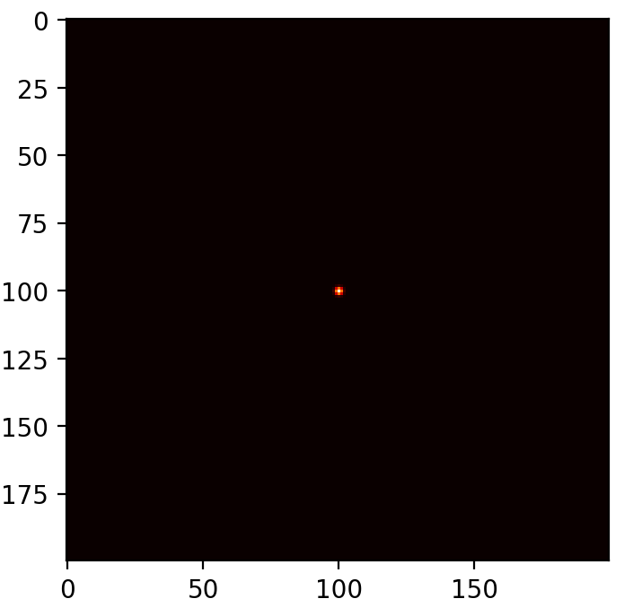
d. Annular Ring
e. Circular with gaussian transmittance

Slide 7
Analysis
In optics, the aperture function as represented by the image can be visualized in the fourier space as intensities which we see as the Fraunhofer diffraction patterns. The fourier transform maps out the component intensities from the 2d aperture function/array, which then corresponds to the patterns when zero-centered/shifted. 2d fft leads to an array in the complex plane, which is why taking the absolute value is necessary.
For the sine wave, two distinct peaks are seen, corresponding to the two peak amplitudes at -1 and 1. The other patterns have a distinct central peak, with intensities decreasing away from the center. Additional less bright peaks/fringes are seen in all except for the sine and gaussian apertures. These results are characteristic of known optical patterns.

Slide 8

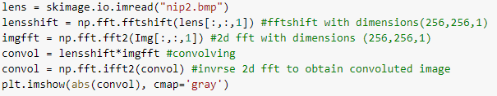




Results
The first image, with “NIP” written on it, is convolved with the four different apertures. The corresponding code is used for each convolution.
Activity 2: Simulation of an Imaging System
25% width
50% width
75% width
100% width

Slide 9
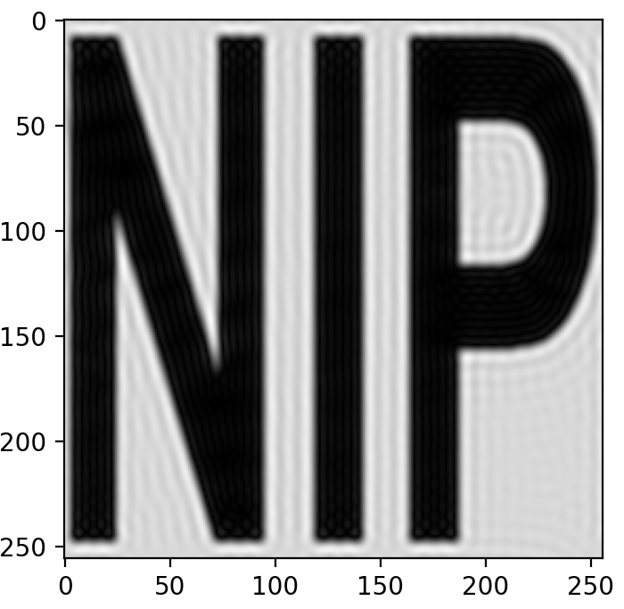
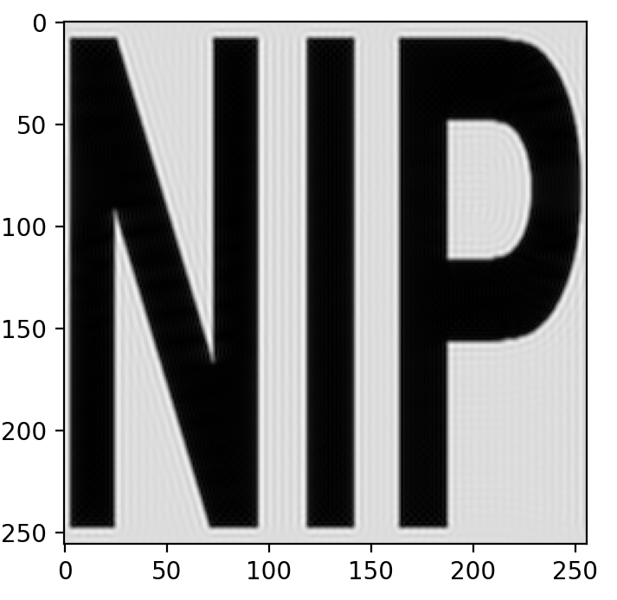

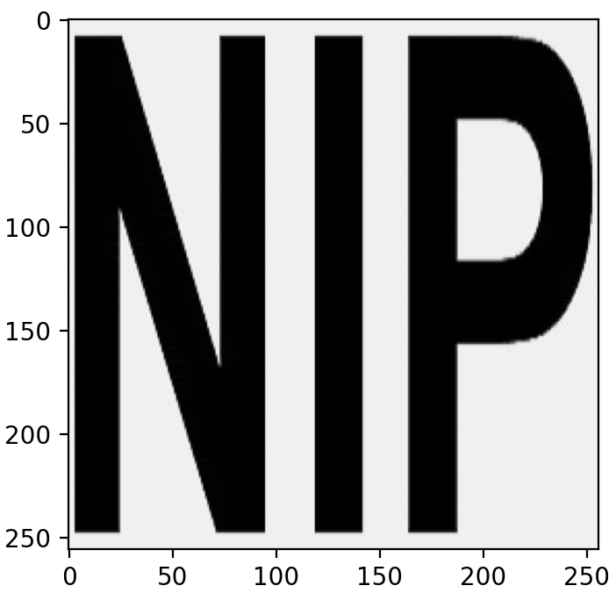
A pattern of increasing clarity can be initially observed as we increase the aperture width of the circular lens.
25% width
50% width
75% width
100% width

Slide 10
Analysis
Mathematically, increasing the aperture width corresponds to increasing the nonzero data. Multiplying less zeroes onto the original image, we gain a clearer image as we increase the width.
Convolving two 2d arrays is multiplication in the complex plane/fourier space, which is why we multiply as is, without taking absolute values.
This physically corresponds to how larger apertures are able to take in more light/data, leading to images with more detail.

Slide 11
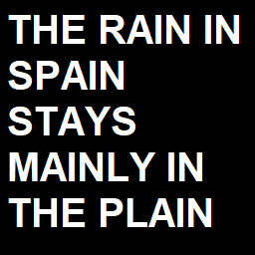
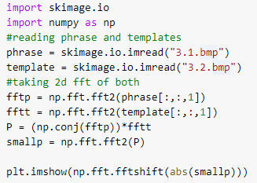
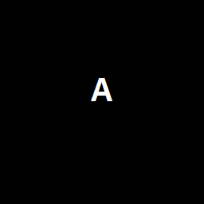

Results
The phrase below is correlated to the two template images containing the letters “A” and “I”. This is done using the given code.
Activity 3: Template matching using correlation

Slide 12
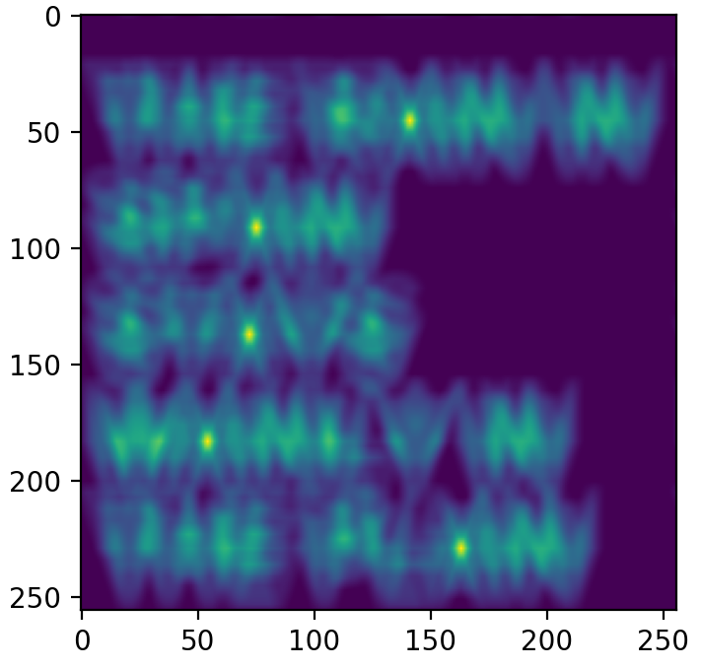
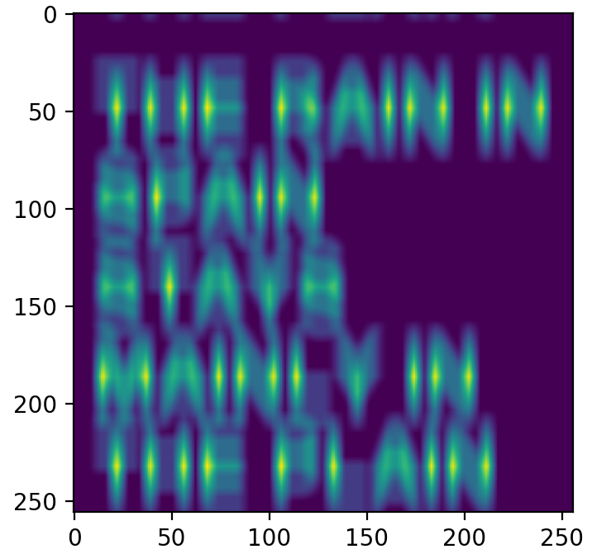
Template matching with “A”
Template matching with “I”

Slide 13
Analysis
We see peaks of intensities where the template image matches the phrase image. This is easy to distinguish for the template “A”, but not so much for “I”. The template for capital ‘i’ correlates with all of the vertical lines, which defeats the purpose.
Correlating the two images is similar to convolving them, both dealing with multiplication in the fourier space. Mathematically, correlation here works by measuring the similarity of the two functions.

Slide 14
Self-Reflection
For all three activities, I believe my results make sense, however I am not fully confident in my analyses or explanations. My intuitive knowledge of the fourier transform is limited, but I know how it is used in frequency isolations. I tried my best to relate this to light intensity mapping. The results for activities 2.2 and 2.3 made intuitive sense quickly, unlike the results from 2.1. I compared results with one of my classmates, Earl, which solidified my confidence in my results Thanks to the fast fourier transform and the numpy fft package, the whole process was much easier to apply than to understand. I am now much more knowledgeable in how fourier transforms work in digital optics.

Slide 15
Self-grade
Technical correctness: 30/33.3
I could use work on the understanding aspect of the lesson.
Presentation quality: 33/33.3
1
I tried my best to make a concise and aesthetically pleasing presentation.
2
Self reflection: 33.3/33.3
I strive to be transparent and honest with how I think I did in this activity.
3

